Slide 1
“Results Analysis & Summary of Beer Data Science Project ”
Submitted by
Mr. Vishal Shirsath

Slide 2
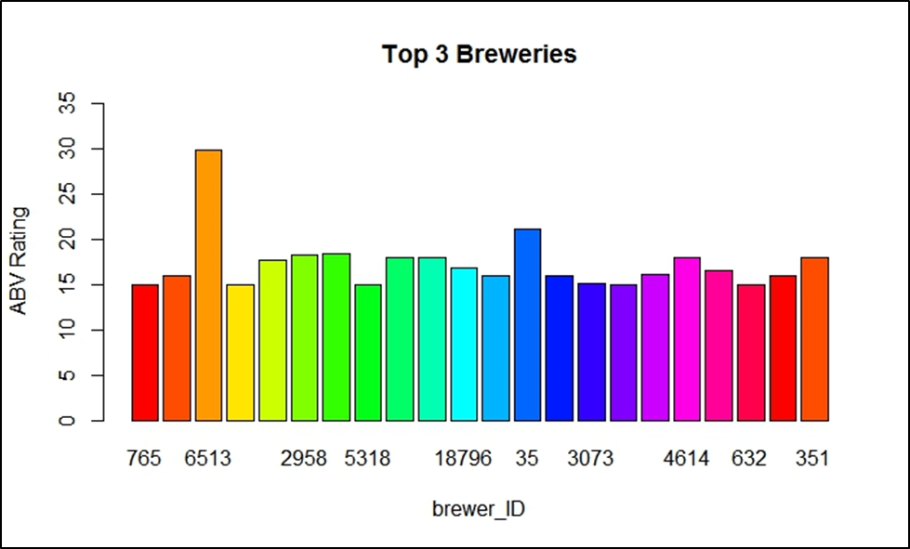
Summary of Analysis
figure 1. Shows the top three breweries according to customer review ratings. Top three breweries ID are 6513, 35, 2958 based on the mean of all the ABV_ratings. Therefore here SQL query used to extract the top 3 breweries here we considered highest mean of ABV_ratings
Figure 1: Top 3 Breweries

Slide 3
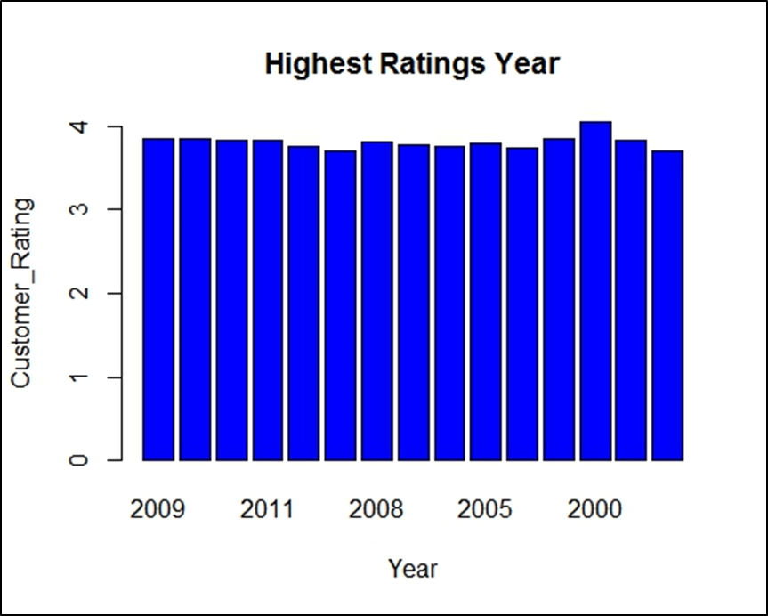
Continue.
According to figure 2 the highest ratings is on year 2000.
To find out the highest ratings considered the parameter such as Review_Time, Mean of Beer_Review.
Figure 2: Highest_Rating

Slide 4
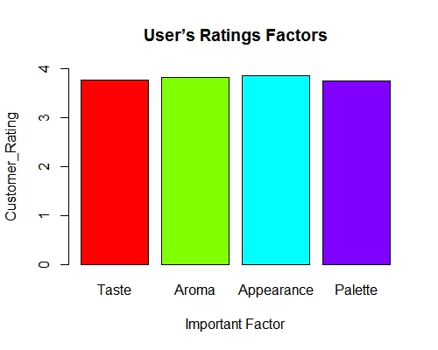
Continue.
In Figure 3 it clears that Appearance is the important factor as per user’s rating,
For this analysis consider a customer review average for factors like taste, aroma, appearance, and palette. For taste, aroma, appearance and palette got user rating 3.76, 3.81, 3.86 and 3.75 respectively. From this analysis we can say that appearance is the important factor
Figure 3: User Rating Factor

Slide 5
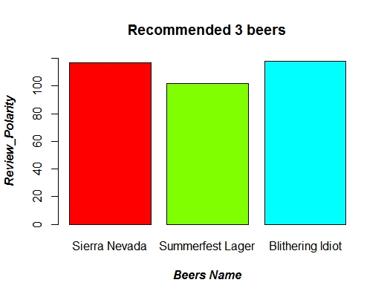
Continue.
In figure 4 I will recommend “Sierra Nevada Summerfest Lager, Sierra Nevada Celebration Ale, Blithering Idiot” to my friends.
For Recommendation of beers used sentiment analysis of review text where we come to know this three beers having most positive review from customer.
Figure 4: Recommended Beers

Slide 6
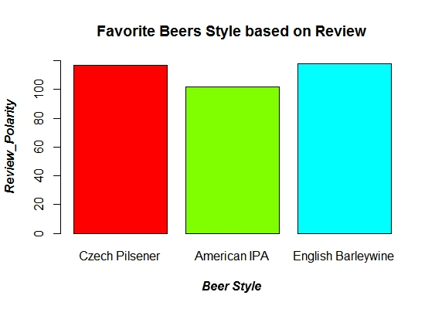
Continue..
In Figure 5 English Barleywine beer style to be favorite based on customer review_text. For the analysis sentiment analysis is performed and considered the most positive review_text.
Figure 5: Favorite Beers Style

Slide 7
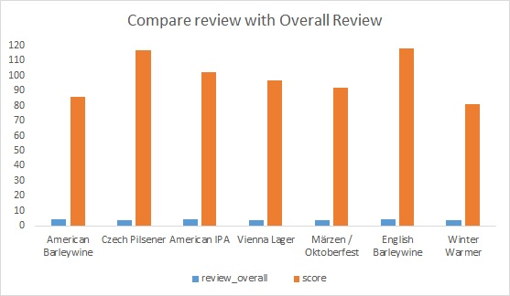
Continue..
In figure 6, while compare to written review score to overall review score it observed that when review overall having more rating then the sentiment score of review text is less and it also observed that when review overall rating is less then sentiment score is high. We can say that instead of review overall ratings, review text gives better results.
Figure 6:Comparision between Written and Overall Review

Slide 8
Summary and Conclusions
From this analysis, its observed that in some cases review_text factor plays more significant role than review_ratings.
We can also recommend the beer to the customers based on any one choice like taste, aroma, appearance, palette.
From the customer review_text, we can extract features which can be useful to suggest appropriate beer to the customer or based on these features we can also find out the expectation or interest of customer.

