Slide 1





PLACEMENT READINESS INTELLIGENCE
Practice with purpose.
Prove readiness with evidence.
A unified campus platform for learning, coding, assessments, interviews and actionable skill-gap analytics.
LEARN
ASSESS
IMPROVE
Team Leader / Anubhav Dhyani
Team / Vivek Semwal | Akshit Rawat
Graphic Era Hill University | Dehradun, Uttarakhand
Notes:
PeerPrep is a placement preparation and skill development platform for students. Team leader: Anubhav Dhyani. Team members: Vivek Semwal and Akshit Rawat. Graphic Era Hill University, Dehradun, Uttarakhand.

Slide 2


PROBLEM // SIGNALS WITHOUT A SYSTEM
The Placement Readiness Gap
Preparation is fragmented. Readiness is invisible.
01
Fragmented preparation
02
Feedback arrives late
03
Cohort visibility is weak
Learning content, coding practice, assessments and interviews live in separate tools - so students cannot see one coherent journey.
Scores show what happened, but not the next best action. Students repeat activity without a clear, evidence-backed priority.
Coordinators manually combine attendance, results and feedback, delaying targeted support for students who need it most.
WHO FEELS THE PAIN
STUDENT
COORDINATOR
UNIVERSITY
What should I improve next?
Who needs help right now?
Is the cohort placement-ready?
Scattered feedback -> unclear priorities
Manual tracking -> delayed intervention
Isolated reports -> no shared readiness view
THE OPPORTUNITY
Create one evidence loop: activity -> assessment -> feedback -> targeted preparation -> readiness.
Design principle: decision-ready insights for students and placement teams - not another content library.
VAR // PEERPREP
02
Notes:
Students need to understand their interview readiness and skill gaps. Coordinators need a consolidated view to target support before placements. National research context: Economic Survey 2025–26, Government of India, Chapter 12, printed page 497, section 12.48, identifies mismatches between industry needs and training. https://www.indiabudget.gov.in/economicsurvey/doc/eschapter/echap12.pdf . This source covers the national skilling ecosystem and does not quantify readiness at Graphic Era Hill University.

Slide 3

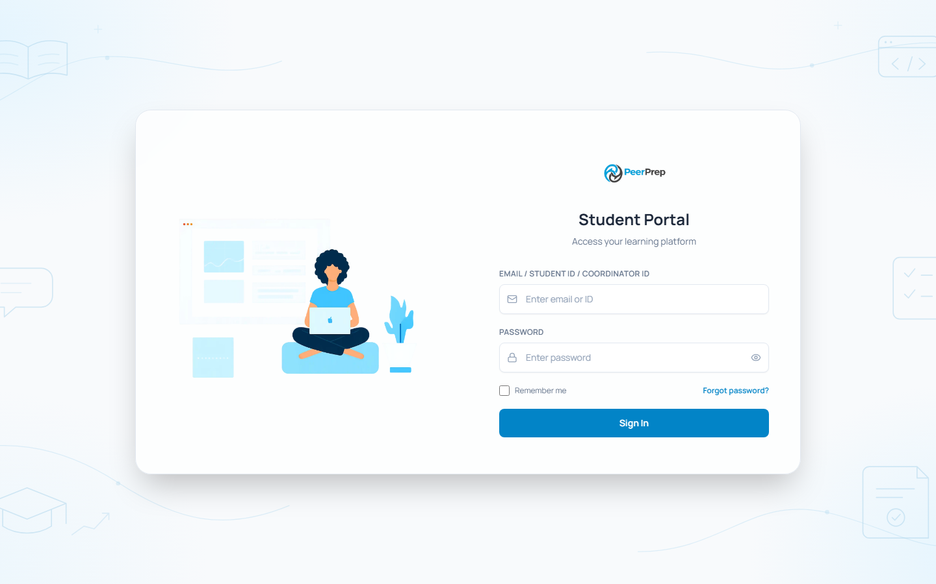
SOLUTION // CLOSED-LOOP PREPARATION
One Platform. Three Role-Aware Journeys.
A single workflow turns preparation activity into the next best action.
REAL PRODUCT VIEWS
THE STUDENT LOOP
peerprep | public experience
peerprep | student portal
01
Learn
Structured modules + QuickPrep
02
Practice
Multi-language coding with Judge0
03
Assess
Timed tests + browser monitoring
04
Interview
Peer and AI-assisted practice
05
Improve
ROLE-AWARE OUTCOMES
Analytics, feedback and missions
STUDENT | NEXT ACTION
COORDINATOR | INTERVENTION
ADMIN | COHORT VIEW
One identity, one progress record, one preparation journey.
VAR // PEERPREP
03
Notes:
PeerPrep proposes one platform linking student preparation to university readiness tracking. Structured learning and coding practice build technical skills. Assessments and mock interviews provide preparation feedback, while analytics identify gaps and track progress. Coordinators and administrators use role-based dashboards to monitor student cohorts and target support. The proposed connection between individual preparation and institutional visibility is the design focus.

Slide 4

TECHNICAL APPROACH // POINT-TO-POINT DATA FLOW
From Practice Event to Readiness Insight
Implemented architecture: modular API + independently scalable execution workers.
REQUEST / COMMAND
VALIDATE + AUTHORIZE
PERSIST + QUEUE
ACTORS
UI
API
DOMAIN
DATA
Role-based users
React 19 + Vite
Express service
Core workflows
State + events
Students
Coordinators
Administrators
Dashboards
Coding workspace
Assessment experience
JWT / HttpOnly cookies
RBAC + validation
Rate limits + audit
Learning | Assessments
Interviews | Analytics
Notifications
MongoDB
Valkey / BullMQ
Socket.IO
ASYNC + SPECIALIZED EXECUTION
QUEUE
WORKER
JUDGE0
INSIGHT
Tracked job
Controlled execution
Sandboxed code
Evidence loop
API creates job ID, applies limits and returns status.
Dedicated worker retries, fails over and applies backpressure.
Compiler verdict, time and memory return to PeerPrep.
Results update analytics, notifications and next actions.
RESULT -> PROFILE -> SKILL GAP -> RECOMMENDED NEXT ACTION
Browser-side monitoring uses MediaPipe / TensorFlow.js; authenticated Socket.IO delivers personal notifications.
VAR // PEERPREP
04
Notes:
PeerPrep's current implementation uses React 19 and Vite for the frontend, Node.js and Express.js for backend services, and MongoDB with Mongoose for preparation data. Socket.IO provides real-time notifications. Valkey/Redis queues and dedicated compiler and assessment workers integrate with Judge0 for coding execution. Browser-based assessment monitoring uses MediaPipe, TensorFlow.js and COCO-SSD. Existing modules include role-based student, coordinator and administrator dashboards, resume building, coding practice, assessments, mock interview workflows, analytics and placement readiness tracking. The analytics are primarily rules-based. Company-specific assessments, explainable skill mapping, personalized improvement recommendations and AI-driven mock interviews are planned enhancements. The platform does not yet have a fully AI-powered interviewer. Monitoring occurs during assessments alongside submission processing; the numbered sections describe the main components rather than a rigid single sequence.

Slide 5

BUSINESS MODEL // VALUE + DIFFERENTIATION
A Campus-First Model That Scales
Recommended commercialization model
Why PeerPrep is defensible
PROPOSED
01
Unified evidence graph
CUSTOMER
Universities, placement cells and training partners
Learning, code, assessment, interview and activity signals share one student context.
02
Operational - not just educational
REVENUE
Annual institutional license + active-student tiers
Admin and coordinator workflows turn insight into assignments, reminders and support.
ADD-ONS
Onboarding, custom assessments and advanced analytics
03
Safe execution pipeline
Queued jobs, tracked status, limits and Judge0 isolation separate bursty code workloads.
VALUE
Less manual tracking; earlier, targeted interventions
Privacy-aware monitoring
04
Browser-side proctoring signals reduce the need to stream raw video to generative AI.
CURRENT STACK
React 19 + Vite | Node.js + Express | MongoDB | Valkey / BullMQ | Judge0 | Socket.IO | MediaPipe / TensorFlow.js
Near-term target: a well-bounded modular monolith with independently scalable workers.
VAR // PEERPREP
05

Slide 6

IMPACT // MEASURE WHAT CHANGES
Pilot -> Evidence -> Campus Scale
Success metrics for a 90-day pilot
01
Completion
02
Skill gap
03
Interview
04
Readiness
Learning + assessment completion rate
Improvement by topic and difficulty
Participation + feedback turnaround
Change in evidence-backed cohort score
90-DAY EXECUTION ROADMAP
0-30 DAYS
31-60 DAYS
61-90 DAYS
Pilot setup
Run the loop
Prove + scale
Select cohort | baseline skills | configure content
Practice | assessments | interviews | interventions
Compare outcomes | harden ops | campus rollout
THE HACKATHON ASK
Pilot PeerPrep with one placement cohort - and evaluate it on evidence, not promises.
Social: clearer support | Economic: less manual coordination | Environmental: digital-first assessments and reports
ANUBHAV DHYANI | VIVEK SEMWAL | AKSHIT RAWAT
Graphic Era Hill University | Dehradun, Uttarakhand
06
VAR // PEERPREP

