Slide 1
Local Positioning System

Slide 2
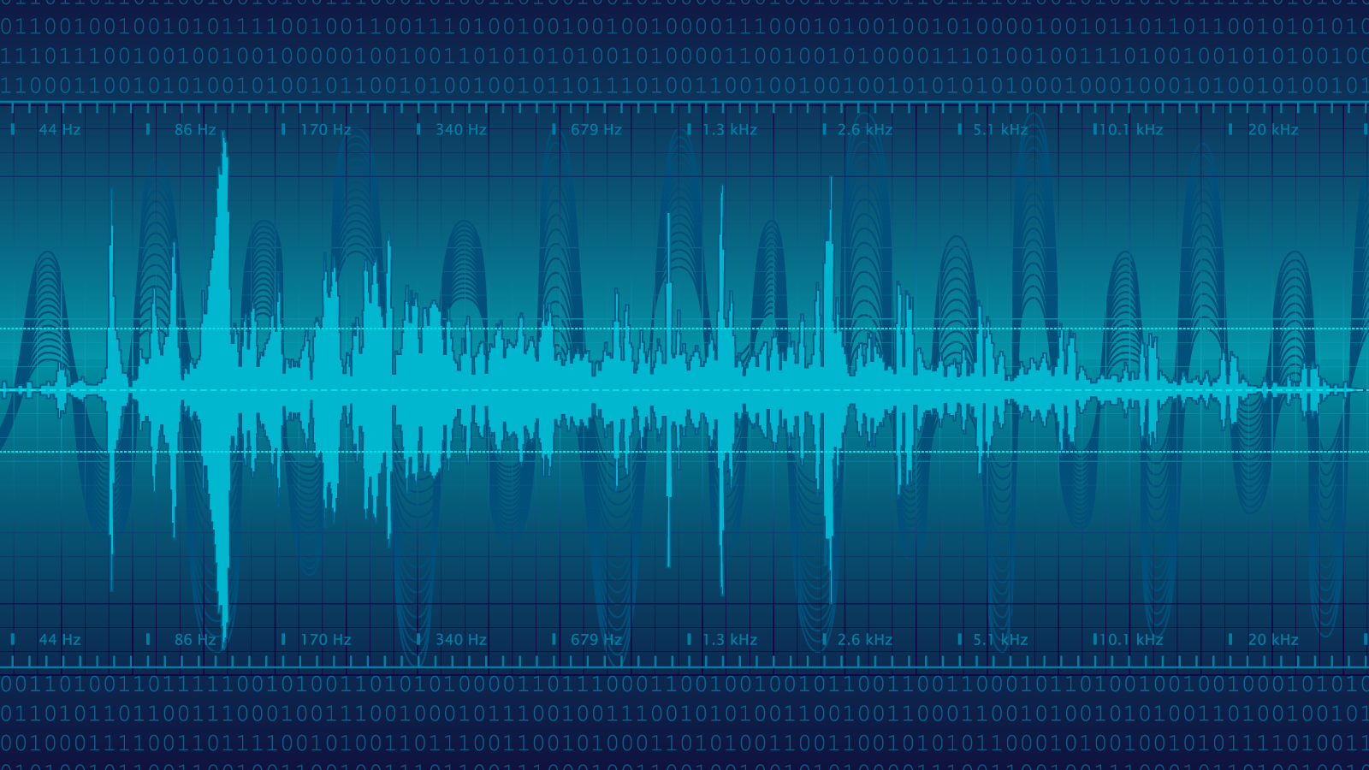
Technology to be Used
WIFI RSSI
Analysing the received signal strength to estimate the distance.

Slide 3

Approach
RSSI Measurement
RSS Signal Improvement
Environmental Characterization
OUTPUT (coordinates)
Trilateration
RSSI -Distance Conversion

Slide 4
RSSI measurement
Use cell phones
Specialized wifi receivers
For eg. : Zigbees

Slide 5
RSS signal improvement is mainly to filter noise and fast fading and inter symbolic interference. This increases the stability of the RSSI signal.
RSSI
Signal Improvement
Noise calibration removal : get SNR ratings of the chip and stuff
For removing fast fading effects and ISI, there are algos and some specific methods. Have been documented.

Slide 6
Environmental Characterization
Here we decide an important parameter in distance calculation known as path loss exponent.

Slide 7

RSSI Distance conversion
N = Path-Loss Exponent
Fm = Fade Margin
Pr = Signal power (dBm) at distance
Po = Signal power (dBm) at zero distance
F = signal frequency in MHz

Slide 8
RSSI distance conversion
All factors except path loss exponent can be calculated using conventional methods.
Calculation of path loss exponent requires some calibration.
RSSI value depends on various environmental factors too.
We plan to implement a continuous calibration system so that the instant changes in the surroundings are accounted. Also learning algorithms will be implemented to increase the accuracy.

Slide 9
Trilateration
and
Coordinate output

Slide 10
Receiver
Get
- RSSI value
- Bit rate of wifi connection (to calculate fade margin)
- Frequency of signal
Transmitter
A router

Slide 11

The team
“None of us is as smart as all of us”
Pranav Sankhe
Saqib Azim
Ritik Madan
Tanya Chaudhary
2nd Year Undergraduate
Electrical Engineering, IITB
2nd Year Undergraduate
Electrical Engineering, IITB
2nd Year Undergraduate
Electrical Engineering, IITB
2nd Year Undergraduate
Electrical Engineering, IITB

