Slide 1

Predicting and Classifying H1-B Visa Application Status
GROUP - I

Slide 2
Problem Statement
The H-1B is an employment-based, non-immigrant visa category for temporary foreign workers in the United States. For a foreign national to apply for H1-B visa, a US employer must offer a job and petition for H-1B visa with the USC Immigration Services.
Data analysts for a visa/immigration consultancy firm
After studying our findings using various tools, we will be able to analyze & explain the following questions:
Explore how different variables interact with CASE_STATUS approval.
Distribution of applications across regions based on prevailing wages
Recommend our clients whether the application will be APPROVED or DENIED

Slide 3
Description of the Dataset
Data Set: h1b_kaggle.csv | Source: https://www.kaggle.com/nsharan/h-1b-visa
Raw Dataset has 3002458 rows x 11 variables for H1-B visa application for years 2011 to 2016.
Variables:
CASE STATUS : Status associated with the last significant event or decision. Valid values include CERTIFIED, CERTIFIED-WITHDRAWN, WITHDRAWN, DENIED
EMPLOYER NAME : Name of employer submitting application.
SOC NAME : Categorical variable, its an occupational name.
JOB TITLE : Categorical variable for different type of JOBs.
FULL TIME POSITION : Y = Full Time Position; N = Part Time Position.
PREVAILING WAGE : Numerical variable, wage requested for applied JOB .
YEAR : Year in which the H-1B visa petition was filed. – CONSIDERED ONLY FOR 2016
WORKSITE : City and State information.
LON: values of Longitude of WORKSITE.
LAT: values of Latitude of WORKSITE

Slide 4
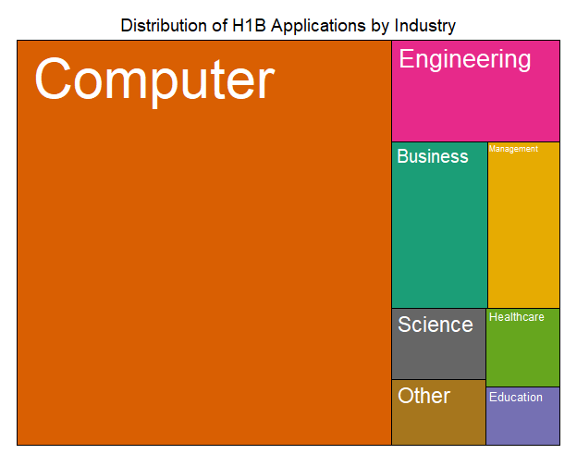
Data Pre-Processing
Data considered for year 2016
Removed 2.7% of records with missing values
Defined new status: APPROVED, DENIED
Segregated WORK_SITE to STATE and CITY
Divided data into Demographics Regions based
on Longitude and Latitude
Categorized all occupational roles (SOC_NAME)
to 9 major categories as below:
Business
Computer
Education
Engineering
Healthcare
Management
Science
Arts
Other

Slide 5
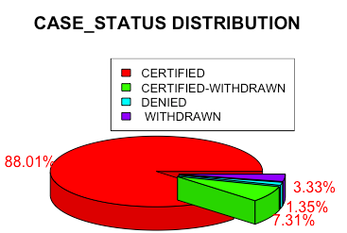
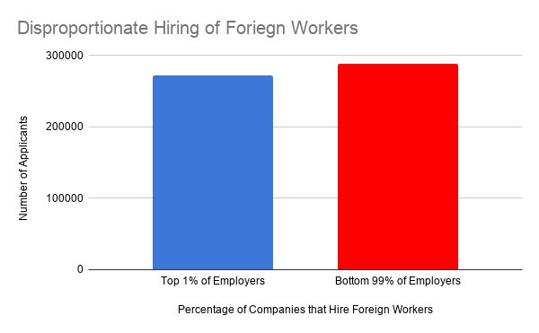
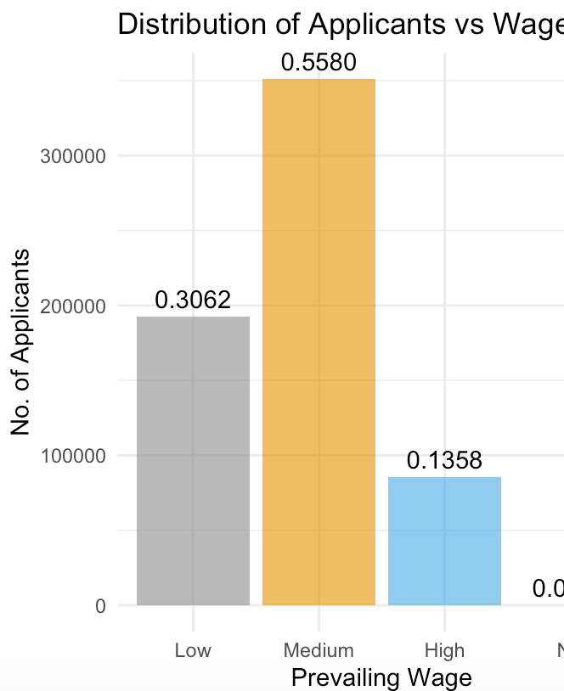
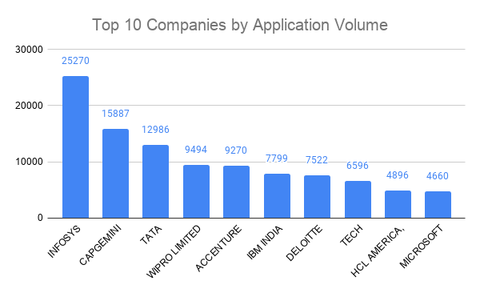
Exploratory analysis
- 98.6% - APPROVED Applications
- 1.4% - DENIED Applications
- Top 1% of Employers filing > avg no of total Application
- Top 10 Employers filing applications
- Wages Distribution:
< 60k - Low | 60 - 100k - Medium | >100K - High
Approval Percentage:
- Low: Approval- 94.7%,Denied-1.8%
- Medium: Approval- 95.6%,Denied-1.0%
- High: Approval- 95.5%,Denied-1.6%
For medium wage, denial rate is less in compared to high and low wage.

Slide 6
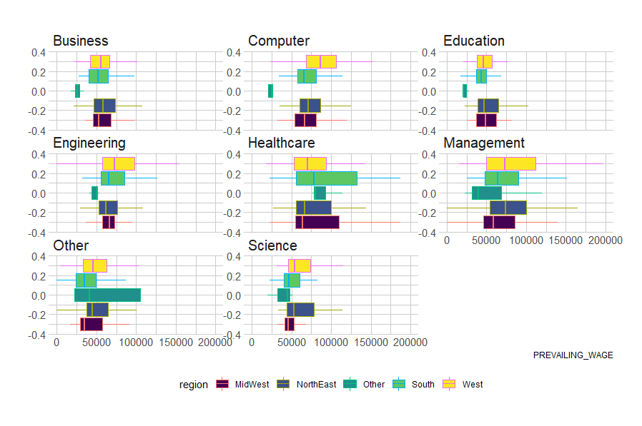
Boxplot of Wages by Region and Category

Slide 7
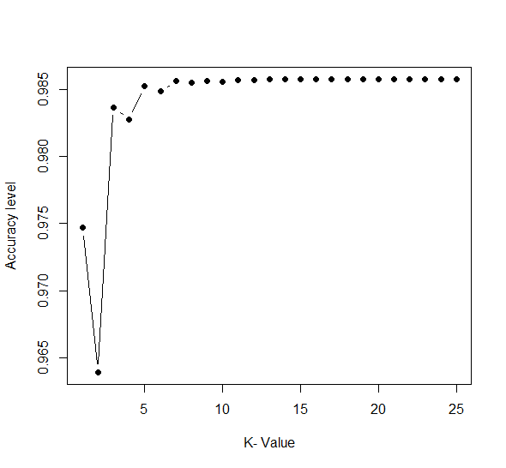
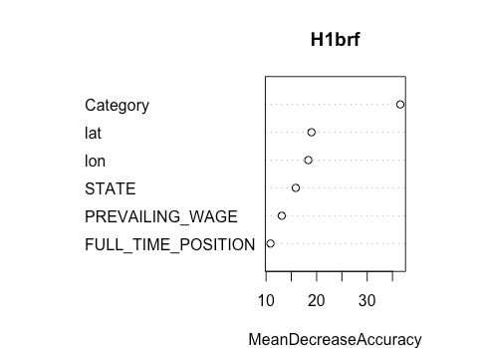
MODEL: Classification Tree & KNN
KNN
Classification Tree
Model: to predict STATUS
Predictors used:
FULL_TIME_POSITION
PREVAILING_WAGE
lon
lat
Category
With best K = 5, accuracy is 98.37%
99.73% accuracy in predicting Approved case.
but, only 4% accuracy in predicting Denied case.
So, KNN is not a good model for this data set.
Accuracy Measures
Category is the most significant variable for the Visa classification .
Full time position has is least contributor for the classification
Default Tree | Pruned Tree (cp =0.000725) | Random forest
98.59% | 98.61% | 98.61%

Slide 8
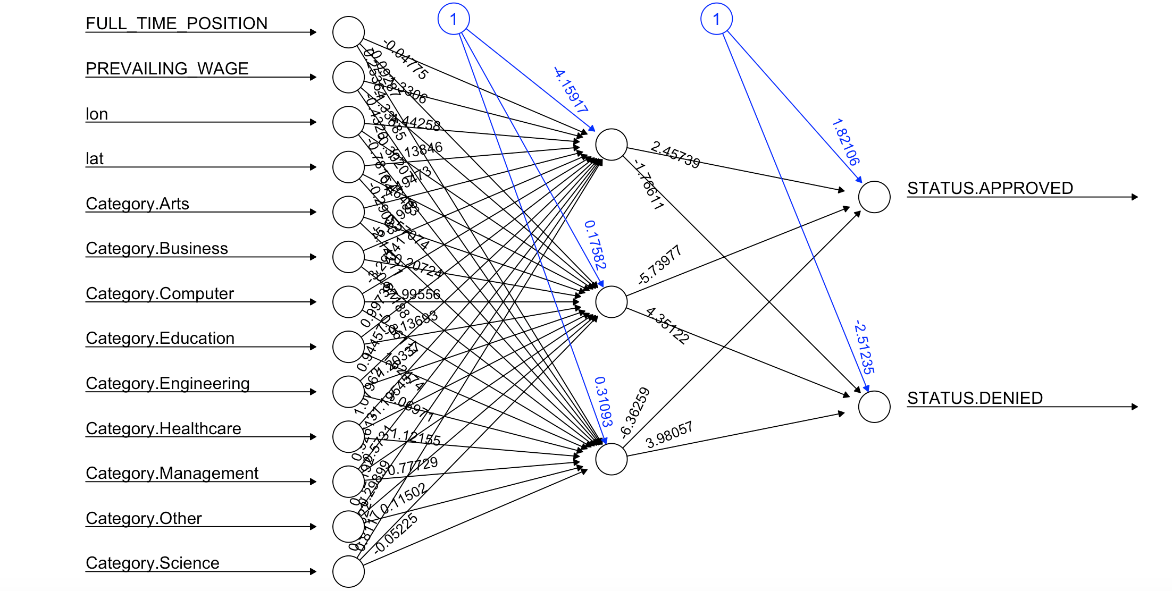
MODEL: Logit & Neural Net
LOGIT
Neural Net
Model: to predict STATUS
Predictors used:
FULL_TIME_POSITION
PREVAILING_WAGE
lon
lat
Category
Accuracy: 98.58%
99.99% correctly predicting the approved case
but, 99% chances of wrongly predicting denied case
Probability taken for predicting is 0.9
Model: to predict STATUS
Predictors used:
FULL_TIME_POSITION
PREVAILING_WAGE
lon
lat
Category
Accuracy: 98.57%
98.57% correctly predicting the case of being approved
100% correctly predicting the case of denied
Probability taken for the Predicting is 0.9

Slide 9
Model Comparison
MODEL | KNN K=5 | Classification Tree cp =0.000725 | Logistic Regression | Neural Net Nodes = 3
Accuracy% | 98.37 | 98.61 | 98.58 | 98.57
Sensitivity% | 4 | 1 | 1 | 100
Specificity% | 99.7 | 100 | 99.99 | 98.57
Positive Class | DENIED | DENIED | DENIED | DENIED

Slide 10
Conclusion
This data is good for exploration and visualization purpose. Following is our observation -
98.6% of total applications are approved whereas 1.4% of applications are denied
Top 1% of employers by number, contribute equally to total no. of applications as bottom 99% of employers.
Multinational companies like Infosys, TCS, Wipro are top contributor towards application volume
55% of applicants are within medium prevailing wage range of 60k-100k
Applicants within medium prevailing wage range has less denial rate as compared to high and low prevailing wage range.
Cost of penalty is high when we wrongly classify the denied cases as approved

