Slide 1

Ecology, Environment, Climate Change and Disaster Management
Project Title : Ped Bachao,Ped ka Khayal Rakho
Team Members:
1.Atul Kumar Agrawal
2.Kashish Rath
3.Suman Rath
4.Suchita Sriramaka
Team: ms.atul1303_c23b

Slide 2

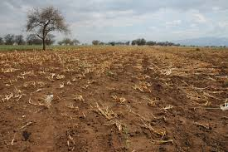

PROBLEM STATEMENT:
Many saplings planted with so much enthusiasm and fanfare die an untimely death due to lack of care and support. It needs a little attention and protection against grazing, dry condition, and hazards of other biotic and abiotic factors.
Solution expected:
Track the trees we plant.
Locate it on the Google map.
Create a database of such plants/trees with geo-spatial reference.
Locate the plant/tree and know the present condition.

Slide 3
Proposed Design Consists of:
Web App:-
Users have to upload the location of sapling which they planted in the app and is later viewed using goggle maps for geotagging purpose.
SENSORS :-
Sensors to accurately measure the temperature, humidity and moisture level of soil for analysis of the plantation area.
1.Soil moisture sensor
2.Temperature and humidity sensor
3.Ultrasonic sensor
4.NodeMCU
DATABASE:-
Different components communicate with the database using Google maps API and firebase module which is used to create a personal area network.
The values of the database get automatically updated with the current sensor values.
Contd.

Slide 4

SOLUTION:-
Each user will login through the app and maintain its own profile and details of the planted saplings and will get updates from the sensors.
The coordinates will be saved in the database for geotagging of the plantation which will act as reference for database.
The app will also monitor basic information about how to prevent plant death and information about what nutrients and conditions are proper for plant growth.
The web app has been designed to alert the user regularly water the plant and check its health and send notifications if any irregularity is detected.
These sensors have been designed to send data every hour to the database.
An automatic sprinkler turns on when the soil moisture level goes below the threshold value and user can also control the sprinkler using the button in the app.
Contd.

Slide 5
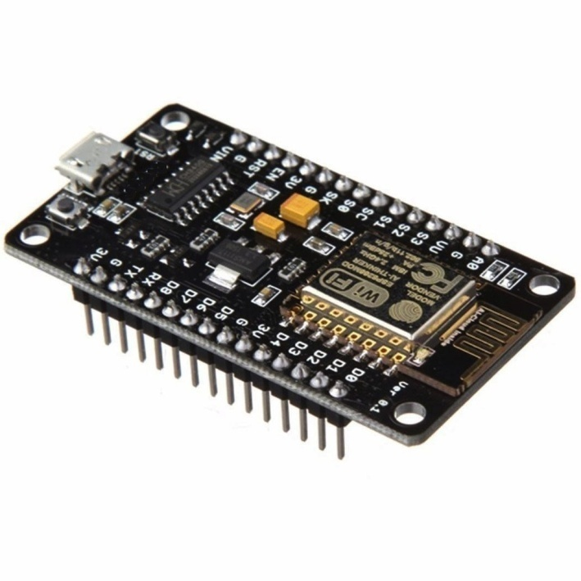
Node MCU:-
NodeMCU is an open source IoT platform. It includes firmware which runs on the ESP8266 Wi-Fi SoC from Espressif Systems, and hardware which is based on the ESP-12 module. The term "NodeMCU" by default refers to the firmware rather than the development kits.
ESP8266 is a low-cost, Wi-Fi Module chip that can be configured to connect to the Internet for Internet of Things(IoT) and similar Technologies.
Advantages:
1.Interactive
2.Programmable
3.Low Cost
4.Simple Interface
5.Smart IOT enabled with inbuilt wifi
6.Arduino Compatible
Node MCU

Slide 6
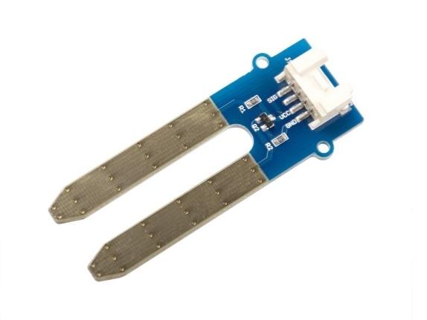
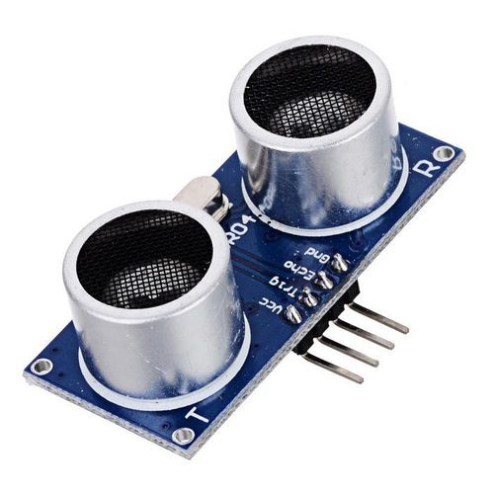
ULTRASONIC SENSOR
Sensors used:-
SOIL MOISTURE SENSOR
2 probes used to measure the volumetric content of water.
Current passes through soil and gets the resistance value to measure the moisture content.
More resistance value implies less moisture and vice versa.
Moisture Sensor
Ultrasonic sensors work by emitting 40KHZ frequency which is not perceivable by humans but can be perceived by cattles and other animals. As this frequency is disturbing for them, they do not come near the plantation area.
It has a transmitter which emits the sound waves and receiver to detect the sound if it is reflected by any object placed in its path.

Slide 7
ADVANTAGES:
Efficient system for long lasting solution.
Compact and easy to setup in any area.
Effective sensor integration and economical.
Efficient and flexible code.
Automatic sprinkler system.
Easy tracking and geo-tagging of plantation area.
The model is scalable for business applications over wide areas.

Slide 8

COST ESTIMATION:-
Things Used and Price Estimation (3 sq.m)
Soil Moisture Sensor – Rs150
Node MCU – Rs 350
Ultrasonic Sensors – Rs 80X8= Rs640
Temperature Sensor and humidity
sensor–Rs 100 (surrounding atmosphere)
Sprinkler System –Rs 90
L298 Motor Driver: Rs 150
Total: Rs 1,480

Slide 9
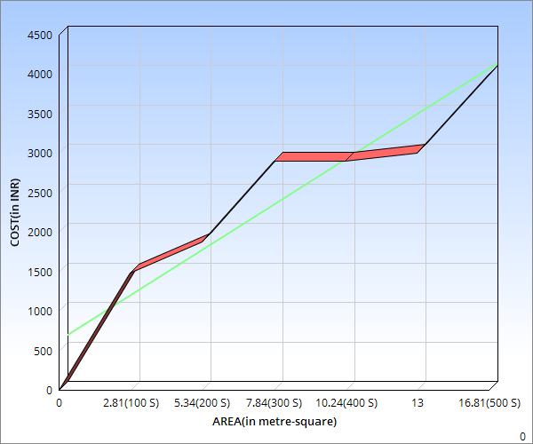
COST vs. AREA ANALYSIS

Slide 10
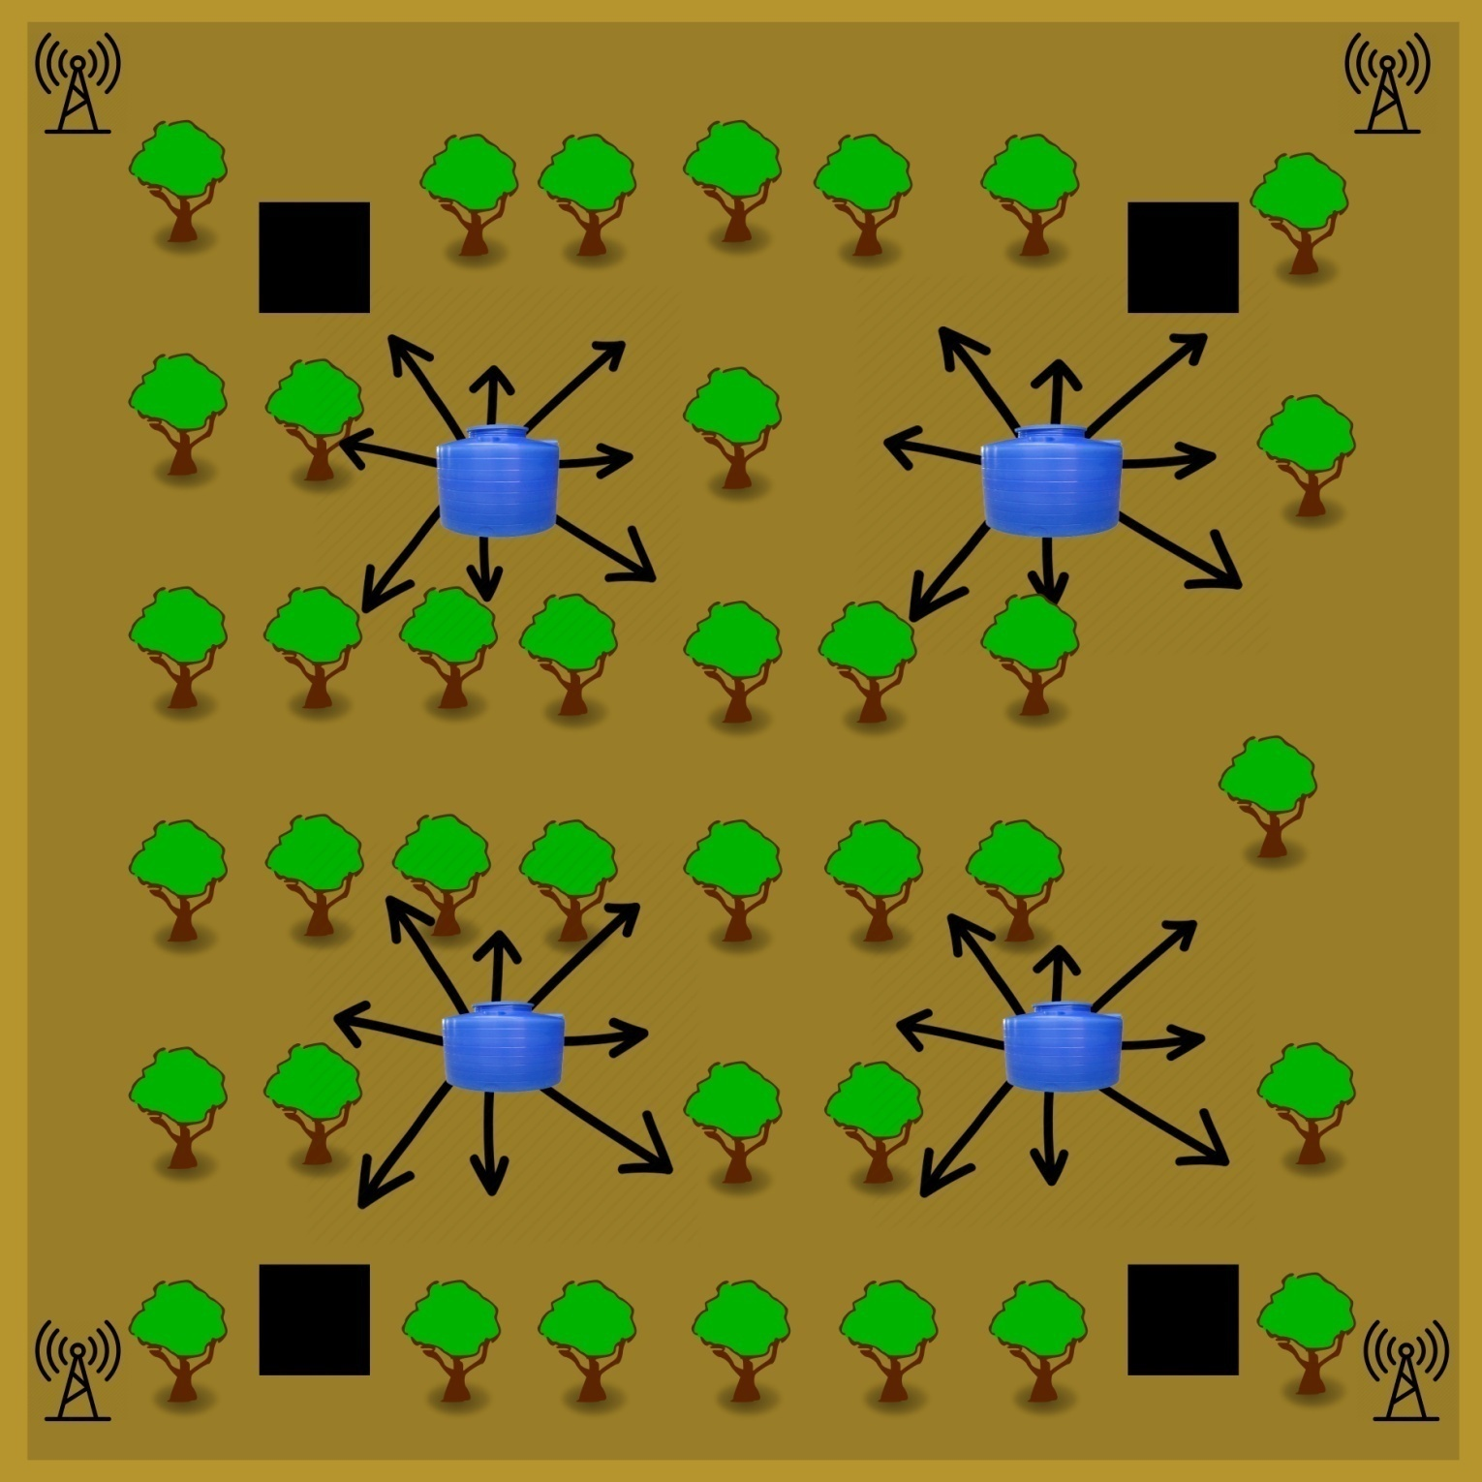



Proposed
Layout
(Forest
Area)
Sensor box
Water
Harvesting Tank With Sprinkler
Wifi

Slide 11

FUTURE ASPECTS:
Rainwater Harvesting:
To conserve water in dry places this method can be adopted to store the rain water in closed tank which will serve as a reserve during summers and the sprinkler will get water from this tank.
GIOVANNI
Use of NASA database to verify sensor values and to detect any malfunction

Slide 12
THANK YOU

