Slide 1
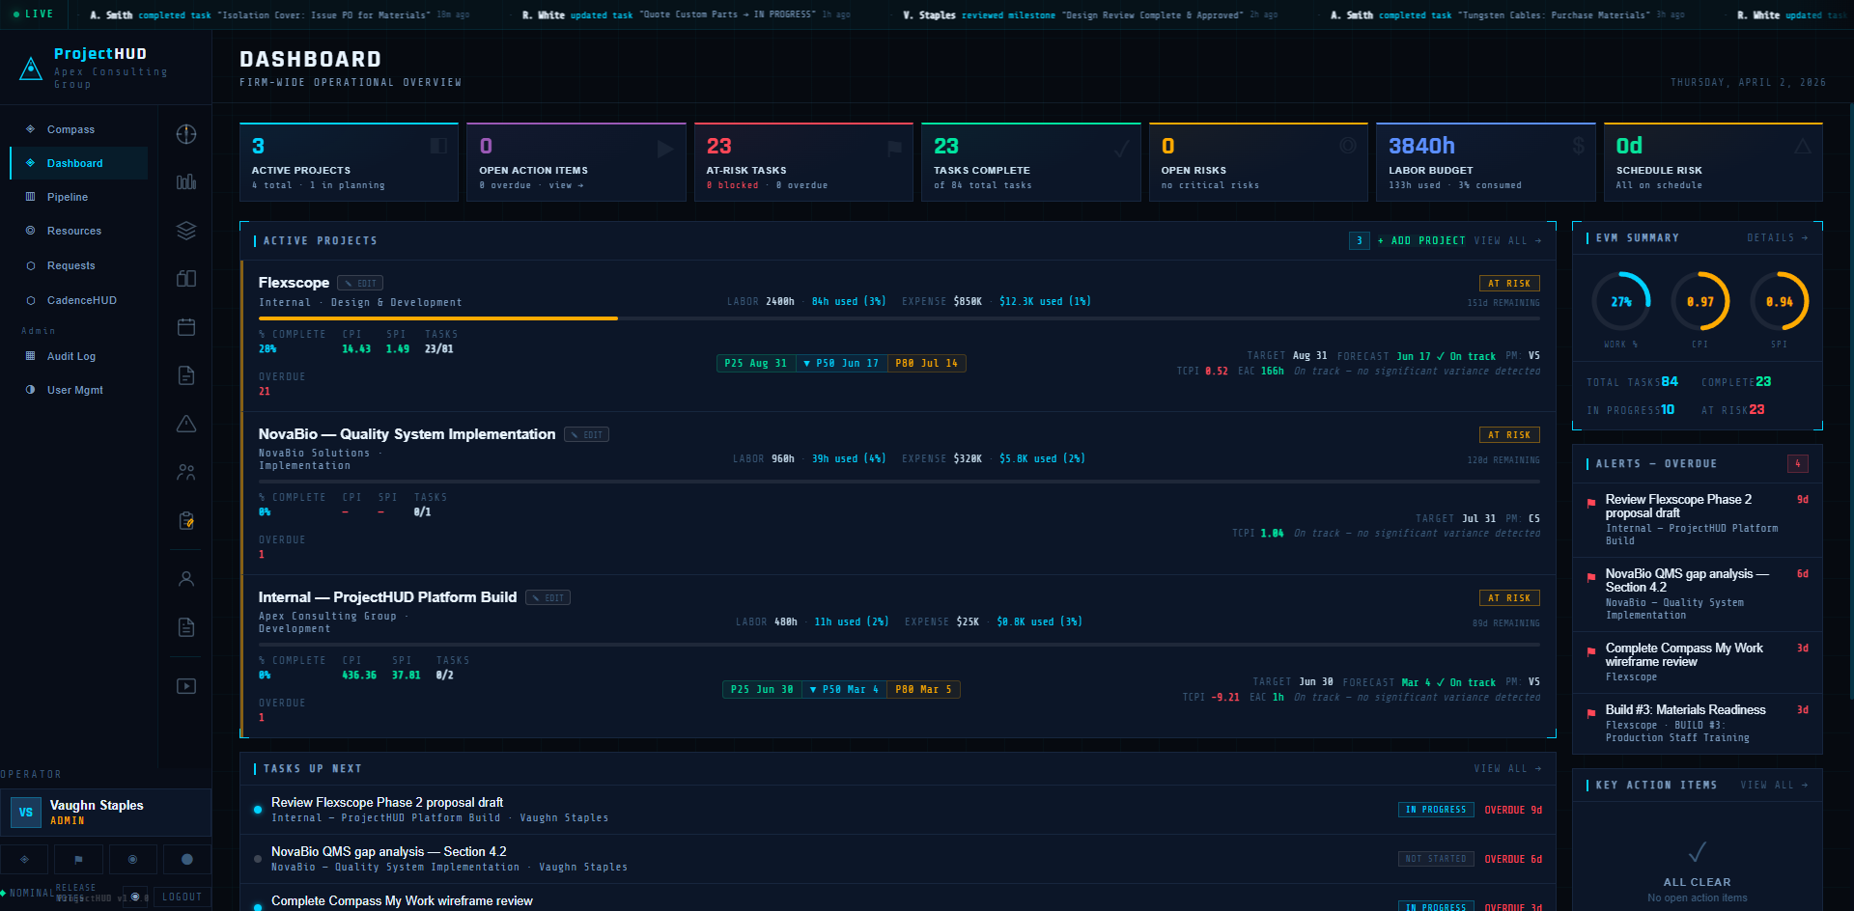
PROJECTHUD DASHBOARD
BEFORE

Slide 2
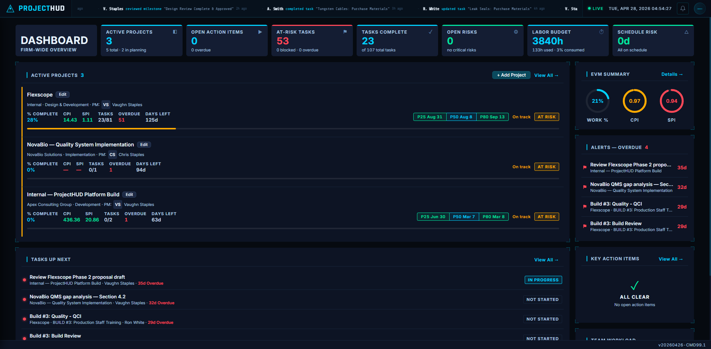
BEFORE

Slide 3
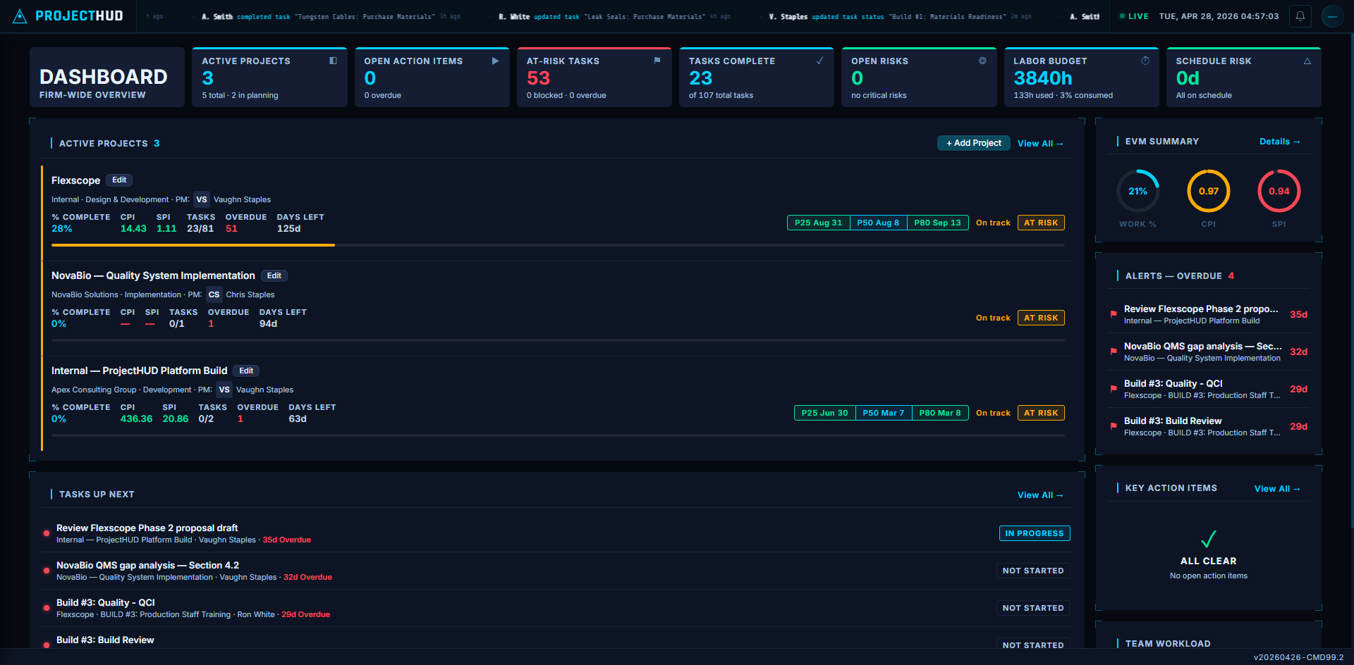
CMD99.2

Slide 4
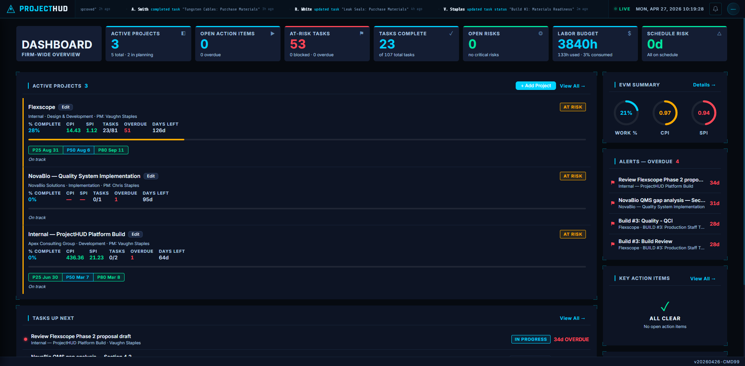
AFTER

Slide 5
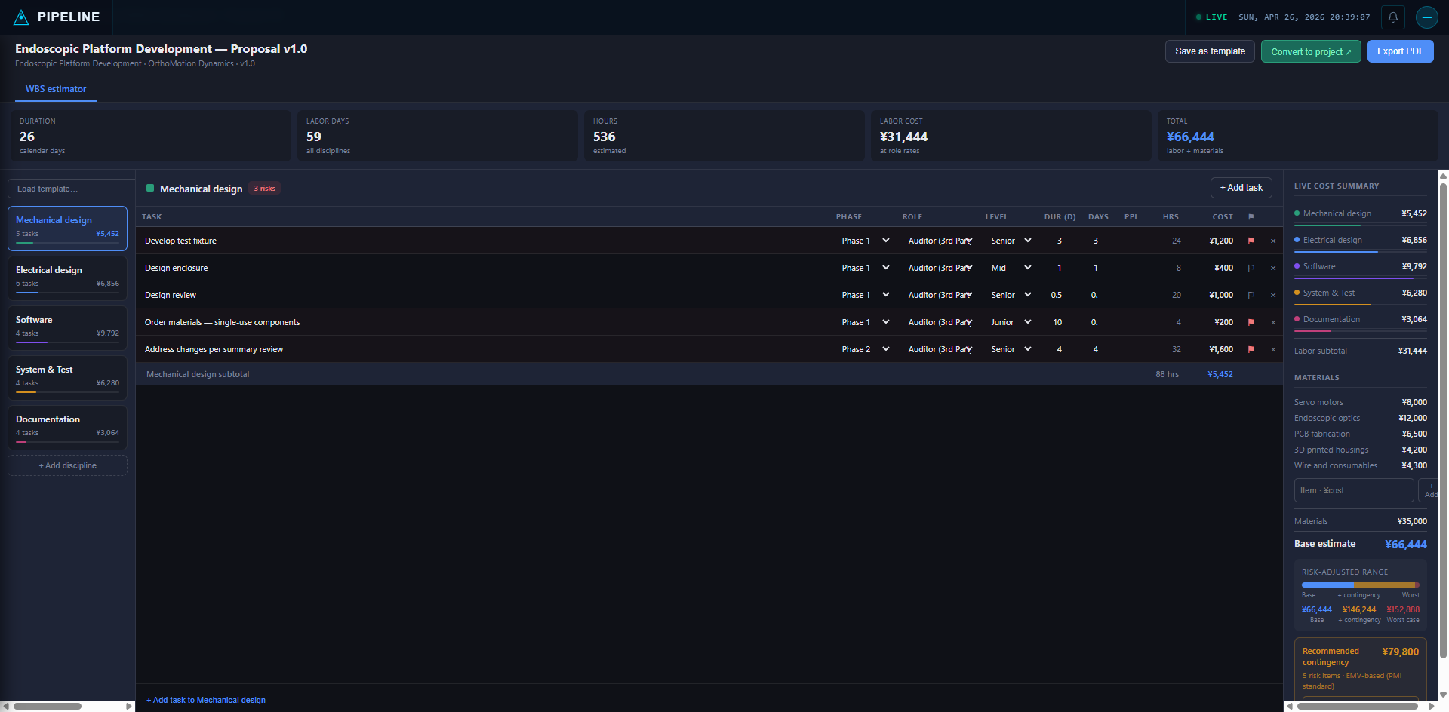
BEFORE

Slide 6
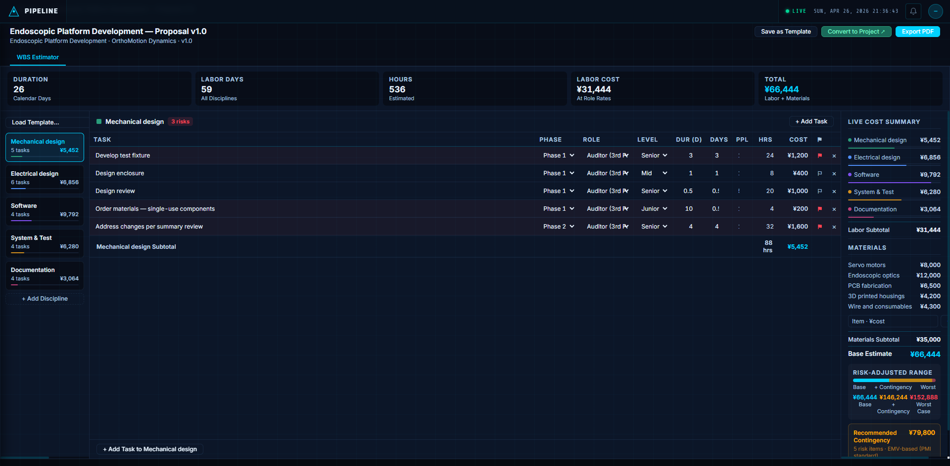
AFTER

Slide 7
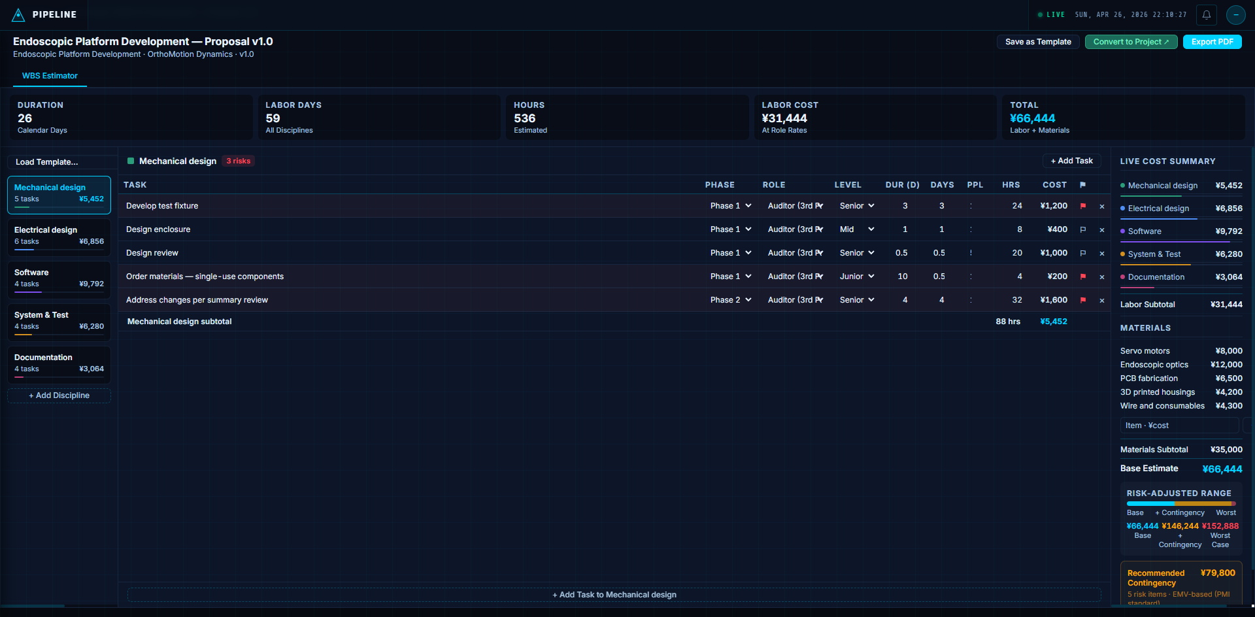
LATEST

Slide 8
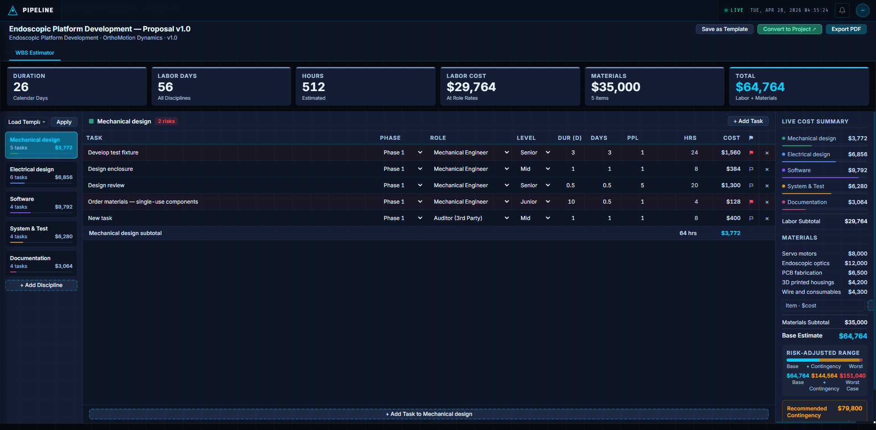
POST-A

Slide 9


Slide 10
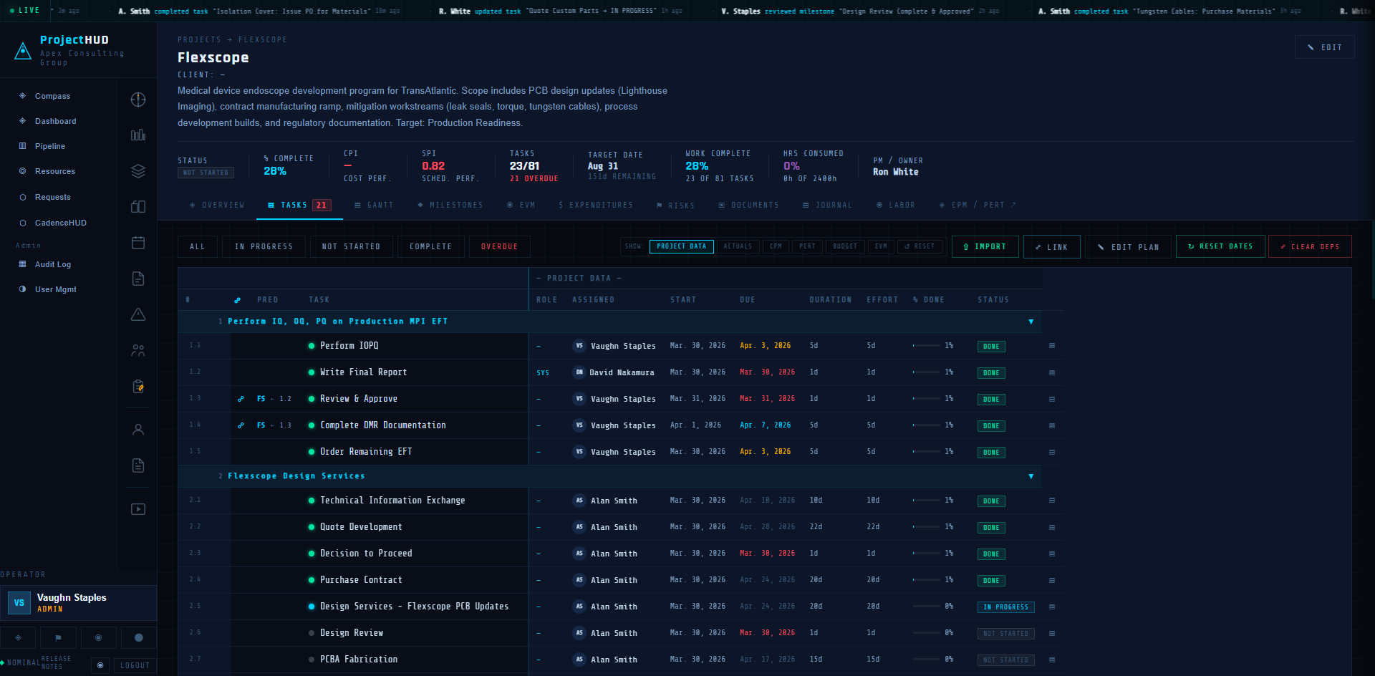
PROJECTHUD PROJECT MANAGEMENT

Slide 11
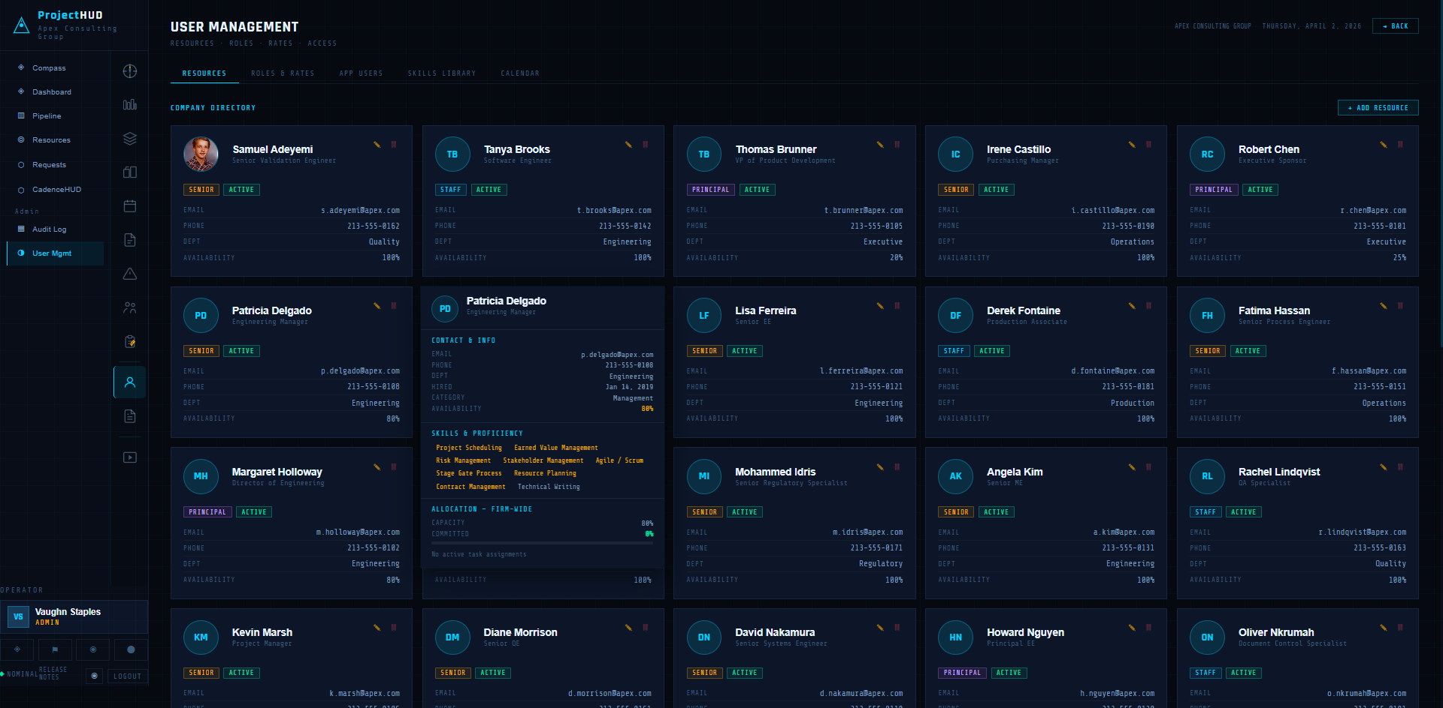
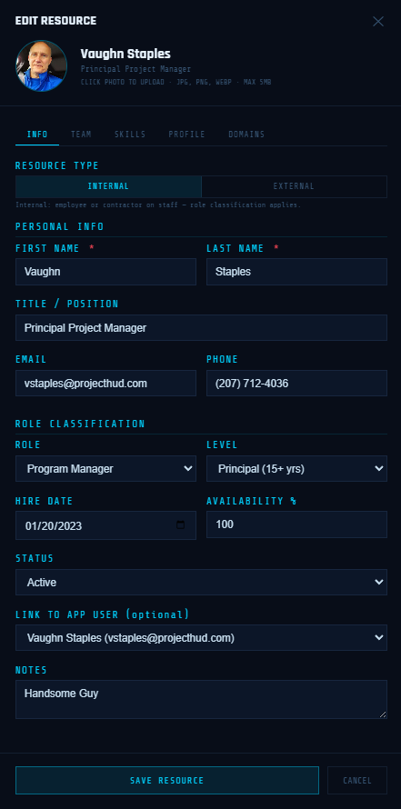
PROJECTHUD USER MANAGEMENT

Slide 12
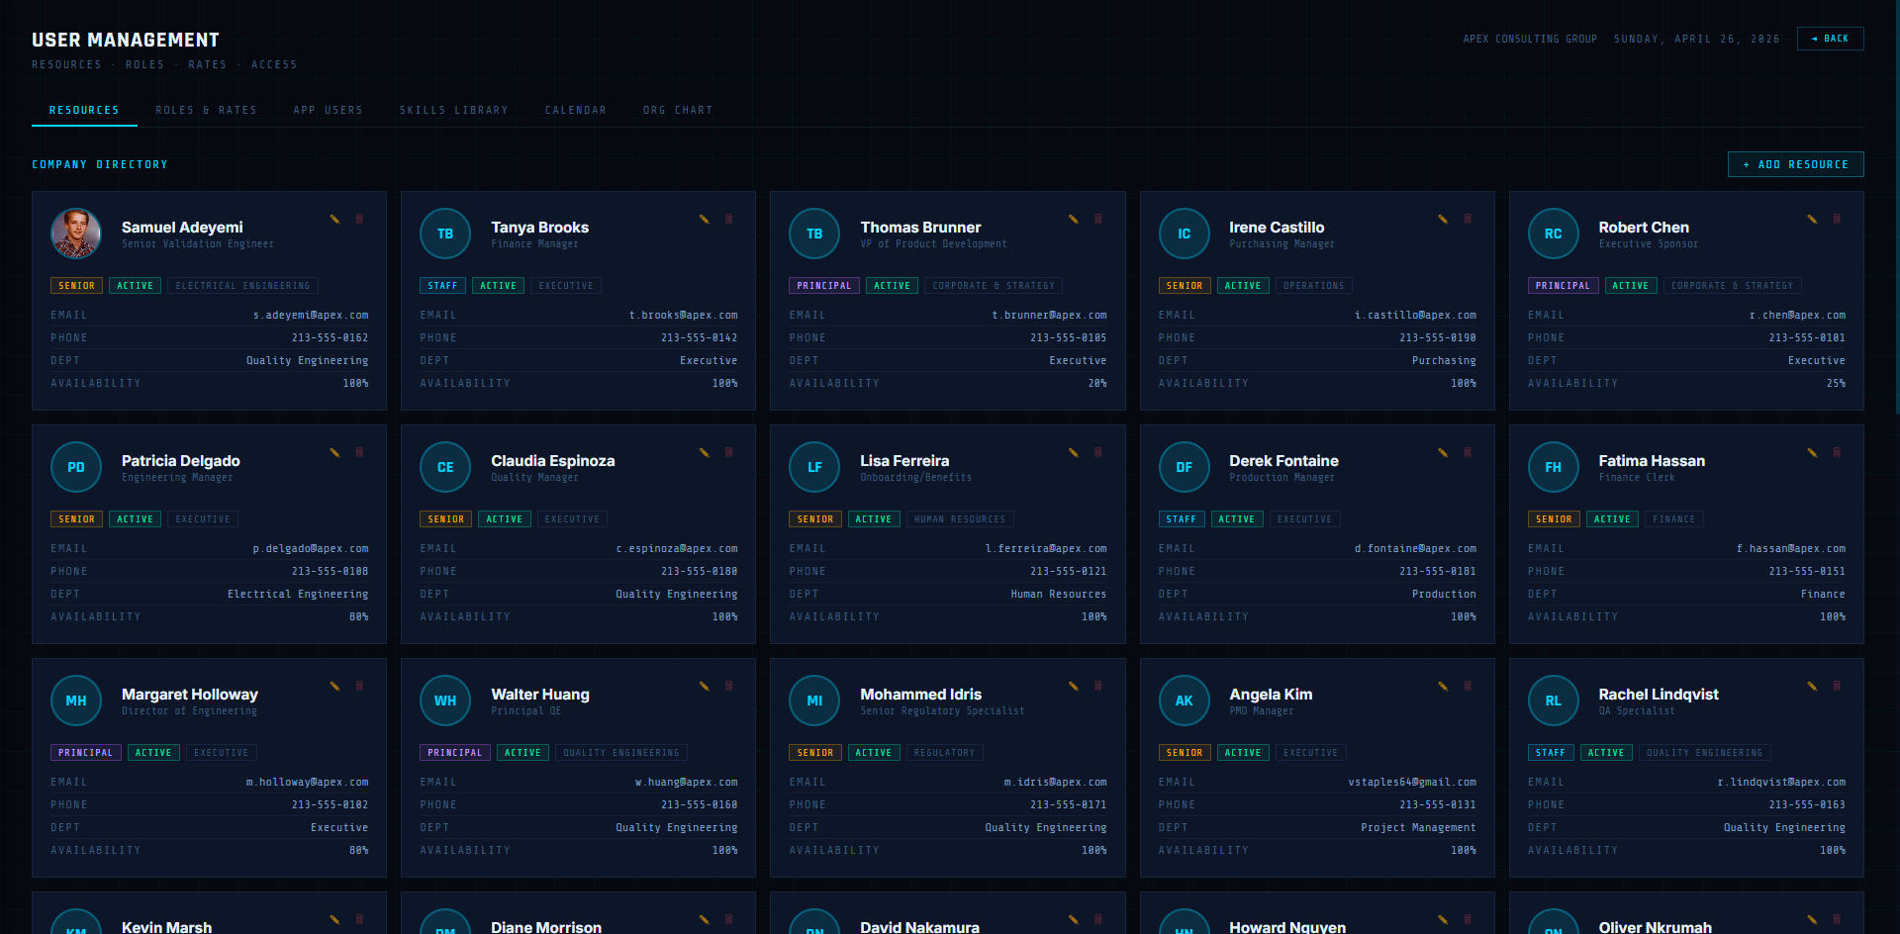

Slide 13
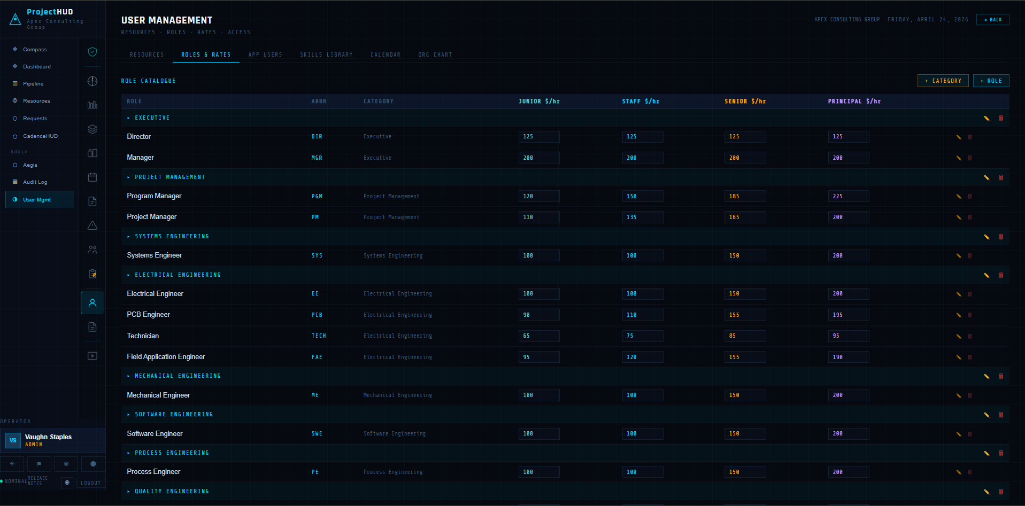
PROJECTHUD ROLES & RATES

Slide 14
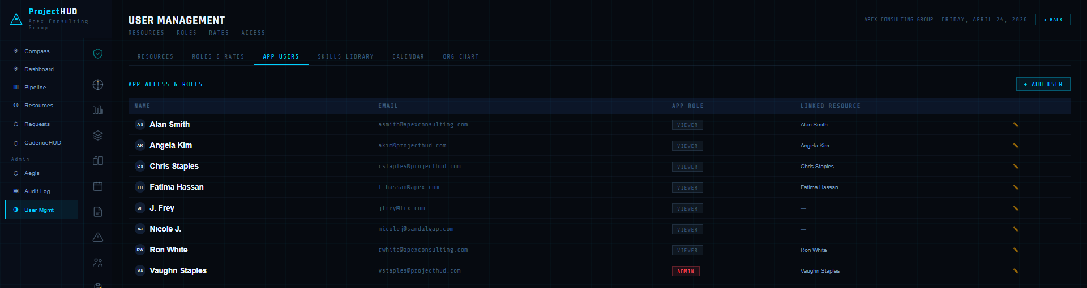
PROJECTHUD USER ACCOUNTS

Slide 15
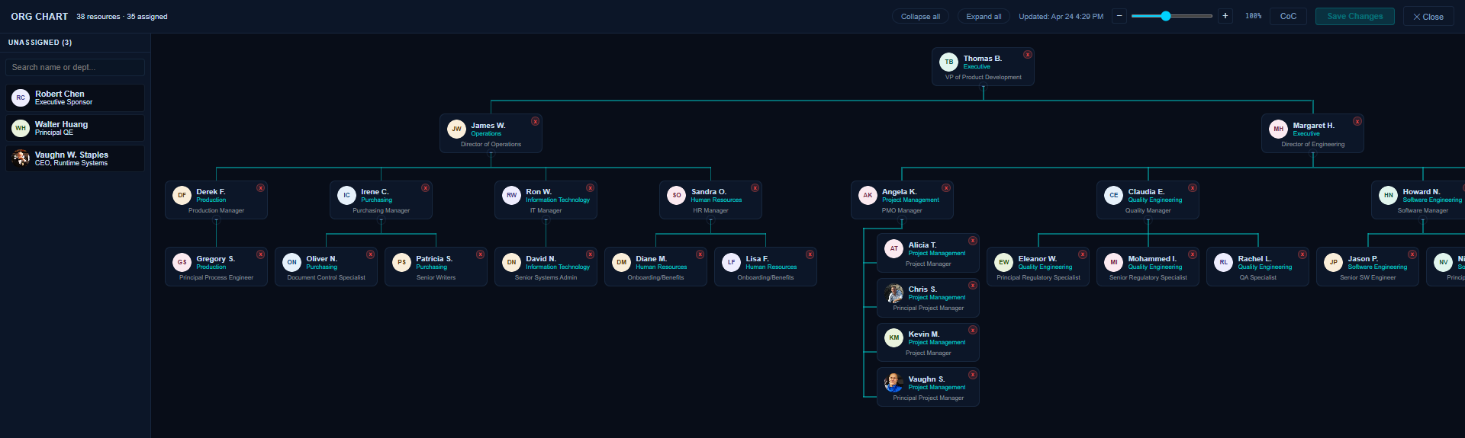
PROJECTHUD ORG CHART

Slide 16
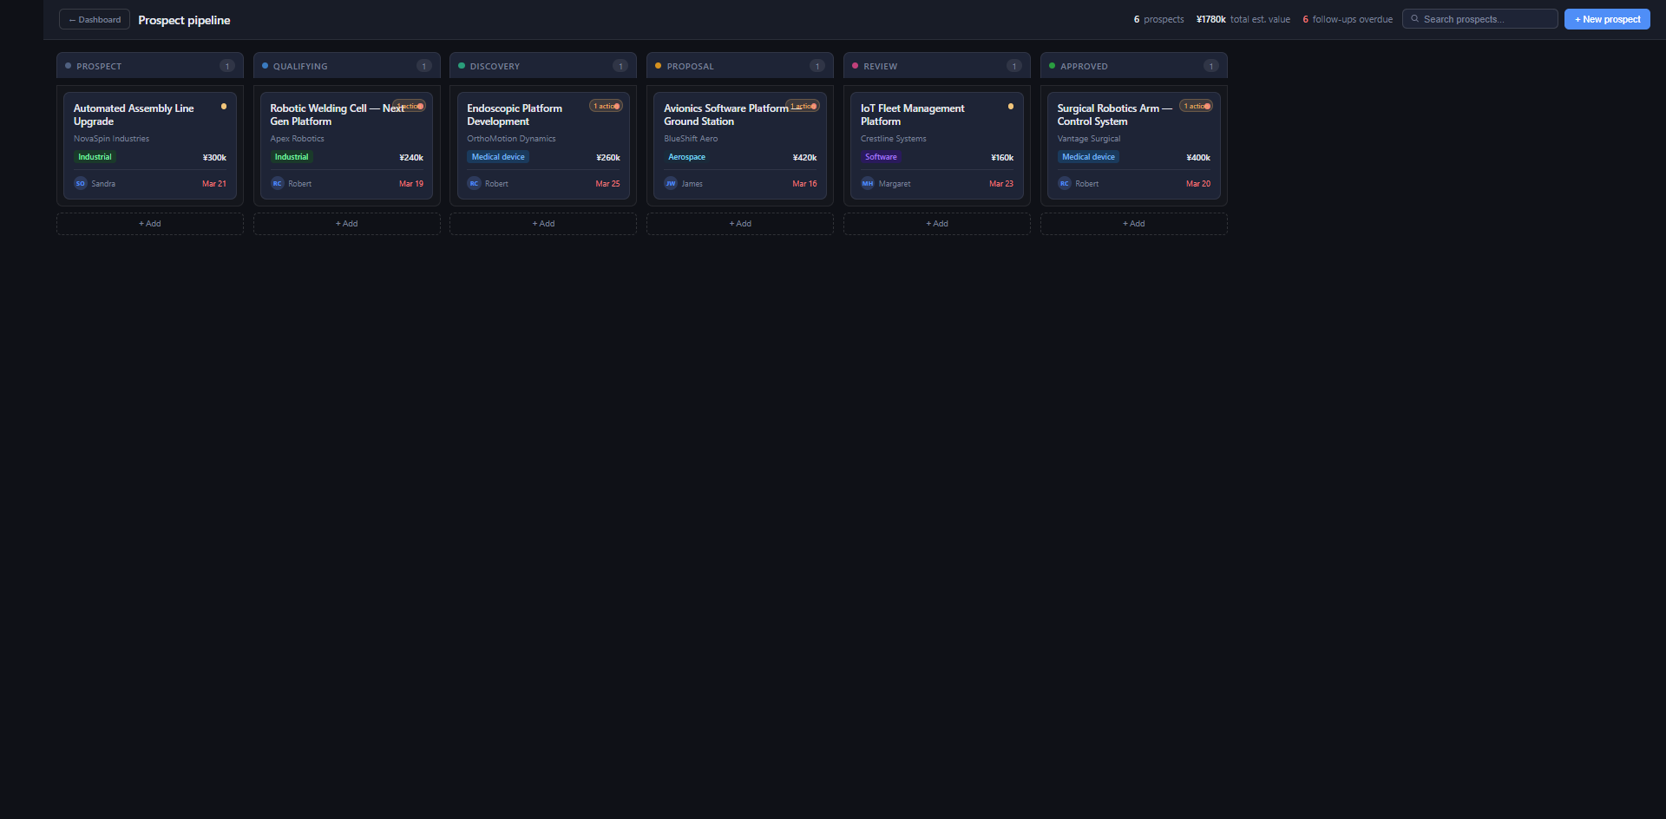
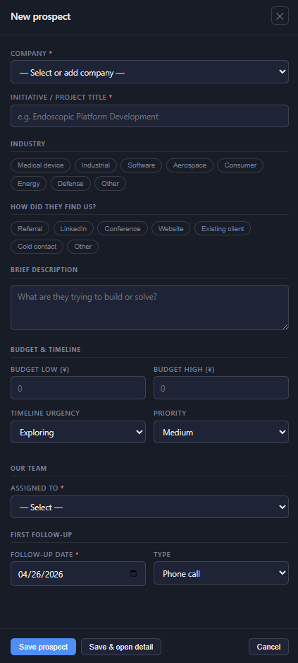

PROJECTHUD PIPELINE MANAGEMENT
ProjectHUD's Pipeline models business development workflow from Concept to WBS & completed Proposal.

Slide 17
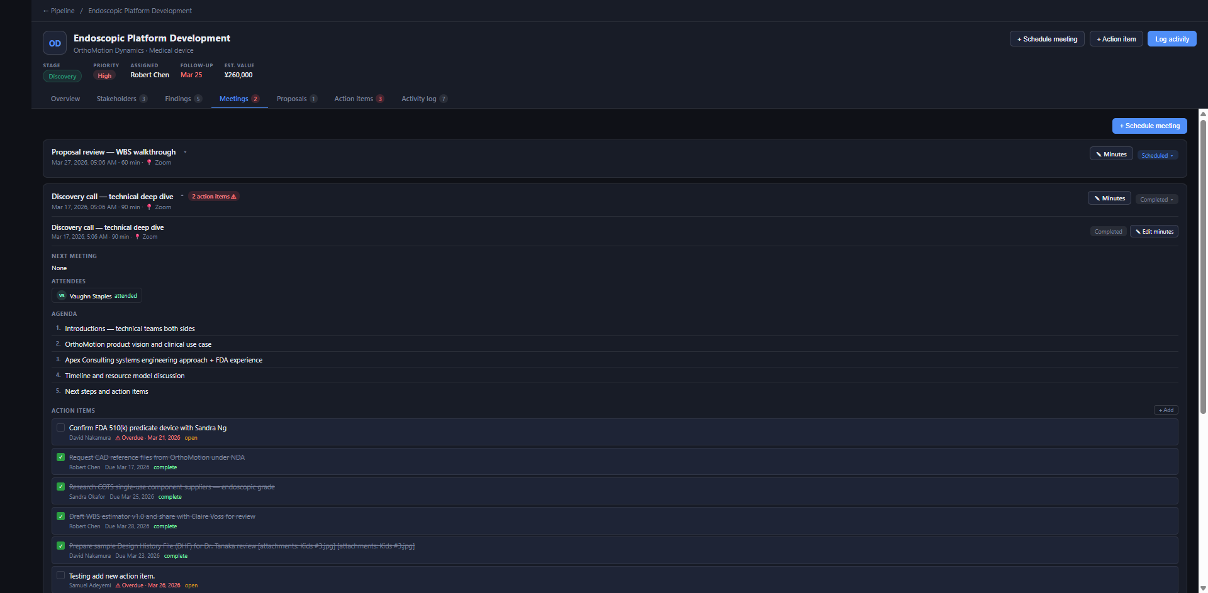
PROJECTHUD MEETING MINUTES

Slide 18
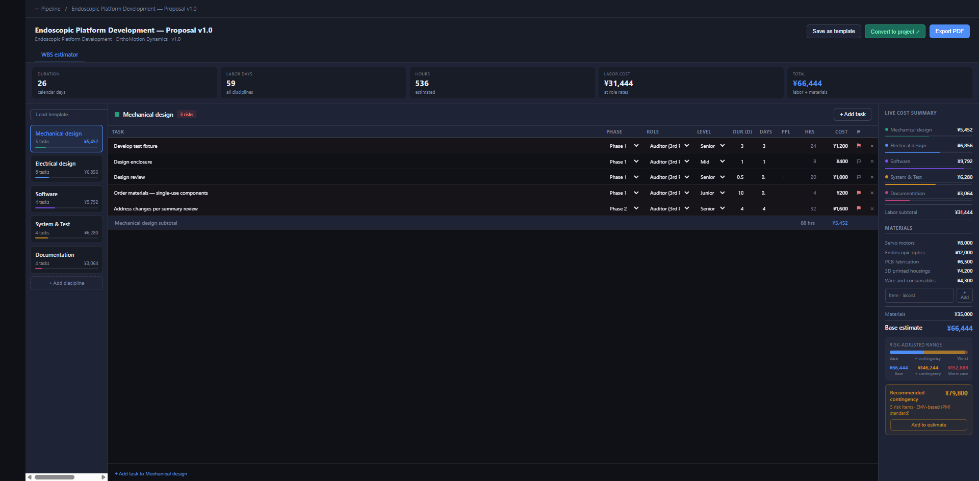
PROJECTHUD PROPOSAL MANAGEMENT

Slide 19
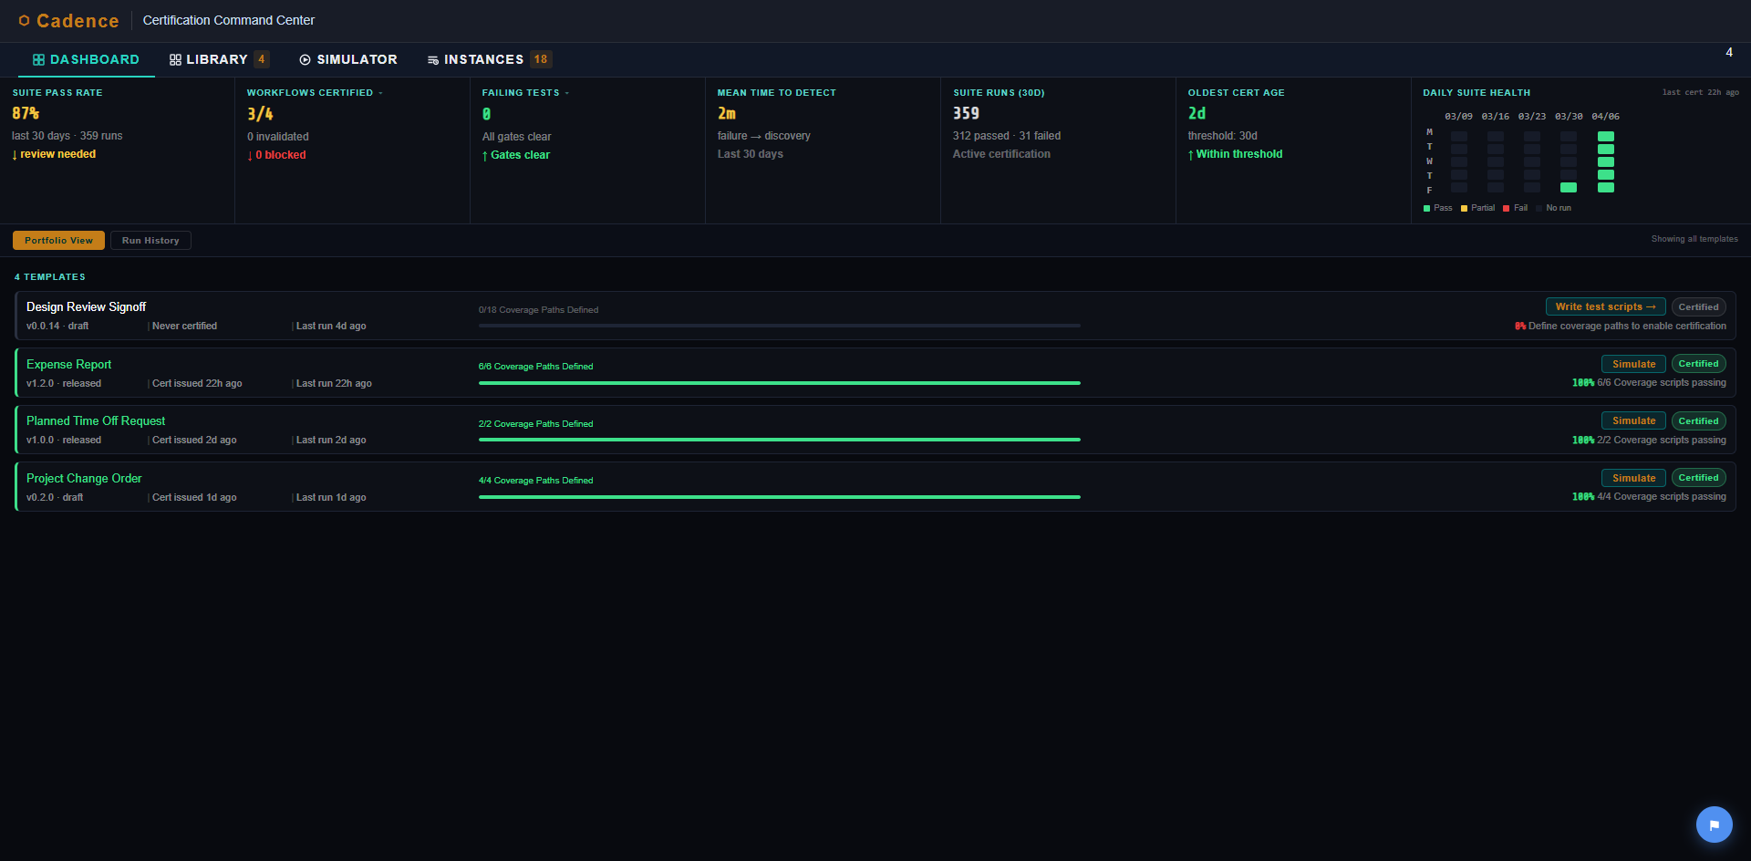
CADENCE DASHBOARD

Slide 20
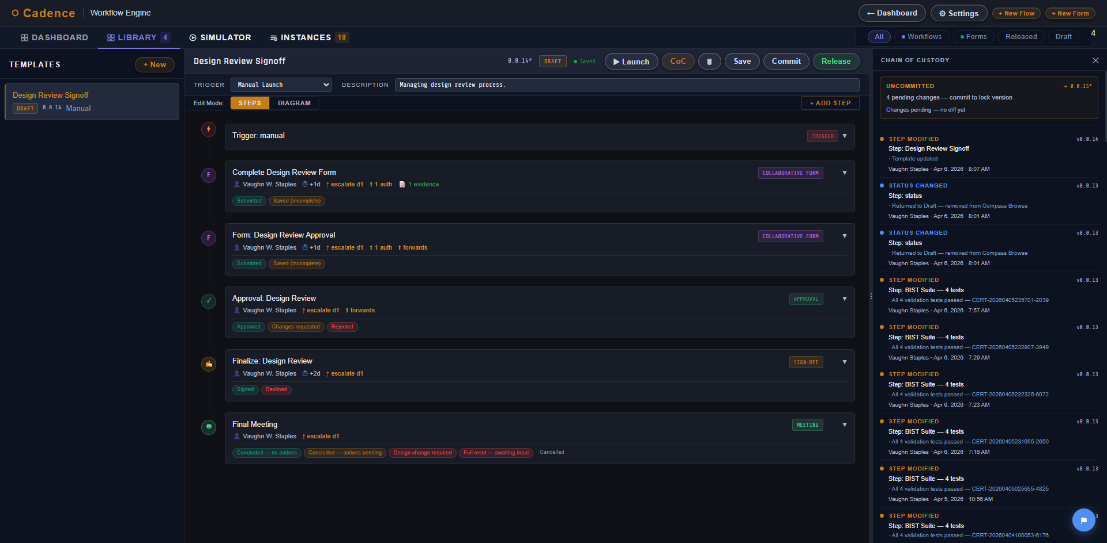
CADENCE WORKFLOW MANAGEMENT

Slide 21
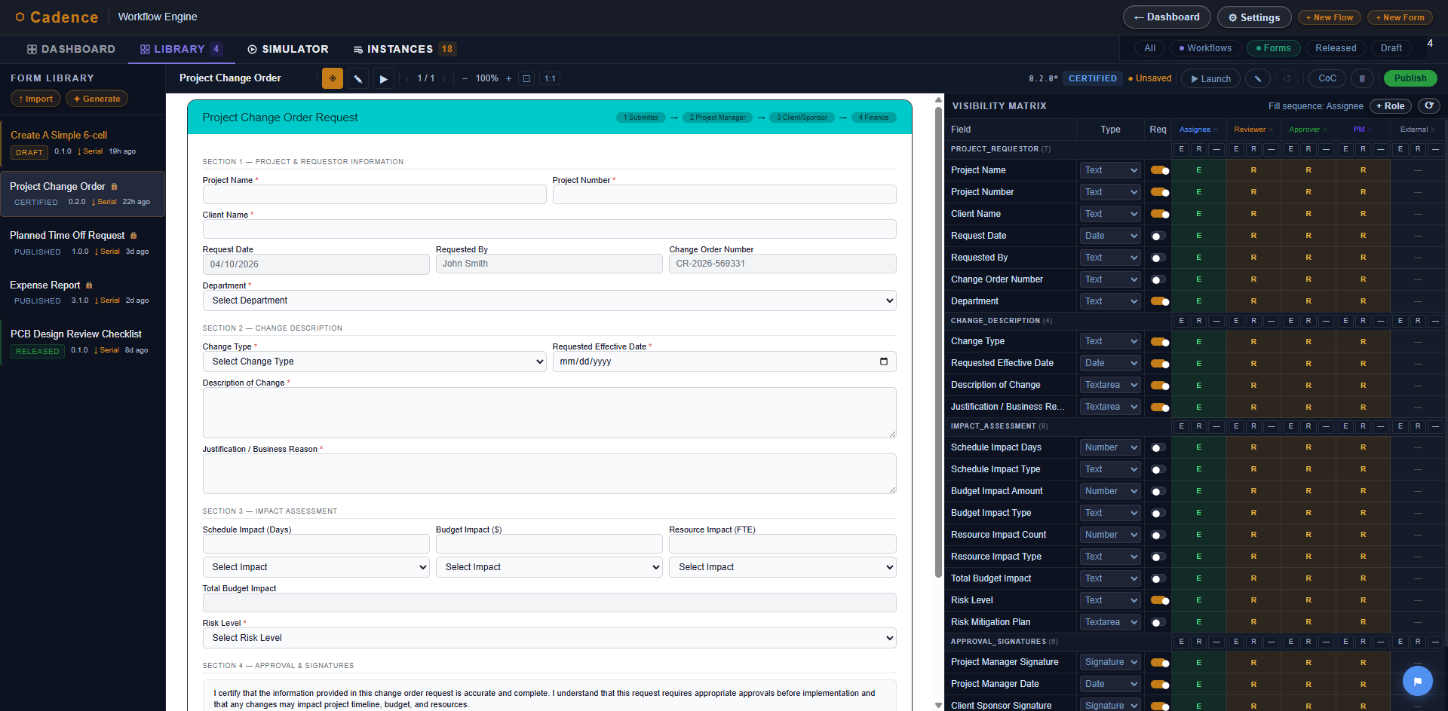
CADENCE FORM MANAGEMENT

Slide 22
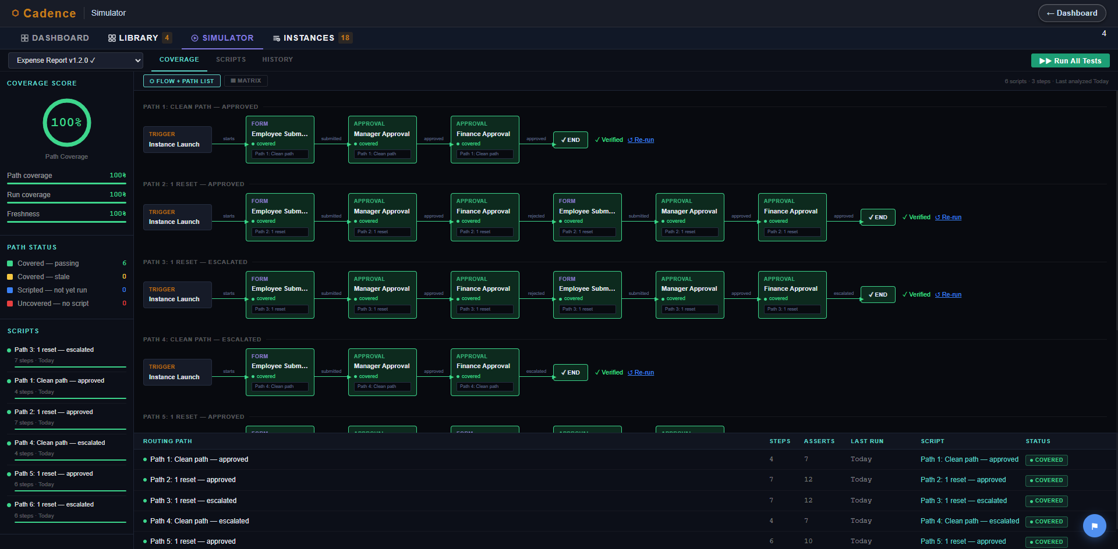
CADENCE COVERAGE SIMULATION

Slide 23
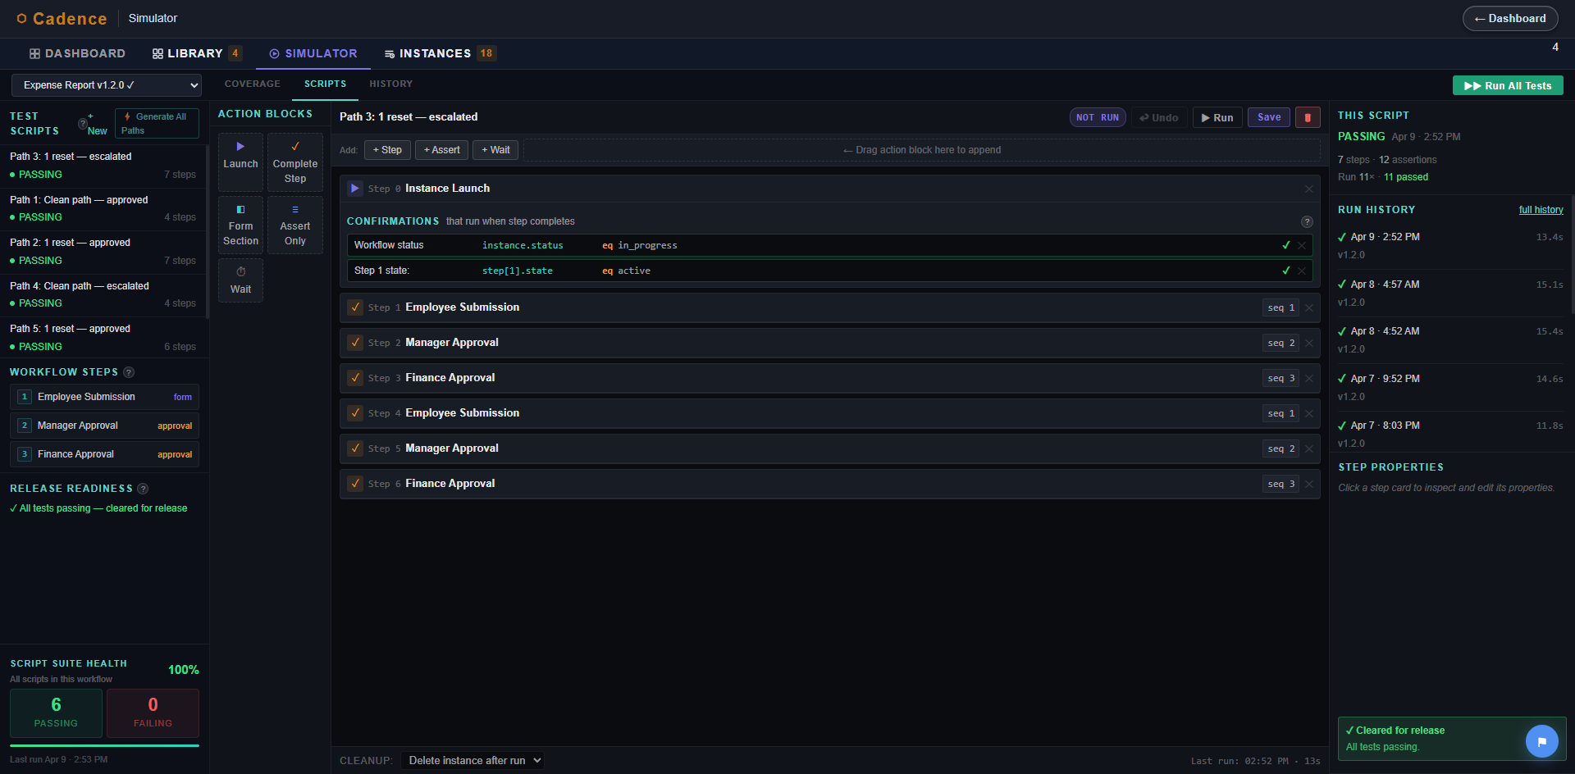
CADENCE SIMULATION SCRIPT EDITOR

Slide 24
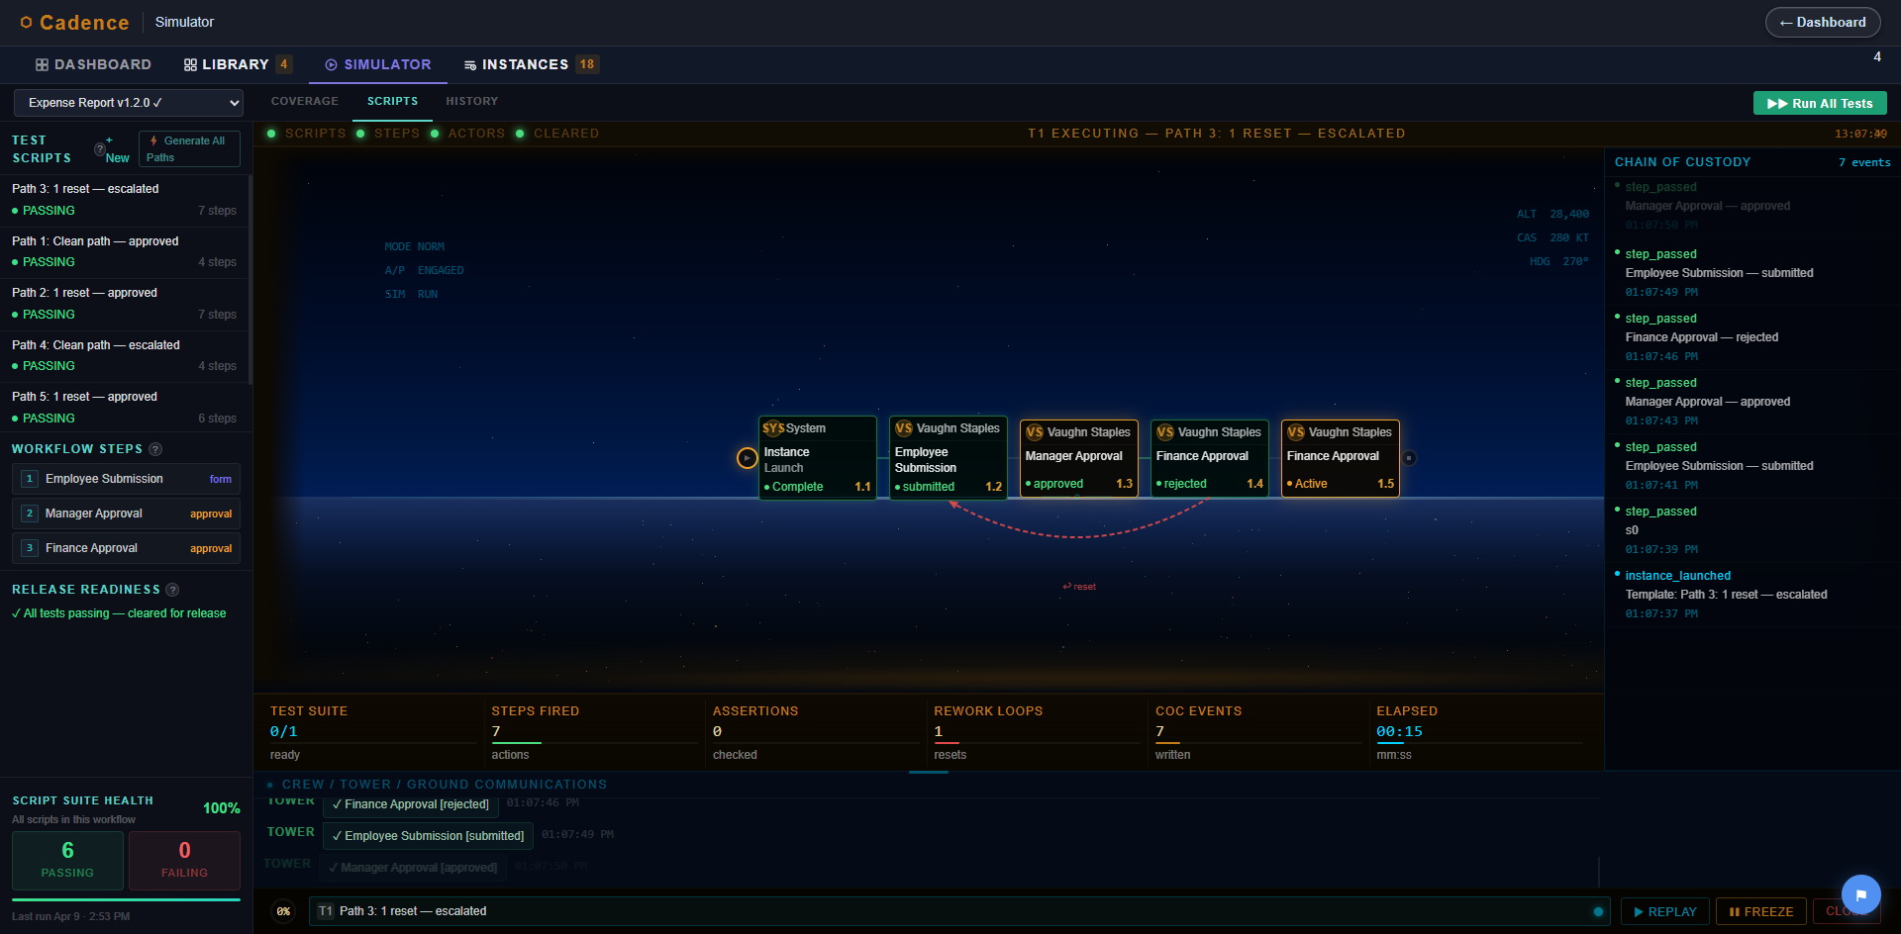
CADENCE WORKFLOW SIMULATOR

Slide 25
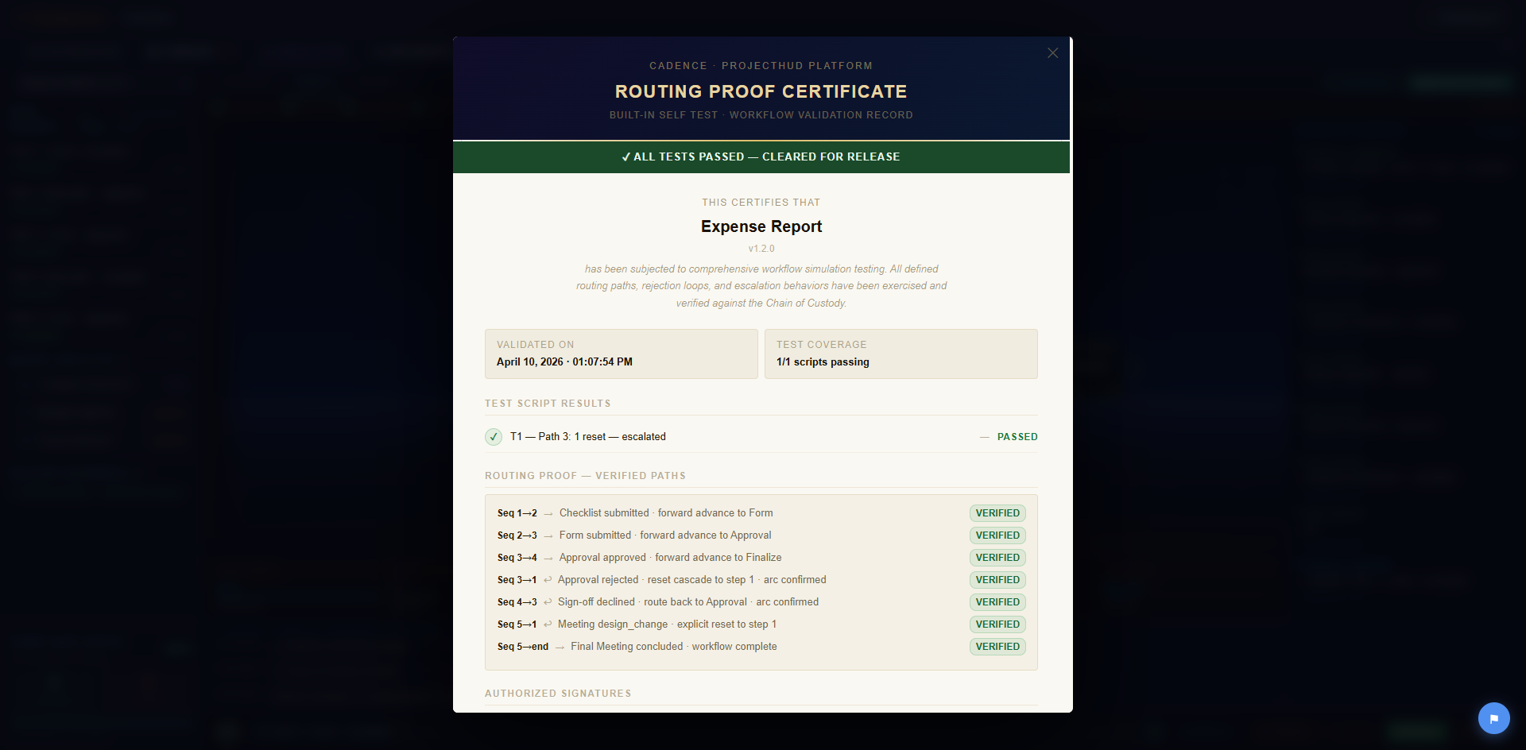
CADENCE SIMULATION CERTIFICATE

Slide 26
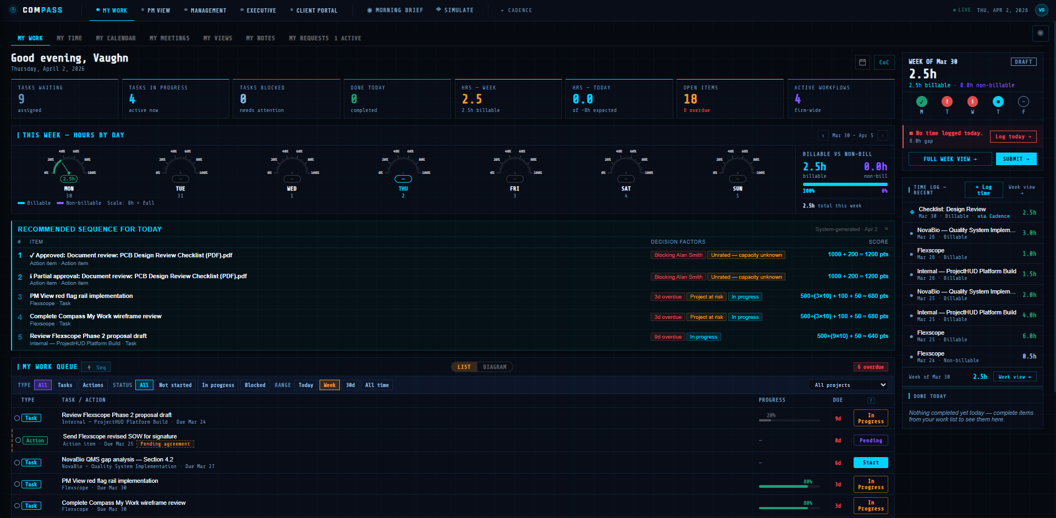
COMPASS PERSONAL DASHBOARD

Slide 27
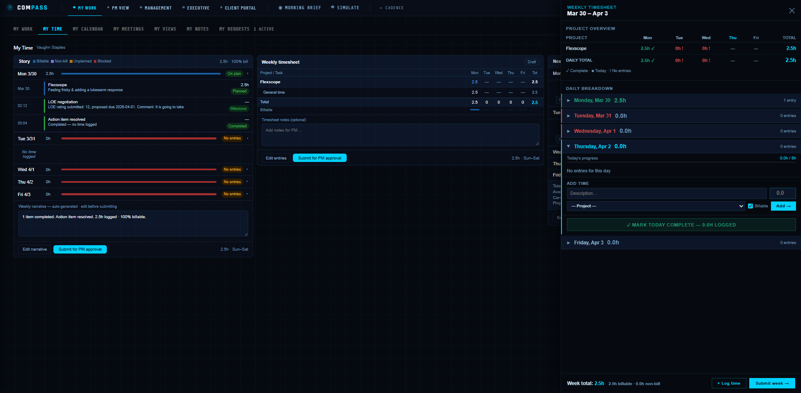
COMPASS TIME ENTRY

Slide 28
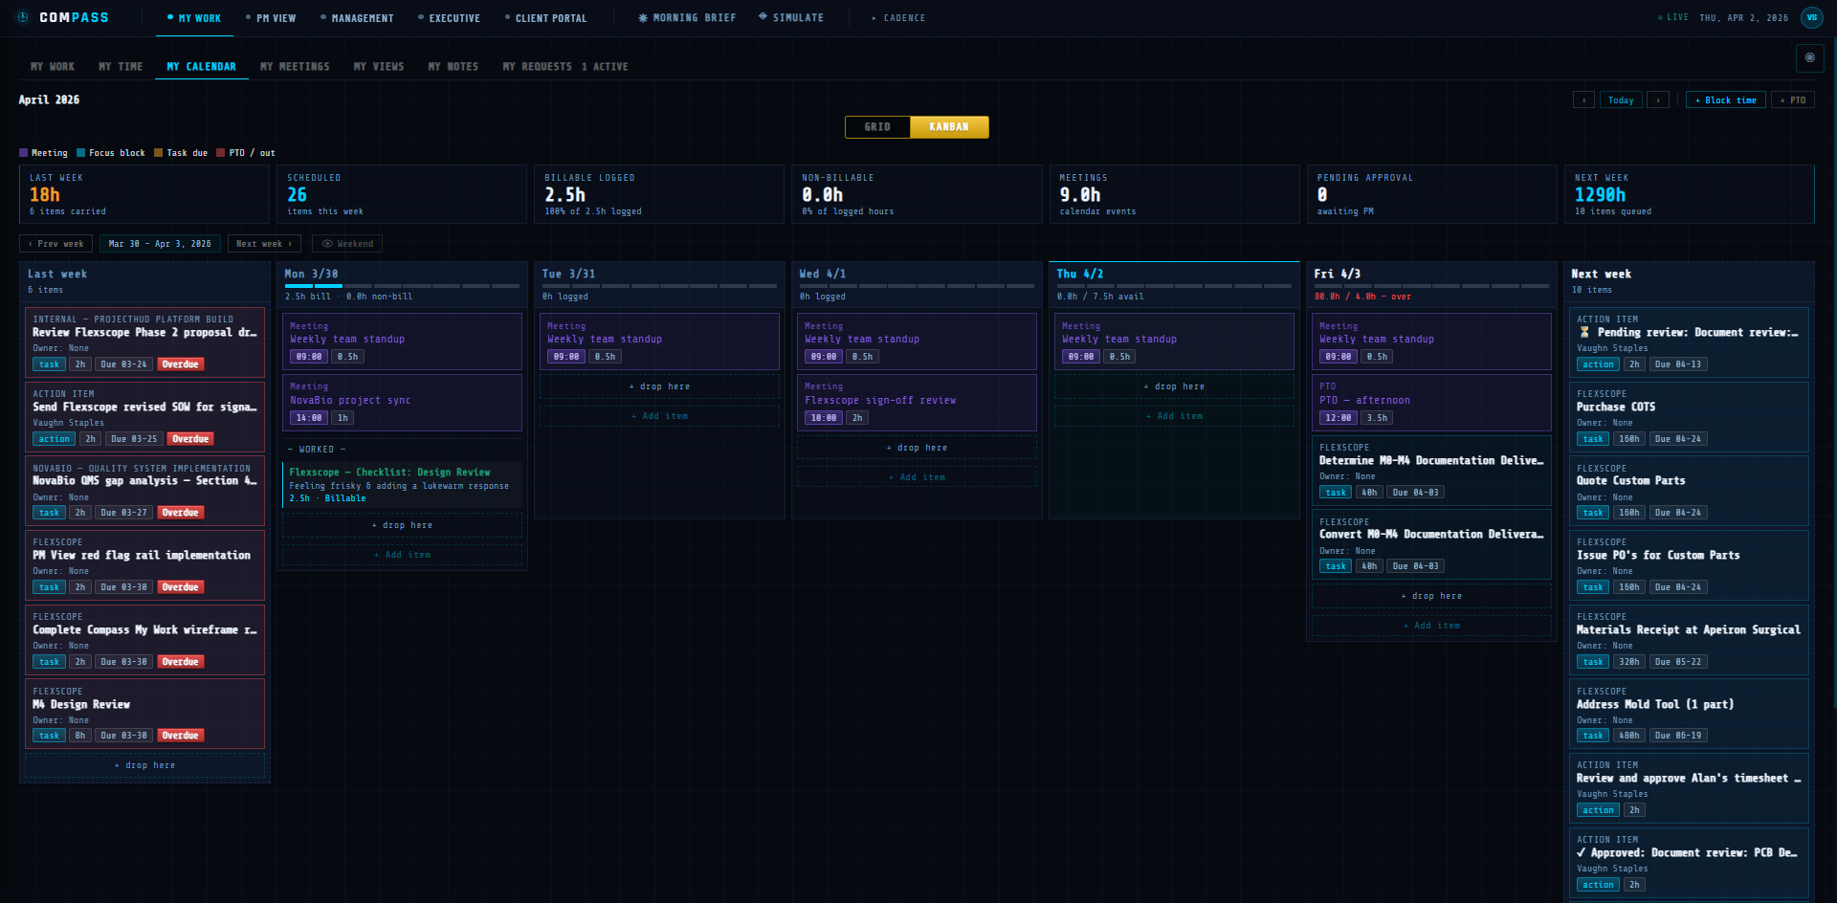
COMPASS CALENDAR/TASK MANAGEMENT

Slide 29
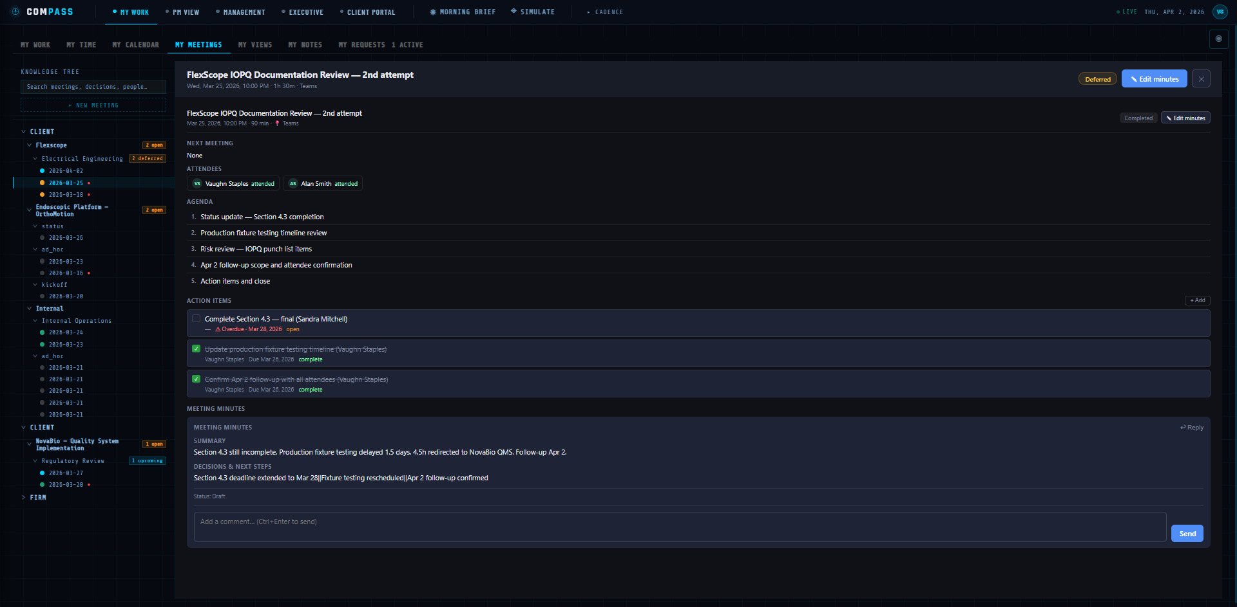
COMPASS MEETING MINUTES MANAGER

Slide 30
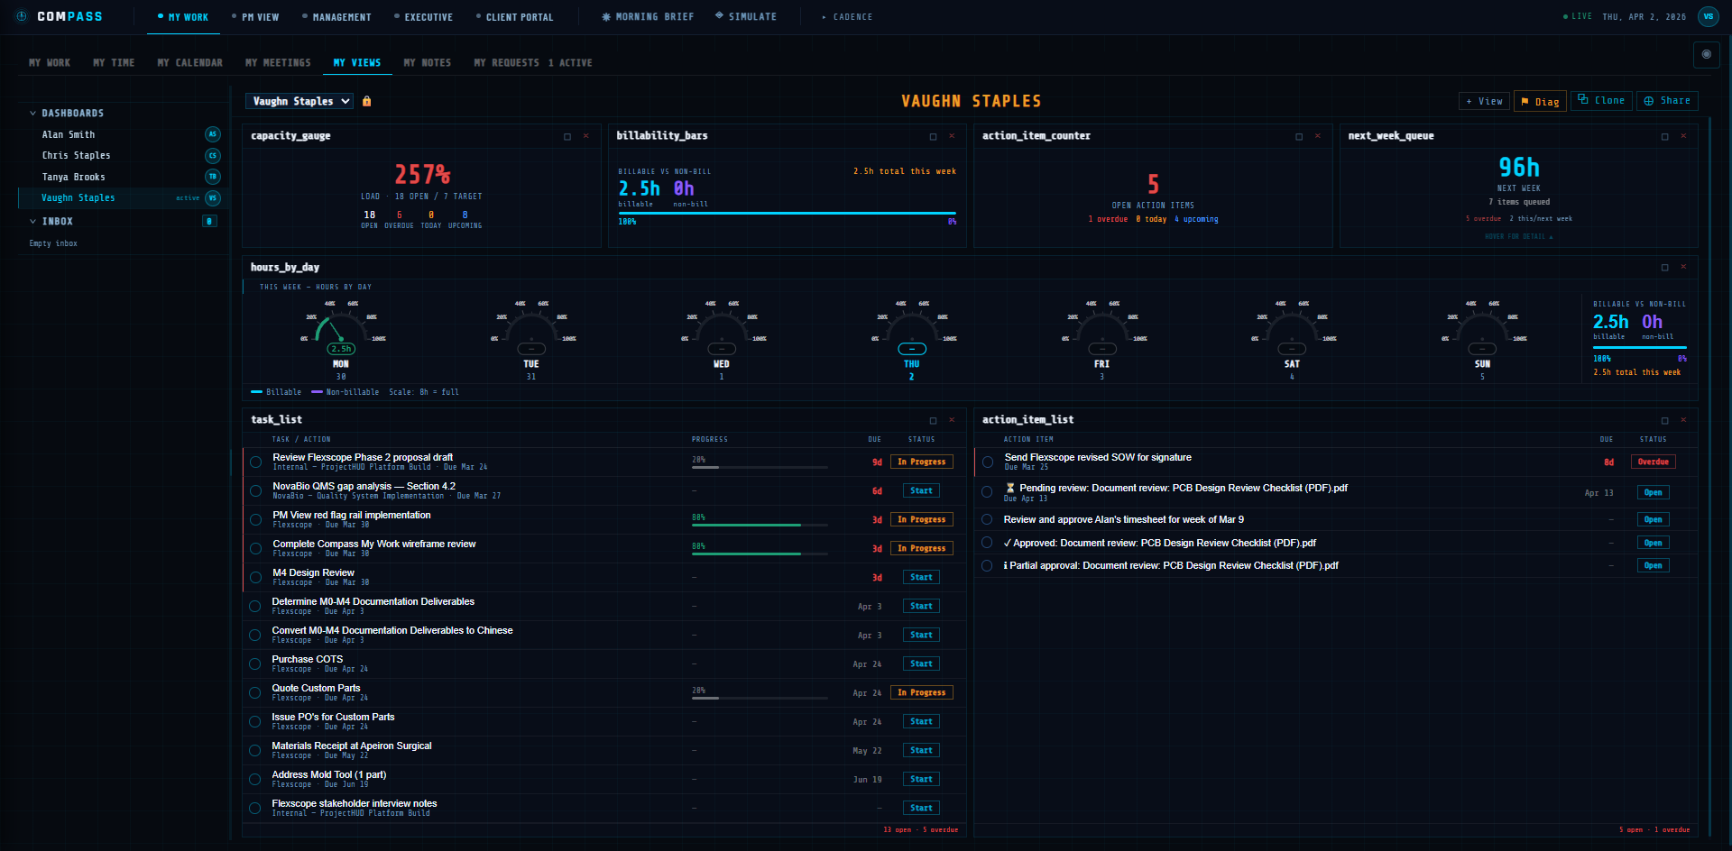
COMPASS VIEWS MANAGER

Slide 31
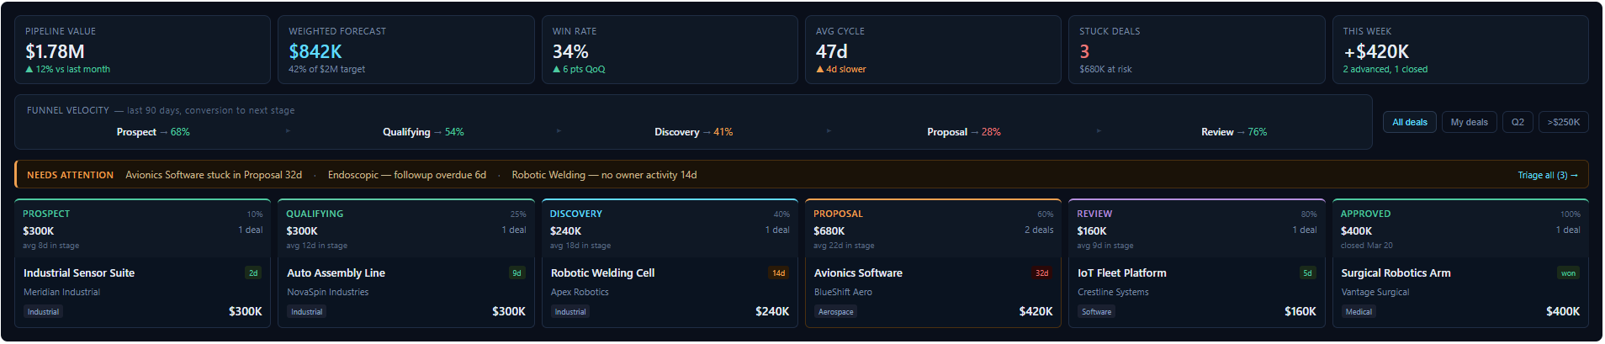
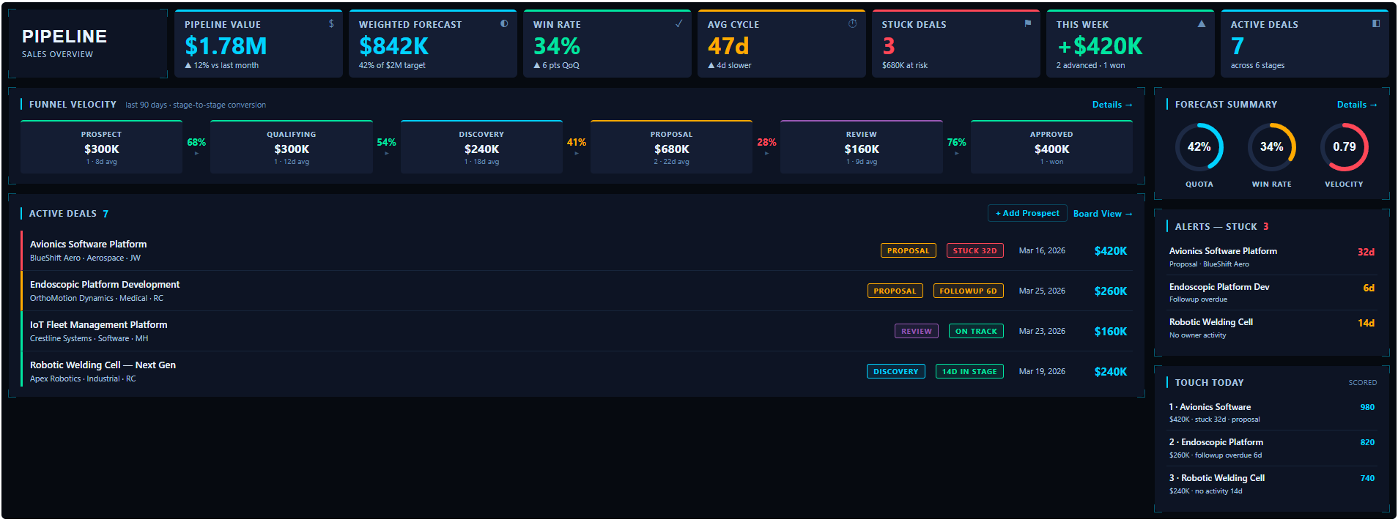

Slide 32
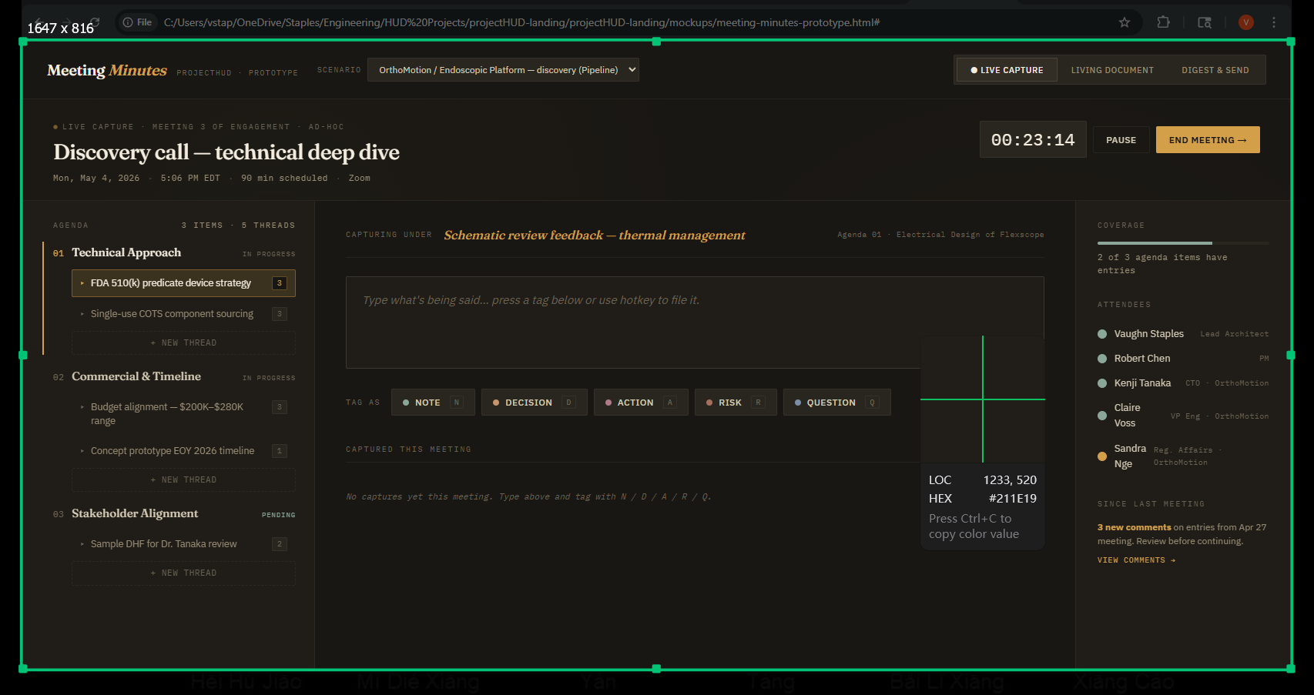
MEETING MINUTES
Electrical Design of Flexscope
Prototype PCBs expected to arrive at Lighthouse on 5/15
4/22: PCB design review complete; purchasing to release build package to Nimbletronics by 4/25
4/19: PCB design review held; need further thermal reliefs … est. turnaround 1 day
4/15: Mike Rucker 50% through PCB layout; expects to complete by 4/17
4/08: Design review discovered ground connection issues; B. Roy to correct schematics & hold updated design review on 4/11.
4/01: Ben Roy has completed schematics of the transceiver board & will hold a design review on 4/05.

Slide 33
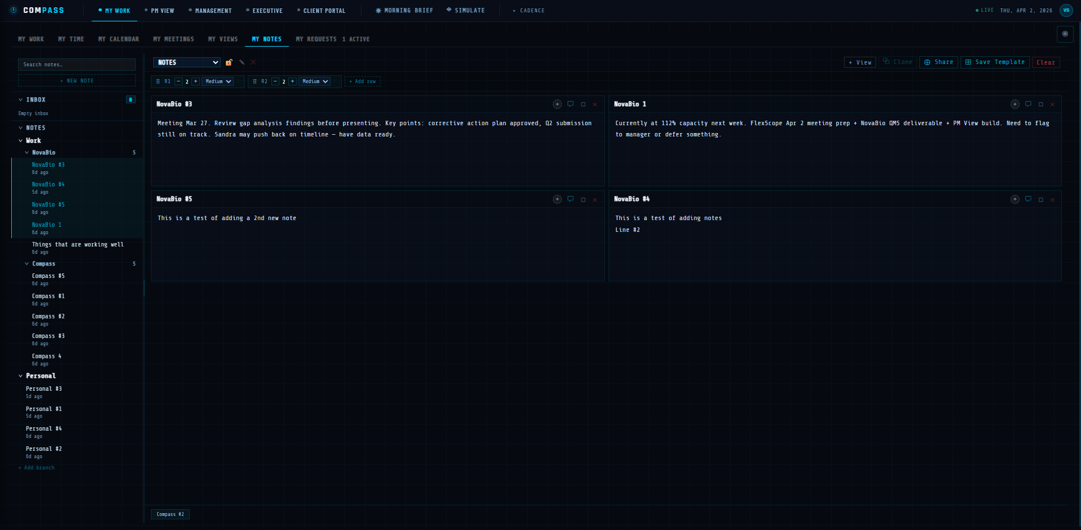
COMPASS NOTES MANAGEMENT

Slide 34
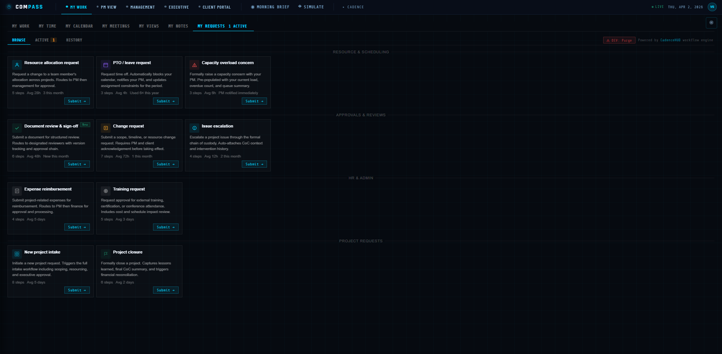
COMPASS FORM & WORKFLOW LIBRARY

Slide 35
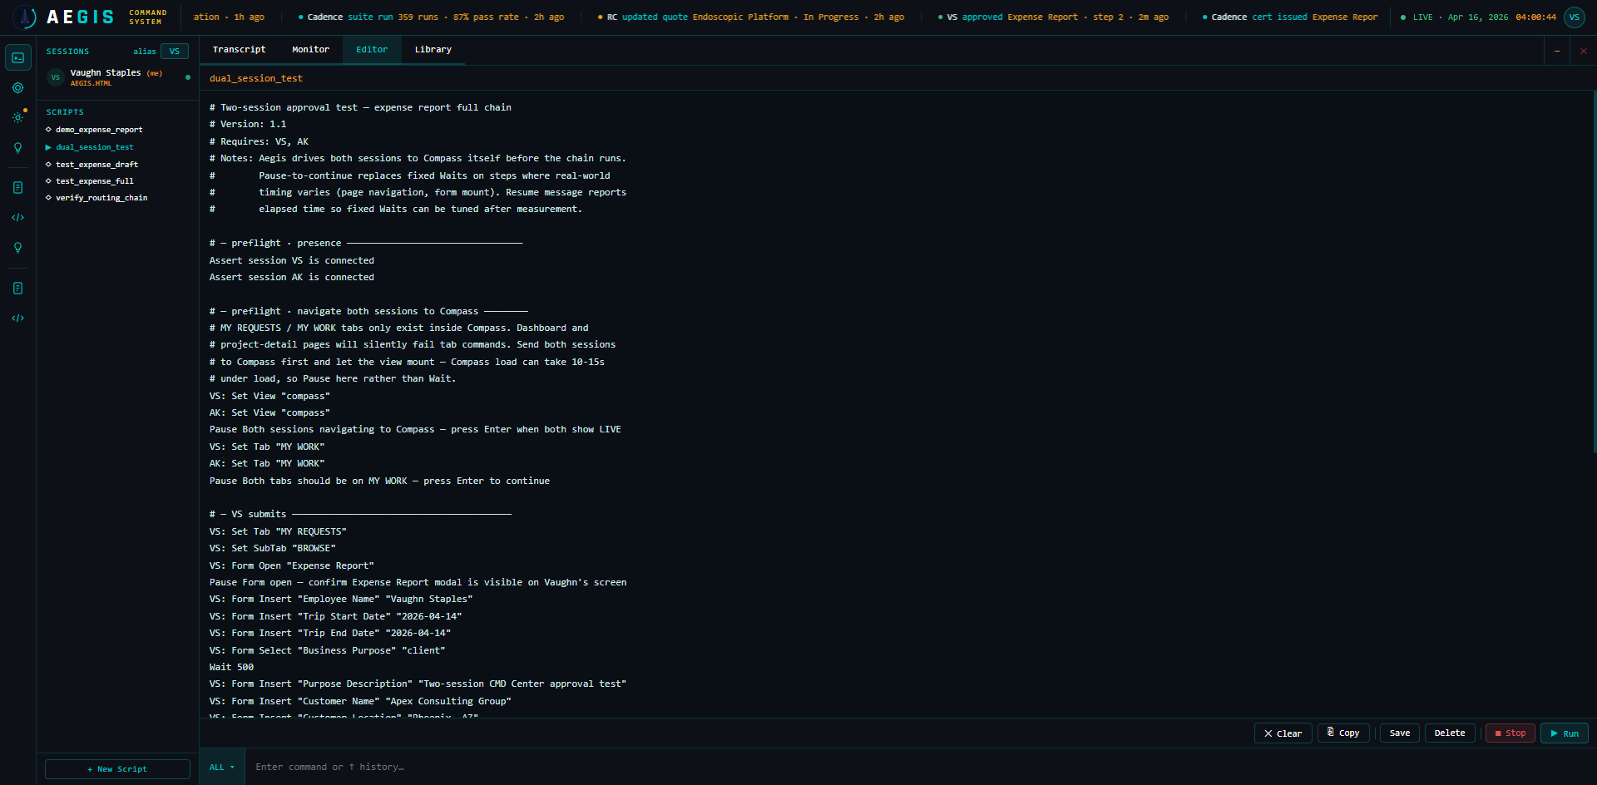
AEGIS COMMAND CENTER

Slide 36










Slide 37


