Slide 1
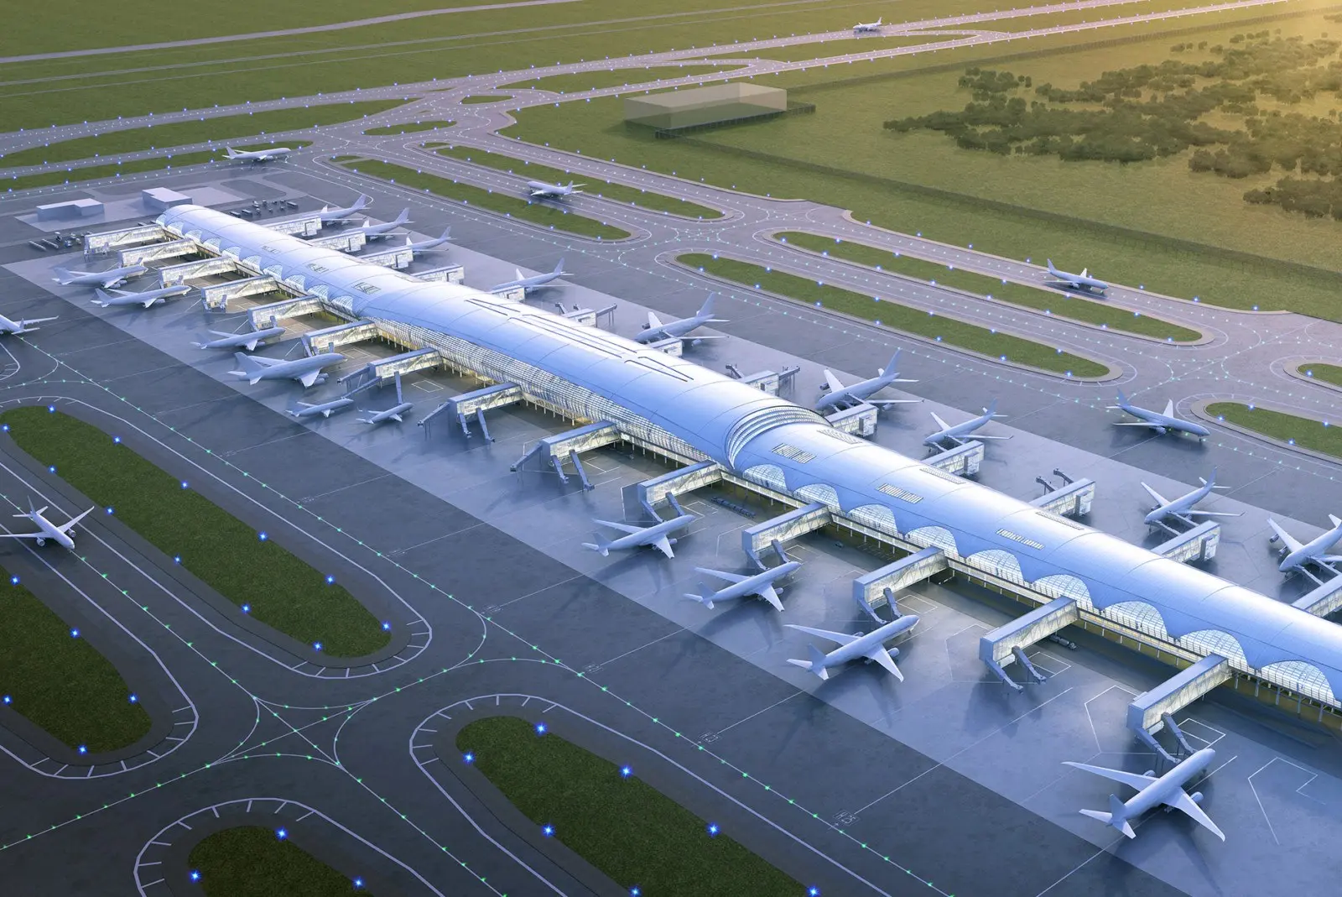

A BRIEFING FOR AOT LEADERSHIP
SOLUTION OVERVIEW
SAWASDEE by AOT and SAS Customer Intelligence 360
Understanding the difference — and the opportunity
01 / 08

Slide 2










THE DIFFERENCE IN ONE LINE
One is what your passengers see. One is what makes it smart.
SAWASDEE by AOT
SAS CI360
The app travelers open at the airport
The invisible engine inside the company
Flight tracking
Customer data
Airport maps
AI decisions
Taxi booking
Personalized offers
Loyalty points
Revenue growth
02 / 08

Slide 3



TODAY, WITHOUT AN ENGINE
What happens today without an intelligence engine?
01
02
03
Every passenger gets the same message — even though each one is different.
AOT cannot predict which traveler is about to stop engaging.
Revenue is missed because the right offer never reaches the right person at the right time.
03 / 08

Slide 4



THE COMPARISON
Side by side — what each one does
SAWASDEE by AOT
SAS CI360
The traveler app
The intelligence engine
Purpose
Help travelers move through the airport
Decide what to offer each customer
Who uses it
Passengers
Marketing & commercial teams
Visible to customer?
Yes — they open it
No — it works behind the scenes
Key features
Flights, maps, taxi, loyalty
Data, AI decisions, personalized offers
Data it handles
What the traveler taps and books
Every signal, from every channel
Business outcome
A smoother airport journey
More revenue and stronger loyalty
Geographic reach
AOT airports in Thailand
Global platform, used worldwide
Who buys it
Built and run by AOT
Licensed by AOT from SAS
Can they work together?
Yes — CI360 powers the intelligence behind SAWASDEE.
04 / 08

Slide 5






THE OPPORTUNITY
Together, they create a smarter airport experience
STEP 1
STEP 2
STEP 3
STEP 4
Traveler opens the SAWASDEE app
App quietly shares what they do
CI360 analyzes and decides
A personal offer returns in real time
Somchai lands every Friday and always buys coffee near Gate D. CI360 notices he hasn't used his loyalty points in 3 months. Before he reaches the terminal, SAWASDEE sends a personal coffee discount. He redeems it. AOT earns more. Somchai feels valued.
05 / 08

Slide 6



ALREADY HAPPENING
Airports and airlines already doing this with CI360
iGA Istanbul Airport
1st Place — SAS 2024 Customer Awards
Turkey
Pegasus Airlines
Turned its mobile app into a personalized engagement platform, tailoring each traveler's experience.
Turkey
Used CI360 to segment passengers and personalize every communication.
RESULT
Significant revenue increase and double-digit growth in fast-track service take-up.
RESULT
Significant revenue contribution and higher guest satisfaction.
Source — sas.com/customers (official SAS published case studies)
06 / 08

Slide 7



THE BUSINESS CASE FOR AOT
What CI360 could mean for AOT
Protect revenue
Grow spend
Build loyalty
Spot passengers who are drifting away before they stop coming.
Send the right retail or dining offer to the right passenger, at the right moment.
Make every traveler feel like AOT knows them personally.
07 / 08

Slide 8
WHERE THIS GOES NEXT
SAWASDEE is already the face . CI360 becomes the brain.
The question is not whether AOT needs intelligent customer engagement. The question is when.
08 / 08

