Slide 1









TEAM
AI
BIGDATA
GPU and AI Infrastructure
GPU Server
Edge AI
Storage Peformance
Software Analytic
Bigdata Platform
AI Vision
AI Stack

Slide 2
HYBRID DATA COMPANY
Updated 2025

Slide 3


the hybrid data company
We believe that data can make what is impossible today, possible tomorrow
We empower people to transform complex data anywhere into actionable insights faster and easier
We deliver a hybrid data platform with secure data management and portable cloud-native data analytics

Slide 4
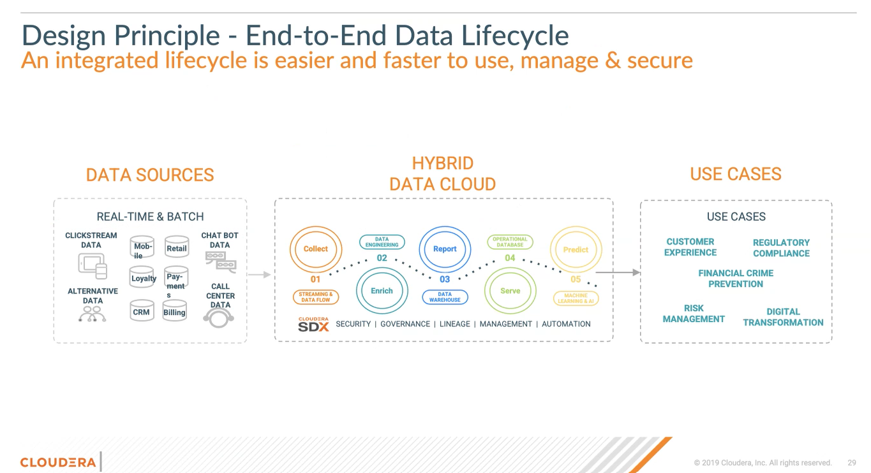

Slide 5
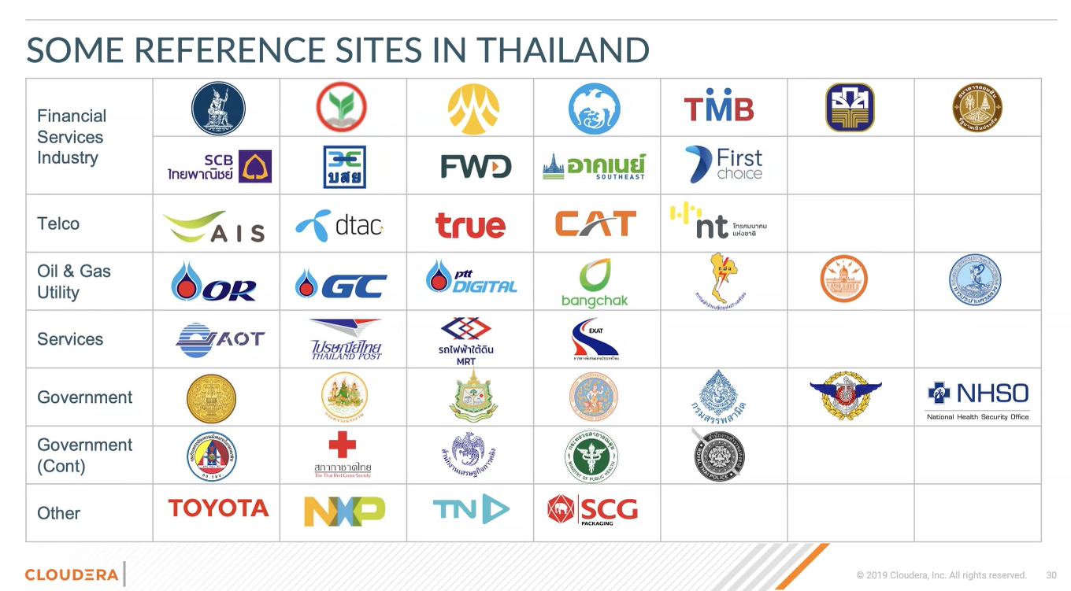

Slide 6
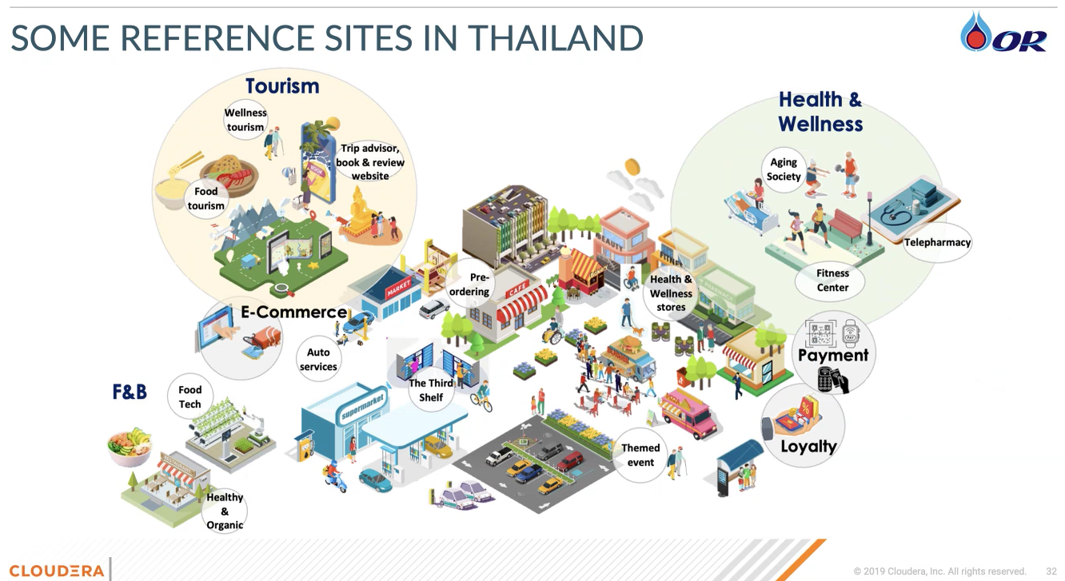

Slide 7
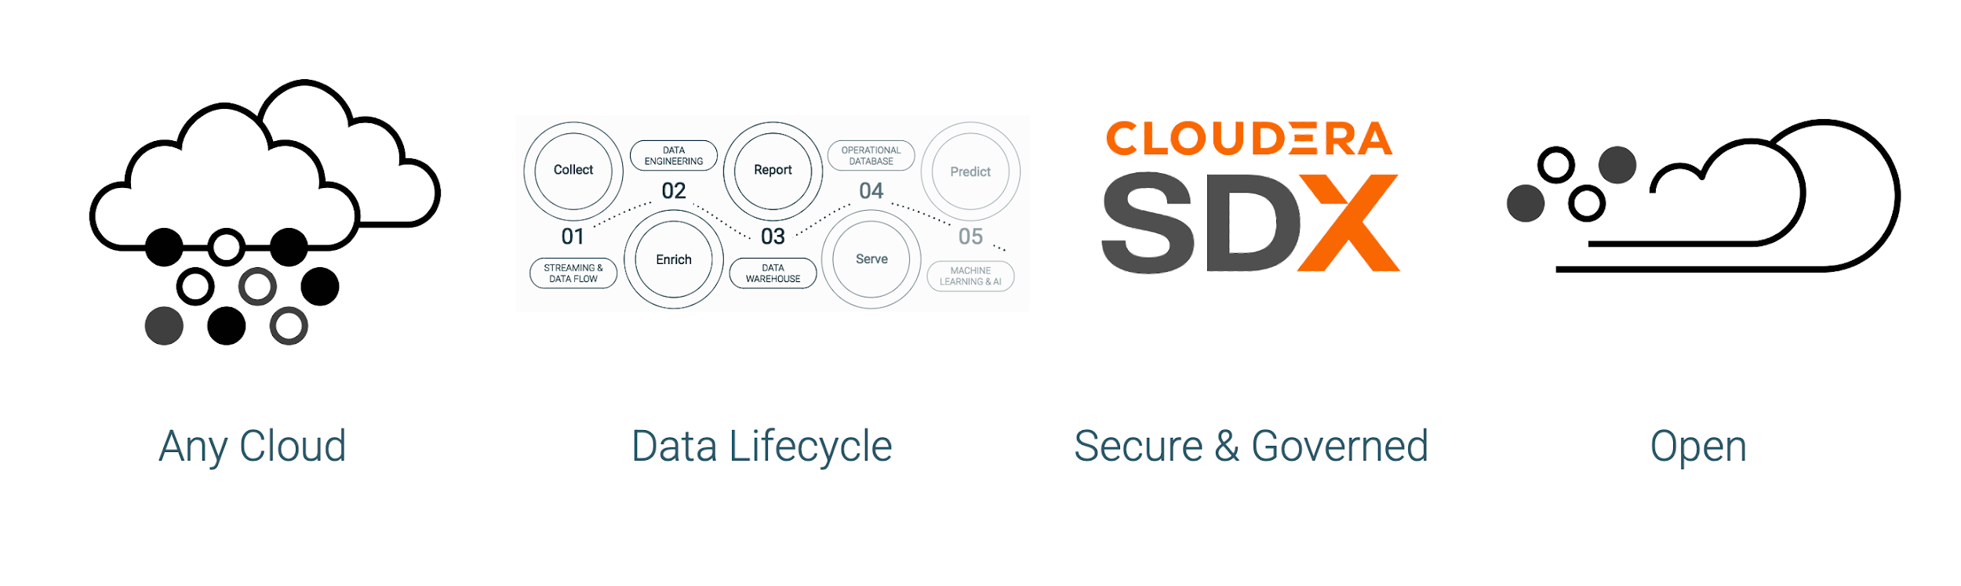




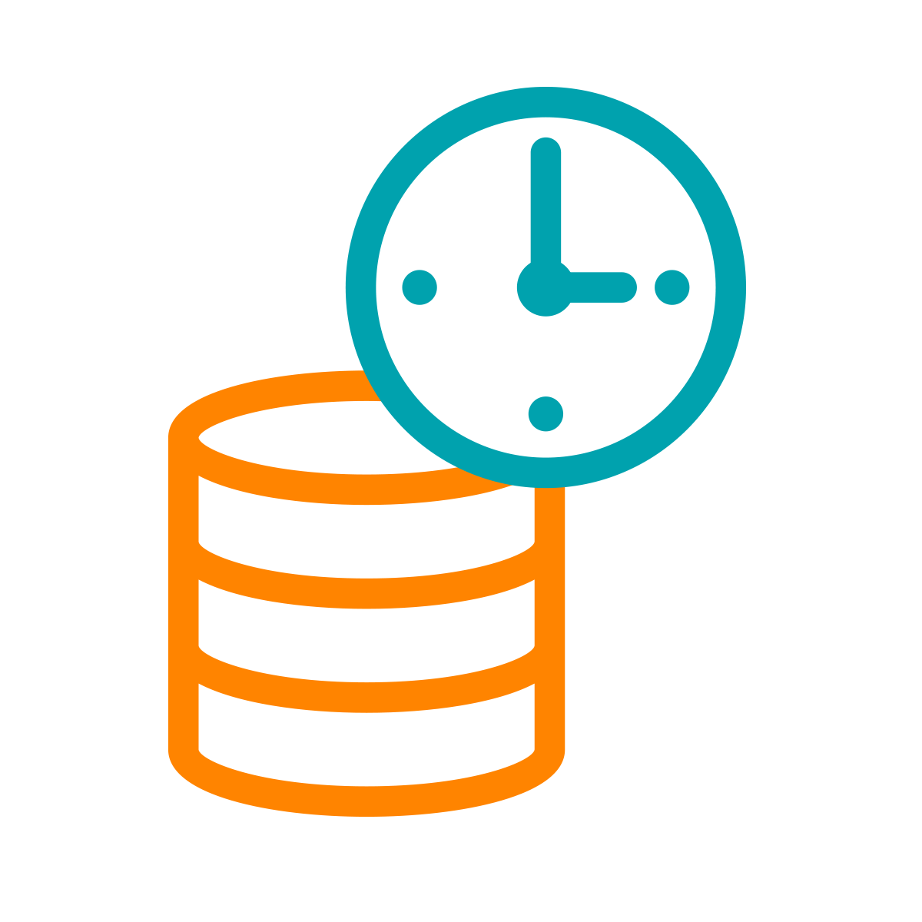



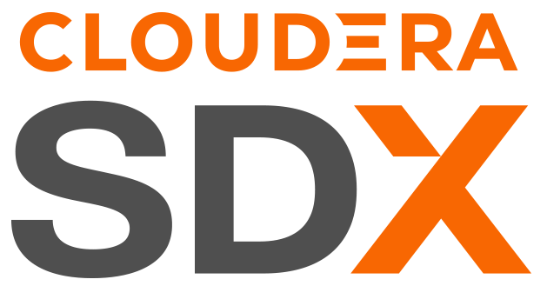





CDP IS A HYBRID / MULTI-CLOUD DATA PLATFORM AND AN INTEGRATED SUITE OF SECURE ANALYTIC APPS
Real-time
Batch
Structured
Unstructured
Data Collection
Data
Engineering
Virtual Data Lake
Data Warehouse
Operational Database
Streaming Analytics
Machine Learning
Data Visualisation
Analysts
Engineers
Scientists
Developers
Data Sources
Data Users
Cloudera Data Platform
Hybrid & Multi-Cloud to leverage existing investments and reduce risk
Data Lifecycle integration for better user productivity and faster time to value
Secure & Governed to simplify data protection, sharing and compliance
Open & Extensible to support more use cases faster and at lower cost

Slide 8
HYBRID CLOUD ARCHITECTURE
CDP HYBRID CLOUD
MANAGEMENT CONSOLE | DATA CATALOG | REPLICATION MANAGER | OBSERVABILITY
DATA SERVICES
DATA SERVICES
DATA FLOW
DATA ENGINEERING
DATA WAREHOUSE
OPERATIONAL DATABASE
MACHINE LEARNING
DATA ENGINEERING
DATA WAREHOUSE
MACHINE LEARNING
METADATA | SECURITY | ENCRYPTION | CONTROL | GOVERNANCE
DATA CLUSTERS
STORAGE
S3 | ADLS | GCS
DATA CLUSTERS
STORAGE
HDFS | Ozone
NiFi*, Kafka, Flink*, Spark, Impala, Hive, HBase, Phoenix
NiFi†, Kafka, Flink, Spark, Impala, Hive, HBase, Phoenix
CDP PUBLIC CLOUD
CDP PRIVATE CLOUD
† Flow Management rate card
On-Cloud
On-Prem

Slide 9
PRIVATE CLOUD BASE
CDP PRIVATE CLOUD
MANAGEMENT CONSOLE | REPLICATION MANAGER | OBSERVABILITY
DATA SERVICES
DATA ENGINEERING
DATA WAREHOUSE
MACHINE LEARNING
METADATA | SECURITY | ENCRYPTION | CONTROL | GOVERNANCE
DATA CLUSTERS
FILE STORAGE
HDFS
OBJECT STORAGE
Ozone
NiFi*, Kafka, Flink*, Spark, Impala, Hive, HBase, Phoenix
CDP PRIVATE CLOUD BASE

Slide 10
PUBLIC CLOUD
CDP PUBLIC CLOUD
MANAGEMENT CONSOLE | DATA CATALOG | REPLICATION MANAGER | OBSERVABILITY
DATA SERVICES
DATA FLOW
DATA ENGINEERING
DATA WAREHOUSE
OPERATIONAL DATABASE
MACHINE LEARNING
METADATA | SECURITY | ENCRYPTION | CONTROL | GOVERNANCE
DATA CLUSTERS
OBJECT STORAGE
S3 | ADLS | GCS
NiFi*, Kafka, Flink, Spark, Impala, Hive, HBase, Phoenix
CDP DATA HUB

Slide 11
CDP PRIVATE CLOUD BASE 7.3.1
Introducing the Open Data Lakehouse for private cloud
Trusted analytics and enterprise AI with trusted data at scale
Available for your data centre; ready for hybrid cloud

Slide 12
RELEASE IN A NUTSHELL
Revolutionising your on-prem data experience for trusted analytics and AI at scale
ENTERPRISE READINESS
OPEN DATA LAKEHOUSE
Deploy critical workloads with confidence
Unify data with engine agnostic architecture
Zero downtime upgrades
Long term support
Apache Iceberg
Iceberg catalog
Optimized data movement
Table maintenance
Iceberg Replication
Enhanced security
High data availability
Base7.3.1
Iceberg support for Spark, Impala, Flink, Nifi, Hive*
Ozone snapshots
Ozone quotas
RHEL 9.x
FIPS compliance
Ozone integration with Knox, Hue, Oozie, Hbase
JDK 17
Python 3.1
SLES 15 SP4
DATA VOLUME & GROWTH
PLATFORM SUPPORT
Highly scalable, performant object store
Expanded support for more integrations
*Coming in next release

Slide 13
RELEASE KEY FEATURES
Unblock account breakers
Zero downtime upgrade for Ranger KMS, Hive (HMS, Tez), Impala, Solr, Schema registry, SRM, Knox, Oozie and Livy
Livy Active/Passive HA
Ozone Snapshots, Improved Manageability, Quotas and Iceberg Support
24
High
Availability
Storage
Kafka 3.4, Zookeeper 3.8.x and Curator 5.4.0 rebase
Aging for audits in Atlas
Zero-downtime upgrades for Atlas
Operational DB
Governance
Impala catalogd: removing self-events
Impala: Graphical Performance Analysis
Impala : Intermediate Results Caching
HMS: Trino / Presto Connector / Certification
HIVE : HPL/SQL Support
RHEL 8.8 FIPS
FIPS: Phoenix, NavEncrypt, Ranger KMS, KTS
RHEL 9.1
SLES 15 SP4 (Py 3.8)
Oracle 8.8 UEK
Python 3.10 support
Data Warehousing
Platform
Iceberg Replication
Ozone Incremental Replication
Ozone Snapshot Policies
Ranger Replication
Kudu : Range aware data placement
Kudu : CM auto-TLS support
Kudu : JWT authentication support
Replication
Manager
Analytics

Slide 14

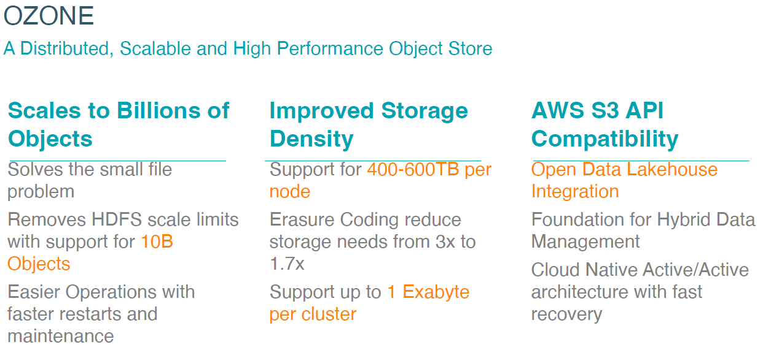
Apache OZONE

Slide 15





SUMMARY OF OZONE BENEFITS
Highly scalable & performant object store for on prem data
Faster performance Queries run faster on Ozone. See TPC-DS test results in Benchmarking Ozone blog.
Ozone delivers a vastly superior object storage solution for modern data workloads
5x storage density Store significantly more data on denser nodes while maintaining reliability, scalability, and performance.
30x scalability Store over 10 billion objects, overcoming the 300M file limit imposed by HDFS. Enable modern data use-cases such as real time streaming.
Easier management Scales linearly and recovers faster. Provides better performance with lower maintenance requirements. Needs fewer control plane nodes and services.
Lower cost per TB Store the same amount of data with less hardware, reducing physical storage costs, operational / maintenance overheads, and management costs.

Slide 16
3 x Master Nodes
2 x Utility Nodes
CPU
Memory
Disk (OS)
Disk (Data)
Nic Port
2x8 Cores (2.1GHz)
128 GB
2x500 GB SSD (Raid1)
4x1 TB
2x10Gbps
2x8 Cores (2.1GHz)
128 GB
2x500 GB SSD (Raid1)
12x4 TB
2x10Gbps
CPU
Memory
Disk (OS)
Disk (Data)
Nic Port
3 x Data Nodes
2 x Gateway Nodes
2x8 Cores (2.1GHz)
128 GB
2x500 GB SSD (Raid1)
12x4 TB
2x10Gbps
CPU
Memory
Disk (OS)
Disk (Data)
Nic Port
2x8 Cores (2.1GHz)
128 GB
2x500 GB SSD (Raid1)
12x4 TB
2x10Gbps
CPU
Memory
Disk (OS)
Disk (Data)
Nic Port

Slide 17
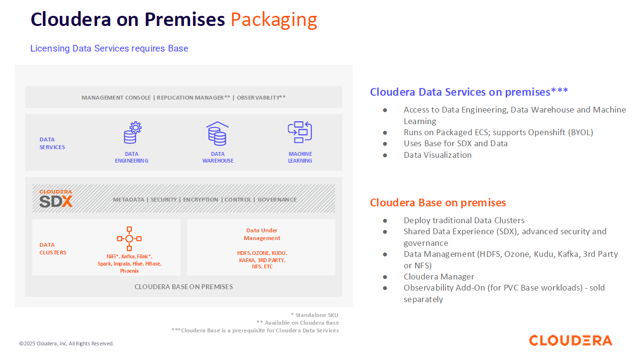

Slide 18
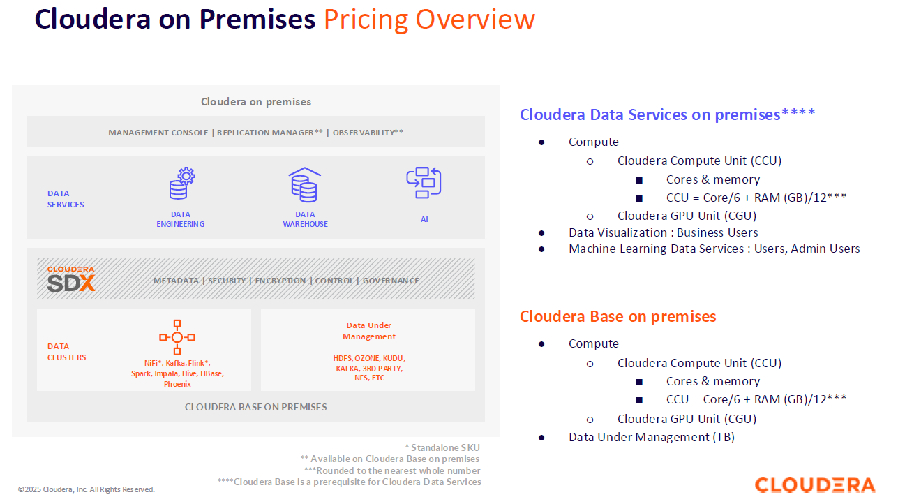

Slide 19
Cloudera Base on premise – Calculation Example
Customer Configuration
Metric | Base QTY | Price
CCU | 1000 | $900 | $900,000
Data Under Management | 3,750 | $200 | $750,000
CGU | 10 | $15,000 | $150,000
Metric | Base QTY
# of Nodes | 50
# of Cores | 1,500
# of Memory in GB | 9,000
# of HDFS Storage in TB | 3,750
# of GPUs | 10
Calculation for Compute & Data Under Management
Min CCU = 50 x 16 = 800
Base CCUs = 1,500 Cores / 6 + 9,000GB RAM /12 = 1,000 CCUs
Licensed CCUs = Higher of 800 or 1,000
Min Data Under Management = 50 x 20 = 1,000
License Data Under Management = Higher of 1,000 or 3,750

Slide 20
Cloudera Data Services on Premise – Calculation Example
Metric | Base QTY | Price
CCU | 1000 | $900 | $900,000
Data Under Management | 3,750 | $200 | $750,000
CGU | 10 | $15,000 | $150,000
Data Services
CCU | 1,280 | $1,300 | $1,664,000
Customer Configuration
Metric | Base QTY | Data Services QTY
# of Nodes | 50
# of Cores | 1,500 | 2,560
# of Memory in GB | 9,000 | 10,240
# of HDFS Storage in TB | 3,750
# of GPUs | 10
Calculation for Compute & Data Under Management
Min CCU = 50 x 16 = 800
Base CCUs = 1,500 Cores / 6 + 9,000GB RAM /12 = 1,000 CCUs
Licensed CCUs = Higher of 800 or 1,000
Min Data Under Management = 50 x 20 = 1,000
License Data Under Management = Higher of 1,000 or 3,750
Data Services CCU Calculation = 2,560 Cores /6 + 10,240GB RAM /12 = 1,280 CCUs

Slide 21
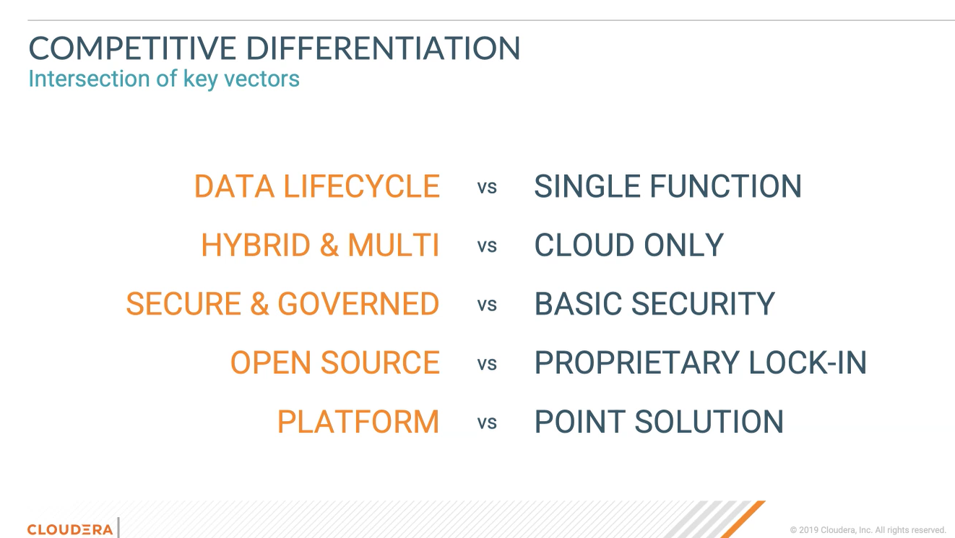

Slide 22
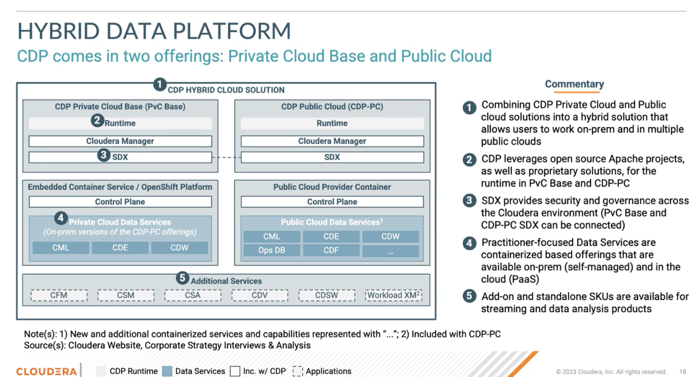

Slide 23
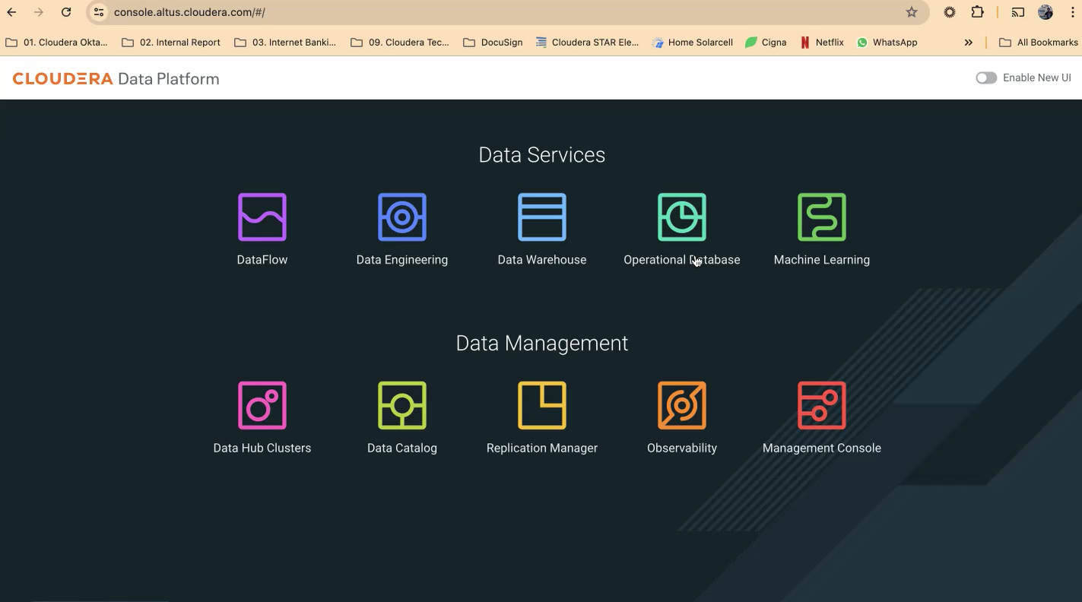

Slide 24
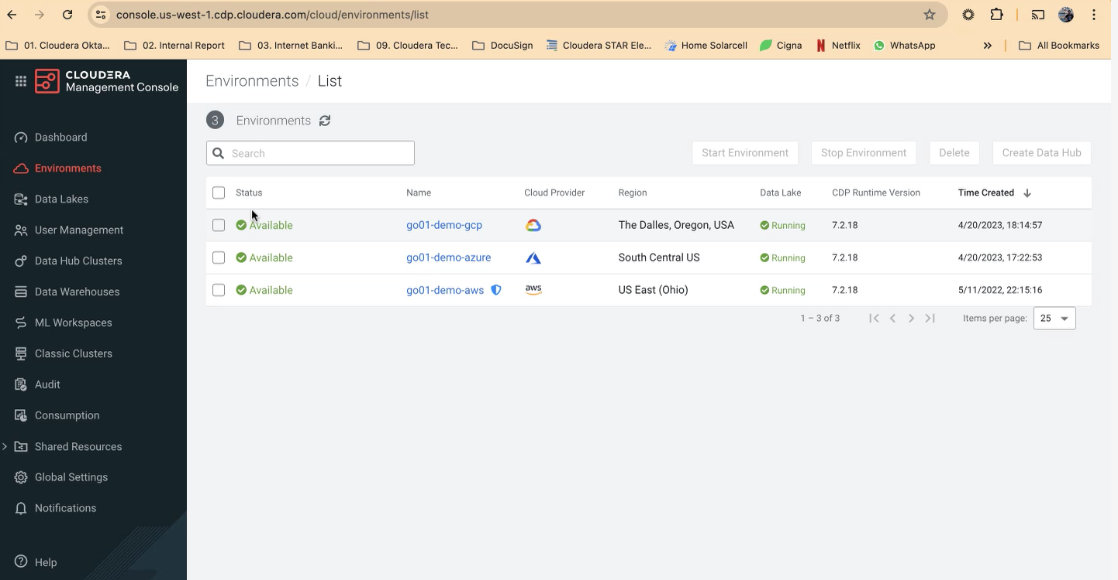

Slide 25
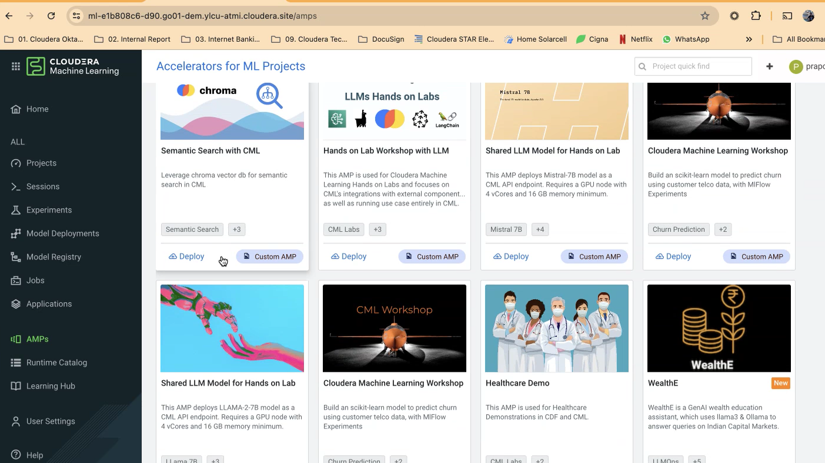

Slide 26
USE CASES
CUSTOMER SUCCESS STORIES

Slide 27
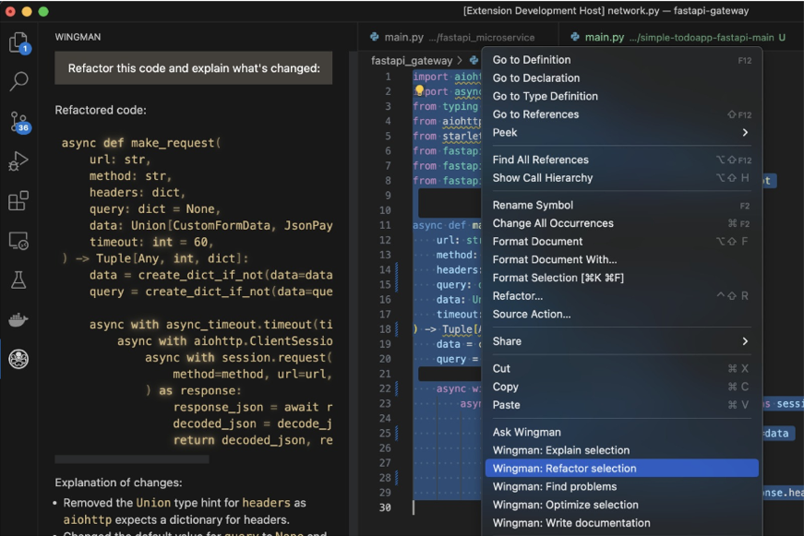





DA
GENERATIVE AI ADOPTION AT OCBC BANK
Complaint: Yes
Reason: CC Dispute
Routing: …
Summary: …
OCBC WINGMAN
OCBC WHISPER
OCBC DOCUMENT AI
20%
Developer
Productivity Gain
10%
Reduction in Ave. Handle Time
95%
Reduction in Effort
Auto-completion, generate code blocks, troubleshooting & explain code.
Simplify contact centre processes and identify silent customer complaints
Document summarisation, knowledgebase Q&A and translation

Slide 28
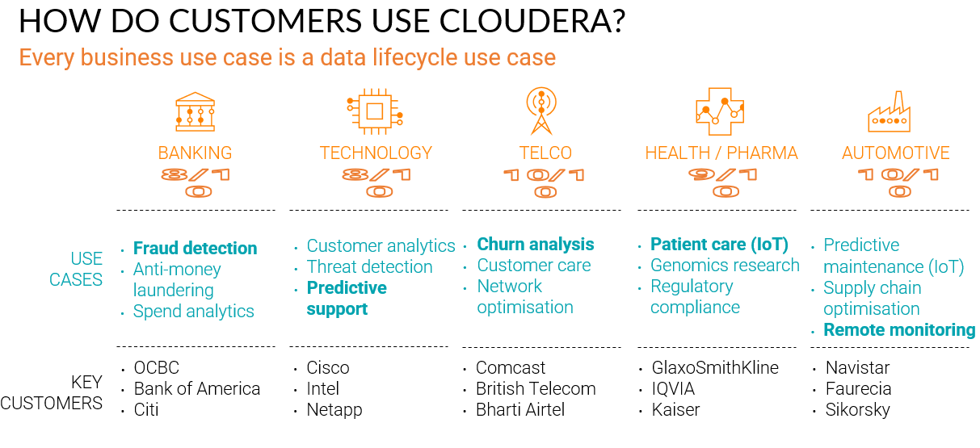

Slide 29
USE CASES
FSI

Slide 30
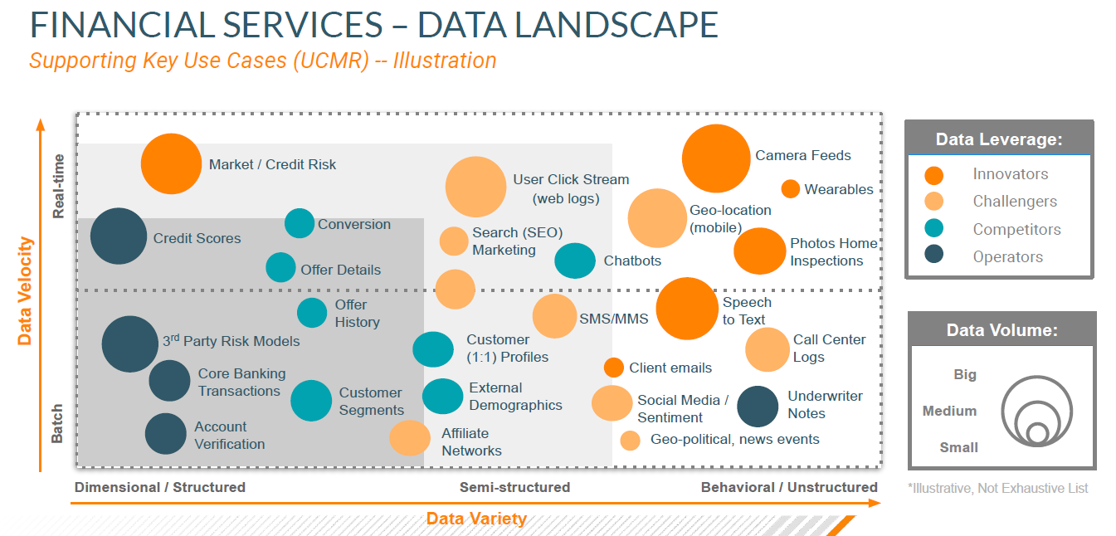

Slide 31
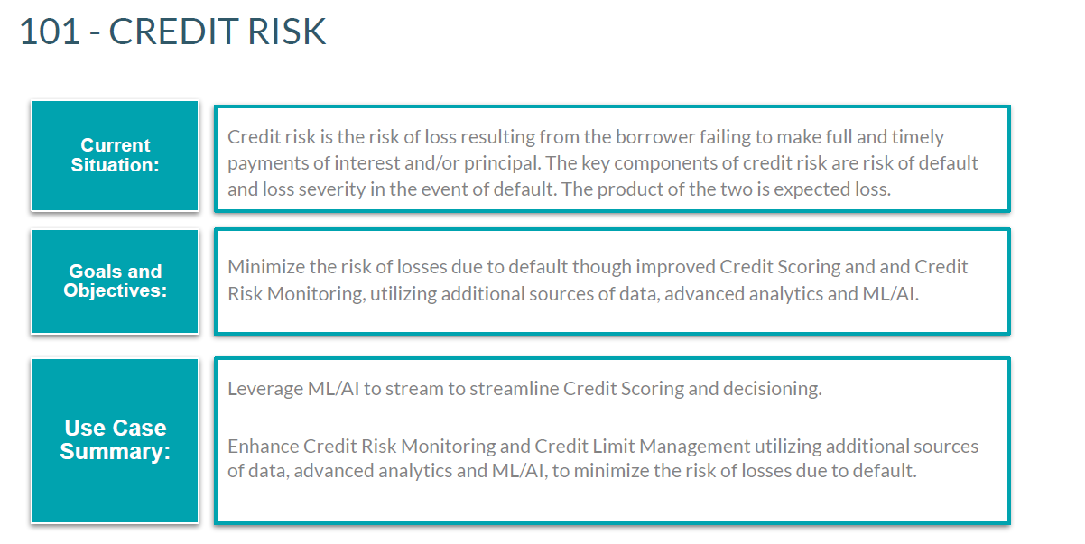

Slide 32
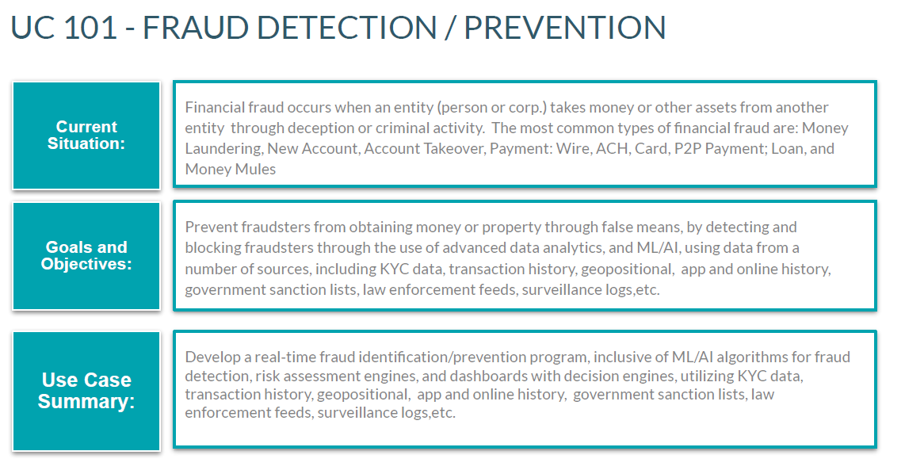

Slide 33
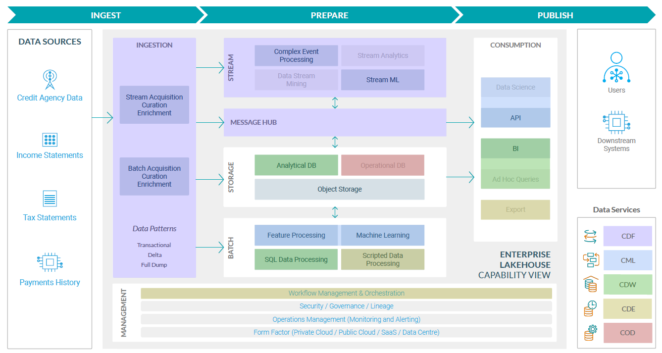

Slide 34
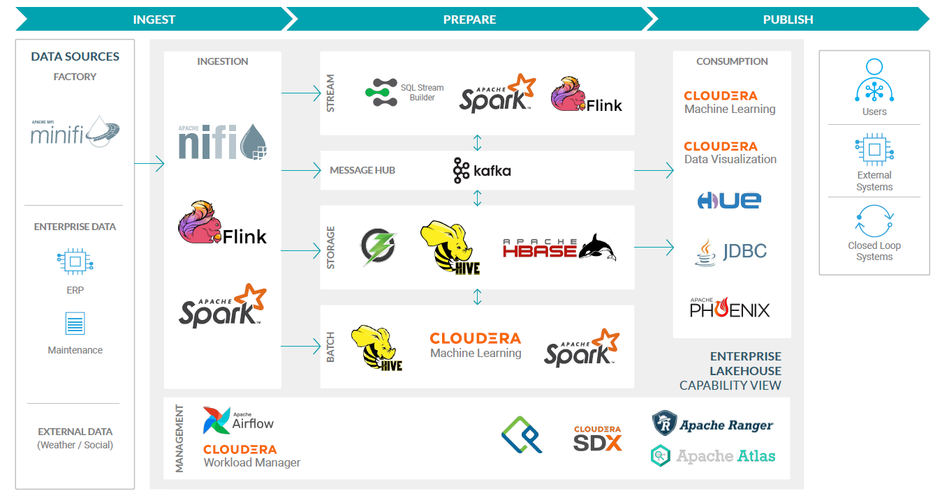

Slide 35
THANK YOU

