Slide 1




Python 3
10 years later
Pycon Italy 2018, Firenze
Victor Stinner
vstinner@redhat.com

Slide 2



Victor Stinner
CPython core developer since 2010
Work on CPython and OpenStack for Red Hat
Very happy user of Fedora and vim!

Slide 3

Autumn

Slide 4

Birth of Python 3000
2006: PEP 3000 “Python 3000”
Fix "Python warts":
long vs int; new class vs old class
int vs float division
Unicode mess
Comparisons
Relative imports

Slide 5
Risk management
Don't break everything, only acknowledged warts
Have an open community process for deciding what to change
Don't reimplement the interpreter from scratch
Plan end of life for Python 2

Slide 6
2008: Python 3.0 released

Slide 7
First migration plan
Run 2to3 to port your whole code base at once: you're done! …
Drop Python 2 is a no-go, modules authors care of Python 2 users!
All dependencies must be Python 3 compatible
Python 2.7 was heavily used in production

Slide 8


Technical debt
Why should I let you work on Python 3 support?
For all these new cool Python 3 features!
Can we use these features?
Well.... since we still have to support Python 2... no

Slide 9
Two branches in Git?
Some projects were forked to add Python 3 support.
Same upstream, two names:
dnspython → dnspython3
Community fork:
PIL → Pillow
Upstream does not reply:
MySQL-python → mysqlclient

Slide 10
Python 2.6 and 3.2
Python 2.6 was the stable version when 3.0 was released
It requires unittest2 and more backports
It requires heavy usage of the six module
Python 3.2 requires six.u("unicode"); u"unicode" is a syntax error

Slide 11

Winter

Slide 12
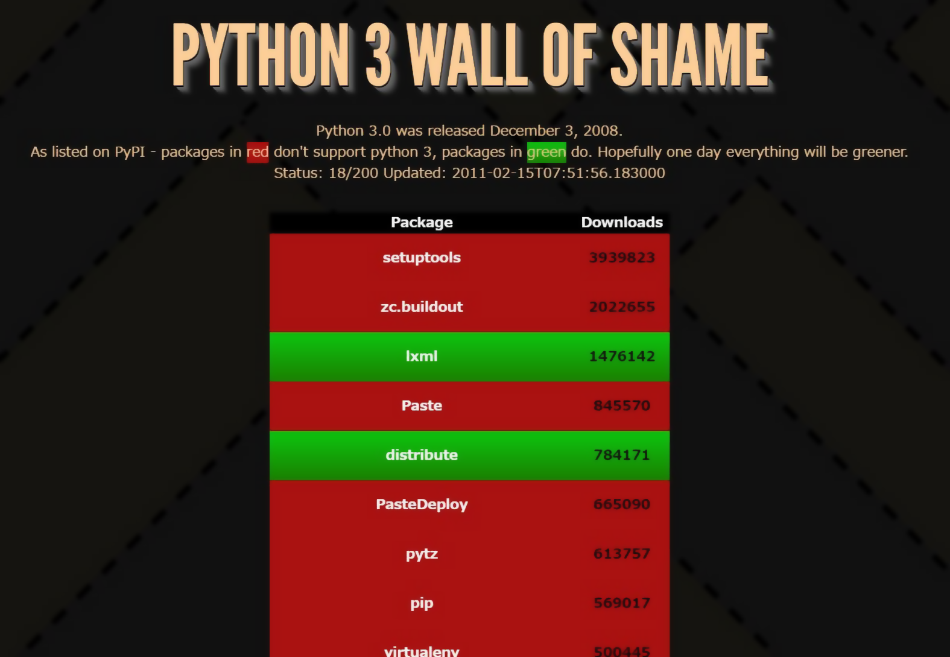
2011: “an attempt at motivating package maintainers to port to python 3”
Only 9% :-(
(18/200)

Slide 13



Big Python 2 projects
Heavy usage of bytes
Twisted
Incomplete Unicode support

Slide 14
Python 3 trolls
Python 3 doesn’t bring anything
Python 3 introduces new Unicode issues
Using bytes is simpler

Slide 15

Python 2.8 idea
Python 2.7 is alive: let’s continue the development!
2014: LWN article “Debating a "transitional" Python 2.8”
“concerns that Python 3
would never take off”
“Python 3 represents
under 2% of package”

Slide 16

No Python 2.8!
2011: PEP 404 (“PEP not found ;-)”) “Python 2.8 Un-release Schedule”
2013: 80% of top 50 projects supports Python 3
2014: Python 2.7
end of life extended
by 5 years to 2020

Slide 17

Spring

Slide 18

Problem #1 solved!
“How to install a dependency?”
“How to install setuptools?”
2011: pip 1.0 released
2014: Python 2.7.9 and 3.4
now come with ensurepip
pip: defacto installer
Linux distros with pip

Slide 19
New approach
Stop promoting 2to3: don’t remove Python 2 support
Add Python 3 support
New tools like modernize and sixer
Incremental changes tested by a CI

Slide 20

Large code base
For legacy code bases: first add new tests to reduce the risk of regression
Dropbox is working on mypy and typing to annotate types in their large code base

Slide 21

Building bridges
2012: Python 3.3 reintroduces u"unicode"
2015: Python 3.5 adds bytes % args (PEP 461)
More py3k warnings added to Python 2.7
More 2.7 backports: unittest2, enum34, …

Slide 22

Summer

Slide 23
2011: 9% :-(
(18/200)

Slide 24
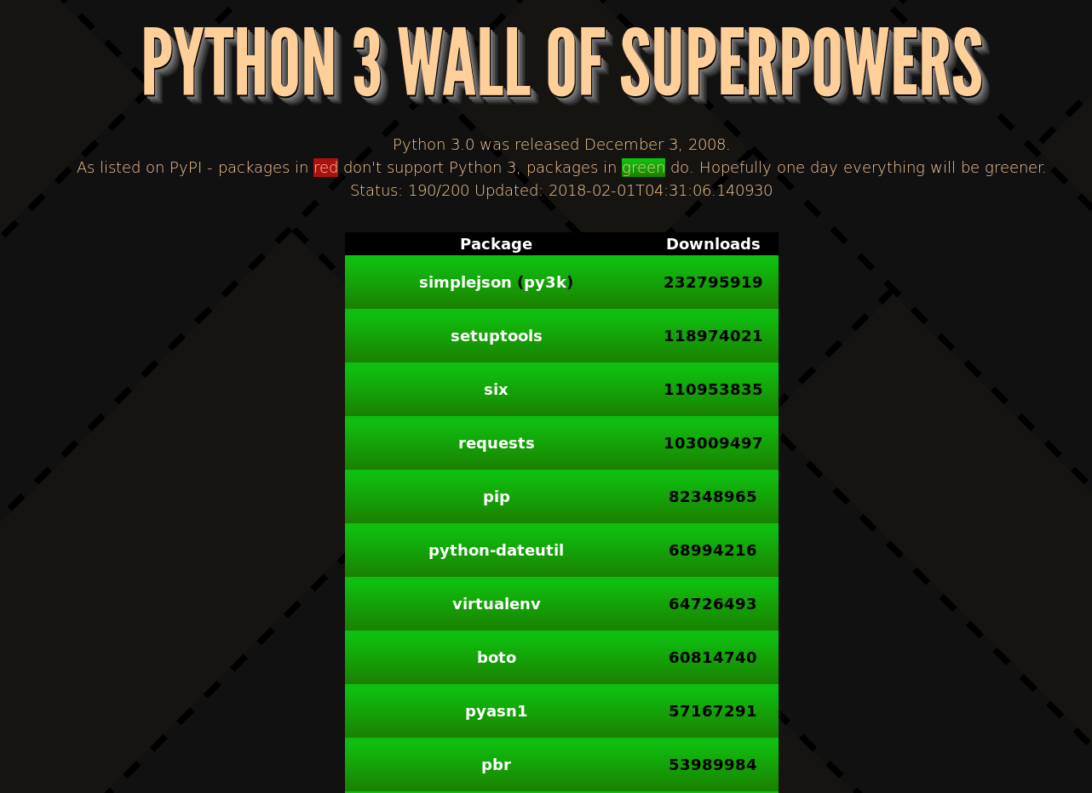
2018: 95% :-)
(190/200)

Slide 25
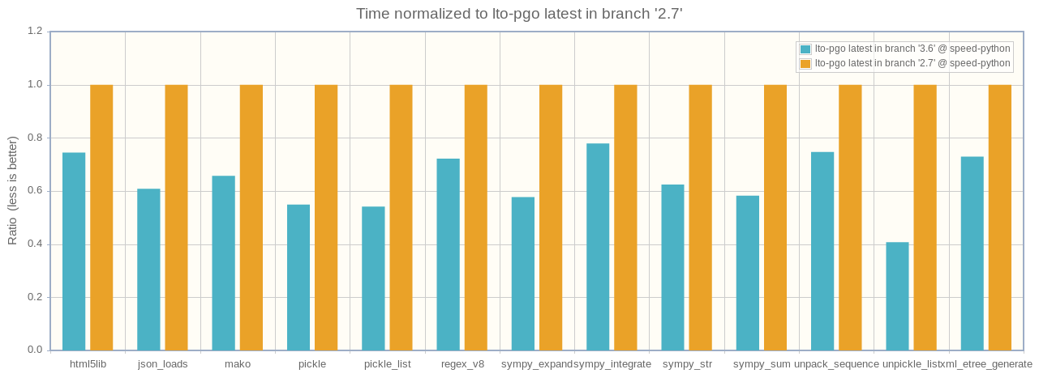
3.6 faster than 2.7
Results normalized to Python 2.7
lower = faster

Slide 26
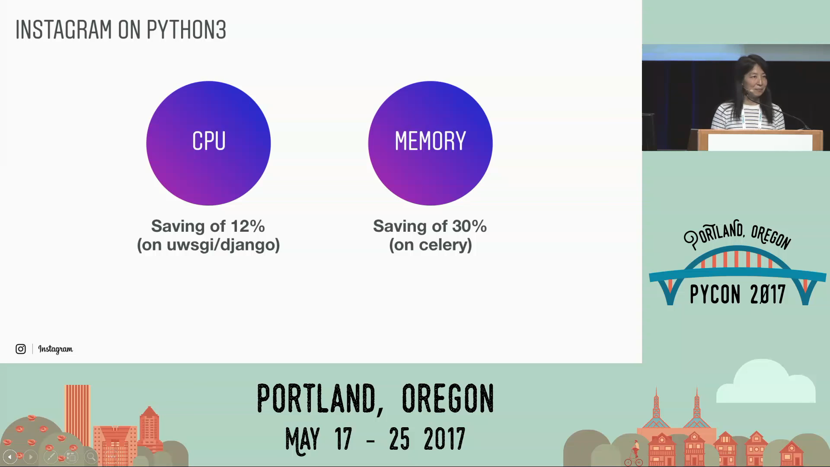
Lisa Guo and Hui Ding Keynote

Slide 27
Python 2.7 WONTFIX
Backward compatibility prevents to fix Python 2.7 bugs:
Unicode support
Hash not randomized by default
subprocess is not thread safe
threading.RLock is not signal safe
Internal clocks are not monotonic

Slide 28
Fixed in Python 3
3.3: time.monotonic() (PEP 418)
3.4: file descriptors non-inheritable, fork+exec safety (PEP 446)
3.5: retry syscalls on EINTR (PEP 475)
“We are aware of the code breakage this is likely to cause, and doing it anyway for the good of mankind.” – Guido van Rossum PEP 446 approval

Slide 29
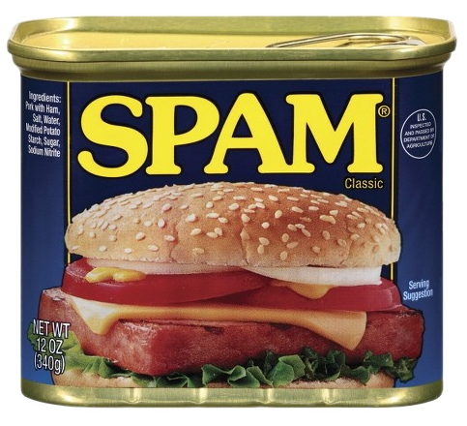
2.7 → 3.7 new modules
asyncio, concurrent.futures, contextvars, dataclasses, enum, ensurepip, faulthandler, importlib, importlib.resources, ipaddress, lzma, pathlib, secrets, selectors, statistics, tkinter.ttk, tracemalloc,
typing, unittest.mock,
venv, zipapp
😍 21 new modules 😍

Slide 30
f-string (PEP 498)
>>> name = "world"; print(f"Hello {name}!")
Hello world!
>>> print(f"Hello {name.title()}!")
Hello World!
>>> x = 1; y = 2; print(f"{x} + {y} = {x + y}")
1 + 2 = 3
>>> msg = f"{1+2}"; print(msg)
3

Slide 31
Python 3 coroutines
def generator():
yield from range(5)
async def coroutine():
return await async_read()
async def async_generator():
yield …
[… async for it in async_gen()]
[await func() for func in funcs()]

Slide 32
New Python 3 syntax
def func(arg, *, kw_only=None): …
print(msg, file=sys.stderr, end=’’)
one, *tail = range(5)
cmd = ['python3', *args, 'script.py']
mydict = {"key": "value", **other_dict}

Slide 33
New Python 3 syntax
million = 1_000_000
x: int = 5
with open(…) as infp, open(…) as outfp: …
bytes % args
matrix_multiplication = a @ b

Slide 34
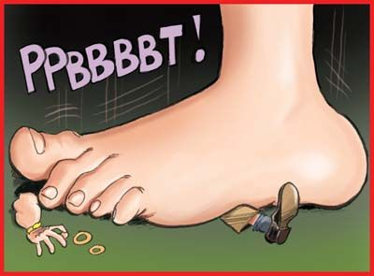
Bury Python 2?
Fedora 23 (2015), Ubuntu 17.10 (2017): no python2 in the base system
python3statement.org
pythonclock.org
2017: IPython 6.0
and Django 2
are Python 3 only

Slide 35
RHEL
RHEL 7.5: Python 2 has been deprecated and will be replaced with Python 3 in the next Red Hat Enterprise Linux major release.
Software Collections (SCL):
Python 3.6: RHEL/Centos 7
Python 3.5: RHEL/Centos 6 & 7
Supported 3 years (ex: 2.7 SCL gone)

Slide 36
Javascript approach
Daniel Esposti’s talk "Evolution or stagnation programming languages" (last Friday at Pycon IT)
Javascript language evolved without breaking the backward compatibility
Transpilling using Babel & polyfill: run newer Javascript on old JS VM

Slide 37

Python 4?

Slide 38
Questions?

Slide 39

Sources, copyrights
Autumn:
https://www.flickr.com/photos/visualpanic/3035384225/
Winter:
https://www.flickr.com/photos/41848869@N04/8511091946/
Spring:
https://www.flickr.com/photos/kubina/448485266/
Summer:
https://www.flickr.com/photos/freaky_designz/14385194484/
Red Hat and Python are registered trademarks.

