Slide 1
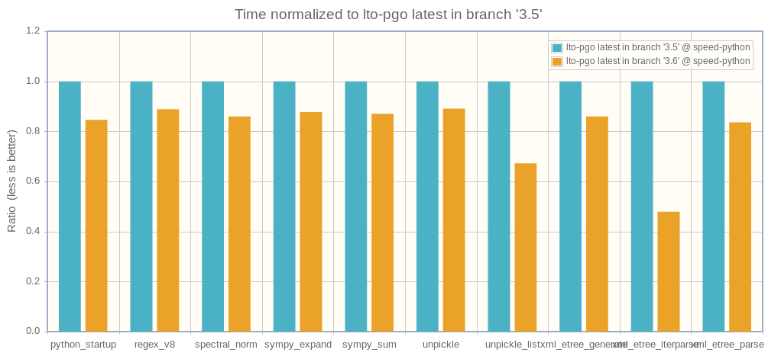

Optimizations which made Python 3.6 faster than Python 3.5
Pycon US 2017, Portland, OR
Victor Stinner
vstinner@redhat.com

Slide 2
Agenda
(1) Benchmarks
(2) Benchmarks results
(3) Python 3.5 optimizations
(4) Python 3.6 optimizations
(5) Python 3.7 optimizations

Slide 3
Agenda
(1) Benchmarks

Slide 4

(1) Unstable benchmarks
March 2016, no developer trusted the Python benchmark suite
Many benchmarks were unstable
It wasn’t possible to decide if an optimization makes CPython faster or not...

Slide 5
(1) perf module
New perf project: spawn 20 processes, each runs the benchmark once to warmup and then run it 3 times
Total of 60 timings: compute average (mean) and standard deviation
Statistics to check for outliers, min/max, percentiles, etc.

Slide 6
(1) performance project
Benchmarks rewritten using perf: new project performance on GitHub
http://speed.python.org now runs performance
CPython is now compiled with Link Time Optimization (LTO) and Profile Guided Optimization (PGO)

Slide 7

(1) Linux and CPUs
python3 -m perf system tune
Use fixed CPU frequency, disable Intel Turbo Boost
Use CPU isolation (Linux isolcpus and rcu_nocbs), pin benchmark process and IRQs on CPUs
Reduce Linux perf sampling rate
Laptop: check that power cable is plugged

Slide 8
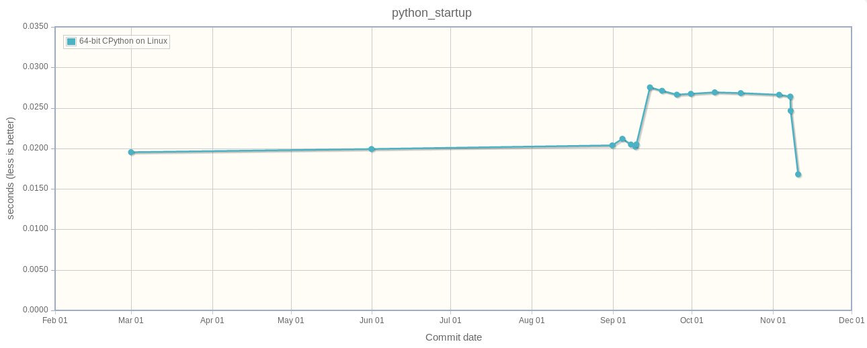
(1) Spot perf regression
python_startup: 20 ms => 27 ms => 17 ms

Slide 9
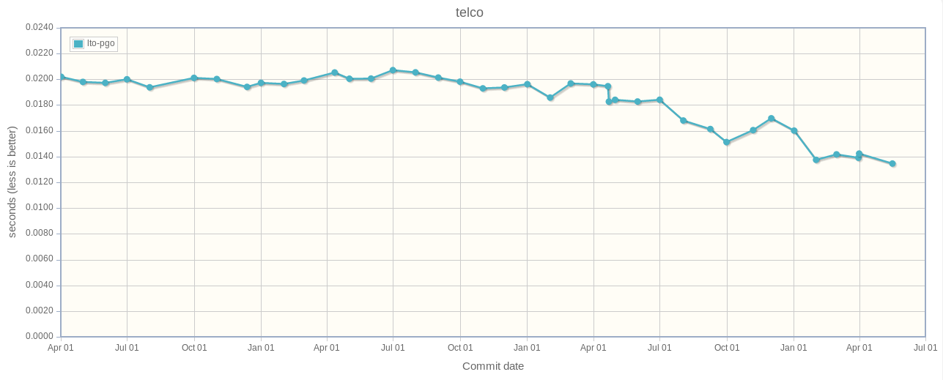
(1) Timeline
April, 2014 – May, 2017: 3 years

Slide 10
Agenda
(2) Benchmarks results

Slide 11
(2) 3.6 faster than 3.5
Results normalized to Python 3.5
lower = faster

Slide 12
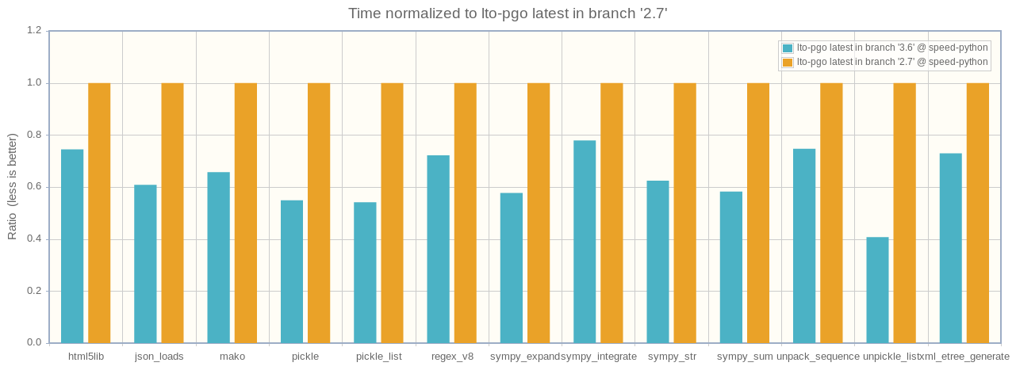
(2) 3.6 faster than 2.7
Results normalized to Python 2.7
lower = faster

Slide 13
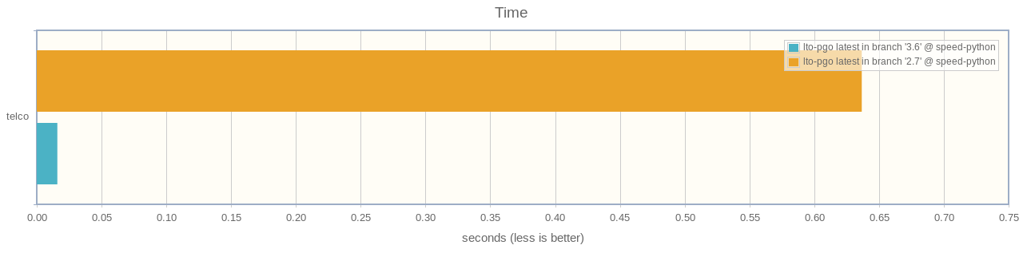
(2) telco: 3.6 vs 2.7
Python 3.6 is 40x faster than Python 2.7
decimal module rewritten in C

Slide 14
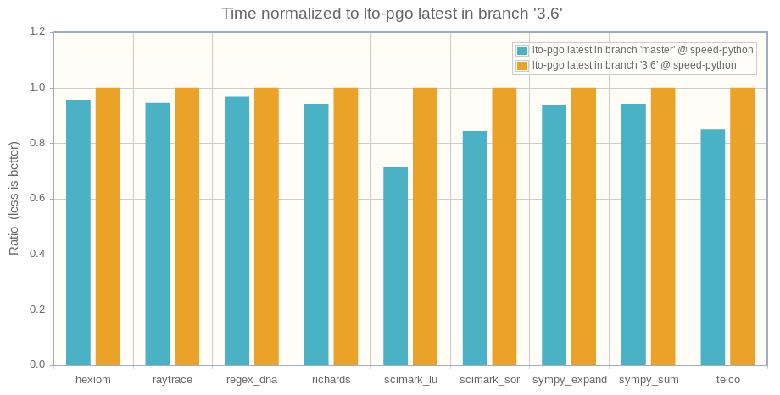
(2) 3.7 faster than 3.6
Results normalized to Python 3.6
lower = faster

Slide 15
Agenda
(3) Python 3.5 optimizations

Slide 16
(3) C lru_cache()
Matt Joiner, Alexey Kachayev and Serhiy Storchaka reimplemented functools.lru_cache() in C
sympy: 1.2x faster
scimark_lu: 1.06x faster
bpo-14373

Slide 17
(3) C OrderedDict
Eric Snow reimplemented collections.OrderedDict in C
html5lib: 1.2x faster
bpo-16991

Slide 18
Agenda
(4) Python 3.6 optimizations

Slide 19
(4) PyMem_Malloc()
Victor Stinner modified PyMem_Malloc() to reuse Python fast memory allocator
Many benchmarks: 1.05x - 1.36x faster
PYTHONMALLOC=debug now available in release builds to detect memory corruptions
bpo-26249

Slide 20
(4) ElementTree parse
Serhiy Storchaka optimized ElementTree.iterparse()
2x faster
bpo-25638

Slide 21
(4) PGO uses tests
Brett Canon modified the build system to guide the compiler using the Python test suite rather than pidigits for the Profile Guided Optimization (PGO)
Many benchmarks: 1.05x - 1.28x faster
bpo-24915

Slide 22
(4) Wordcode
Demur Rumed and Serhiy Storchaka modified the bytecode to always use 16-bit instructions:
8 bit op, 8 bit arg (arg=0 if unused)
Removed an if from ceval.c hotcode for better CPU branch prediction:
if (HAS_ARG(opcode))
oparg = NEXTARG();
bpo-26647

Slide 23
(4) FASTCALL
Victor Stinner wrote a new C API to avoid the creation of temporary tuples to pass function arguments
Many microbenchmarks: 1.13x - 1.92x faster
obj[0], getattr(obj, "attr"),
{1: 2}.get(1), …
Avoid 20 ns per modified function call

Slide 24
(4) Unicode codecs
Victor Stinner optimized ASCII and UTF-8 codecs for ignore, replace, surrogateescape and surrogatepass error handlers
UTF-8: decoder 15x faster, encoder 75x faster
ASCII: decoder 60x faster, encoder 3x faster

Slide 25
(4) bytes % args
Victor Stinner wrote a new private _PyBytesWriter API to optimize functions creating bytes and bytearray strings
bytes % args: 2x faster
bytes.fromhex(): 3x faster

Slide 26
(4) Globbing
Serhiy Storchaka optimized glob.glob(), glob.iglob() and pathlib globbing
glob: 3x - 6x faster
Pathlib glob: 1.5x - 4x faster
bpo-25596, bpo-26032

Slide 27
(4) C asyncio
Yury Selivanov and Naoki INADA reimplemented asyncio Future and Task classes in C
Asyncio programs: 1.3x faster
bpo-26081, bpo-28544

Slide 28
Agenda
(5) Python 3.7 optimizations

Slide 29
(5) Method calls
Yury Selivanov and Naoki INADA added LOAD_METHOD and CALL_METHOD opcodes
Methods calls: 1.2x faster
Idea coming from PyPy, bpo-26110

Slide 30
(5) Future optimizations
More optimizations are coming in Python 3.7…
Stay tuned!

Slide 31
Questions?
http://speed.python.org/
http://faster-cpython.readthedocs.io/

