Slide 1


How to get more contributors on Python?
Tech is easy
People are hard
Pycon FR 2018, Lille
Victor Stinner

Slide 2
Python is all about code

Slide 3

Python is all about code
Python is all
about people

Slide 4

Depression
Unsubscribed from 7 Python mailing lists
Closed all my pull requests
Notifications → /dev/null
Doctor → One full month off
No commit for 3 months ½

Slide 5
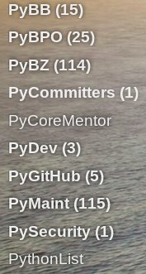
Depression
Previous
typical
INBOX:

Slide 6
Depression
Time to step back
Realized my engagment in Python
I was working 13h per day on Python in average
Personal reasons, will not elaborate here…

Slide 7
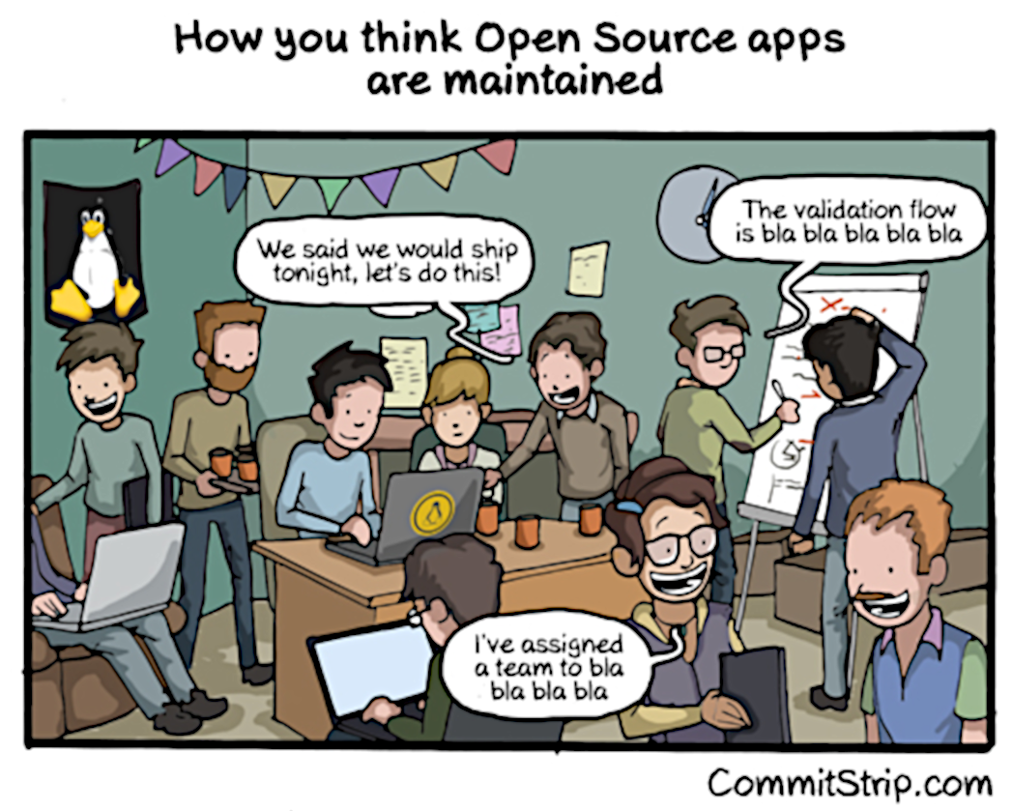

Slide 8
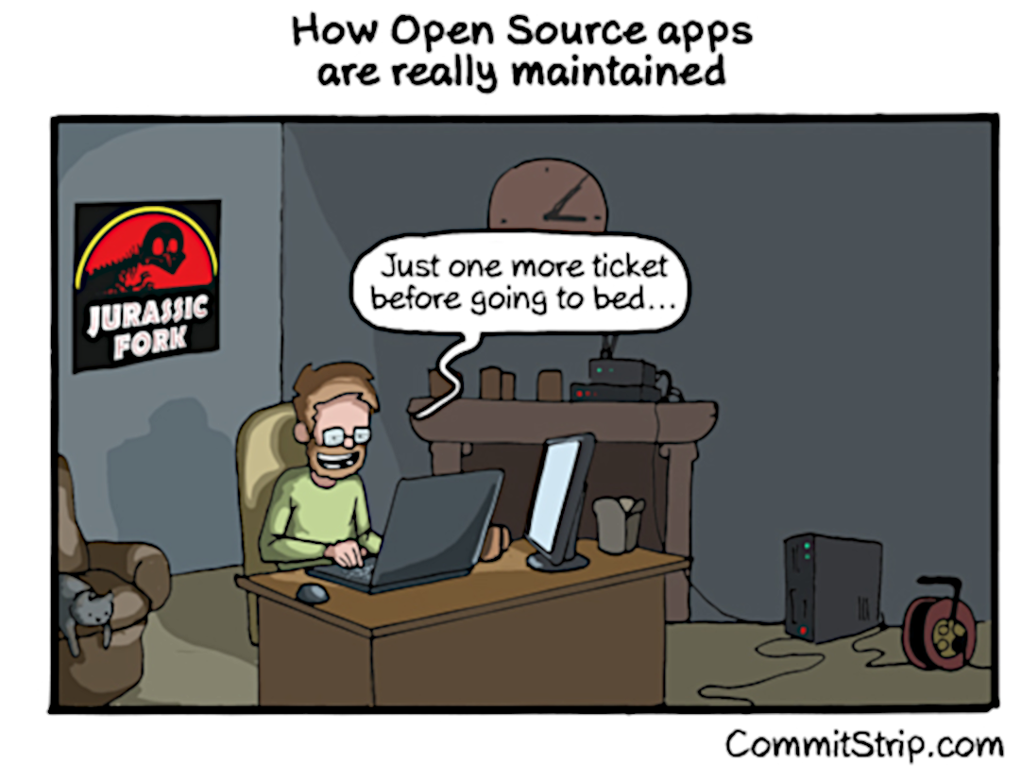

Slide 9



Victor Stinner
CPython core developer since 2010
Work on CPython and OpenStack for Red Hat
Very happy user of Fedora and vim!

Slide 10

Sources, copyrights
Butterfly:
https://www.flickr.com/photos/rbh/12490872423/
Depression:
https://www.flickr.com/photos/alextrump/5327340643/
Commitstrip:
http://www.commitstrip.com/en/2014/05/07/the-truth-behind-open-source-apps/
Red Hat and Python are registered trademarks.

