Slide 1


Track memory leaks in Python
Pycon 2014, Montréal
Victor Stinner
victor.stinner@gmail.com
Distributed under CC BY-SA license: http://creativecommons.org/licenses/by-sa/3.0/

Slide 2

Victor Stinner
Python core developer since 2010
github.com/haypo/
bitbucket.org/haypo/
Working for eNovance

Slide 3
Agenda
RSS memory
Reference cycle
Manual computation
Heapy, Pympler, Melia
PEP 445: malloc() API
PEP 454: tracemalloc

Slide 4
RSS memory
Representative for the system
Coarse measurement
Difficult to exploit
Heap fragmentation

Slide 5
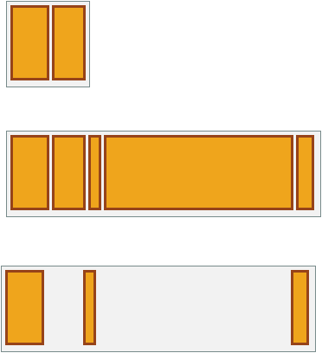
Heap fragmentation
2 Mo / 2 Mo
10 Mo / 10 Mo
1.5 Mo / 10 Mo

Slide 6
memory_profiler
Mem usage Increment Line Contents
=====================================
@profile
5.97 MB 0.00 MB def my_func():
13.61 MB 7.64 MB a = [1] * (10 ** 6)
166.20 MB 152.59 MB b = [2] * (10 ** 8)
13.61 MB -152.59 MB del b
13.61 MB 0.00 MB return a
http://pypi.python.org/pypi/memory_profiler

Slide 7
Reference cycle
a.b = b
b.a = a
a = None
b = None
gc.collect()

Slide 8
Reference cycle
a.b = b
b.a = weakref.ref(a)
# a = b.a()
a = None

Slide 9
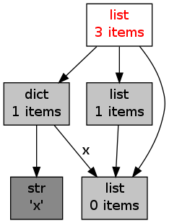
View the references
objgraph project
http://mg.pov.lt/objgraph/

Slide 10

Python introspection
  gc.get_objects()
  gc.get_referrers()
  gc.get_refents()
  id(obj)
  sys.getsizeof(obj)

Slide 11
Manual computation
>>> data = {None: b'x' * 10000}
>>> sys.getsizeof(data)
296
>>> sum(sys.getsizeof(ref)
... for ref in gc.get_referents(data))
10049

Slide 12
Heapy, Pympler, Melia
List all Python objects
Compute the size of objects
Group objects by size

Slide 13
Heapy, Pympler, Melia
Total 17916 objects, 96 types,
Total size = 1.5MiB
Count Size Kind
701 546,460 dict
7,138 414,639 str
208 94,016 type
1,371 93,228 code
...

Slide 14
Heapy, Pympler, Melia
Don't trace all the memory
(ex: zlib)
Don't provide the origin of objects
Difficult to exploit

Slide 15

Heapy, Pympler, Melia
http://guppy-pe.sourceforge.net/
http://code.google.com/p/pympler/
https://pypi.python.org/pypi/meliae

Slide 16
PEP 445: API malloc()
PyMem_GetAllocator()
PyMem_SetAllocator()
Implemented in Python 3.4

Slide 17
PEP 454: tracemalloc
Memory block: 768 kB
File "test/support/__init__.py", line 142
__import__(name)
File "test/support/__init__.py", line 206
_save_and_remove_module(name)
File "test/test_decimal.py", line 48
C = import_fresh_module('decimal')
File "importlib/__init__.py", line 95
return _bootstrap._gcd_import(name)
File "test/regrtest.py", line 1269
the_module = importlib.import(abstest)

Slide 18
PEP 454: tracemalloc
[ Top 5 ]
#1: Lib/linecache.py:127: 225.5 kB
#2: collections.py:368: 200.6 kB
#3: unittest/case.py:571: 108.6 kB
#4: Lib/abc.py:133: 87.3 kB
#5: Lib/shutil.py:401: 61.9 kB
10347 other: 3279.3 kB
Total allocated size: 4188.3 KB

Slide 19
PEP 454: tracemalloc
[ Top 5 differences ]
#1: test.py:4: 0.0 kB (-5.0 kB)
#2: test.py:1: 2.4 kB (0.0 kB)
#3: test.py:20: 0.6 kB (+0.6 kB)
#4: test.py:8: 0.2 kB (0.0 kB)
#5: test.py:25: 0.1 kB (0.0 kB)

Slide 20
Status tracemalloc
Available at PyPI
Require to patch and recompile Python
... maybe also recompile Python extensions written in C
Patches for Python 2.7 and 3.3

Slide 21
Status PEP 454
PEP 445 (API malloc) implémentée dans Python 3.4
PEP 454 (tracemalloc) : brouillon, implémentation prête
Portable ! Windows, Linux, FreeBSD, ...
2x plus lent et mémoire x 2
Pérenne : va être intégré à Python 3.4

Slide 22

Suite de tracemalloc ?
Faire accepter la PEP 454 !
Mettre à jour les projets PyPI
Outils pour générer des graphiques
GUI pour exploiter les données
GUI pour suivre l'évolution avec le temps

Slide 23
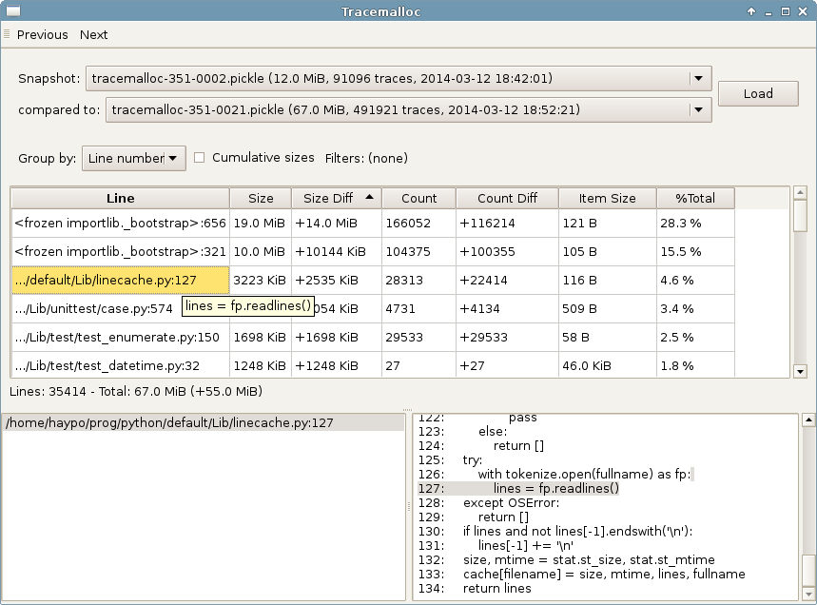

Slide 24
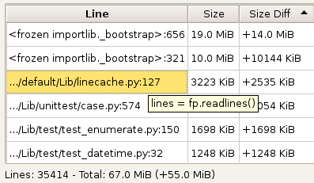
tracemallocqt

Slide 25
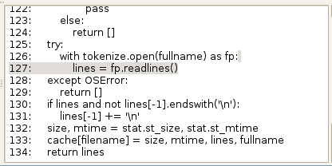
tracemallocqt

Slide 26
Questions ? http://pypi.python.org/pypi/pytracemalloc http://www.python.org/dev/peps/pep-0445/ http://www.python.org/dev/peps/pep-0454/
Contact :
victor.stinner@gmail.com
Distributed under CC BY-SA license: http://creativecommons.org/licenses/by-sa/3.0/

Slide 27
PEP 445 (API malloc)
Ticket opened in 2008
Patch proposed in march 2013
Patch commited in june 2013
Commit reverted -> PEP 445 written
Better API thanks to the PEP
BDFL delegate: Antoine Pitrou

Slide 28
PEP 454 (tracemalloc)
Store the traceback, not just 1 frame
Almost all code has been rewritten
API generalized and higher level
Exchanges with Kristján Valur Jónsson
BDFL delegate: Charles-François Natali

Slide 29
Thanks David Malcom for the LibreOffice model
http://dmalcolm.livejournal.com/

