Slide 1

Python
C API
Victor
Stinner

Slide 2

Victor Stinner
CPython core developer for 14 years
Maintain Python CI (GitHub Actions, buildbots), fix regressions, memory leaks, race conditions
Work for Red Hat: backport fixes up to Python 3.6 and fix security vulnerabilities
Happy vim and Fedora user!

Slide 3
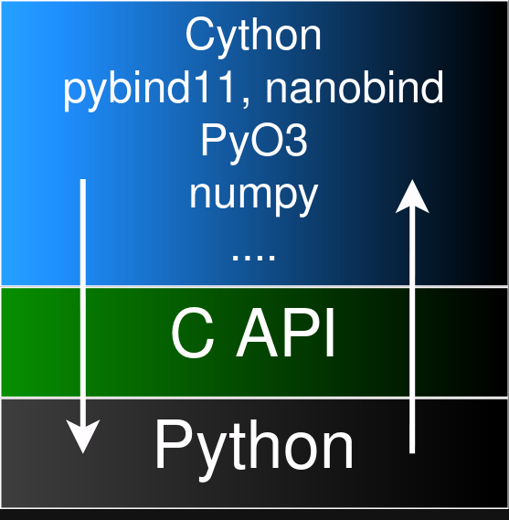
C API

Slide 4
My C API long term goals
Limited C API by default!
Stable ABI for all!
It’s a long term goal,
not the exact purpose of this talk

Slide 5
Stable ABI
Build once, work on all Python versions
Less wheel packages to distribute (one per "platform")
Platform: {OS, CPU, libc}
Added to Python 3.2 (2011) but is incomplete
Used by 500+ C extensions on PyPI:
PySide6, cryptography, ...

Slide 6
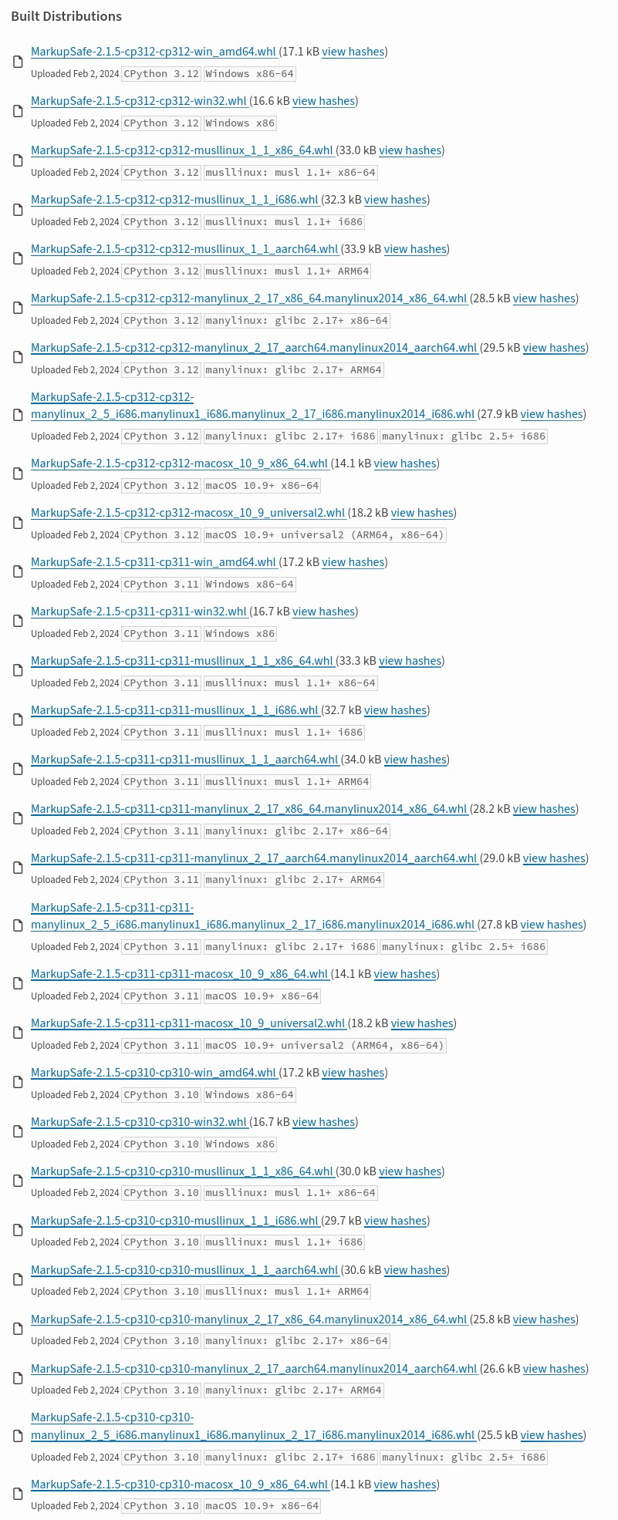
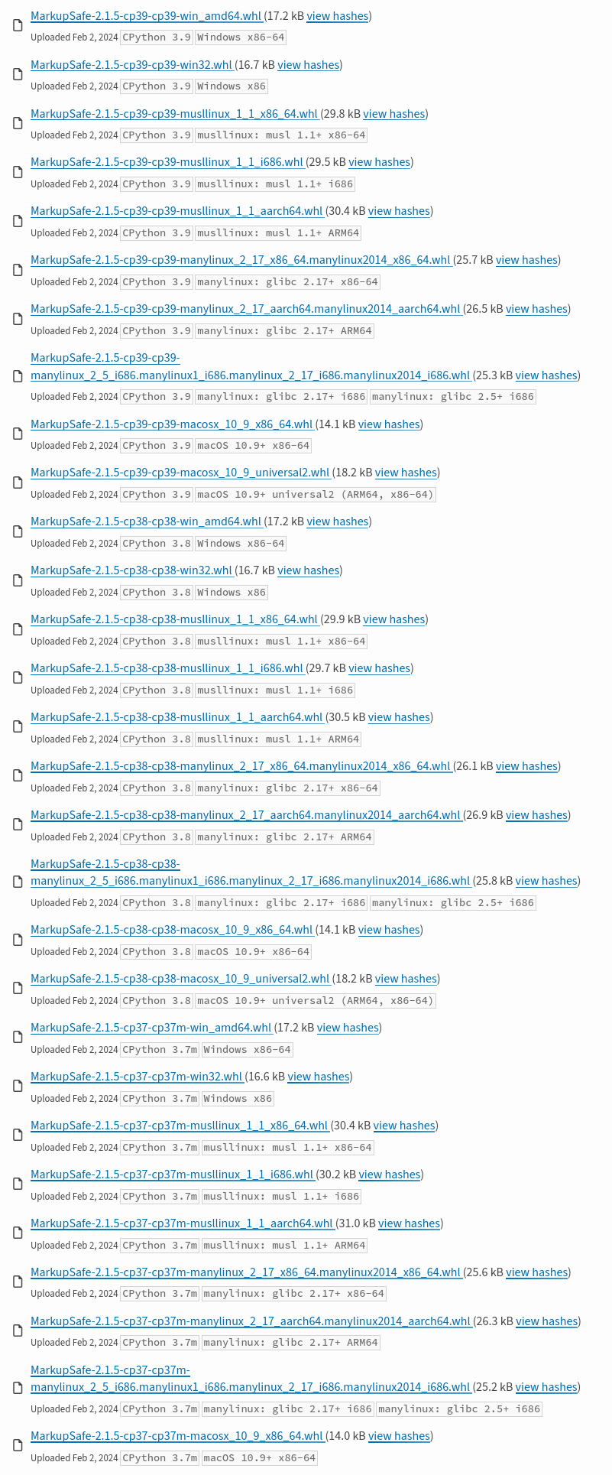
MarkupSafe: 60 wheel pkgs

Slide 7
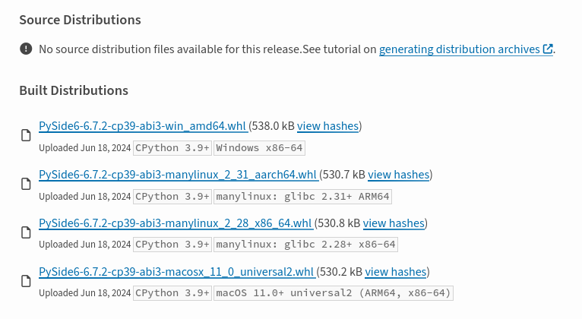
PySide6: 4 wheel packages

Slide 8
My C API long term goals
More freedom to change Python internals
Reduce 3rd party maintenance burden when updating Python (goal: no change)
Reduce friction/stress related to the C API, on the Python side, and on the 3rd party side
Get C extensions ready since Python alpha1 release: no need to request release

Slide 9
Challenges
Need to change some 3rd party code to reach this long term goal
Usually 1-10 lines per Python release in the few impacted projects
Unknown number of impacted projects per change

Slide 10

Python 3.13

Slide 11
C API Working Group
PEP 731 "C API Working Group Charter"
Created in November 2023
New C API must be approved by the WG
6 members: Erlend Aasland, Michael Droettboom, Petr Viktorin, Serhiy Storchaka, Steve Dower, Victor Stinner
PEP 733 "An Evaluation of Python’s Public C API"

Slide 12
C API WG projects
decisions: decide on an API
api-evolution: list small API changes
api-revolution: list disruptive API changes
https://github.com/capi-workgroup/

Slide 13
Remove private funcs
No doc, no test
No backward compatibility support
Private functions are not part of the limited C API
Replace them with public functions

Slide 14
Remove private funcs
Removed 300+ private functions in Python 3.13 alpha1
Some removals impacted 5-30 projects
As planned, removals causing most trouble have been reverted (mostly in alpha2)
3.13 beta1: 264 functions removed

Slide 15

Remove private funcs

Slide 16

Remove private funcs

Slide 17
Better public functions
Promote private to public functions
Add backward compatibility warranty
Add documentation and tests
C API Working Group designs a better API
Enforce error checking
Avoid inefficient PyErr_Occurred() check

Slide 18
PyDict_Pop() example
3.12: PyObject* _PyDict_Pop(PyObject *dict, PyObject *key, PyObject *deflt)
→ NULL means "not found" or error
3.13: int PyDict_Pop(PyObject *op, PyObject *key, PyObject **result)
→ Return -1 on error and set an exception
→ Return 0 if not found (NULL result)
→ Return 1 if found (non-NULL result)

Slide 19

And Python <= 3.12 ?
pythoncapi-compat provides new Python 3.13 functions on Python 3.12 and older
PyDict_GetItemRef()
PyLong_AsInt()
PyUnicode_EqualToUTF8()
...

Slide 20

Python 3.13
Limited C API

Slide 21
Argument Clinic Limited API
Use limited C API if code uses #define Py_LIMITED_API …
Only use public functions of the limited C API
Inline code to avoid calling private/internal functions

Slide 22
AC: fcntl.fcntl() clinic input
fd: fildes
cmd as code: int
arg: object(c_default='NULL') = 0
/

Slide 23
AC: fcntl.fcntl() code in 3.12
if (!_PyArg_CheckPositional(
"fcntl", nargs, 2, 3)) …
if (!_PyLong_FileDescriptor_Converter(
args[0], &fd)) …
code = _PyLong_AsInt(args[1]);

Slide 24
AC: fcntl.fcntl() code in 3.13
if (nargs < 2) { PyErr_Format(…)… }
if (nargs > 3) { PyErr_Format(…)… }
fd = PyObject_AsFileDescriptor(args[0]);
if (fd < 0) …
code = PyLong_AsInt(args[1]);

Slide 25
Build stdlib ext with limited
Limited C API was not really used/tested by Python itself
Test the limited C API
Make sure that it works with non trivial code
"Eating your own dog food"

Slide 26
Build stdlib ext with limited
Build 16 stdlib extensions with the limited C API
errno, md5, resource, _uuid, …
PEP 737 "Unify type formatting" adds %T and %N formats for error messages

Slide 27

Future
(3.14)

Slide 28
HPy
New C API which looks like the Python C API
More efficient on PyPy
"Universal mode" which is a stable ABI working any CPython version and any PyPy version
numpy is being porting to HPy

Slide 29
Limited C API & stakeholders
Cython: opt-in build mode
PyO3 (Rust): opt-in build mode; consider making it the default!
pybind11 (C++11): not supported
nanobind (C++11): opt-in build mode, 100% feature complete
cffi: not supported

Slide 30
Use the Limited C API
Define Py_LIMITED_API macro to a Python "hex" version.
Example: 0x03080000 for Python 3.8.
Cython: define CYTHON_LIMITED_API macro to 1

Slide 31
abi3audit
Test if a binary uses the stable ABI or not
https://github.com/trailofbits/abi3audit

Slide 32

Q & A

