Slide 1
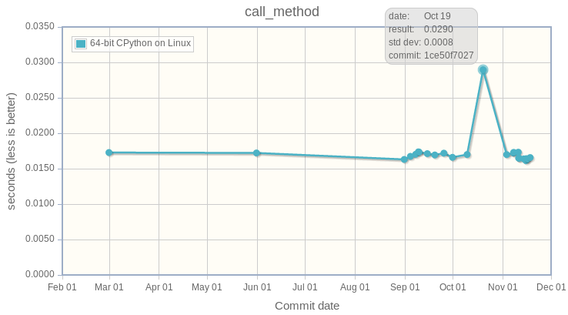
How to run stable benchmarks
FOSDEM 2017, Brussels
Victor Stinner
victor.stinner@gmail.com

Slide 2

BINARY_ADD optim
In 2014, int+int optimization proposed: 14 patches, many authors
Is is faster? Is it worth it?
The Grand Unified Python Benchmark Suite
Sometimes slower, sometimes faster
Unreliable and unstable benchmarks?

Slide 3
Goal
Unstable benchmarks lead to bad decisions
Patch makes Python faster, slower or… is not significant?
Need reproductible benchmark results on the same computer

Slide 4
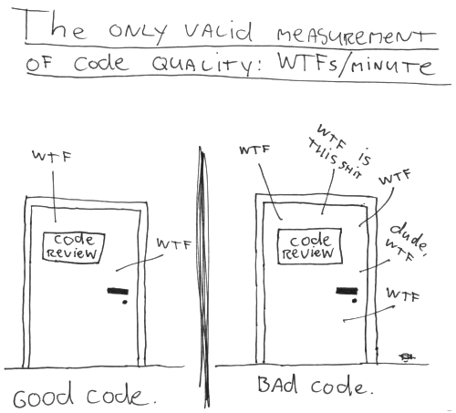
WTF meter

Slide 5
System & noisy apps
CPU-bound microbenchmark:
python3 -m timeit 'sum(range(10**7))'
Idle system: 229 ms
Busy system: 372 ms (1.6x slower, +62%)
python3 -c 'while True: pass'
WTF?

Slide 6
Isolated CPUs
System and applications share same CPUs , memory and storage
Linux kernel isolcpus=3 don’t schedule processes on CPU 3
Pin a process to a CPU:
taskset -c 3 python3 script.py
Idle system: 229 ms
Busy system, isolated CPU: 230 ms!

Slide 7

NOHZ_FULL & RCU
Enter GRUB, modify Linux command line to add: isolcpus=3
nohz_full=3: if only 0 or 1 process running on CPU 3, disable all interruptions on this CPU (WARNING: see later!)
rcu_nocbs=3: don’t run kernel code on CPU 3

Slide 8
FASTCALL optim
April 2016, experimental change to avoid temporary tuple to call functions
Builtin functions 20-50% faster!
But some slower benchmarks
20,000 lines patch reduced to adding two unused functions... still slower. WTF??

Slide 9
Deadcode
Reference:
1201.0 ms +/- 0.2 ms
Add 2 unused functions:
1273.0 ms +/- 1.8 ms (slower!)
Add 1 empty unused function:
1169.6 ms +/- 0.2 ms (faster!)

Slide 10

Deadcode

Slide 11
Code placement
Root cause: code placement
Memory layout and function addresses impact CPU cache usage
It’s very hard to get the best placement and so reproductible benchmarks

Slide 12
70% slower!

Slide 13
PGO fix deadcode
Profiled Guided Optimizations (PGO):
./configure --with-optimizations
(1) Compile with instrumentation
(2) Run the test suite to collect statistics on branches and code paths (hot code)
(3) Use statistics to recompile Python

Slide 14
Python hash function
Hash function randomized by default.
PYTHONHASHSEED=1: 198 ms
PYTHONHASHSEED=3: 207 ms (slower!)
PYTHONHASHSEED=4: 187 ms (faster!)
WTF???
Different number of hash collisions

Slide 15
More fun
Performance also impacted by:
Unused environment variables
Current working directory
Unused command line arguments
etc.

Slide 16

WTF????

Slide 17
Average
First, I disabled Address Space Layout Randomization (ASLR), randomizing Python hash function, etc.
Lost cause: too many factors impact randomly performances
Solution to random noise: compute average of multiple samples

Slide 18
perf
Spawn multiple processes
Compute average and standard deviation
Store all individual run timings as JSON
Command line tool to display, compare and analyze data
http://perf.rtfd.io/

Slide 19
New drama
Everything was fine for days, until... the new drama:
Suddenly, a benchmark became 20% faster
WHAT-THE-FUCK ?????

Slide 20
Modern Intel CPUs
Since 2005, the frequency of Intel CPUs changes anytime for various reasons:
Workload
CPU temperature
and… the number of active cores

Slide 21
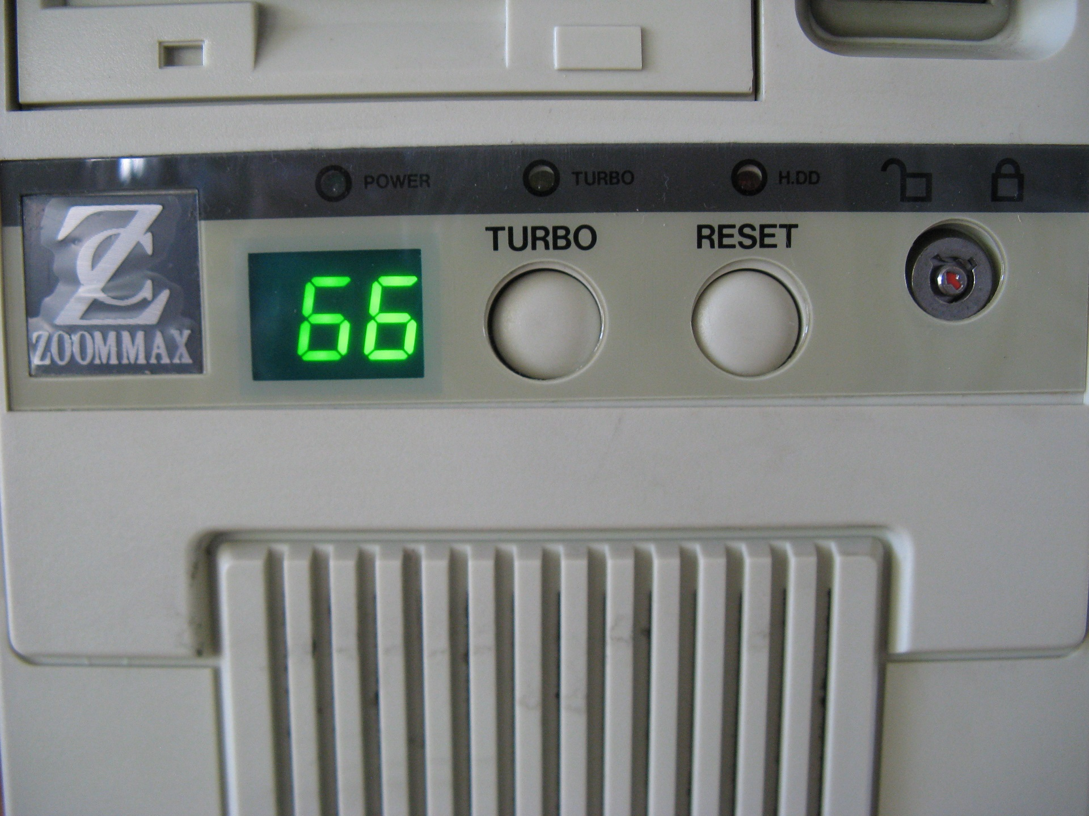
Turbo Button?

Slide 22
Turbo Boost
My laptop: 4 cores (HyperThreading)
2-4 active cores: 3.4 GHz
1 active core: 3.6 GHz (+5%)
sudo cpupower frequency-info
Disable Turbo Boost in BIOS, or write 1 into:
/sys/devices/system/cpu/
intel_pstate/no_turbo

Slide 23
And now?
I ran different benchmarks for days and even for weeks
Everything was SUPER STABLE

Slide 24

Stable benchmarks!

Slide 25
Nightmare never ends
But…
… one friday afternoon after I closed my GNOME session
… the benchmark became 2.0x faster
WTF?????? (sorry, this one should really be the last one… right?)

Slide 26

Nightmare never ends

Slide 27
Let me recall
System and noisy apps: isolcpus
Deadcode, code placement: PGO
ASLR, Python hash function, env vars, cmdline, ...: average + std dev
Turbo Boost: disable TB

Slide 28
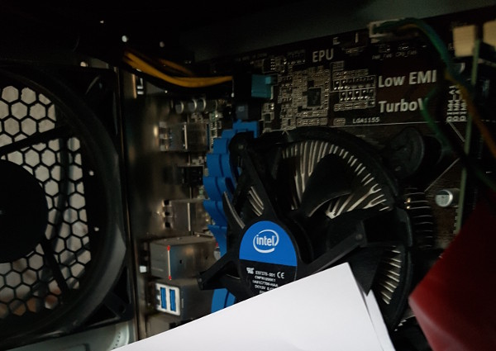
CPU temperature?

Slide 29

CPU temperature?

Slide 30
NOHZ_FULL and Pstate
nohz_full=3 (…) disables all interruptions
intel_pstate and intel_idle CPU drivers registers a scheduler callback
No interruption means no scheduler interruption (LOC in /proc/interrupts)
CPU 3 Pstate doesn’t depend on isolated CPUs workload, but other CPUs workload

Slide 31
NOHZ_FULL and Pstate
intel_pstate and intel_idle drivers maintainer never tried NOHZ_FULL
Linux real time (RT) developers: « it’s not a bug, it’s a feature! »
⇒ Use a fixed CPU frequency
⇒ or: don’t use NOHZ_FULL

Slide 32
Takeaway
Tune system to run benchmarks:
python3 -m perf system tune
Stop using timeit! Replace:
python3 -m timeit -s SETUP STMT
with:
python3 -m perf timeit -s SETUP STMT
Read perf documentation!
http://perf.rtfd.io/

Slide 33
Before

Slide 34
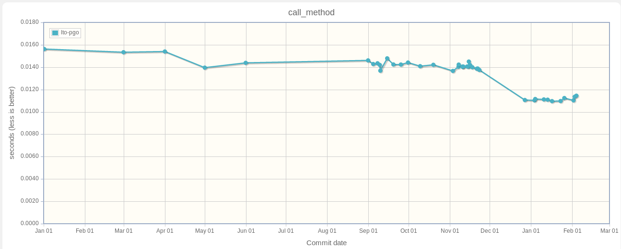
After (with PGO)

Slide 35
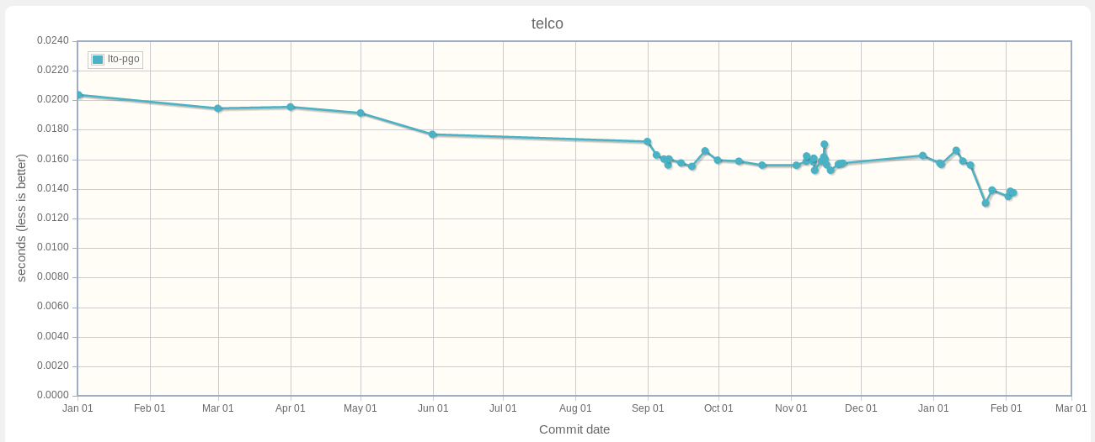
Telco benchmark

Slide 36
Questions?
http://perf.rtfd.io/
https://github.com/python/performance/
https://speed.python.org/
Victor Stinner
victor.stinner@gmail.com

Slide 37
Perf features
Collect metadata: CPU speed, uptime, Python version, kernel task#, …
Compare two results, check if significant
Stats: min/max, mean/median, sample#, …
Dump all timings including warmup
Check stability, render histogram, …

