Slide 1


Python performance
Past, Present, Future
Victor Stinner
EuroPython 2019, Basel

Slide 2

Past

Slide 3

Python Implementations
1989: CPython (Guido van Rossum)
1997: Jython (Jim Hugunin)
1998: Stackless Python (Christian Tismer)
2006: IronPython (Jim Hugunin)
2014: MicroPython (Damien George)

Slide 4
Faster Pythons
2002-2012: psyco (Armin Rigo)
2007: PyPy
2009-2010: Unladen Swallow (Google)
2014-2017: Pyston (Dropbox)
2016-2017: Pyjion (Microsoft)
Notice end date for most of these projects...

Slide 5
Two approaches
Fork CPython
Implementation from scratch

Slide 6
Fork CPython
Unladen Swallow, Pyston, Pyjion, …
Performance limited by old CPython design (1989)
Specific memory allocators, C structures, reference counting, specific GC, …
CPython is limited to 1 thread because of the GIL (more later)

Slide 7
From scratch
PyPy, Jython, IronPython, …
Jython and IronPython have no GIL!
PyPy uses an efficient tracing garbage collector
C extensions: no support, or slow
cpyext creates CPython PyObject on demand, sync with PyPy objects

Slide 8
Competition with CPython
CPython has around 30 active core developers to maintain it
New features first land into CPython
Why would users prefer an outdated and incompatible implementation?
Who will sponsor the development?

Slide 9
Unladen Swallow (2011)
“Most Python code at Google isn't performance critical”
“deployment was too difficult: being a replacement was not enough.”
“Our potential customers eventually found other ways of solving their performance problems.”
http://qinsb.blogspot.com/2011/03/unladen-swallow-retrospective.html

Slide 10
Pyston & Dropbox (2017)
“Dropbox has increasingly been writing its performance-sensitive code in other languages, such as Go”
“We spent much more time than we expected on compatibility”
https://blog.pyston.org/2017/01/31/pyston-0-6-1-released-and-future-plans/

Slide 11
Summary
CPython remains the reference implementation but shows its age
Multiple optimization projects failed
PyPy: drop-in replacement, 4.4x faster, but not widely adopted yet: why?

Slide 12

Present

Slide 13
PyPy just works!
Drop-in replacement for CPython!
4.4x faster than CPython in average (exact speedup depends on your workflow)
Fully compatible with CPython

Slide 14
PyPy issues
Subtle behavior differences with CPython on corner cases, ex: PyPy calls __del__() “later”
Support C extension with cpyext: slower than CPython, heavily optimized in 2018
Larger memory footprint (JIT)
Longer startup time (JIT)

Slide 15
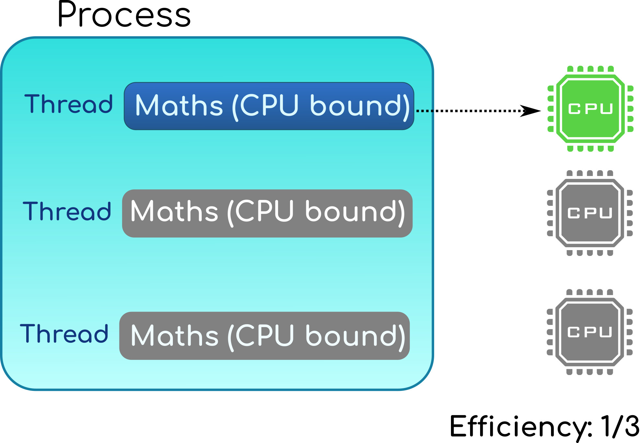
CPython GIL

Slide 16
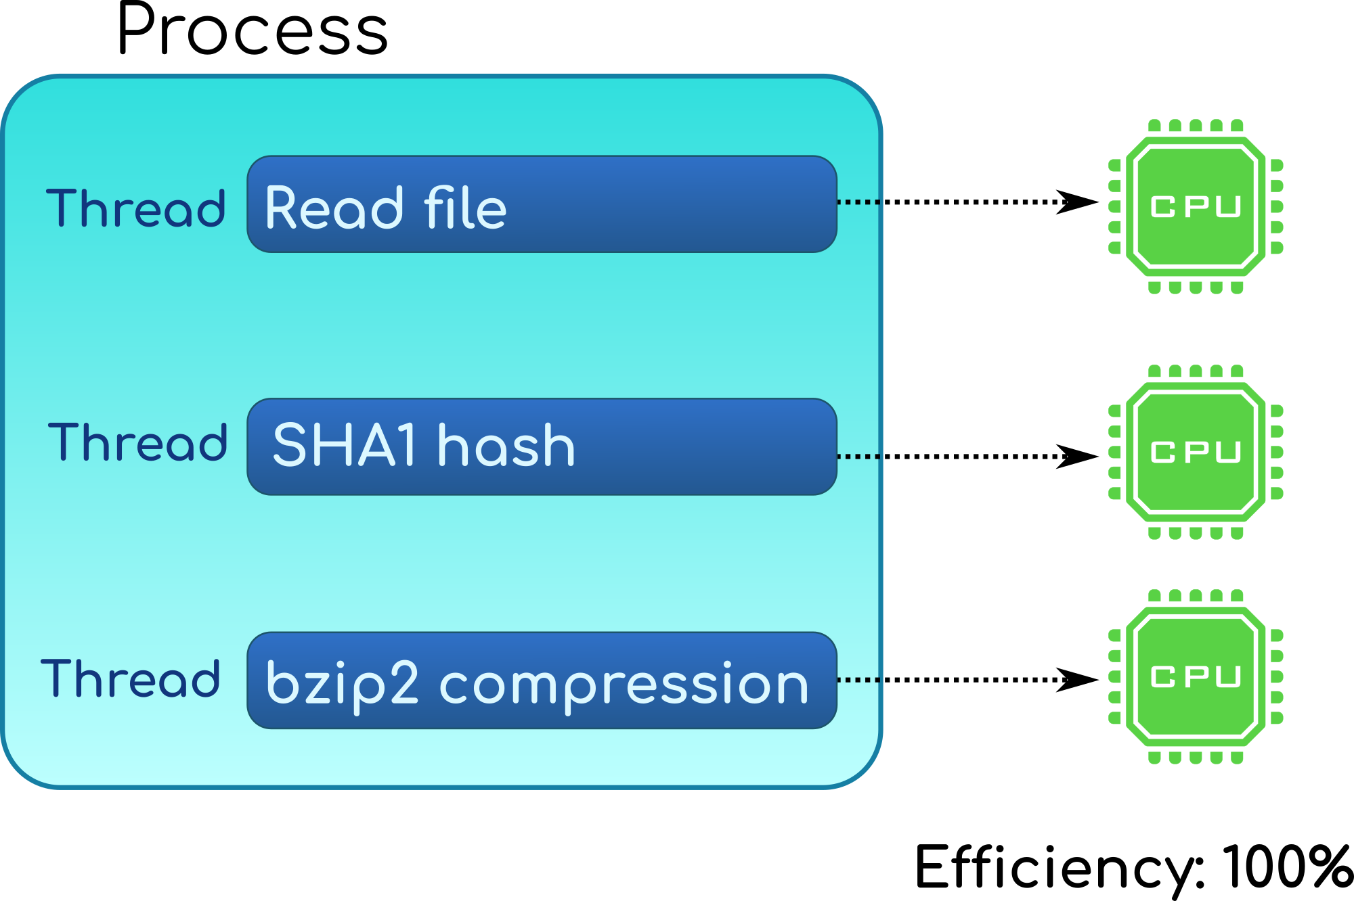
CPython: release the GIL

Slide 17
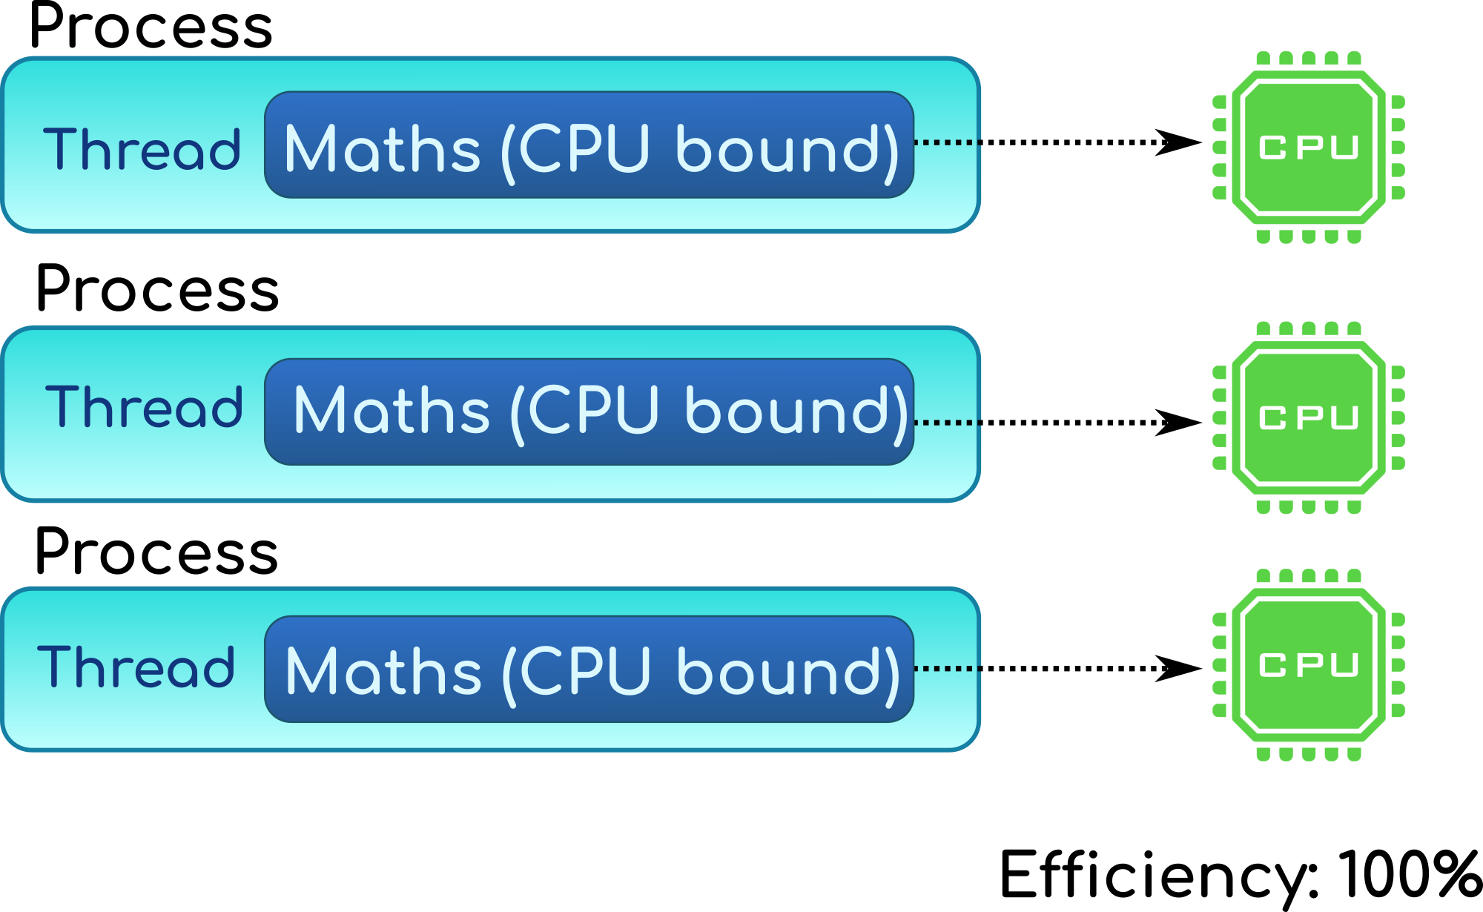
CPython: multiprocessing

Slide 18
multiprocessing
Work around the GIL limitation
Shared memory (Python 3.8) avoids memory copies between workers
New pickle version 5 (Python 3.8) avoids copying large objects:
PEP 574

Slide 19
Cython
Easy way to write C extension
Syntax similar to Python
Support multiple Python versions
Handle reference counting for you
The optimizer emits efficient code using CPython internals for you

Slide 20
Numba
JIT compiler translating subset of Python and NumPy into fast code
Simplified Threading: release GIL
SIMD Vectorization: SSE, AVX, AVX-512
GPU Acceleration: NVIDIA's CUDA and AMD's ROCm

Slide 21
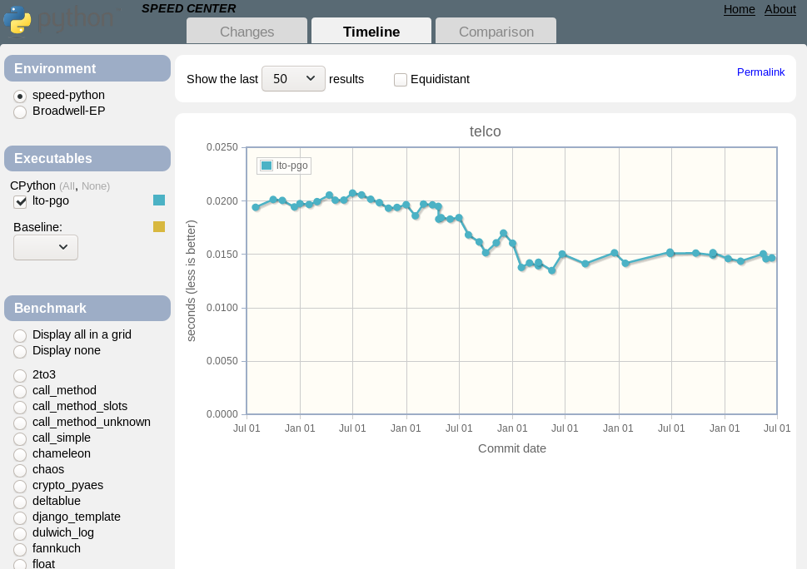
https://speed.python.org
Track CPython performance
Stable benchmarks

Slide 22
Summary
PyPy doesn’t require any code change
Multiprocessing scales
Use Cython, don’t use the CAPI directly
Numba makes numpy faster

Slide 23

Future

Slide 24
Python C API
Evolved organically: internal functions are exported by mistake
No design: expose everything
API exposes implementation details: structure fields, memory allocators, reference counting, ...

Slide 25
Python 3.8 changes
Python 3.8 has 3 levels of C API:
Include/: public “portable” C API
Include/cpython/: C API specific to CPython
Include/internal/: internal C API
Many private functions (“_Py…”) moved to internal/

Slide 26
Stable ABI
Support multiple Python versions: Python 3.8, 3.9, …
CPython 3.8 debug build is ABI compatible with the release build
Debug build can use C extensions compiled in release mode

Slide 27
Accessing structs
Python list: array of pointers (PyObject*)
PyPy specialized list: list of integers (in C: int64_t array[n])
Problem 1: PyList_GET_ITEM() macro access directly PyListObject.ob_item[index]
C extensions must not access PyListObject directly

Slide 28
Borrowed reference
Problem 2: PyList_GetItem() returns a borrowed reference, Py_DECREF() must not be called
If PyList_GetItem() creates a temporary object, when should it be destroyed? We don’t know…
Many C functions return borrowed references

Slide 29
Better C API
Make structures opaque. Must fail with a compiler error:
PyObject *obj = PyLong_FromLong(1);
PyObject *type = obj->ob_type;
Remove functions using borrowed references or “stealing” refererences.
Replace macros with function calls.

Slide 30
Break compatibility
Any C API change can break an unknown number of projects
Maybe not all C API design issues can be fixed
Updating all C extensions on PyPI will take a lot of time
… there should be another way…

Slide 31
New PyHandle C API
New C API: correct since day 1
PyHandle: opaque integer, similar to an Unix file descriptor
Implemented on top of CPython C API
Efficient on PyPy
Cython: no need to change your code

Slide 32
Subinterpreters
Eric Snow’s PEP 554 “Multiple Interpreters in the Stdlib”
Replace the unique Global Interpreter Lock (GIL) with one lock per interpreter
Work-in-progress refactoring of CPython complex internals

Slide 33
CPython GIL

Slide 34
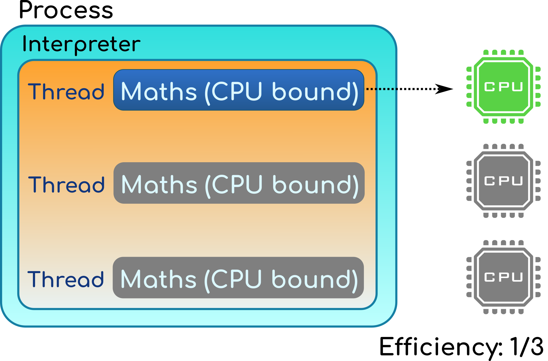
CPython GIL

Slide 35
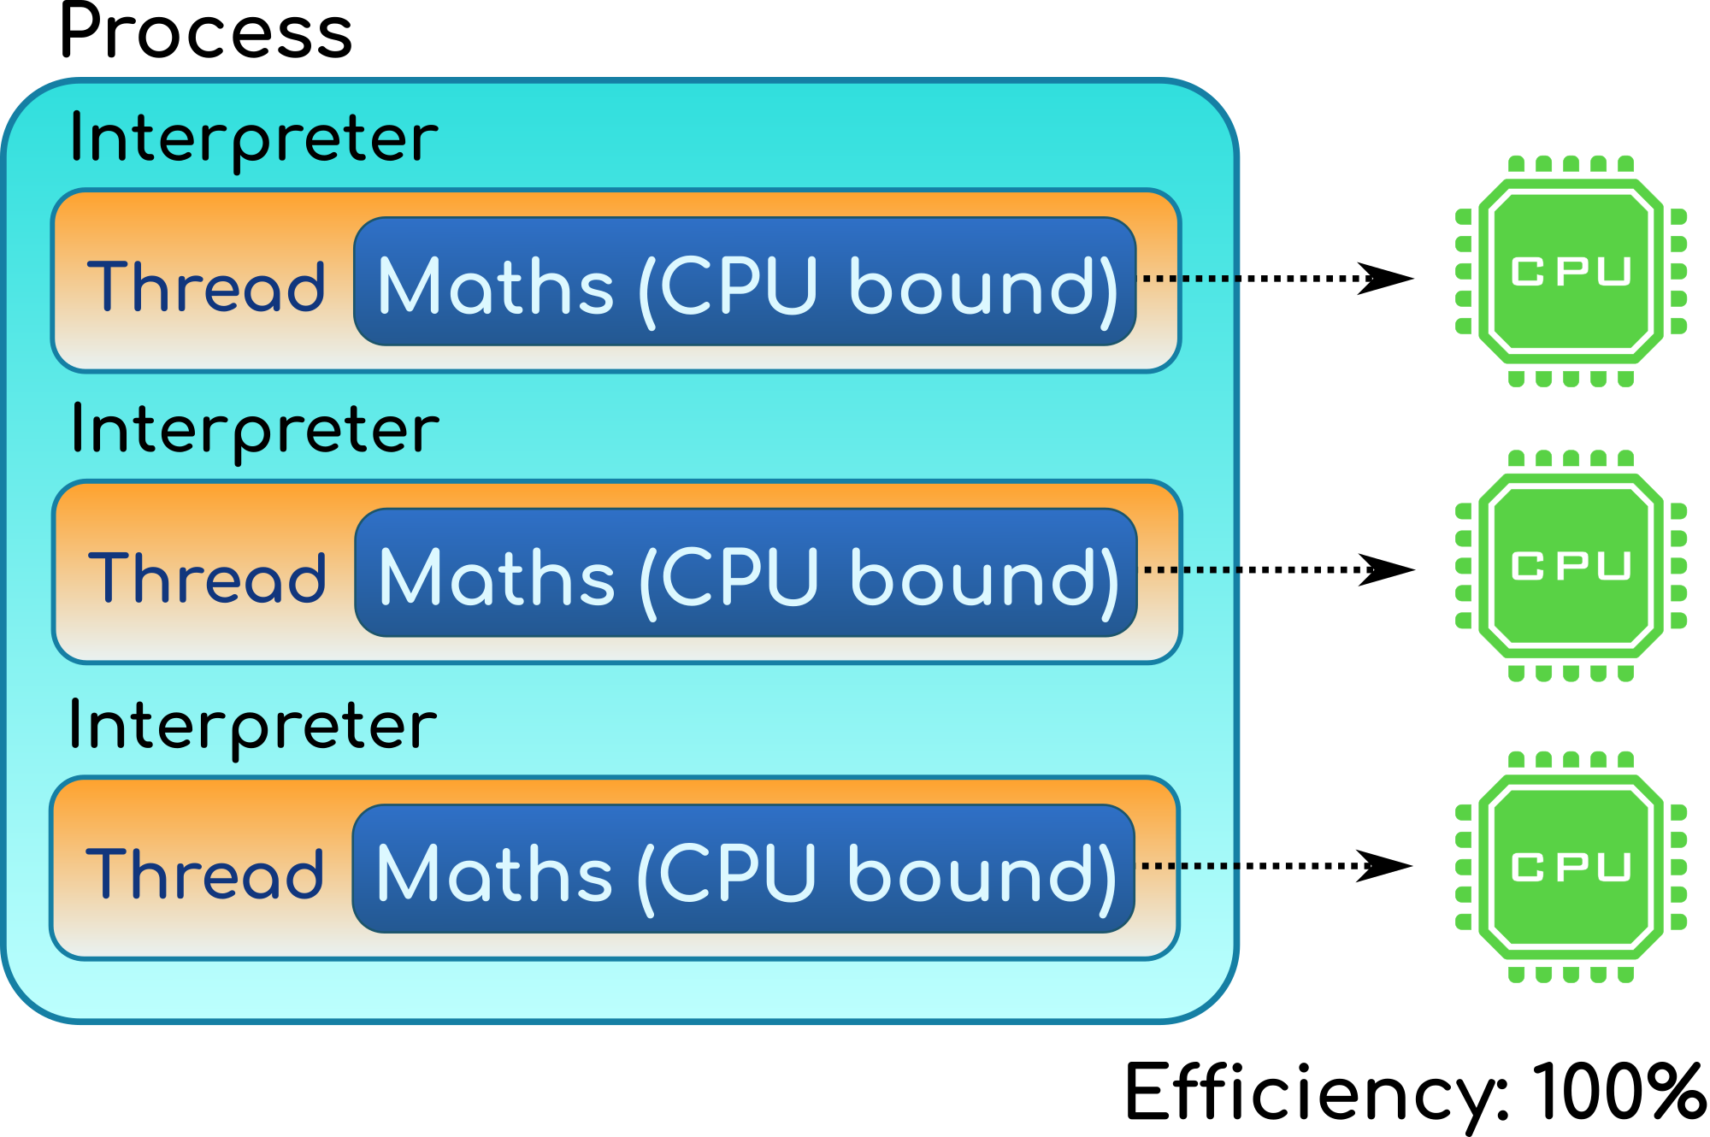
CPython subinterpreters

Slide 36
Subinterpreters
Expectation (should be verified with a working implementation):
Lower memory footprint: share more memory
Faster locks
Limitation: Python objects cannot be shared between interpreters.

Slide 37
Gilectomy
“Remove the GIL”: replace unique GIL with one lock per mutable object
Atomic increment/decrement
Log INCREF/DECREF
Reference counting doesn’t scale with the number of threads

Slide 38
Tracing GC for CPython
Many modern language implementations use tracing GC
PyPy has a tracing GC
Existing C API would continue to use reference counting

Slide 39
Summary
Enhance existing C API
Write a new “PyHandle” C API
CPython subinterpreters
Tracing garbage collector for CPython

Slide 40

Conclusion

Slide 41
Conclusion
Many previous optimizations projects failed
Cython, multiprocessing and Numba are working well to make Python faster
PyHandle, subinterpreters and tracing GC are very promising!

Slide 42

Questions?
http://pypy.org/
https://faster-cpython.readthedocs.io/
https://pythoncapi.readthedocs.io/
https://speed.python.org/
https://mail.python.org/mailman3/lists/speed.python.org/

