Slide 1


How to engage Python
contributors in the
long term?
Tech is easy.
People are complex.
Pycon US 2019, Cleveland
Victor Stinner

Slide 2
Python is all about code

Slide 3

LIAR
Python is all about acode
Python is
about people

Slide 4
Depression
Burnout

Slide 5

Burnout
February 2018
Unsubscribed from 7 Python mailing lists
Closed all my pull requests
Notifications → /dev/null
Doctor → One month off
No commit for 3 months ½

Slide 6
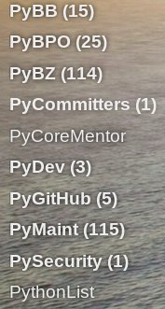
Burnout
Previous
typical
INBOX:

Slide 7
Burnout
Time to step back
Too many responsibilities
Working 13h per day in average
A burnout is complex
(other reasons omitted here)

Slide 8
Open Source

Slide 9

Problem
I don’t scale
Increase of the workload
Decrease of the number of new core developers

Slide 10
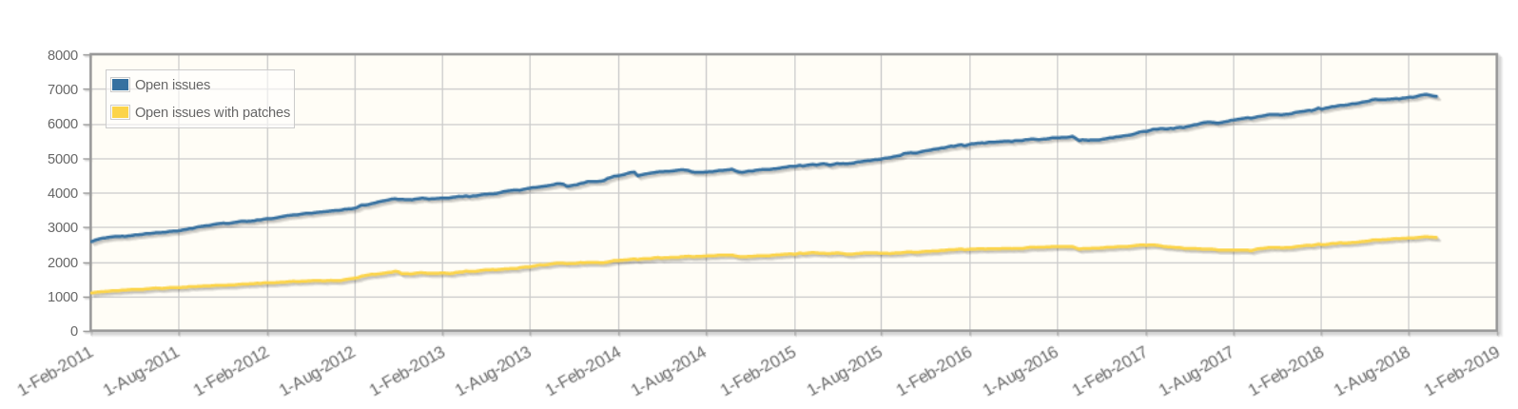
Open issues (2011-2018)
6916 open issues
995 open PR
New core devs per year (2007-2018)
96 core devs on GitHub
(total, including
inactive)

Slide 11
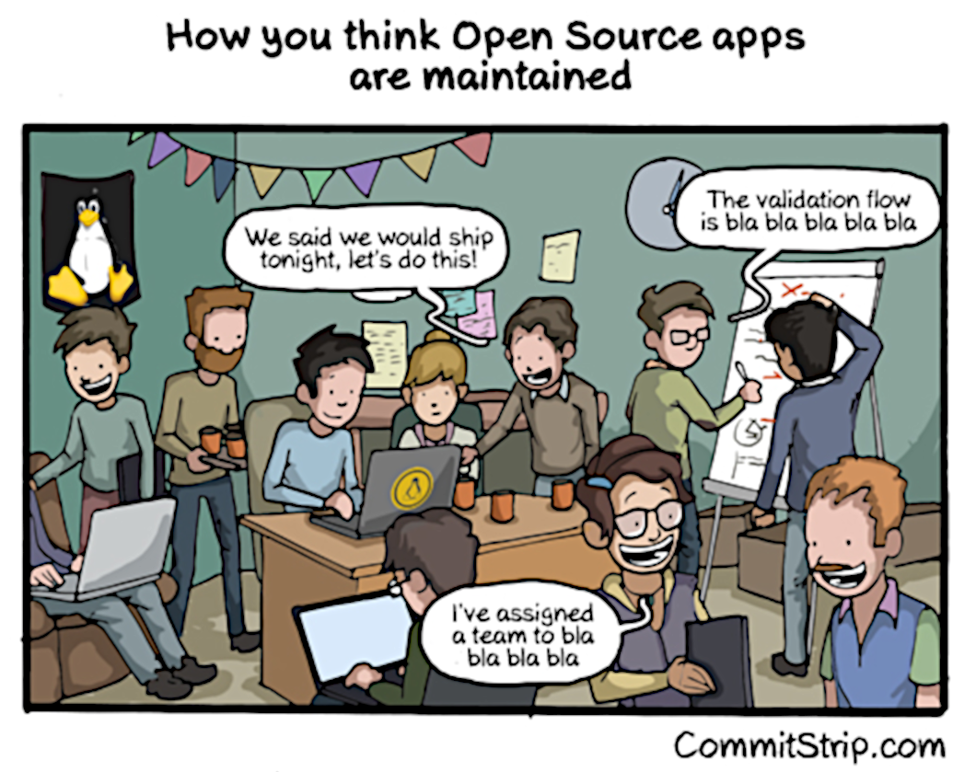

Slide 12
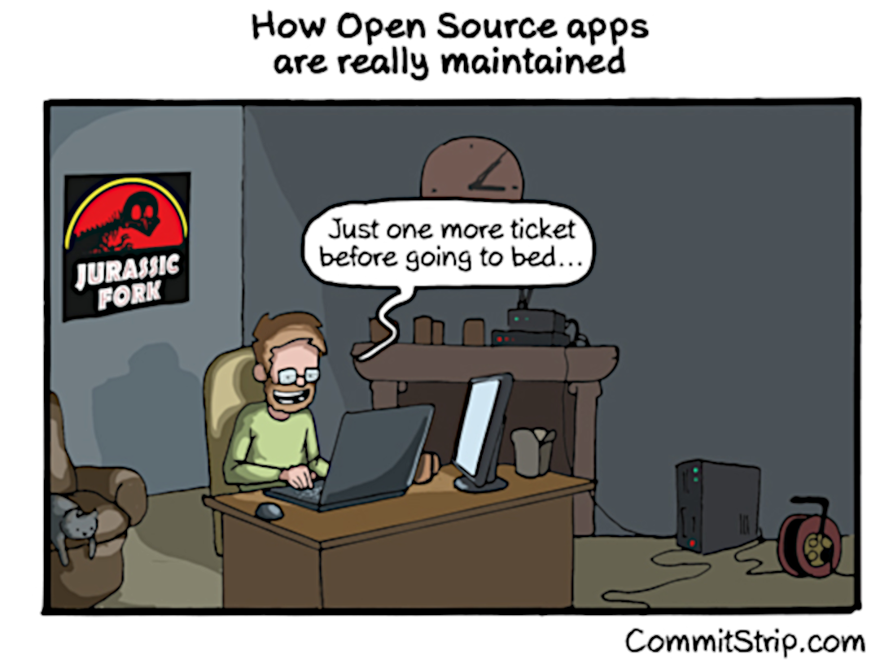

Slide 13

“We are all volunteers”
Contributors give their free time to Python: evenings, weekends, maybe also part of their nights.
Trade time between family/friends and Python.
Few employers allow to contribute to Python upstream.

Slide 14
“We are all volunteers”
Red Hat: I (Victor) am paid full time.
Microsoft: Brett Cannon, Barry Warsaw, Eric Snow, Steve Dower have one day per week.
Dropbox: Guido van Rossum (±50%).
Cuttlesoft: Emily Morehouse (1 day/week).
Neil Schemenauer, INADA Naoki
(±1 day/week).
→ 2.9 full time dev
TIOBE: Python is #3

Slide 15

“Think of a contribution like a puppy: you might view it as this cute, wonderful thing you're giving me while I'm looking at it as
over a decade of feeding, walking, and vet bills.” – Brett Cannon

Slide 16
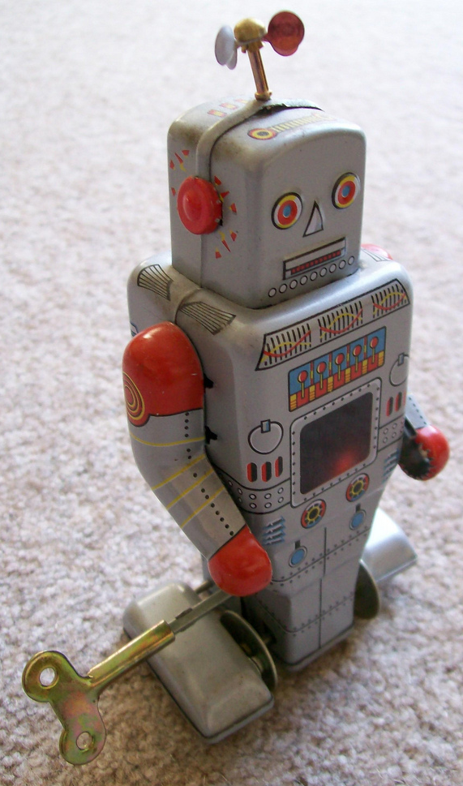
Past Actions
Developer Guide
Migrate to Git on GitHub
CI Linux and Windows run on pull requests
… core devs remain the bottleneck
“You can’t solve people problems with software.”
– Baldur Bjarnason

Slide 17
Diversity Problems

Slide 18

There is no public complain,
so there is no diversity problem!
Diversity

Slide 19
“When women speak out about diversity and the community, they get penalized and branded as non-technical. Some women chose not to speak out because of this.
We will not be silenced.” – Mariatta Wijaya
Diversity

Slide 20

Toxicity
Attack a person,
rather than their arguments
Attack in public space
or private space
Bullying
Misogyny
Racism

Slide 21
I modified 7 lines…
(doc & comments)
- # master pattern object
+ # main pattern object
- in master process and freeze before fork ...
+ in parent process and freeze before fork ...
- multiprocessing: stop the master process somehow
+ multiprocessing: stop the parent process somehow
- # This method (and its pliant slaves, like 'finalize_unix()',
+ # This method (and its helpers, like 'finalize_unix()',
- # OptionParser: create the master option mappings
+ # OptionParser: create the main option mappings
- # test_ssl: Force different suites on client and master
+ # test_ssl: Force different suites on client and server
-buildbot Batchfiles for running on Windows buildslaves.
+buildbot Batchfiles for running on Windows buildbot workers.

Slide 22
30+ articles in 1 week: The Register, Russia Today, Breitbart, developpez.com, Hacker News, Motherboard VICE, Slashdot, 4chan, OSChina, Twitter, Weibo, …
English, Russian, Japanese, Mandarin, German, French, Czech, …
Mention my full name and my employer
Slashdot: 1200 comments in 2 days

Slide 23
"Fuck you Victor Stinner. You're the enemy of /g/ now. Eat shit. I'll probably make a video about this gay shit."
– Anonymous, 4chan

Slide 24
"I would like him dead."
– Anonymous, 4chan

Slide 25

...
short
break
with
an
adorable
panda
…

Slide 26
Diversity Solutions

Slide 27

“Unconscious biases are social stereotypes about certain groups of people that individuals form outside their own conscious awareness.”
– diversity.ucsf.edu

Slide 28
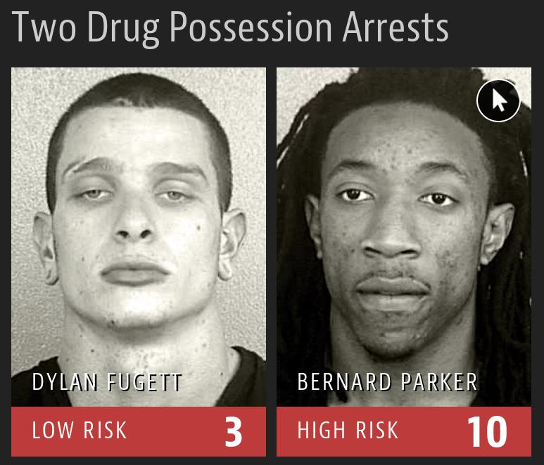
A study on machine learning used to predict future crimes shows that machine learning is biased against blacks.
Subsequent
Offenses:
3 drug possessions
Subsequent
Offenses:
None
https://www.propublica.org/article/machine-bias-risk-assessments-in-criminal-sentencing

Slide 29
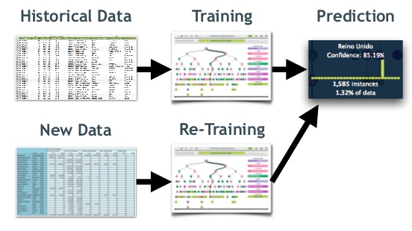
Machine Learning

Slide 30
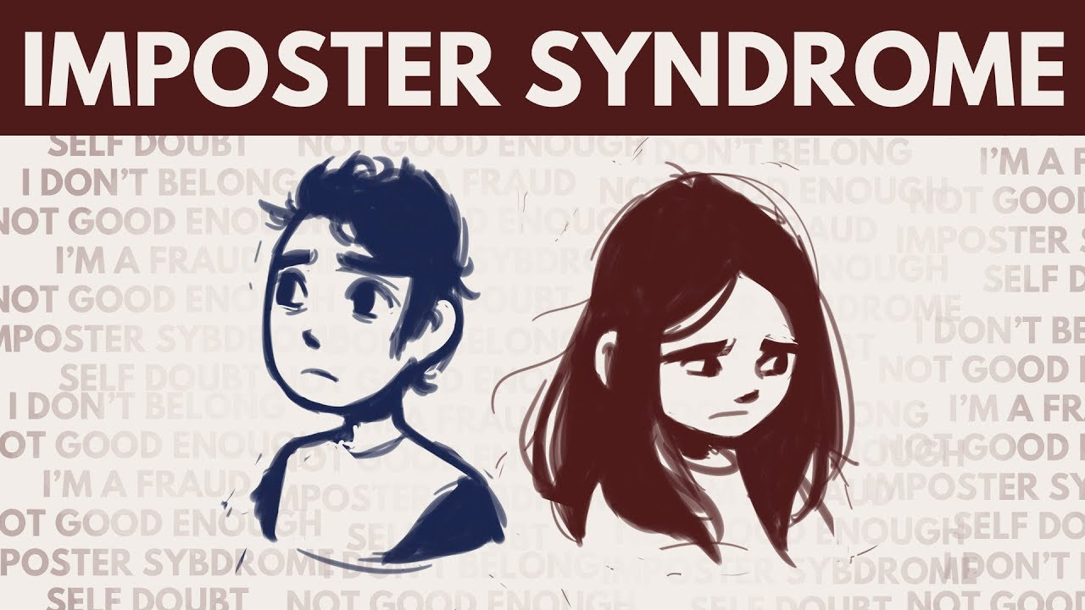
“Imposter syndrome is a psychological pattern in which an individual doubts their accomplishments and has a persistent internalized fear of being exposed as a "fraud".” – Wikipedia

Slide 31

Social medias can trigger imposter syndrome

Slide 32

Code of Conduct
No Code of Conduct (CoC)
CoC applied to mailing lists, bug tracker and python.org
CoC applied to Pycon events
May 2018: Pycon US used the service of a company to help to manage CoC incidents
The PSF now requires a CoC on « Pycon » events
Discussions on how to handle incidents and bans

Slide 33
Diversity of points of view: documentation, reference counting (C), compatibility, API, language consistency, simple solution, corner cases, performance, security, PyPy, etc.
Diversity

Slide 34
Diversity of use cases: CLI running less than one second (startup time), server running for multiple days, GUI, machine learning, REST server, games, etc.
Diversity

Slide 35
INADA Naoki (Japan) promoted as core dev in 2016: BDFL-delegate of PEP 538 (C locale coercion) and PEP 540 (UTF-8 mode). English speakers are satisfied with ASCII, Japanese speakers care more about Unicode.
Diversity

Slide 36
Mentoring

Slide 37
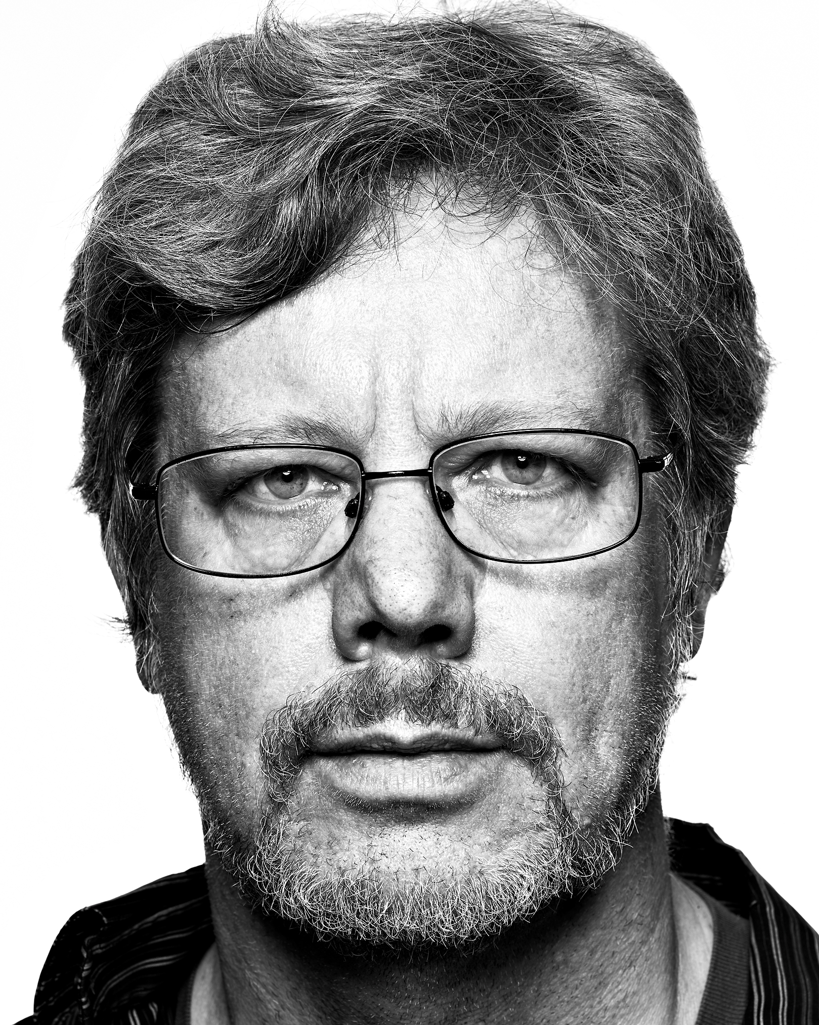
Positive Action
Pycon US 2016, Guido van Rossum encouraged women to contact him
for mentoring
He mentored Mariatta Wijaya who became the first woman core dev in January 2017

Slide 38
Positive Action
May 2017: Carol Willing
Sept 2018: Lisa Roach
and Emily Morehouse
Feb 2019: Cheryl Sabella
2016: 0 woman core devs
2017: 2 woman core devs
2018: 4 woman core devs
2019: 5 woman core devs

Slide 39

“Give a man a fish and
you feed him for a day.
Teach a man to fish and
you feed him for a lifetime.”
Mentoring

Slide 40
I mentored Pablo Salgado,
between January and
June 2018. He became
a core dev in June.
Mentoring

Slide 41
The development of
an Open Source project
is a matter of trust.
Mentoring

Slide 42
Communities

Slide 43


“Women Who Love Coding in Python”
Events in Australia, Brazil, France, India, Netherlands, Nigeria, Taiwan, …
pyladies.com

Slide 44
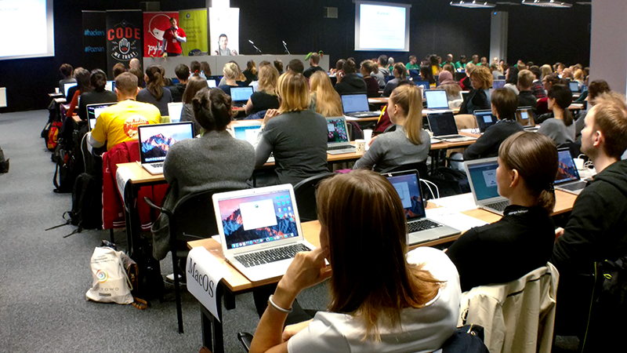

Slide 45

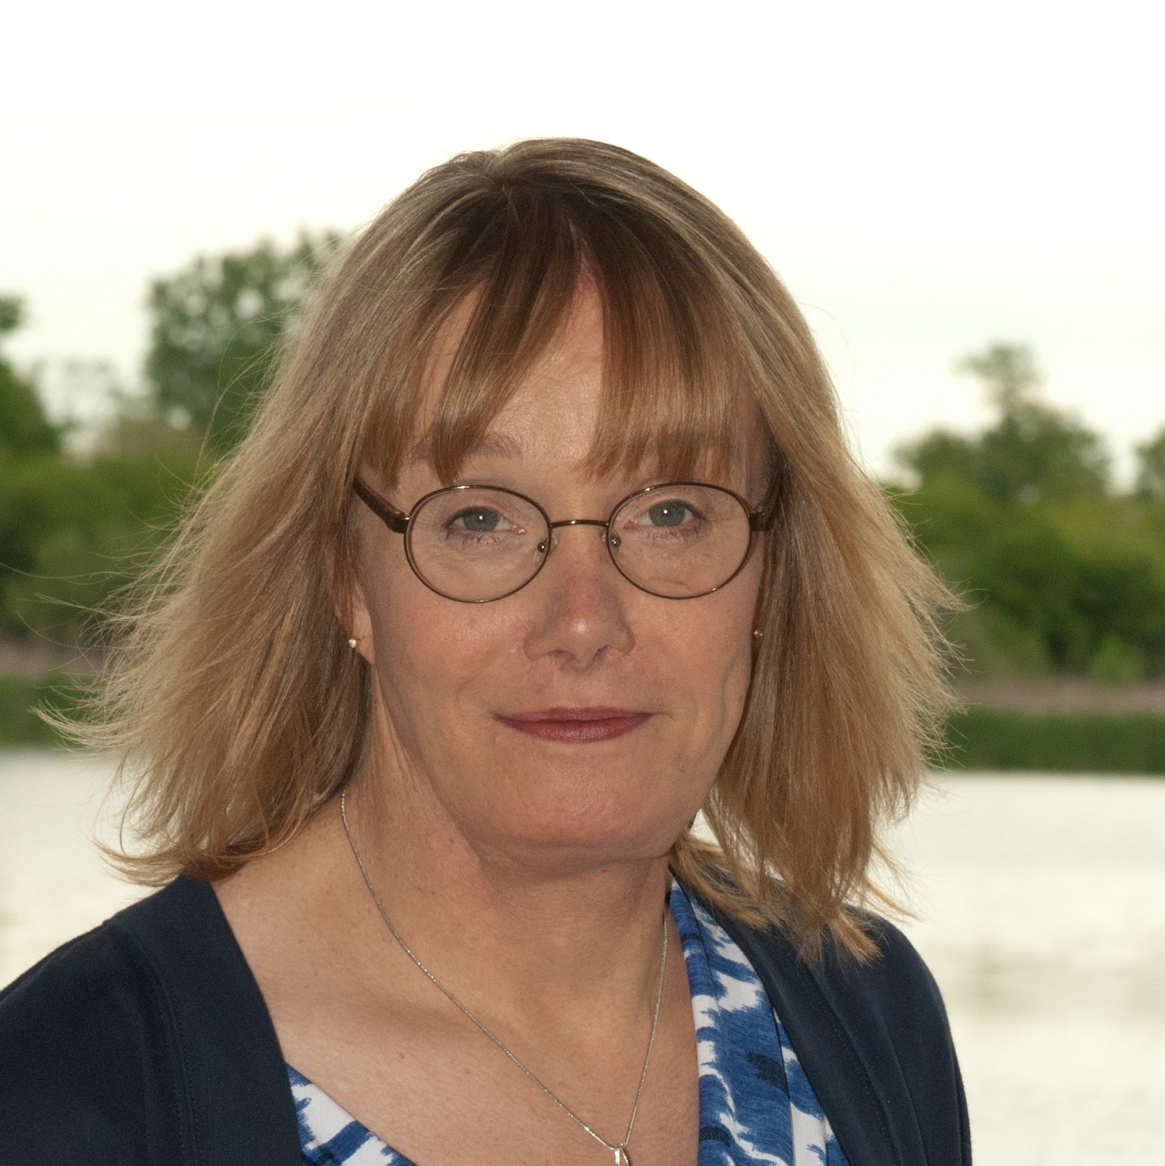
“The event that aims to help draw attention to transgender issues through a topic-focused hackday.”
Latest event: PyLondonium
(London, UK)
trans-code.github.io

Slide 46
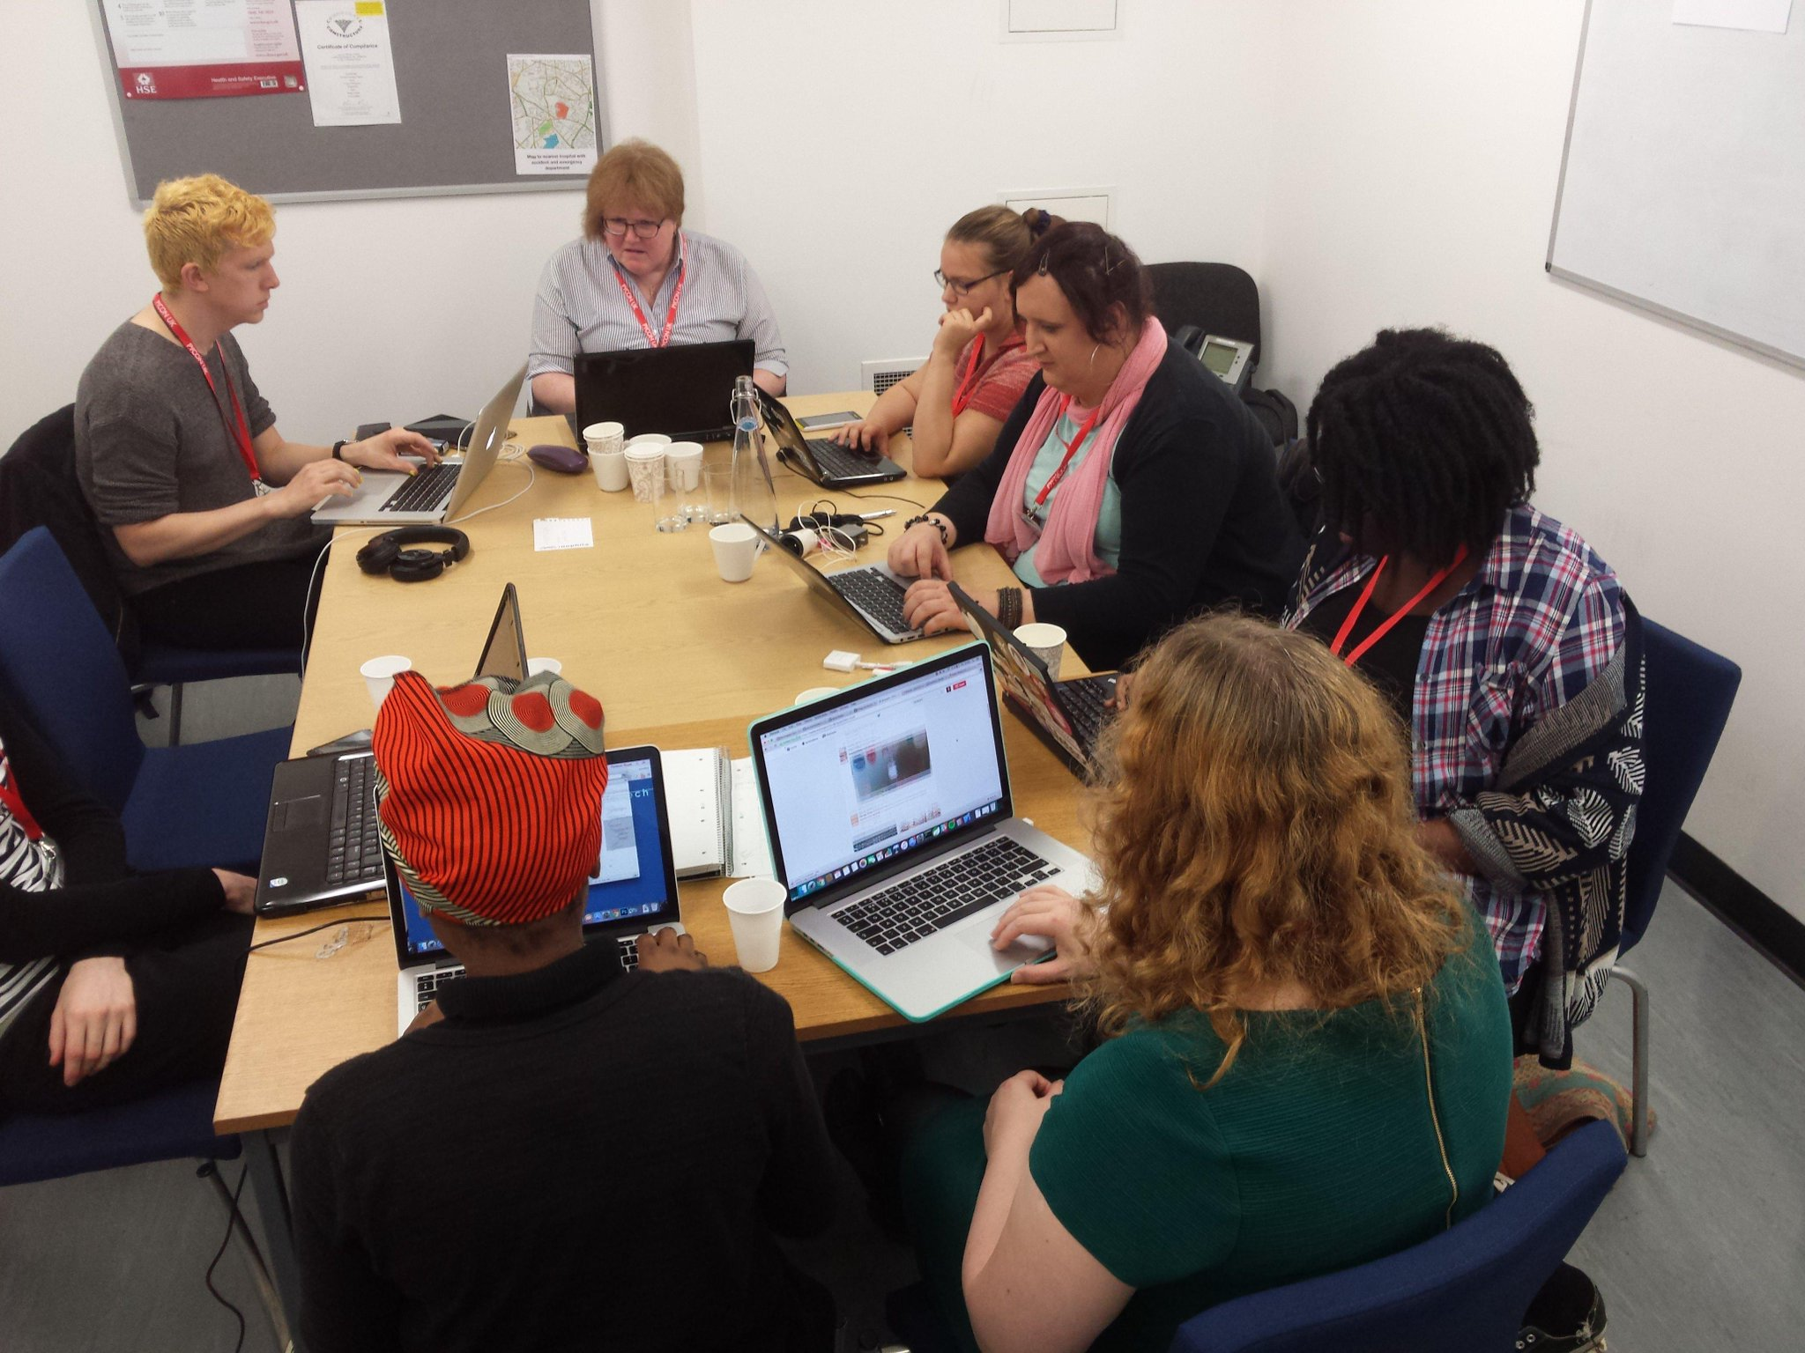
Creation of trans.tech (previous website)

Slide 47

“We inspire women to fall in love with programming.”
733 events: Cameroon, Finland, France, Ghana, India, Japan, Spain, Switzerland, ….
djangogirls.org

Slide 48
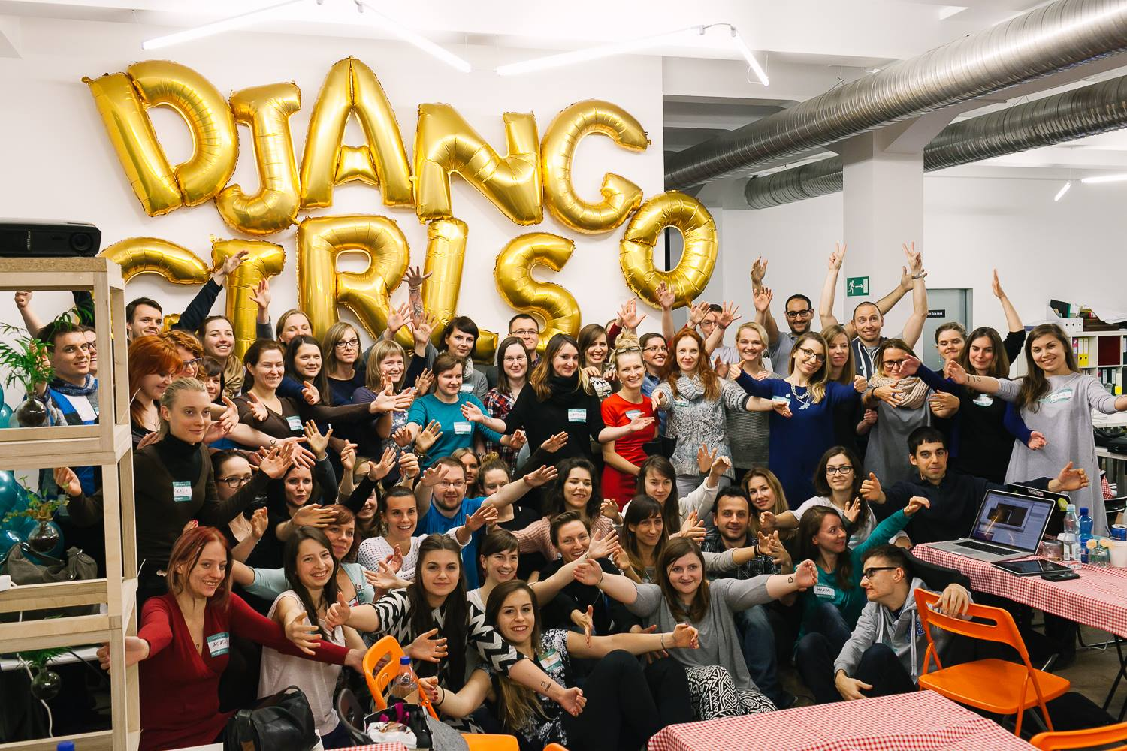

Slide 49
Conclusion

Slide 50

Take Away
Core devs are
the bottleneck.
We are aware that
Python has “people
issues”.
Mentoring is efficient to train contributors as future core developers.
The Code of Conduct reduces the toxicity.

Slide 51
“Increasing the core’s diversity is a very important goal to
ensure the future
health of Python.”
– Guido van Rossum

Slide 52
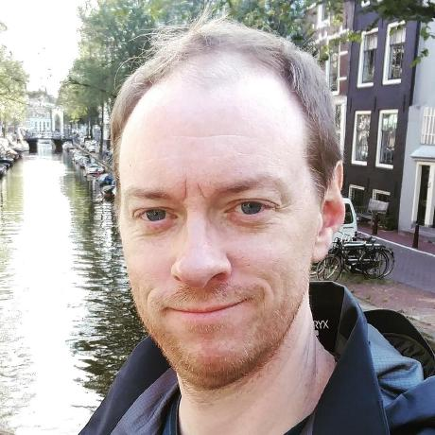
“Come for the Language,
Stay for the Community”
– Brett Cannon & Naomi Ceder

Slide 53

What’s Next?
Promotion
Process
Mentoring
Guide
Contributor
Tutorial
cpython-core-tutorial.rtfd.io

