Slide 1


Python performance
Past, Present, Future
Victor Stinner
Pycon India 2020 (online)

Slide 2

Past

Slide 3

Python Implementations
1989: CPython (Guido van Rossum)
1997: Jython (Jim Hugunin)
1998: Stackless Python (Christian Tismer)
2006: IronPython (Jim Hugunin)
2014: MicroPython (Damien George)

Slide 4
Faster Pythons
2002-2012: psyco (Armin Rigo)
2007: PyPy
2009-2010: Unladen Swallow (Google)
2014-2017: Pyston (Dropbox)
2016-2017: Pyjion (Microsoft)
Notice end date for most of these projects...

Slide 5
Two approaches
Fork CPython
Implementation from scratch

Slide 6
Fork CPython
Unladen Swallow, Pyston, Pyjion, …
Performance limited by old CPython design (1989)
Specific memory allocators, C structures, reference counting, specific GC, …
CPython is limited to 1 thread because of the GIL (more later)

Slide 7
From scratch
PyPy, Jython, IronPython, …
Jython and IronPython have no GIL!
PyPy uses an efficient tracing garbage collector
C extensions: no support, or slow
cpyext creates CPython PyObject on demand, sync with PyPy objects

Slide 8
Competition with CPython
CPython has around 30 active core developers to maintain it
New features first land into CPython
Why would users prefer an outdated and incompatible implementation?
Who will sponsor the development?

Slide 9
Unladen Swallow (2011)
“Most Python code at Google isn't performance critical”
“deployment was too difficult: being a replacement was not enough.”
“Our potential customers eventually found other ways of solving their performance problems.”
http://qinsb.blogspot.com/2011/03/unladen-swallow-retrospective.html

Slide 10
Pyston & Dropbox (2017)
“Dropbox has increasingly been writing its performance-sensitive code in other languages, such as Go”
“We spent much more time than we expected on compatibility”
https://blog.pyston.org/2017/01/31/pyston-0-6-1-released-and-future-plans/

Slide 11
Summary
CPython remains the reference implementation but shows its age
Multiple optimization projects failed
PyPy: drop-in replacement, 4.4x faster, but not widely adopted yet: why?

Slide 12

Present

Slide 13
Optimize your code
Let’s say that you identified your code causing the performance bottleneck
How to make your code faster?

Slide 14
PyPy just works!
Drop-in replacement for CPython!
4.4x faster than CPython in average (exact speedup depends on your workload)
Fully compatible with CPython

Slide 15
PyPy issues
Support C extension with cpyext: heavily optimized in 2018, but still slower than CPython
(more about the C API later...)
Larger memory footprint (JIT)
Longer startup time (JIT)

Slide 16

C and Rust extensions
Identify the performance bottleneck
Rewrite a small part of your application as a C or Rust extension
github.com/dgrunwald/rust-cpython
github.com/PyO3/pyo3

Slide 17
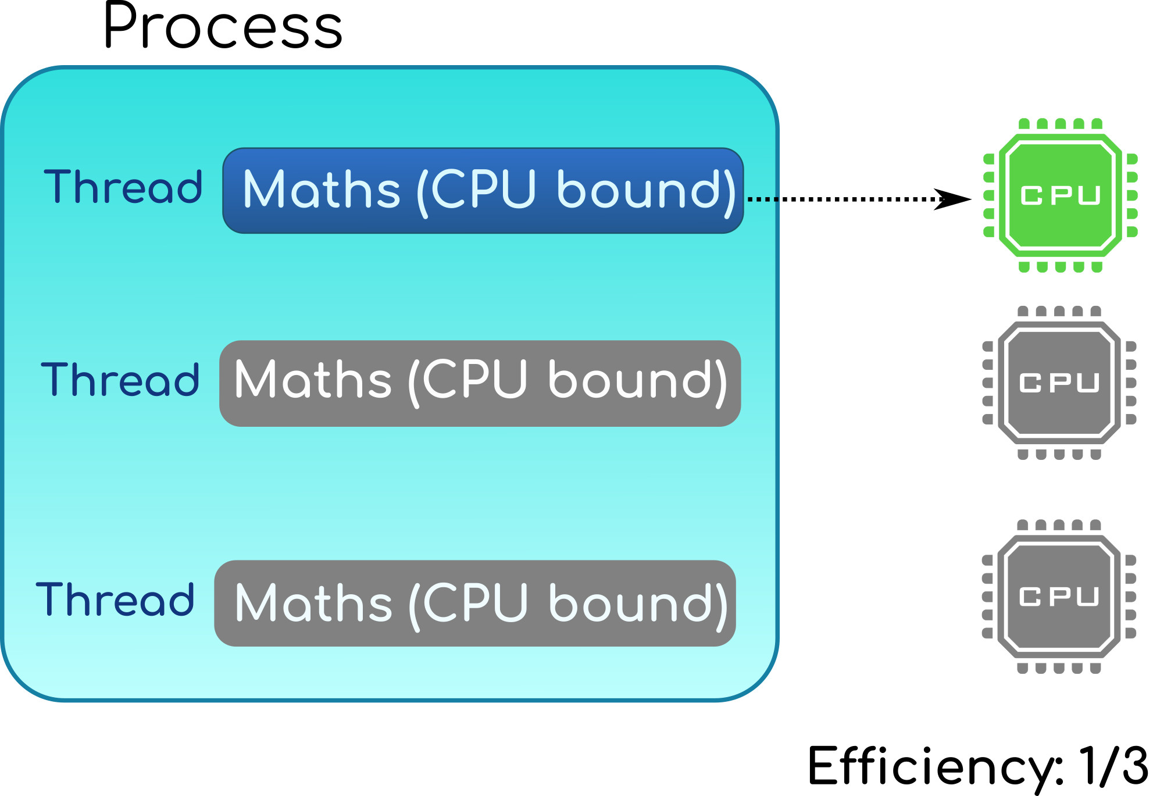
CPython GIL

Slide 18
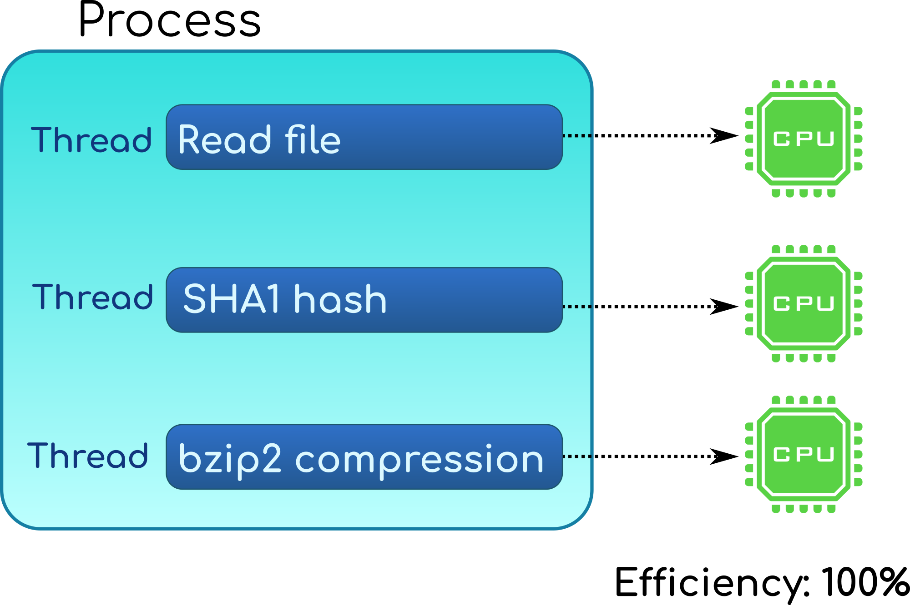
CPython: release the GIL

Slide 19
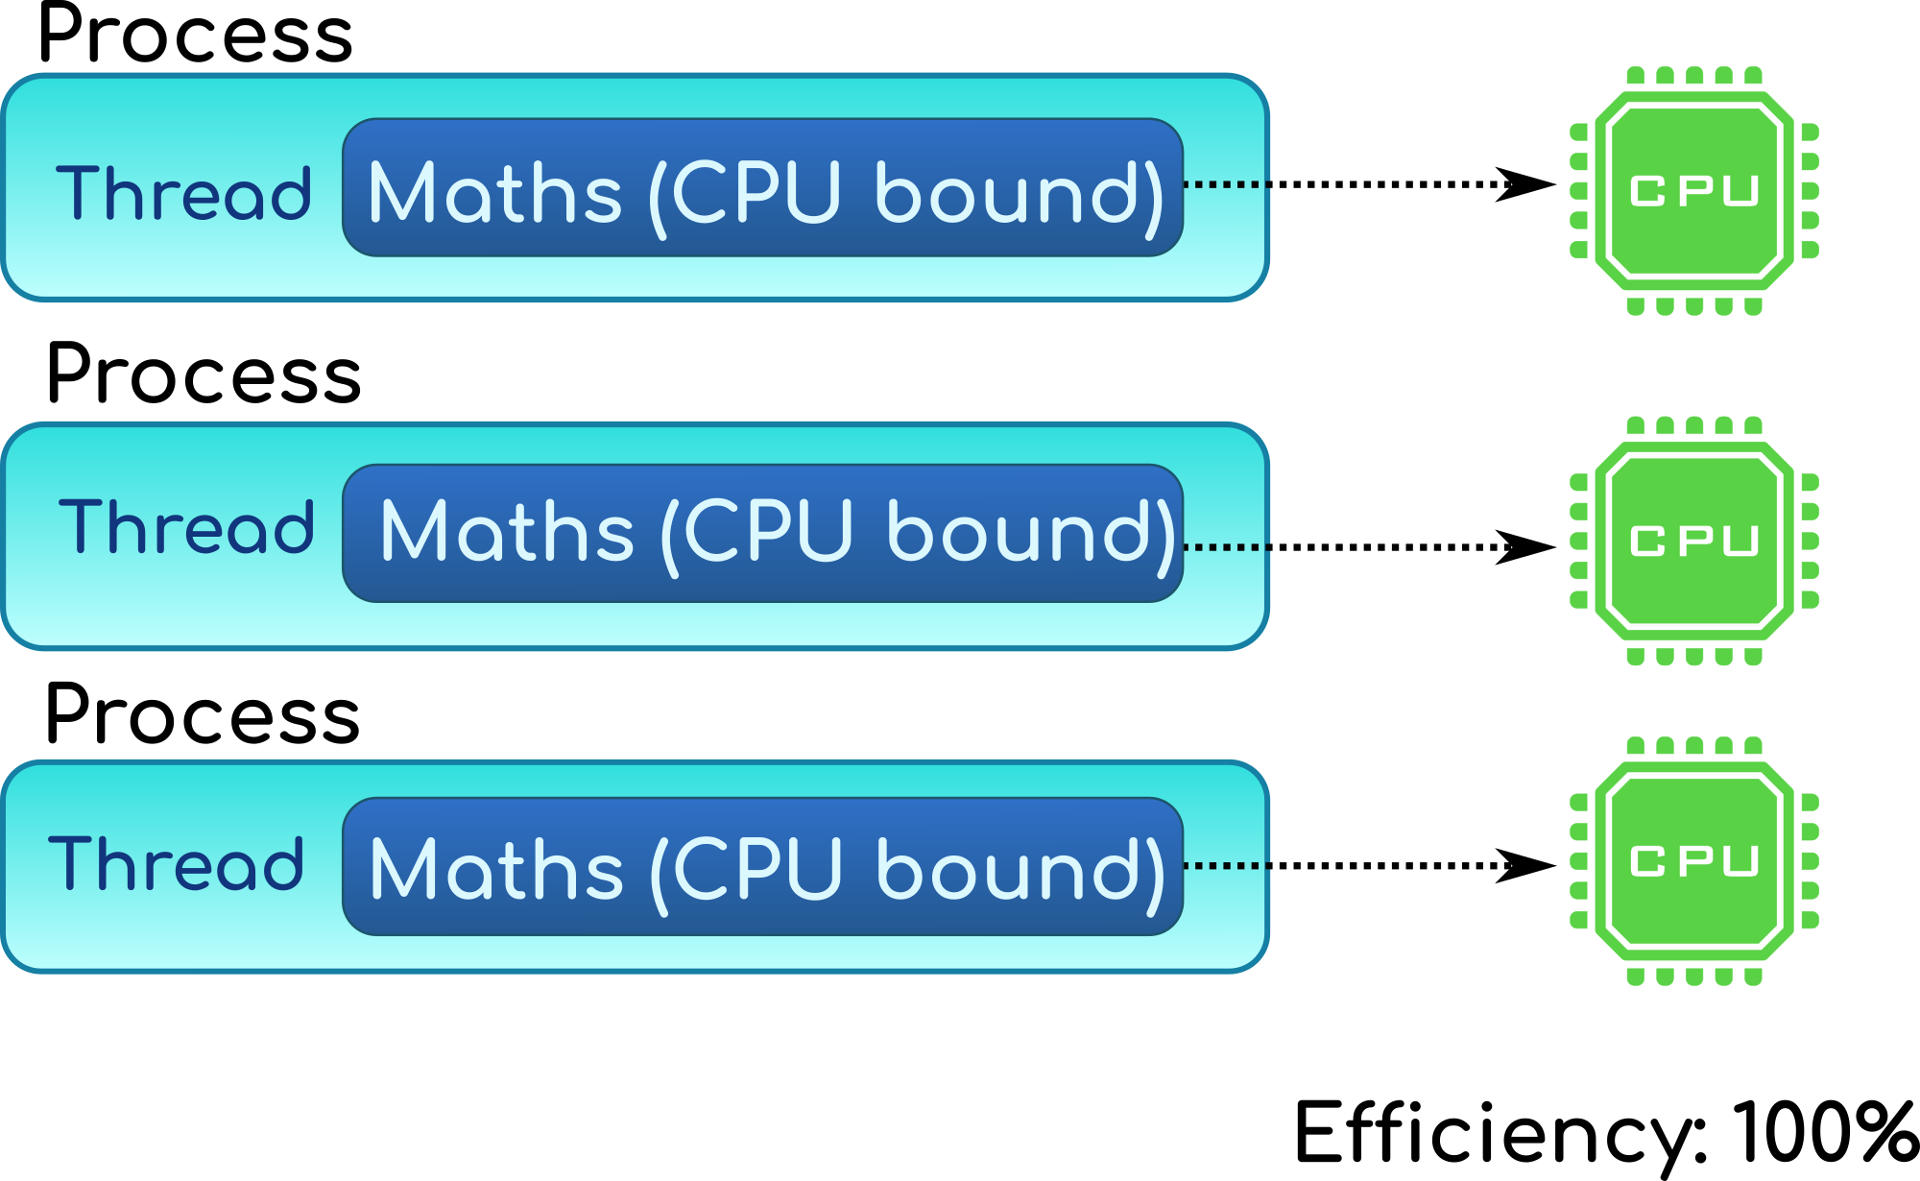
CPython: multiprocessing

Slide 20
Multiprocessing
Work around the GIL limitation
Shared memory (Python 3.8) avoids memory copies between workers
New pickle version 5 (Python 3.8) avoids copying large objects:
PEP 574

Slide 21
Cython
Easy way to write C extension
Syntax similar to Python
Support multiple Python versions
Handle reference counting for you
The optimizer emits efficient code using CPython internals for you

Slide 22
Numba
JIT compiler translating subset of Python and NumPy into fast code
Simplified Threading: release GIL
SIMD Vectorization: SSE, AVX, AVX-512
GPU Acceleration: NVIDIA's CUDA and AMD's ROCm

Slide 23
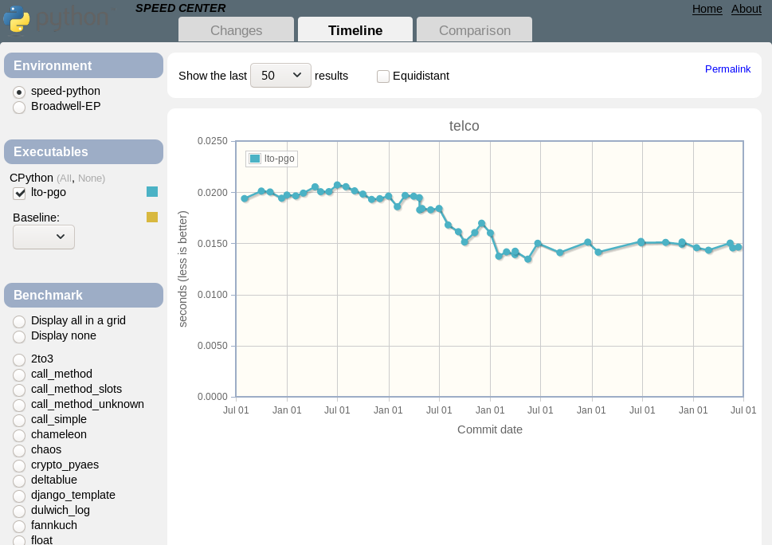
https://speed.python.org
Track CPython performance
Stable benchmarks

Slide 24
Summary
PyPy doesn’t require any code change
C and Rust extensions
Multiprocessing scales
Use Cython, don’t use the C API directly
Numba makes numpy faster

Slide 25

Future

Slide 26
Python C API

Slide 27
Python C API
Evolved organically: internal functions are exported by mistake
First written to be consumed by CPython itself
No design: expose everything
It exposes too many implementation details

Slide 28
Python 3.8 changes
Python 3.8 now has 3 levels of C API:
Include/: public “stable” C API
Include/cpython/: C API specific to CPython
Include/internal/: internal C API
Many private functions (“_Py…”) and PyInterpreterState structure moved to the internal API.

Slide 29
Stable ABI
Support multiple Python versions: Python 3.8, 3.9, …
CPython 3.8 debug build is ABI compatible with the release build
It can use C extensions compiled in release mode
It has much more sanity checks at runtime to detect bugs

Slide 30
Specialized lists
CPython list: array of pointers PyObject*
PyPy specialized list: list of integers int64_t array[n]
Can it be implemented in CPython?
Can we modify PyListObject?

Slide 31
Accessing structs
Problem 1: PyList_GET_ITEM() macro access directly PyListObject.ob_item[index] (PyObject*)
C extensions must not access PyListObject fields directly
PyList_GET_ITEM() macro could be modified to convert int64_t to PyObject*, but...

Slide 32
Borrowed reference
Problem 2: PyList_GET_ITEM() returns a borrowed reference, Py_DECREF() must not be called
If PyList_GET_ITEM() would create a temporary object, when should it be destroyed? We don’t know…
Many C functions return borrowed references

Slide 33
Better C API
Make structures opaque. Such code must fail with a compiler error:
PyObject *obj = PyLong_FromLong(1);
PyTypeObject *type = obj->ob_type;
Remove functions using borrowed references or “stealing” refererences
Replace macros with function calls

Slide 34
Break compatibility?
Any C API change can break an unknown number of projects
Maybe not all C API design issues can be fixed
Updating all C extensions on PyPI will take a lot of time
… there should be another way…

Slide 35
New HPy C API
New C API: correct since day 1
PyHandle: opaque integer
Similar to an Unix file descriptor or Windows HANDLE:
open(), dup(), close()

Slide 36
New PyHandle C API
CPython: Implemented on top of the current C API
PyPy: More efficient than the current C API
Cython: no need to change your code, Cython will generate code using PyHandle for you

Slide 37
Reference counting

Slide 38
Gilectomy
“Remove the GIL”: replace unique GIL with one lock per mutable object
Atomic increment/decrement
Log INCREF/DECREF
Reference counting doesn’t scale with the number of threads

Slide 39
Tracing GC for CPython
Many modern language implementations use tracing GC
PyPy has a tracing GC
Existing C API would continue to use reference counting

Slide 40
Subinterpreters

Slide 41
Subinterpreters
Eric Snow’s PEP 554 “Multiple Interpreters in the Stdlib”
Replace the unique Global Interpreter Lock (GIL) with one lock per interpreter
Work-in-progress refactoring of CPython complex internals

Slide 42
CPython GIL

Slide 43
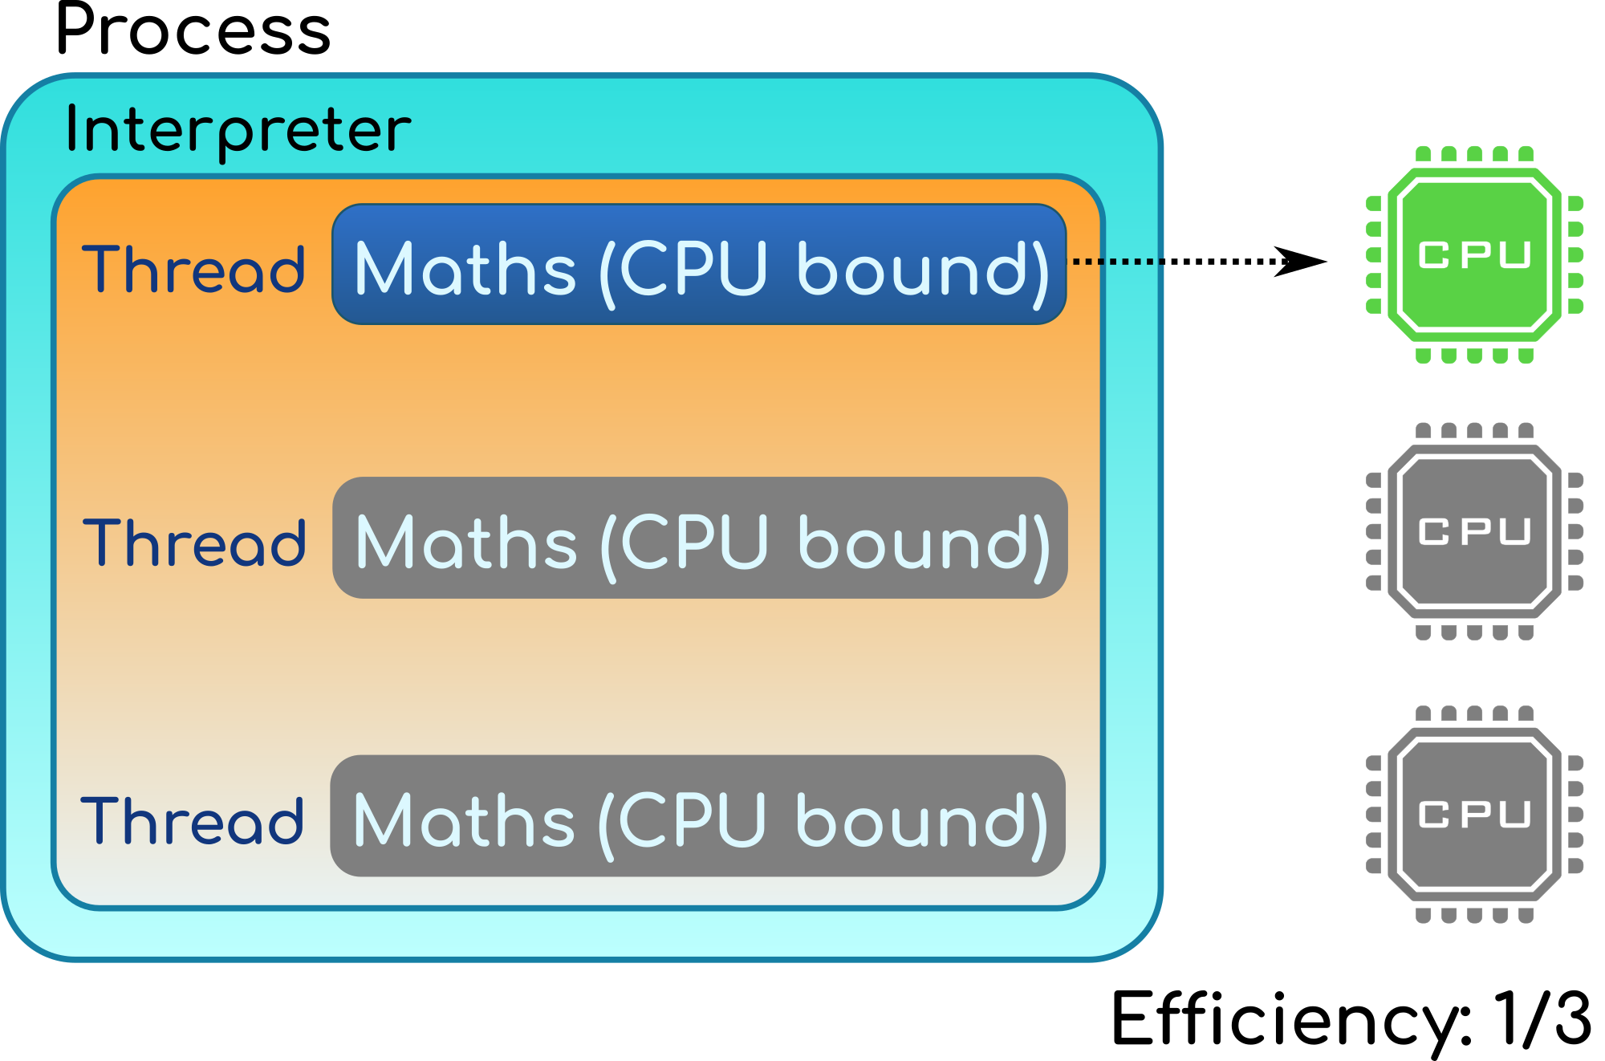
CPython GIL

Slide 44
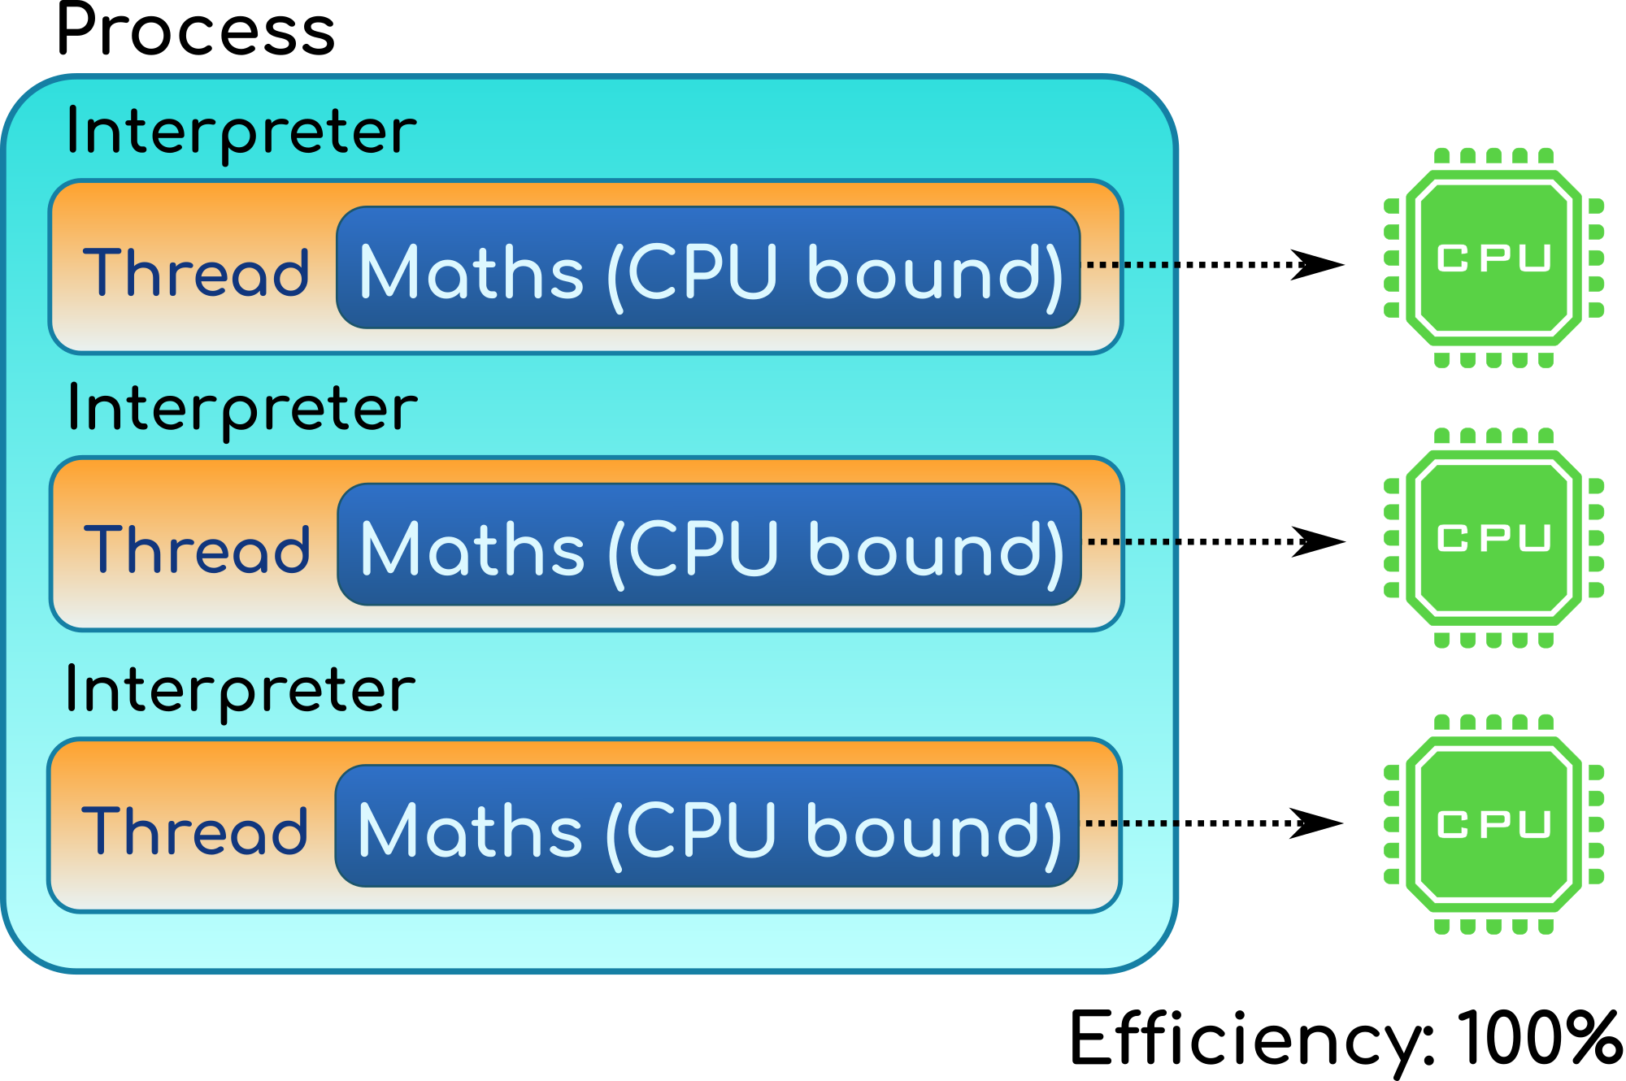
CPython subinterpreters

Slide 45
Subinterpreters
Expectation (should be verified with a working implementation):
Lower memory footprint: share more memory
Faster locks (no syscall?)
Limitation: Python objects cannot be shared between interpreters

Slide 46
Summary
Current C API has design issues
New “PyHandle” C API
Tracing garbage collector for CPython
CPython subinterpreters

Slide 47

Conclusion

Slide 48
Conclusion
Many previous optimizations projects failed
Cython, multiprocessing and Numba are working well to make your code faster
HPy, tracing GC and subinterpreters are very promising!

Slide 49
Questions?
http://pypy.org/
https://faster-cpython.readthedocs.io/
https://pythoncapi.readthedocs.io/
https://speed.python.org/
https://mail.python.org/mailman3/lists/speed.python.org/
https://github.com/hpyproject/hpy

