Slide 1


Discover asyncio
event loop
Pycon 2014, Lyon
Victor Stinner
victor.stinner@gmail.com
Distributed under CC BY-SA license: http://creativecommons.org/licenses/by-sa/3.0/

Slide 2

Victor Stinner
Python core developer since 2010
github.com/haypo/
bitbucket.org/haypo/
Working for eNovance

Slide 3
Disclamer
How asyncio is implemented
Simplified code snippets close to asyncio, but different
No error handling nor optimization
(asyncio handles errors and is optimized)

Slide 4
Agenda
Callbacks
Timers
Selectors
Generator
Coroutine and BaseTask
Future and Task

Slide 5
Callbacks
class CallbackEventLoop:
def __init__(self):
self.callbacks = []
def call_soon(self, func):
self.callbacks.append(func)
def execute_callbacks(self):
callbacks = self.callbacks
self.callbacks = []
for cb in callbacks:
cb()

Slide 6
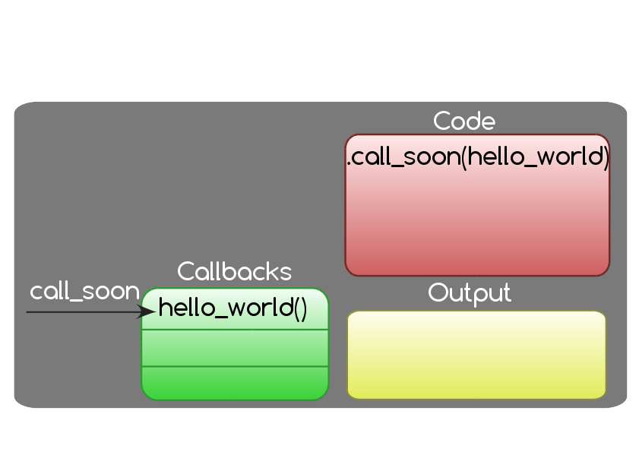
Callbacks

Slide 7
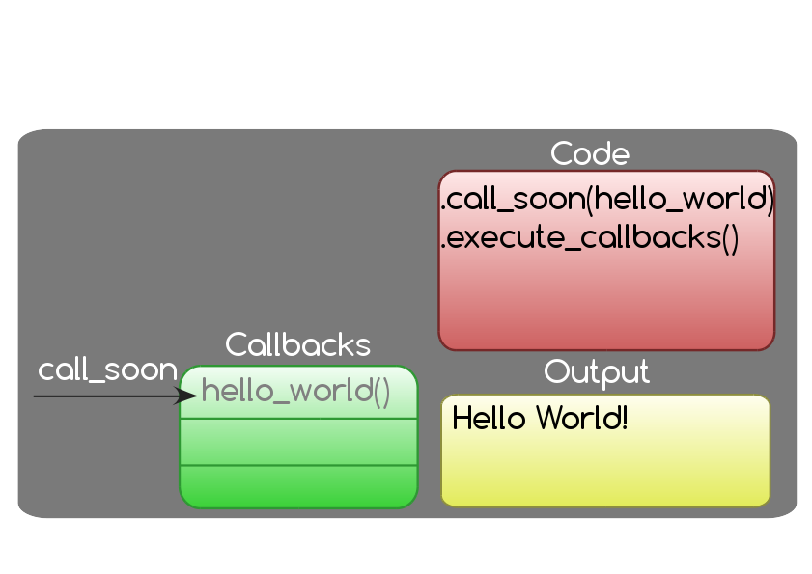
Callbacks

Slide 8
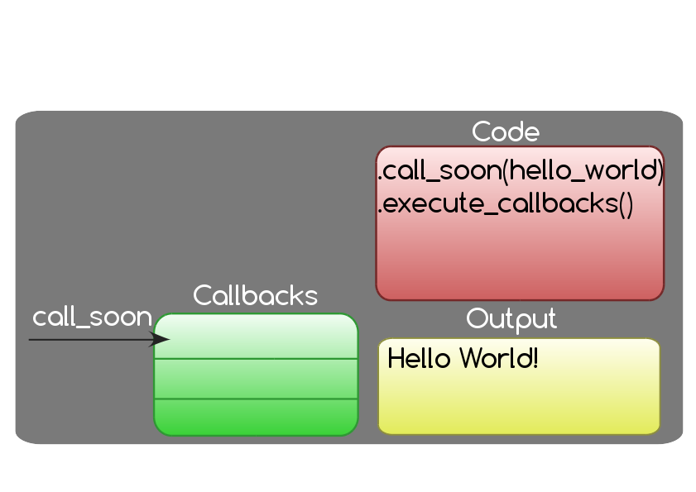
Callbacks

Slide 9
Timers
class TimerEventLoop(CallbackEventLoop):
def __init__(self):
super().__init__()
self.timers = []
def call_at(self, when, func):
timer = (when, func)
self.timers.append(timer)
...

Slide 10
Timers
class TimerEventLoop(CallbackEventLoop):
...
def execute_timers(self):
now = time.time()
new_timers = []
for when, func in self.timers:
if when <= now:
self.call_soon(func)
else:
new_timers.append((when, func))
self.timers = new_timers
self.execute_callback()

Slide 11
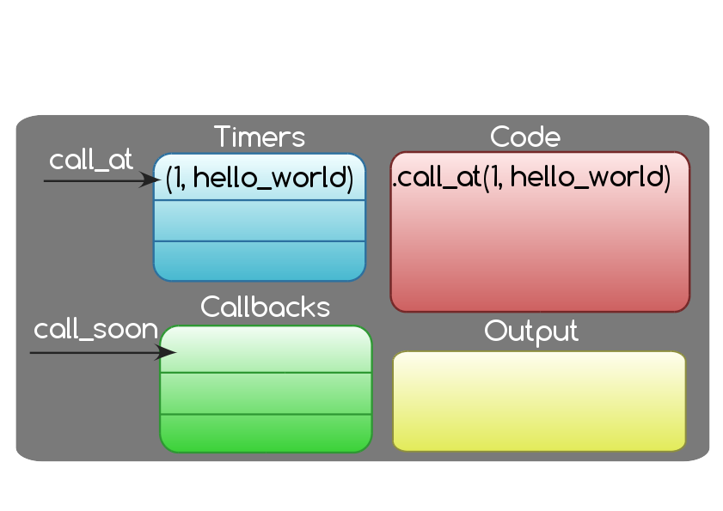
Timers

Slide 12
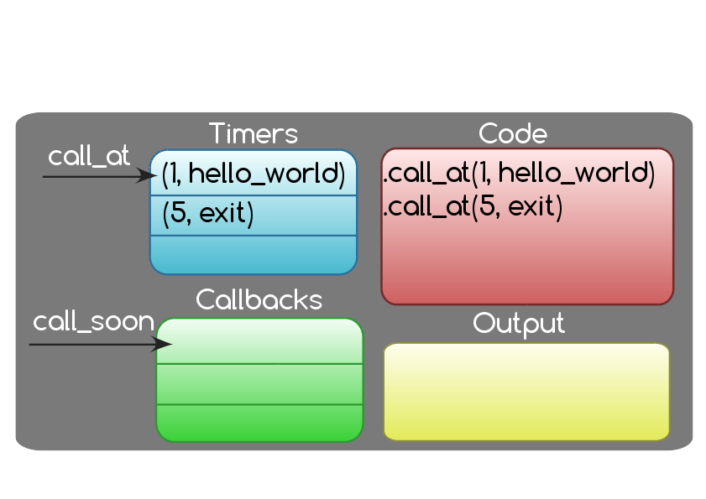
Timers

Slide 13
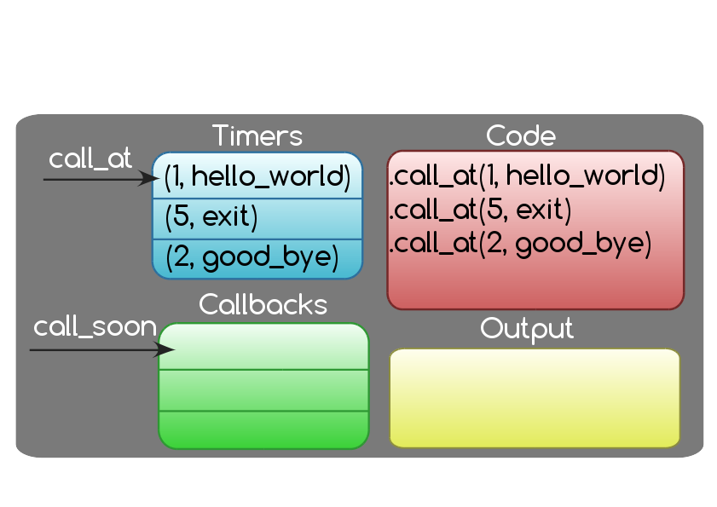
Timers

Slide 14
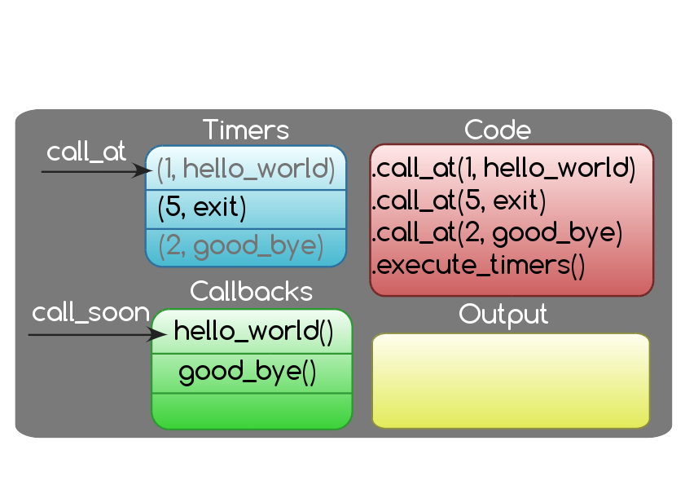
Timers

Slide 15
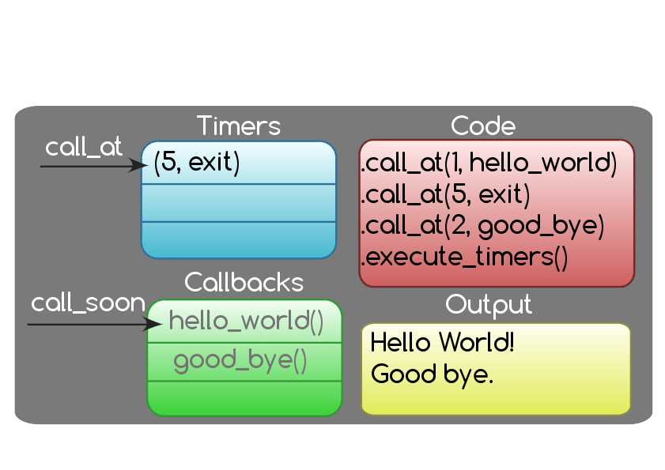
Timers

Slide 16
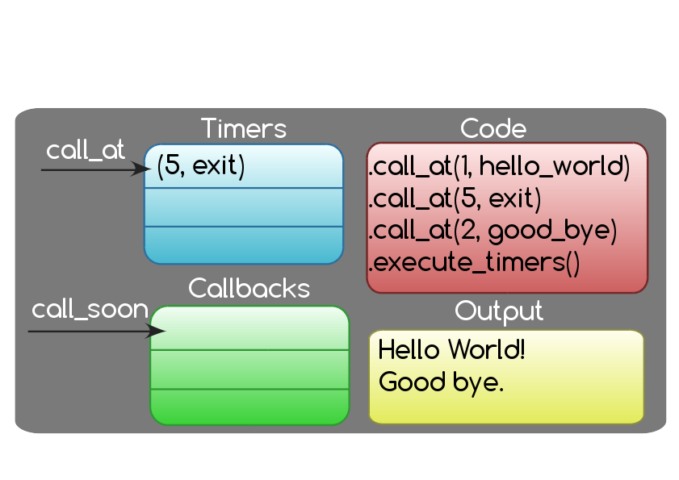
Timers

Slide 17
Selector
class SelectorEventLoop(TimerEventLoop):
def __init__(self):
super().__init__()
self.selector = selectors.Selector()
def add_reader(self, sock, func):
self.selector.register(sock,
selectors.EVENT_READ, func)
...

Slide 18
Selector
class SelectorEventLoop(TimerEventLoop):
...
def select(self):
timeout = self.compute_timeout()
events = self.selector.select(timeout)
for key, mask in events:
func = key.data
self.call_soon(func, key.fileobj)
self.execute_timers()

Slide 19
Selector
class SelectorEventLoop(TimerEventLoop):
...
def compute_timeout(self):
if self.callbacks:
# already something to do
return 0
elif self.timers:
next_timer = min(self.timers)[0]
timeout = next_timer - time.time()
return max(timeout, 0.0)
else:
# blocking call
return None

Slide 20
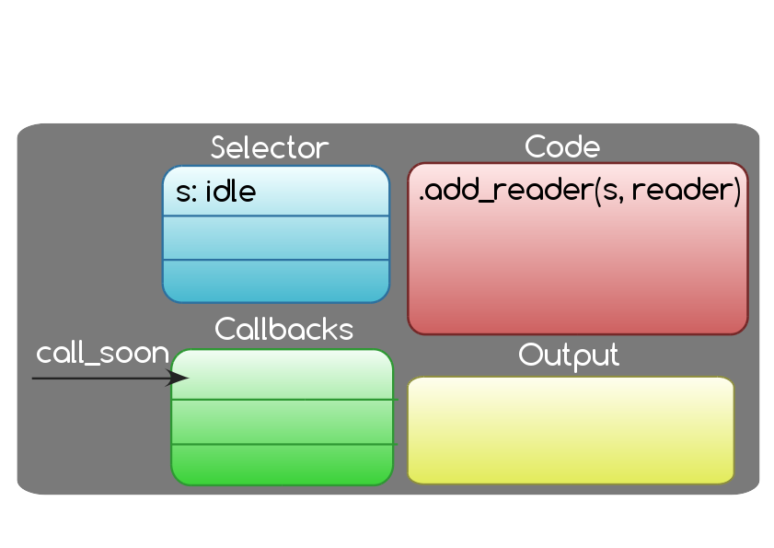
Selector

Slide 21
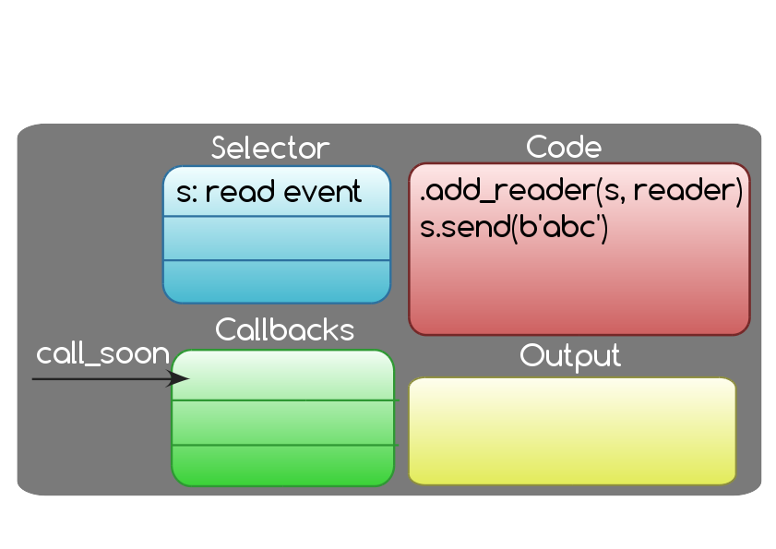
Selector

Slide 22
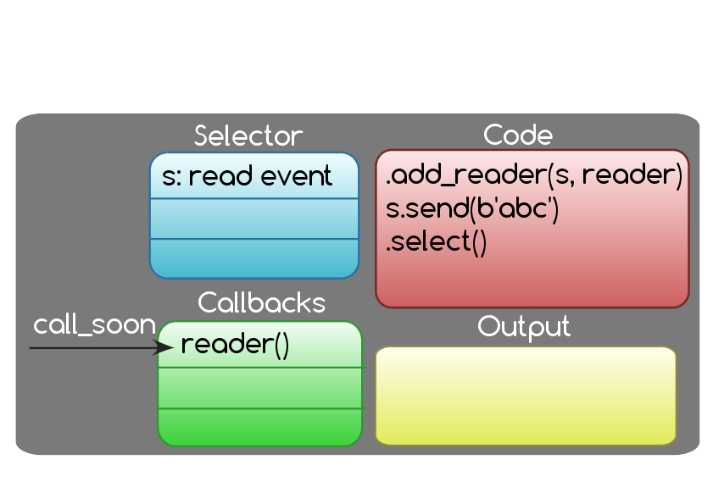
Selector

Slide 23
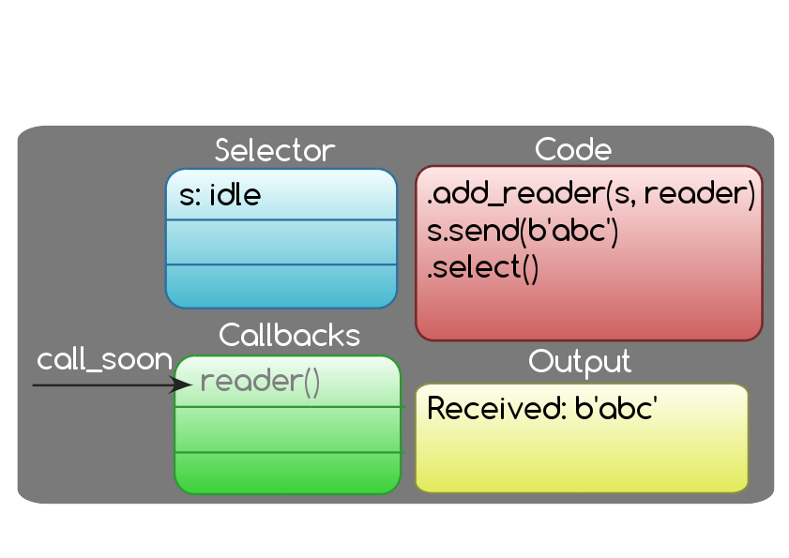
Selector

Slide 24
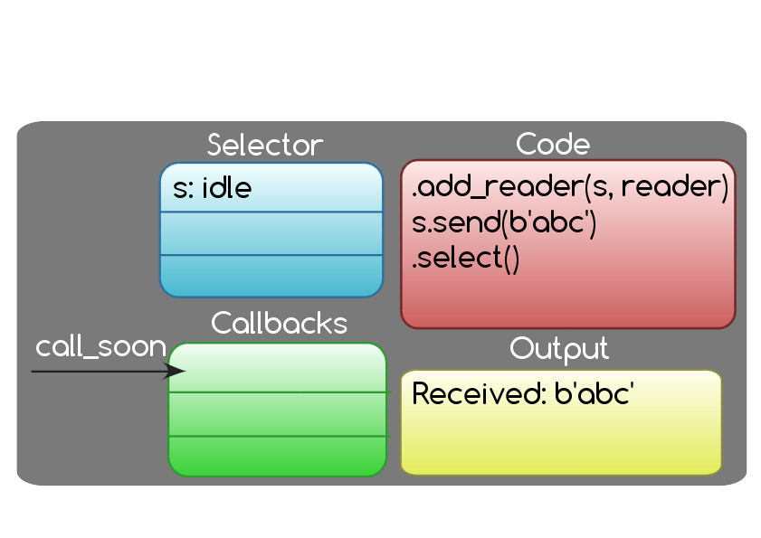
Selector

Slide 25
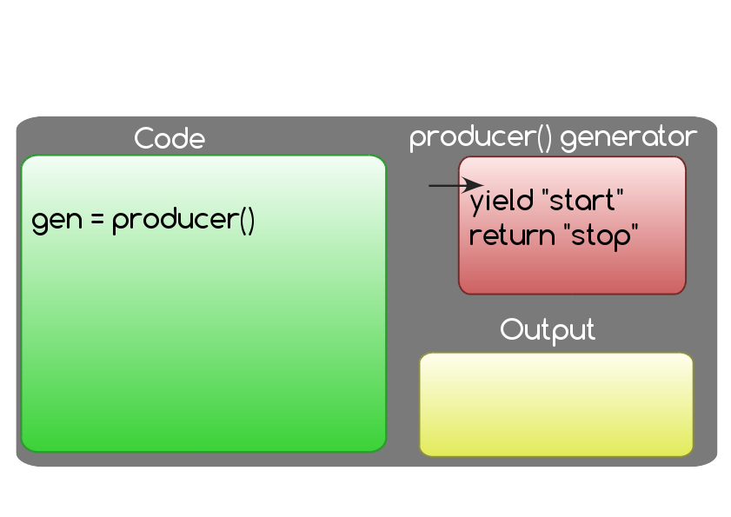
Generator

Slide 26
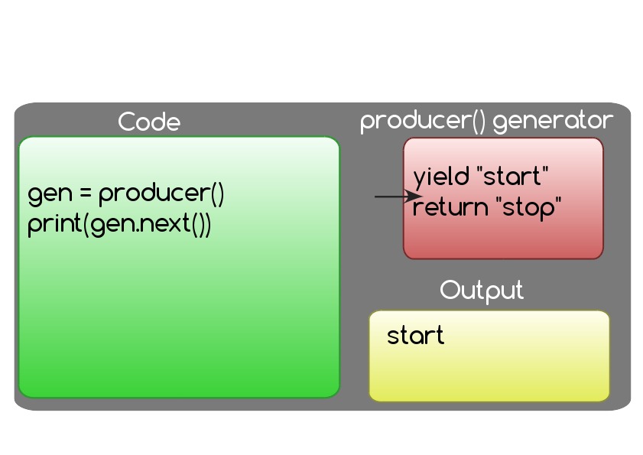
Generator

Slide 27
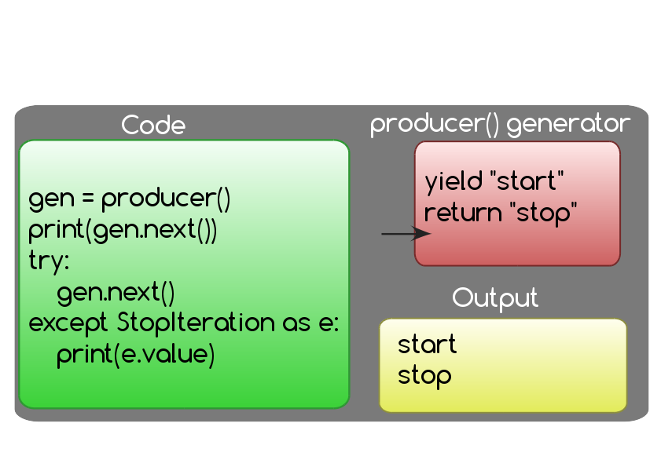
Generator

Slide 28
Coroutine
@asyncio.coroutine
def my_coroutine(future):
res = yield from future
return res

Slide 29
BaseTask
class BaseTask:
def __init__(self, coro):
self.coro = coro
def step(self):
try:
next(self.coro)
except StopIteration:
pass

Slide 30
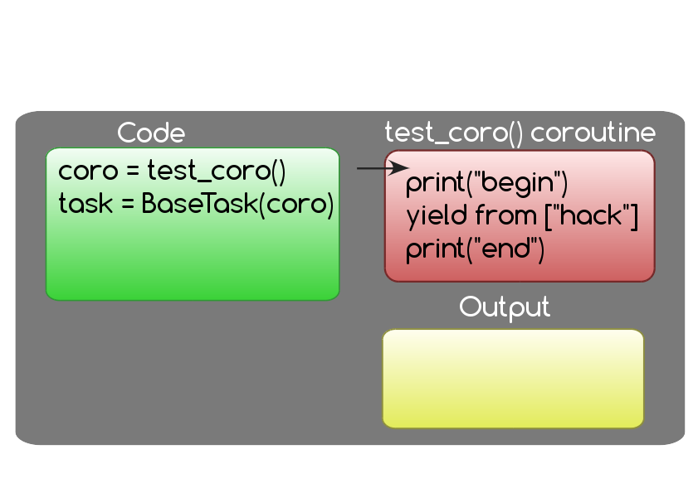
BaseTask

Slide 31
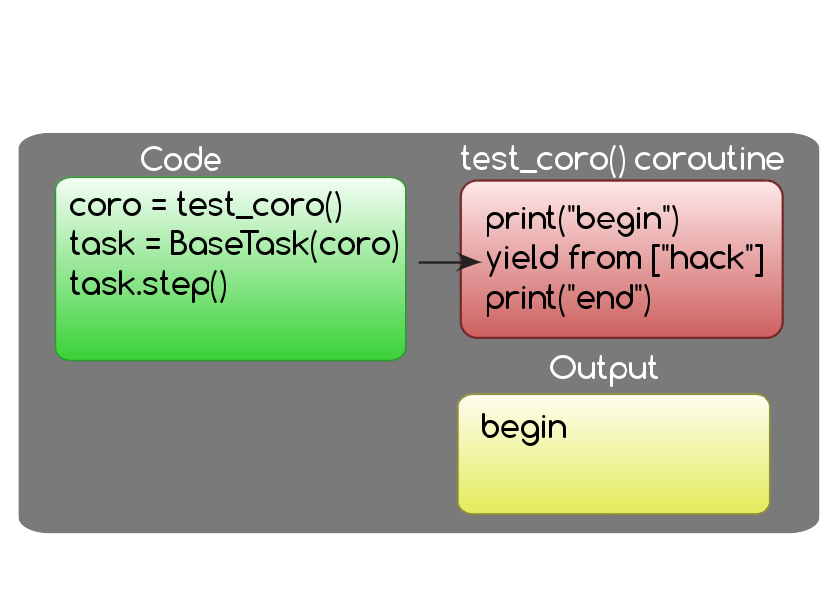
BaseTask

Slide 32
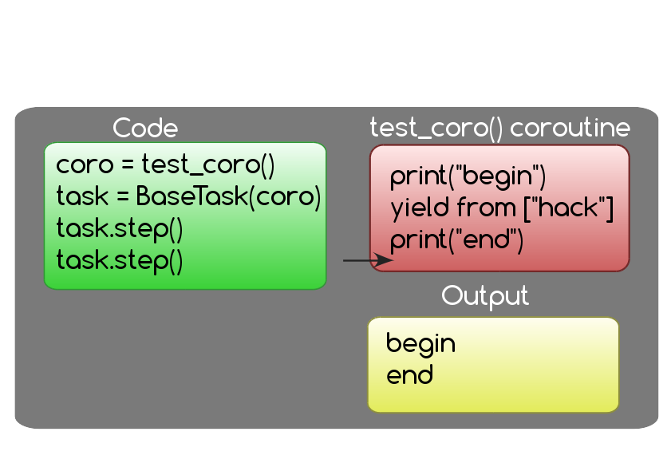
BaseTask

Slide 33
Future
class Future:
def __init__(self, loop):
self.loop = loop
self.callbacks = []
self._result = None
def add_done_callback(self, func):
self.callbacks.append(func)
def result(self):
return self._result
...

Slide 34
Future
class Future:
...
def set_result(self, result):
self._result = result
for func in self.callbacks:
self.loop.call_soon(func, self)
def __iter__(self):
# “yield from future” yields future
yield self

Slide 35
Task
class Task:
def __init__(self, coro, loop):
self.coro = coro
loop.call_soon(self.step)
...

Slide 36
Task
class Task:
...
def step(self):
try:
result = next(self.coro)
except StopIteration:
pass
else:
if isinstance(result, Future):
result.add_done_callback(
self.step)

Slide 37
Questions?
http://docs.python.org/dev/library/asyncio.html http://github.com/haypo/ http://bitbucket.org/haypo/
Victor Stinner victor.stinner@gmail.com

Slide 38
Thanks David Malcom for the LibreOffice model
http://dmalcolm.livejournal.com/

