Slide 1
Slide about Lector

Slide 2
Effective AI (or what can I do)
Chat with AI
Can be:
- Using custom designed interface with different API (OpenAI, Gemini, Groq)
- Locally running on your PC
- Using prompt (if needed)

Slide 3
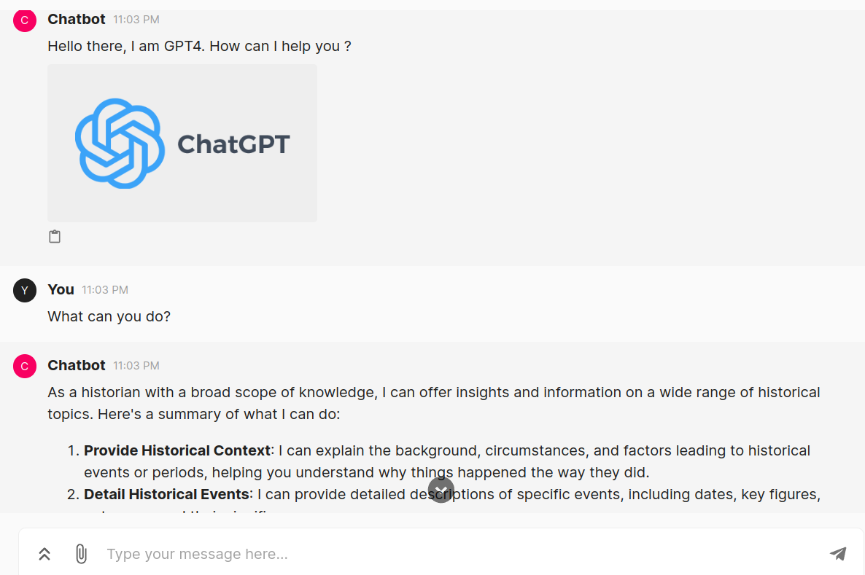
User Interface with AI API
Langchain & ChainLit & GPT4
It`s the GPT4 but in your custom interface

Slide 4
User Interface with AI API
Langchain & ChainLit & GPT4
Rag
Chat with our documents using GPT4 power!

Slide 5
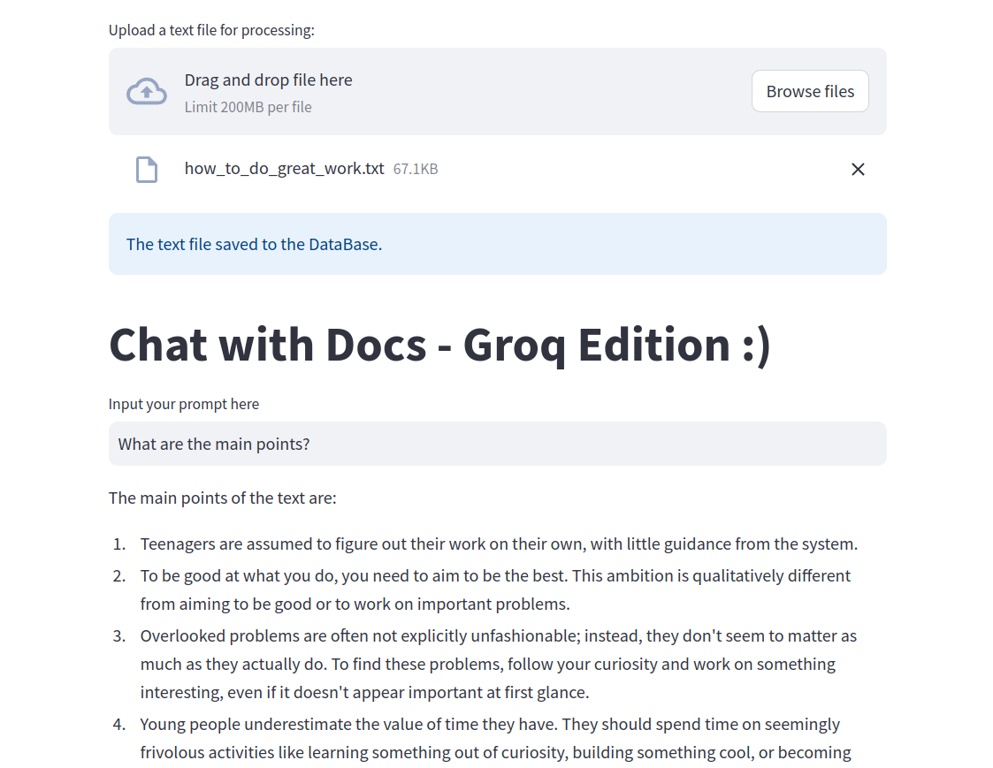
User Interface with AI API
Groq & Langchain &
Rag
Chat with our documents using Groq free API!

Slide 6
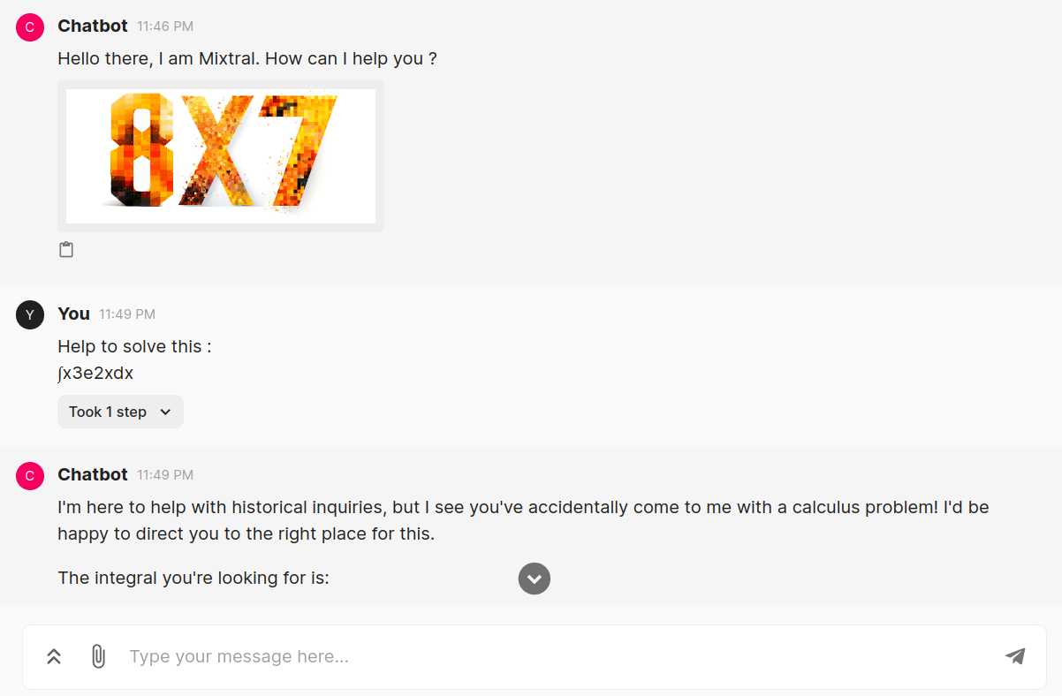
User Interface with Local AI
Langchain & ChainLit & Mixtral
Powerful local Mixtral will help to solve your tasks!

Slide 7
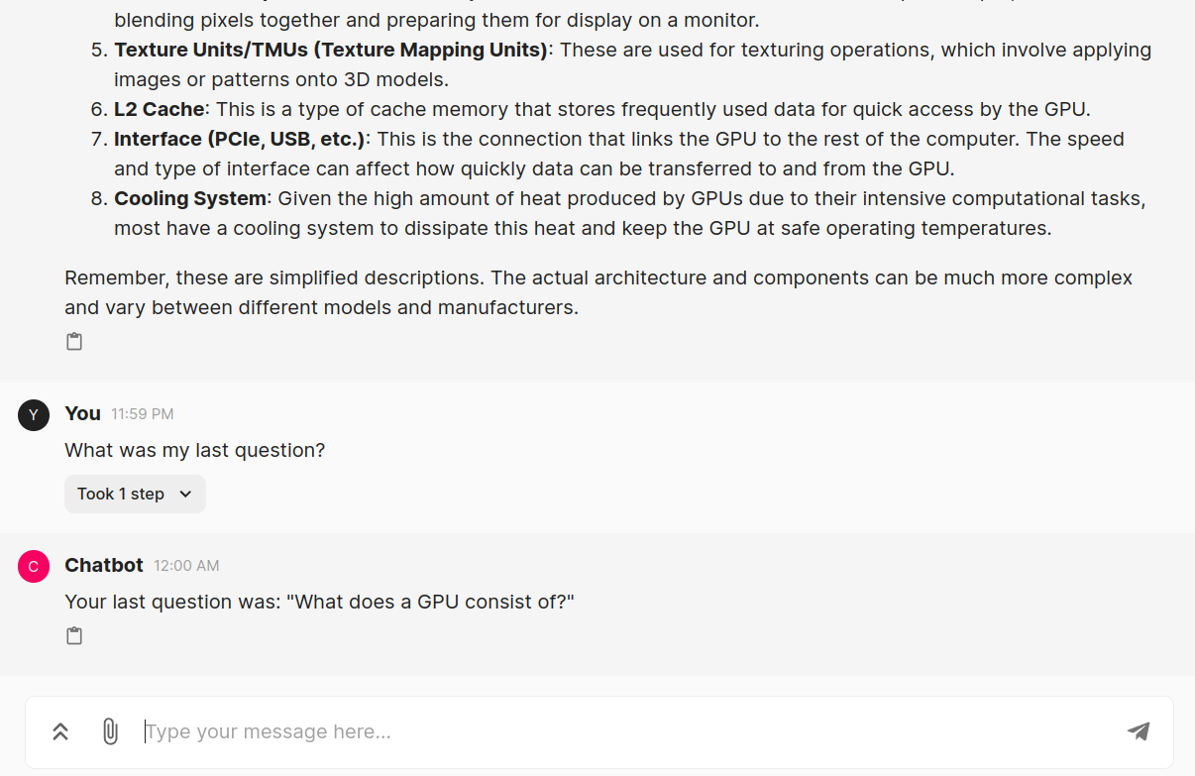
User Interface with Local AI
Langchain & ChainLit & Mixtral & Memory
Local Mixtral that remembers your chat history!

Slide 8
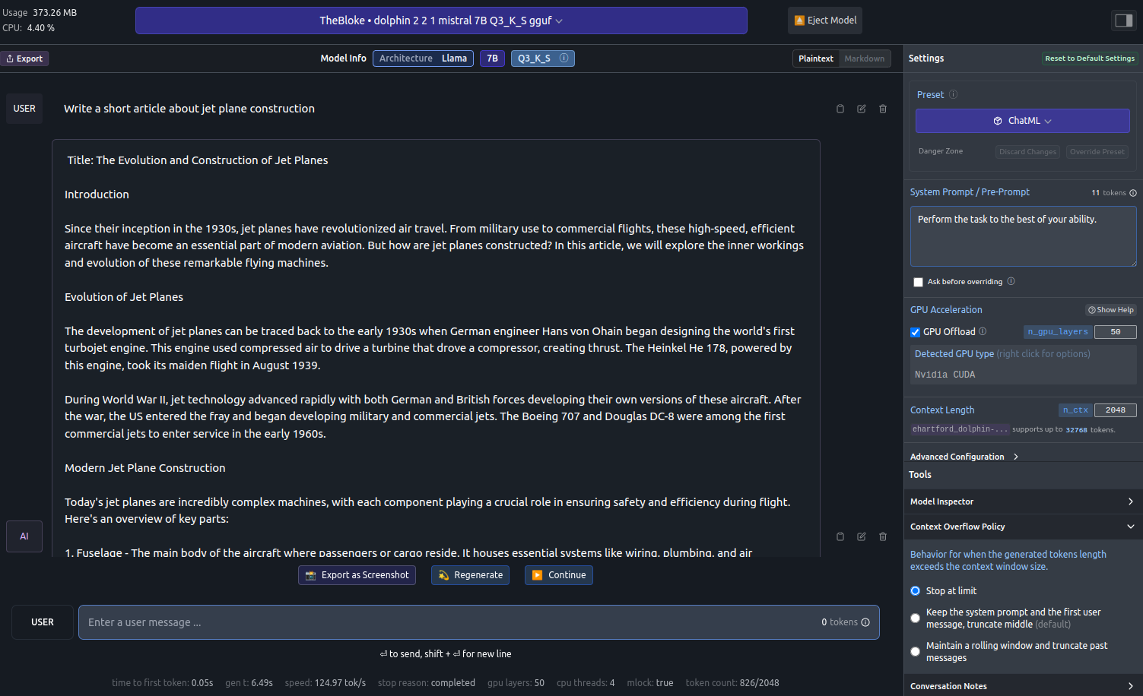
User Interface with Local AI
LM Studio

Slide 9
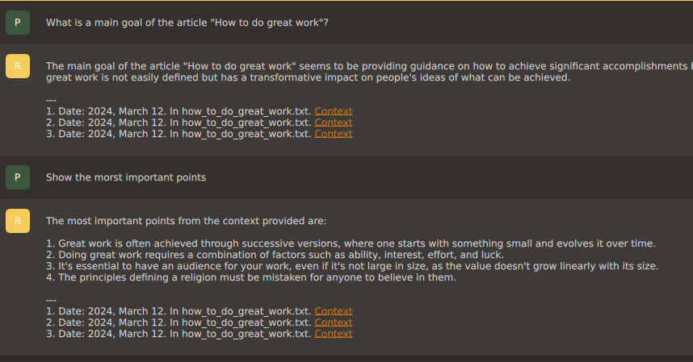
User Interface with Local AI
GPT4ALL & RAG
Chat with your files easelly!

Slide 10
Multi-agent AI using API
Multi-agent chatbot based on GPT4 can do much more effective work than just model.
For example write a very good article using google search

