Slide 1
Reading With Your Eyes
Ashkan Bozorgzad, Kyle Diederich, Suhas Kumar, Ziqi Su

Slide 2
Problem Formulation
Description:
Develop techniques to convert eye the tracking into the precision text detecting during the reading for children
Input:
An environment contains the picture and texts
User who wants detect text
Eye tracker
Output:
Highlighted text
Voice of the detected word

Slide 3
Problem Formulation
Technical Challenges:
How detect eyes continuously and constantly
The best way of detecting object (Text)
The limitation of the Tobii eye engine

Slide 4
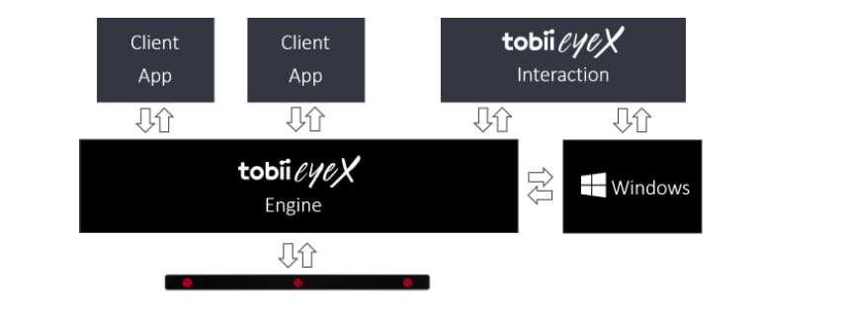

tobii eyeX Programming
Build application atop tobii eyeX Engine
Engine API provides only link between 3 systems:
Windows OS
App
Device

Slide 5
Gaze-Aware Behavior
Set of interactable objects
Launch events on boundary cross
Apply delay time
Control for rapid, random eye movements
Focus until activation
Manually delay adjustment
Provide focus points:
Visual hotspot: captions, buttons, etc.
Sufficiently spacing for visual elements
Clear, unobtrusive visual feedback

Slide 6
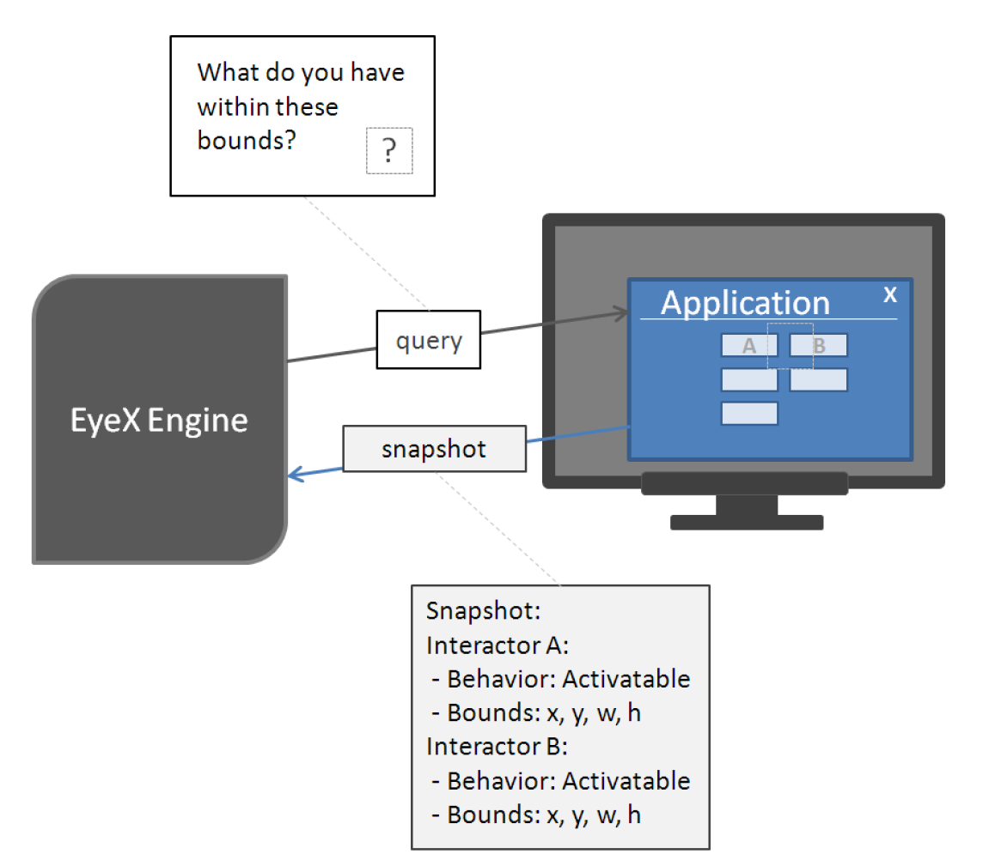
The Query Snapshot Cycle
Interactor manipulation method
Requires both keyboard and gaze in conjunction
Process:
Press key to activate snapshot
EyeX Engine queries screen
Snapshot returned to Engine
Engine translates to meaning information
Info passed to application

Slide 7
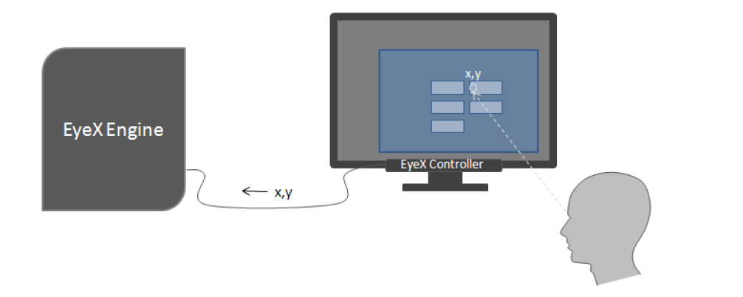
Control Flow of Application
User gaze at screen
EyeX Controller sends gaze location to EyeX Engine
EyeX Engine interacts client app to determine type of gaze target
Perform required actions if necessary

Slide 8
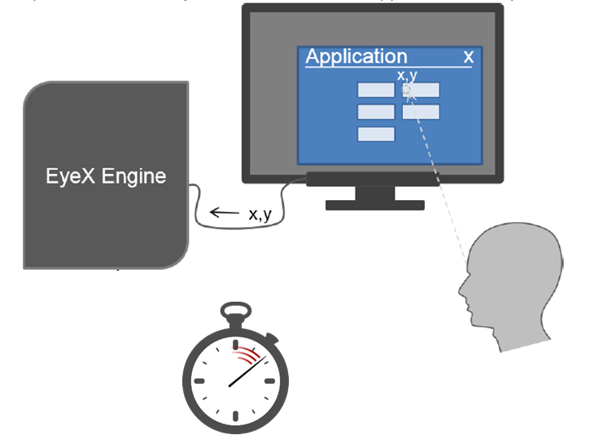
Control Flow of Application
Interactor boundary crossed spawns timer
Text: short timer
Button: long time
Timer match for button/text
Text: highlight and play sound
Button: manipulate story
Timer start
Timer up

Slide 9
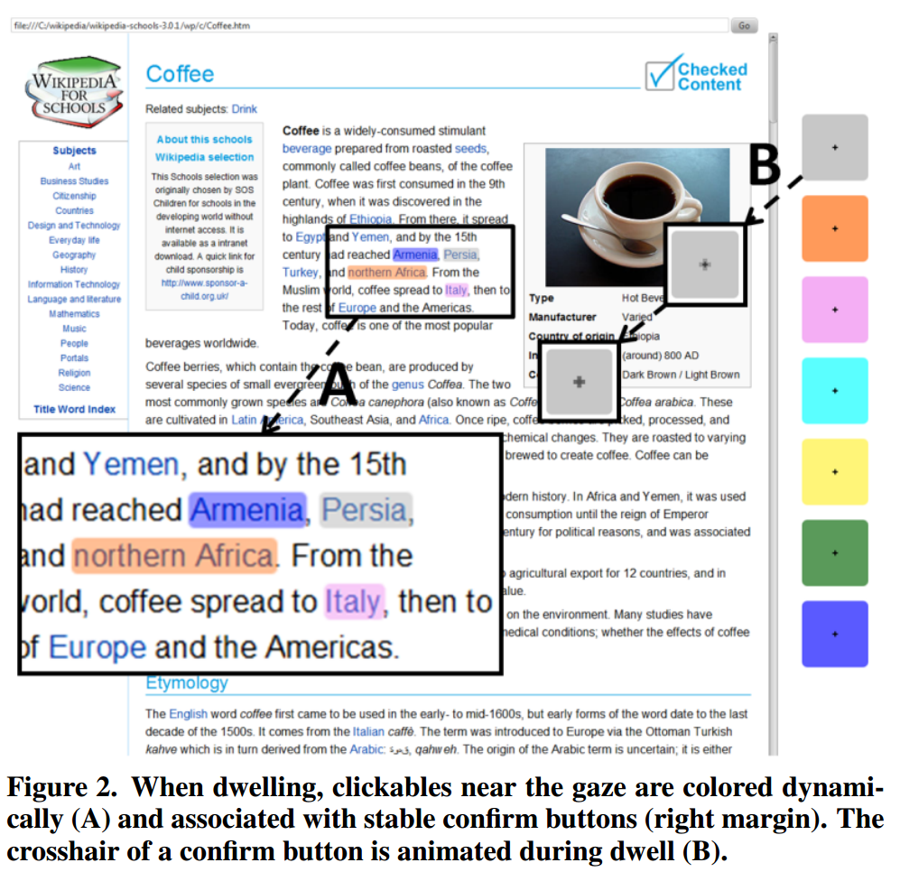
Gaze vs. Mouse
Gaze: quick and natural
Can be slow and error prone
Intended v. unintended gaze
actigaze
Color and confirm interactors
Algorithm highlights potential links
Link rich environment
Hands-free browsing
Lutteroth et al. 2015

Slide 10
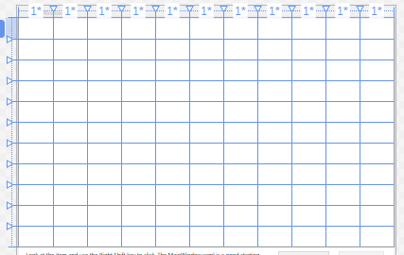
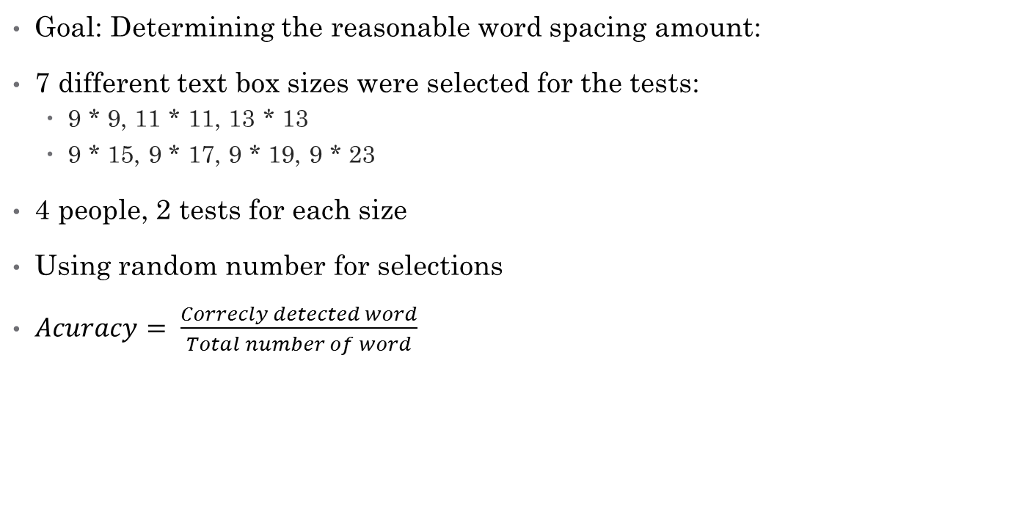
Experimentation for the Textbox Size
Goal: Determining the reasonable word spacing amount:
7 different text box sizes were selected for the tests:
9 * 9, 11 * 11, 13 * 13
9 * 15, 9 * 17, 9 * 19, 9 * 23
4 people, 2 tests for each size
Using random number for selections
$Acuracy= \frac{Correcly detected word}{Total number of word}$
11 * 11 grid line

Slide 11
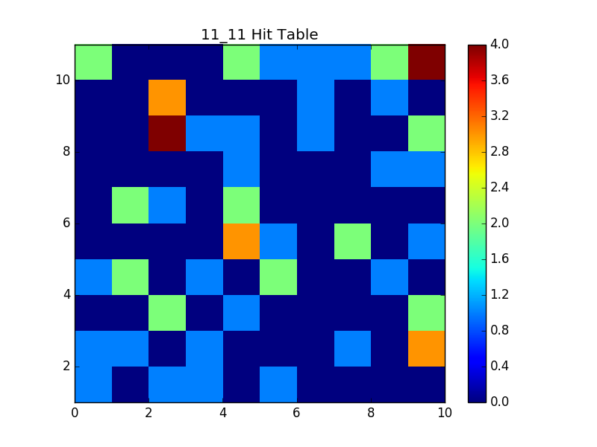
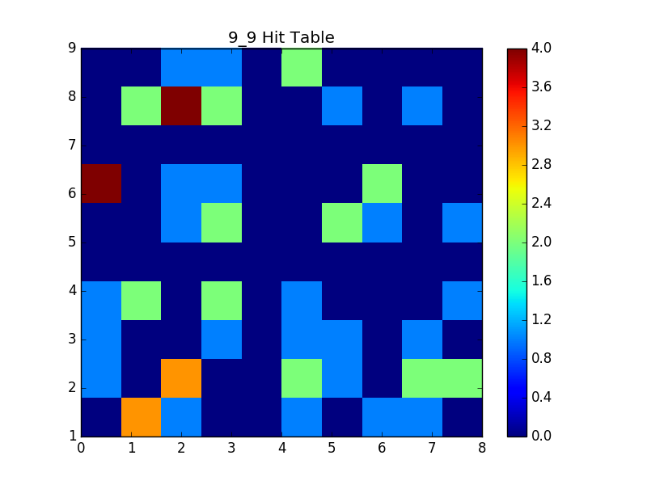
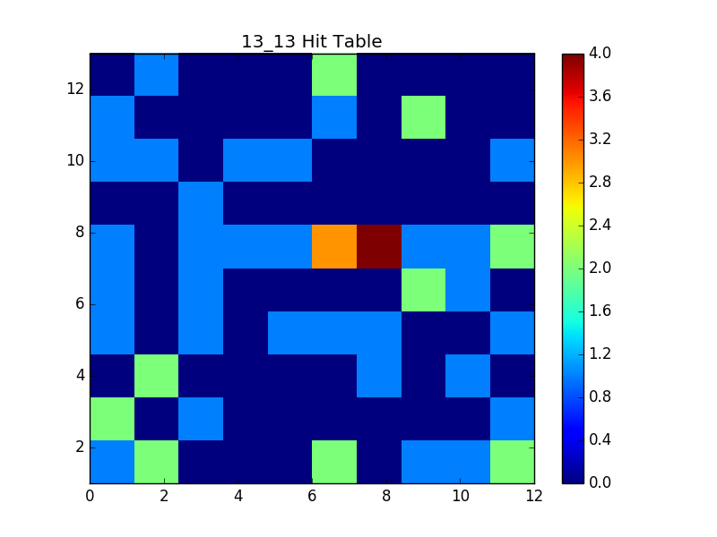
Hit Table

Slide 12
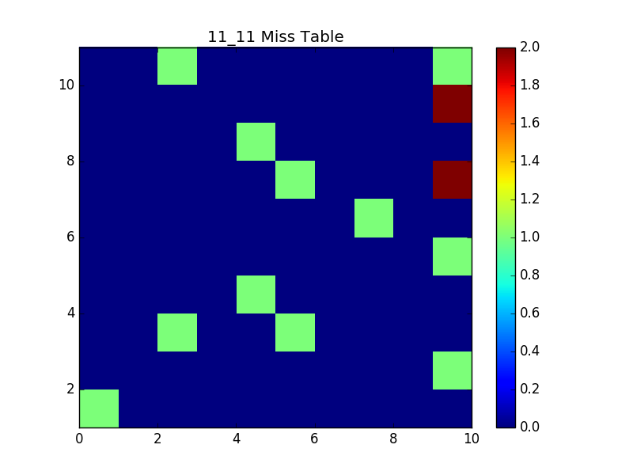
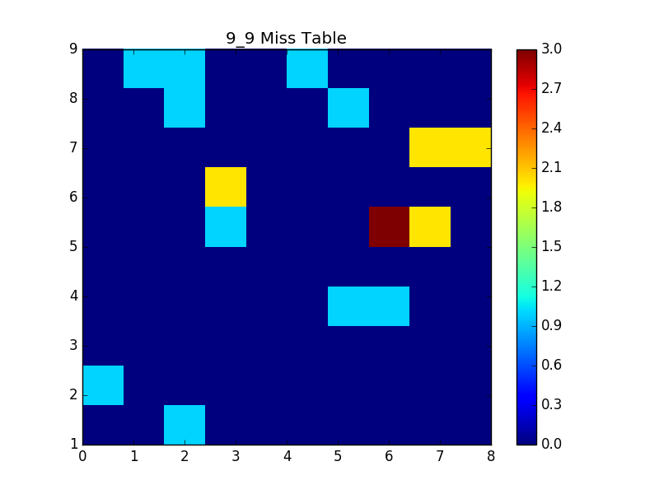
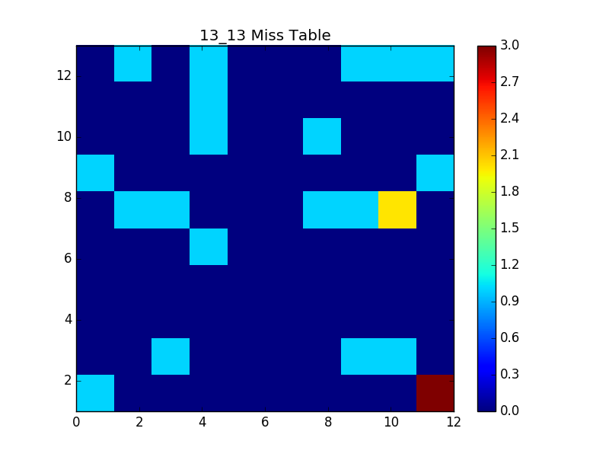
Miss Table

Slide 13
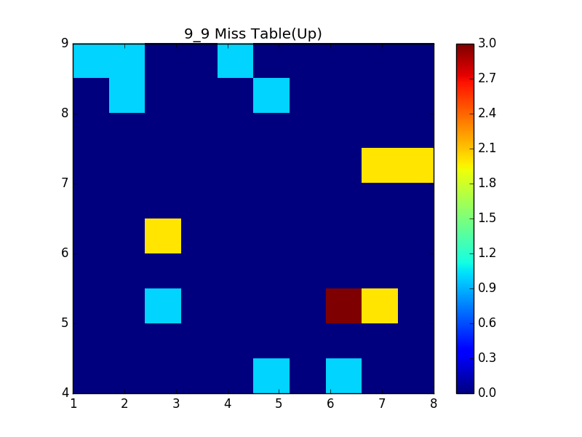
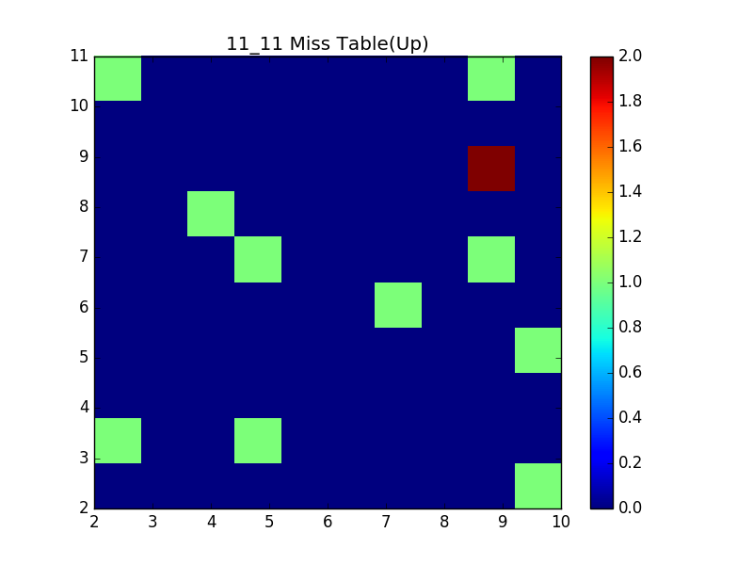
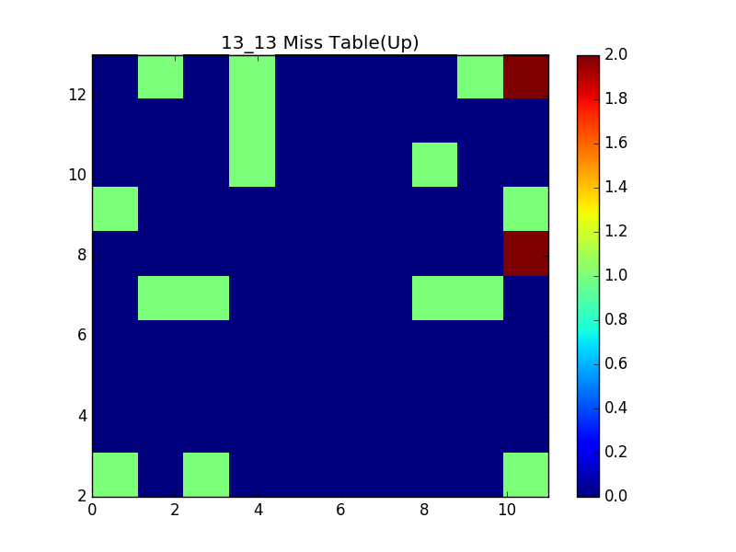
Miss Table Comparison

Slide 14
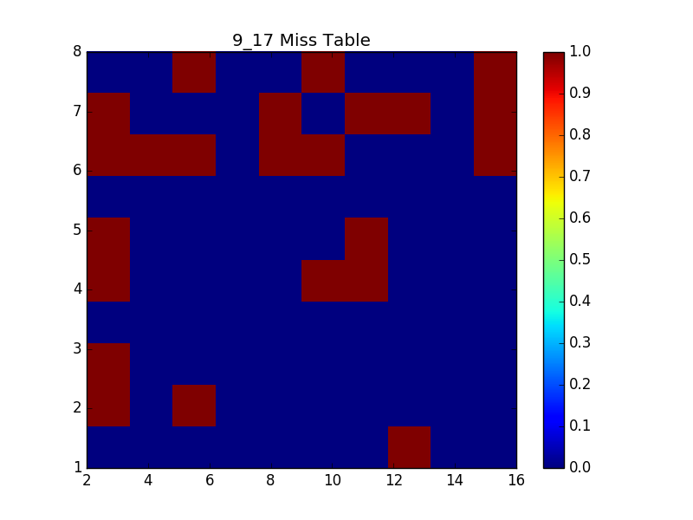
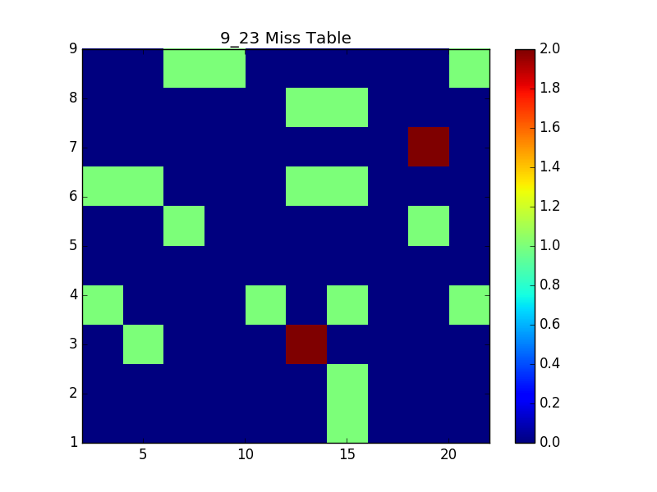
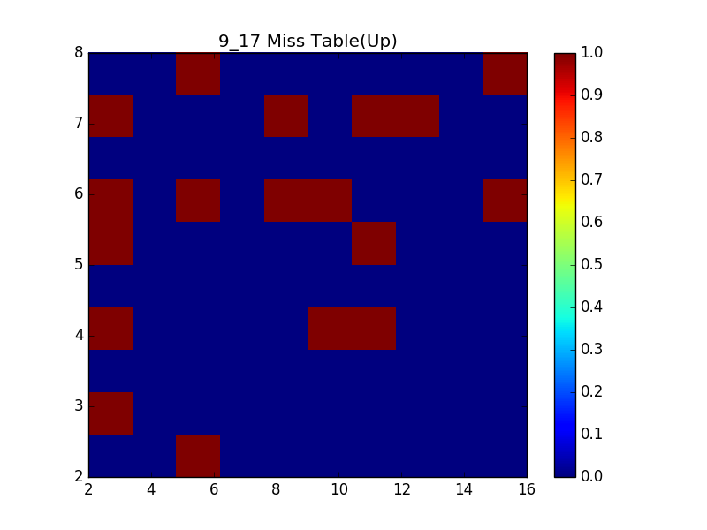
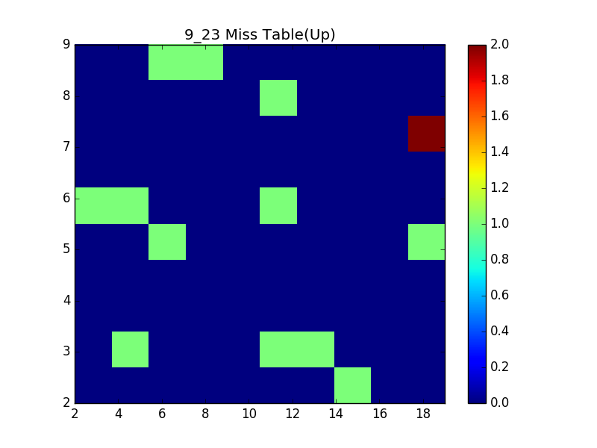
Miss Table

Slide 15
Experimentation for the Textbox Size

Slide 16
Experimentation for the Textbox Size
The reasons of result variability
User learning process during the tests
High sensitivity of the calibration process
Limited number of the experiments
People with individual differences:
Glasses
Contact lenses
Eye shapes

Slide 17
Experiment for the Delay Amounts
Goal: Determine reasonable delay
Delay governs when text is activated
Setup various amounts of manual delay:
Delay in milliseconds: 200, 300, 400, 450, 500, 600
Participants rate user experience on Likert Scale of 1 to 5
Require participants to provide feedback explaining choice
Choose average amount as acceptable delay

Slide 18
Experiment for the Delay Amounts

Slide 19
Experiment for the Delay Amounts

Slide 20
Demo
Story
Gaze Only
What you will observe in the Story ?
MAGIC
Text highlight
Sound production
Gaze navigation

Slide 21
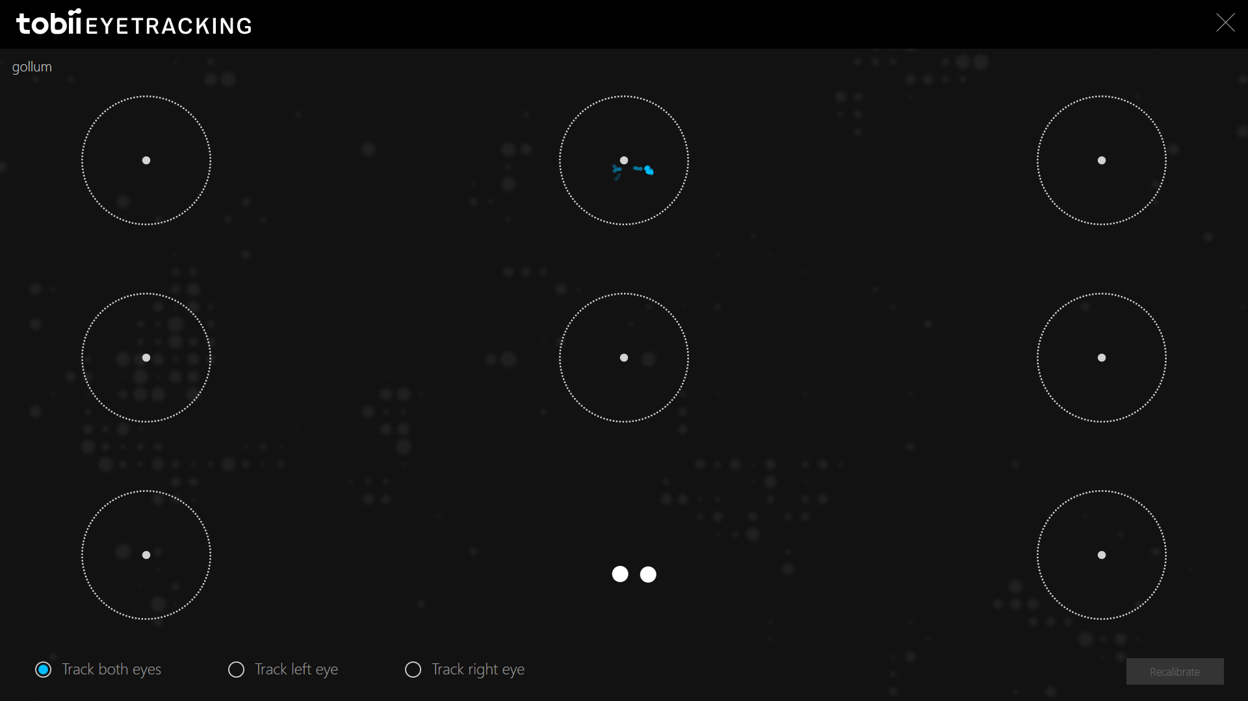
Demo
First Thing to do - Calibration

Slide 22
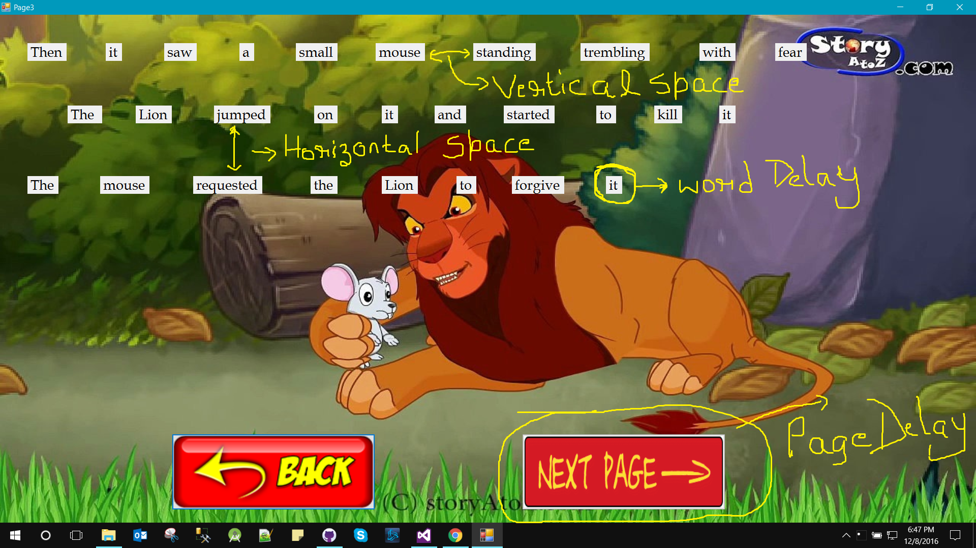
Demo
1. Vertical Space 3. Word Delay
2. Horizontal Space 4. Page Delay

Slide 23
References
Evans, M. A., & Saint-Aubin, J. (2005). What children are looking at during shared storybook reading evidence from eye movement monitoring. Psychological Science, 16(11), 913-920.
Eye Tracking. https://www.usability.gov/how-to-and-tools/methods/eye-tracking.html. (Retrieved Nov 11).
Lutteroth, C., Penkar, M., & Weber, G. (2015, November). Gaze vs. Mouse: A Fast and Accurate Gaze-Only Click Alternative. In Proceedings of the 28th Annual ACM Symposium on User Interface Software & Technology (pp. 385-394). ACM.

