Slide 1
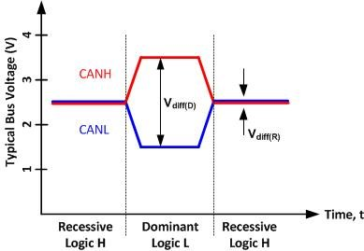
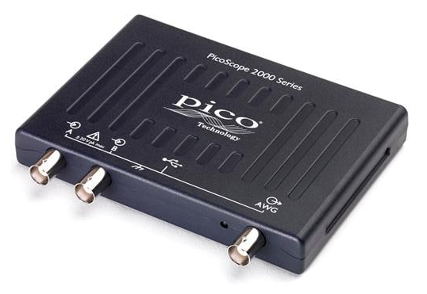
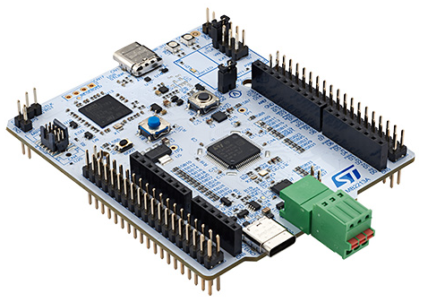
CANH
CANL

Slide 2
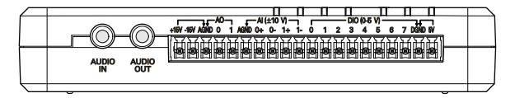
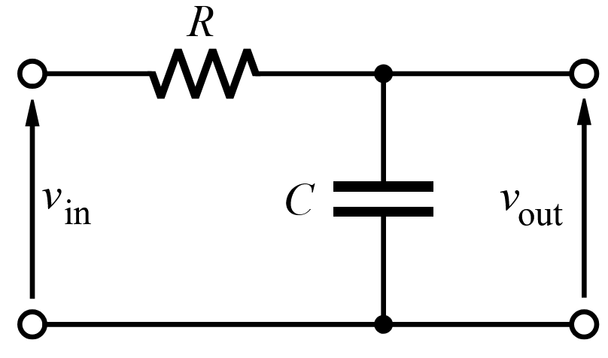
AI0 channel
AI1 channel
AO0

Slide 3
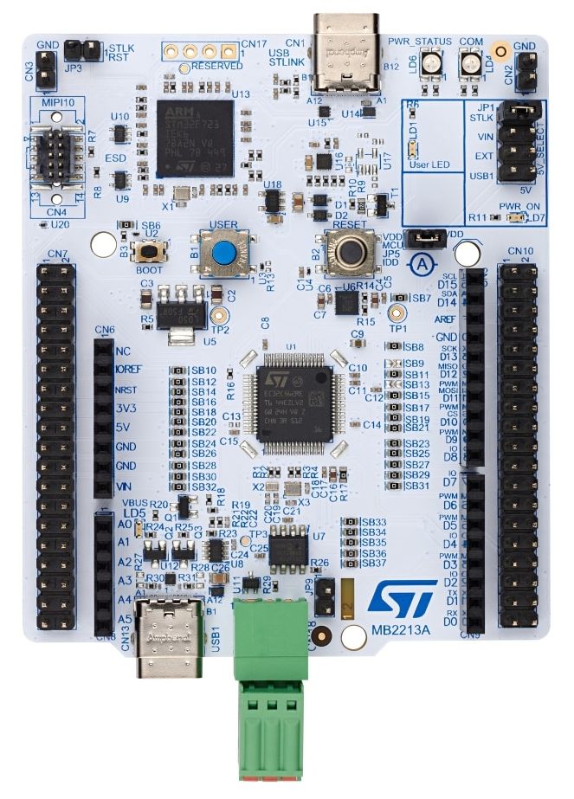
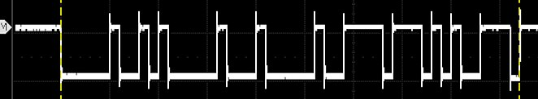
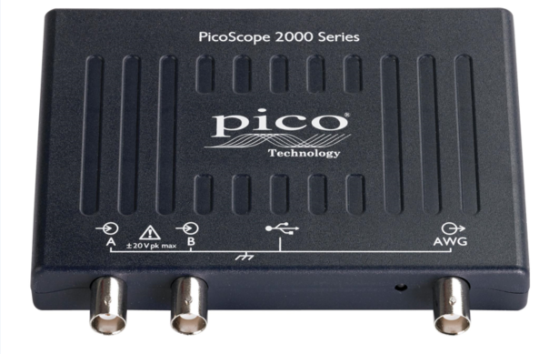
Stimulator
DUT
CANH
CANL

Slide 4
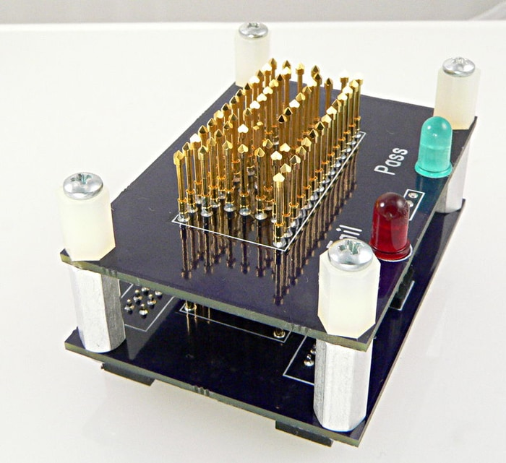
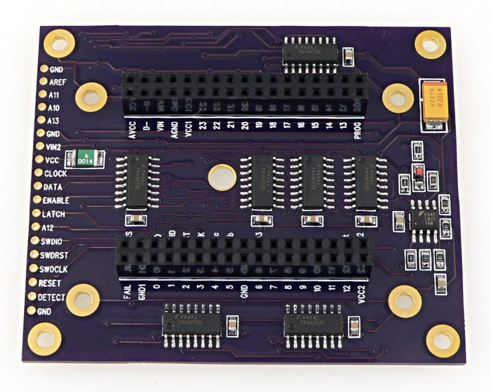
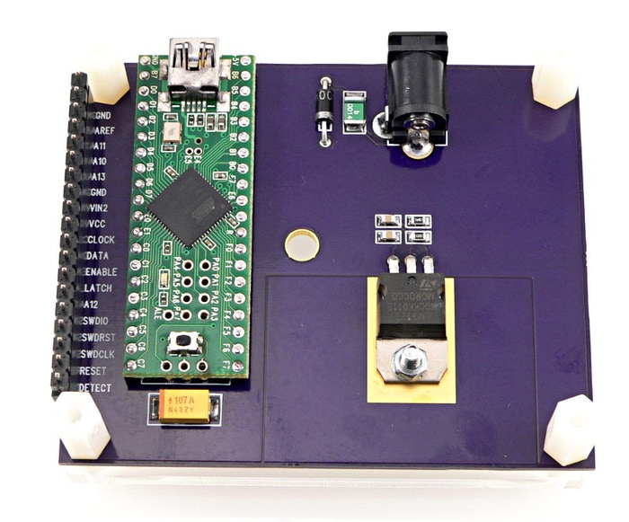

Slide 5
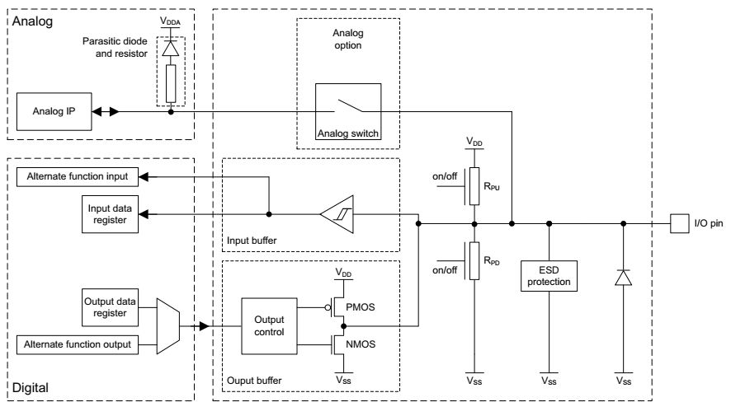
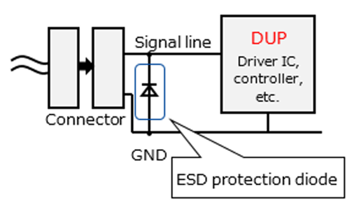

Slide 6
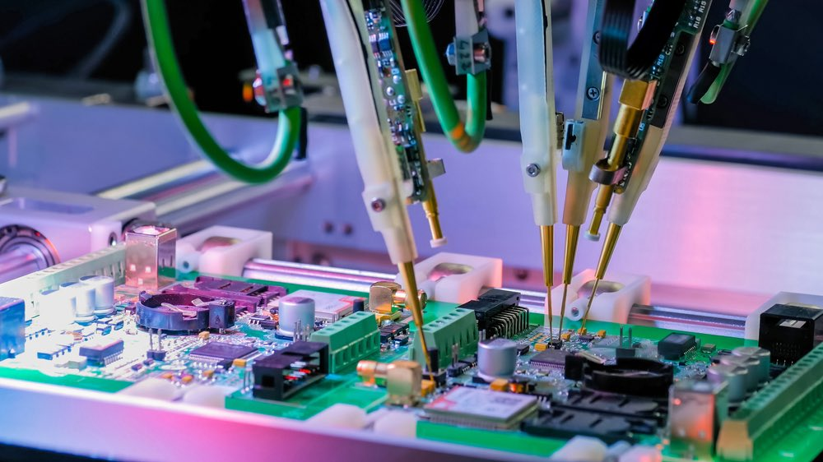
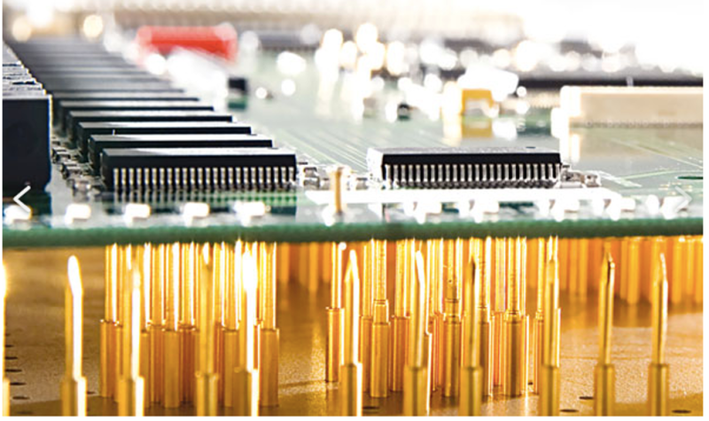
In-Circuit Test (ICT)
bed-of-nails
Flying Probe Test (FPT)

Slide 7
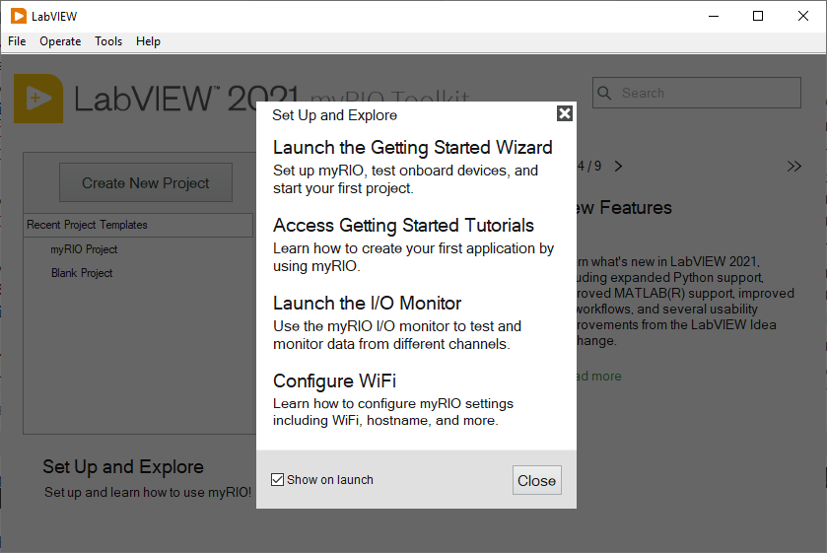
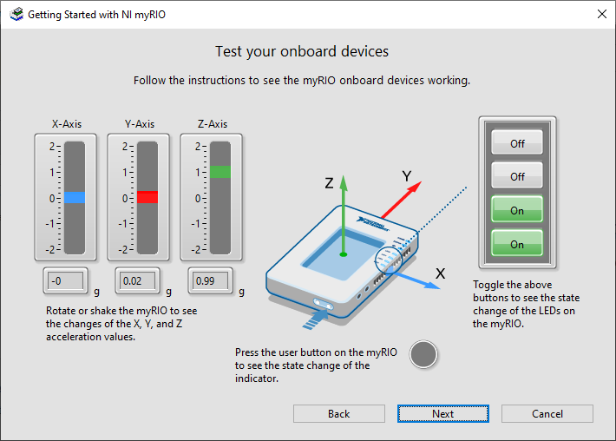
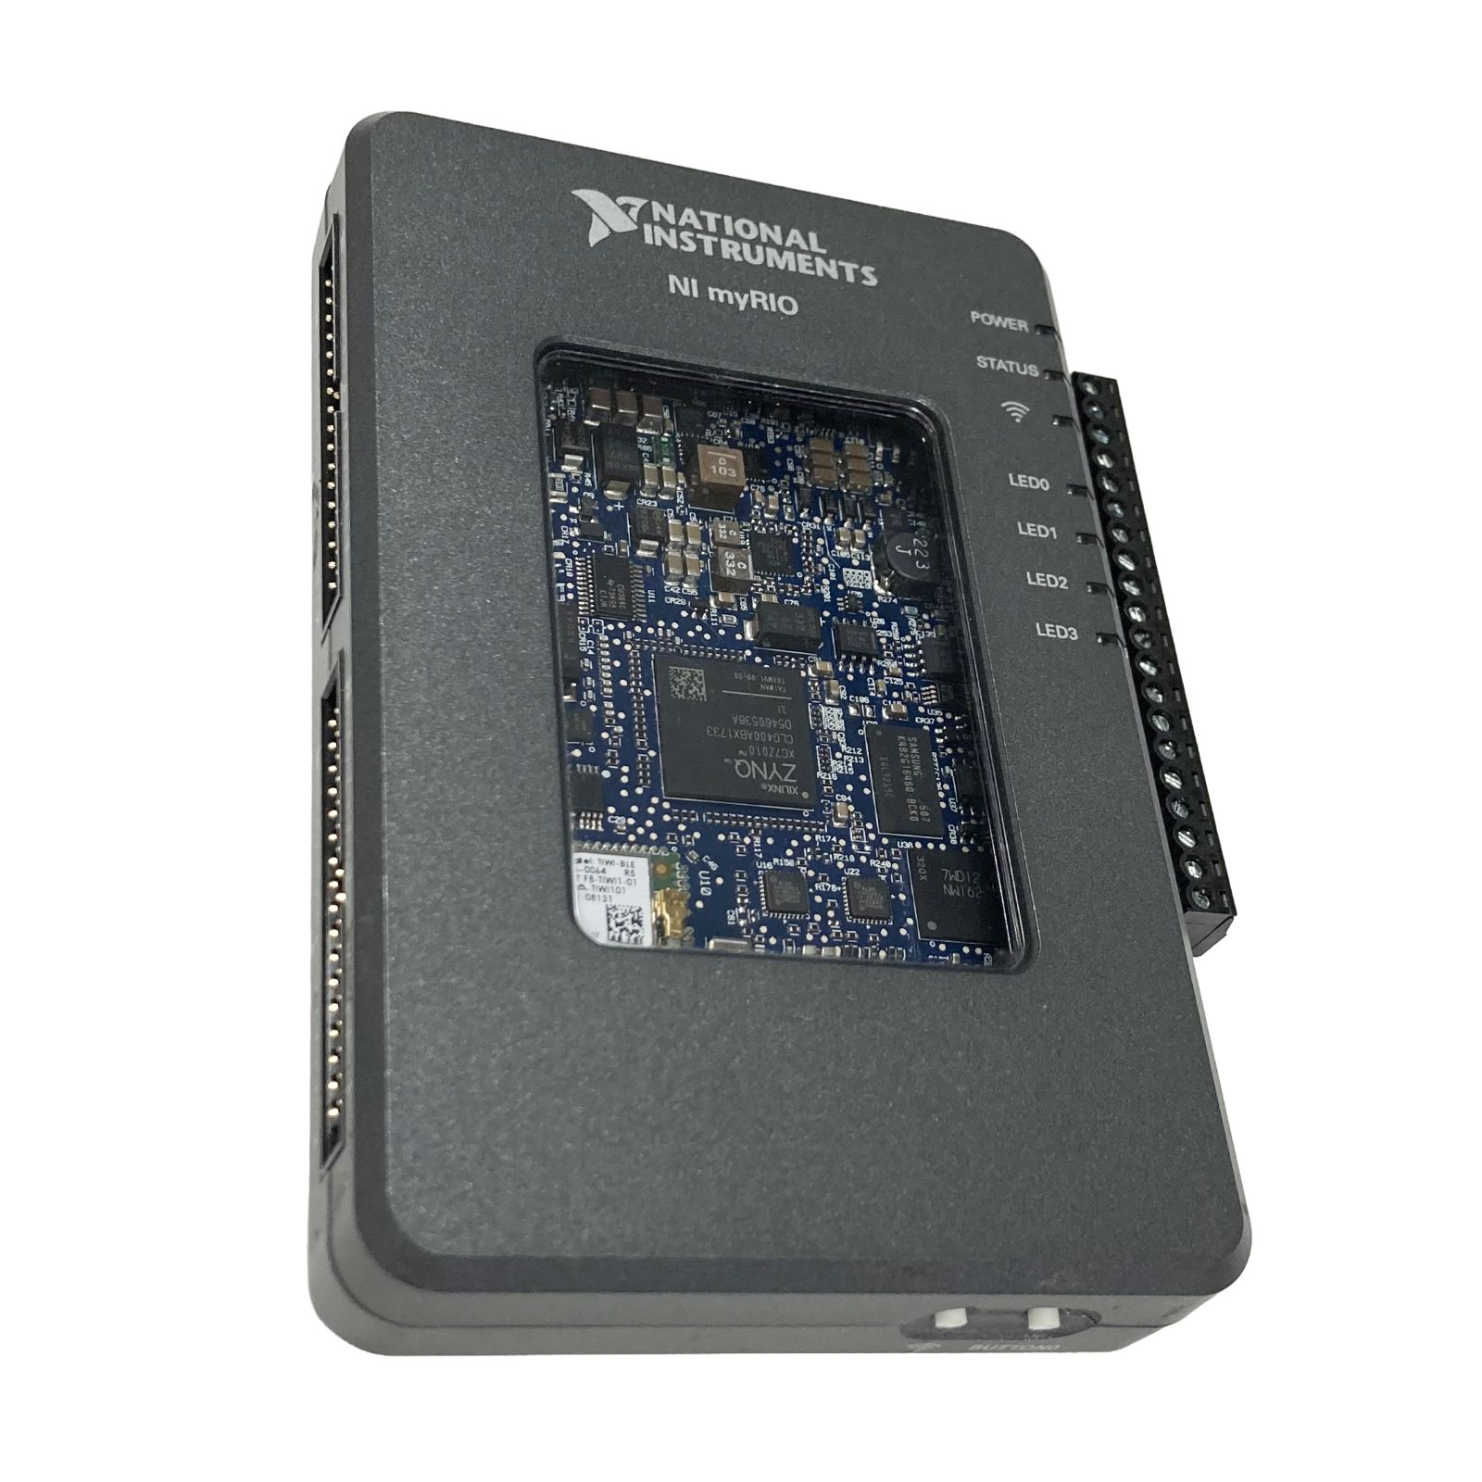
MXP A
LED x 4
MSP C
MXP B
button

Slide 8
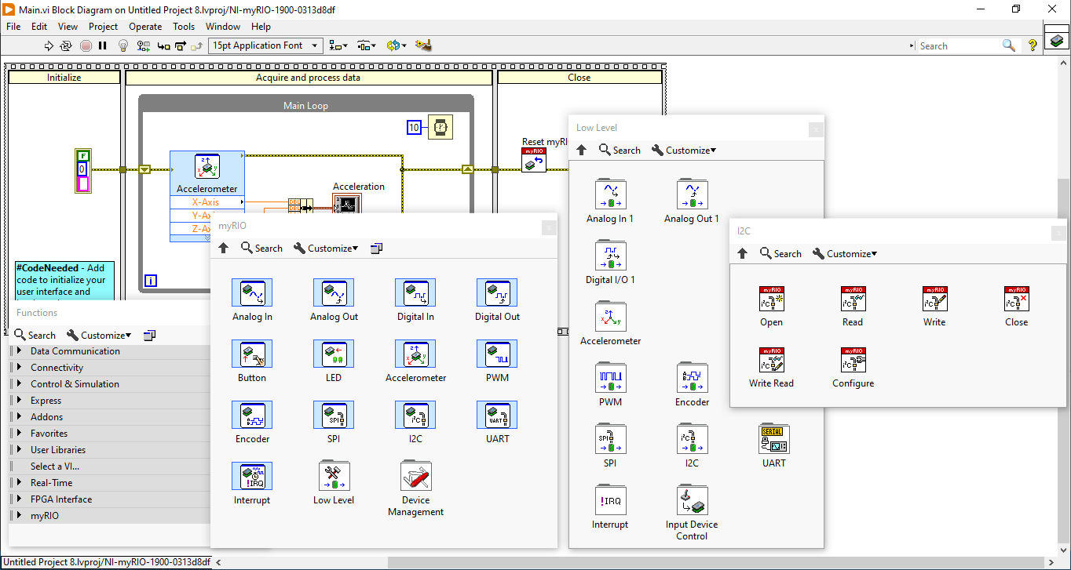

Slide 9
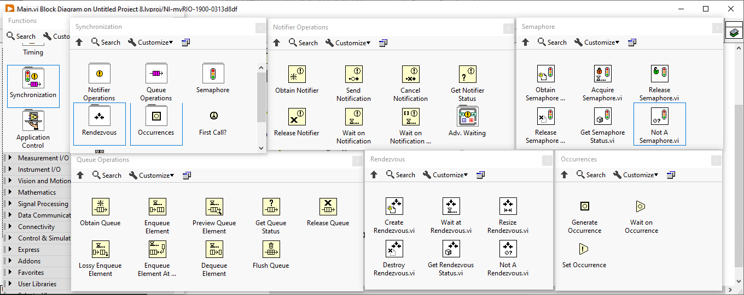
ไม่แนะนำ

Slide 10
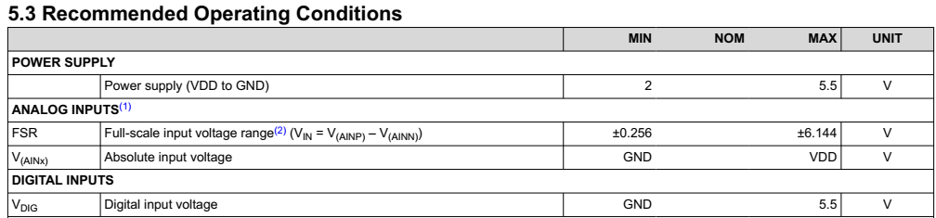
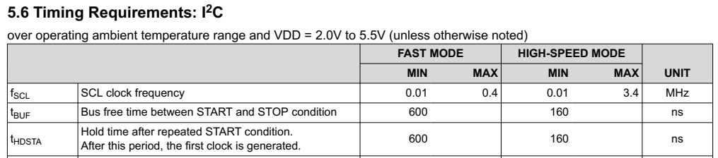

Slide 11
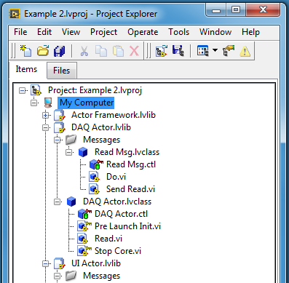
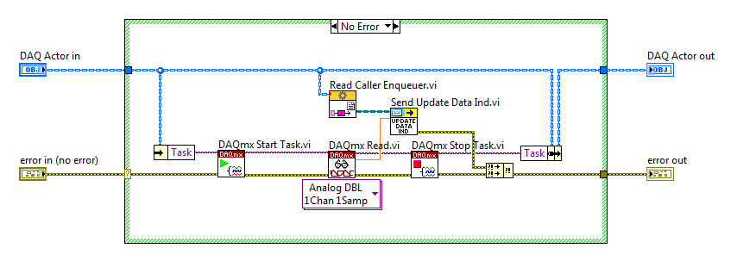

Slide 12
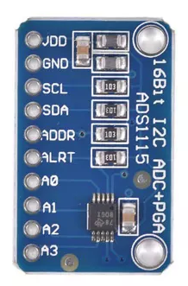
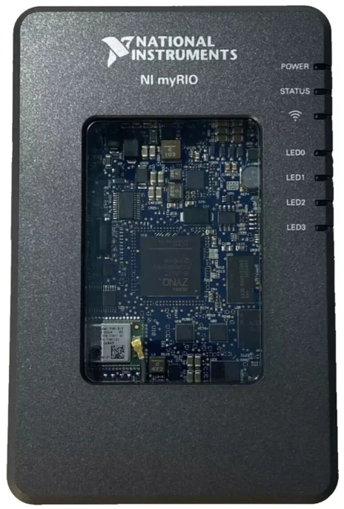

Slide 13
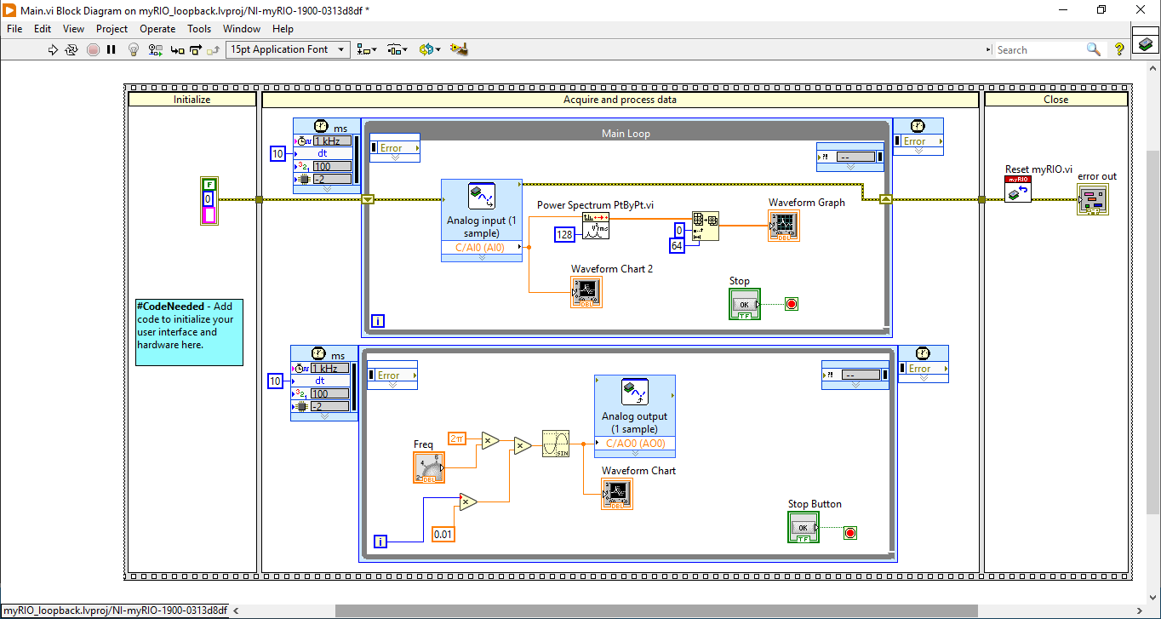
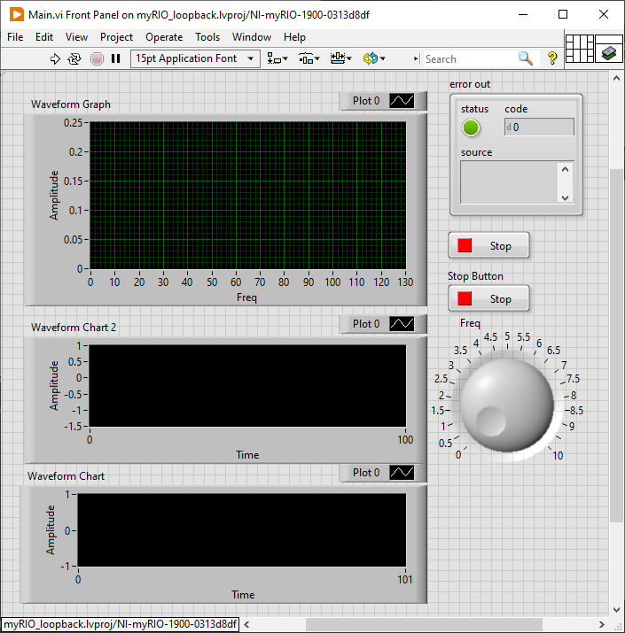

Slide 14
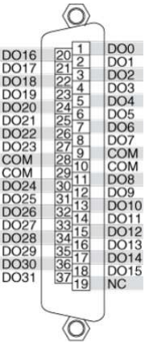
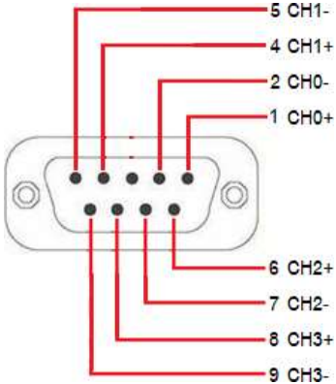
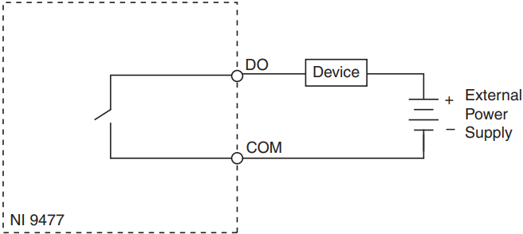
NI 9239/9269 Connector
NI 9477 Connector

Slide 15
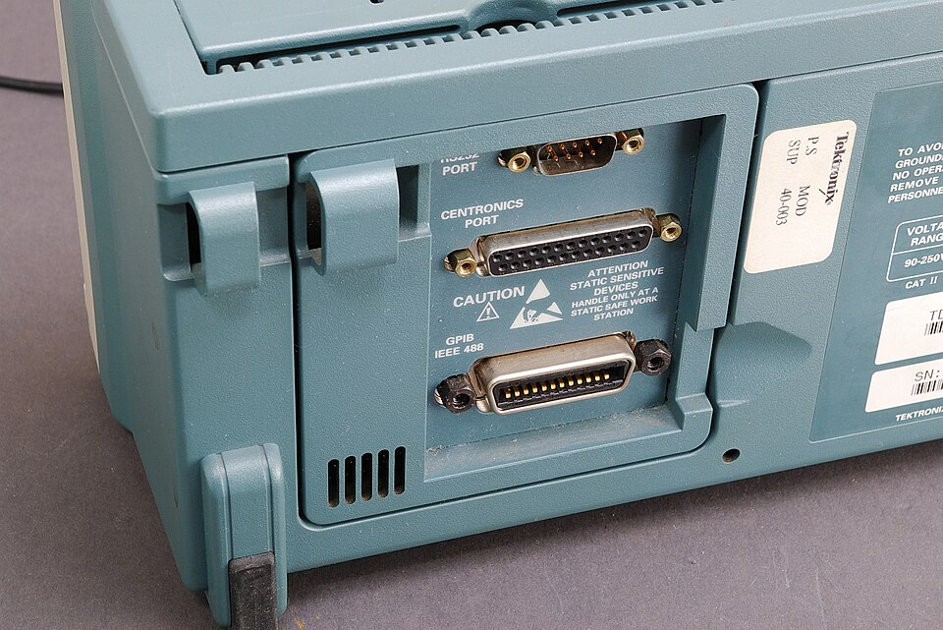
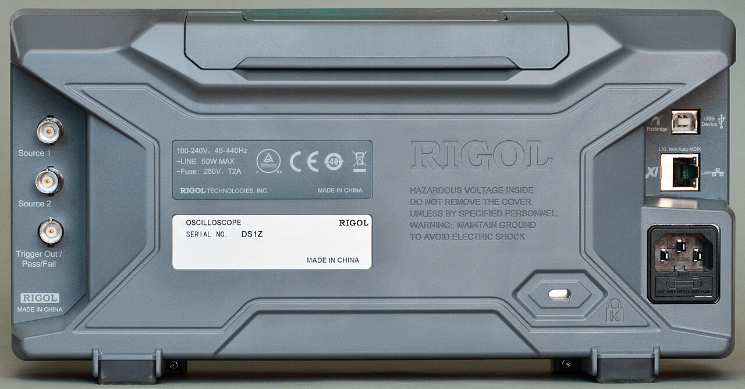

Slide 16
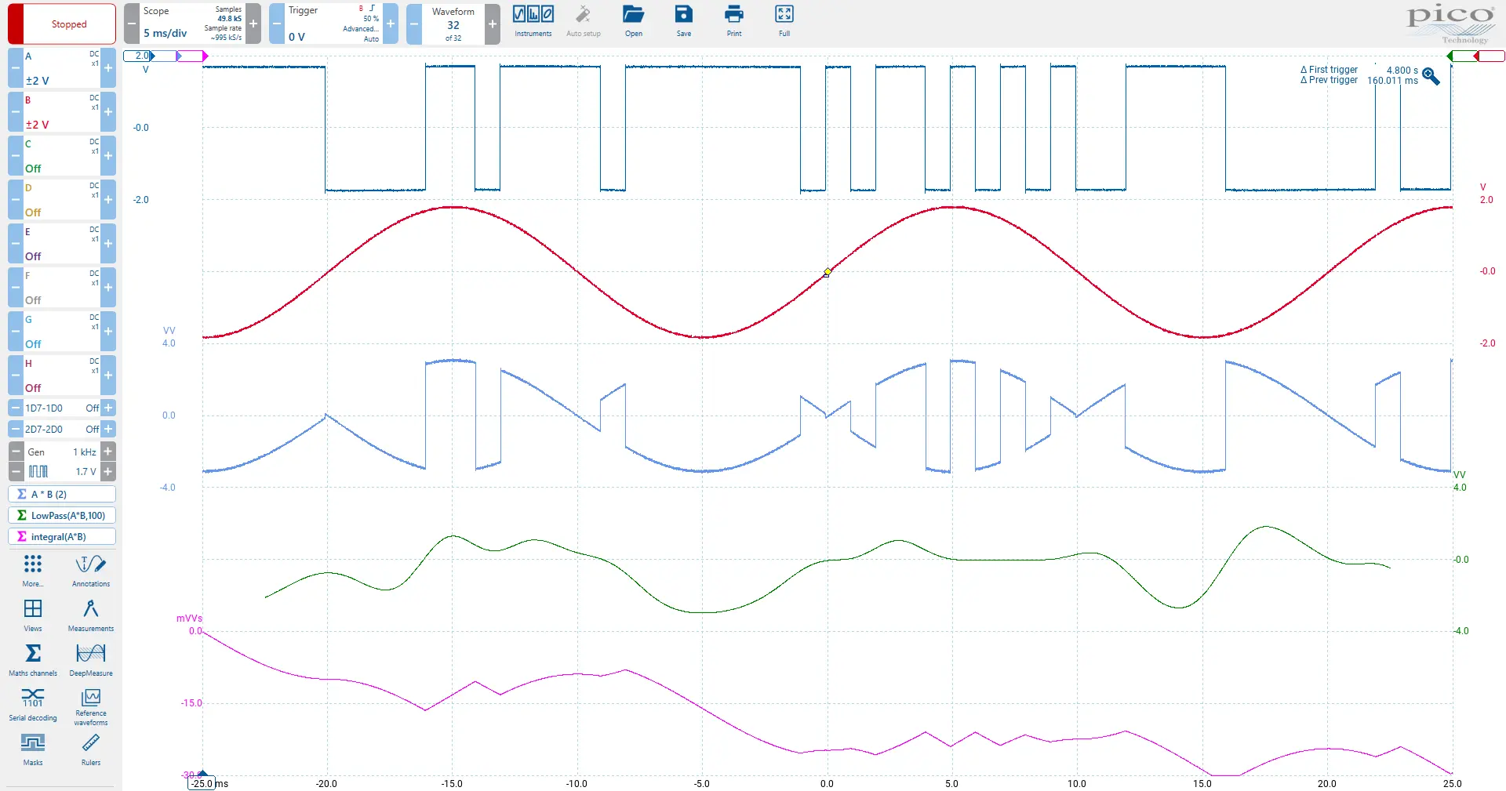
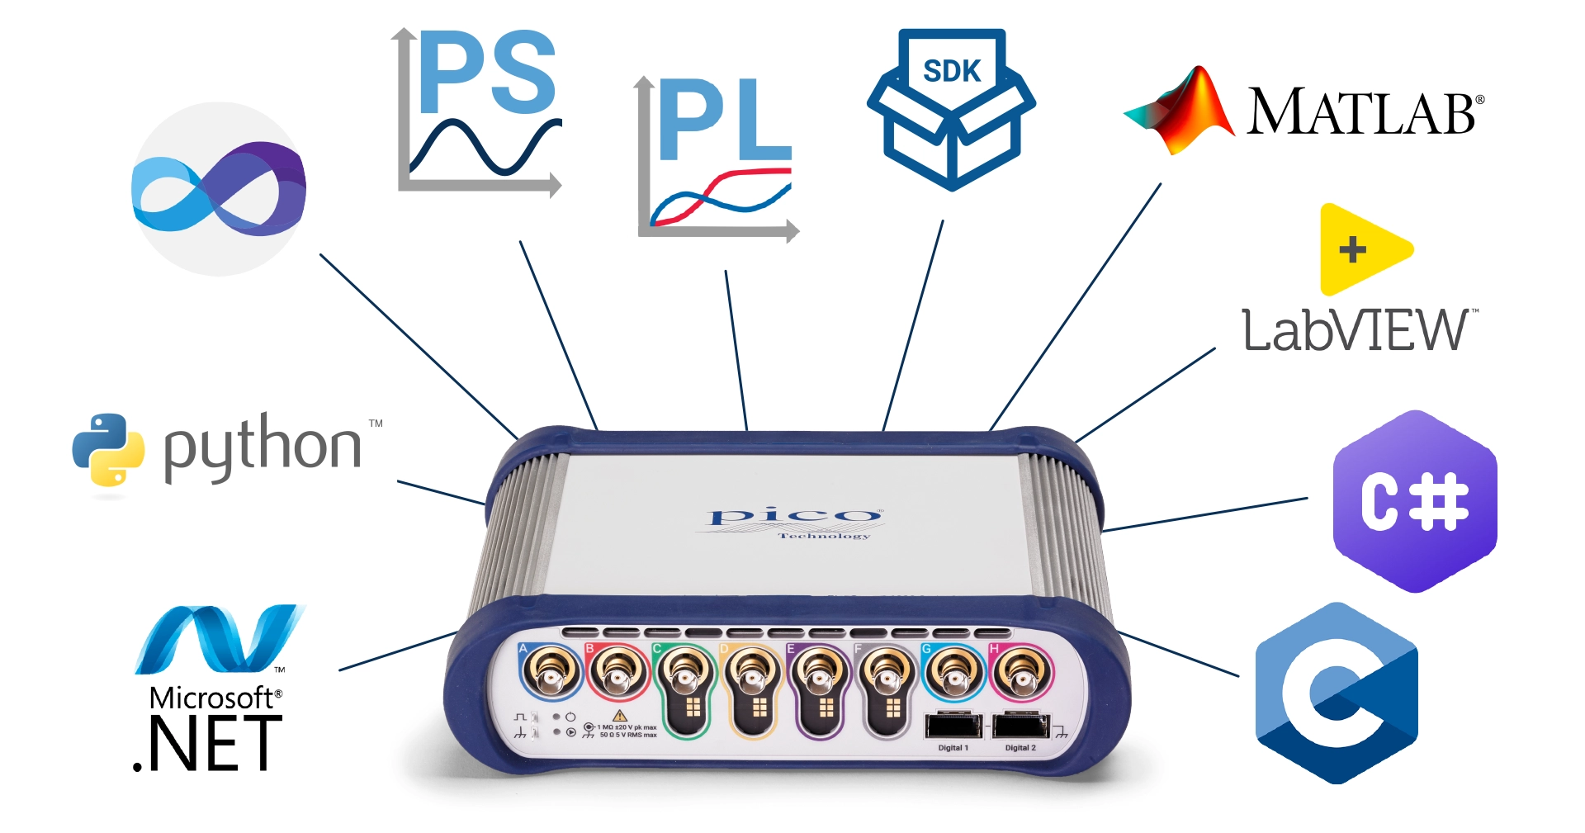
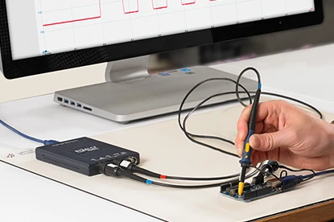
PicoScope 7 software
PicoSDK + wrapper
PicoSDK
PicoScope drivers

Slide 17
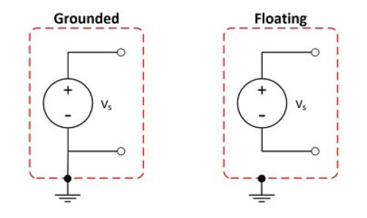
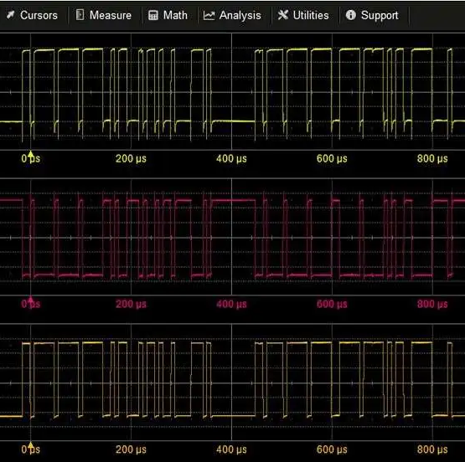
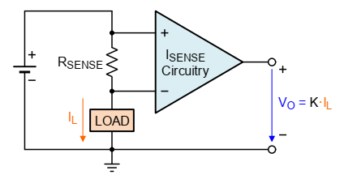
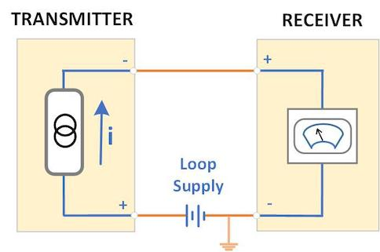
Real-world
Signals
Value
Signal source
Grounded
Floating
Amplitude
Logic
Waveform
Spectrum
Signal transmission
Single-ended input
Differential input
Special format
Current loop 4-20 mA
Voltage-to-Frequency

Slide 18
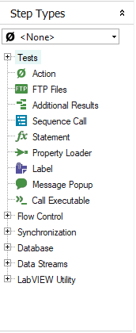
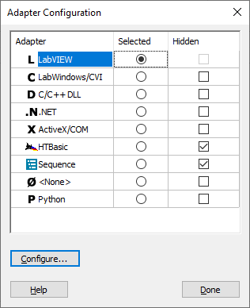
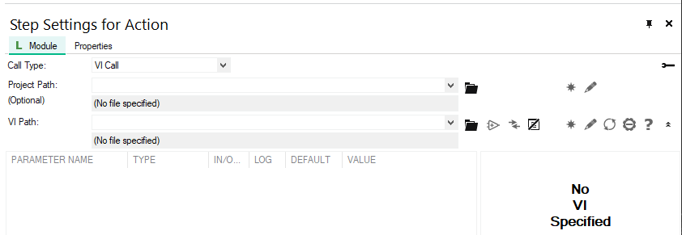
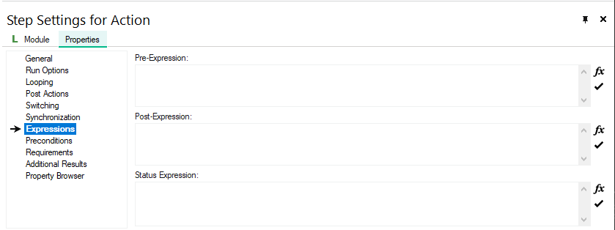
…

Slide 19
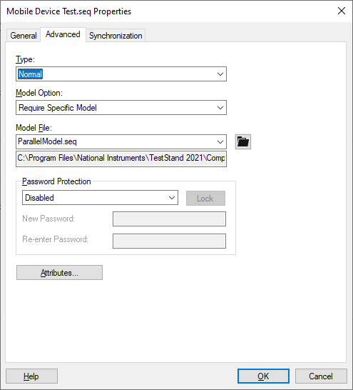
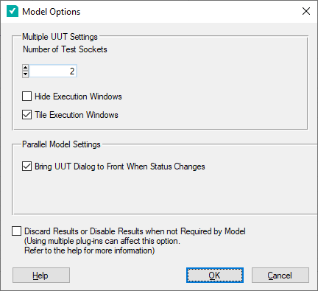
Edit > Sequence File Properties
Configure > Model Options

Slide 20
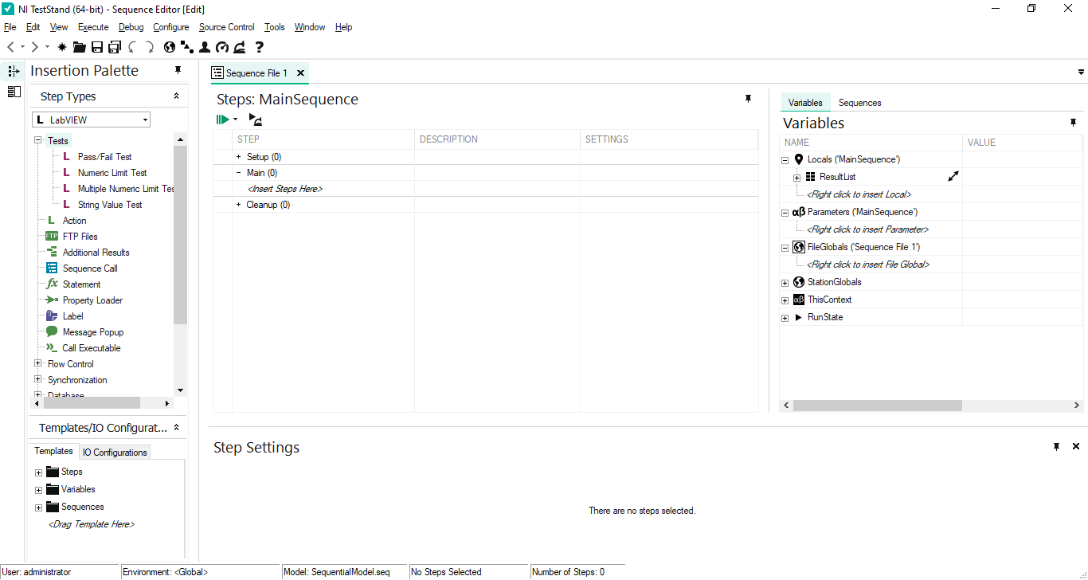
❶ Step
❷ Sequence
❹ Variables
❸ Step settings

Slide 21
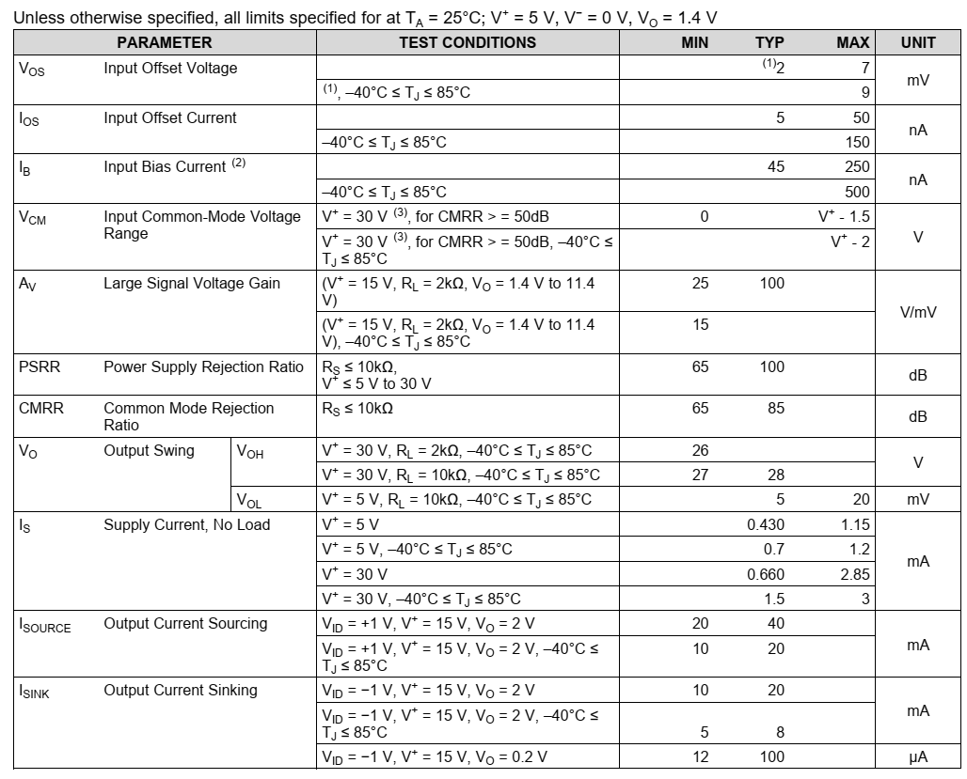
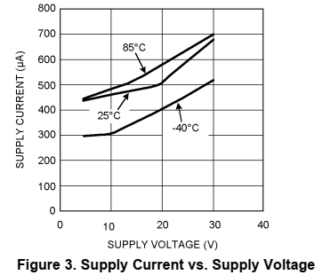
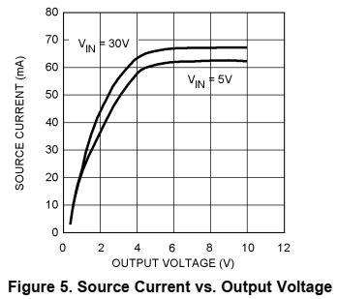

Slide 22



Edit > Sequence File Callbacks

Slide 23




Slide 24



Slide 25





Pattern
drill / imaging / etching
Laminate
AOI
Elec test
Flying probe
Surface
solder mask / surface finish / silkscreen
Wafer test
Singulation
Packaging
Final test
Interconnect
Semiconductor process
Assembly – Test - Packaging
PCB process
Solder Paste Printing
Pick & Place
Reflow
AOI
Elec test
ICT / FCT
PCBA process

Slide 26




Slide 27


Slide 28



Slide 30
STOP (Test UUTs only)
ProcessSetup
PreUUTLoop
Get options:
model, report, database
Get UUT serial number
MainSequence
setup → main → cleanup
Process results:
report
database
ProcessCleanup
PostUUTLoop
Test UUTs only

Slide 31



Slide 32


Slide 33



Slide 34


Slide 35


Slide 36


Slide 37


Slide 38



Slide 39



Slide 40



Slide 41


Slide 42


Slide 43


Slide 44


Slide 45


