Slide 1
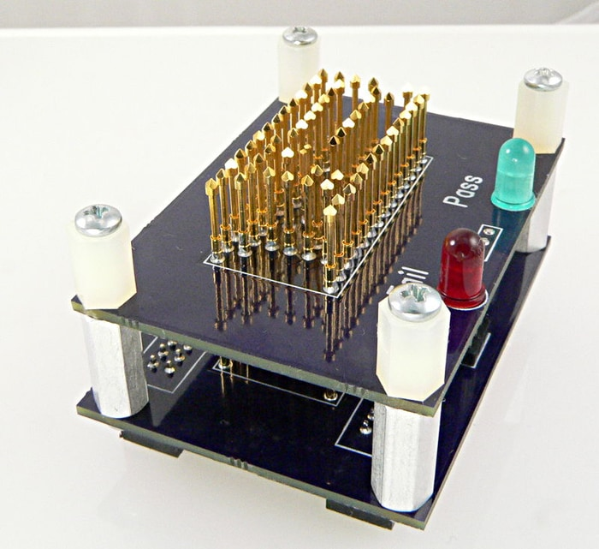
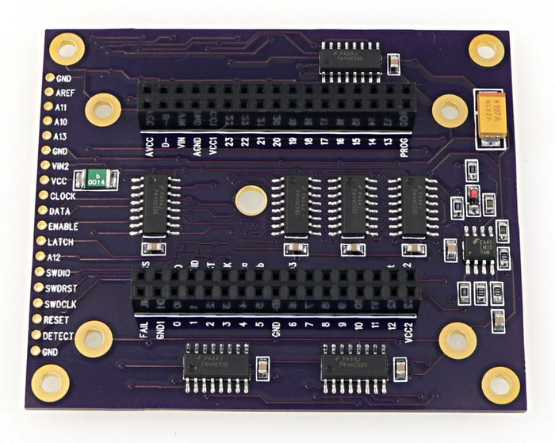
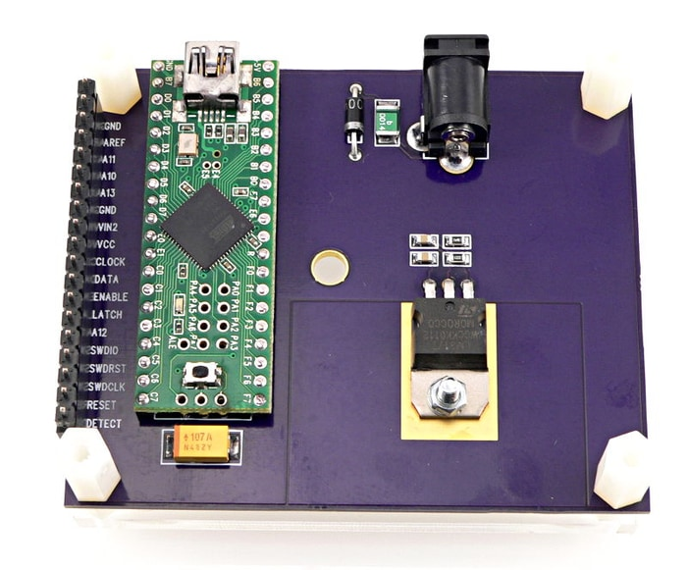

Slide 2
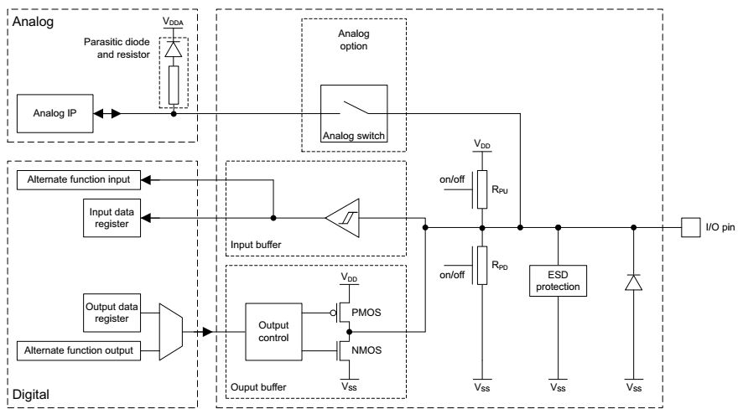
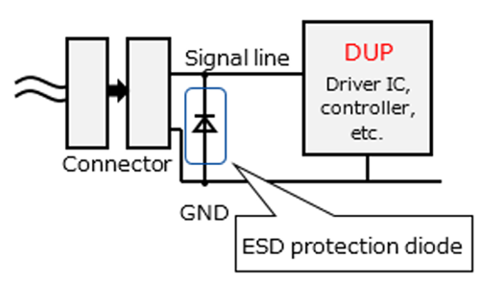

Slide 3
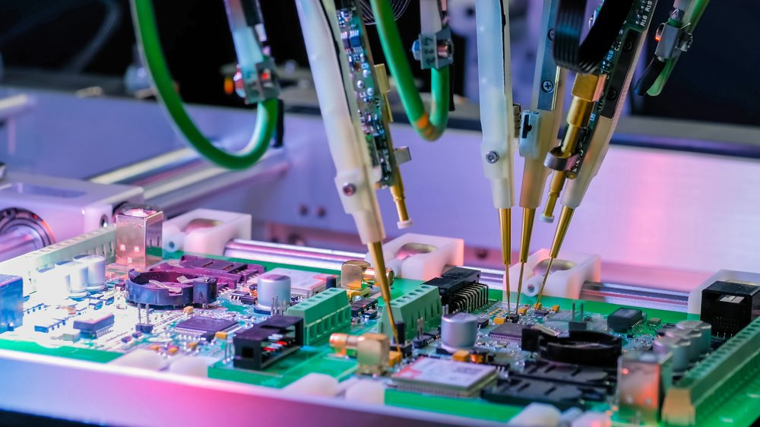
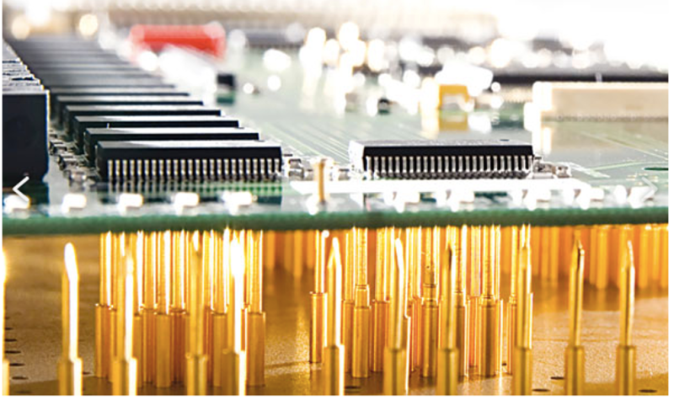
In-Circuit Test (ICT)
bed-of-nails
Flying Probe Test (FPT)

Slide 4
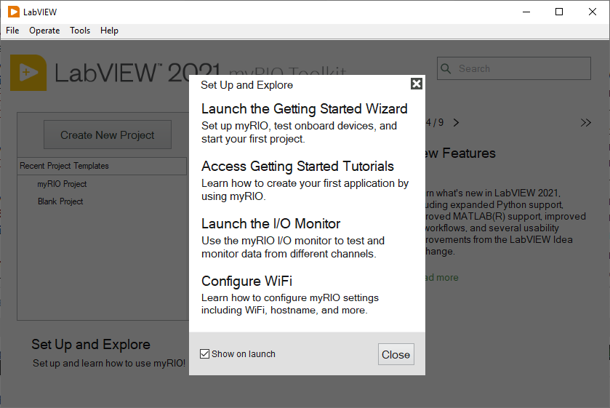
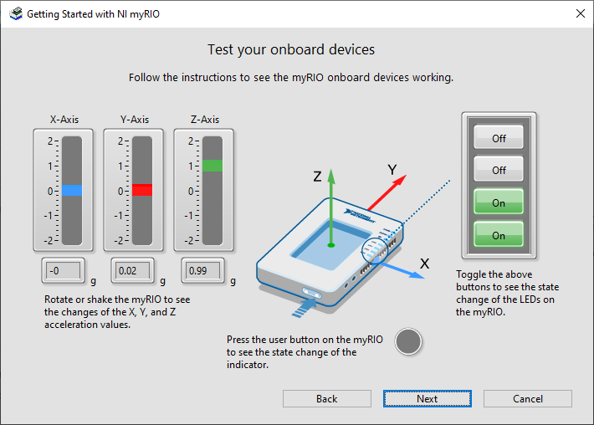
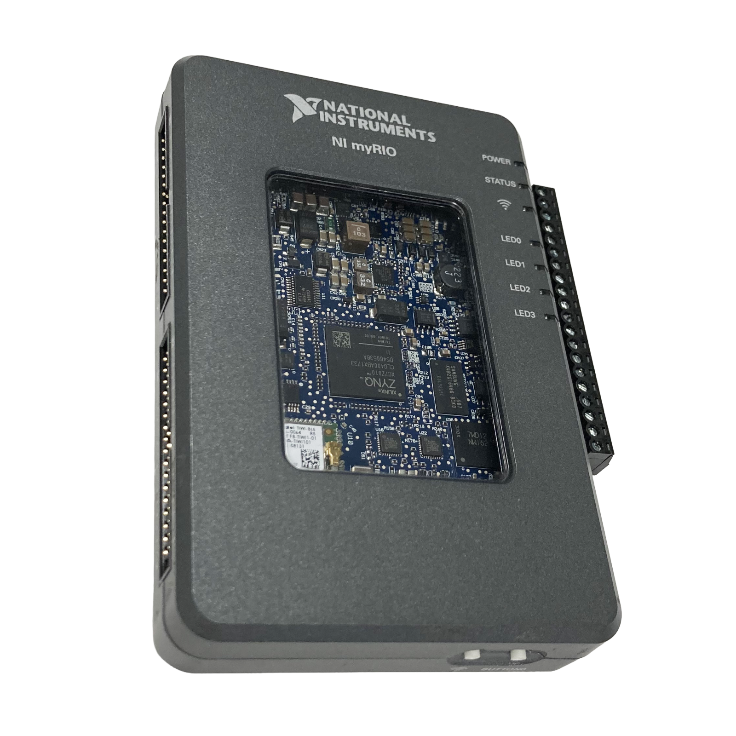
MXP A
LED x 4
MSP C
MXP B
button

Slide 5
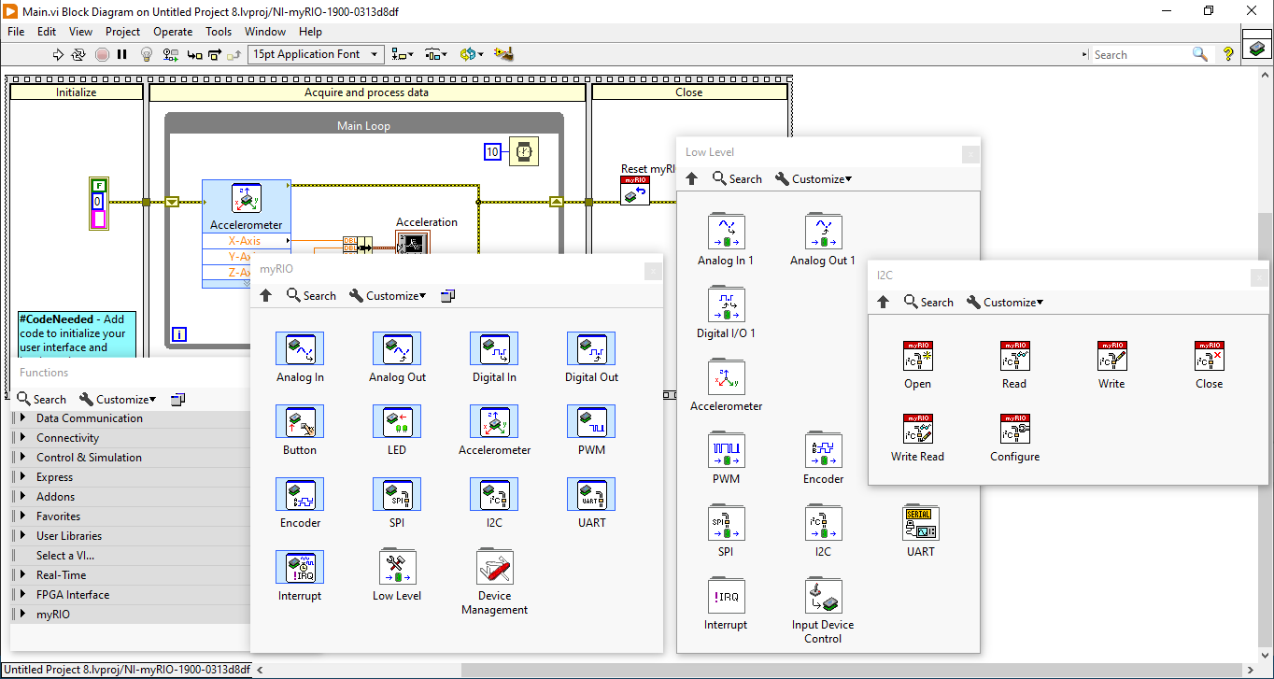

Slide 6
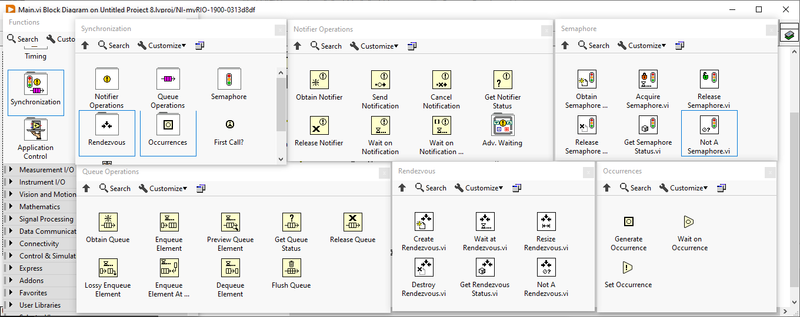
ไม่แนะนำ

Slide 7
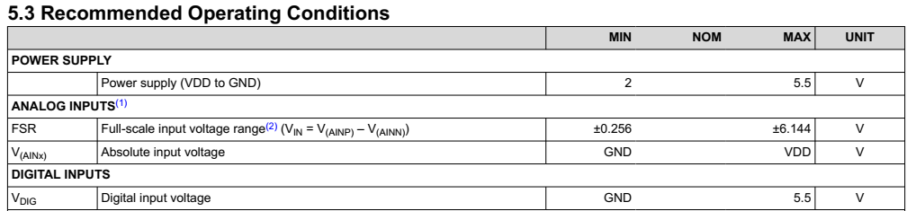
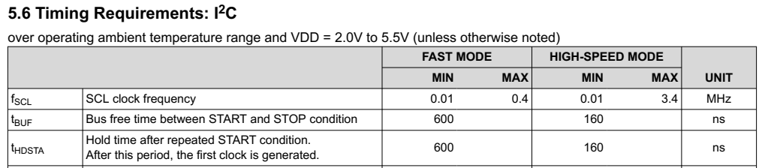

Slide 8
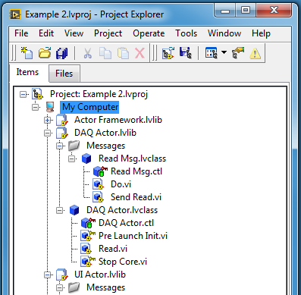
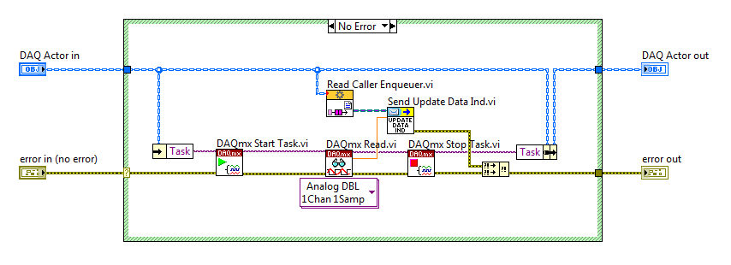

Slide 9
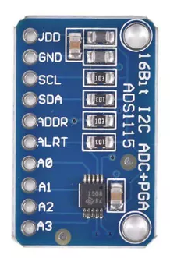
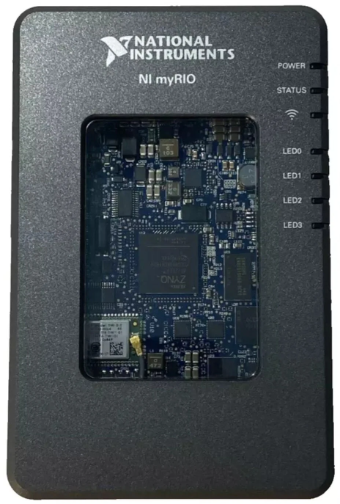

Slide 10
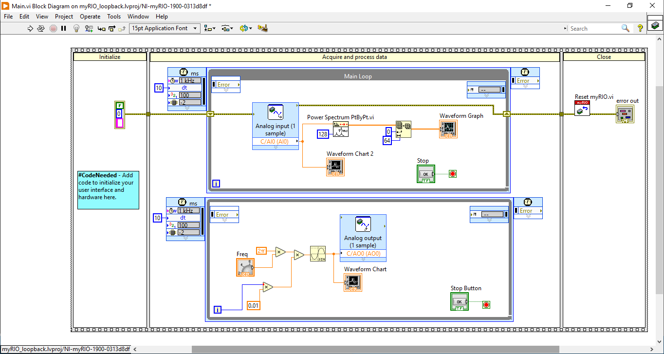
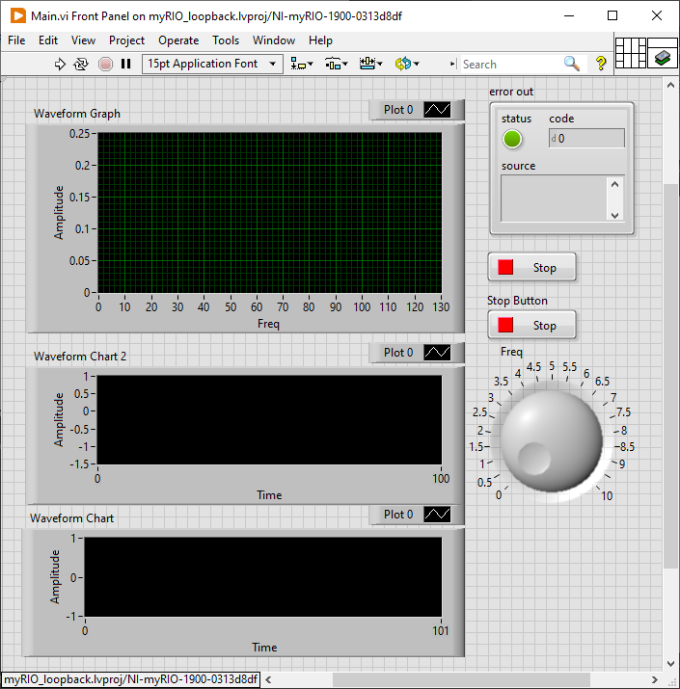

Slide 11
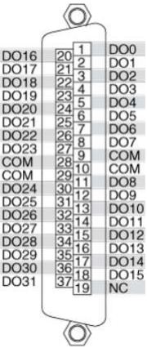
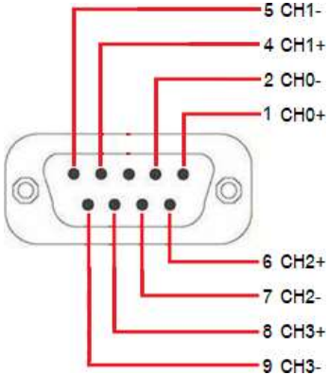
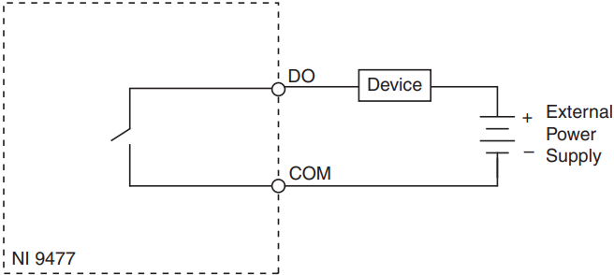
NI 9239/9269 Connector
NI 9477 Connector

Slide 12
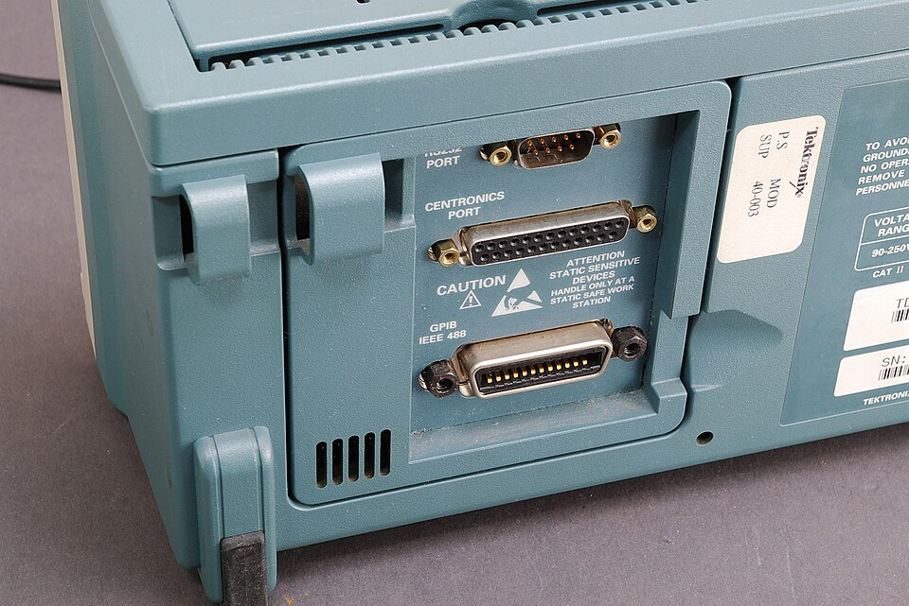
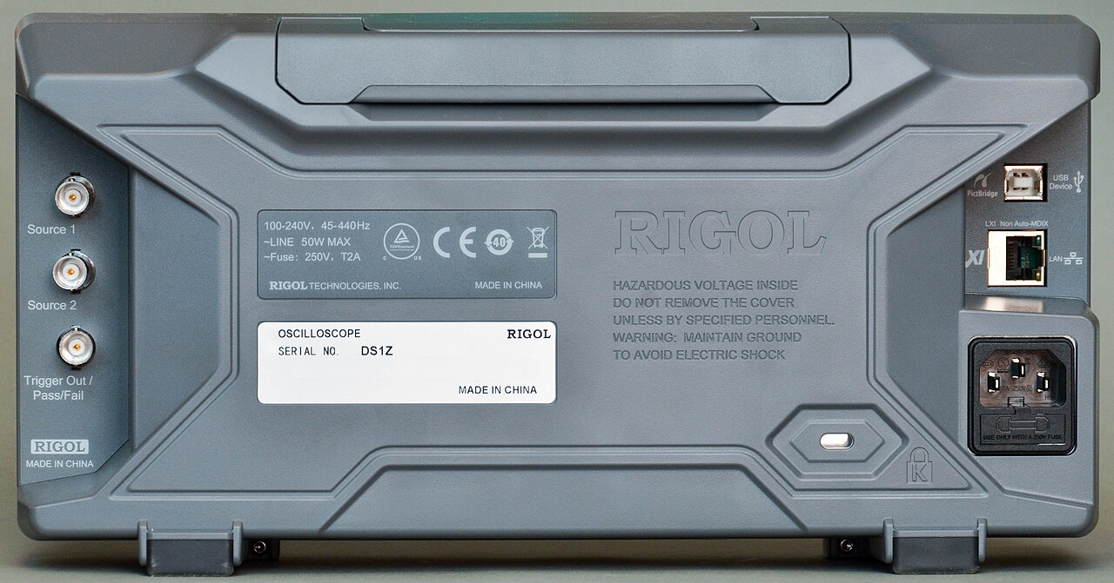

Slide 13
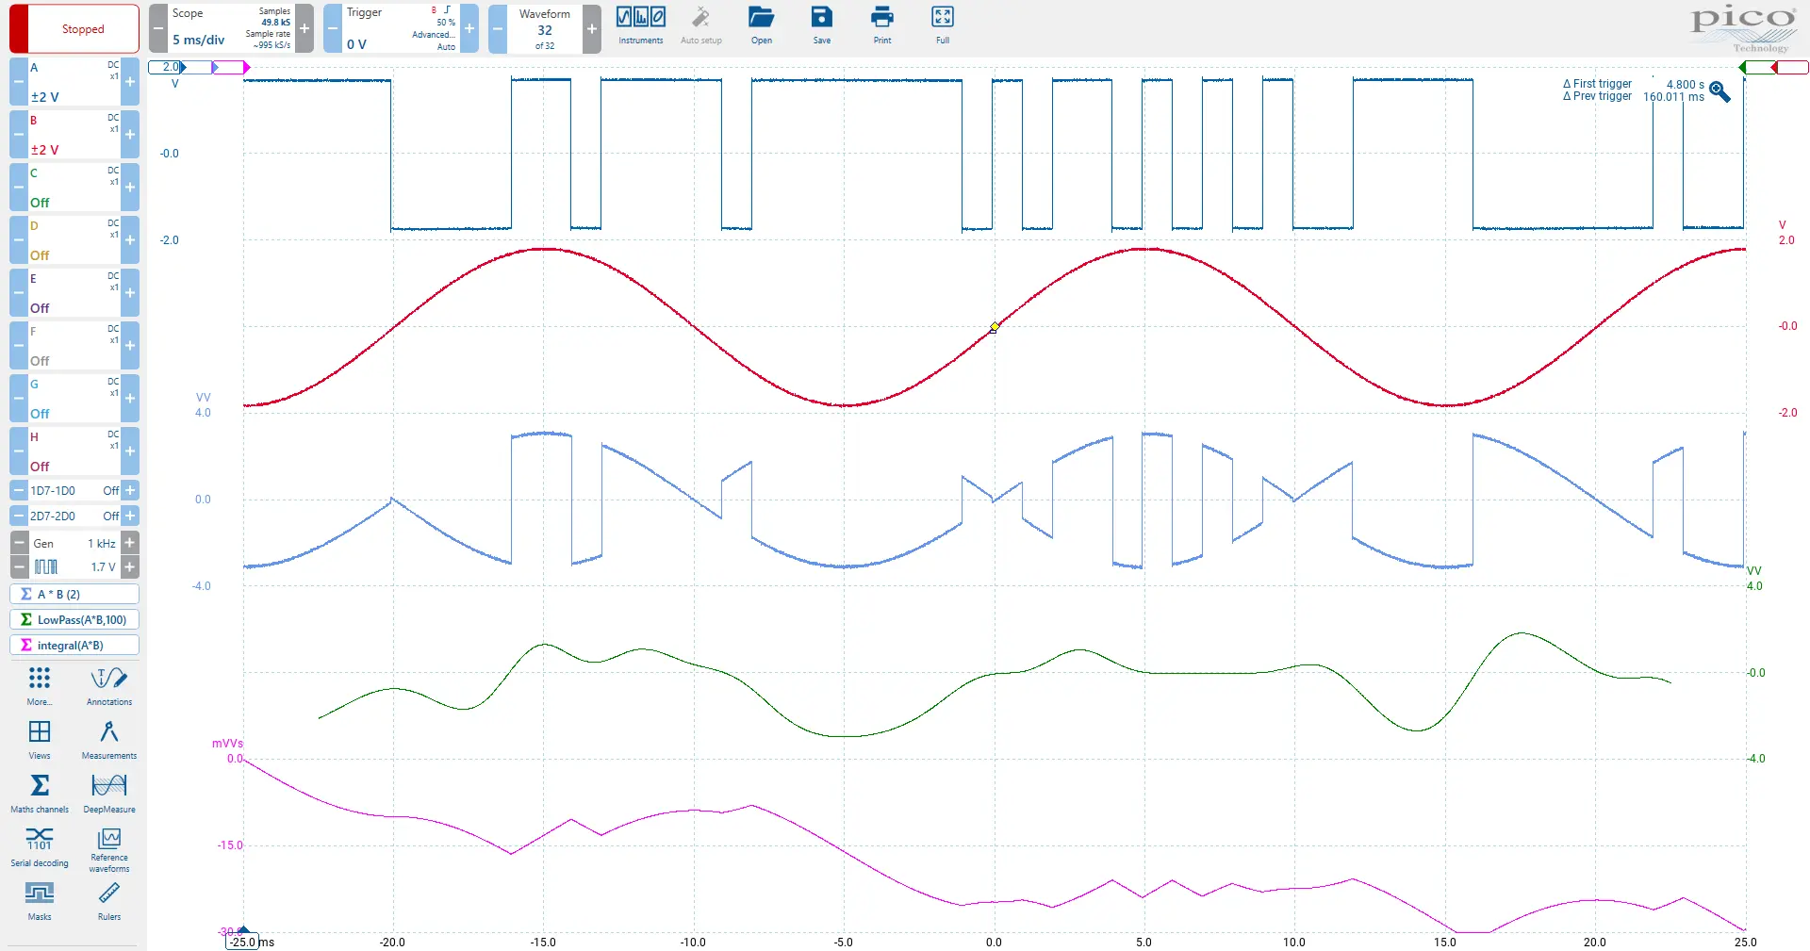
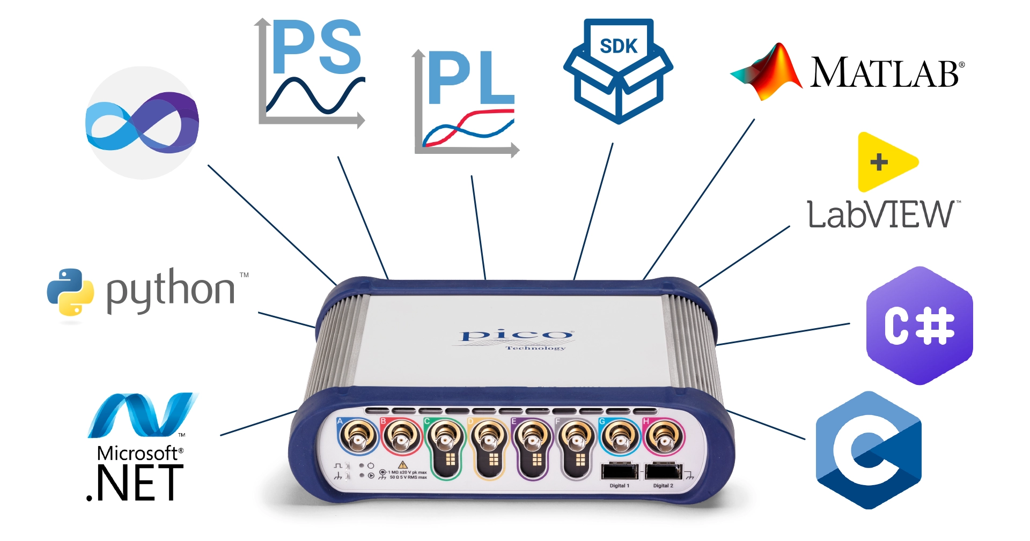
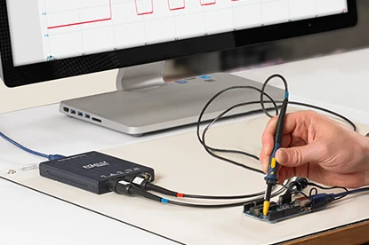
PicoScope 7 software
PicoSDK + wrapper
PicoSDK
PicoScope drivers

Slide 14
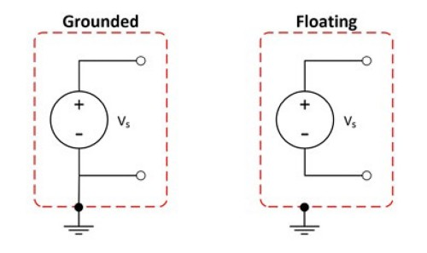
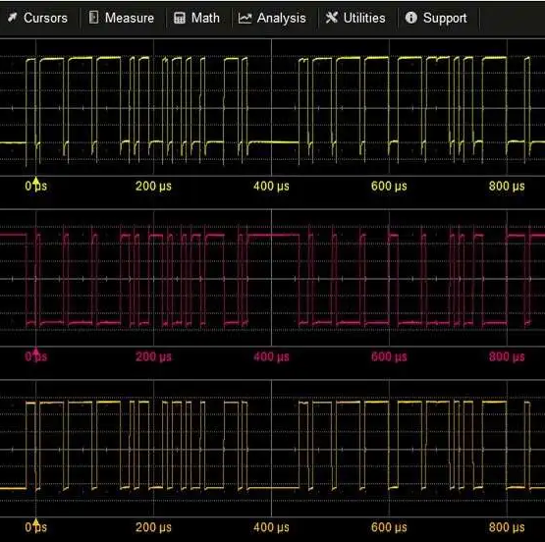
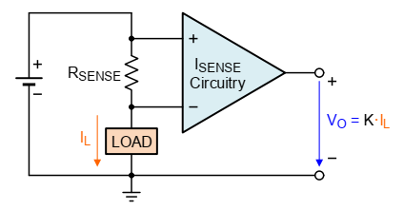
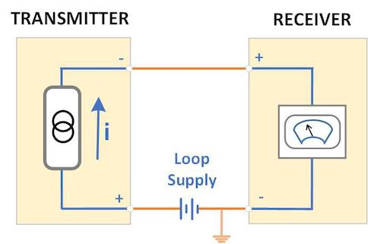
Real-world
Signals
Value
Signal source
Grounded
Floating
Amplitude
Logic
Waveform
Spectrum
Signal transmission
Single-ended input
Differential input
Special format
Current loop 4-20 mA
Voltage-to-Frequency

Slide 15
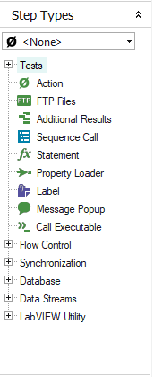
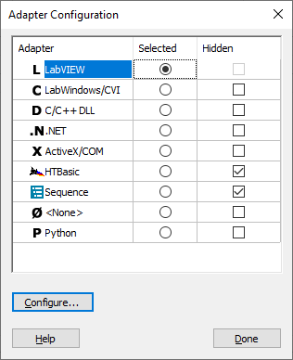
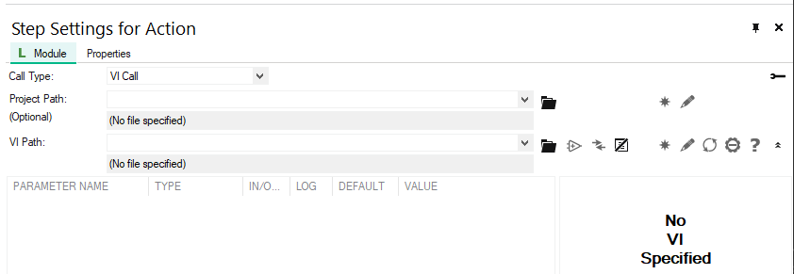
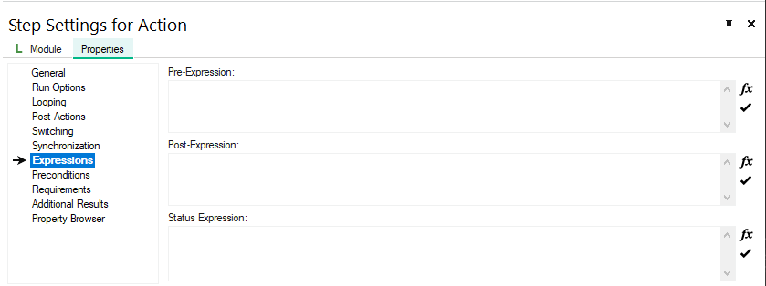
…

Slide 16
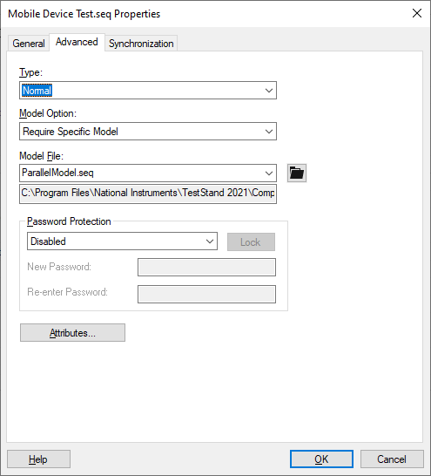
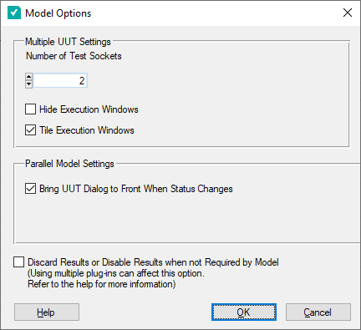
Edit > Sequence File Properties
Configure > Model Options

Slide 17
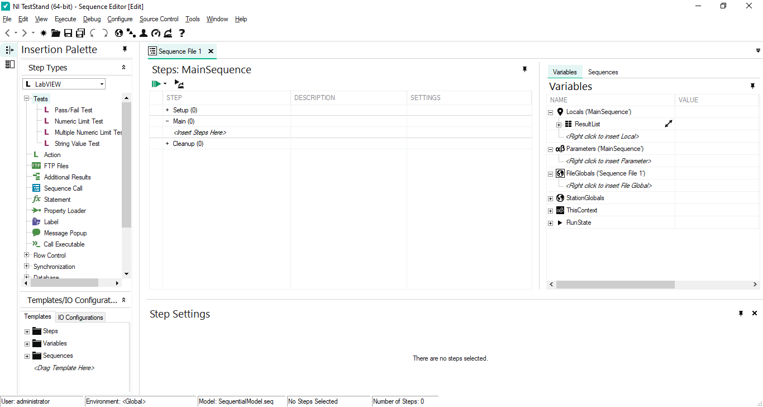
❶ Step
❷ Sequence
❹ Variables
❸ Step settings

Slide 18
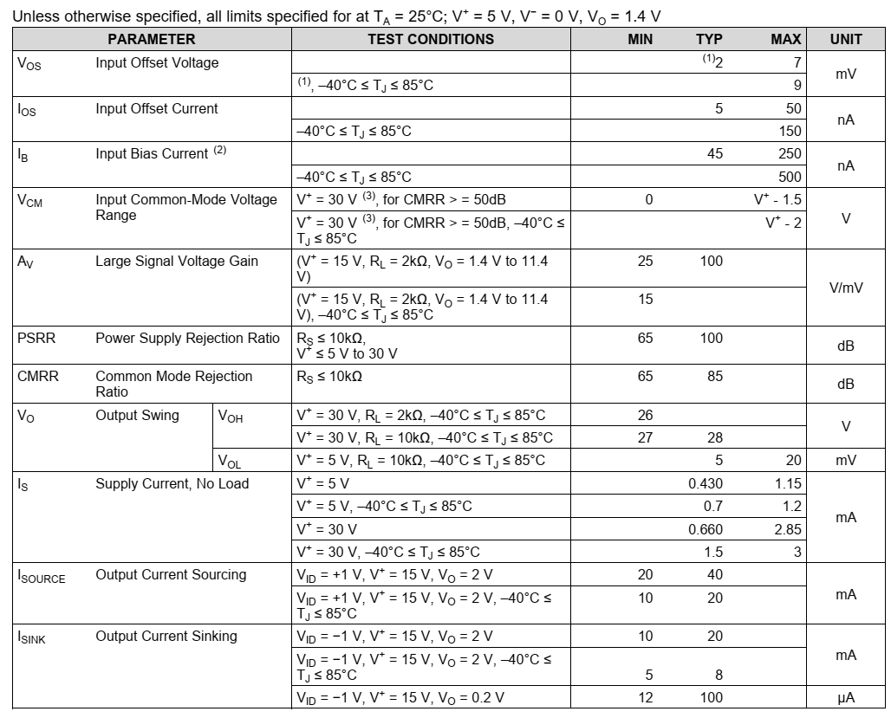
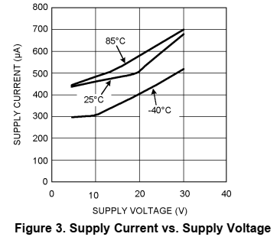
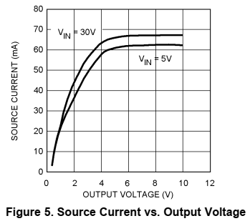

Slide 19
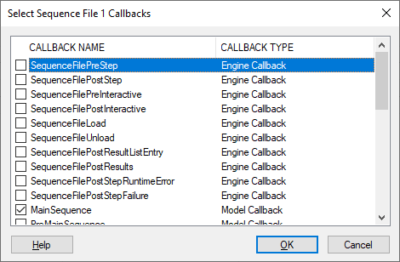
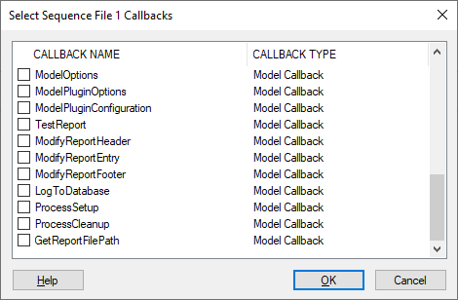
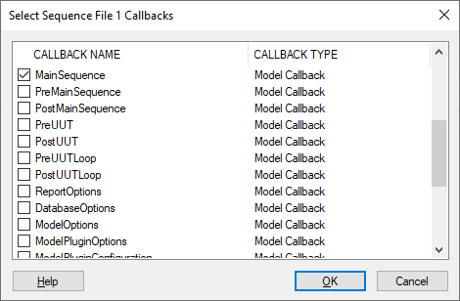
Edit > Sequence File Callbacks

Slide 20
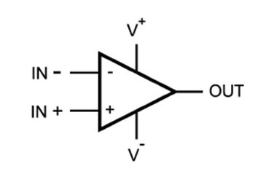
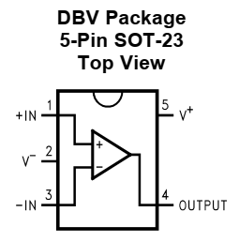
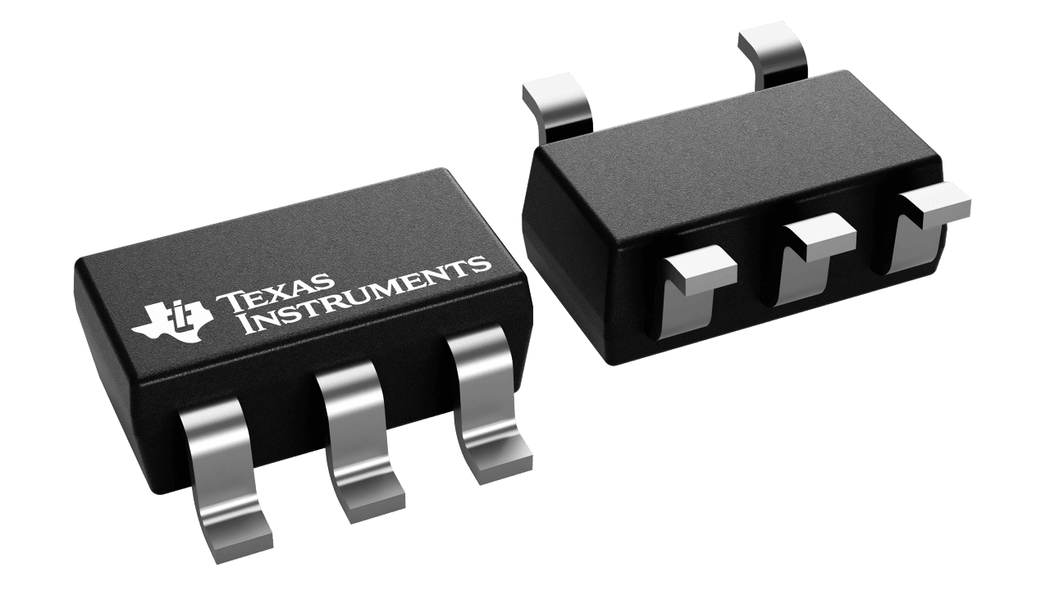

Slide 21
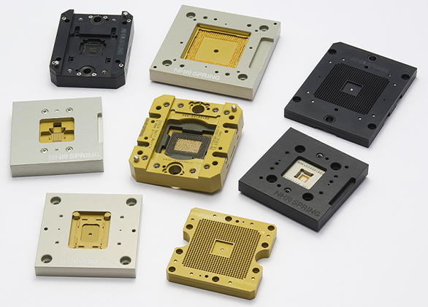
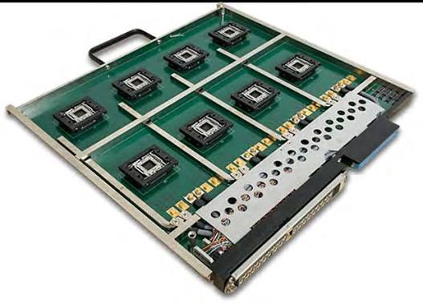

Slide 22





Pattern drill / imaging / etching
Laminate
AOI
Elec test
Flying probe
Surface solder mask / surface finish / silkscreen
Wafer test
Singulation
Packaging
Final test
Interconnect
Semiconductor process
Assembly – Test - Packaging
PCB process
Solder Paste Printing
Pick & Place
Reflow
AOI
Elec test
ICT / FCT
PCBA process

Slide 23




Slide 24


Slide 25



Slide 27
STOP (Test UUTs only)
ProcessSetup
PreUUTLoop
Get options: model, report, database
Get UUT serial number
MainSequence setup → main → cleanup
Process results:
report
database
ProcessCleanup
PostUUTLoop
Test UUTs only

Slide 28



Slide 29


Slide 30



Slide 31


Slide 32


Slide 33


Slide 34


Slide 35



Slide 36



Slide 37



Slide 38


Slide 39


Slide 40


Slide 41


Slide 42


