Slide 1
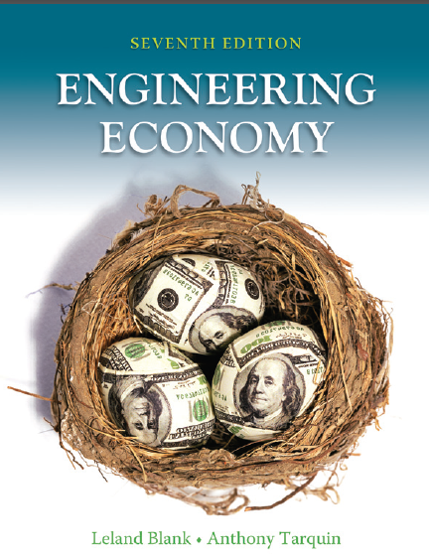

Chapter 2
Factors: How Time and Interest Affect Money
Lecture slides to accompany
Engineering Economy
7th edition
Leland Blank
Anthony Tarquin
2-<number>
© 2012 by McGraw-Hill, New York, N.Y All Rights Reserved

Slide 2
LEARNING OUTCOMES
F/P and P/F Factors
P/A and A/P Factors
F/A and A/F Factors
Factor Values
Arithmetic Gradient
Geometric Gradient
Find i or n
2-<number>
© 2012 by McGraw-Hill, New York, N.Y All Rights Reserved

Slide 3
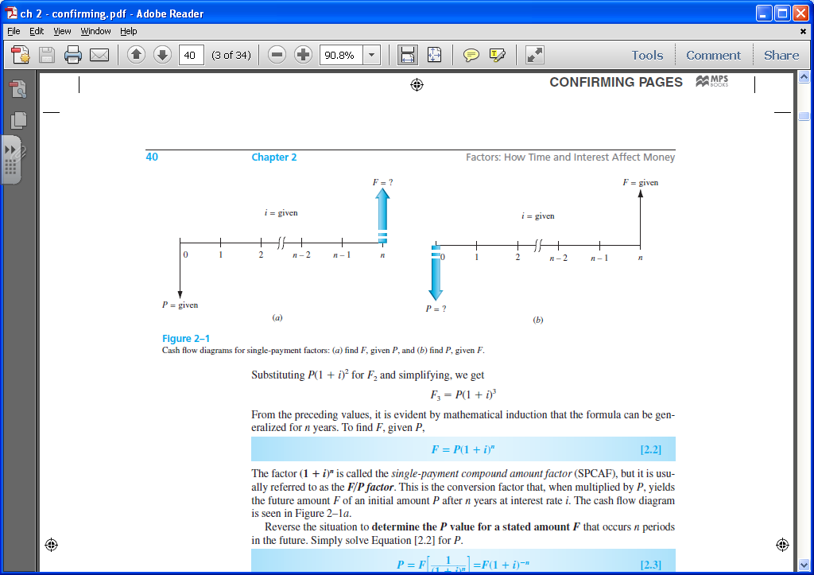
Single Payment Factors (F/P and P/F)
Single payment factors involve only P and F. Cash flow diagrams are as follows:
Formulas are as follows:
F = P(1 + i ) ^{n}
P = F[1 / (1 + i ) ^{n}]
Terms in parentheses or brackets are called factors. Values are in tables for i and n values
Factors are represented in standard factor notation such as (F/P,i,n),
where letter to left of slash is what is sought; letter to right represents what is given
2-<number>
© 2012 by McGraw-Hill, New York, N.Y All Rights Reserved

Slide 4
F/P and P/F for Spreadsheets
Future value F is calculated using FV function:
  = FV(i%,n,,P)
Present value P is calculated using PV function:
  = PV(i%,n,,F)
Note the use of double commas in each function
2-<number>
© 2012 by McGraw-Hill, New York, N.Y All Rights Reserved

Slide 5
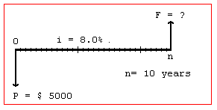
Example: Finding Future Value
A person deposits $5000 into an account which pays interest at a rate of 8% per year. The amount in the account after 10 years is closest to:
(A) $2,792 (B) $9,000 (C) $10,795 (D) $12,165
The cash flow diagram is:
Solution:
F = P(F/P,i,n )
= 5000(F/P,8%,10 )
= 5000(2.1589)
= $10,794.50
Answer is (C)
2-<number>
© 2012 by McGraw-Hill, New York, N.Y All Rights Reserved

Slide 6
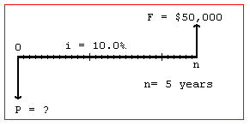
Example: Finding Present Value
A small company wants to make a single deposit now so it will have enough money to
purchase a backhoe costing $50,000 five years from now. If the account will earn
interest of 10% per year, the amount that must be deposited now is nearest to:
(A) $10,000 (B) $ 31,050 (C) $ 33,250 (D) $319,160
Solution:
The cash flow diagram is:
P = F(P/F,i,n )
= 50,000(P/F,10%,5 )
= 50,000(0.6209)
= $31,045
Answer is (B)
2-<number>
© 2012 by McGraw-Hill, New York, N.Y All Rights Reserved

Slide 7
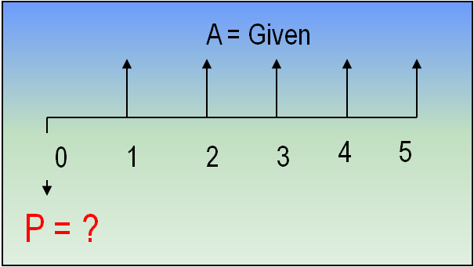
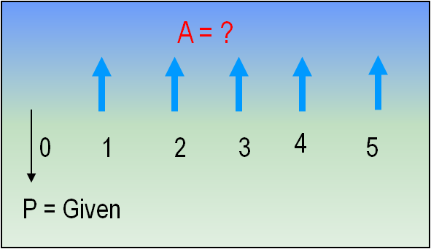
Uniform Series Involving P/A and A/P
The uniform series factors that involve P and A are derived as follows:
(1) Cash flow occurs in consecutive interest periods
(2) Cash flow amount is same in each interest period
The cash flow diagrams are:
P = A(P/A,i,n)
A = P(A/P,i,n)
Standard Factor Notation
Note: P is one period Ahead of first A value
2-<number>
© 2012 by McGraw-Hill, New York, N.Y All Rights Reserved

Slide 8
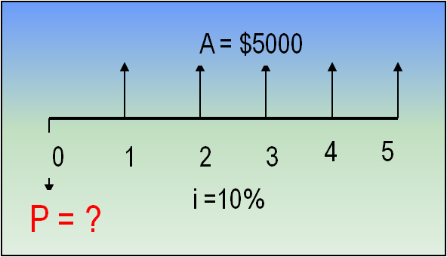
Example: Uniform Series Involving P/A
A chemical engineer believes that by modifying the structure of a certain water
treatment polymer, his company would earn an extra $5000 per year. At an interest
rate of 10% per year, how much could the company afford to spend now to just
break even over a 5 year project period?
(A) $11,170 (B) 13,640 (C) $15,300 (D) $18,950
Solution:
The cash flow diagram is as follows:
P = 5000(P/A,10%,5)
= 5000(3.7908)
= $18,954
Answer is (D)
2-<number>
© 2012 by McGraw-Hill, New York, N.Y All Rights Reserved

Slide 9
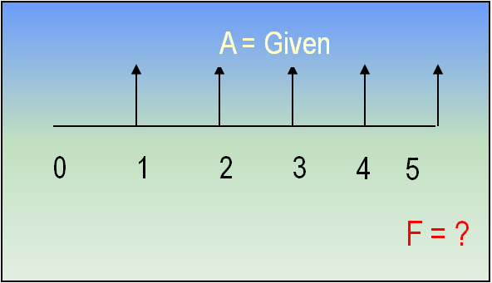
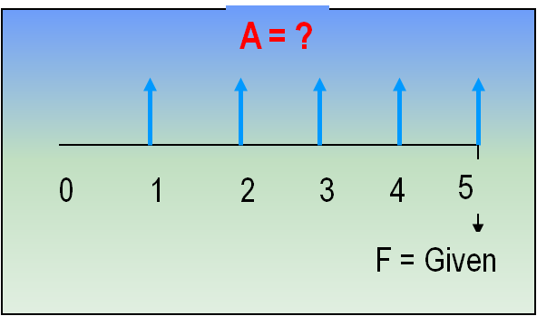
Uniform Series Involving F/A and A/F
The uniform series factors that involve F and A are derived as follows:
(1) Cash flow occurs in consecutive interest periods
(2) Last cash flow occurs in same period as F
Cash flow diagrams are:
F = A(F/A,i,n)
Standard Factor Notation
A = F(A/F,i,n)
Note: F takes place in the same period as last A
2-<number>
© 2012 by McGraw-Hill, New York, N.Y All Rights Reserved

Slide 10
Example: Uniform Series Involving F/A
An industrial engineer made a modification to a chip manufacturing process that will save her company $10,000 per year. At an interest rate of 8% per year, how much will the savings amount to in 7 years?
(A) $45,300 (B) $68,500 (C) $89,228 (D) $151,500
The cash flow diagram is:
F = ?
Solution:
F = 10,000(F/A,8%,7)
i = 8%
= 10,000(8.9228)
0 1 2 3 4 5 6 7
= $89,228
Answer is (C)
A = $10,000
2-<number>
© 2012 by McGraw-Hill, New York, N.Y All Rights Reserved

Slide 11
Factor Values for Untabulated i or n
3 ways to find factor values for untabulated i or n values
Use formula
Use spreadsheet function with corresponding P, F, or A value set to 1
Linearly interpolate in interest tables
Formula or spreadsheet function is fast and accurate
Interpolation is only approximate
2-<number>
© 2012 by McGraw-Hill, New York, N.Y All Rights Reserved

Slide 12
Example: Untabulated i
Determine the value for (F/P, 8.3%,10)
Formula: F = (1 + 0.083)¹⁰ = 2.2197
OK
Spreadsheet: = FV(8.3%,10,,1) = 2.2197
OK
Interpolation: 8% ------ 2.1589
8.3% ------ x
9% ------ 2.3674
x = 2.1589 + [(8.3 - 8.0)/(9.0 - 8.0)][2.3674 – 2.1589]
= 2.2215
(Too high)
Absolute Error = 2.2215 – 2.2197 = 0.0018
2-<number>
© 2012 by McGraw-Hill, New York, N.Y All Rights Reserved

Slide 13
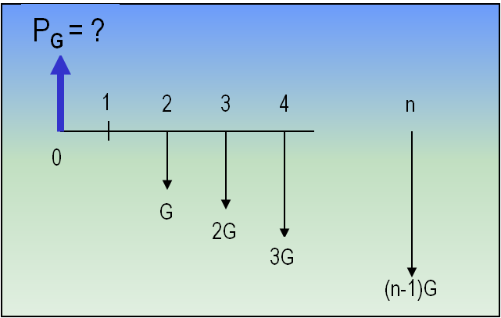
Arithmetic Gradients
Arithmetic gradients change by the same amount each period
The cash flow diagram for the P_{G}
of an arithmetic gradient is:
G starts between periods 1 and 2
(not between 0 and 1)
This is because cash flow in year 1 is usually not equal to G and is handled separately as a base amount
(shown on next slide)
Note that P_{G} is located Two Periods Ahead of the first change that is equal to G
Standard factor notation is
P_{G} = G(P/G,i,n)
2-<number>
© 2012 by McGraw-Hill, New York, N.Y All Rights Reserved

Slide 14
Typical Arithmetic Gradient Cash Flow
P_{T} = ?
i = 10%
0 1 2 3 4 5
400
Amount in year 1
is base amount
450
500
550
600
This diagram = this base amount plus this gradient
P_{A} = ?
P_{G} = ?
i = 10%
i = 10%
0 1 2 3 4 5
+
0 1 2 3 4 5
Amount in year 1
is base amount
400
400
400
400
400
50
P_{G} = 50(P/G,10%,5)
100
P_{A} = 400(P/A,10%,5)
150
200
P_{T} = P_{A} + P_{G} = 400(P/A,10%,5) + 50(P/G,10%,5)
2-<number>
© 2012 by McGraw-Hill, New York, N.Y All Rights Reserved

Slide 15
Converting Arithmetic Gradient to A
Arithmetic gradient can be converted into equivalent A value using G(A/G,i,n)
i = 10%
i = 10%
0 1 2 3 4 5
0 1 2 3 4 5
G
A = ?
2G
3G
4G
General equation when base amount is involved is
A = base amount + G(A/G,i,n)
For decreasing gradients,
change plus sign to minus
0 1 2 3 4 5
4G
3G
A = base amount - G(A/G,i,n)
2G
G
2-<number>
© 2012 by McGraw-Hill, New York, N.Y All Rights Reserved

Slide 16
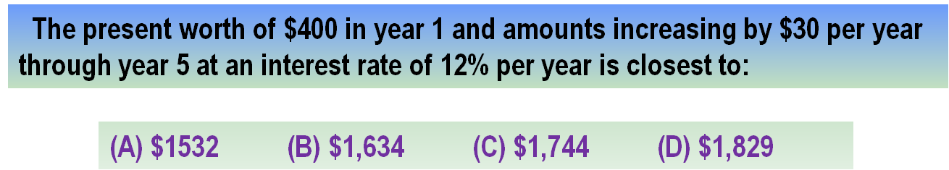
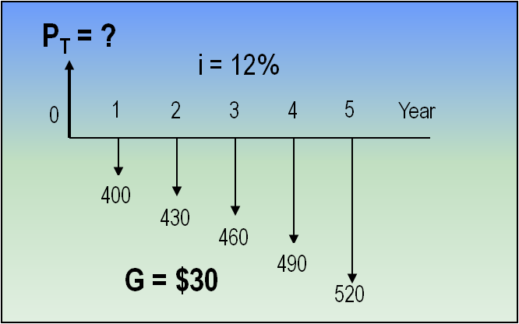
Example: Arithmetic Gradient
Solution:
P_{T} = 400(P/A,12%,5) + 30(P/G,12%,5)
= 400(3.6048) + 30(6.3970)
= $1,633.83
Answer is (B)
The cash flow could also be converted
into an A value as follows:
A = 400 + 30(A/G,12%,5)
= 400 + 30(1.7746)
= $453.24
2-<number>
© 2012 by McGraw-Hill, New York, N.Y All Rights Reserved

Slide 17
Geometric Gradients
Geometric gradients change by the same percentage each period
Cash flow diagram for present worth
of geometric gradient
There are no tables for geometric factors
Use following equation for g ≠ i:
P_{g} = ?
1
2
3
4
n
P_{g} = A₁{1- [(1+g)/(1+i)]^{n}}/(i-g)
0
where: A₁ = cash flow in period 1
g = rate of increase
If g = i, P_{g} = A₁n/(1+i)
A₁
A ₁(1+g)¹
A ₁(1+g)²
Note: g starts between
periods 1 and 2
A ₁(1+g)^{n-1}
Note: If g is negative, change signs in front of both g values
2-<number>
© 2012 by McGraw-Hill, New York, N.Y All Rights Reserved

Slide 18
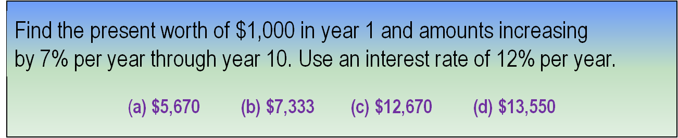
Example: Geometric Gradient
P_{g} = ?
Solution:
i = 12%
1
2
3
4
10
P_{g} = 1000[1-(1+0.07/1+0.12)¹⁰]/(0.12-0.07)
= $7,333
0
1000
1070
Answer is (b)
1145
g = 7%
1838
To find A, multiply P_{g} by (A/P,12%,10)
2-<number>
© 2012 by McGraw-Hill, New York, N.Y All Rights Reserved

Slide 19

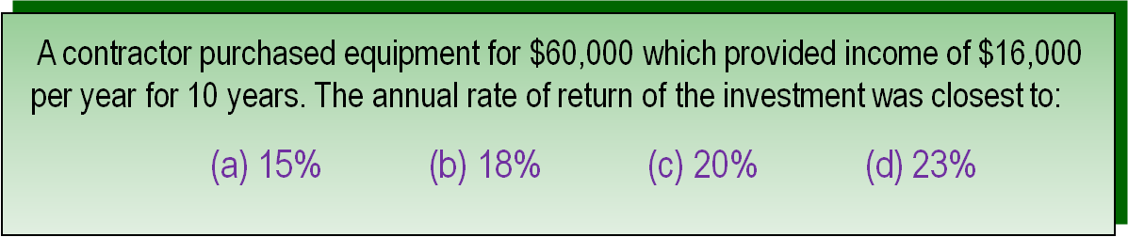
Unknown Interest Rate i
(Usually requires a trial and error solution or interpolation in interest tables)
Procedure: Set up equation with all symbols involved and solve for i
Solution:
Can use either the P/A or A/P factor. Using A/P:
60,000(A/P,i%,10) = 16,000
(A/P,i%,10) = 0.26667
From A/P column at n = 10 in the interest tables, i is between 22% and 24%
Answer is (d)
2-<number>
© 2012 by McGraw-Hill, New York, N.Y All Rights Reserved

Slide 20
Unknown Recovery Period n
Unknown recovery period problems involve solving for n,
given i and 2 other values (P, F, or A)
(Like interest rate problems, they usually require a trial & error solution or interpolation in interest tables)
Procedure: Set up equation with all symbols involved and solve for n
A contractor purchased equipment for $60,000 that provided income of $8,000
per year. At an interest rate of 10% per year, the length of time required to recover
the investment was closest to:
(a) 10 years (b) 12 years (c) 15 years (d) 18 years
Solution:
Can use either the P/A or A/P factor. Using A/P:
60,000(A/P,10%,n) = 8,000
(A/P,10%,n) = 0.13333
From A/P column in i = 10% interest tables, n is between 14 and 15 years
Answer is (c)
2-<number>
© 2012 by McGraw-Hill, New York, N.Y All Rights Reserved

Slide 21
Summary of Important Points
In P/A and A/P factors, P is one period ahead of first A
In F/A and A/F factors, F is in same period as last A
To find untabulated factor values, best way is to use formula or spreadsheet
For arithmetic gradients, gradient G starts between periods 1 and 2
Arithmetic gradients have 2 parts, base amount (year 1) and gradient amount
For geometric gradients, gradient g starts been periods 1 and 2
In geometric gradient formula, A₁ is amount in period 1
To find unknown i or n, set up equation involving all terms and solve for i or n
2-<number>
© 2012 by McGraw-Hill, New York, N.Y All Rights Reserved

