Slide 1


Chapter 3
Combining Factors and Spreadsheet Functions
Lecture slides to accompany
Engineering Economy
7th edition
Leland Blank
Anthony Tarquin
3-<number>
© 2012 by McGraw-Hill, New York, N.Y All Rights Reserved

Slide 2
LEARNING OUTCOMES
Shifted uniform series
Shifted series and single cash flows
Shifted gradients
3-<number>
© 2012 by McGraw-Hill, New York, N.Y All Rights Reserved

Slide 3
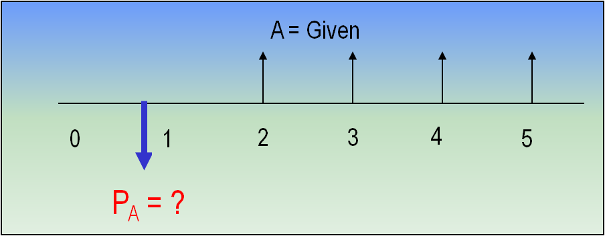
Shifted Uniform Series
A shifted uniform series starts at a time other than period 1
The cash flow diagram below is an example of a shifted series
Series starts in period 2, not period 1
F_{A} = ?
Shifted series usually
require the use of
multiple factors
Remember: When using P/A or A/P factor, P_{A} is always one year ahead
of first A
When using F/A or A/F factor, F_{A} is in same year as last A
3-<number>
© 2012 by McGraw-Hill, New York, N.Y All Rights Reserved

Slide 4
Example Using P/A Factor: Shifted Uniform Series
The present worth of the cash flow shown below at i = 10% is:
(a) $25,304 (b) $29,562 (c) $34,462 (d) $37,908
P₀ = ?
P₁ = ?
i = 10%
Actual year
0 1 2 3 4 5 6
0 1 2 3 4 5
Series year
A = $10,000
Solution: (1) Use P/A factor with n = 5 (for 5 arrows) to get P₁ in year 1
(2) Use P/F factor with n = 1 to move P₁ back for P₀ in year 0
P₀ = P₁(P/F,10%,1) = A(P/A,10%,5)(P/F,10%,1) = 10,000(3.7908)(0.9091) = $34,462
Answer is (c)
3-<number>
© 2012 by McGraw-Hill, New York, N.Y All Rights Reserved

Slide 5
Example Using F/A Factor: Shifted Uniform Series
How much money would be available in year 10 if $8000 is deposited each year in years 3 through 10 at an interest rate of 10% per year?
Cash flow diagram is:
F_{A} = ?
i = 10%
Actual year
0 1 2 3 4 5 6 7 8 9 10
0 1 2 3 4 5 6 7 8
Series year
A = $8000
Solution:
Re-number diagram to determine n = 8 (number of arrows)
F_{A} = 8000(F/A,10%,8)
= 8000(11.4359)
= $91,487
3-<number>
© 2012 by McGraw-Hill, New York, N.Y All Rights Reserved

Slide 6
Shifted Series and Random Single Amounts
For cash flows that include uniform series and randomly placed single amounts:
Uniform series procedures are applied to the series amounts
Single amount formulas are applied to the one-time cash flows
The resulting values are then combined per the problem statement
The following slides illustrate the procedure
3-<number>
© 2012 by McGraw-Hill, New York, N.Y All Rights Reserved

Slide 7

Example: Series and Random Single Amounts
Find the present worth in year 0 for the cash flows
shown using an interest rate of 10% per year.
P_{T} = ?
i = 10%
0 1 2 3 4 5 6 7 8 9 10
A = $5000
$2000
P_{T} = ?
i = 10%
Actual year
0 1 2 3 4 5 6 7 8 9 10
0 1 2 3 4 5 6 7 8
Series year
A = $5000
$2000
Solution:
First, re-number cash flow diagram to get n for uniform series: n = 8
3-<number>
© 2012 by McGraw-Hill, New York, N.Y All Rights Reserved

Slide 8
Example: Series and Random Single Amounts
P_{A}
P_{T} = ?
i = 10%
0 1 2 3 4 5 6 7 8 9 10
Actual year
0 1 2 3 4 5 6 7 8
Series year
A = $5000
$2000
Use P/A to get P_{A} in year 2: P_{A} = 5000(P/A,10%,8) = 5000(5.3349) = $26,675
Move P_{A} back to year 0 using P/F: P₀ = 26,675(P/F,10%,2) = 26,675(0.8264) = $22,044
Move $2000 single amount back to year 0: P₂₀₀₀ = 2000(P/F,10%,8) = 2000(0.4665) = $933
Now, add P₀ and P₂₀₀₀ to get P_{T}: P_{T} = 22,044 + 933 = $22,977
1-<number>
© 2012 by McGraw-Hill, New York, N.Y All Rights Reserved

Slide 9
Example Worked a Different Way
(Using F/A instead of P/A for uniform series)
The same re-numbered diagram from the previous slide is used
P_{T} = ?
F_{A} = ?
i = 10%
0 1 2 3 4 5 6 7 8 9 10
0 1 2 3 4 5 6 7 8
A = $5000
$2000
Solution:
Use F/A to get F_{A} in actual year 10: F_{A} = 5000(F/A,10%,8) = 5000(11.4359) = $57,180
Move F_{A} back to year 0 using P/F: P₀ = 57,180(P/F,10%,10) = 57,180(0.3855) = $22,043
Move $2000 single amount back to year 0: P₂₀₀₀ = 2000(P/F,10%,8) = 2000(0.4665) = $933
Now, add two P values to get P_{T}: P_{T} = 22,043 + 933 = $22,976
Same as before
As shown, there are usually multiple ways to work equivalency problems
3-<number>
© 2012 by McGraw-Hill, New York, N.Y All Rights Reserved

Slide 10
Example: Series and Random Amounts
Convert the cash flows shown below (black arrows) into
an equivalent annual worth A in years 1 through 8 (red arrows)
at i = 10% per year.
A = ?
i = 10%
0 1 2 3 4 5 6 7 8
0 1 2 3 4 5
A = $3000
$1000
Approaches:
1. Convert all cash flows into P in year 0 and use A/P with n = 8
2. Find F in year 8 and use A/F with n = 8
Solution:
Solve for F: F = 3000(F/A,10%,5) + 1000(F/P,10%,1)
= 3000(6.1051) + 1000(1.1000)
= $19,415
Find A: A = 19,415(A/F,10%,8)
= 19,415(0.08744)
= $1698
3-<number>
© 2012 by McGraw-Hill, New York, N.Y All Rights Reserved

Slide 11
Shifted Arithmetic Gradients
Shifted gradient begins at a time other than between periods 1 and 2
Present worth P_{G} is located 2 periods before gradient starts
Must use multiple factors to find P_{T} in actual year 0
To find equivalent A series, find P_{T} at actual time 0 and apply (A/P,i,n)
3-<number>
© 2012 by McGraw-Hill, New York, N.Y All Rights Reserved

Slide 12
Example: Shifted Arithmetic Gradient
John Deere expects the cost of a tractor part to increase by $5 per year beginning 4 years from now. If the cost in years 1-3 is $60, determine the present worth in year 0 of the cost through year 10 at an interest rate of 12% per year.
P_{T} = ?
i = 12%
Actual years
0
1
2
3
4
5
10
0 1 2 3 8
Gradient years
60
60
60
65
70
G = 5
95
Solution:
First find P₂ for G = $5 and base amount ($60) in actual year 2
P₂ = 60(P/A,12%,8) + 5(P/G,12%,8) = $370.41
P₀ = P₂(P/F,12%,2) = $295.29
Next, move P₂ back to year 0
Next, find P_{A} for the $60 amounts of years 1 and 2
P_{A} = 60(P/A,12%,2) = $101.41
Finally, add P₀ and P_{A} to get P_{T} in year 0
P_{T} = P₀ + P_{A} = $396.70
© 2012 by McGraw-Hill, New York, N.Y All Rights Reserved
3-<number>

Slide 13
Shifted Geometric Gradients
Shifted gradient begins at a time other than between periods 1 and 2
Equation yields P_{g} for all cash flows (base amount A₁ is included)
Equation (i ≠ g):
P_{g} = A ₁{1 - [(1+g)/(1+i)]^{n}/(i-g)}
For negative gradient, change signs on both g values
There are no tables for geometric gradient factors
3-<number>
© 2012 by McGraw-Hill, New York, N.Y All Rights Reserved

Slide 14
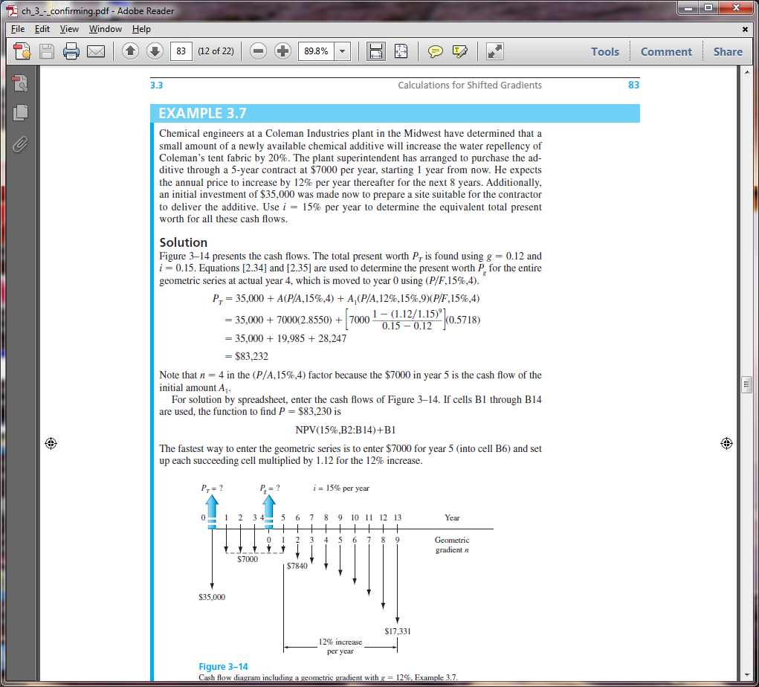
Example: Shifted Geometric Gradient
Weirton Steel signed a 5-year contract to purchase water treatment chemicals from a local distributor for $7000 per year. When the contract ends, the cost of the chemicals is expected to increase by 12% per year for the next 8 years. If an initial investment in storage tanks is $35,000, determine the equivalent present worth in year 0 of all of the cash flows at i = 15% per year.
3-<number>
© 2012 by McGraw-Hill, New York, N.Y All Rights Reserved

Slide 15
Example: Shifted Geometric Gradient
Gradient starts between actual years 5 and 6; these are gradient years 1 and 2.
P_{g} is located in gradient year 0, which is actual year 4
P_{g} = 7000{1-[(1+0.12)/(1+0.15)]⁹/(0.15-0.12)} = $49,401
Move P_{g} and other cash flows to year 0 to calculate P_{T}
P_{T} = 35,000 + 7000(P/A,15%,4) + 49,401(P/F,15%,4) = $83,232
1-<number>
© 2012 by McGraw-Hill, New York, N.Y All Rights Reserved

Slide 16
Negative Shifted Gradients
For negative arithmetic gradients, change sign on G term from + to -
General equation for determining P: P = present worth of base amount - P_{G}
Changed from + to -
For negative geometric gradients, change signs on both g values
Changed from + to -
P_{g} = A₁{1-[(1-g)/(1+i)]^{n}/(i+g)}
Changed from - to +
All other procedures are the same as for positive gradients
3-<number>
© 2012 by McGraw-Hill, New York, N.Y All Rights Reserved

Slide 17
Example: Negative Shifted Arithmetic Gradient
For the cash flows shown, find the future worth in year 7 at i = 10% per year
F = ?
P_{G} = ?
i = 10%
Actual years
0 1 2 3 4 5 6 7
0 1 2 3 4 5 6
Gradient years
500
450
600
550
700
650
G = $-50
Solution:
Gradient G first occurs between actual years 2 and 3; these are gradient years 1 and 2
P_{G} is located in gradient year 0 (actual year 1); base amount of $700 is in gradient years 1-6
P_{G} = 700(P/A,10%,6) – 50(P/G,10%,6) = 700(4.3553) – 50(9.6842) = $2565
F = P_{G}(F/P,10%,6) = 2565(1.7716) = $4544
3-<number>
© 2012 by McGraw-Hill, New York, N.Y All Rights Reserved

Slide 18



Summary of Important Points
P for shifted uniform series is one period ahead of first A;
n is equal to number of A values
F for shifted uniform series is in same period as last A;
n is equal to number of A values
For gradients, first change equal to G or g occurs
between gradient years 1 and 2
For negative arithmetic gradients, change sign on G from + to -
For negative geometric gradients, change sign on g from + to -
3-<number>
© 2012 by McGraw-Hill, New York, N.Y All Rights Reserved

