Slide 1
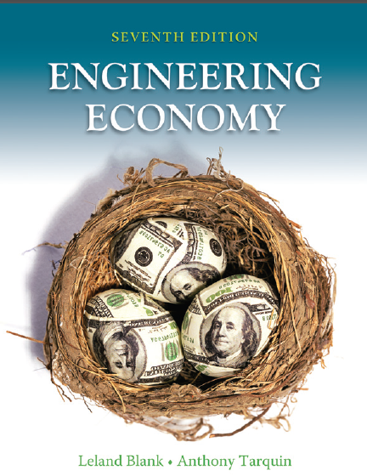

Chapter 6
Annual Worth Analysis
Lecture slides to accompany
Engineering Economy
7th edition
Leland Blank
Anthony Tarquin
6-<number>
© 2012 by McGraw-Hill, New York, N.Y All Rights Reserved

Slide 2
LEARNING OUTCOMES
Advantages of AW
Capital Recovery and AW values
AW analysis
Perpetual life
Life-Cycle Cost analysis
6-<number>
© 2012 by McGraw-Hill All Rights Reserved

Slide 3


Advantages of AW Analysis
AW calculated for only one life cycle
Assumptions:
Services needed for at least the LCM of lives of alternatives
Selected alternative will be repeated in succeeding life cycles
in same manner as for the first life cycle
All cash flows will be same in every life cycle (i.e., will change
by only inflation or deflation rate)
6-<number>
© 2012 by McGraw-Hill All Rights Reserved

Slide 4
Alternatives usually have the following
cash flow estimates
Initial investment, P – First cost of an asset
Salvage value, S – Estimated value of asset at end of useful life
Annual amount, A – Cash flows associated with asset, such
as annual operating cost (AOC), etc.
Relationship between AW, PW and FW
AW = PW(A/P,i%,n) = FW(A/F,i%,n)
n is years for equal-service comparison (value of LCM or specified study period)
6-<number>
© 2012 by McGraw-Hill All Rights Reserved

Slide 5

Calculation of Annual Worth
AW for one life cycle is the same for all life cycles!!
An asset has a first cost of $20,000, an annual operating
cost of $8000 and a salvage value of $5000 after 3 years.
Calculate the AW for one and two life cycles at i = 10%
AW_{one} = - 20,000(A/P,10%,3) – 8000 + 5000(A/F,10%,3)
= $-14,532
AW_{two} = - 20,000(A/P,10%,6) – 8000 – 15,000(P/F,10%,3)(A/P,10%,6)
+ 5000(A/F,10%,6)
= $-14,532
6-<number>
© 2012 by McGraw-Hill All Rights Reserved

Slide 6
Capital Recovery and AW
Capital recovery (CR) is the equivalent annual amount that an asset, process, or system must earn each year to just recover the first cost and a stated rate of return over its expected life. Salvage value is considered when calculating CR.
CR = -P(A/P,i%,n) + S(A/F,i%,n)
Use previous example: (note: AOC not included in CR )
CR = -20,000(A/P,10%,3) + 5000(A/F,10%,3) = $ – 6532 per year
Now AW = CR + A
AW = – 6532 – 8000 = $ – 14,532
6-<number>
© 2012 by McGraw-Hill All Rights Reserved

Slide 7
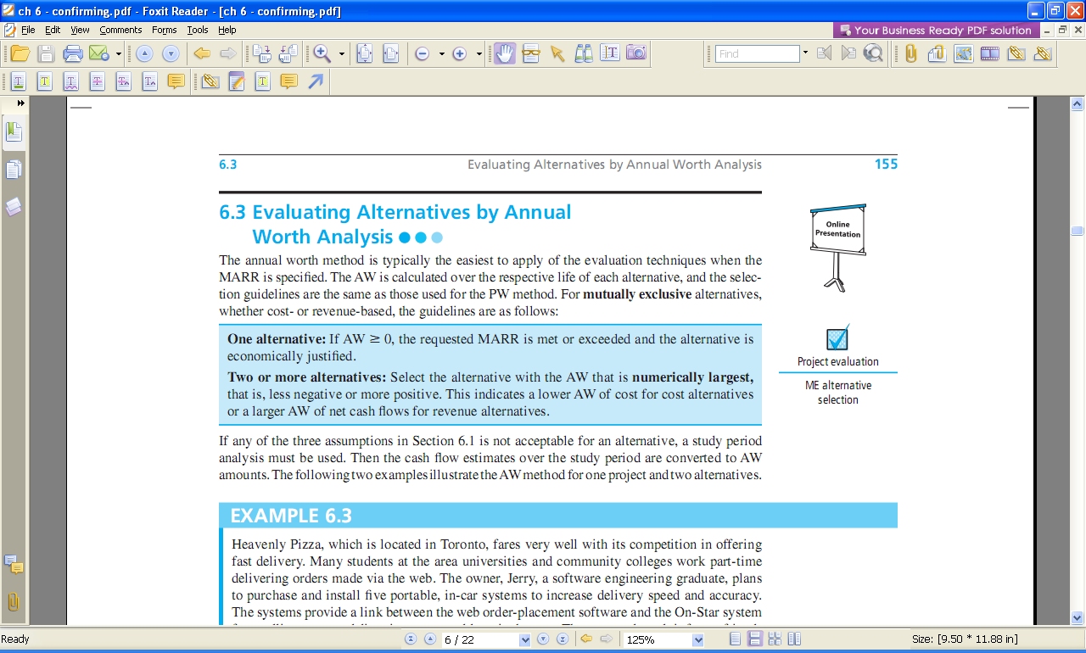
Selection Guidelines for AW Analysis
6-<number>
© 2012 by McGraw-Hill All Rights Reserved

Slide 8
ME Alternative Evaluation by AW
Not necessary to use LCM for different life alternatives
A company is considering two machines. Machine X has a first cost of $30,000, AOC of $18,000, and S of $7000 after 4 years.
Machine Y will cost $50,000 with an AOC of $16,000 and S of $9000 after 6 years.
Which machine should the company select at an interest rate of 12% per year?
Solution:
AW_{X} = -30,000(A/P,12%,4) –18,000 +7,000(A/F,12%,4)
= $-26,412
AW_{Y} = -50,000(A/P,12%,6) –16,000 + 9,000(A/F,12%,6)
= $-27,052
Select Machine X; it has the numerically larger AW value
6-<number>
© 2012 by McGraw-Hill All Rights Reserved

Slide 9
AW of Permanent Investment
Use A = Pi for AW of infinite life alternatives
Find AW over one life cycle for finite life alternatives
Compare the alternatives below using AW and i = 10% per year
C D
First Cost, $ -50,000 -250,000
Annual operating cost, $/year -20,000 -9,000
Salvage value, $ 5,000 75,000
Life, years 5 ∞
Solution: Find AW of C over 5 years and AW of D using relation A = Pi
AW_{C} = -50,000(A/P,10%,5) – 20,000 + 5,000(A/F,10%,5)
= $-32,371
AW_{D} = Pi + AOC = -250,000(0.10) – 9,000
= $-34,000
Select alternative C
6-<number>
© 2012 by McGraw-Hill All Rights Reserved

Slide 10
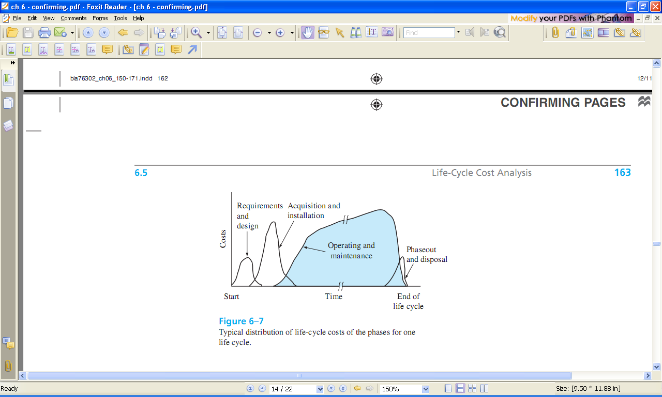
Typical Life-Cycle Cost Distribution by Phase
6-<number>
© 2012 by McGraw-Hill All Rights Reserved

Slide 11
Life-Cycle Cost Analysis
LCC analysis includes all costs for entire life span,
from concept to disposal
Best when large percentage of costs are M&O
Includes phases of acquisition, operation, & phaseout
Apply the AW method for LCC analysis of 1 or more cost alternatives
Use PW analysis if there are revenues and other benefits considered
6-<number>
© 2012 by McGraw-Hill All Rights Reserved

Slide 12
Summary of Important Points
AW method converts all cash flows to annual value at MARR
Alternatives can be mutually exclusive, independent,
revenue, or cost
AW comparison is only one life cycle of each alternative
For infinite life alternatives, annualize initial cost as A = P(i)
Life-cycle cost analysis includes all costs over
a project’s life span
6-<number>
© 2012 by McGraw-Hill All Rights Reserved

