Slide 1
Azure Kunernetes Assessment
Created AKS with high-availability
Attached all screenshots for
*AKS cluster
*Connected on Azure Powershell
*Attached code to deploy
*Ran the code using “kubectl apply”
*kubectl get pods; kubectl get services
*Opened application using External-IP
*Screenshots of Services, Namespaces, Node-pools

Slide 2
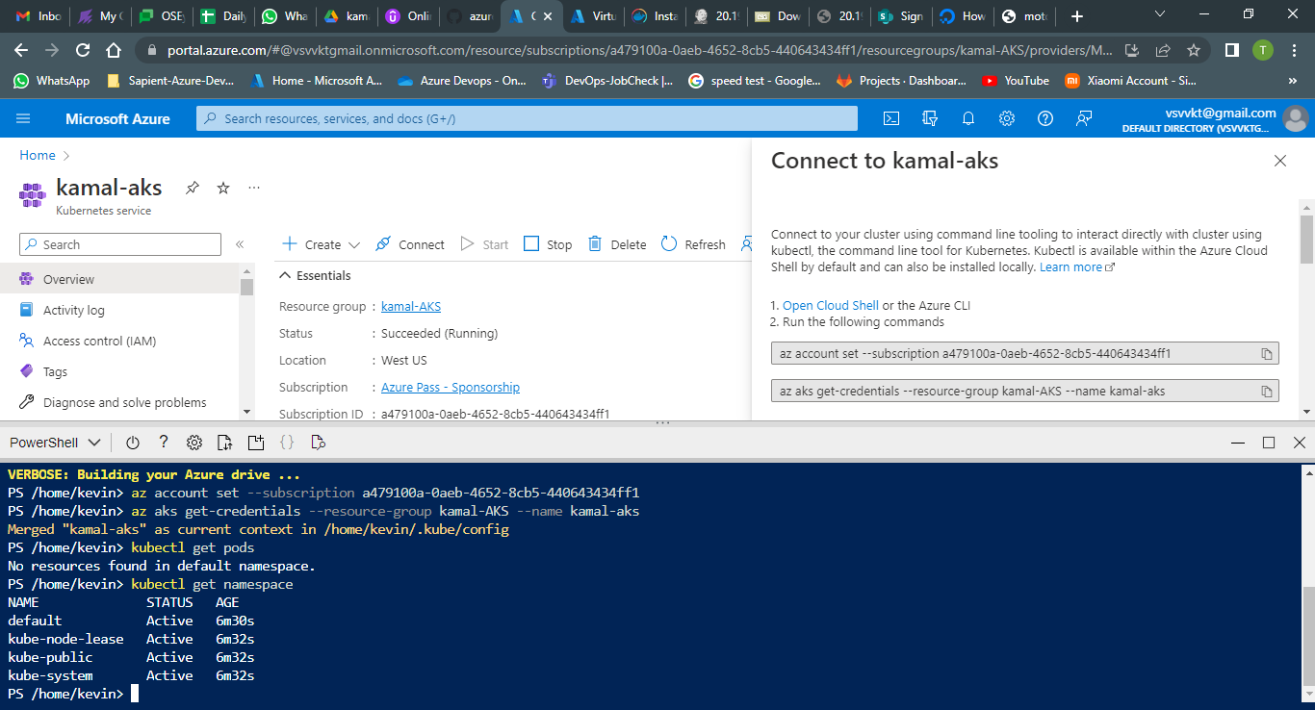

Slide 3
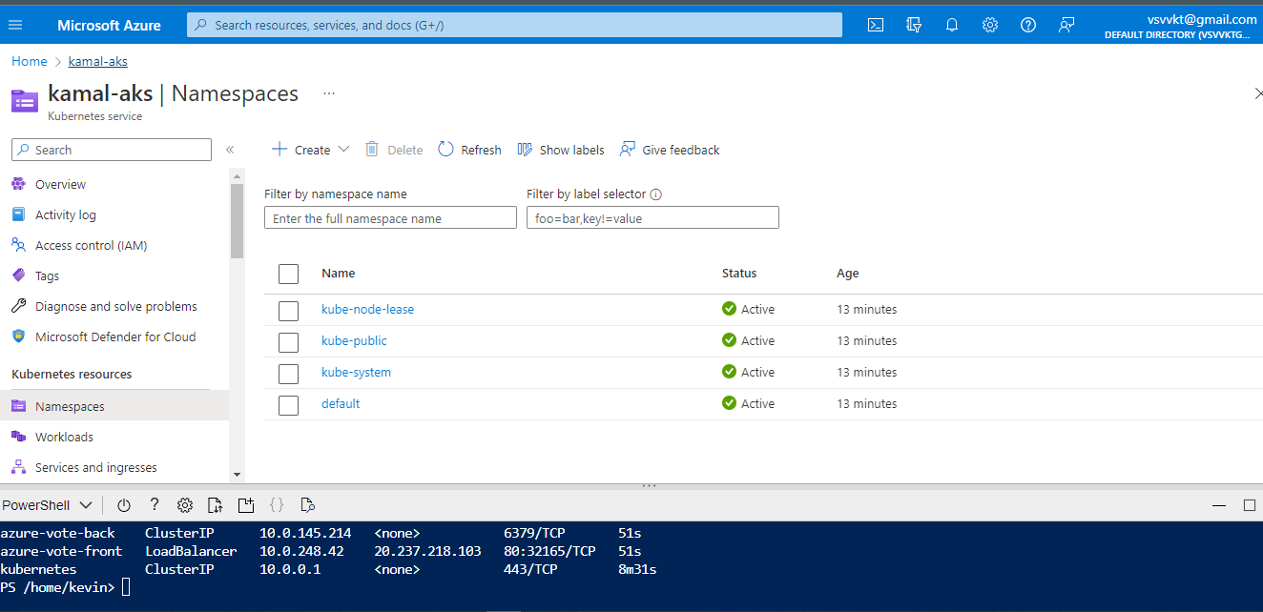

Slide 4
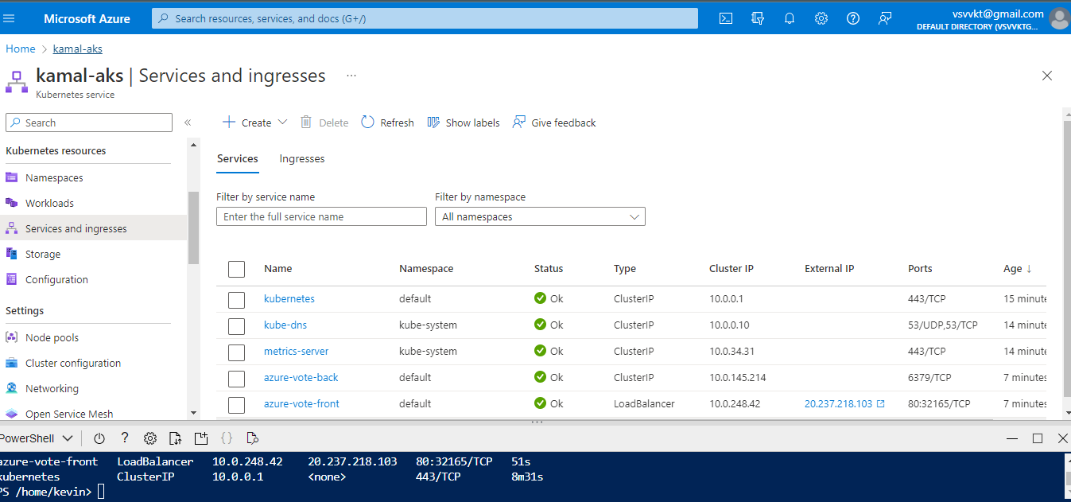

Slide 5
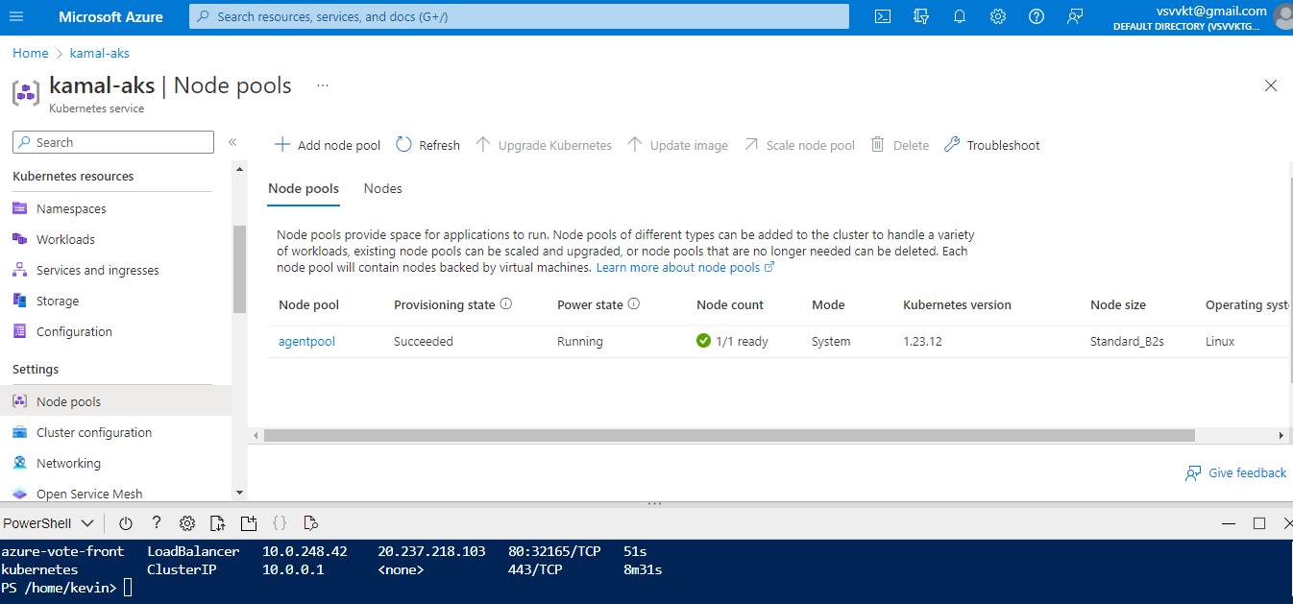

Slide 6
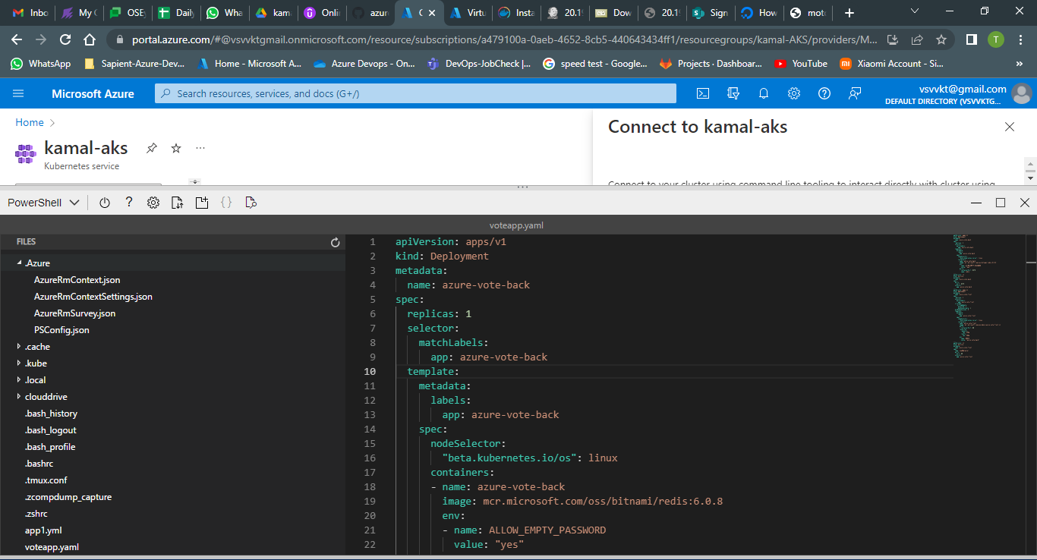

Slide 7
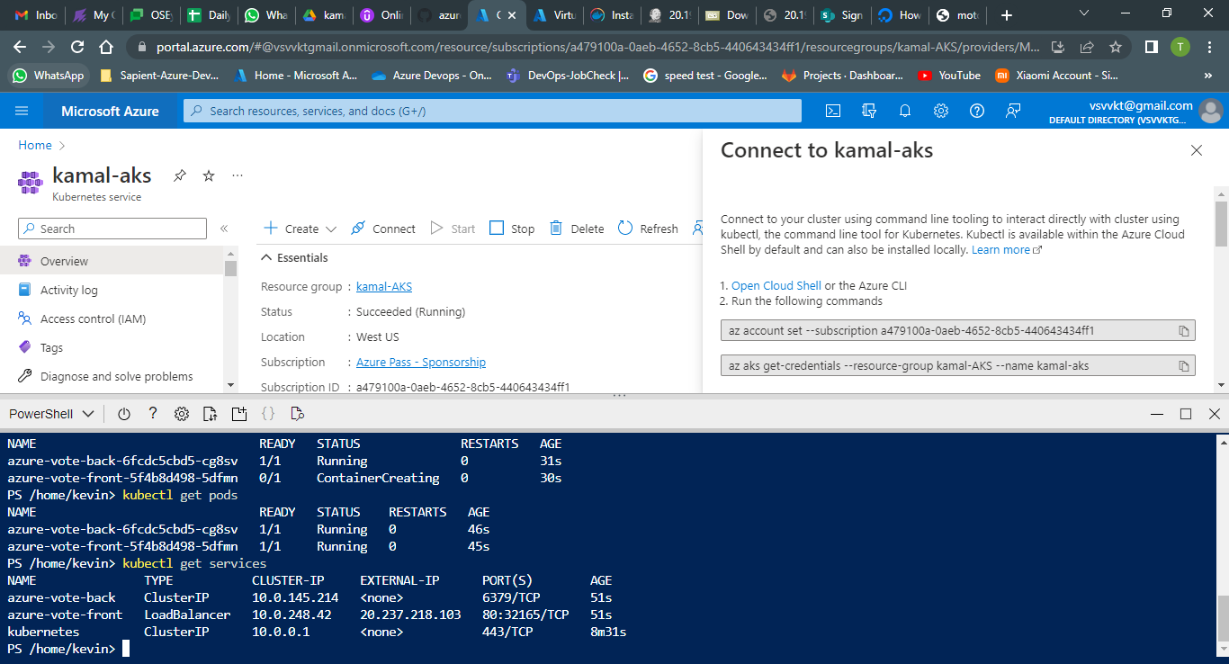

Slide 8
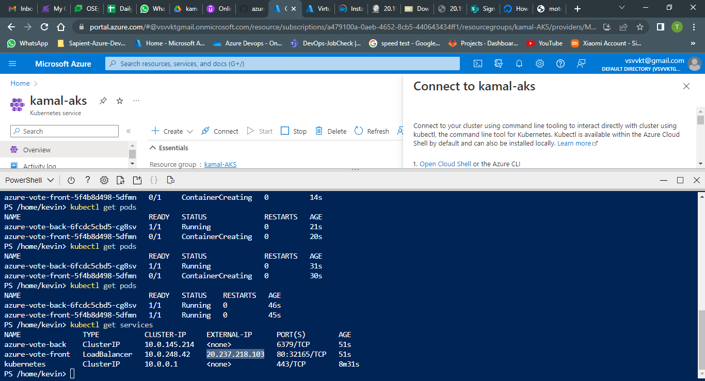

Slide 9
