Slide 1
Terraform Assessment to Create VM in Azure
*Opened Azure cloudshell to create main.tf
*Conposed tf script to create VM
*Added Providers, Resource Group,V- Net,Subnet,Public IP,Azure Network Interface, Windows VM
*In Azure cloudshell, logged into Azure cloud using “AZ login” .
* Executed main.tf with terraform init, terraform apply.
*Got error in the Subnet creation part, rectified successfully.
*After rectification, VM created successfully using Terraform.

Slide 2
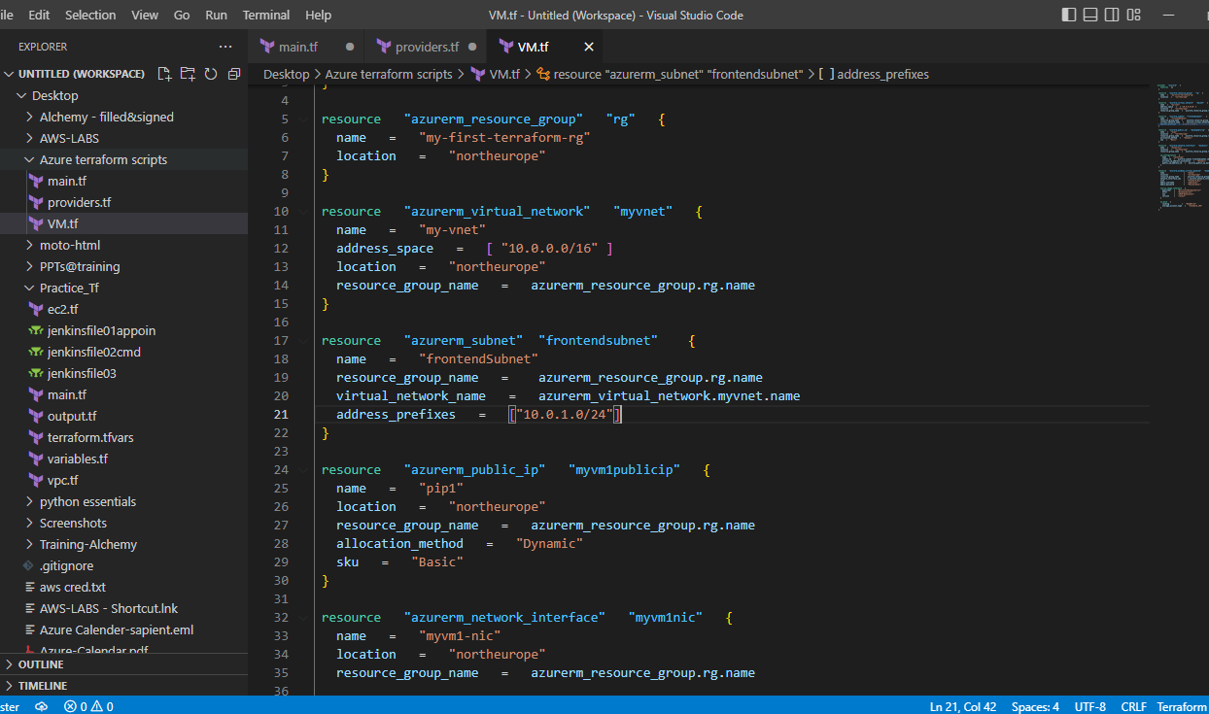

Slide 3
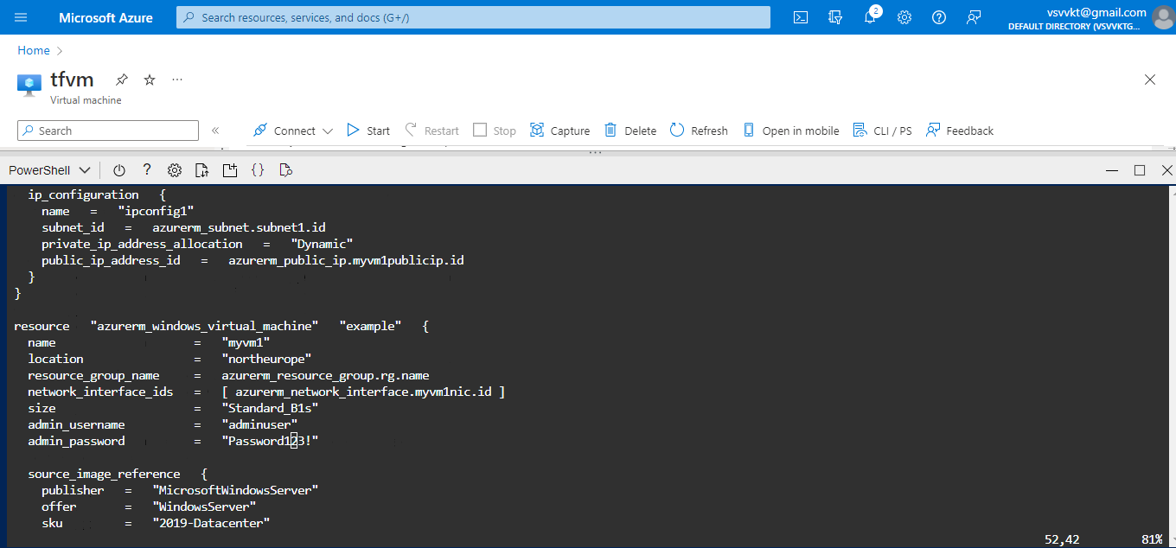

Slide 4
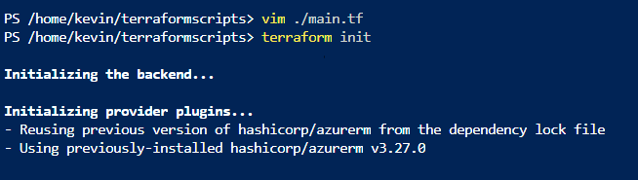

Slide 5
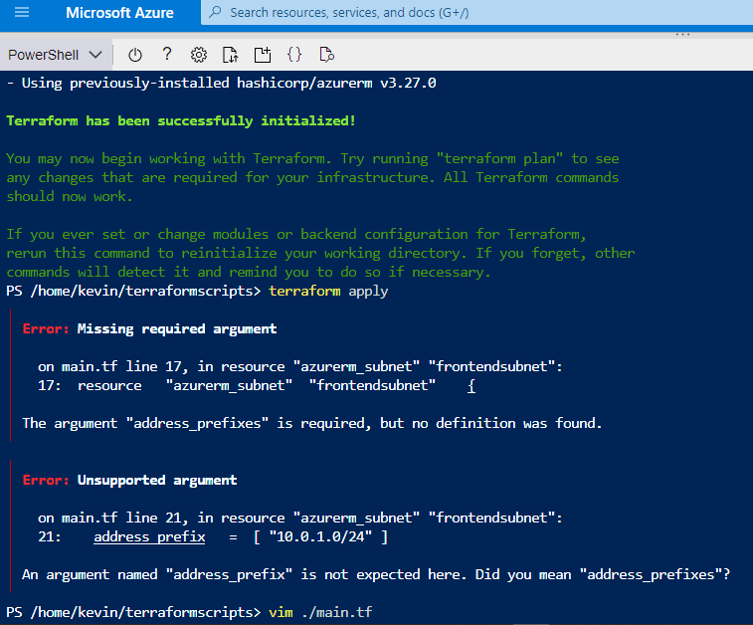

Slide 6
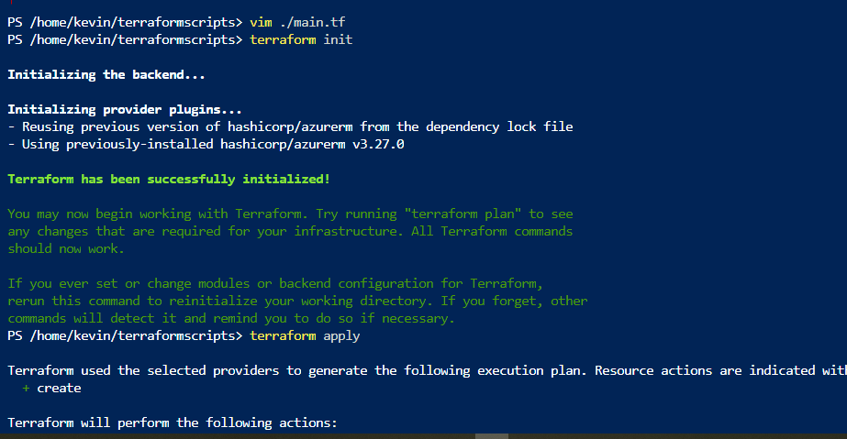

Slide 7
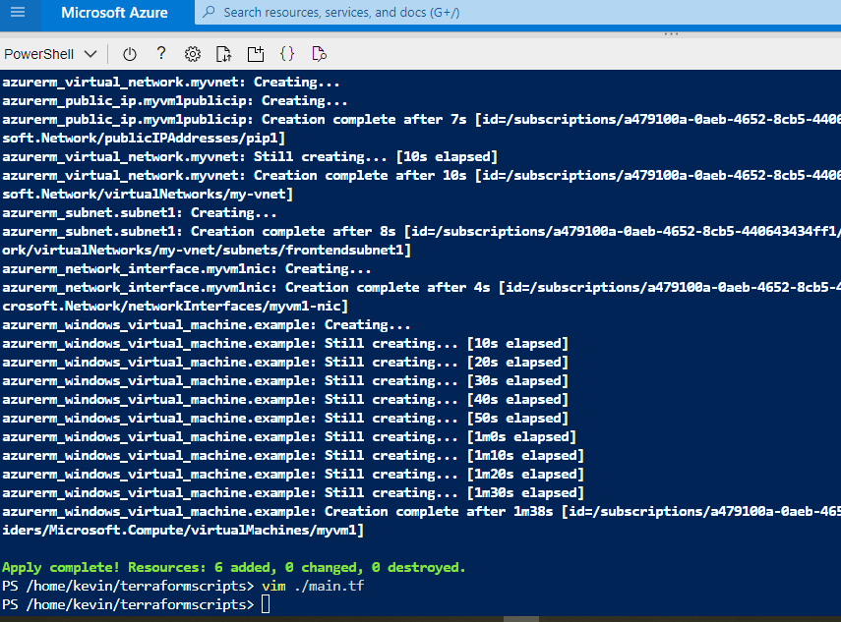

Slide 8
