Slide 1
Creating a Virtual Machine using Terraform

Slide 2
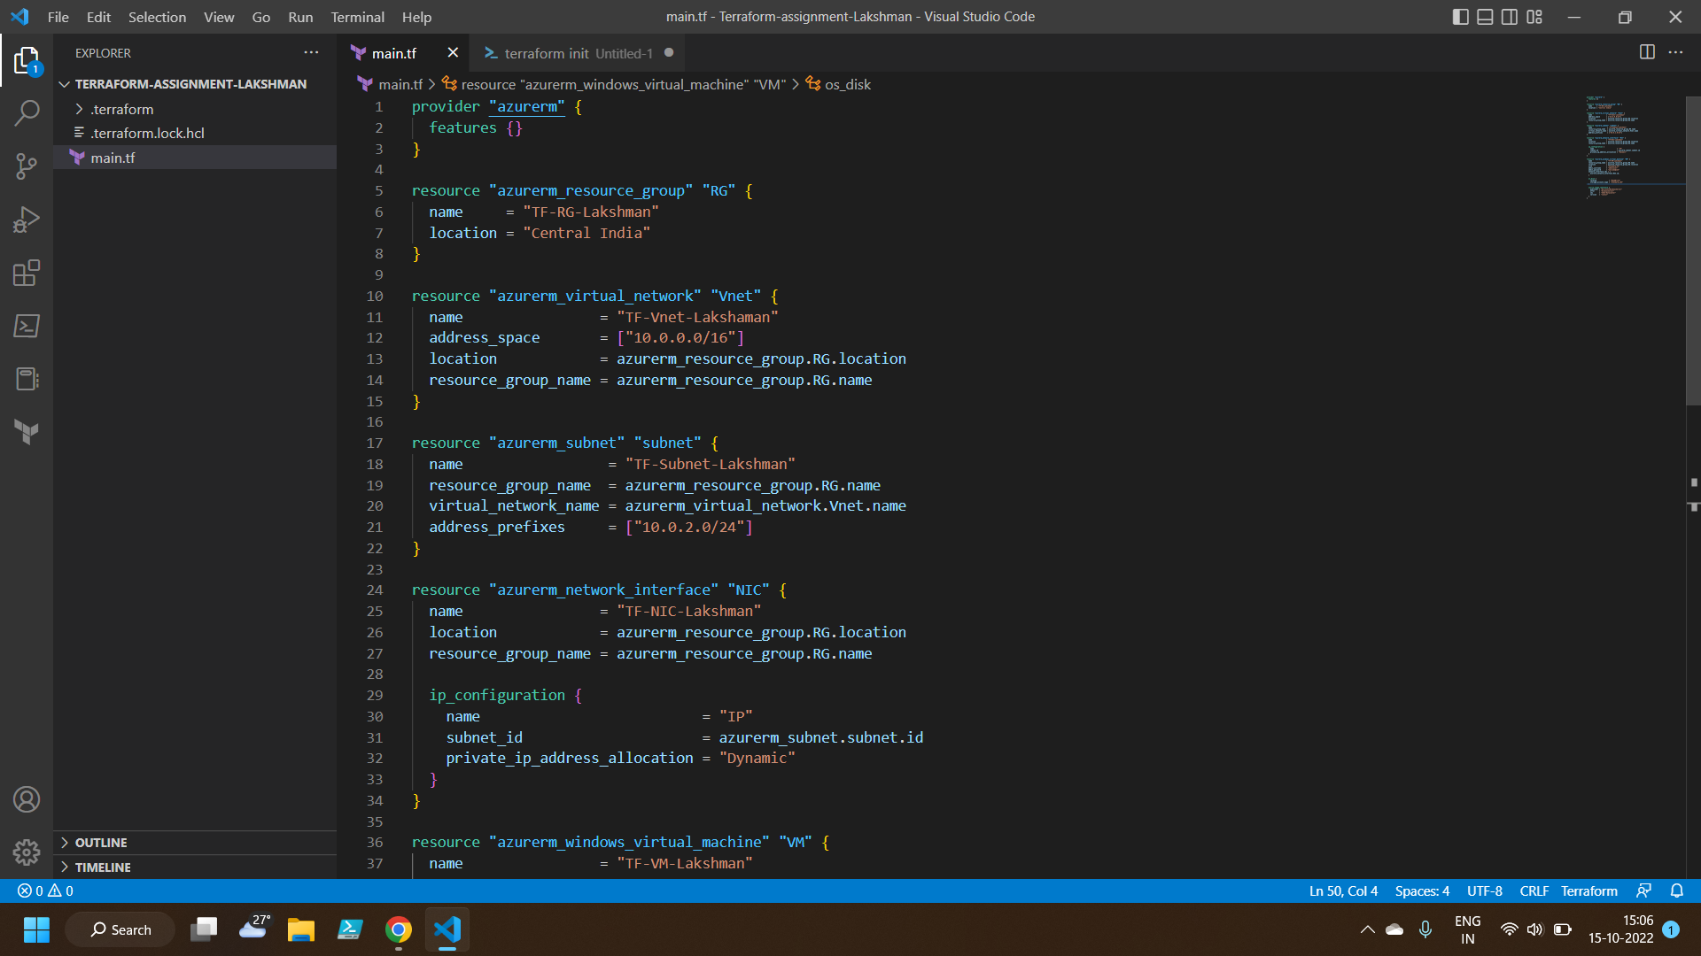
Terraform code to create a Virtual Machine

Slide 3
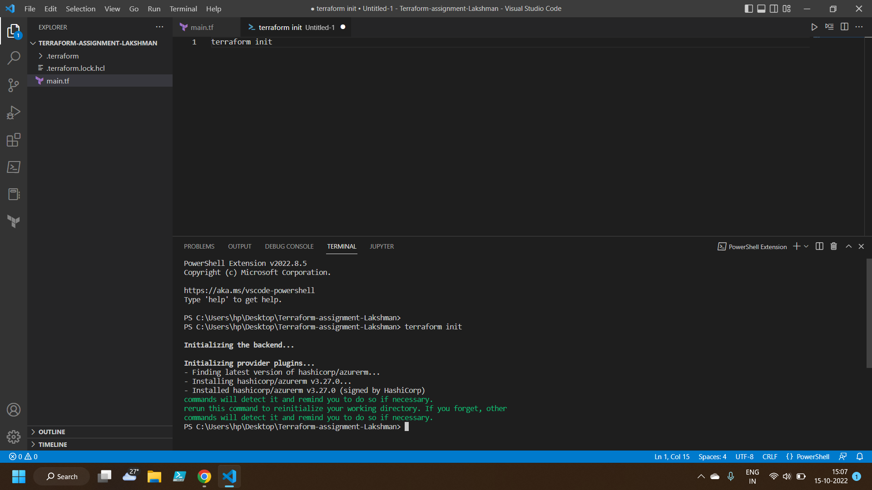
Initializing Terraform using Powershell

Slide 4
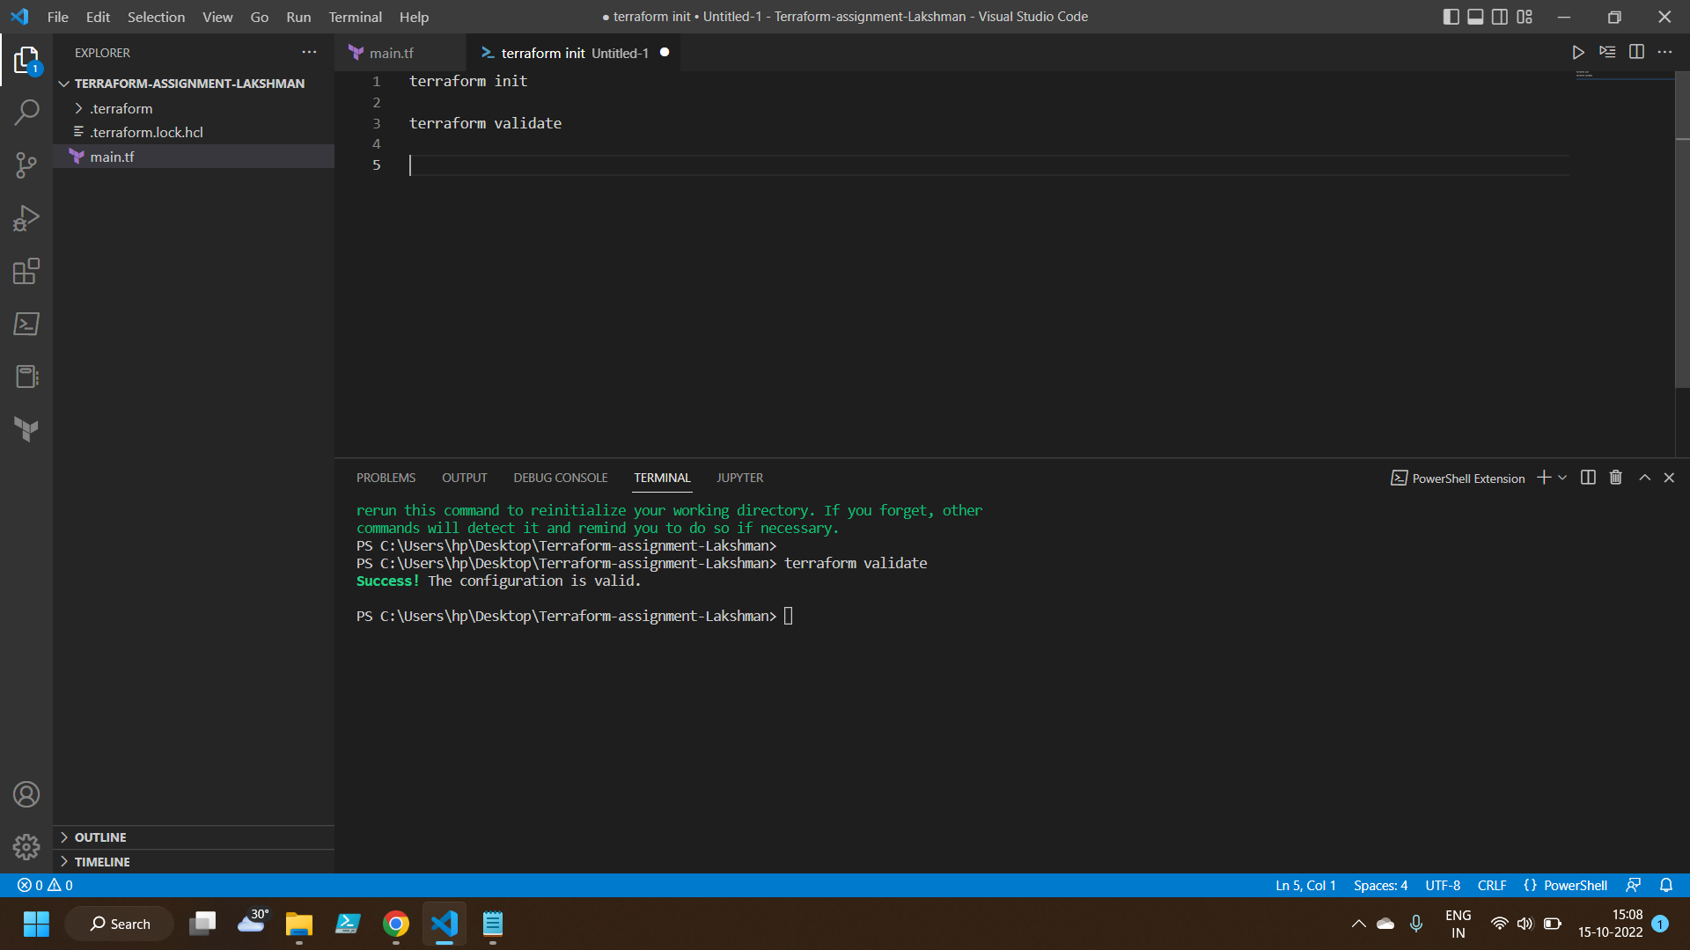
Validating Terraform script

Slide 5
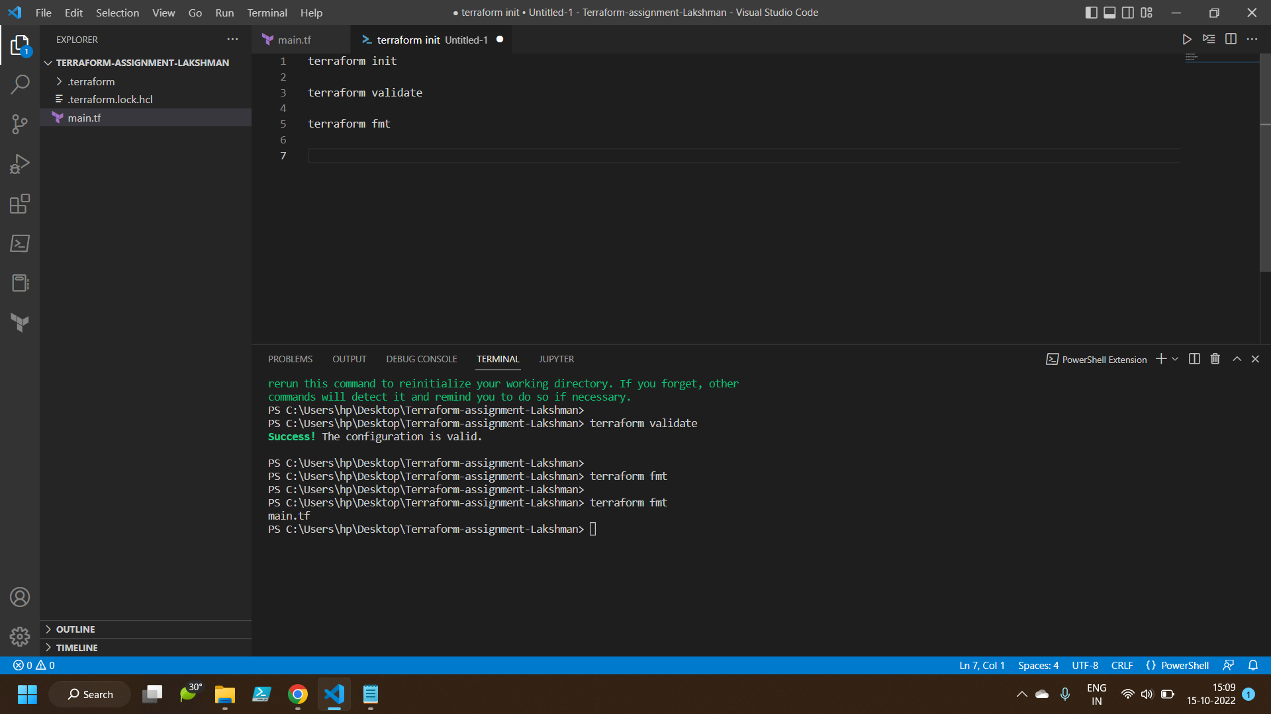
Terraform format

Slide 6
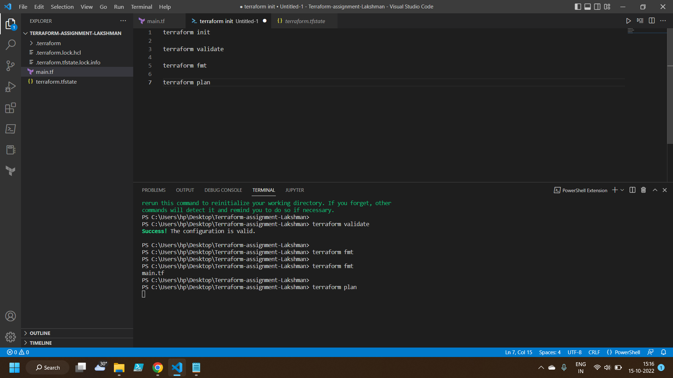
Terraform plan

Slide 7
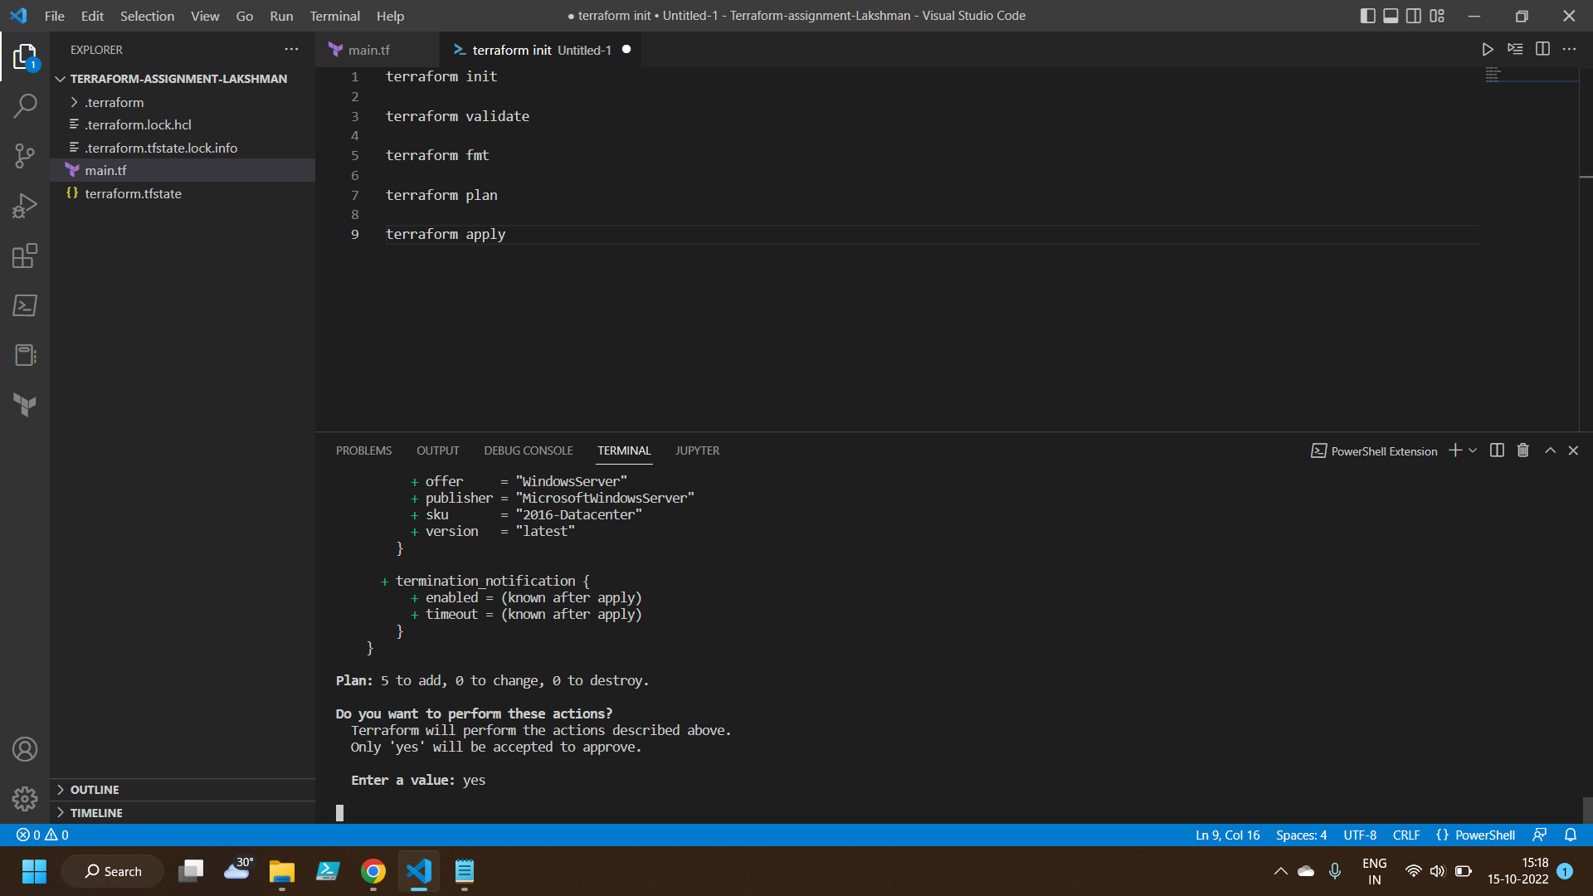
Terraform apply

Slide 8
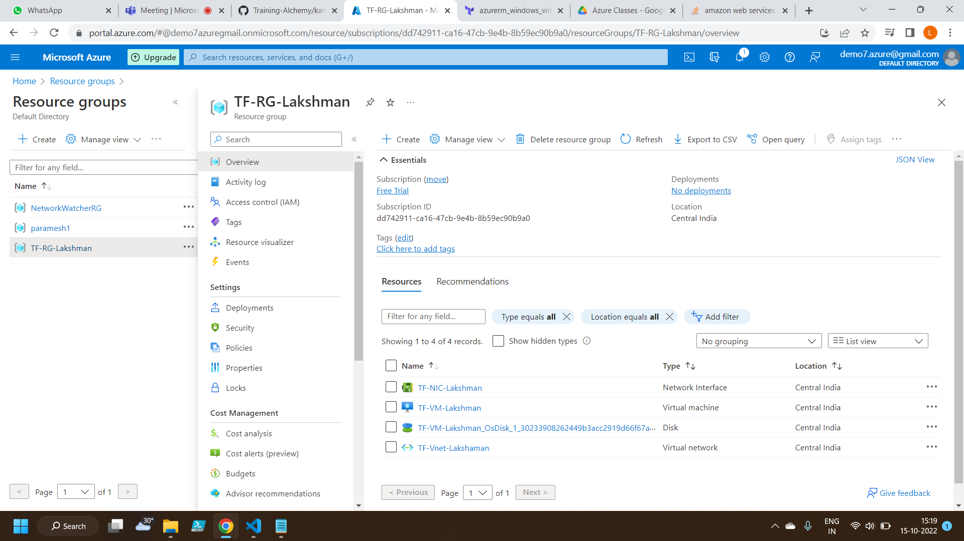
Resource Group created using Terraform script

Slide 9
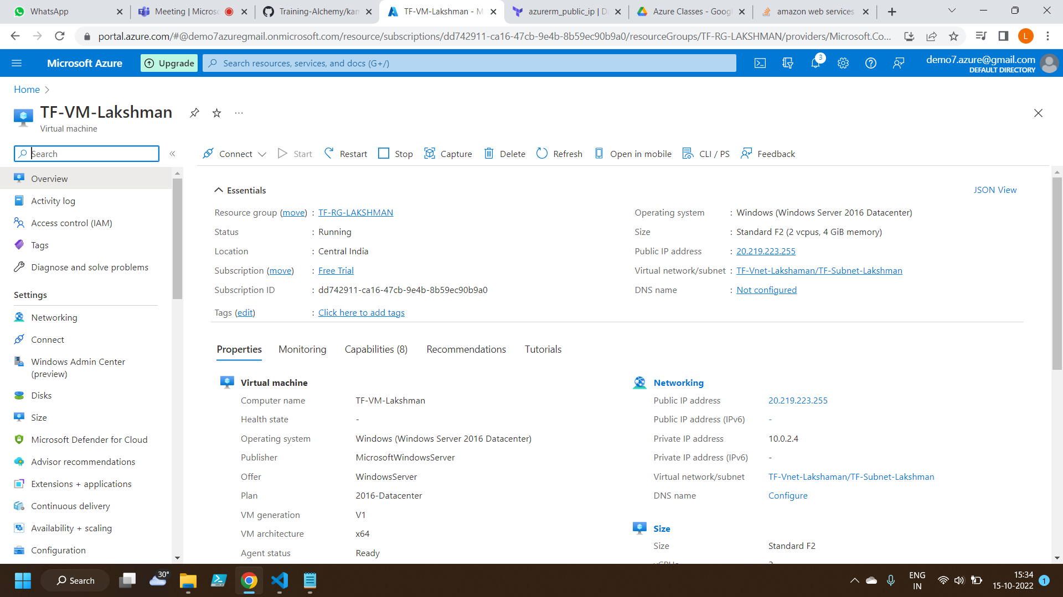
Virtual Machine created using Terraform script

Slide 10
Thankyou

