Slide 1
Deploying a sample code using Kubernetes

Slide 2
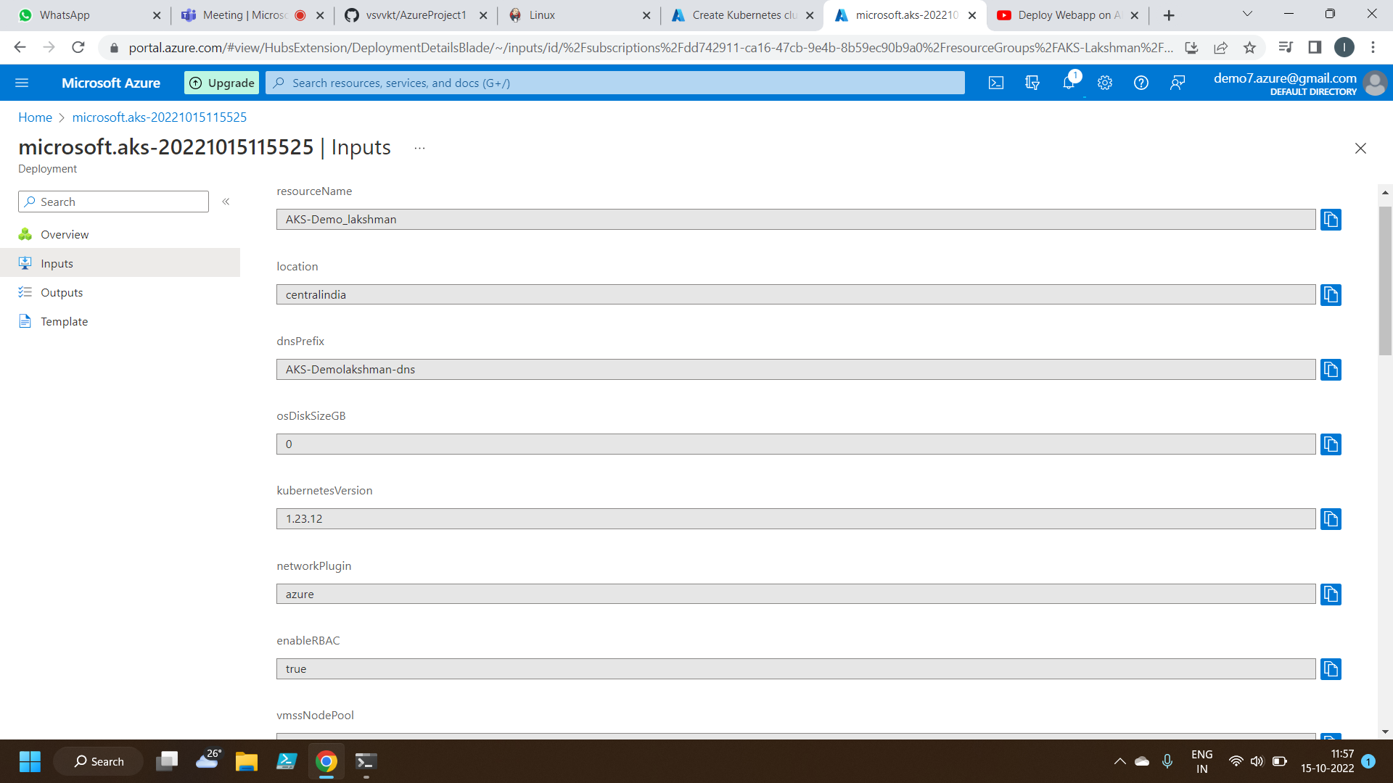
Creating a Azure Kubernetes Service

Slide 3
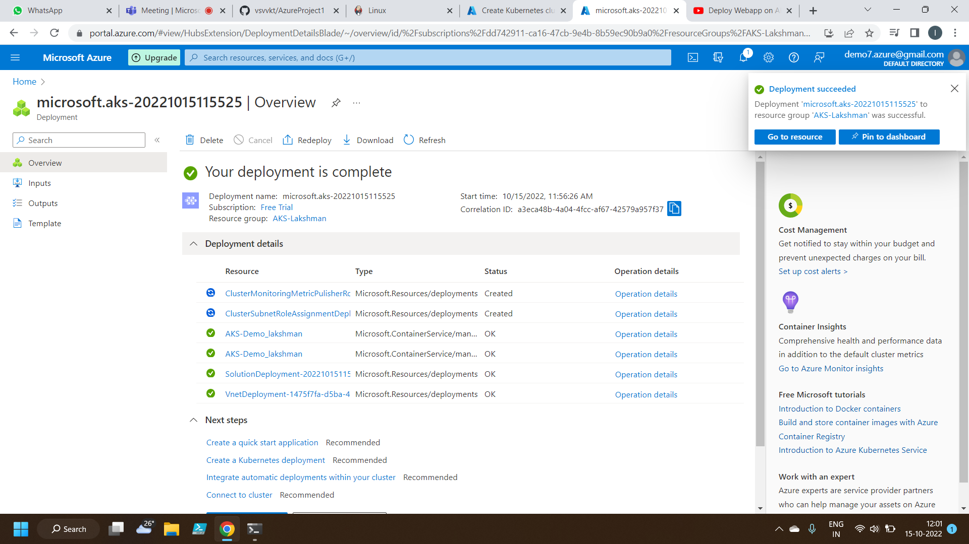
Deployment of Kubernetes Service

Slide 4
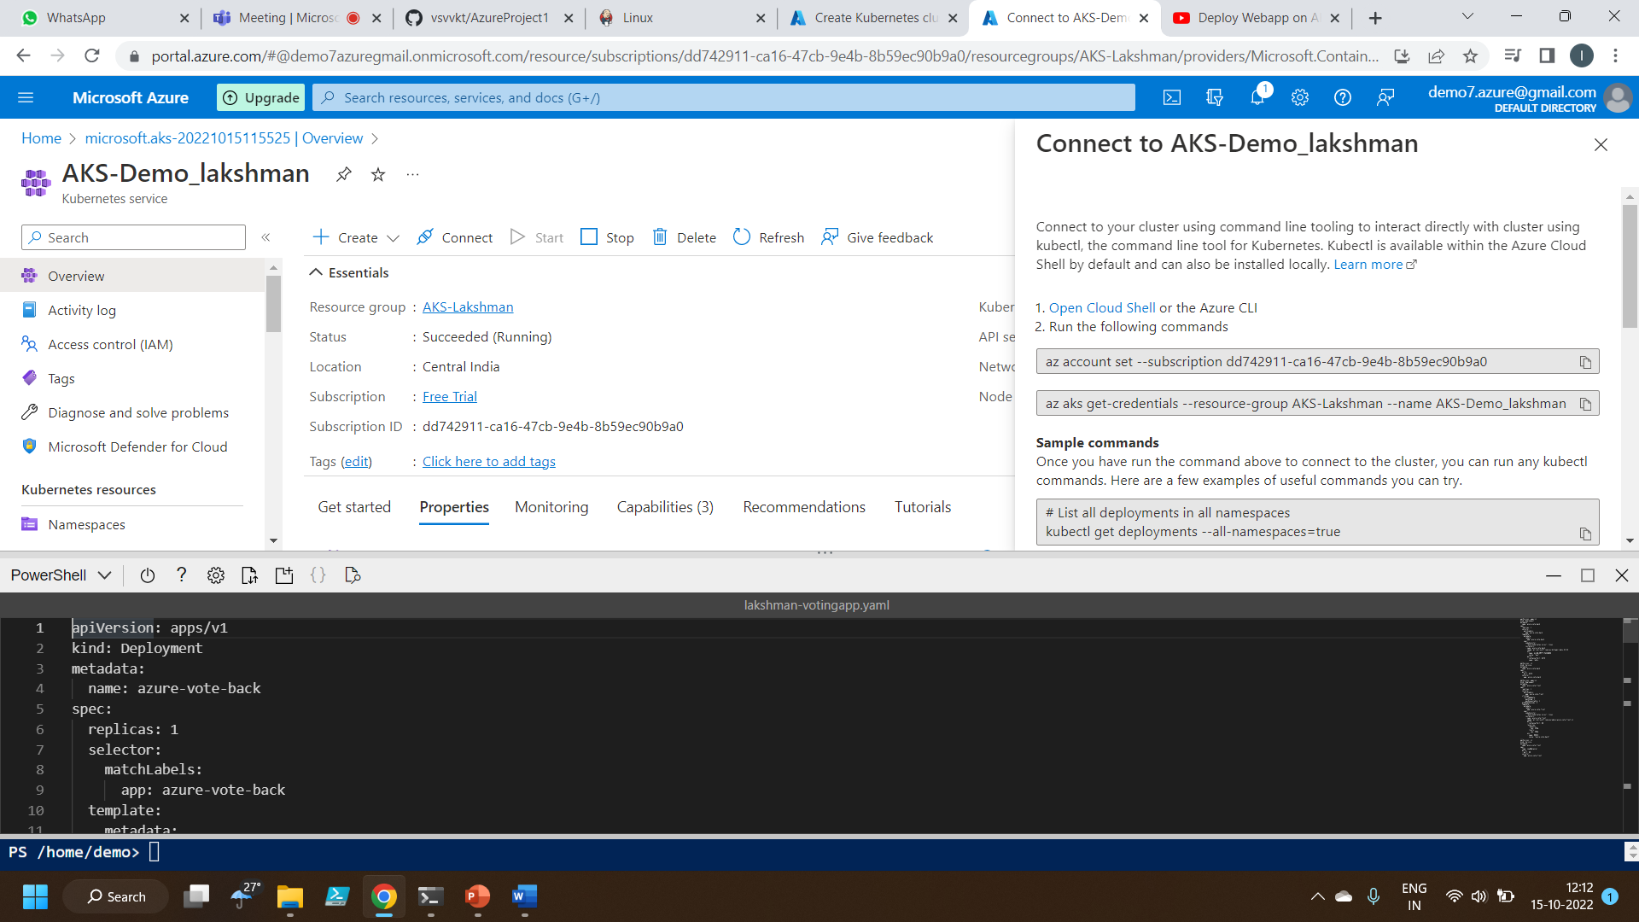
Deploying the voting app code

Slide 5
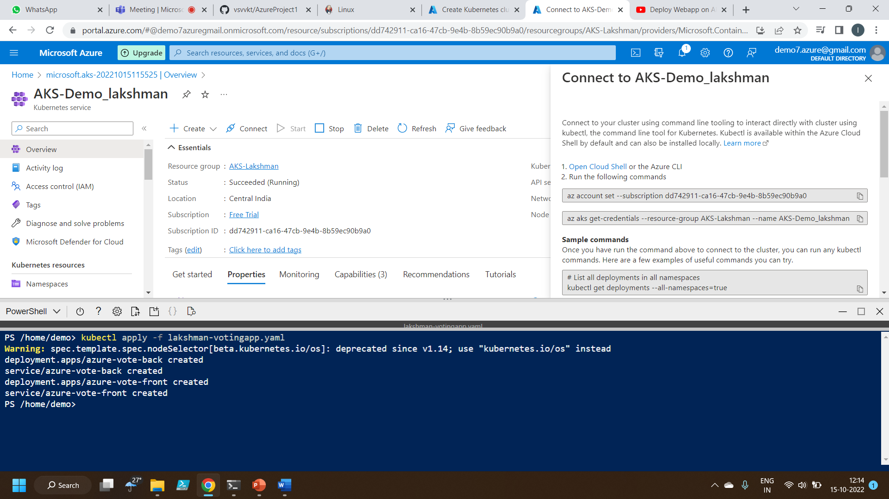
Executing the code

Slide 6
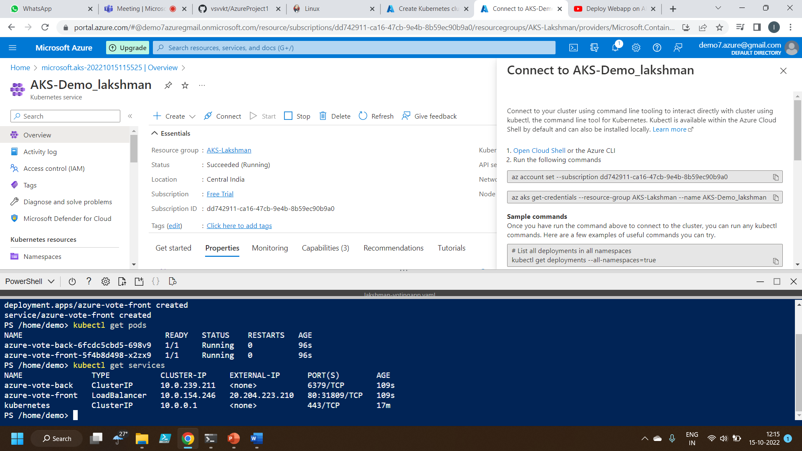
Checking Pods status & services

Slide 7
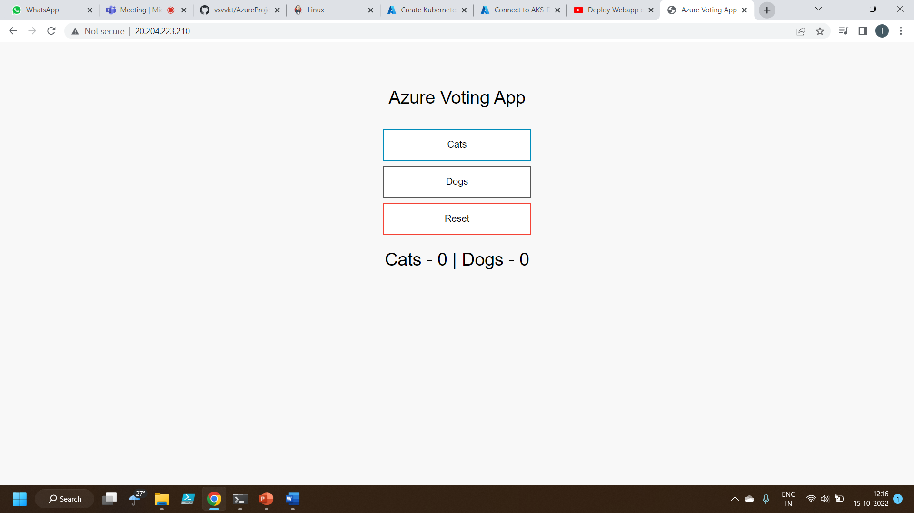
Output

Slide 8
Thankyou

