Slide 1
Presentation of Azure-class: 16/09/2022
By Kamal teja.

Slide 2
Networking
Network
IP Adress – Static IP, Dynamic IP, DHCP
IPV4, IPV6
Types of distribution methods- 1.Class Full Distribution Method
, 2.Class Less Inter Domain Routing (CIDR)

Slide 3
Types of IP address classes
Class A: (0-126)
• Network.Host.Host.Host (N.H.H.H)
•A.256x256x256 = 16,777,216
Class B: (128-191)
•Network.Network.Host.Host (N.N.H.H)
•A.B.256X256 = 65,536
Class C: (192-223)
•Network.Network.Nerwork.Host (N.N.N.H)
•A.B.C.256 = 256
Class D: (224-239)
•Class D addresses are used for multicasting applications.
Class E: (224-239)
•This IP Class is reserved for experimental purposes only for R&D or Study

Slide 4
CIDR ranges
•It’s a block of IP address
•a . b . c .d / n
•n = value of CIDR
Standard IP address = 2^x
X= 0,1,2,3,4,5…..
Standard IP will be equal to 2^(32-n)
•2^x=2^(32-n)
•x=32-n
n=32-x

Slide 5
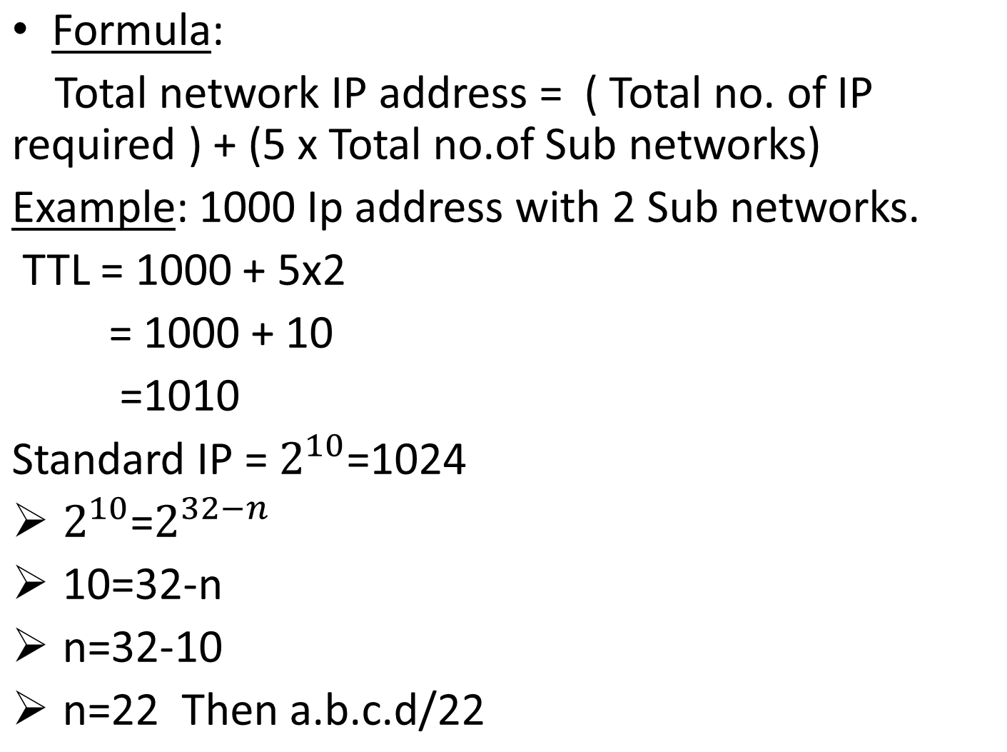
Calculating the value of CIDR ranges(n)

Slide 6





Azure Virtual Network (V-Net)

Slide 7
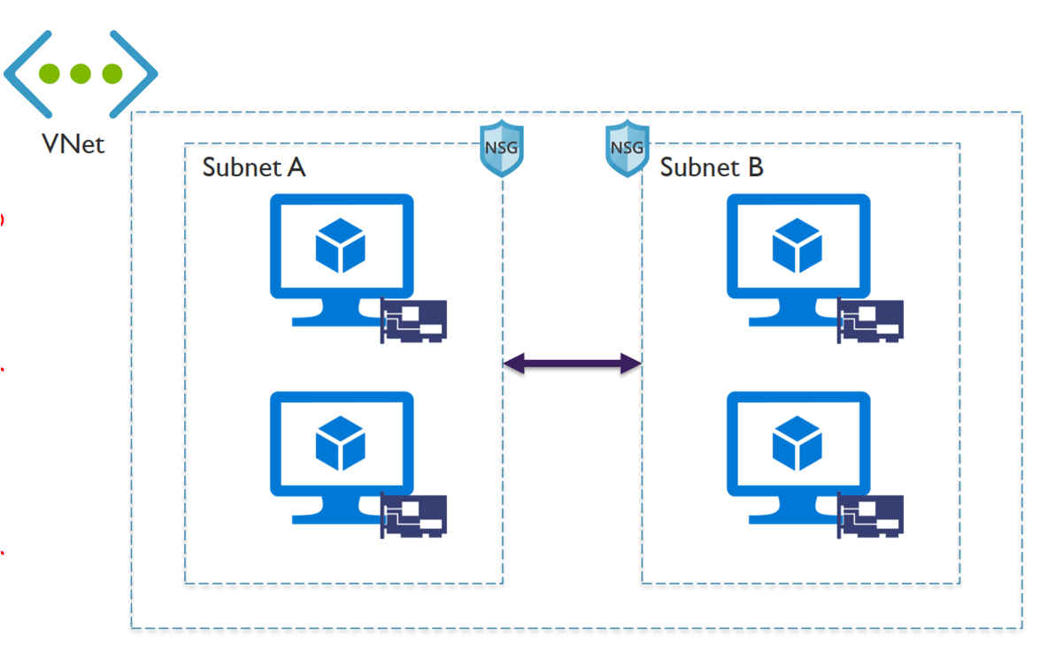
•Azure Virtual Network (VNet) is the fundamental building block for your private network in Azure. VNet enables many types of Azure resources, such as Azure Virtual Machines (VM), to securely communicate with each other, the internet, and on-premises networks.
•A subnet is a range of IP addresses in the virtual network. You can divide a virtual network into multiple subnets for organization and security. Each NIC in a VM is connected to one subnet in one virtual network.

Slide 8
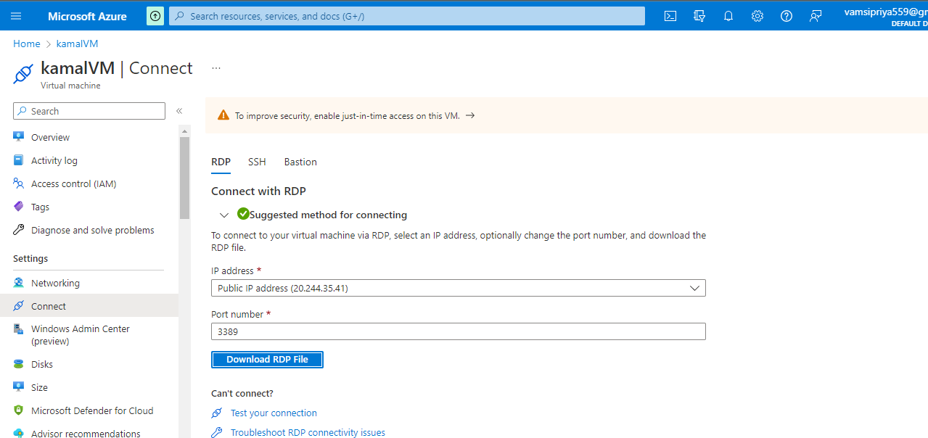
Creation of Virtual Machine(VM) in Microsoft Azure

Slide 9
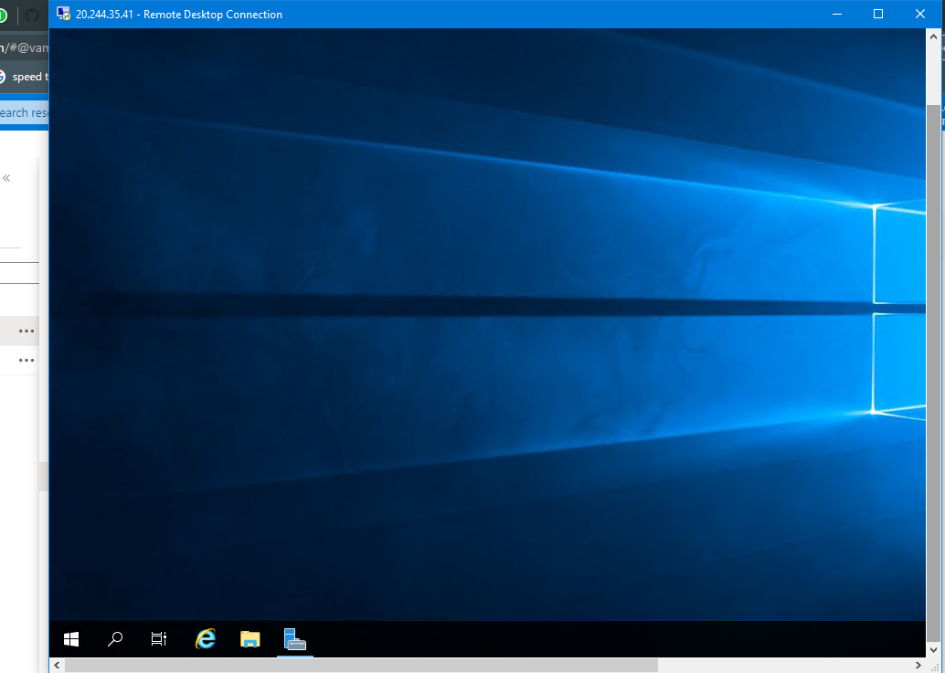
Login to Windows VM using RDP

Slide 10
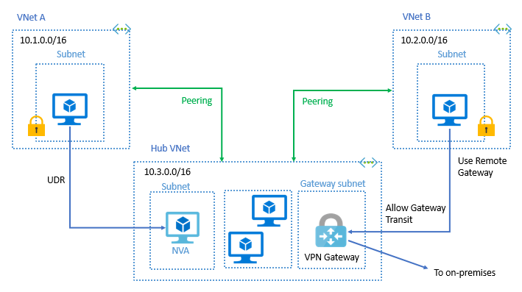
Peering of 2 V-nets in same Region
Virtual network peering enables you to seamlessly connect two or more Virtual Networks in Azure. The virtual networks appear as one for connectivity purposes. The traffic between virtual machines in peered virtual networks uses the Microsoft backbone infrastructure.

Slide 11
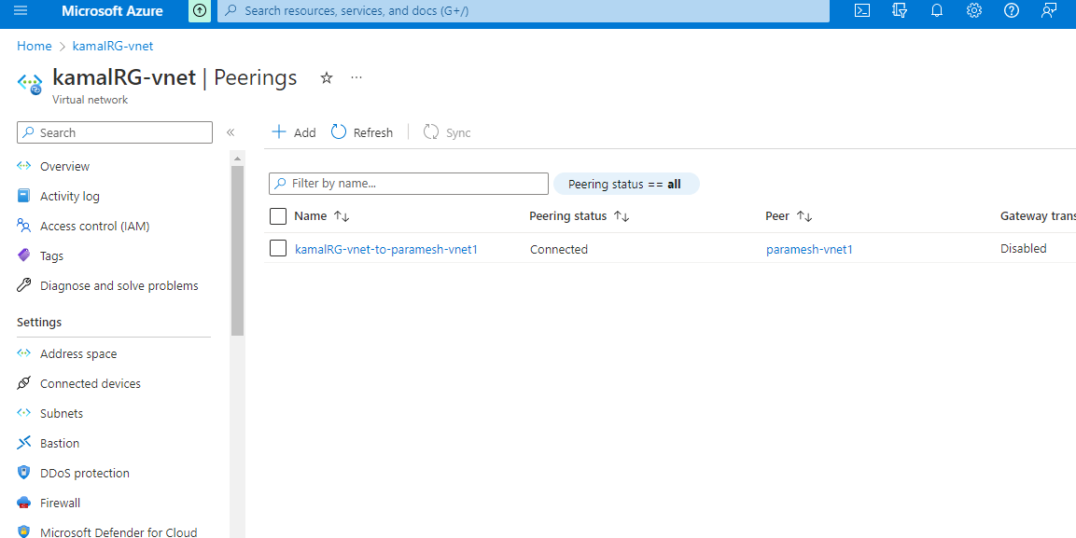
.
In this, I connected 2 V-nets named kamalRG-vnet and paramesh-vnet1 are in the same region named Central India in Microsoft Azure Cloud

Slide 12

Thank You!

