Slide 1
AZURE KUBERNETES SERVICE
Azure Kubernetes Service (AKS) simplifies deploying a managed Kubernetes cluster in Azure by offloading the operational overhead to Azure. As a hosted Kubernetes service, Azure handles critical tasks, like health monitoring and maintenance. Since Kubernetes masters are managed by Azure, you only manage and maintain the agent nodes. Thus, AKS is free; you only pay for the agent nodes within your clusters, not for the masters.

Slide 2
Integrated logging and monitoring
Clusters and nodes
Cluster node and pod scaling
Cluster node upgrades
GPU-enabled nodes
Docker image support and private container registry
Development tooling integration
Storage volume support

Slide 3
Core Kubernetes infrastructure components:
control plane
nodes
node pools
Workload resources:
pods
deployments
sets

Slide 4
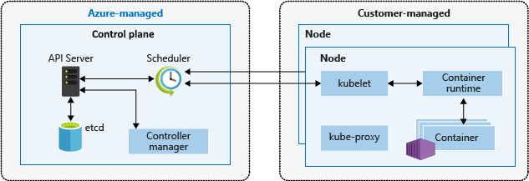
AKS Flow Diagram

Slide 5
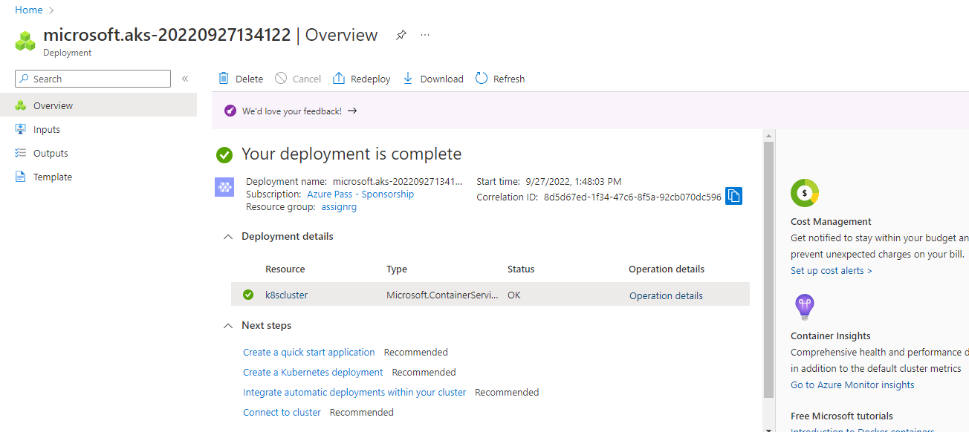
Created AKS cluster

Slide 6
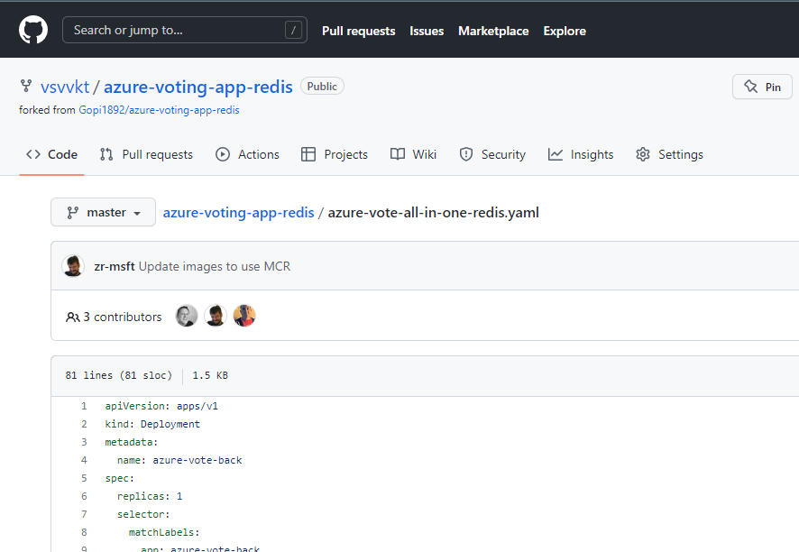
Application running using this code

Slide 7
http://20.207.74.111/
Appliation is running in this ipa.
Created sample application

Slide 8
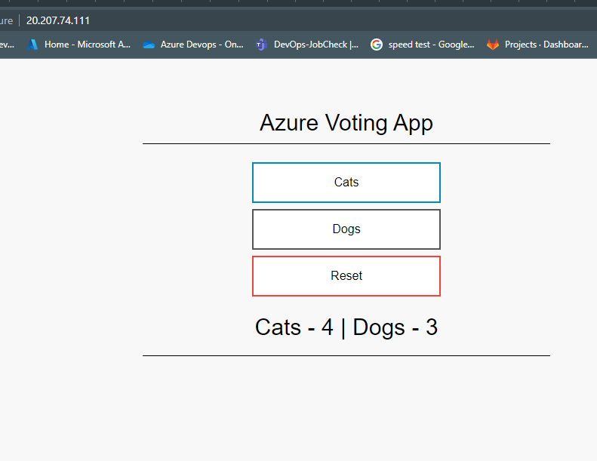
Application is running

Slide 9
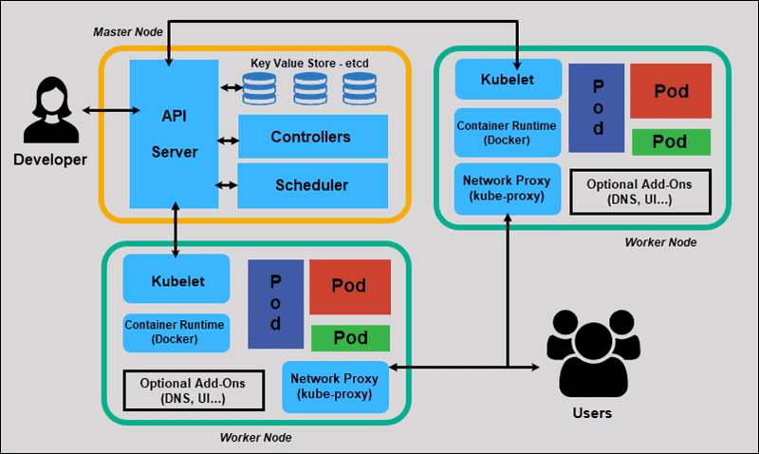
KUBERNETES MAIN COMPONENTS

Slide 10
kube-apiserver
The API server is a component of the Kubernetes control plane that exposes the Kubernetes API. The API server is the front end for the Kubernetes control plane.
The main implementation of a Kubernetes API server is kube-apiserver. kube-apiserver is designed to scale horizontally—that is, it scales by deploying more instances. You can run several instances of kube-apiserver and balance traffic between those instances.

Slide 11
etcd
Consistent and highly-available key value store used as Kubernetes' backing store for all cluster data.
If your Kubernetes cluster uses etcd as its backing store, make sure you have a back up plan for those data.

Slide 12
kube-scheduler
Control plane component that watches for newly created Pods with no assigned node, and selects a node for them to run on.
Factors taken into account for scheduling decisions include: individual and collective resource requirements, hardware/software/policy constraints, affinity and anti-affinity specifications, data locality, inter-workload interference, and deadlines.

Slide 13
kube-controller-manager
Control plane component that runs controller processes.
Logically, each controller is a separate process, but to reduce complexity, they are all compiled into a single binary and run in a single process.
Some types of these controllers are:
Node controller: Responsible for noticing and responding when nodes go down.
Job controller: Watches for Job objects that represent one-off tasks, then creates Pods to run those tasks to completion.
Endpoints controller: Populates the Endpoints object (that is, joins Services & Pods).
Service Account & Token controllers: Create default accounts and API access tokens for new namespaces.

Slide 14
Node Components kubelet
An agent that runs on each node in the cluster. It makes sure that containers are running in a Pod.
The kubelet takes a set of PodSpecs that are provided through various mechanisms and ensures that the containers described in those PodSpecs are running and healthy. The kubelet doesn't manage containers which were not created by Kubernetes.

Slide 15
kube-proxy
kube-proxy is a network proxy that runs on each node in your cluster, implementing part of the Kubernetes Service concept.
kube-proxy maintains network rules on nodes. These network rules allow network communication to your Pods from network sessions inside or outside of your cluster.
kube-proxy uses the operating system packet filtering layer if there is one and it's available. Otherwise, kube-proxy forwards the traffic itself.

Slide 16
Container runtime
The container runtime is the software that is responsible for running containers.
Kubernetes supports container runtimes such as containerd, CRI-O, and any other implementation of the Kubernetes CRI (Container Runtime Interface)

