Slide 1
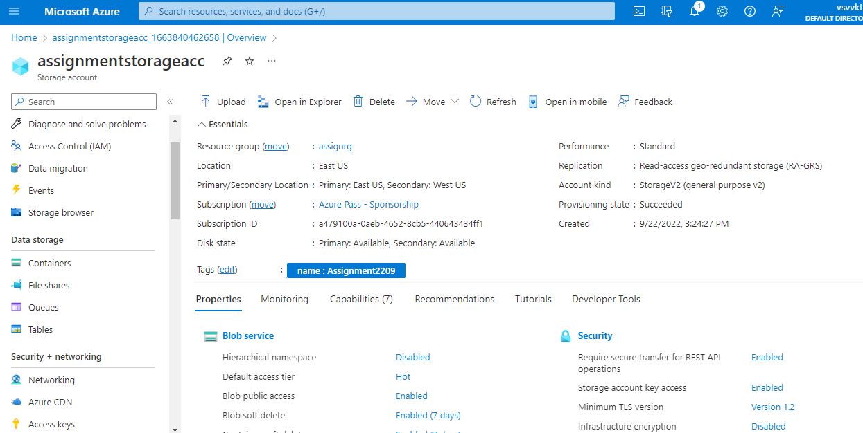
Creation of Storage Account in Azure

Slide 2
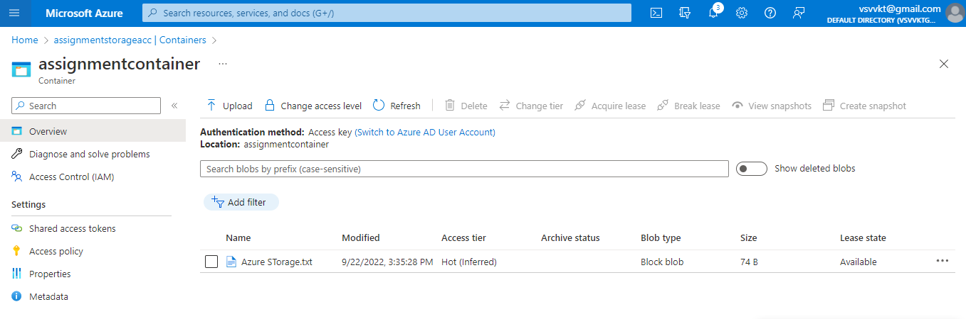
Creation of Container in Storage Account

Slide 3
Uploaded .txt file in Storage Container

Slide 4
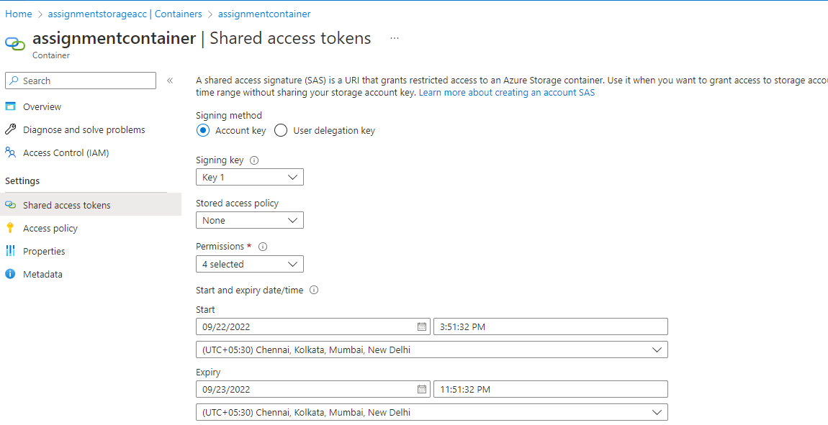
File Transfer in Storage Container

