Slide 1
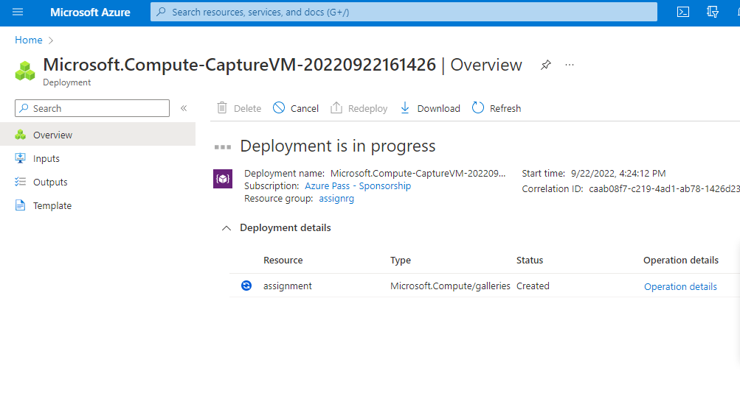
Backup of Instance (creating the Capture image using existing VM)

Slide 2
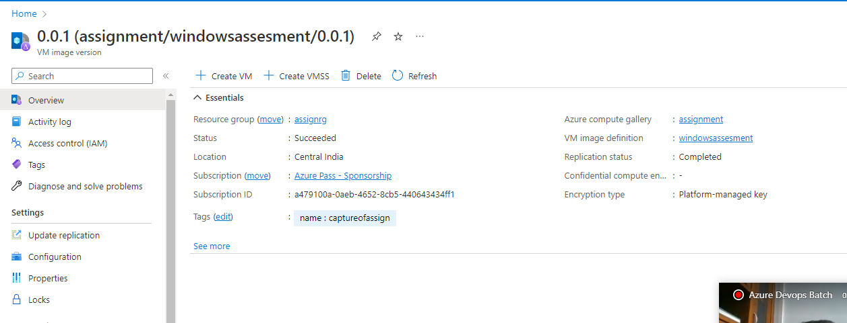
Created Capture Image using VM

Slide 3
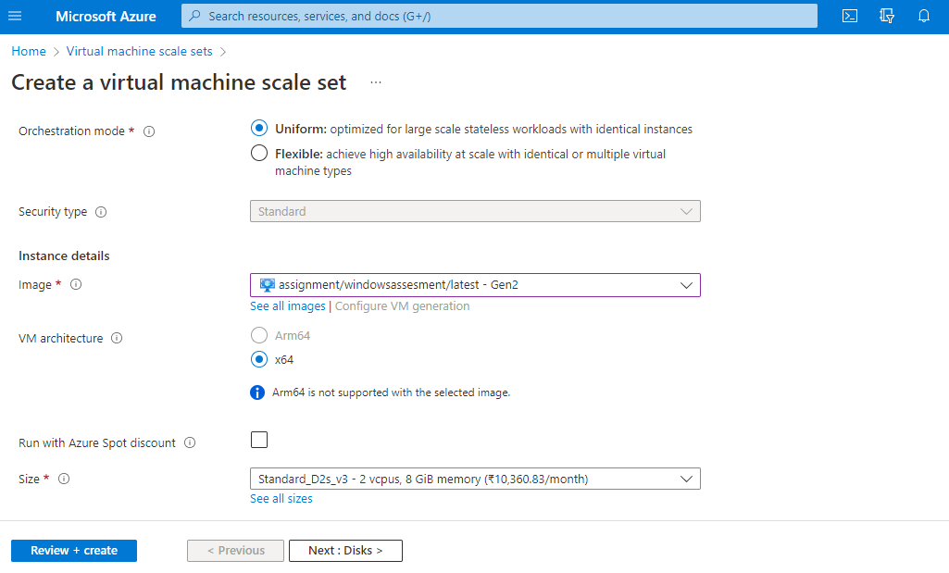
VMSS Creating Using Captured Image

Slide 4
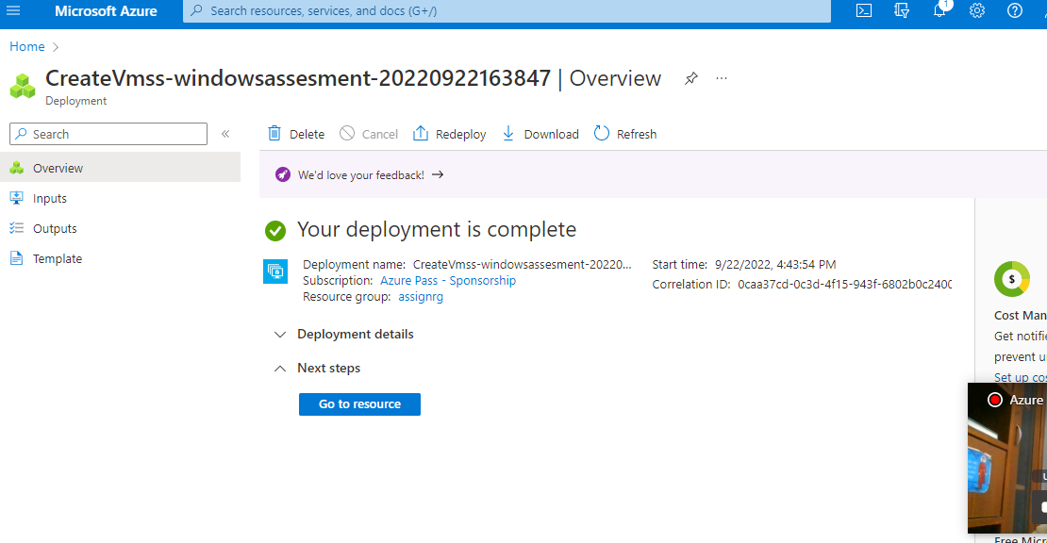
VMSS Created

