Slide 1
AGT and Data Science
Jamie Morgenstern, University of Pennsylvania
Vasilis Syrgkanis, Microsoft Research

Slide 2
AGT and Data Science
Part 2
Econometric Theory for Games
Vasilis Syrgkanis, Microsoft Research

Slide 3
Comparison with Part (1)
Optimization vs Estimation
  Part 1: find revenue maximizing mechanism from data
  Part 2: interested in inference of private parameters of structural model
Truthful vs Strategic Data
  Part 1: data set were i.i.d. samples of player valuations
  Part 2: data are observed outcomes of strategic interaction (e.g. bids in FPA)
Technical Exposition vs Overview
  Part 1: in-depth exposition of basic tools
  Part 2: overview of econometric theory for games literature with some in-depth drill downs

Slide 4
A Primer on Econometric Theory
Basic Tools and Terminology

Slide 5
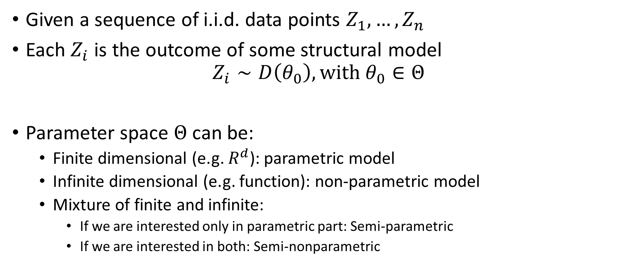
Econometric Theory
Given a sequence of i.i.d. data points $Z_{1},…,Z_{n}$
Each $Z_{i}$ is the outcome of some structural model
$$Z_{i}∼D\left(θ_{0}\right), with θ_{0}∈Θ$$
Parameter space $Θ$ can be:
  Finite dimensional (e.g. $R^{d}$): parametric model
  Infinite dimensional (e.g. function): non-parametric model
  Mixture of finite and infinite:
    If we are interested only in parametric part: Semi-parametric
    If we are interested in both: Semi-nonparametric

Slide 6
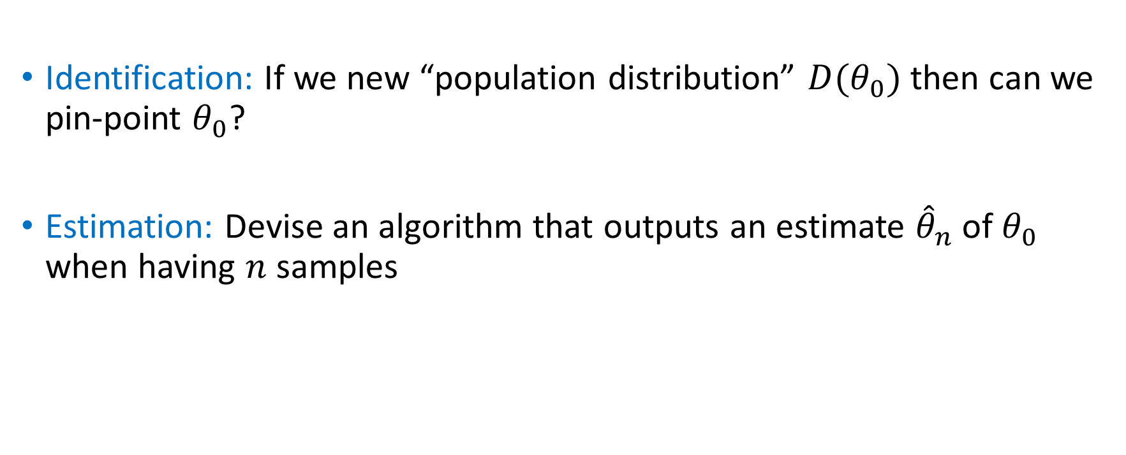
Main Goals
Identification: If we new “population distribution” $D(θ_{0})$ then can we pin-point $θ_{0}$?
Estimation: Devise an algorithm that outputs an estimate ${\hat{θ}}_{n}$ of $θ_{0}$ when having $n$ samples

Slide 7
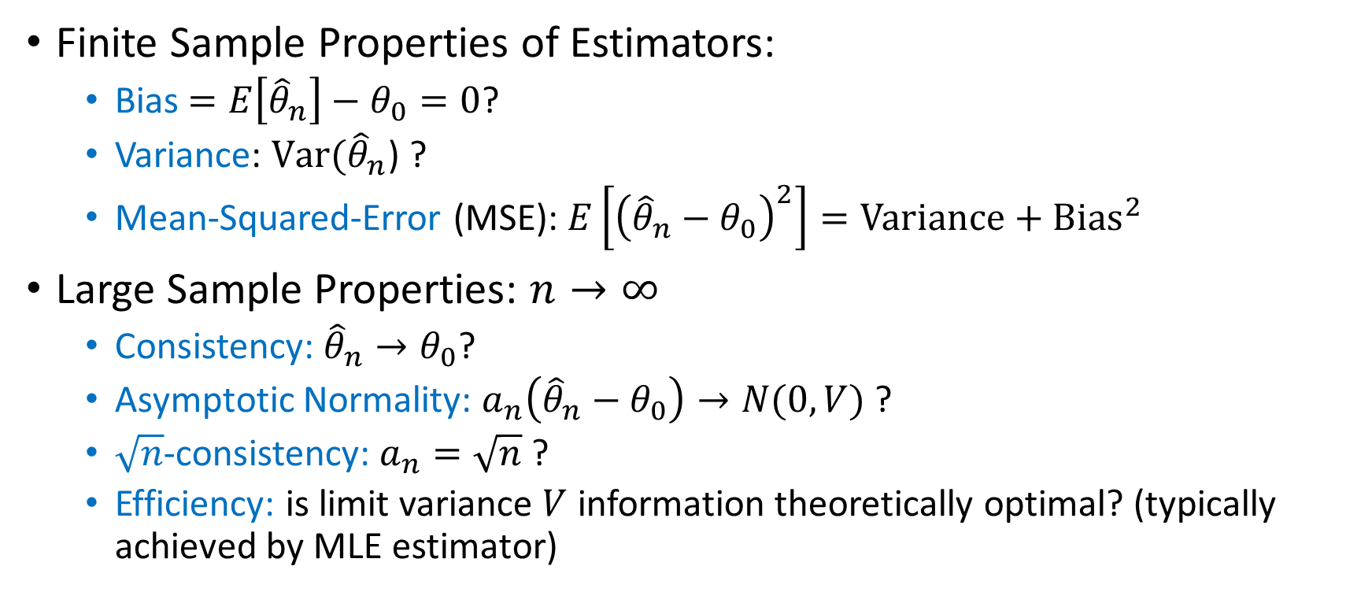
Estimator Properties of Interest
Finite Sample Properties of Estimators:
  Bias $=E\left[{\hat{θ}}_{n}\right]−θ_{0}=0$?
  Variance: $Var({\hat{θ}}_{n}$) ?
  Mean-Squared-Error (MSE): $E\left[{\left({\hat{θ}}_{n}−θ_{0}\right)}^{2}\right]=Variance+Bias^{2}$
Large Sample Properties: $n→∞$
  Consistency: ${\hat{θ}}_{n}→θ_{0}$?
  Asymptotic Normality: $a_{n}\left({\hat{θ}}_{n}−θ_{0}\right)→N(0,V)$ ?
  $\sqrt{n}$-consistency: $a_{n}=\sqrt{n}$ ?
  Efficiency: is limit variance $V$ information theoretically optimal? (typically achieved by MLE estimator)

Slide 8
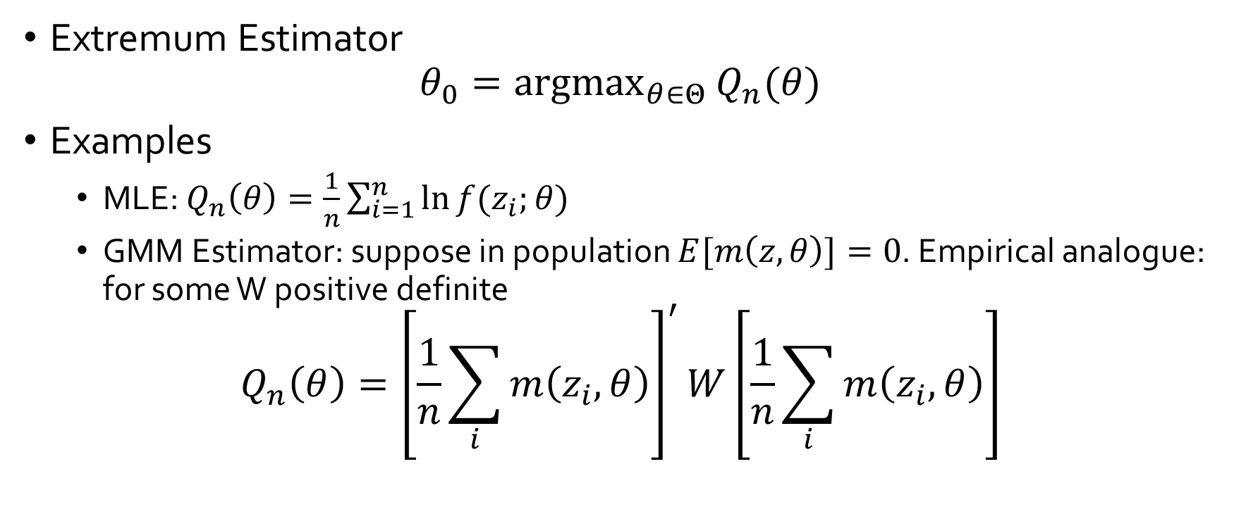
General Classes of Estimators
Extremum Estimator
$$θ_{0}={argmax}_{θ∈Θ}{Q_{n}(θ)}$$
Examples
  MLE: $Q_{n}\left(θ\right)=\frac{1}{n}\sum_{i=1}^{n}{\ln{f(z_{i};θ)}}$
  GMM Estimator: suppose in population $E[m\left(z,θ\right)]=0$. Empirical analogue: for some W positive definite
$$Q_{n}\left(θ\right)={\left[\frac{1}{n}\sum_{i}{m\left(z_{i},θ\right)}\right]}^{′}W\left[\frac{1}{n}\sum_{i}{m\left(z_{i},θ\right)}\right]$$

Slide 9
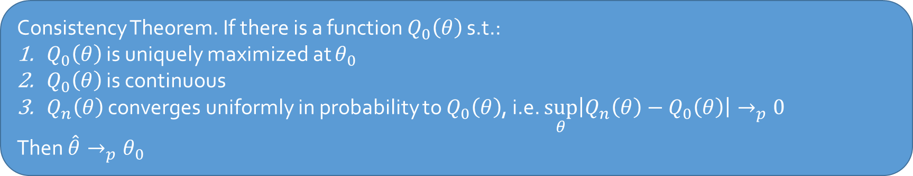
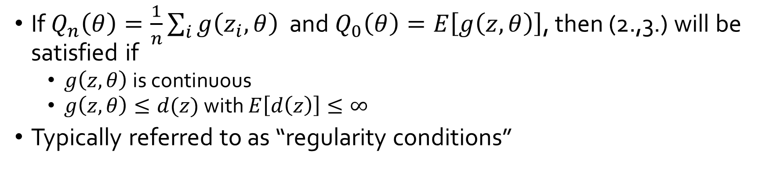
Consistency of Extremum Estimators
Consistency Theorem. If there is a function $Q_{0}\left(θ\right)$ s.t.:
$Q_{0}\left(θ\right)$ is uniquely maximized at $θ_{0}$
$Q_{0}\left(θ\right)$ is continuous
$Q_{n}\left(θ\right)$ converges uniformly in probability to $Q_{0}\left(θ\right)$, i.e. $\sup_{θ}\left|Q_{n}\left(θ\right)−Q_{0}\left(θ\right)\right|→_{p}0$
Then $\hat{θ}→_{p}θ_{0}$
If $Q_{n}\left(θ\right)=\frac{1}{n}\sum_{i}{g\left(z_{i},θ\right)}$ and $Q_{0}\left(θ\right)=E\left[g\left(z,θ\right)\right]$, then (2.,3.) will be satisfied if
  $g\left(z,θ\right)$ is continuous
  $g\left(z,θ\right)≤d(z)$ with $E\left[d\left(z\right)\right]≤∞$
Typically referred to as “regularity conditions”

Slide 10

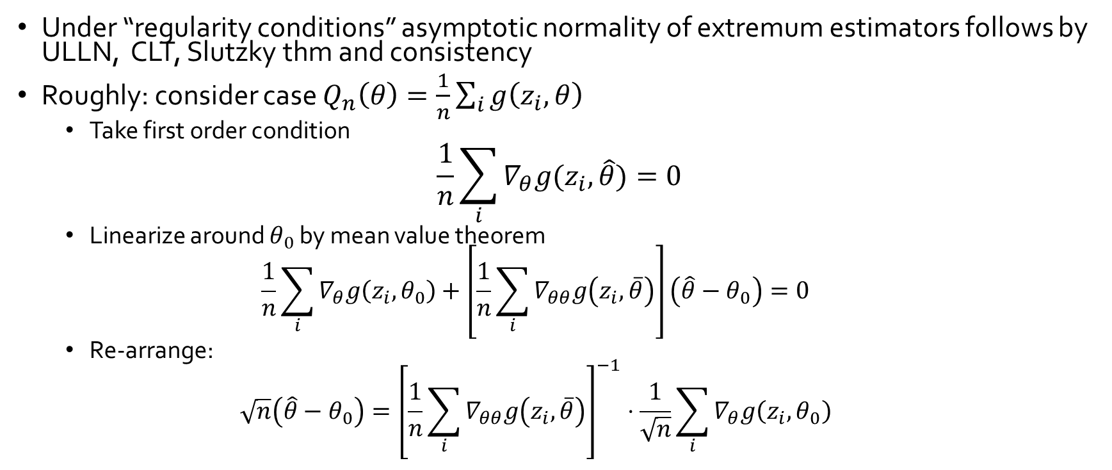


Asymptotic Normality
Under “regularity conditions” asymptotic normality of extremum estimators follows by ULLN, CLT, Slutzky thm and consistency
Roughly: consider case $Q_{n}\left(θ\right)=\frac{1}{n}\sum_{i}{g\left(z_{i},θ\right)}$
  Take first order condition
$$\frac{1}{n}\sum_{i}{∇_{θ}g(z_{i},\hat{θ})}=0$$
  Linearize around $θ_{0}$ by mean value theorem
  $$\frac{1}{n}\sum_{i}{∇_{θ}g\left(z_{i},θ_{0}\right)}+\left[\frac{1}{n}\sum_{i}{∇_{θθ}g\left(z_{i},\overline{θ}\right)}\right]\left(\hat{θ}−θ_{0}\right)=0$$
  Re-arrange:
  $$\sqrt{n}\left(\hat{θ}−θ_{0}\right)={\left[\frac{1}{n}\sum_{i}{∇_{θθ}g\left(z_{i},\overline{θ}\right)}\right]}^{−1}⋅\frac{1}{\sqrt{n}}\sum_{i}{∇_{θ}g\left(z_{i},θ_{0}\right)}$$
In practice, typically variance is computed via Bootstrap [Efron’79]:
Re-sample from your samples with replacement and compute empirical variance
$$→_{d}N\left(0,U\right)$$
$$→_{p}E\left[∇_{θθ}g\left(z,θ_{0}\right)\right]$$
$$→_{d}N\left(0,Var\left(∇_{θ}g\left(z,θ_{0}\right)\right)\right)$$

Slide 11
Econometric Theory for Games

Slide 12
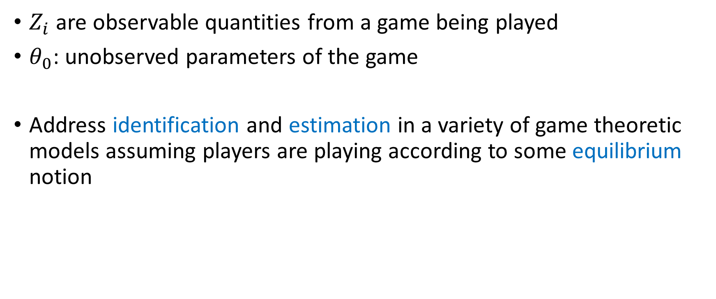
Econometric Theory for Games
$Z_{i}$ are observable quantities from a game being played
$θ_{0}$: unobserved parameters of the game
Address identification and estimation in a variety of game theoretic models assuming players are playing according to some equilibrium notion

Slide 13
Why useful?
Scientific: economically meaningful quantities
Perform counter-factual analysis: what would happen if we change the game?
Performance measures: welfare, revenue
Testing game-theoretic models: if theory on estimated quantities predicts different behavior, then in trouble

Slide 14
Outline of the rest of the talk
Complete information games
  Multiplicity of equilibria: partial identification and set inference
Discrete Static and Dynamic Games of Incomplete Information
  Two-stage estimators
Auction games
  Identification and estimation in first price auctions with independent private values
Algorithmic game theory and econometrics
  Mechanism design for data science
  Econometrics for learning agents

Slide 15
A Seminal Example
Entry Games [Bresnahan-Reiss’90,91] and [Berry’92]

Slide 16
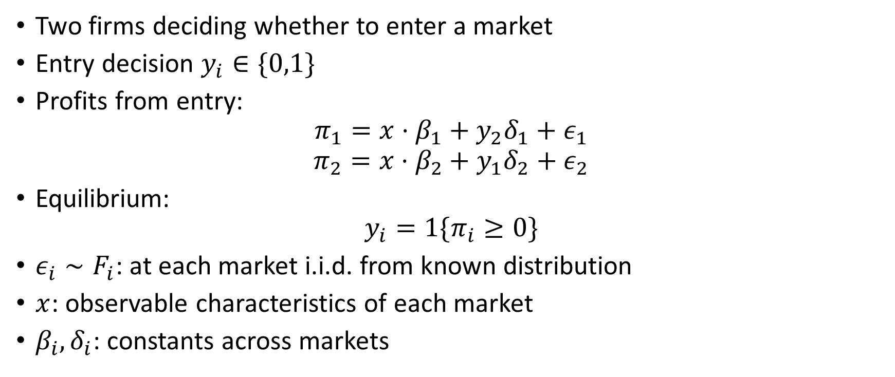
Entry Game
Two firms deciding whether to enter a market
Entry decision $y_{i}∈\{0,1\}$
Profits from entry:
$$π_{1}=x⋅β_{1}+y_{2}δ_{1}+ε_{1}$$
$$π_{2}=x⋅β_{2}+y_{1}δ_{2}+ε_{2}$$
Equilibrium:
$$y_{i}=1\{π_{i}≥0\}$$
$ε_{i}∼F_{i}$: at each market i.i.d. from known distribution
$x$: observable characteristics of each market
$β_{i},δ_{i}$: constants across markets

Slide 17

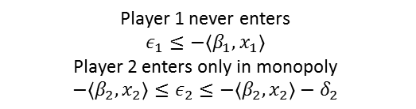
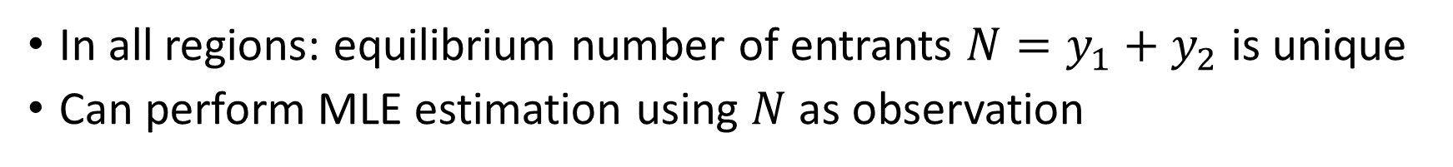




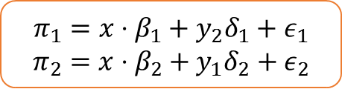




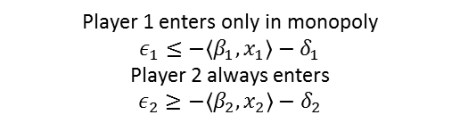



Assume $δ_{1},δ_{2}<0$
$$π_{1}=x⋅β_{1}+y_{2}δ_{1}+ε_{1}$$
$$π_{2}=x⋅β_{2}+y_{1}δ_{2}+ε_{2}$$
[Bresnahan-Reiss’90,91], [Berry’92]
$$ε_{2}$$
$(0,1)$
Player 1 enters only in monopoly
$$ε_{1}≤−\left\langle β_{1},x_{1}\right\rangle −δ_{1}$$
Player 2 always enters
$$ε_{2}≥−〈β_{2},x_{2}〉−δ_{2}$$
$(1,1)$
Both players always enter
$$ε_{1}≥−\left\langle β_{1},x_{1}\right\rangle −δ_{1}$$
$$ε_{2}≥−〈β_{2},x_{2}〉−δ_{2}$$
$$ε_{1}$$
$$\left(−\left\langle β_{1},x_{1}\right\rangle −δ_{1},−〈β_{2},x_{2}〉−δ_{2}\right)$$
Player 1 never enters
$$ε_{1}≤−\left\langle β_{1},x_{1}\right\rangle$$
Player 2 enters only in monopoly
$$−〈β_{2},x_{2}〉≤ε_{2}≤−〈β_{2},x_{2}〉−δ_{2}$$
$(0,1)$ or (1,0)
$$\left(−\left\langle β_{1},x_{1}\right\rangle ,−〈β_{2},x_{2}〉\right)$$
$(1,0)$
$(0,0)$
In all regions: equilibrium number of entrants $N=y_{1}+y_{2}$ is unique
Can perform MLE estimation using $N$ as observation

Slide 18


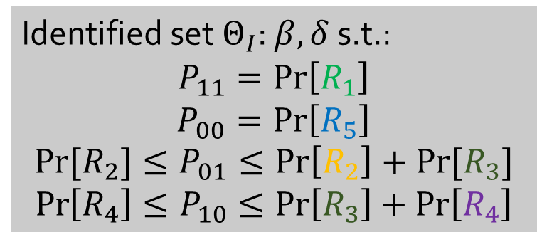

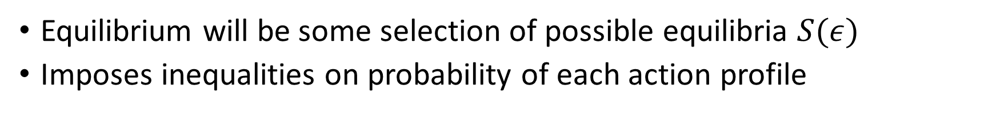





More generally
Identified set $Θ_{I}$: $β, δ$ s.t.:
$$P_{11}=\operatorname{Pr}\left[R_{1}\right]$$
$$P_{00}=\operatorname{Pr}\left[R_{5}\right]$$
$$Pr⁡[R_{2}]≤P_{01}≤\operatorname{Pr}\left[R_{2}\right]+Pr⁡[R_{3}]$$
$$\operatorname{Pr}\left[R_{4}\right]≤P_{10}≤\operatorname{Pr}\left[R_{3}\right]+\operatorname{Pr}\left[R_{4}\right]$$
[Tamer’03] [Cilliberto-Tamer’09]
$$ε_{2}$$
$(0,1)$
$(1,1)$
$$R_{2}$$
$$R_{1}$$
$$ε_{1}$$
$(0,1)$ or (1,0)
$$R_{3}$$
$$R_{4}$$
$(1,0)$
$$R_{5}$$
$(0,0)$
Equilibrium will be some selection of possible equilibria $S(ε)$
Imposes inequalities on probability of each action profile

Slide 19
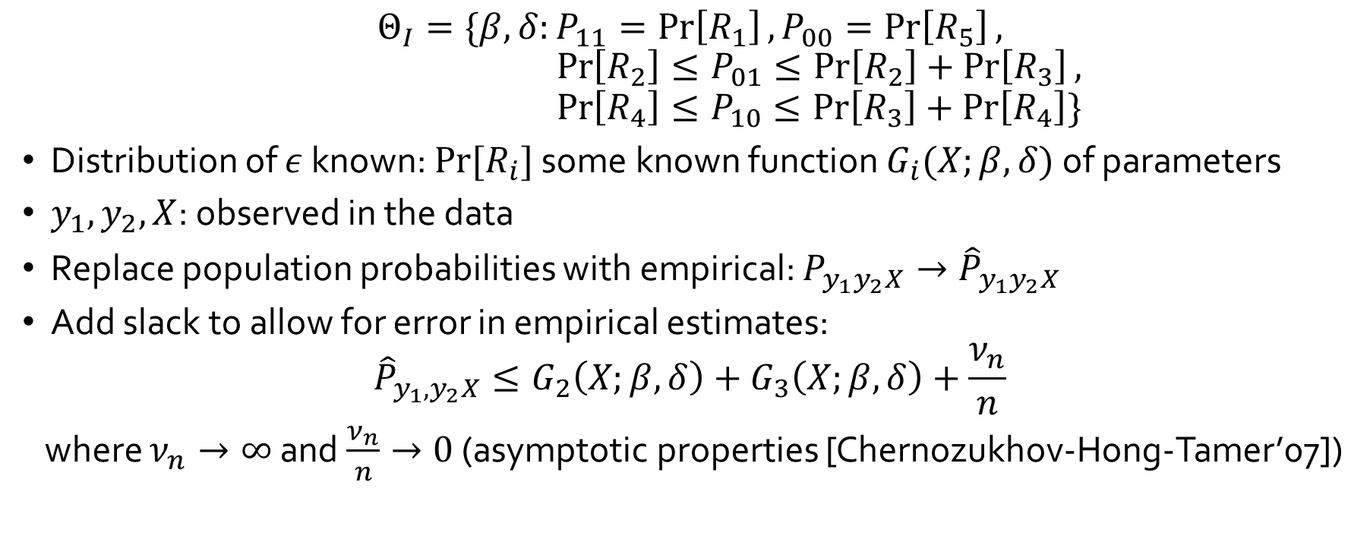
Estimating the Identified set
[Cilliberto-Tamer’09]
$$Θ_{I}=\{β,δ:P_{11}=\operatorname{Pr}\left[R_{1}\right], P_{00}=\operatorname{Pr}\left[R_{5}\right],$$
$$\operatorname{Pr}\left[R_{2}\right]≤P_{01}≤\operatorname{Pr}\left[R_{2}\right]+\operatorname{Pr}\left[R_{3}\right],$$
$$\operatorname{Pr}\left[R_{4}\right]≤P_{10}≤\operatorname{Pr}\left[R_{3}\right]+\operatorname{Pr}\left[R_{4}\right]\}$$
Distribution of $ε$ known: $Pr⁡[R_{i}]$ some known function $G_{i}(X;β,δ)$ of parameters
$y_{1}, y_{2},X$: observed in the data
Replace population probabilities with empirical: $P_{y_{1}y_{2}X}→{\hat{P}}_{y_{1}y_{2}X}$
Add slack to allow for error in empirical estimates:
$${\hat{P}}_{y_{1},y_{2}X}≤G_{2}\left(X;β,δ\right)+G_{3}\left(X;β,δ\right)+\frac{ν_{n}}{n}$$
where $ν_{n}→∞$ and $\frac{ν_{n}}{n}→0$ (asymptotic properties [Chernozukhov-Hong-Tamer’07])

Slide 20


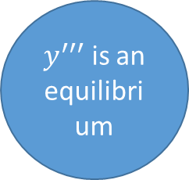
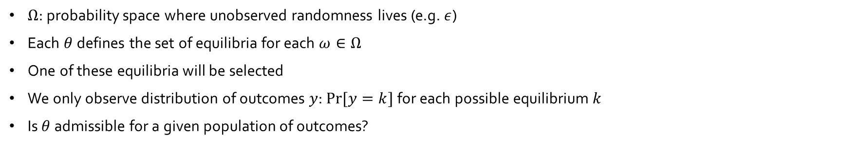
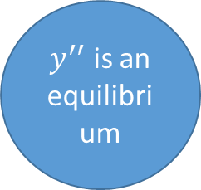

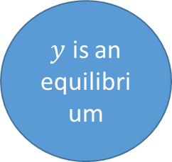
General Games
$y$ is an equilibrium
$y^{′′}$ is an equilibrium
$y^{′}$ is an equilibrium
$$θ$$
$$Ω$$
$y^{′′′}$ is an equilibrium
$Ω$: probability space where unobserved randomness lives (e.g. $ε$)
Each $θ$ defines the set of equilibria for each $ω∈Ω$
One of these equilibria will be selected
We only observe distribution of outcomes $y$: $Pr⁡[y=k]$ for each possible equilibrium $k$
Is $θ$ admissible for a given population of outcomes?

Slide 21
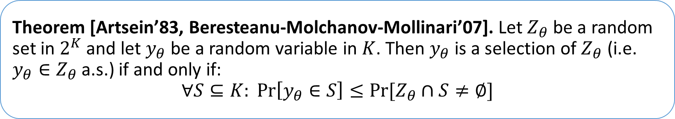
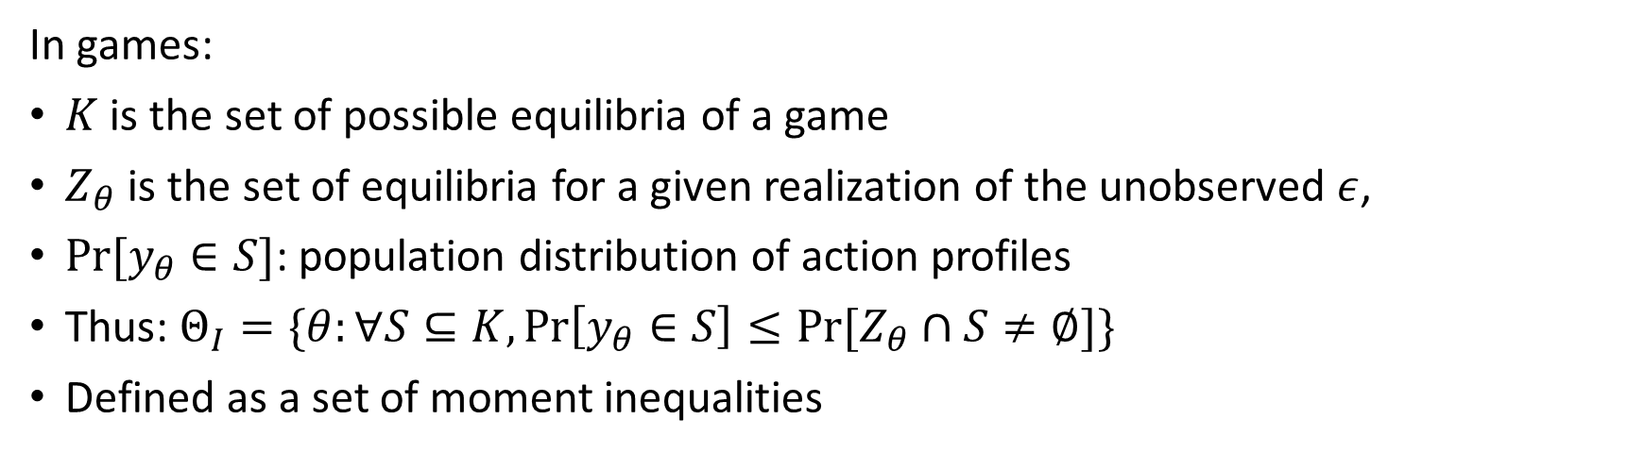
Characterization of the Identified Set
[Beresteanu-Molchanov-Mollinari’09]
Theorem [Artsein’83, Beresteanu-Molchanov-Mollinari’07]. Let $Z_{θ}$ be a random set in $2^{K}$ and let $y_{θ}$ be a random variable in $K$. Then $y_{θ}$ is a selection of $Z_{θ}$ (i.e. $y_{θ}∈Z_{θ}$ a.s.) if and only if:
$$∀S⊆K: \operatorname{Pr}\left[y_{θ}∈S\right]≤Pr⁡[Z_{θ}∩S≠∅]$$
In games:
$K$ is the set of possible equilibria of a game
$Z_{θ}$ is the set of equilibria for a given realization of the unobserved $ε$,
$Pr⁡[y_{θ}∈S]$: population distribution of action profiles
Thus: $Θ_{I}=\{θ:∀S⊆K,\operatorname{Pr}\left[y_{θ}∈S\right]≤Pr⁡[Z_{θ}∩S≠∅]\}$
Defined as a set of moment inequalities

Slide 22
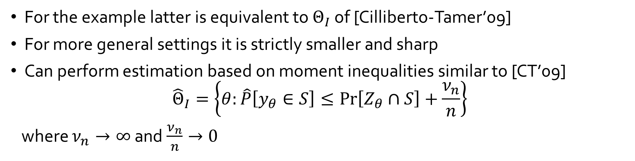
Characterization of the Identified Set
[Beresteanu-Molchanov-Mollinari’09]
Theorem [Artsein’83, Beresteanu-Molchanov-Mollinari’07]. Let $Z_{θ}$ be a random set in $2^{K}$ and let $y_{θ}$ be a random variable in $K$. Then $y_{θ}$ is a selection of $Z_{θ}$ (i.e. $y_{θ}∈Z_{θ}$ a.s.) if and only if:
$$∀S⊆K: \operatorname{Pr}\left[y_{θ}∈S\right]≤Pr⁡[Z_{θ}∩S≠∅]$$
For the example latter is equivalent to $Θ_{I}$ of [Cilliberto-Tamer’09]
For more general settings it is strictly smaller and sharp
Can perform estimation based on moment inequalities similar to [CT’09]
$${\hat{Θ}}_{I}=\left\{θ:\hat{P}\left[y_{θ}∈S\right]≤\operatorname{Pr}\left[Z_{θ}∩S\right]+\frac{ν_{n}}{n}\right\}$$
where $ν_{n}→∞$ and $\frac{ν_{n}}{n}→0$

Slide 23
Main take-aways
Games of complete information are typically partially identified
Multiplicity of equilibrium is the main issue
Leads to set-estimation strategies and machinery [Chernozhukov et al’09]
Very interesting random set theory for estimating the sharp identifying set

Slide 24
Incomplete Information Games and Two-Stage Estimators
Static Games: [Bajari-Hong-Krainer-Nekipelov’12]
Dynamic Games: [Bajari-Benkard-Levin’07], [Pakes-Ostrovsky-Berry’07], [Aguirregabiria-Mira’07], [Ackerberg-Benkard-Berry-Pakes’07], [Bajari-Hong-Chernozhukov-Nekipelov’09]

Slide 25
High level idea
At equilibrium agents have beliefs about other players actions and best respond
If econometrician observes the same information about opponents as the player does then:
  Estimate these beliefs from the data in first stage
  Use best-response inequalities to these estimated beliefs in the second stage and infer parameters of utility

Slide 26
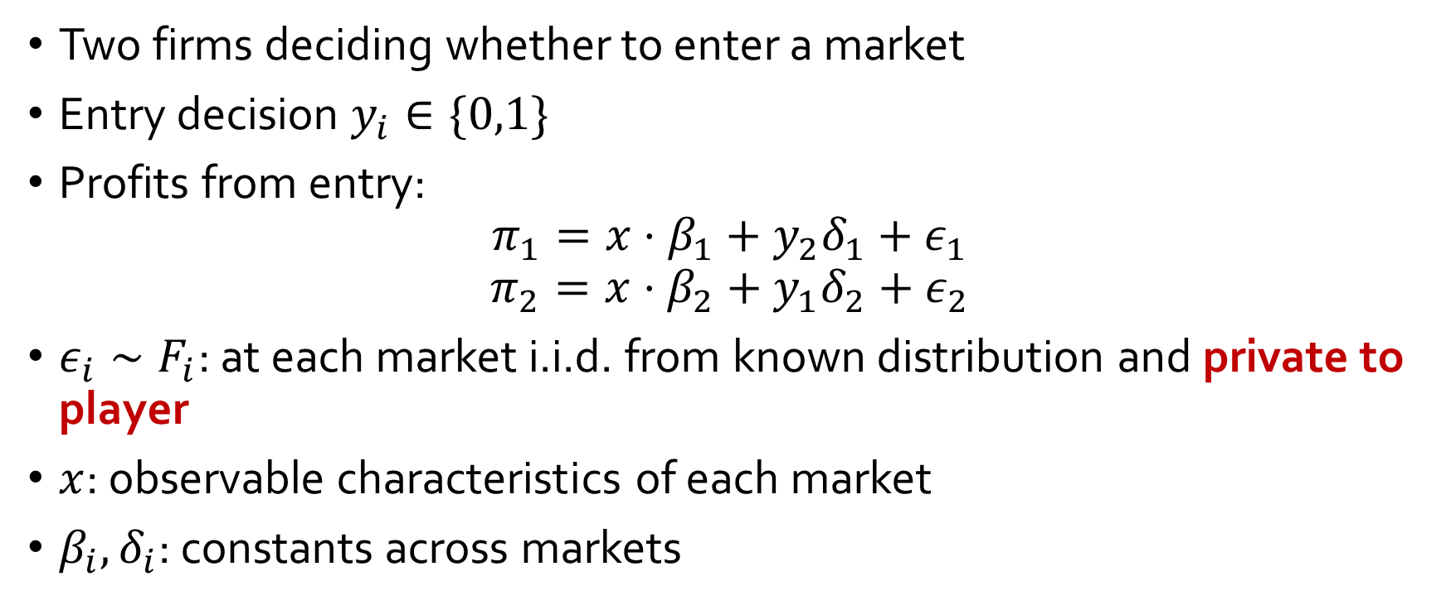
Static Entry Game with Private Shocks
Two firms deciding whether to enter a market
Entry decision $y_{i}∈\{0,1\}$
Profits from entry:
$$π_{1}=x⋅β_{1}+y_{2}δ_{1}+ε_{1}$$
$$π_{2}=x⋅β_{2}+y_{1}δ_{2}+ε_{2}$$
$ε_{i}∼F_{i}$: at each market i.i.d. from known distribution and private to player
$x$: observable characteristics of each market
$β_{i},δ_{i}$: constants across markets

Slide 27
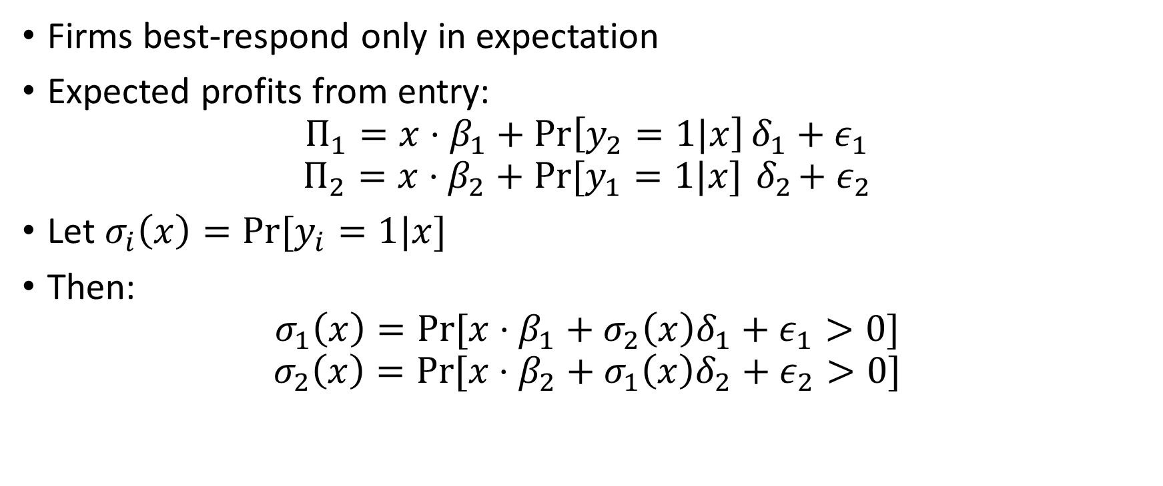
Static Entry Game with Private Shocks
Firms best-respond only in expectation
Expected profits from entry:
$$Π_{1}=x⋅β_{1}+\operatorname{Pr}\left[y_{2}=1|x\right]δ_{1}+ε_{1}$$
$$Π_{2}=x⋅β_{2}+Pr⁡[y_{1}=1|x]{ δ}_{2}+ε_{2}$$
Let $σ_{i}\left(x\right)=Pr⁡[y_{i}=1|x]$
Then:
$$σ_{1}\left(x\right)=Pr⁡[x⋅β_{1}+σ_{2}\left(x\right)δ_{1}+ε_{1}>0]$$
$$σ_{2}\left(x\right)=Pr⁡[x⋅β_{2}+σ_{1}\left(x\right)δ_{2}+ε_{2}>0]$$

Slide 28
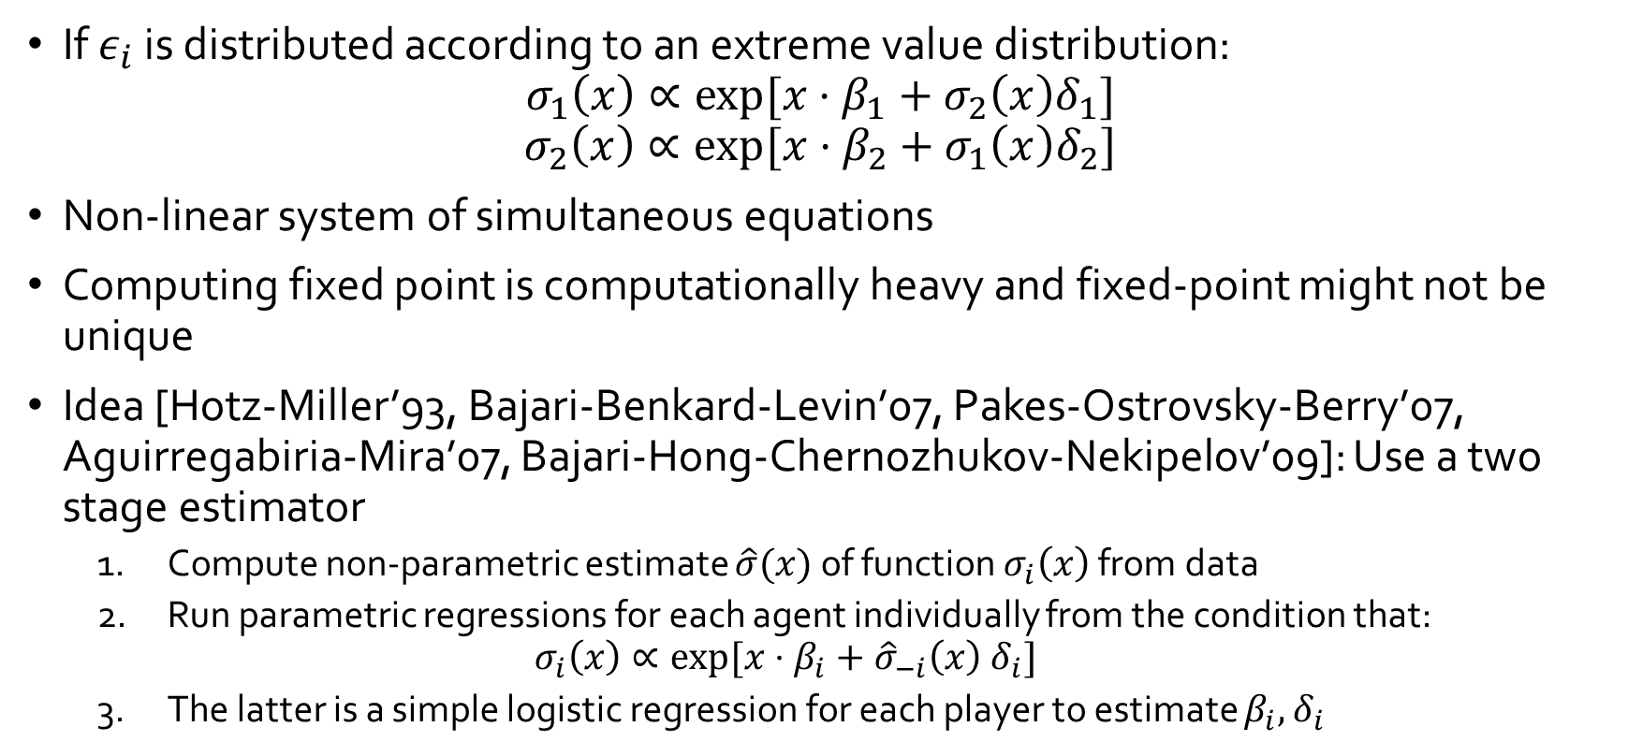
Static Entry Game with Private Shocks
If $ε_{i}$ is distributed according to an extreme value distribution:
$$σ_{1}\left(x\right)∝exp⁡[x⋅β_{1}+σ_{2}\left(x\right)δ_{1}]$$
$$σ_{2}\left(x\right)∝\exp{⁡[x⋅β_{2}+σ_{1}\left(x\right)δ_{2}]}$$
Non-linear system of simultaneous equations
Computing fixed point is computationally heavy and fixed-point might not be unique
Idea [Hotz-Miller’93, Bajari-Benkard-Levin’07, Pakes-Ostrovsky-Berry’07, Aguirregabiria-Mira’07, Bajari-Hong-Chernozhukov-Nekipelov’09]: Use a two stage estimator
  Compute non-parametric estimate $\hat{σ}(x)$ of function $σ_{i}\left(x\right)$ from data
  Run parametric regressions for each agent individually from the condition that:
  $$σ_{i}\left(x\right)∝\exp{[x⋅β_{i}+{\hat{σ}}_{−i}\left(x\right) δ_{i}]}$$
  The latter is a simple logistic regression for each player to estimate $β_{i},δ_{i}$

Slide 29
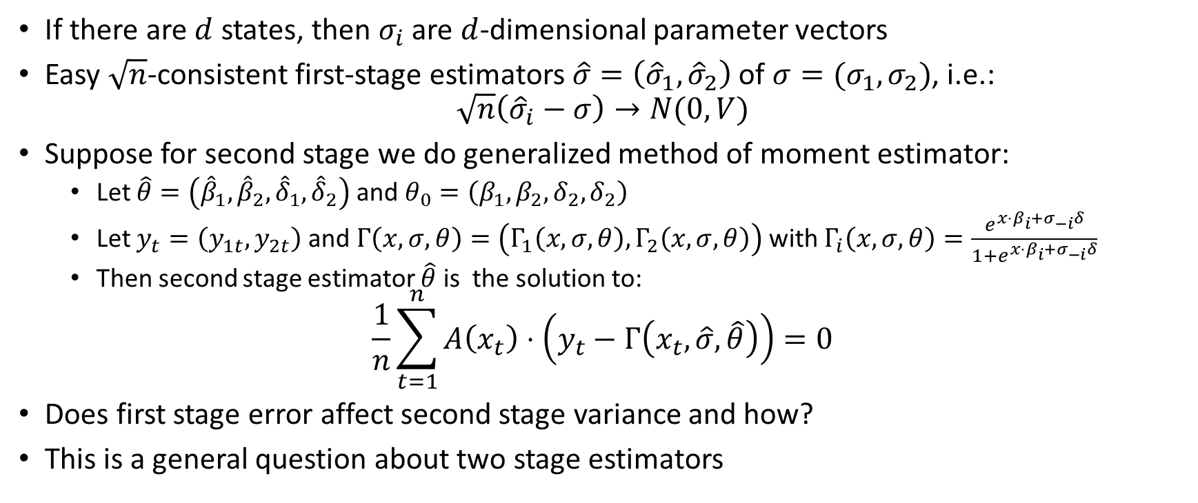
Simple case: finite discrete states
If there are $d$ states, then $σ_{i}$ are $d$-dimensional parameter vectors
Easy $\sqrt{n}$-consistent first-stage estimators $\hat{σ}=\left({\hat{σ}}_{1},{\hat{σ}}_{2}\right)$ of $σ=(σ_{1},σ_{2})$, i.e.:
$$\sqrt{n}\left({\hat{σ}}_{i}−σ\right)→N(0,V)$$
Suppose for second stage we do generalized method of moment estimator:
  Let $\hat{θ}=\left({\hat{β}}_{1},{\hat{β}}_{2},{\hat{δ}}_{1},{\hat{δ}}_{2}\right)$ and $θ_{0}=\left(β_{1},β_{2}, δ_{2},δ_{2}\right)$
  Let $y_{t}=\left(y_{1t},y_{2t}\right)$ and $Γ\left(x,σ,θ\right)=\left(Γ_{1}\left(x,σ,θ\right), Γ_{2}\left(x,σ,θ\right)\right)$ with $Γ_{i}\left(x,σ,θ\right)=\frac{e^{x⋅β_{i}+σ_{−i}δ}}{1+e^{x⋅β_{i}+σ_{−i}δ}}$
  Then second stage estimator $\hat{θ}$ is the solution to:
$$\frac{1}{n}\sum_{t=1}^{n}{A\left(x_{t}\right)⋅\left(y_{t}−Γ\left(x_{t},\hat{σ}, \hat{θ}\right)\right)}=0$$
Does first stage error affect second stage variance and how?
This is a general question about two stage estimators

Slide 30






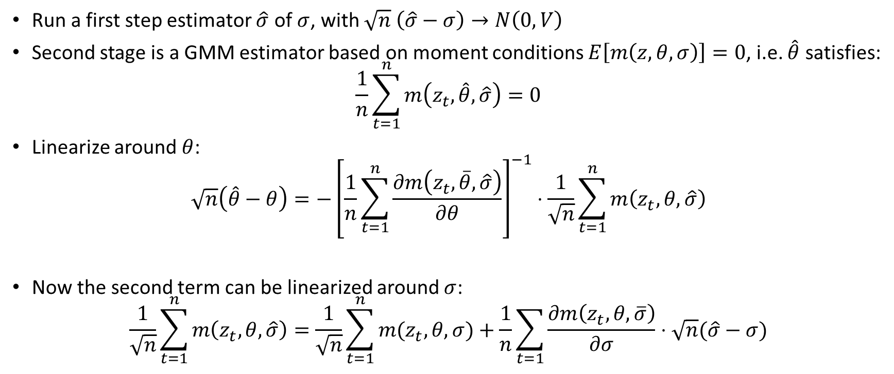
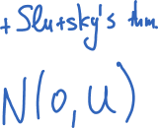

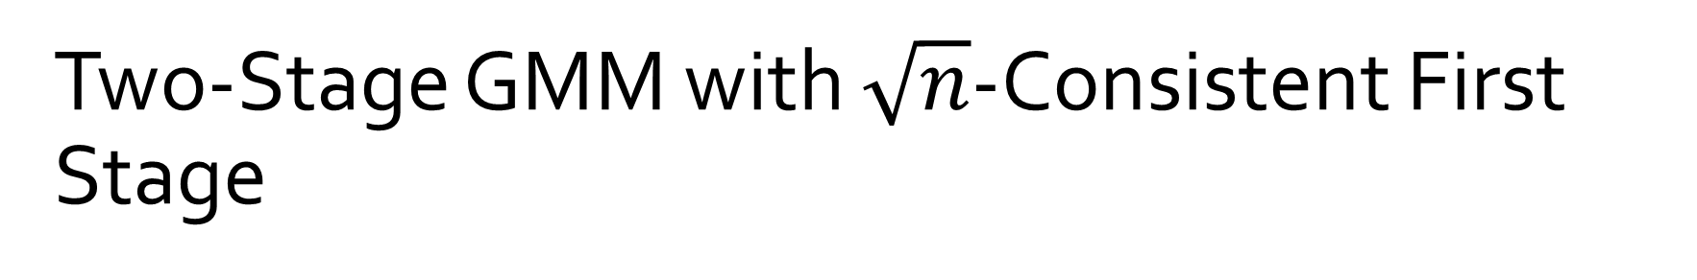
Two-Stage GMM with $\sqrt{n}$-Consistent First Stage
[Newey-McFadden’94: Large Sample Estimation and Hypothesis Testing]
Run a first step estimator $\hat{σ}$ of $σ$, with $\sqrt{n} \left(\hat{σ}−σ\right)→N\left(0,V\right)$
Second stage is a GMM estimator based on moment conditions $E\left[m\left(z,θ,σ\right)\right]=0$, i.e. $\hat{θ}$ satisfies:
$$\frac{1}{n}\sum_{t=1}^{n}{m\left(z_{t},\hat{θ},\hat{σ}\right)}=0$$
Linearize around $θ$:
$$\sqrt{n}\left(\hat{θ}−θ\right)={−\left[\frac{1}{n}\sum_{t=1}^{n}{\frac{∂m\left(z_{t},\overline{θ},\hat{σ}\right)}{∂θ}}\right]}^{−1}⋅\frac{1}{\sqrt{n}}\sum_{t=1}^{n}{m\left(z_{t},θ,\hat{σ}\right)}$$
Now the second term can be linearized around $σ$:
$$\frac{1}{\sqrt{n}}\sum_{t=1}^{n}{m\left(z_{t},θ,\hat{σ}\right)}=\frac{1}{\sqrt{n}}\sum_{t=1}^{n}{m(z_{t},θ,σ)}+\frac{1}{n}\sum_{t=1}{\frac{∂m\left(z_{t}, θ,\overline{σ}\right)}{∂σ}}⋅\sqrt{n}(\hat{σ}−σ)$$

Slide 31
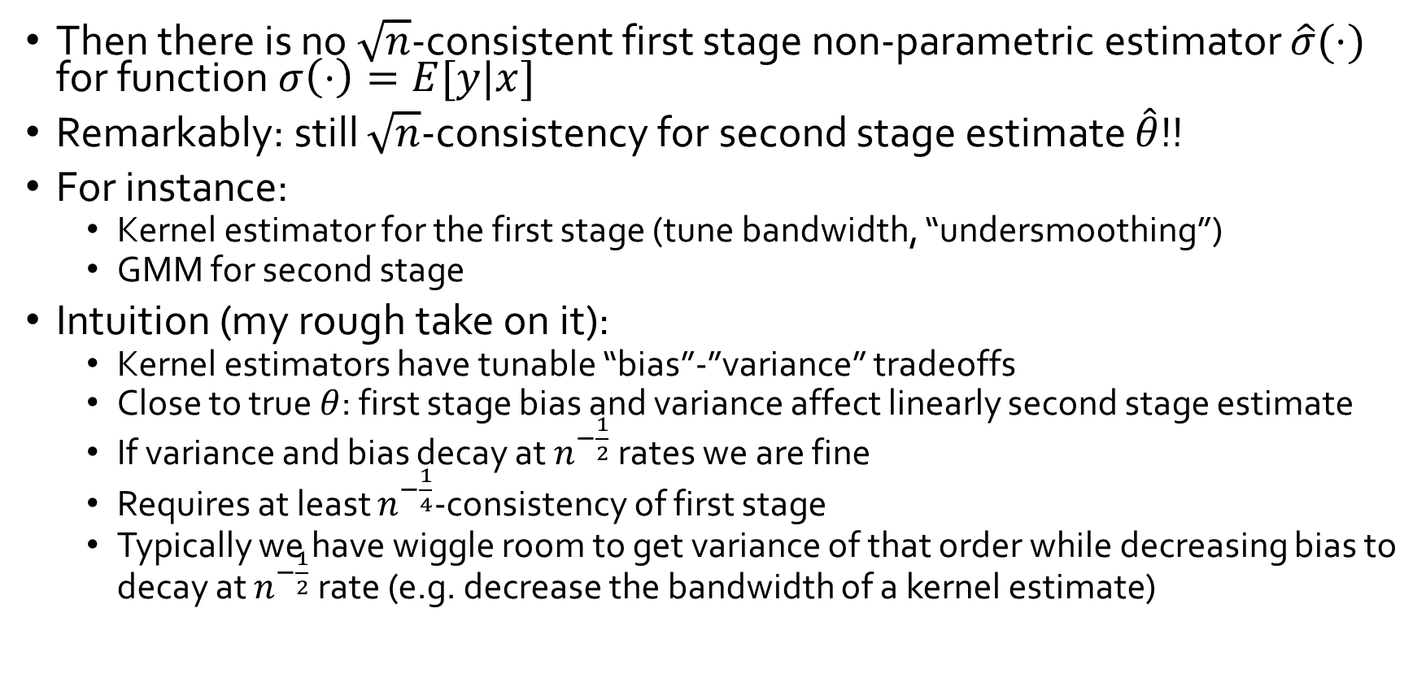

Continuous State Space: $x∈R^{d}$
[Bajari-Hong-Kranier-Nekipelov’12]
Then there is no $\sqrt{n}$-consistent first stage non-parametric estimator $\hat{σ}(⋅)$ for function $σ\left(⋅\right)=E[y|x]$
Remarkably: still $\sqrt{n}$-consistency for second stage estimate $\hat{θ}$!!
For instance:
  Kernel estimator for the first stage (tune bandwidth, “undersmoothing”)
  GMM for second stage
Intuition (my rough take on it):
  Kernel estimators have tunable “bias”-”variance” tradeoffs
  Close to true $θ$: first stage bias and variance affect linearly second stage estimate
  If variance and bias decay at $n^{−\frac{1}{2}}$ rates we are fine
  Requires at least $n^{−\frac{1}{4}}$-consistency of first stage
  Typically we have wiggle room to get variance of that order while decreasing bias to decay at $n^{−\frac{1}{2}}$ rate (e.g. decrease the bandwidth of a kernel estimate)
  For detailed exposition see:
  [Newey94, Ai-Chen’03]
  Section 8.3 of survey of [Newey-McFadden’94]
  Han Hong’s Lecture notes on semi-parametric efficiency [ECO276 Stanford]

Slide 32
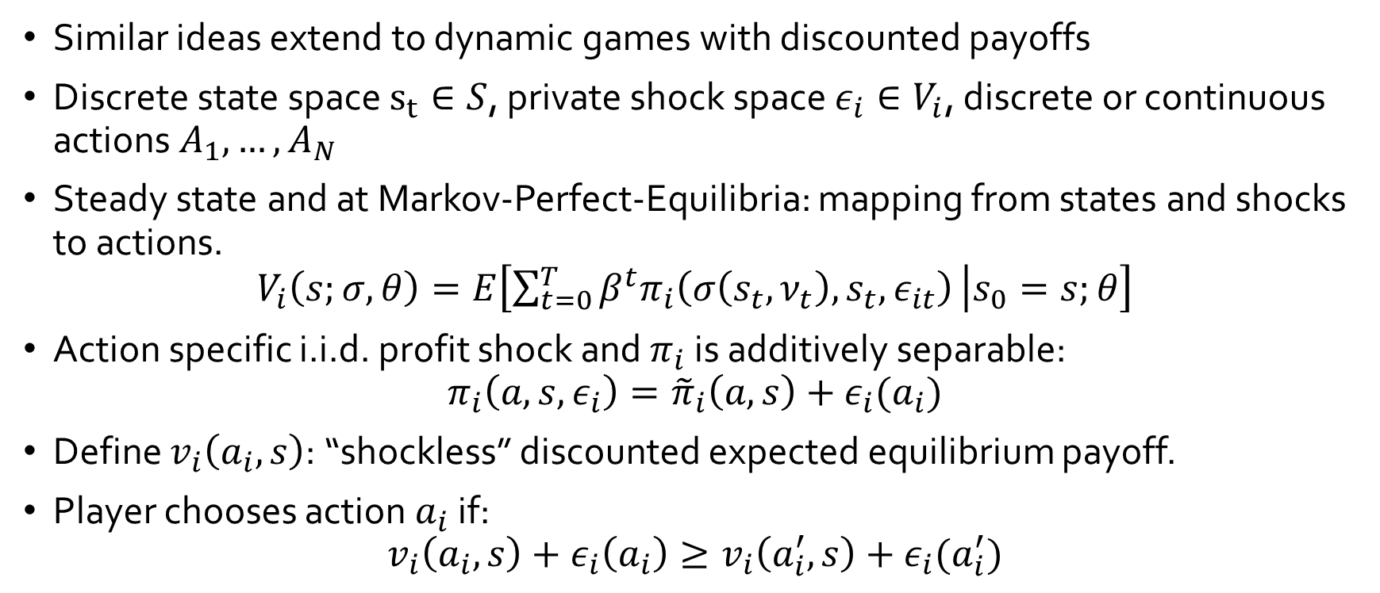
Dynamic Games
Similar ideas extend to dynamic games with discounted payoffs
Discrete state space $s_{t}∈S$, private shock space $ε_{i}∈V_{i}$, discrete or continuous actions $A_{1},…,A_{N}$
Steady state and at Markov-Perfect-Equilibria: mapping from states and shocks to actions.
$$V_{i}\left(s;σ,θ\right)=E\left[\sum_{t=0}^{T}{β^{t}π_{i}\left(σ\left(s_{t},ν_{t}\right),s_{t},ε_{it}\right)} | s_{0}=s;θ\right]$$
Action specific i.i.d. profit shock and $π_{i}$ is additively separable:
$$π_{i}\left(a,s,ε_{i}\right)={\tilde{π}}_{i}\left(a,s\right)+ε_{i}(a_{i})$$
Define $v_{i}\left(a_{i},s\right)$: “shockless” discounted expected equilibrium payoff.
Player chooses action $a_{i}$ if:
$$v_{i}\left(a_{i},s\right)+ε_{i}\left(a_{i}\right)≥v_{i}\left(a_{i}^{′},s\right)+ε_{i}(a_{i}^{′})$$

Slide 33
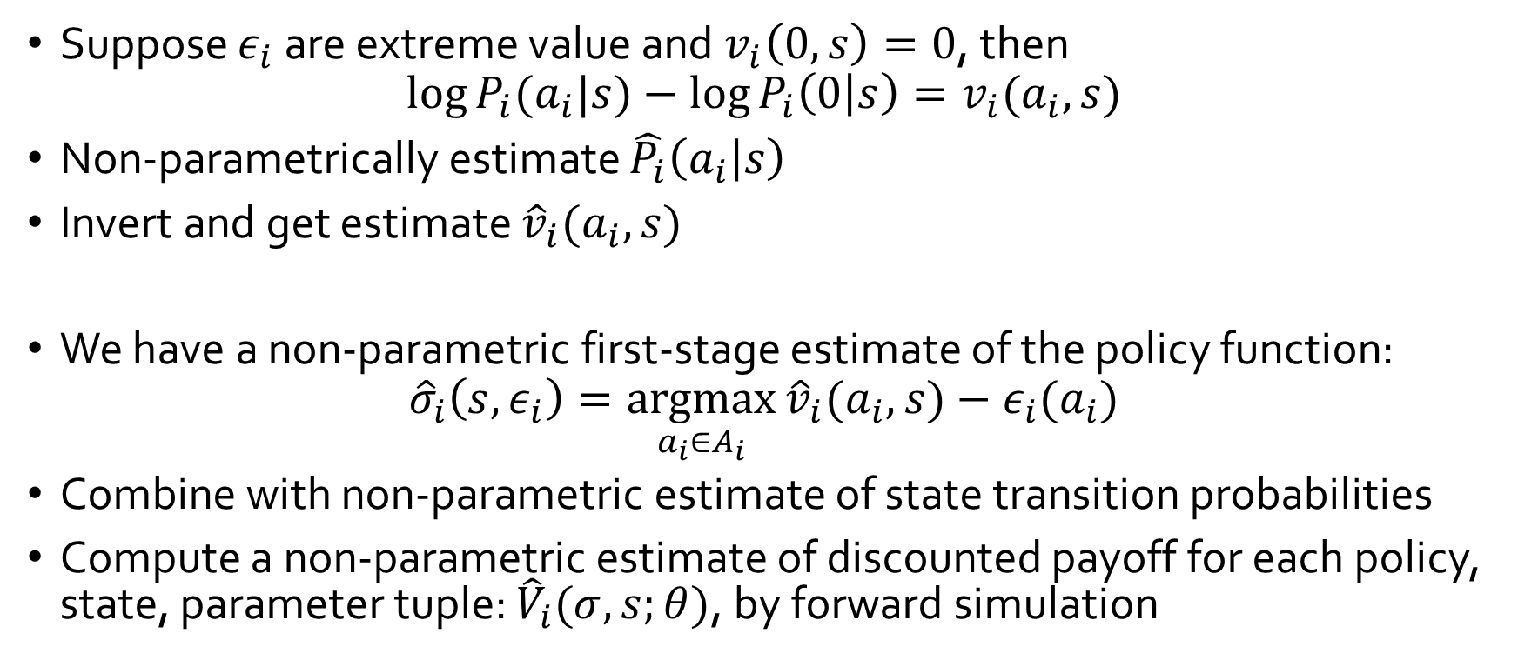
Dynamic Games: First Stage
[Bajari-Benkard-Levin’07]
Suppose $ε_{i}$ are extreme value and $v_{i}\left(0,s\right)=0$, then
$$\log{P_{i}(a_{i}|s)}−\log{P_{i}\left(0 | s\right)}=v_{i}(a_{i}, s)$$
Non-parametrically estimate $\hat{P_{i}}\left(a_{i} | s\right)$
Invert and get estimate ${\hat{v}}_{i}(a_{i},s)$
We have a non-parametric first-stage estimate of the policy function:
$${\hat{σ}}_{i}\left(s,ε_{i}\right)=\underset{a_{i}∈A_{i}}{argmax}{{\hat{v}}_{i}(a_{i},s})−ε_{i}(a_{i})$$
Combine with non-parametric estimate of state transition probabilities
Compute a non-parametric estimate of discounted payoff for each policy, state, parameter tuple: ${\hat{V}}_{i}(σ,s;θ)$, by forward simulation

Slide 34
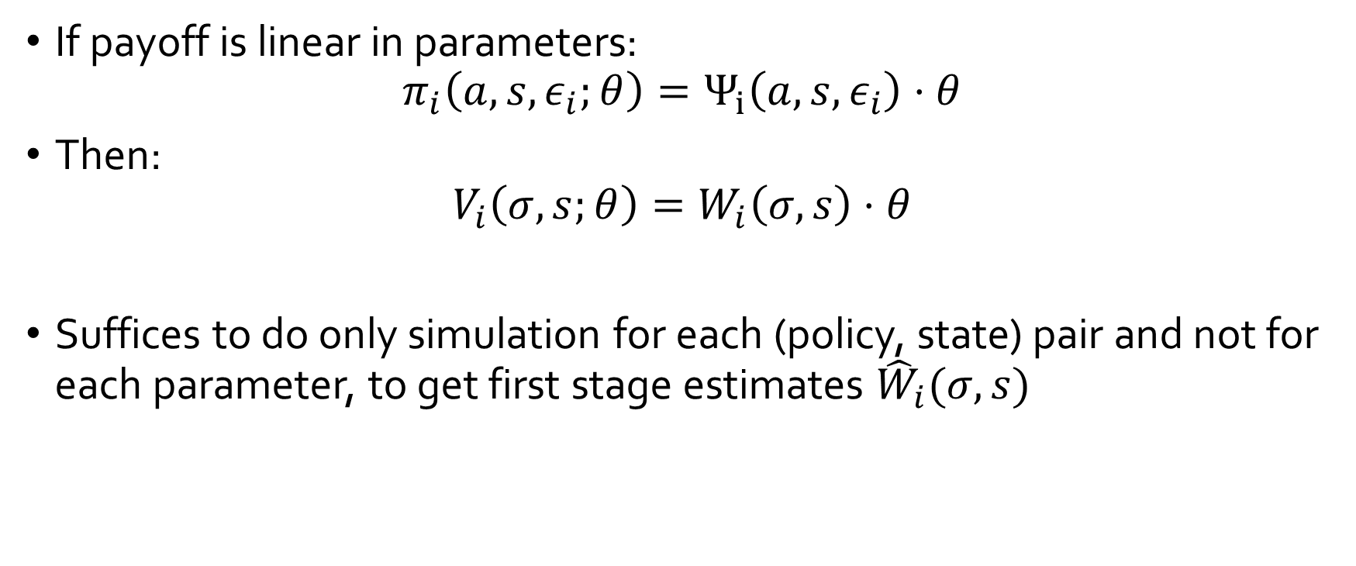
Dynamic Games: First Stage
[Bajari-Benkard-Levin’07]
If payoff is linear in parameters:
$$π_{i}\left(a,s,ε_{i};θ\right)=Ψ_{i}\left(a,s,ε_{i}\right)⋅θ$$
Then:
$$V_{i}\left(σ,s;θ\right)=W_{i}\left(σ,s\right)⋅θ$$
Suffices to do only simulation for each (policy, state) pair and not for each parameter, to get first stage estimates ${\hat{W}}_{i}(σ,s)$

Slide 35
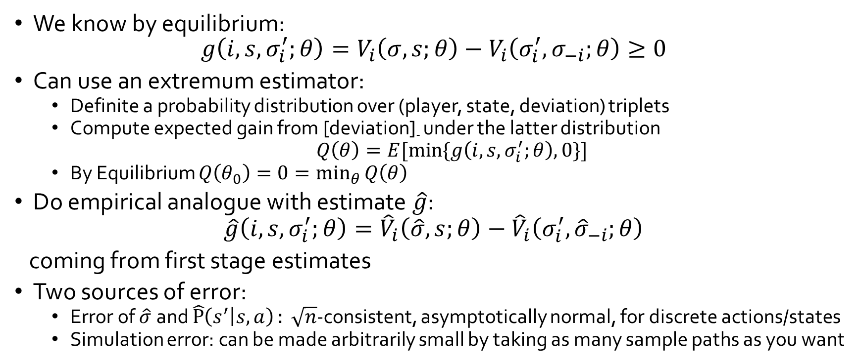
Dynamic Games: Second Stage
[Bajari-Benkard-Levin’07]
We know by equilibrium:
$$g\left(i,s,σ_{i}^{′};θ\right)=V_{i}\left(σ,s;θ\right)−V_{i}\left(σ_{i}^{′},σ_{−i};θ\right)≥0$$
Can use an extremum estimator:
  Definite a probability distribution over (player, state, deviation) triplets
  Compute expected gain from [deviation]₋ under the latter distribution
  $Q\left(θ\right)=E[\min{\{g\left(i,s,σ_{i}^{′};θ\right),0\}}]$
  By Equilibrium $Q\left(θ_{0}\right)=0=\min_{θ}{Q\left(θ\right)}$
Do empirical analogue with estimate $\hat{g}$:
$$\hat{g}\left(i,s,σ_{i}^{′};θ\right)={\hat{V}}_{i}\left(\hat{σ},s;θ\right)−{\hat{V}}_{i}\left(σ_{i}^{′},{\hat{σ}}_{−i};θ\right)$$
coming from first stage estimates
Two sources of error:
  Error of $\hat{σ}$ and $\hat{P}\left(s^{′} | s,a\right): \sqrt{n}$-consistent, asymptotically normal, for discrete actions/states
  Simulation error: can be made arbitrarily small by taking as many sample paths as you want

Slide 36
Notable Literature
[Pakes-Ostrovsky-Berry’07], [Aguirregabiria-Mira’07], [Ackerberg-Benkard-Berry-Pakes’07], [Bajari-Hong-Chernozhukov-Nekipelov’09]
  Provide similar but alternative two stage estimation approaches for dynamic games
  [BHCN’09] can handle continuous states and semi-parametric estimation
  All of them based on the inversion strategy proposed by [Hotz-Miller’93] for estimating single agent MDPs

Slide 37
Main take-aways
When econometrician’s information is the same as each individuals (i.e. shocks are private to the players)
Model can be viewed as fixed point of distribution over actions of players over the unobserved heterogeneity
Can apply two-stage simulation approaches to avoid solving the fixed-point
Data “designates” which equilibrium is selected
Needs main assumption of “unique equilibrium in the data”

Slide 38
Auction Games:
Identification and Estimation
FPA IPV: [Guerre-Perrigne-Vuong’00],
Beyond IPV: [Athey-Haile’02]
Partial Identification: [Haile-Tamer’03]
Comprehensive survey of structural estimation in auctions: [Paarsch-Hong’06]

Slide 39
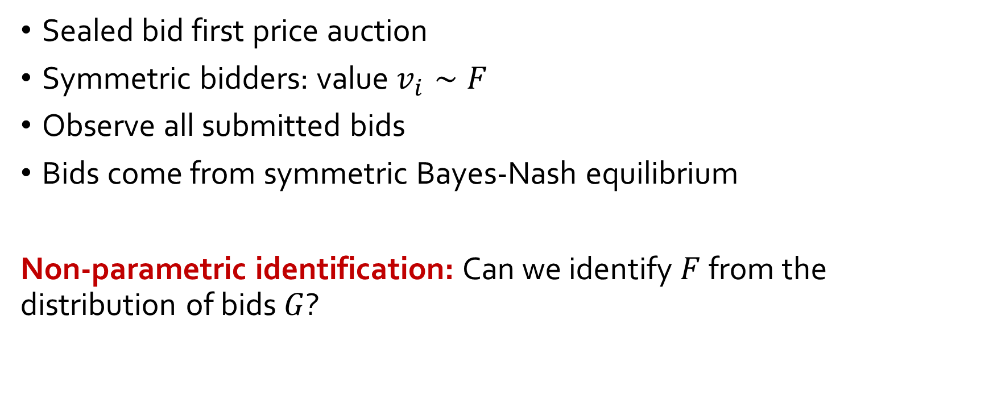
First Price Auction: Non-Parametric Identification
[Guerre-Perrigne-Vuong’00]
Sealed bid first price auction
Symmetric bidders: value $v_{i}∼F$
Observe all submitted bids
Bids come from symmetric Bayes-Nash equilibrium
Non-parametric identification: Can we identify $F$ from the distribution of bids $G$?

Slide 40
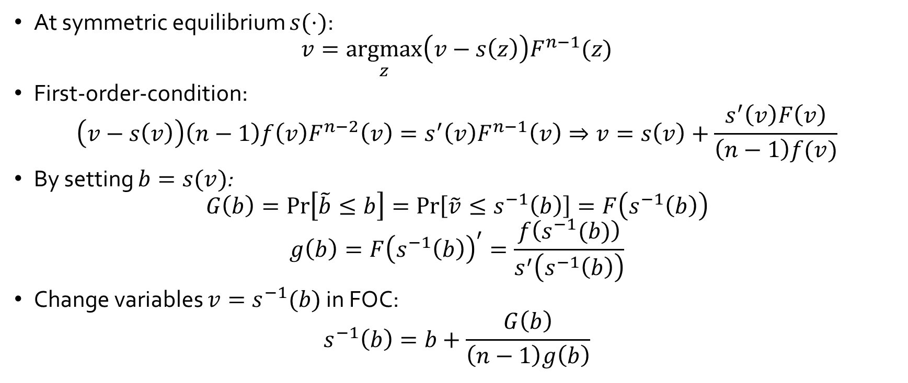
First Price Auction: Non-Parametric Identification
[Guerre-Perrigne-Vuong’00]
At symmetric equilibrium $s(⋅)$:
$$v=\underset{z}{argmax}\left(v−s\left(z\right)\right)F^{n−1}(z)$$
First-order-condition:
$$\left(v−s\left(v\right)\right)\left(n−1\right)f\left(v\right)F^{n−2}\left(v\right)=s^{′}\left(v\right)F^{n−1}\left(v\right)⇒v=s\left(v\right)+\frac{s^{′}\left(v\right)F\left(v\right)}{\left(n−1\right)f(v)}$$
By setting $b=s(v)$:
$$G\left(b\right)=\operatorname{Pr}\left[\tilde{b}≤b\right]=\operatorname{Pr}\left[\tilde{v}≤s^{−1}\left(b\right)\right]=F\left(s^{−1}\left(b\right)\right)$$
$$g\left(b\right)=F{\left(s^{−1}\left(b\right)\right)}^{′}=\frac{f\left(s^{−1}(b)\right)}{s^{′}\left(s^{−1}\left(b\right)\right)}$$
Change variables $v=s^{−1}(b)$ in FOC:
$$s^{−1}\left(b\right)=b+\frac{G\left(b\right)}{\left(n−1\right)g\left(b\right)}$$

Slide 41
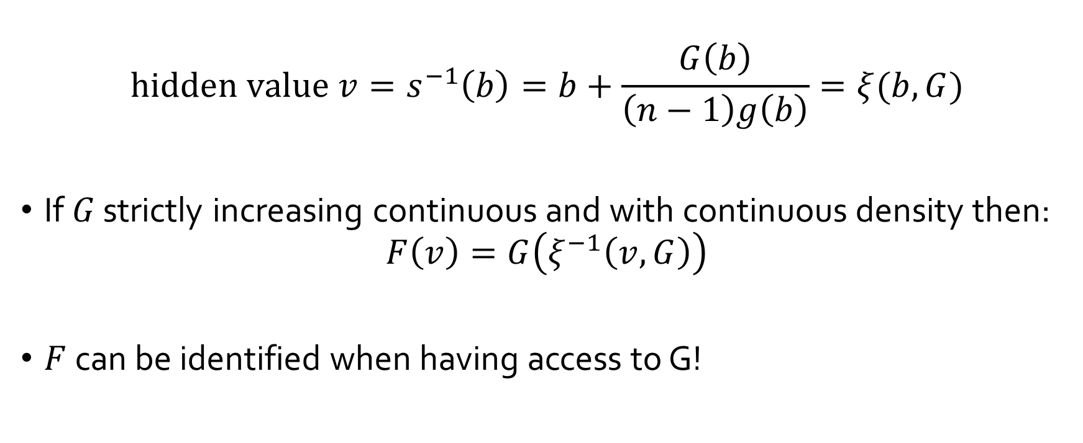
First Price Auction: Non-Parametric Identification
[Guerre-Perrigne-Vuong’00]
$$hidden value v=s^{−1}\left(b\right)=b+\frac{G\left(b\right)}{\left(n−1\right)g\left(b\right)}=ξ(b,G)$$
If $G$ strictly increasing continuous and with continuous density then:
$$F\left(v\right)=G\left(ξ^{−1}\left(v,G\right)\right)$$
$F$ can be identified when having access to G!

Slide 42
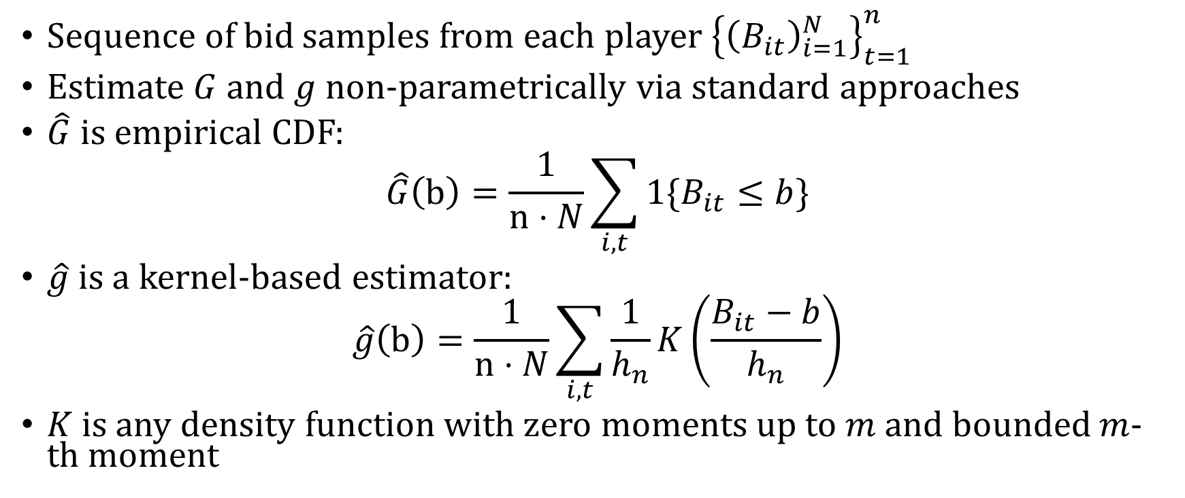
First Price Auction: Non-Parametric Estimation
[Guerre-Perrigne-Vuong’00]
Sequence of bid samples from each player ${\left\{{\left(B_{it}\right)}_{i=1}^{N}\right\}}_{t=1}^{n}$
Estimate $G$ and $g$ non-parametrically via standard approaches
$\hat{G}$ is empirical CDF:
$$\hat{G}\left(b\right)=\frac{1}{n⋅N}\sum_{i,t}{1\{B_{it}≤b\}}$$
$\hat{g}$ is a kernel-based estimator:
$$\hat{g}\left(b\right)=\frac{1}{n⋅N}\sum_{i,t}{\frac{1}{h_{n}}K\left(\frac{B_{it}−b}{h_{n}}\right)}$$
$K$ is any density function with zero moments up to $m$ and bounded $m$-th moment

Slide 43
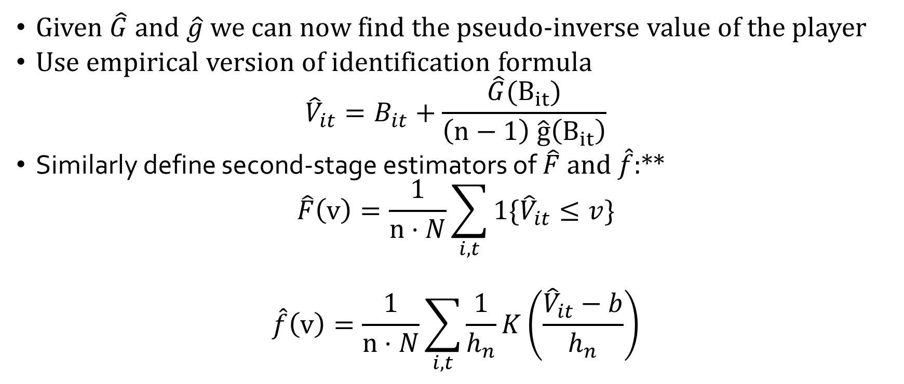
First Price Auction: Non-Parametric Estimation
[Guerre-Perrigne-Vuong’00]
Given $\hat{G}$ and $\hat{g}$ we can now find the pseudo-inverse value of the player
Use empirical version of identification formula
$${\hat{V}}_{it}=B_{it}+\frac{\hat{G}(B_{it})}{\left(n−1\right) \hat{g}\left(B_{it}\right)}$$
Similarly define second-stage estimators of $\hat{F}$ and $\hat{f}$:**
$$\hat{F}\left(v\right)=\frac{1}{n⋅N}\sum_{i,t}{1\{{\hat{V}}_{it}≤v\}}$$
$$\hat{f}\left(v\right)=\frac{1}{n⋅N}\sum_{i,t}{\frac{1}{h_{n}}K\left(\frac{{\hat{V}}_{it}−b}{h_{n}}\right)}$$
** Need some modifications if one wants unbiasedness

Slide 44
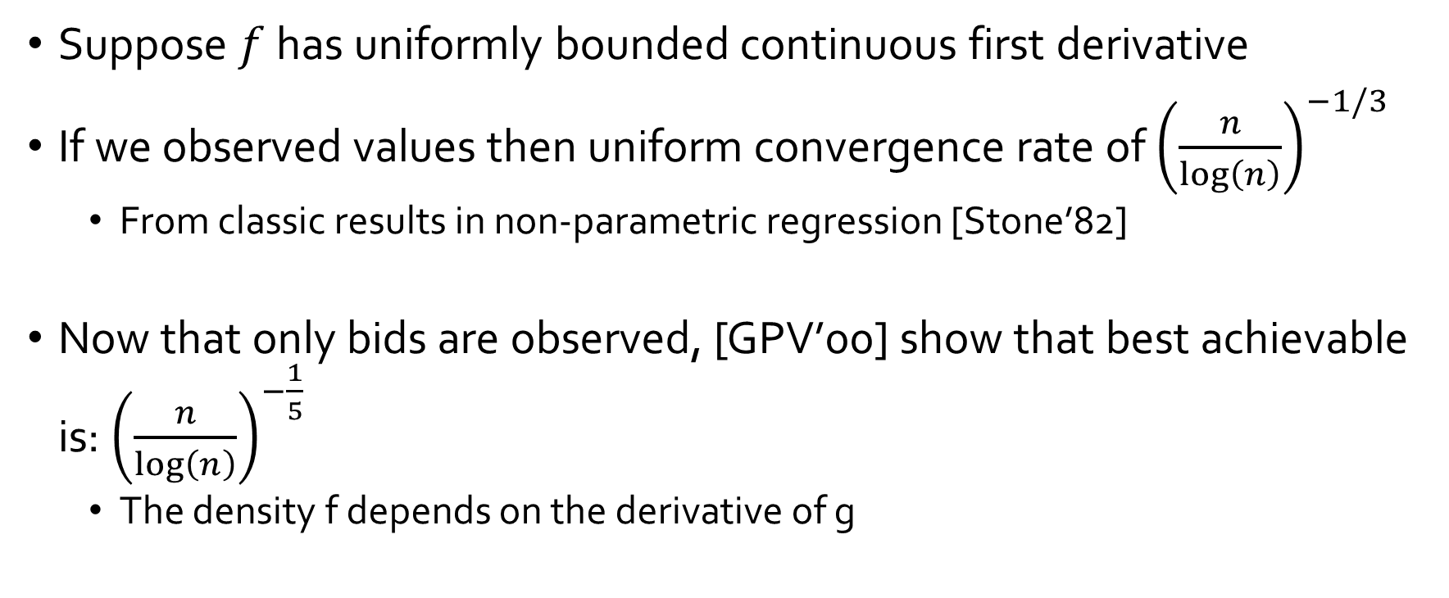
Uniform Rates of Convergence
Suppose $f$ has uniformly bounded continuous first derivative
If we observed values then uniform convergence rate of ${\left(\frac{n}{\log\left(n\right)}\right)}^{−1/3}$
  From classic results in non-parametric regression [Stone’82]
Now that only bids are observed, [GPV’00] show that best achievable is: ${\left(\frac{n}{log\left(n\right)}\right)}^{−\frac{1}{5}}$
  The density f depends on the derivative of g

Slide 45
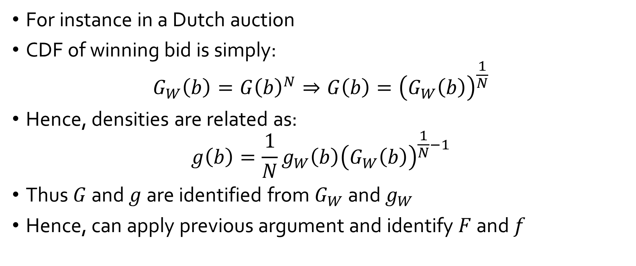
What if only winning bid is observed?
For instance in a Dutch auction
CDF of winning bid is simply:
$$G_{W}\left(b\right)=G{\left(b\right)}^{N}⇒G\left(b\right)={\left(G_{W}\left(b\right)\right)}^{\frac{1}{N}}$$
Hence, densities are related as:
$$g\left(b\right)=\frac{1}{N}g_{W}\left(b\right){\left(G_{W}\left(b\right)\right)}^{\frac{1}{N}−1}$$
Thus $G$ and $g$ are identified from $G_{W}$ and $g_{W}$
Hence, can apply previous argument and identify $F$ and $f$

Slide 46
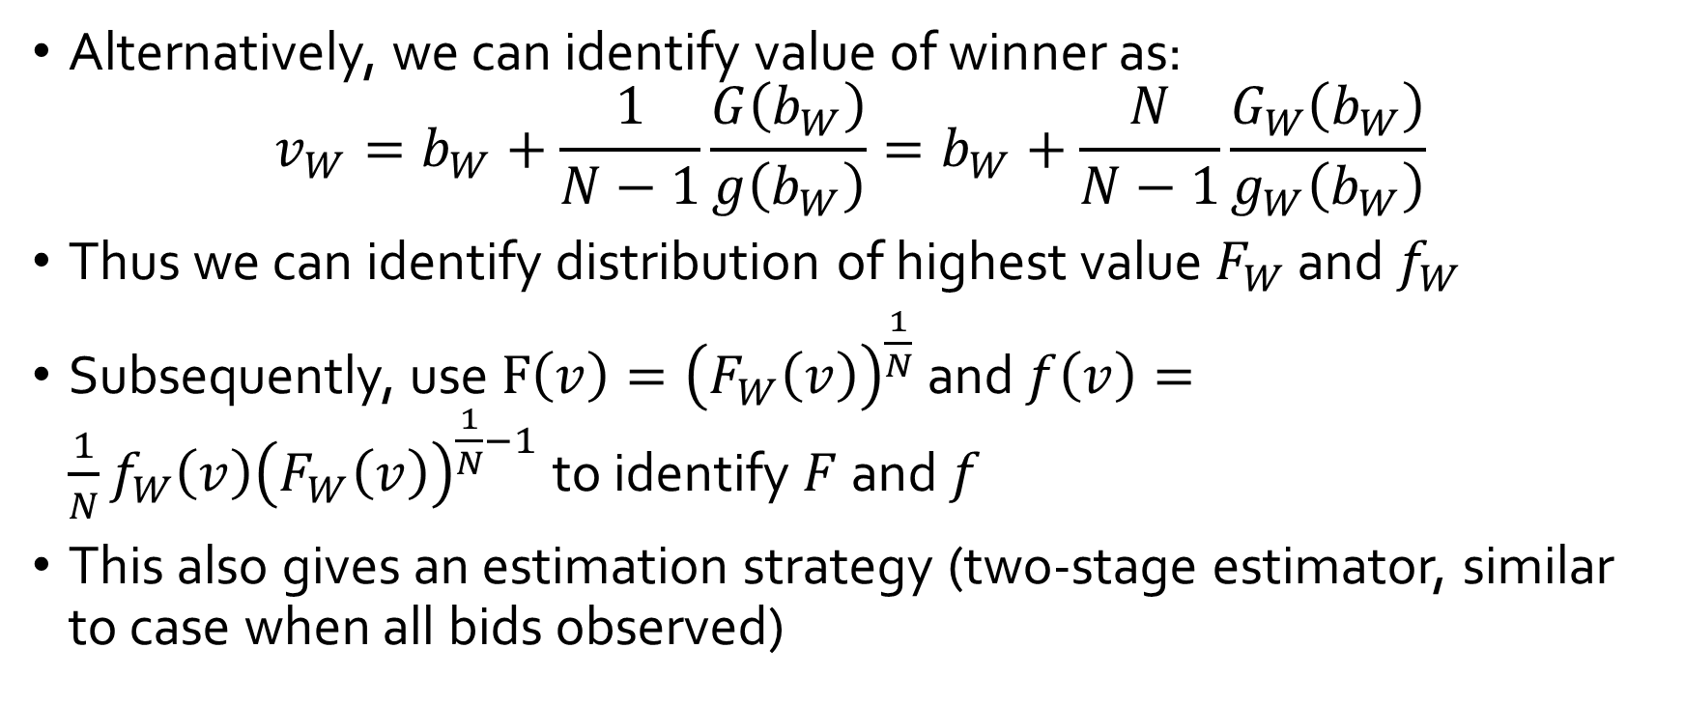
What if only winning bid is observed?
Alternatively, we can identify value of winner as:
$$v_{W}=b_{W}+\frac{1}{N−1}\frac{G\left(b_{W}\right)}{g\left(b_{W}\right)}=b_{W}+\frac{N}{N−1}\frac{G_{W}\left(b_{W}\right)}{g_{W}\left(b_{W}\right)}$$
Thus we can identify distribution of highest value $F_{W}$ and $f_{W}$
Subsequently, use $F\left(v\right)={\left(F_{W}\left(v\right)\right)}^{\frac{1}{N}}$ and $f\left(v\right)=\frac{1}{N}f_{W}\left(v\right){\left(F_{W}\left(v\right)\right)}^{\frac{1}{N}−1}$ to identify $F$ and $f$
This also gives an estimation strategy (two-stage estimator, similar to case when all bids observed)

Slide 47
Notable Literature
[Athey-Haile’02]
  Identification in more complex than independent private values setting.
  Primarily second price and ascending auctions
  Mostly, winning price and bidder is observed
  Most results in IPV or Common Value model
[Haile-Tamer’03]
  Incomplete data and partial identification
  Prime example: ascending auction with large bid increments
  Provides upper and lower bounds on the value distribution from necessary equilibrium conditions
[Paarsch-Hong’06]
  Complete treatment of structural estimation in auctions and literature review
  Mostly presented in the IPV model

Slide 48
Main Take-Aways
Closed form solutions of equilibrium bid functions in auctions
Allows for non-parametric identification of unobserved value distribution
Easy two-stage estimation strategy (similar to discrete incomplete information games)
Estimation and Identification robust to what information is observed (winning bid, winning price)
Typically rates for estimating density of value distribution are very slow

Slide 49
Algorithmic Game Theory and Econometrics
Mechanism Design for Inference
Econometrics for Learning Agents

Slide 50
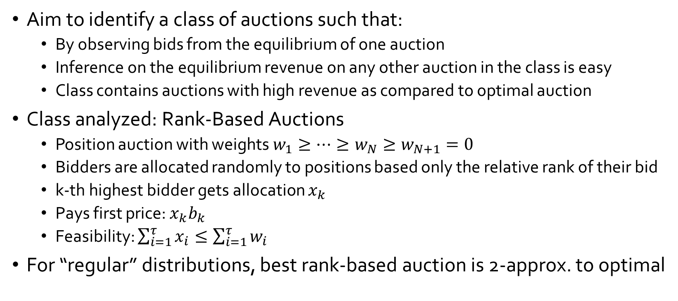
Mechanism Design for Data Science
[Chawla-Hartline-Nekipelov’14]
Aim to identify a class of auctions such that:
  By observing bids from the equilibrium of one auction
  Inference on the equilibrium revenue on any other auction in the class is easy
  Class contains auctions with high revenue as compared to optimal auction
Class analyzed: Rank-Based Auctions
  Position auction with weights $w_{1}≥…≥w_{N}≥w_{N+1}=0$
  Bidders are allocated randomly to positions based only the relative rank of their bid
  k-th highest bidder gets allocation $x_{k}$
  Pays first price: $x_{k}b_{k}$
  Feasibility: $\sum_{i=1}^{τ}{x_{i}}≤\sum_{i=1}^{τ}{w_{i}}$
For “regular” distributions, best rank-based auction is 2-approx. to optimal

Slide 51
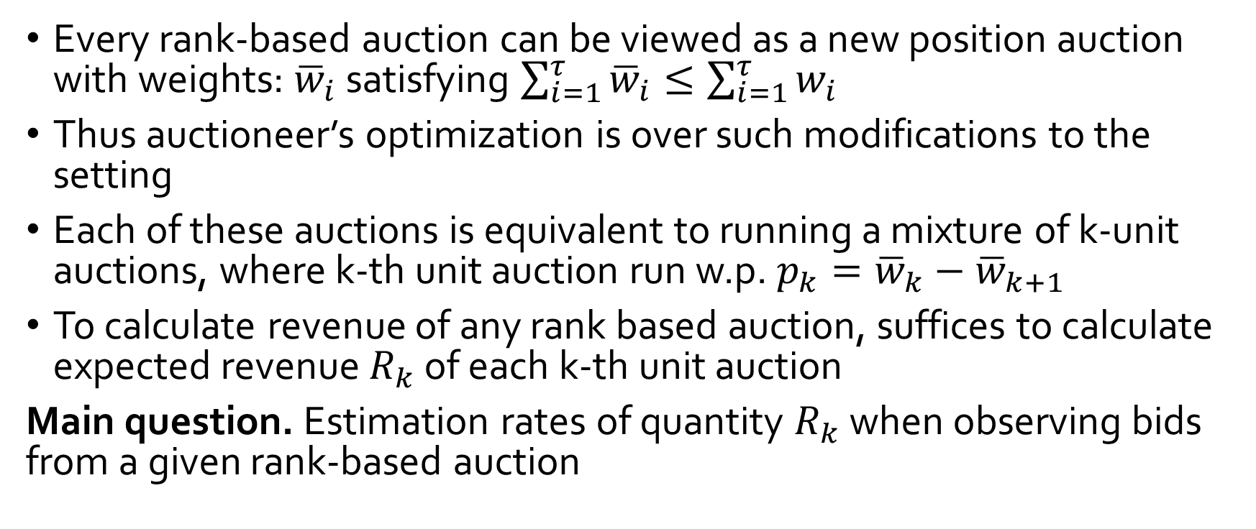
Optimizing over Rank-Based Auctions
[Chawla-Hartline-Nekipelov’14]
Every rank-based auction can be viewed as a new position auction with weights: ${\overline{w}}_{i}$ satisfying $\sum_{i=1}^{τ}{{\overline{w}}_{i}}≤\sum_{i=1}^{τ}{w_{i}}$
Thus auctioneer’s optimization is over such modifications to the setting
Each of these auctions is equivalent to running a mixture of k-unit auctions, where k-th unit auction run w.p. $p_{k}={\overline{w}}_{k}−{\overline{w}}_{k+1}$
To calculate revenue of any rank based auction, suffices to calculate expected revenue $R_{k}$ of each k-th unit auction
Main question. Estimation rates of quantity $R_{k}$ when observing bids from a given rank-based auction

Slide 52
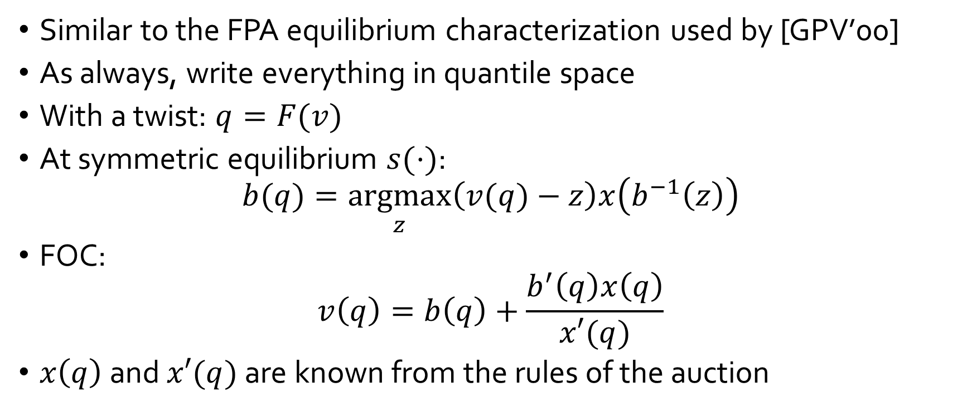
Estimation analysis
[Chawla-Hartline-Nekipelov’14]
Similar to the FPA equilibrium characterization used by [GPV’00]
As always, write everything in quantile space
With a twist: $q=F(v)$
At symmetric equilibrium $s(⋅)$:
$$b(q)=\underset{z}{argmax}\left(v(q)−z\right)x\left(b^{−1}\left(z\right)\right)$$
FOC:
$$v\left(q\right)=b\left(q\right)+\frac{b^{′}\left(q\right)x\left(q\right)}{x′(q)}$$
$x\left(q\right)$ and $x′(q)$ are known from the rules of the auction

Slide 53
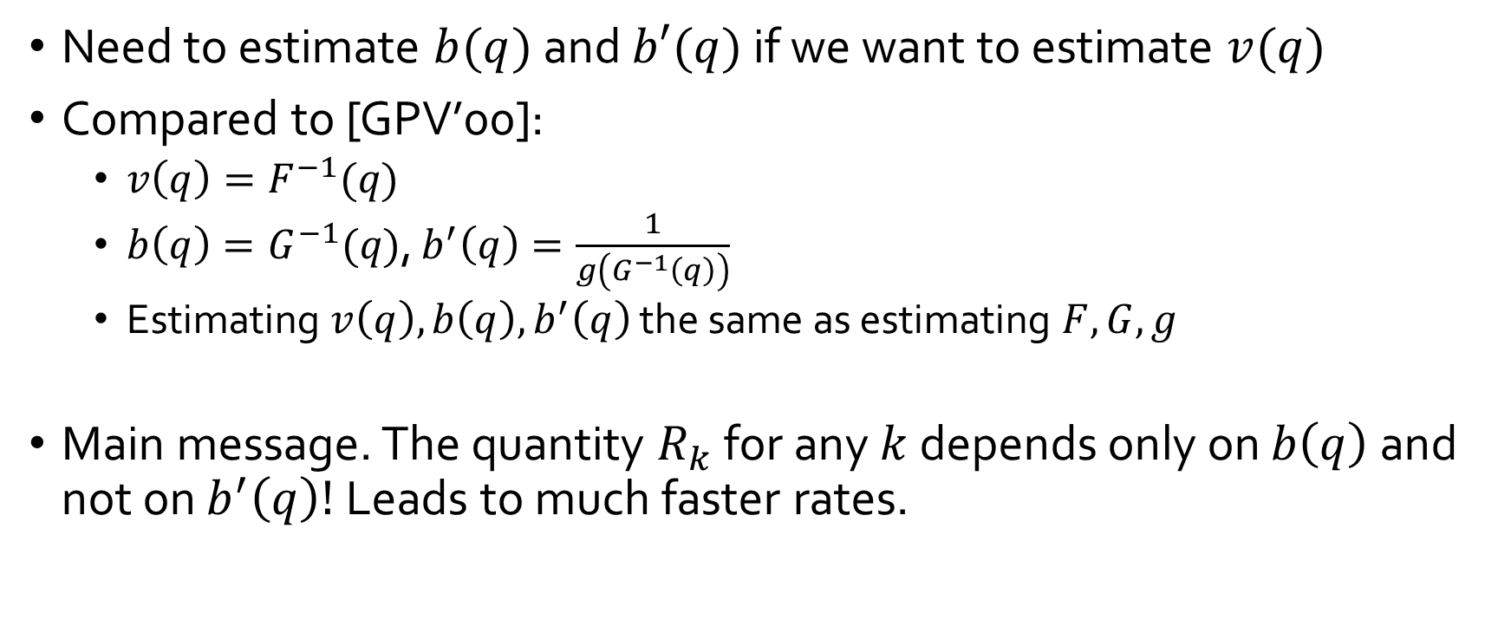
Estimation
[Chawla-Hartline-Nekipelov’14]
Need to estimate $b(q)$ and $b′(q)$ if we want to estimate $v(q)$
Compared to [GPV’00]:
  $v\left(q\right)=F^{−1}(q)$
  $b\left(q\right)=G^{−1}(q)$, $b^{′}\left(q\right)=\frac{1}{g\left(G^{−1}\left(q\right)\right)}$
  Estimating $v\left(q\right),b\left(q\right), b^{′}\left(q\right)$ the same as estimating $F,G,g$
Main message. The quantity $R_{k}$ for any $k$ depends only on $b\left(q\right)$ and not on $b^{′}\left(q\right)!$ Leads to much faster rates.

Slide 54
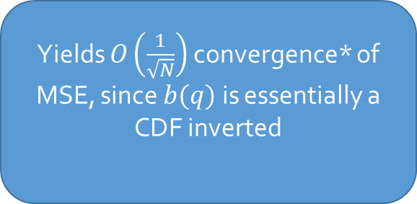
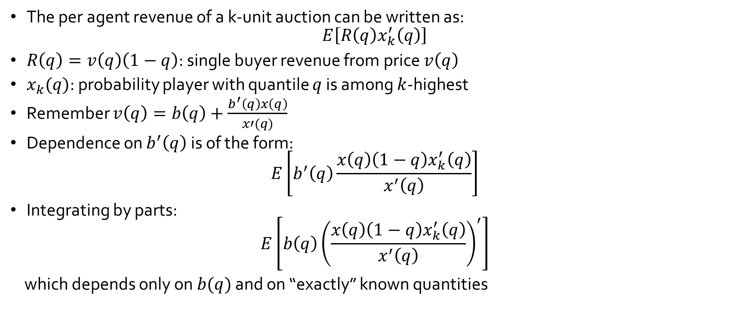
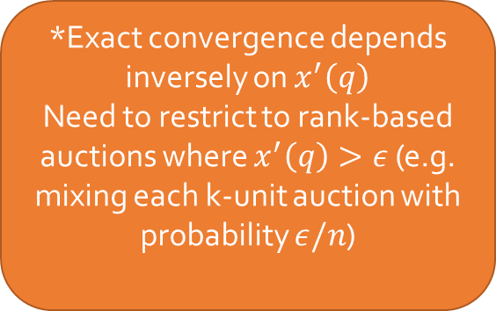
Fast Convergence for Counterfactual Revenue
[Chawla-Hartline-Nekipelov’14]
The per agent revenue of a k-unit auction can be written as:
$$E\left[R\left(q\right)x_{k}^{′}\left(q\right)\right]$$
$R\left(q\right)=v\left(q\right)\left(1−q\right)$: single buyer revenue from price $v\left(q\right)$
$x_{k}(q)$: probability player with quantile $q$ is among $k$-highest
Remember $v\left(q\right)=b\left(q\right)+\frac{b^{′}\left(q\right)x\left(q\right)}{x′(q)}$
Dependence on $b^{′}\left(q\right)$ is of the form:
$$E\left[b^{′}\left(q\right)\frac{x\left(q\right)\left(1−q\right)x_{k}^{′}\left(q\right)}{x^{′}\left(q\right)}\right]$$
Integrating by parts:
$$E\left[b\left(q\right){\left(\frac{x\left(q\right)\left(1−q\right)x_{k}^{′}\left(q\right)}{x^{′}\left(q\right)}\right)}^{′}\right]$$
which depends only on $b(q)$ and on “exactly” known quantities
Yields $O\left(\frac{1}{\sqrt{N}}\right)$ convergence* of MSE, since $b(q)$ is essentially a CDF inverted
*Exact convergence depends inversely on $x^{′}\left(q\right)$
Need to restrict to rank-based auctions where $x^{′}\left(q\right)>ε$ (e.g. mixing each k-unit auction with probability $ε/n$)

Slide 55

Take-away points
[Chawla-Hartline-Nekipelov’14]
By isolating mechanism design to rank based auctions, we achieve:
  Constant approximation to the optimal revenue within the class
  Estimation rates of revenue of each auction in the class of $O\left(\sqrt{N}\right)$
Allows for easy adaptation of mechanism to past history of bids
[Chawla et al. EC’16]: allows for A/B testing among auctions and for a universal B test! (+improved rates)

Slide 56

Econometrics for Learning Agents
[Nekipelov-Syrgkanis-Tardos’15]
Analyze repeated strategic interactions
Finite horizon $t∈\left\{1,…,T\right\}$
Players are learning over time
Unlike stationary equilibrium, or stationary MPE, or static game
Use no-regret notion of learning behavior:
$$∀a_{i}^{′}: \sum_{t}{π_{i}(a_{i}^{t},a_{−i}^{t};θ)}≥\sum_{t}{π_{i}\left(a_{i}^{′},a_{−i}^{t};θ\right)}−ε$$

Slide 57






High-level approach
[Nekipelov-Syrgkanis-Tardos’15]
If we assume $ε$ regret
$$For all a_{i}^{′}: \frac{1}{T}\sum_{t}{π_{i}\left(a^{t};θ\right)}≥\frac{1}{T}\sum_{t}{π_{i}\left(a_{i}^{′},a_{−i}^{t};θ\right)}−ε$$
Inequalities that unobserved $θ$ must satisfy
Varying $ε$ we get the rationalizable set
of parameters
Current average utility
Average deviating utility from fixed action
Regret
$$ε$$
rationalizable set
$$ε′′$$
$$ε′$$
$$ε$$
$$θ$$

Slide 58


Application: Online Ad Auction setting
[Nekipelov-Syrgkanis-Tardos’15]
Each player has value-per-click $v_{i}$
Bidders ranked according to a scoring rule
Number of clicks and cost depends on position
Quasi-linear utility
$$π_{i}\left(b;v_{i}\right)=v_{i}⋅x_{i}\left(b\right)−p_{i}\left(b\right)$$
Value-Per-Click
Expected Payment
Expected click probability

Slide 59
Main Take-Aways of Econometric Approach
[Nekipelov-Syrgkanis-Tardos’15]
Rationalizable set is convex
Support function representation of convex set depends on a one dimensional function
Can apply one-dimensional non-parametric regression rates
Avoids complicated set-inference approaches
Comparison with prior econometric approaches:
Behavioral learning model computable in poly-time by players
Models error in decision making as unknown parameter rather than profit shock with known distribution
Much simpler estimation approach than prior repeated game results
Can handle non-stationary behavior

Slide 60
Potential Points of Interaction with Econometric Theory
Inference for objectives (e.g. welfare, revenue, etc.) + combine with approximation bounds (see e.g. Chawla et al’14-16, Hoy et al.’15, Liu-Nekipelov-Park’16,Coey et al.’16)
Computational complexity of proposed econometric methods, computationally efficient alternative estimation approaches
Game structures that we have studied exhaustively in theory (routing games, simple auctions)
Game models with combinatorial flavor (e.g. combinatorial auctions)
Computational learning theory and online learning theory techniques for econometrics
Finite sample estimation error analysis

Slide 61
AGT+Data Science
Large scale mechanism design and game theoretic analysis needs to be data-driven
Learning good mechanisms from data
Inferring game properties from data
Designing mechanisms for good inference
Testing our game theoretic models in practice (e.g. Nisan-Noti’16)

Slide 62
References
Primer on Econometric Theory
Newey-McFadden, 1994: Large sample estimation and hypothesis testing, Chapter 36, Handbook of Econometrics
Amemiya, 1985: Advanced Econometrics, Harvard University Press
Hong, 2012: Stanford University, Dept. of Economics, course ECO276, Limited Dependent Variables
Surveys on Econometric Theory for Games
Ackerberg-Benkard-Berry-Pakes , 2006: Econometric tools for analyzing market outcomes, Handbook of Econometrics
Bajari-Hong-Nekipelov, 2010: Game theory and econometrics: a survey of some recent research, NBER 2010
Berry-Tamer, 2006: Identification in models of oligopoly entry, Advances in Economics and Econometrics
Complete Information Games
Bresnahan-Reiss, 1990: Entry in monopoly markets, Review of Economic Studies
Bresnahan-Reiss, 1991: Empirical models of discrete games, Journal of Econometrics
Berry, 1992: Estimation of a model of entry in the airline industry, Econometrica
Tamer, 2003: Incomplete simultaneous discrete response model with multiple equilibria, Review of Economic Studies
Ciliberto-Tamer, 2009: Market Structure and Multiple Equilibria in Airline Markets, Econometrica
Beresteanu-Molchanov-Molinari, 2011: Sharp identification regions in models with convex moment predictions, Econometrica
Chernozhukov-Hong-Tamer, 2007: Estimation and confidence regions for parameter sets in econometrics models, Econometrica
Bajari-Hong-Ryan, 2010: Identification and estimation of a discrete game of complete information, Econometrica

Slide 63

References
Dynamic Games of Incomplete Information
Bajari-Benkard-Levin, 2007: Estimating dynamic models of imperfect competition, Econometrica
Aguirregabiria-Mira, 2007: Sequential estimation of dynamic discrete games, Econometrica
Pakes-Ostrovsky-Berry, 2007: Simple estimators for the parameters of discrete dynamic games (with entry/exit examples), RAND Journal of Economics
Pesendorfer-Schmidt-Dengler, 2003: Identification and estimation of dynamic games
Bajari-Chernozhukov-Hong-Nekipelov, 2009: Non-parametric and semi-parametric analysis of a dynamic game model
Hotz-Miller, 1993: Conditional choice probabilities and the estimation of dynamic models, Review of Economic Studies
Static Games of Incomplete Information
Bajari-Hong-Krainer-Nekipelov, 2006: Estimating static models of strategic interactions, Journal of Business and Economic Statistics
Semi-Parametric two-stage estimation $\sqrt{n}$-consistency
Hong, 2012: ECO276, Lecture 5: Basic asymptotic for $\sqrt{n}$ Consistent semiparametric estimation
Robinson, 1988: Root-n-consistent semiparametric regression, Econometrica
Newey, 1990: Semiparametric efficiency bounds, Journal of Applied Econometrics
Newey, 1994: The asymptotic variance of semiparametric estimators, Econometrica
Ai-Chen, 2003: Efficient estimation of models with conditional moment restrictions containing unknown functions, Econometrica
Chen, 2008: Large sample sieve estimation of semi-nonparametric models Chapter 76, Handbook of Econometrics

Slide 64
References
Auctions
Guerre-Perrigne-Vuong, 2000: Optimal non-parametric estimation of first-price auctions, Econometrica
Haile-Tamer, 2003: Inference in an incomplete model of English auctions, Journal of Political Economy
Athey-Haile, 2007: Non-parametric approaches to auctions, Handbook of Econometrics
Paarsch-Hong, 2006: An introduction to the structural econometrics of auction data, The MIT Press
Algorithmic Game Theory and Econometrics
Chawla-Hartline-Nekipelov, 2014: Mechanism design for data science, ACM Conference on Economics and Computation
Nekipelov-Syrgkanis-Tardos, 2015: Econometrics for learning agents, ACM Conference on Economics and Computation
Chawla-Hartline-Nekipelov, 2016: A/B testing in auctions, ACM Conference on Economics and Computation
Hoy-Nekipelov-Syrgkanis, 2015: Robust data-driven guarantees in auctions, Workshop on Algorithmic Game Theory and Data Science

