Slide 1
Econometrics and Machine Learning
Vasilis Syrgkanis
Microsoft Research
New England

Slide 2
Econometrics and Machine Learning
Machine learning infiltrating decision making
Most decision-making questions are causal/counterfactual
At odds with ML power: prediction vs counterfactual prediction
Econometrics -> ML: recipes for identification of causal quantities
ML -> Econometrics: flexible non-parametric estimation

Slide 3
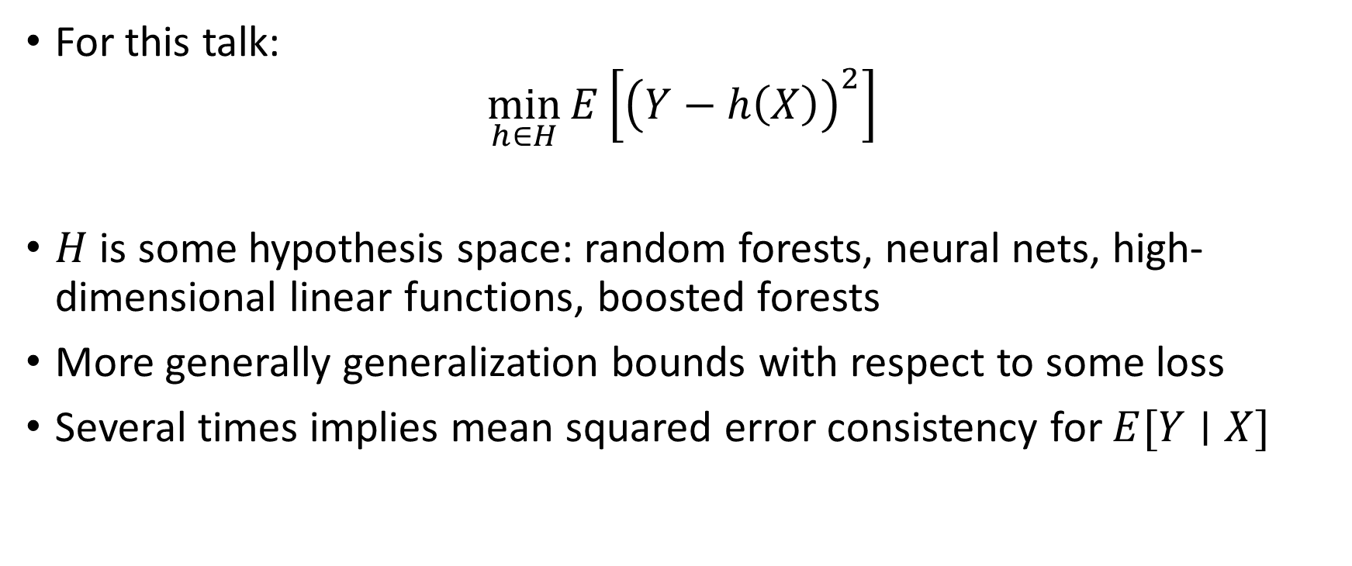
What is Machine Learning
For this talk:
$$\min_{h∈H}{E\left[{\left(Y−h\left(X\right)\right)}^{2}\right]}$$
$H$ is some hypothesis space: random forests, neural nets, high-dimensional linear functions, boosted forests
More generally generalization bounds with respect to some loss
Several times implies mean squared error consistency for $E[Y∣X]$

Slide 4
Example 1:
Estimating Effect of Price on Demand

Slide 5

Example: Estimating Price Elasticity of Demand
Goal: Estimate elasticity, the effect of a change in price on demand
log(demand)
$$Y = θ_{0} ⋅ T + ε$$
log(demand)
elasticity
log(price)
noise
log(price)
Conclusion: Increasing price increases demand!
Problem: Demand increases in winter and price anticipates demand

Slide 6
Example: Estimating Price Elasticity of Demand
Goal: Estimate elasticity, the effect of a change in price on demand
log(demand)
$$Y = θ_{0} ⋅ T + β_{0} ⋅ X + ε$$
log(demand)
elasticity
log(price)
season
indicator
noise
log(price)
Idea: Introduce confounder (the season) into regression

Slide 7
Example: Estimating Price Elasticity of Demand
Goal: Estimate elasticity, the effect of a change in price on demand
log(demand)
$$Y = θ_{0} ⋅ T + β_{0} ⋅ X + ε$$
log(demand)
elasticity
log(price)
season
indicator
noise
log(price)
Problem: What if there are 100s or 1000s of potential confounders?

Slide 8
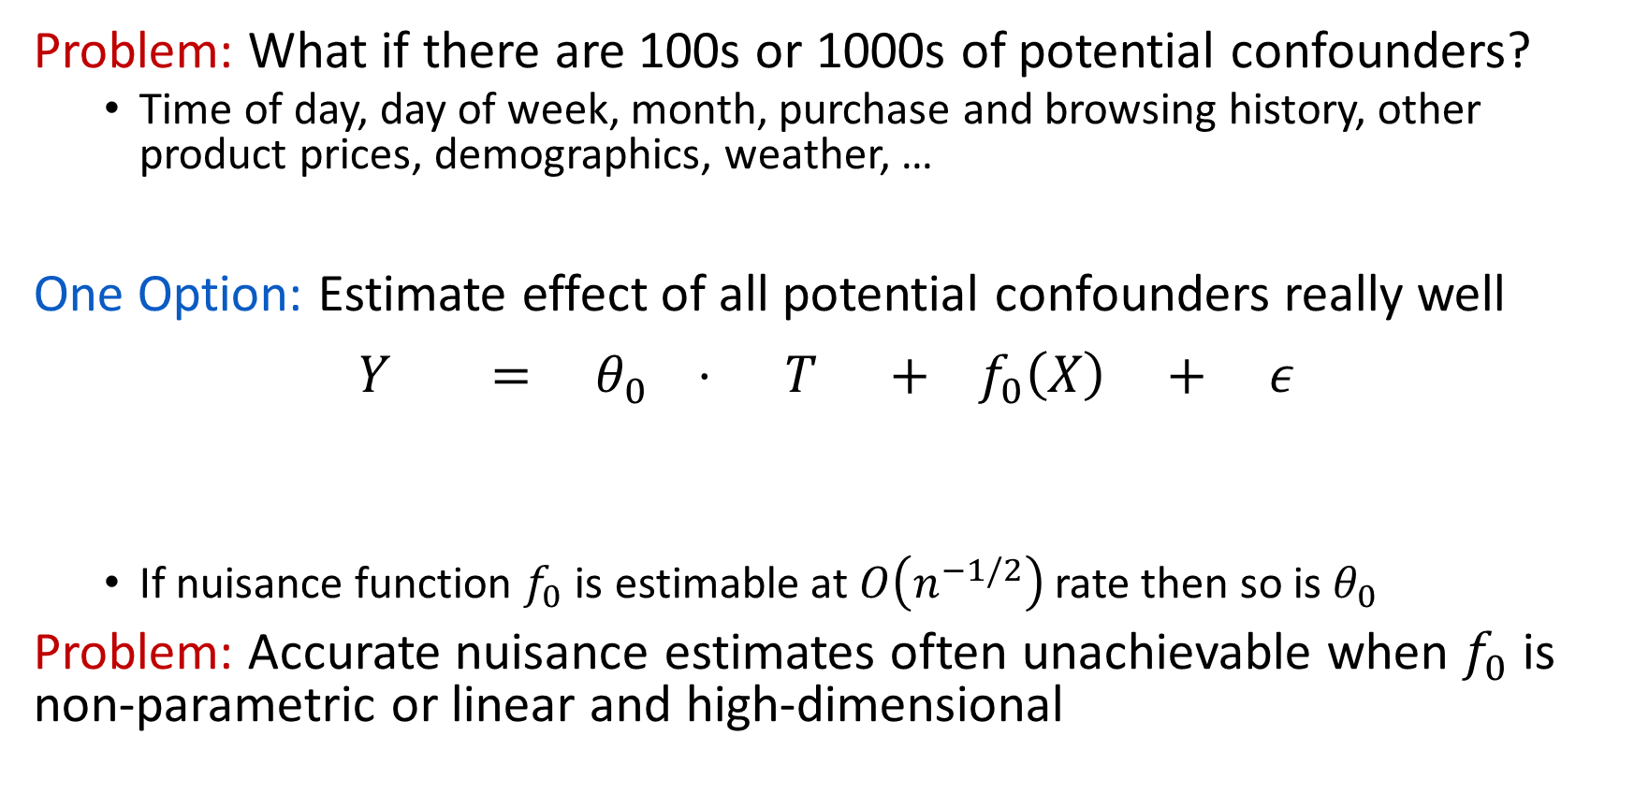
Example: Estimating Price Elasticity of Demand
Problem: What if there are 100s or 1000s of potential confounders?
  Time of day, day of week, month, purchase and browsing history, other product prices, demographics, weather, …
One Option: Estimate effect of all potential confounders really well
$$Y = θ_{0} ⋅ T + f_{0}\left(X\right) + ε$$
  If nuisance function $f_{0}$ is estimable at $O\left(n^{−1/2}\right)$ rate then so is $θ_{0}$
Problem: Accurate nuisance estimates often unachievable when $f_{0}$ is non-parametric or linear and high-dimensional
log(demand)
elasticity
log(price)
effect of potential confounders
noise

Slide 9
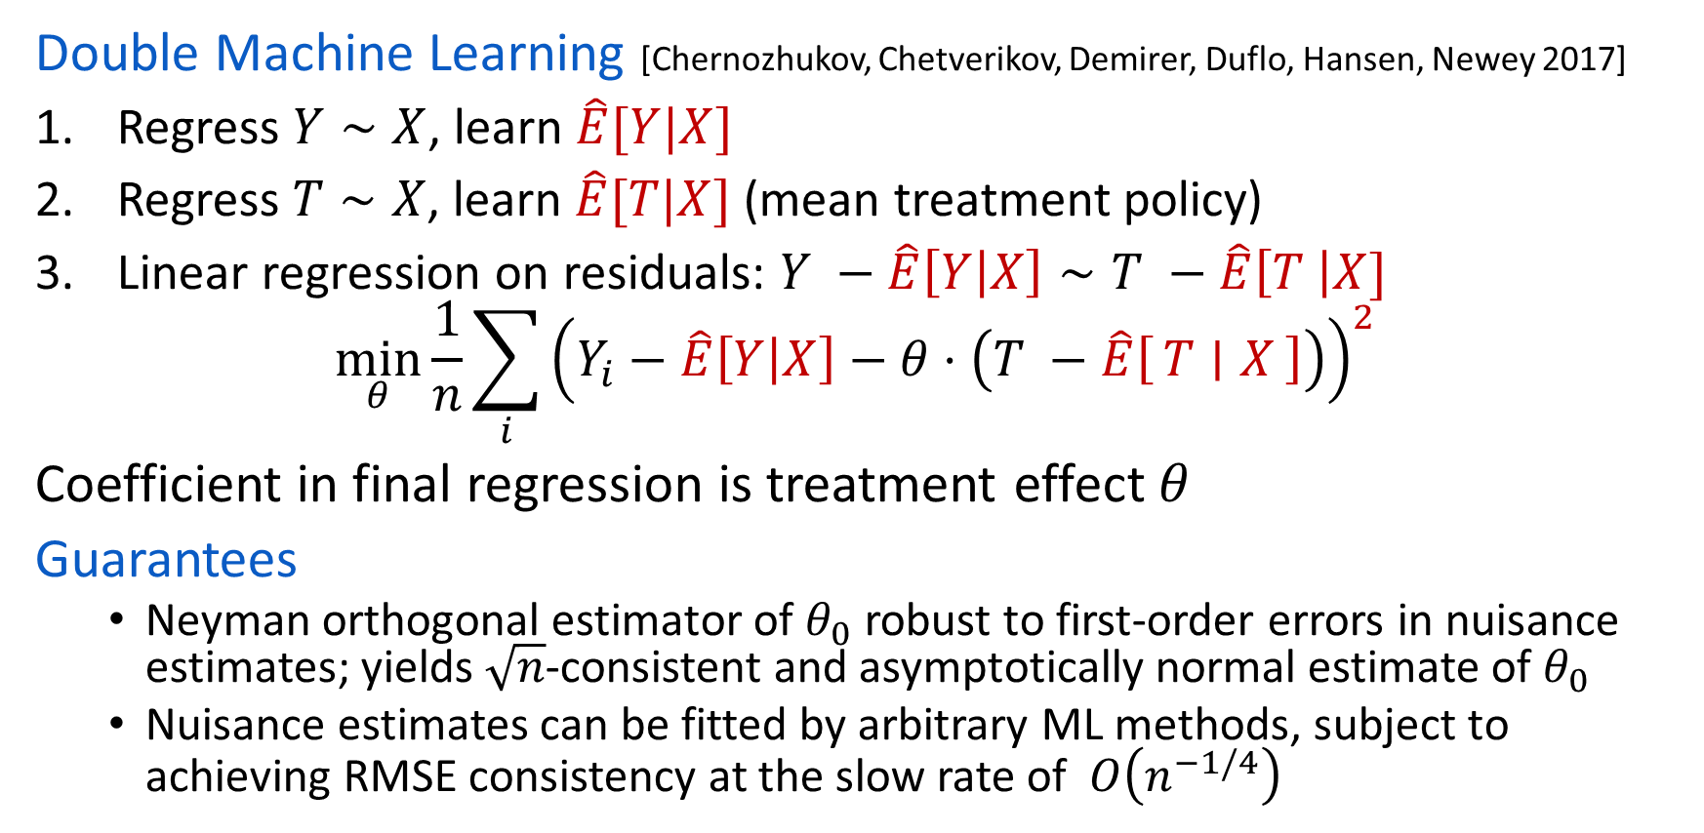
Double ML for Treatment Effect Inference
Double Machine Learning [Chernozhukov, Chetverikov, Demirer, Duflo, Hansen, Newey 2017]
Regress $Y∼X$, learn $\hat{E}[Y|X]$
Regress $T∼X$, learn $\hat{E}[T|X]$ (mean treatment policy)
Linear regression on residuals: $Y −\hat{E}\left[Y | X\right]∼T −\hat{E}\left[T \right|X]$
$$\min_{θ}{\frac{1}{n}\sum_{i}{{\left(Y_{i}−\hat{E}\left[Y | X\right]−θ⋅\left(T −\hat{E}\left[T ∣ X\right]\right)\right)}^{2} }}$$
Coefficient in final regression is treatment effect $θ$
Guarantees
  Neyman orthogonal estimator of $θ_{0}$ robust to first-order errors in nuisance estimates; yields $\sqrt{n}$-consistent and asymptotically normal estimate of $θ_{0}$
  Nuisance estimates can be fitted by arbitrary ML methods, subject to achieving RMSE consistency at the slow rate of $O\left(n^{−1/4}\right)$

Slide 10
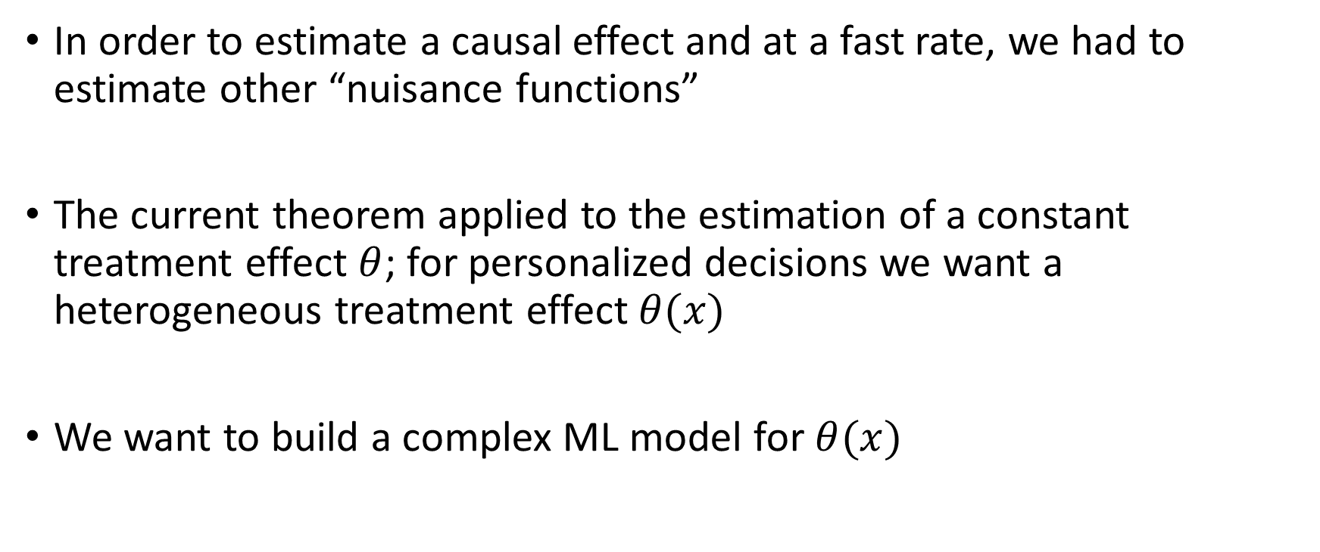
Some Remarks
In order to estimate a causal effect and at a fast rate, we had to estimate other “nuisance functions”
The current theorem applied to the estimation of a constant treatment effect $θ$; for personalized decisions we want a heterogeneous treatment effect $θ(x)$
We want to build a complex ML model for $θ(x)$

Slide 11
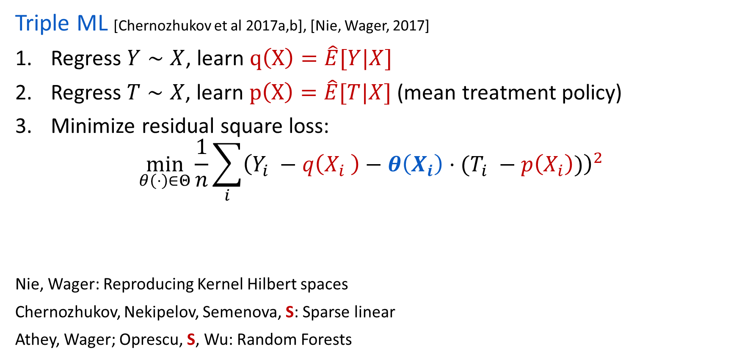
Triple ML for Treatment Effect Inference
Triple ML [Chernozhukov et al 2017a,b], [Nie, Wager, 2017]
Regress $Y∼X$, learn $q\left(X\right)=\hat{E}[Y|X]$
Regress $T∼X$, learn $p\left(X\right)=\hat{E}[T|X]$ (mean treatment policy)
Minimize residual square loss:
$$\min_{θ\left(⋅\right)∈Θ}{\frac{1}{n}\sum_{i}{{\left(Y_{i} −q\left(X_{i} \right)−θ\left(X_{i}\right)⋅(T_{i} −p\left(X_{i}\right))\right)}^{2} }}$$
Nie, Wager: Reproducing Kernel Hilbert spaces
Chernozhukov, Nekipelov, Semenova, S: Sparse linear
Athey, Wager; Oprescu, S, Wu: Random Forests
Error in final regression is of the same order as if we knew the nuisance functions

Slide 12
Walkthrough Example 2:
Binary Treatments

Slide 13
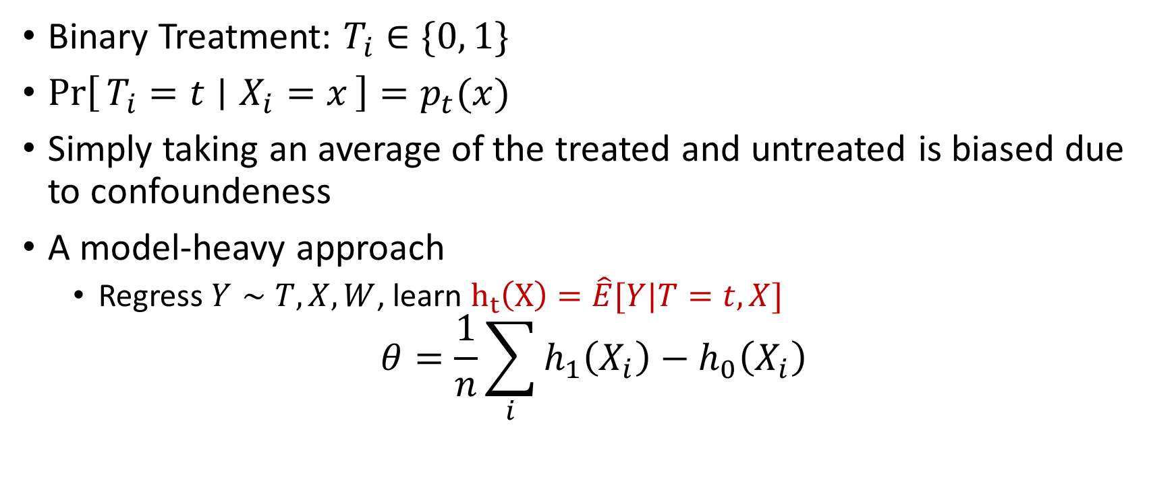
Binary Treatment Effects
Binary Treatment: $T_{i}∈\{0, 1\}$
$\operatorname{Pr}\left[T_{i}=t ∣ X_{i}=x\right]=p_{t}(x)$
Simply taking an average of the treated and untreated is biased due to confoundeness
A model-heavy approach
  Regress $Y∼T, X,W$, learn $h_{t}\left(X\right)=\hat{E}[Y|T=t,X]$
$$θ=\frac{1}{n}\sum_{i}{h_{1}\left(X_{i}\right)−h_{0}\left(X_{i}\right)}$$

Slide 14
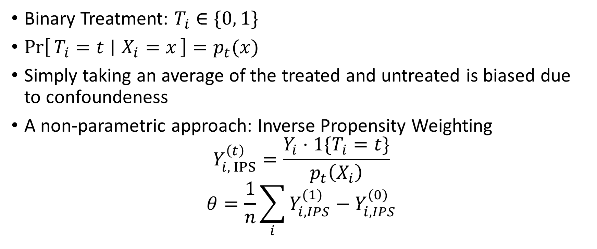
Binary Treatment Effects
Binary Treatment: $T_{i}∈\{0, 1\}$
$\operatorname{Pr}\left[T_{i}=t ∣ X_{i}=x\right]=p_{t}(x)$
Simply taking an average of the treated and untreated is biased due to confoundeness
A non-parametric approach: Inverse Propensity Weighting
$$Y_{i, IPS}^{\left(t\right)}=\frac{Y_{i}⋅1\{T_{i}=t\}}{p_{t}\left(X_{i}\right)}$$
$$θ=\frac{1}{n}\sum_{i}{Y_{i, IPS}^{(1)}−Y_{i, IPS}^{(0)}}$$

Slide 15
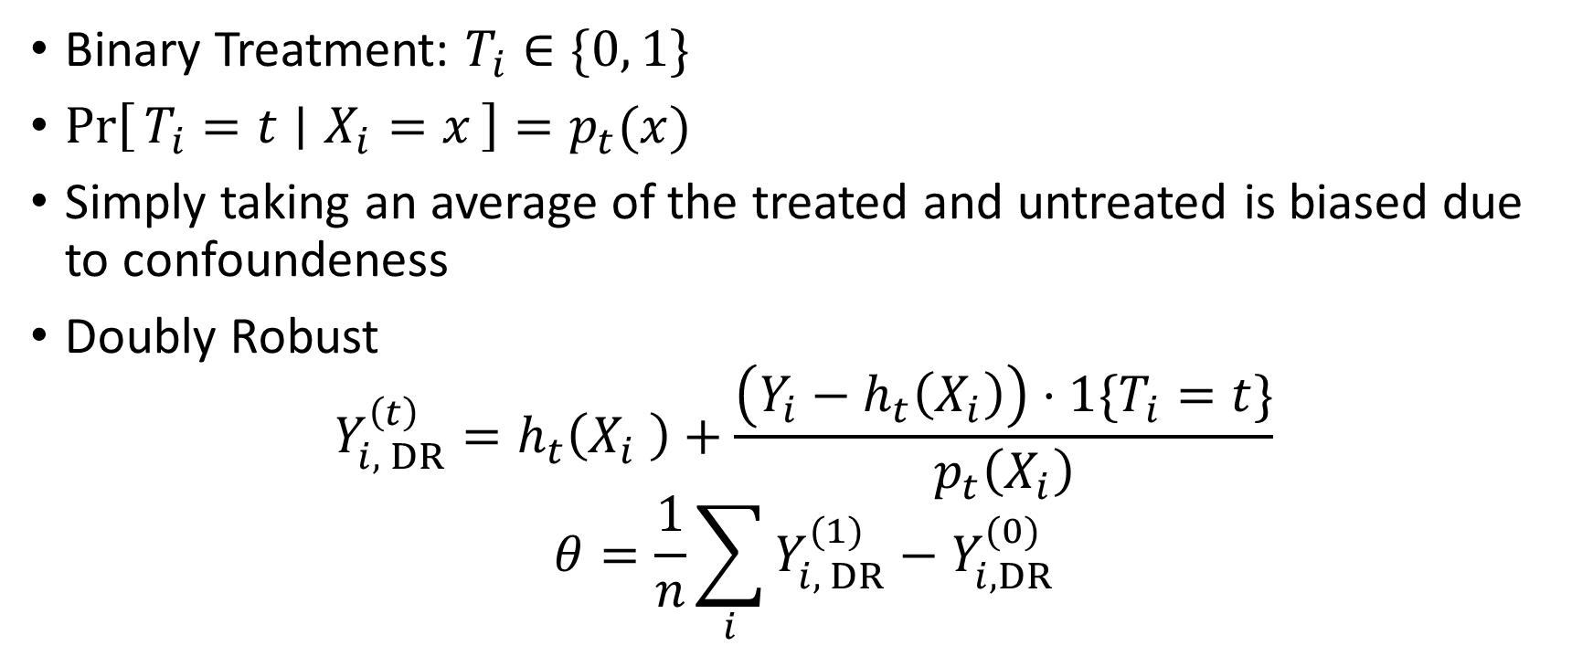
Binary Treatment Effects
Binary Treatment: $T_{i}∈\{0, 1\}$
$\operatorname{Pr}\left[T_{i}=t ∣ X_{i}=x\right]=p_{t}(x)$
Simply taking an average of the treated and untreated is biased due to confoundeness
Doubly Robust
$$Y_{i, DR}^{\left(t\right)}=h_{t}\left(X_{i} \right)+\frac{\left(Y_{i}−h_{t}\left(X_{i}\right)\right)⋅1\{T_{i}=t\}}{p_{t}\left(X_{i}\right)}$$
$$θ=\frac{1}{n}\sum_{i}{Y_{i, DR}^{(1)}−Y_{i, DR}^{(0)}}$$

Slide 16
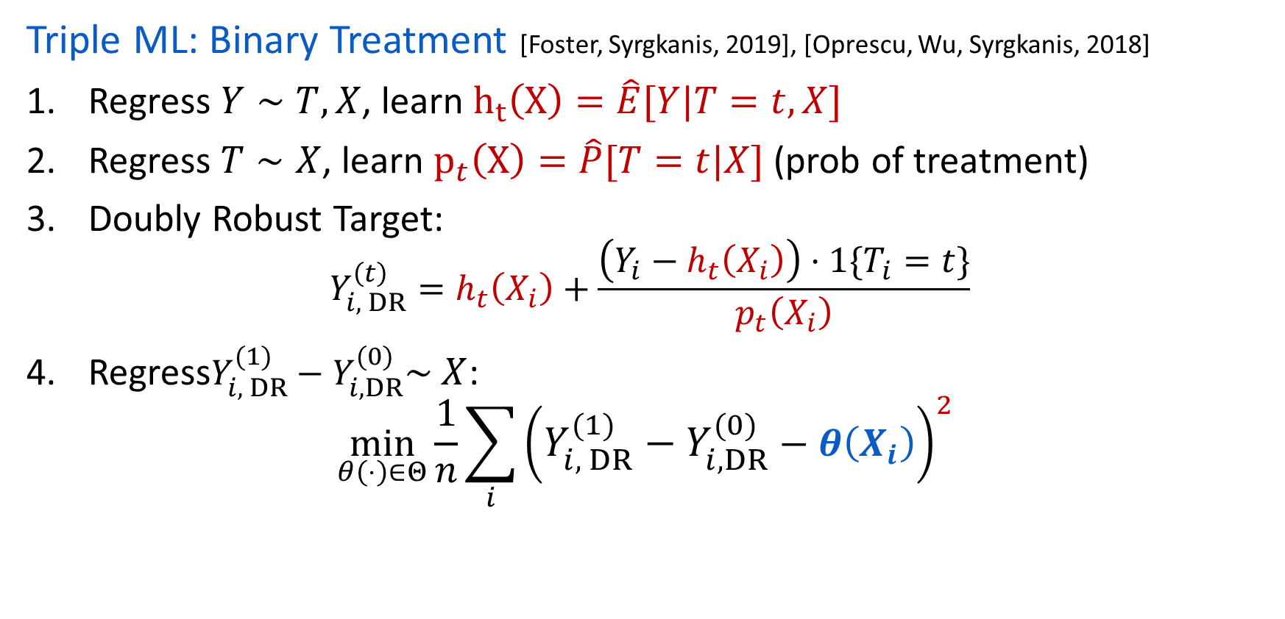
Triple ML for Treatment Effect Inference
Triple ML: Binary Treatment [Foster, Syrgkanis, 2019], [Oprescu, Wu, Syrgkanis, 2018]
Regress $Y∼T, X$, learn $h_{t}\left(X\right)=\hat{E}[Y|T=t,X]$
Regress $T∼X$, learn $p_{t}\left(X\right)=\hat{P}[T=t|X]$ (prob of treatment)
Doubly Robust Target:
$$Y_{i, DR}^{\left(t\right)}=h_{t}\left(X_{i}\right)+\frac{\left(Y_{i}−h_{t}\left(X_{i}\right)\right)⋅1\{T_{i}=t\}}{p_{t}\left(X_{i}\right)}$$
Regress$Y_{i, DR}^{(1)}−Y_{i, DR}^{(0)}\sim X$:
$$\min_{θ\left(⋅\right)∈Θ}{\frac{1}{n}\sum_{i}{{\left(Y_{i, DR}^{(1)}−Y_{i, DR}^{(0)}−θ\left(X_{i}\right)\right)}^{2} }}$$

Slide 17
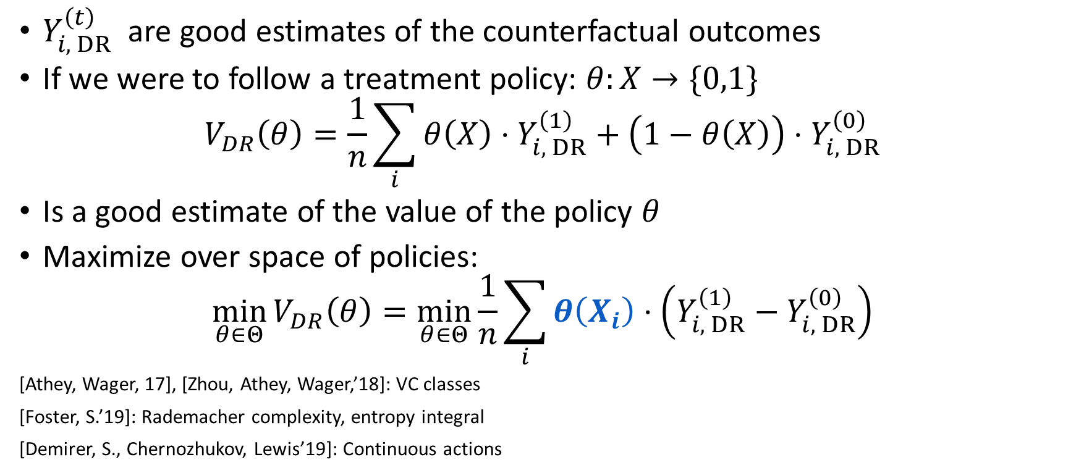
Optimal Treatment Policy
$Y_{i, DR}^{\left(t\right)}$ are good estimates of the counterfactual outcomes
If we were to follow a treatment policy: $θ:X→\{0,1\}$
$$V_{DR}\left(θ\right)=\frac{1}{n}\sum_{i}{θ\left(X\right)⋅Y_{i, DR}^{\left(1\right)}+\left(1−θ\left(X\right)\right)⋅Y_{i, DR}^{\left(0\right)}}$$
Is a good estimate of the value of the policy $θ$
Maximize over space of policies:
$$\min_{θ∈Θ}{V_{DR}\left(θ\right)}=\min_{θ∈Θ}\frac{1}{n}\sum_{i}{θ\left(X_{i}\right)⋅\left(Y_{i, DR}^{\left(1\right)}−Y_{i, DR}^{\left(0\right)}\right)}$$
[Athey, Wager, 17], [Zhou, Athey, Wager,’18]: VC classes
[Foster, S.’19]: Rademacher complexity, entropy integral
[Demirer, S., Chernozhukov, Lewis’19]: Continuous actions

Slide 18
Technical Vignette:
Orthogonal Statistical Learning
[Foster, S., COLT 2019 (best paper)]

Slide 19
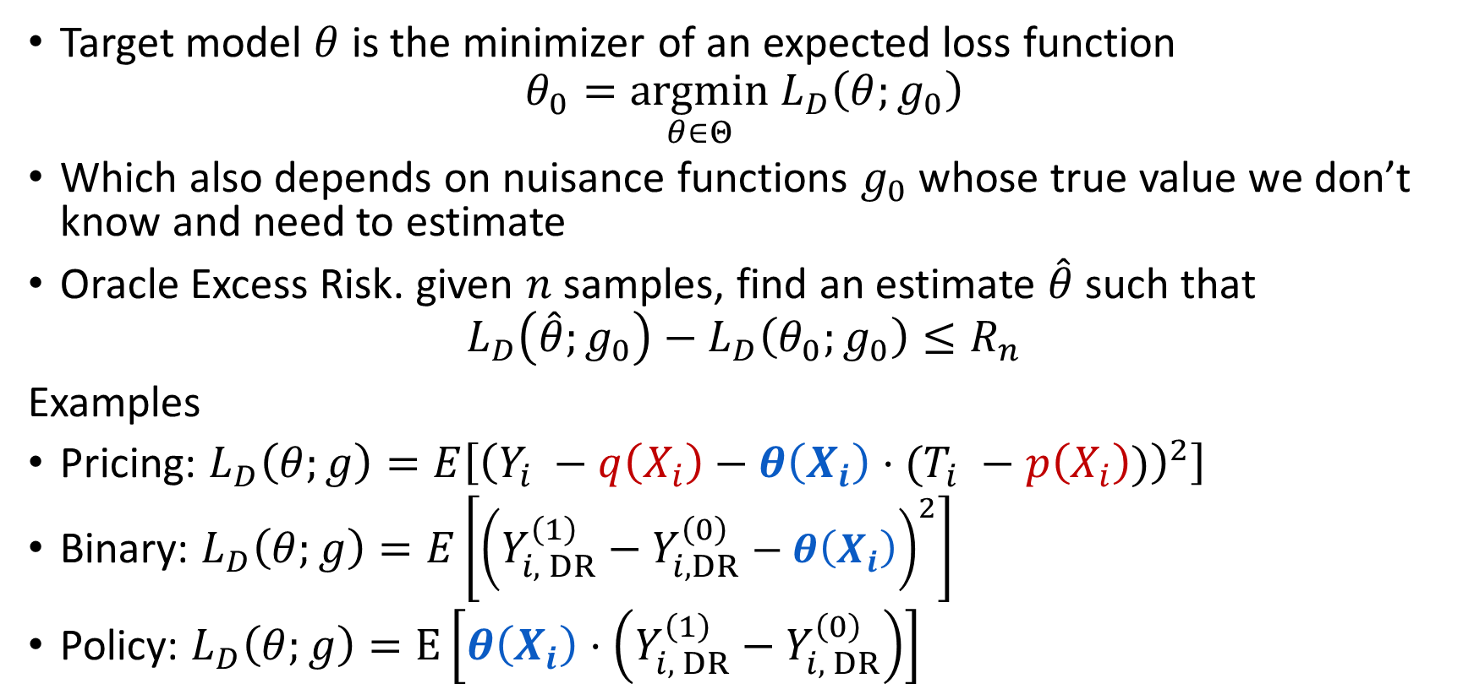
Orthogonal Statistical Learning
Target model $θ$ is the minimizer of an expected loss function
$$θ_{0}=\underset{θ∈Θ}{argmin} L_{D}\left(θ;g_{0}\right)$$
Which also depends on nuisance functions $g_{0}$ whose true value we don’t know and need to estimate
Oracle Excess Risk. given $n$ samples, find an estimate $\hat{θ}$ such that
$$L_{D}\left(\hat{θ};g_{0}\right)−L_{D}\left(θ_{0};g_{0}\right)≤R_{n}$$
Examples
Pricing: $L_{D}\left(θ;g\right)=E\left[{\left(Y_{i} −q\left(X_{i}\right)−θ\left(X_{i}\right)⋅(T_{i} −p\left(X_{i}\right))\right)}^{2}\right]$
Binary: $L_{D}\left(θ;g\right)=E\left[{\left(Y_{i, DR}^{\left(1\right)}−Y_{i, DR}^{\left(0\right)}−θ\left(X_{i}\right)\right)}^{2}\right]$
Policy: $L_{D}\left(θ;g\right)=E\left[θ\left(X_{i}\right)⋅\left(Y_{i, DR}^{\left(1\right)}−Y_{i, DR}^{\left(0\right)}\right)\right]$

Slide 20
Machine Learning and Generalization
Machine learning is good at achieving excess risk for known losses
For any loss function $L_{D}\left(θ\right)$, find $\hat{θ}$ such that:
$$L_{D}\left(\hat{θ}\right)−L_{D}\left(θ_{0}\right)≤R_{n}$$
Most ML theory addresses such questions (generalization bounds)
Excess risk has meaningful problem-specific interpretations
  For square losses it implies mean squared error: $E\left[{\left(\hat{θ}\left(X\right)−θ_{0}\left(X\right)\right)}^{2}\right]$
  For policy learning it is a bound on the regret of a policy
Can we reduce our problem to what ML is good at?

Slide 21
Side Advantages of Excess Risk
Fewer Assumptions
  Does not require stringent assumptions on identification of parameters of model (e.g. full rank co-variance of features, restricted eigenvalue conditions)
Allow for Mis-Specification
  Convergence to best within class model w.r.t. some distance metric
  Can be easily combined with analysis of mis-specification “bias”

Slide 22
Meta-Algorithm
Split samples in half
Stage 1. Estimate $\hat{g}$ on first half, with estimation error
$$\left\|\hat{g}−g_{0}\right\|≤R_{n}\left(g\right)$$
Stage 2. Estimate $\hat{θ}$ on second half in a plugin manner: use any algorithm that guarantees
$$L_{D}\left(\hat{θ};\hat{g}\right)−L_{D}\left(θ_{0};\hat{g}\right)≤{\hat{R}}_{n}\left(θ\right)$$
When does this algorithm achieve good oracle excess risk?
$$L_{D}\left(\hat{θ};g_{0}\right)−L_{D}\left(θ_{0};g_{0}\right)≤R_{n}\left(θ\right)$$

Slide 23
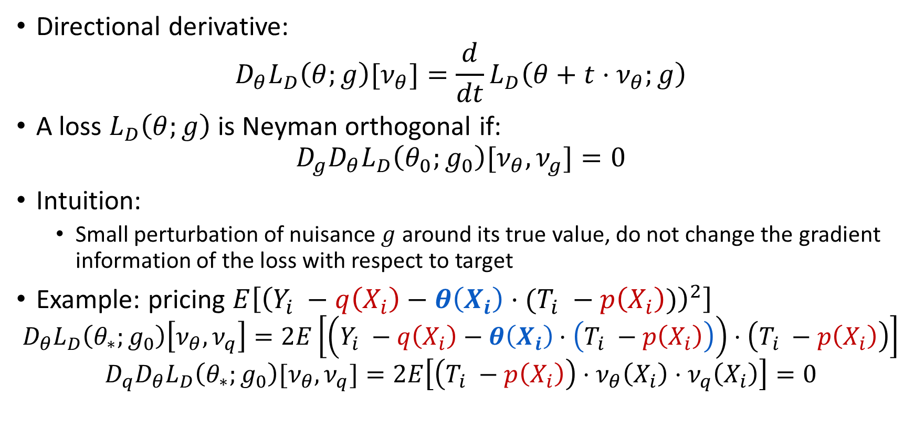
Neyman Orthogonality
Directional derivative:
$$D_{θ}L_{D}\left(θ;g\right)[ν_{θ}]=\frac{d}{dt}L_{D}\left(θ+t⋅ν_{θ};g\right)$$
A loss $L_{D}\left(θ;g\right)$ is Neyman orthogonal if:
$$D_{g}D_{θ}L_{D}\left(θ_{0};g_{0}\right)[ν_{θ},ν_{g}]=0$$
Intuition:
  Small perturbation of nuisance $g$ around its true value, do not change the gradient information of the loss with respect to target
Example: pricing $E\left[{\left(Y_{i} −q\left(X_{i}\right)−θ\left(X_{i}\right)⋅(T_{i} −p\left(X_{i}\right))\right)}^{2}\right]$
$$D_{θ}L_{D}\left(θ_{∗};g_{0}\right)\left[ν_{θ},ν_{q}\right]=2E\left[\left(Y_{i} −q\left(X_{i}\right)−θ\left(X_{i}\right)⋅\left(T_{i} −p\left(X_{i}\right)\right)\right)⋅\left(T_{i} −p\left(X_{i}\right)\right)\right]$$
$$D_{q}D_{θ}L_{D}\left(θ_{∗};g_{0}\right)[ν_{θ},ν_{q}]=2E\left[\left(T_{i} −p\left(X_{i}\right)\right)⋅ν_{θ}\left(X_{i}\right)⋅ν_{q}\left(X_{i}\right)\right]=0$$

Slide 24
Main Theorem 1
If loss is orthogonal, strongly convex in $θ$ and smooth, $θ_{∗}$ first-order optimal
$$R_{n}\left(θ\right)≤{\hat{R}}_{n}\left(θ\right)+R_{n}{\left(g\right)}^{4}$$
Assumptions. Let $ν_{θ}=θ−θ_{∗}$, $ν_{g}=g−g_{0}$
1. Strongly Convex:
$$D_{θ}L_{D}\left(θ, g\right)\left[ν_{θ},ν_{θ}\right]≥λ{\left\|ν_{θ}\right\|}^{2}$$
2. Smooth:
$$D_{θ}^{2}L_{D}\left(θ, g_{0}\right)\left[ν_{θ},ν_{θ}\right]≤β{\left\|ν_{θ}\right\|}^{2}$$
$$D_{g}^{2}D_{θ}L_{D}\left(θ_{∗}, g\right)\left[ν_{θ},ν_{g}, ν_{g}\right]≤β\left\|ν_{θ}\right\|⋅{\left\|ν_{g}\right\|}^{2}$$
3. First-order Optimality:
$$D_{θ}L_{D}\left(θ_{∗},g_{0}\right)\left[θ−θ_{∗}\right]≥0$$
$$−κ{\left\|ν_{g}\right\|}^{4}$$

Slide 25

Proof Sketch 1
Strongly Convex at $\hat{g}$:
$$L_{D}\left(\hat{θ},\hat{g}\right)−L_{D}\left(θ_{∗};\hat{g}\right)−D_{θ}L_{D}\left(θ_{∗};\hat{g}\right)≥{λ\left\|\hat{θ}−θ_{∗}\right\|}^{2}$$
Neyman Orthogonal and smooth:
$$D_{θ}L_{D}\left(θ_{∗};\hat{g}\right)≤D_{θ}L_{D}\left(θ_{∗};g_{0}\right)+D_{g}^{2}D_{θ}L_{D}\left(θ_{∗}, g\right)\left[ν_{θ},ν_{g}, ν_{g}\right]$$

Slide 26

Proof Sketch 1
Strongly Convex at $\hat{g}$:
$$L_{D}\left(\hat{θ},\hat{g}\right)−L_{D}\left(θ_{∗};\hat{g}\right)−D_{θ}L_{D}\left(θ_{∗};\hat{g}\right)≥{λ\left\|\hat{θ}−θ_{∗}\right\|}^{2}$$
Neyman Orthogonal and smooth:
$$D_{θ}L_{D}\left(θ_{∗};\hat{g}\right)≤ D_{θ}L_{D}\left(θ_{∗};g_{0}\right)+β\left\|ν_{θ}\right\|⋅{\left\|ν_{g}\right\|}^{2}$$

Slide 27

Proof Sketch 1
Strongly Convex at $\hat{g}$:
$$L_{D}\left(\hat{θ},\hat{g}\right)−L_{D}\left(θ_{∗};\hat{g}\right)−D_{θ}L_{D}\left(θ_{∗};\hat{g}\right)≥{λ\left\|\hat{θ}−θ_{∗}\right\|}^{2}$$
Neyman Orthogonal and smooth:
$$D_{θ}L_{D}\left(θ_{∗};\hat{g}\right)≤ D_{θ}L_{D}\left(θ_{∗};g_{0}\right)+R_{n}{\left(g\right)}^{4}+o\left({λ\left\|\hat{θ}−θ_{∗}\right\|}^{2}\right)$$

Slide 28
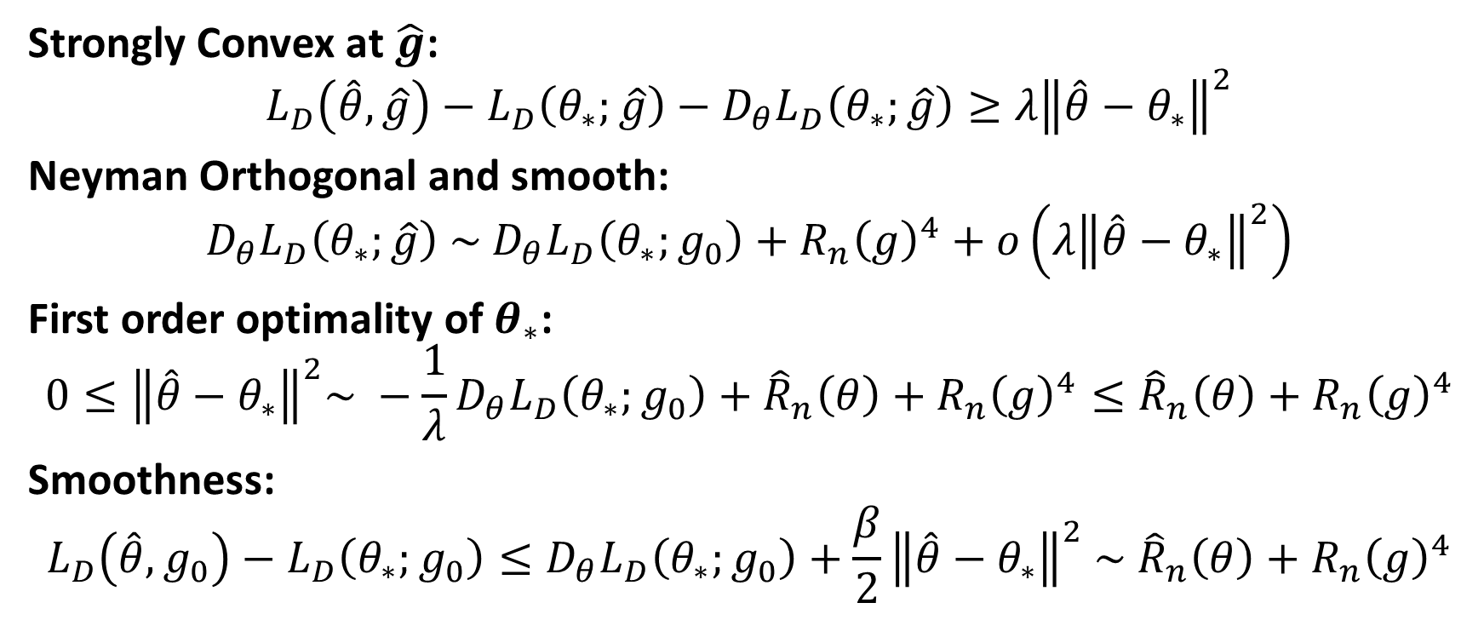
Proof Sketch 1
Strongly Convex at $\hat{g}$:
$$L_{D}\left(\hat{θ},\hat{g}\right)−L_{D}\left(θ_{∗};\hat{g}\right)−D_{θ}L_{D}\left(θ_{∗};\hat{g}\right)≥{λ\left\|\hat{θ}−θ_{∗}\right\|}^{2}$$
Neyman Orthogonal and smooth:
$$D_{θ}L_{D}\left(θ_{∗};\hat{g}\right) \sim D_{θ}L_{D}\left(θ_{∗};g_{0}\right)+R_{n}{\left(g\right)}^{4}+o\left({λ\left\|\hat{θ}−θ_{∗}\right\|}^{2}\right)$$
First order optimality of $θ_{∗}$:
$$0≤{\left\|\hat{θ}−θ_{∗}\right\|}^{2}\sim −\frac{1}{λ}D_{θ}L_{D}\left(θ_{∗};g_{0}\right)+{\hat{R}}_{n}\left(θ\right)+R_{n}{\left(g\right)}^{4}≤{\hat{R}}_{n}\left(θ\right)+R_{n}{\left(g\right)}^{4}$$
Smoothness:
$$L_{D}\left(\hat{θ},g_{0}\right)−L_{D}\left(θ_{∗};g_{0}\right)≤D_{θ}L_{D}\left(θ_{∗};g_{0}\right)+\frac{β}{2}{\left\|\hat{θ}−θ_{∗}\right\|}^{2} \sim {\hat{R}}_{n}\left(θ\right)+R_{n}{\left(g\right)}^{4}$$

Slide 29
Main Theorem 2
If loss is universally Neyman orthogonal and smooth
$$R_{n}\left(θ\right)≤{\hat{R}}_{n}\left(θ\right)+R_{n}{\left(g\right)}^{2}$$
Universally Neyman Orthogonal:
$$D_{g}D_{θ}L_{D}\left(θ, g_{0}\right)\left[ν_{θ},ν_{g}\right]=0$$
Smooth:
$$D_{g}^{2}L_{D}\left(θ, g_{0}\right)\left[ν_{g},ν_{g}\right]≤β{\left\|ν_{g}\right\|}^{2}$$

Slide 30
Proof Sketch 2
Smoothness:
$$L_{D}\left(\hat{θ},g_{0}\right)−L_{D}\left(θ_{∗};g_{0}\right)≤L_{D}\left(\hat{θ},\hat{g}\right)−L_{D}\left(θ_{∗};\hat{g}\right)+D_{g}L_{D}\left(θ_{∗};g_{0}\right)−D_{g}L_{D}\left(\hat{θ};g_{0}\right)+R_{n}{\left(g\right)}^{2}≤{\hat{R}}_{n}\left(θ\right)+R_{n}{\left(g\right)}^{2}+D_{g}L_{D}\left(θ_{∗};g_{0}\right)−D_{g}L_{D}\left(\hat{θ};g_{0}\right)$$
Universally Neyman Orthogonal:
$$D_{g}L_{D}\left(\hat{θ};g_{0}\right)=D_{g}L_{D}\left(θ_{∗};g_{0}\right)+D_{θ}D_{g}L_{D}\left(\overline{θ};g_{0}\right)=D_{g}L_{D}\left(θ_{∗};g_{0}\right)$$

Slide 31
Sufficient Conditions for Single-Index Losses
Generalized Single-Index Models
$$L_{D}\left(θ,g\right)=E\left[Φ\left(\left\langle θ\left(X\right),Λ\left(g\left(W\right),V\right)\right\rangle , g\left(W\right), Z\right)\right]$$
with
$$\frac{∂Φ(ζ,γ,z)}{∂ζ}=φ\left(ζ\right)−ψ\left(γ, z\right)$$
$φ, ψ$ are smooth, $φ^{′}\left(⋅\right)≥τ$ a.s.
$θ\left(X\right)$ is bounded a.s.
Strong convexity: $E\left[{\left\langle θ(X), Λ\left(g_{0}\left(W\right), V\right)\right\rangle }^{2}\right]≥γ E\left[{\left\|θ\left(X\right)\right\|}^{2}\right]$
e.g. $E\left[Λ\left(g_{0}\left(W\right),V\right)Λ{\left(g_{0}\left(W\right), V\right)}^{T} ∣ X\right]≥γ$
Then assumptions satisfied with respect to norms ${\left\|θ\right\|}_{2}$ and ${\left\|g\right\|}_{4}$

Slide 32
Unobserved Confounders
&
Instrumental Variables

Slide 33


Unobserved Confoundedness
$$Y = θ_{0}(X) ⋅ T + f_{0}\left(W\right) + ε$$
One solution: Instrumental variables
  Variables $Z$ that affect $T$ but does not directly affect $Y$
  $$Y = θ_{0}(X) ⋅ T + ε$$
  $$T=g\left(Z\right)+η$$
outcome
heterogeneous effect
treatment
effect of potential confounders
noise
$W$ is not observed

Slide 34
Example: Estimating Price Elasticity of Demand
Goal: Estimate elasticity, the effect of a change in price on demand
  Instrument: weather in brasil affects production cost of coffee and hence price of coffee but does not directly affect the demand in US
log(demand)
log(demand)
Good
weather
Good
weather
Avg demand in bad weather
Bad
weather
Bad
weather
log(price)
log(price)
Avg price in bad weather

Slide 35
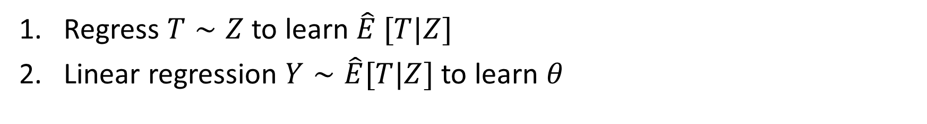
More generally: 2SLS
ML
Regress $T∼Z$ to learn $\hat{E} [T|Z]$
Linear regression $Y∼\hat{E}[T|Z]$ to learn $θ$
ML
log(demand)
log(demand)
Good
weather
Good
weather
Avg demand in bad weather
Bad
weather
Bad
weather
log(price)
log(price)
Avg price in bad weather
Requires the demand function (counterfactual function) to be linear in price (treatment)

Slide 36
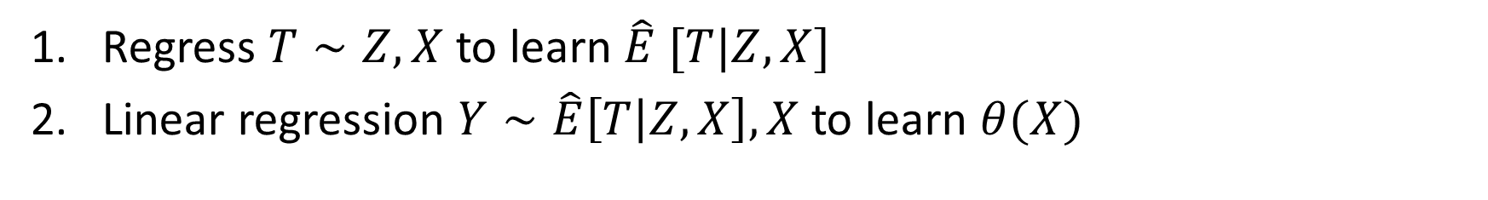
More generally: 2SLS
ML
Regress $T∼Z,X$ to learn $\hat{E} [T|Z,X]$
Linear regression $Y∼\hat{E}\left[T | Z, X\right], X$ to learn $θ(X)$
ML
log(demand)
log(demand)
Good
weather
Good
weather
Avg demand in bad weather
Bad
weather
Bad
weather
log(price)
log(price)
Avg price in bad weather
Requires the demand function (counterfactual function) to be linear in price (treatment)

Slide 37
Intent-to-Treat A/B Test: TripAdvisor Example
Value of membership. What is the value of becoming a member and which visitors are high-value?
  Treatment: becoming a member
  Outcome: number of visits, revenue spend
  Features: features of the user, e.g. past web history, geolocation, platform
  How to measure?
  We cannot run an A/B test where we force half of the users to become members
  We cannot measure the revenue of members vs non-members (self-selection bias=unobserved confounders)
  Solution. We can run a recommendation A/B test!

Slide 38
Effect of Membership on TripAdvisor
[S., Lei, Oprescu, Hei, Battocchi, Lewis, ’19]
A/B Test: For random half of 4million users, easier sign-up flow was enabled
Easier sign-up incentivizes membership
Recommendation has an effect on whether you become a member
No direct effect on downstream engagement
A/B test can be used as an instrument

Slide 39
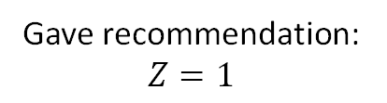
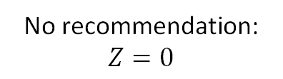
IV Estimation for Intent-to-Treat A/B Test
[S., Lei, Oprescu, Hei, Battocchi, Lewis, ’19]
outcome
No recommendation: $Z=0$
outcome
Avg response with no rec
Gave recommendation: $Z=1$
treatment
treatment
T=0
T=1
Prob of treatment when Z=1

Slide 40
Regression Discontinuity

Slide 41
Discontinuous Policy
ML
Income
T=0
T=1
Treatment effect
ML
Threshold for getting into college
SAT Score

Slide 42
Time Series

Slide 43
Synthetic Controls
Local Revenue
effect
UK
ML
Canada
ML
South US
time
Built a new Azure data center in Canada
[Abadie et al, ‘03,’10,’15,’16], [Synthetic Learner, Bradic, Viviano, ‘19]

Slide 44
Differences-in-Differences
Local Revenue
ML
effect
time
Built a new Azure data center in Canada
[Synthetic Diff-in-Diff, Arkhangelsky et al,’18]

Slide 45
Take-Aways
Econometrics interested in causality
ML is good at prediction/correlation
Often extracting causal quantities can reduce to set of prediction tasks
  Econometrics provides “recipes” for identifying causal quantities
  ML can be used for prediction sub-tasks of these recipes
  [Double/Debiased ML, Chernozhukov et al,’18], [ML Estimation of Hetero Effects with Instruments, S. et al, ‘19], [Synthetic Learner, Bradic, Viviano, ‘19], [Synthetic Diff-in-Diff, Arkhangelsky et al,’18]
ML can be used for automated detection/estimation of heterogeneity in the causal quantity of interest as function of observables [Generalized/Causal Forests, Tibshirani, Athey, Wager, ’19], [Quasi-Oracle Estimation of Hetero Effects, Nie, Wager, ‘17], [ML Estimation of Hetero Effects with Instruments, S. et al, ‘19]
Very rich and interesting theoretical research on
  Propagation of estimation errors [Orthogonal Statistical Learning, Foster, S., COLT19]
  Valid confidence intervals/hypothesis testing [Causal Forests, Athey, Wager, ‘19], [Orthogonal Random Forests, Oprescu, S, Wu, ’19], [Double/Debiased ML, Chernozhukov et al, ‘18]

Slide 46


A Python Library
Go to our GitHub repo: https://github.com/microsoft/econml
Check out our documentation: https://econml.azurewebsites.net/
Install EconML: “pip install econml”

Slide 47








EconML Unified API
Outcome (Y)
Treatment (T)
Features (X)
EconML Estimator
Test Features (X_{test})
Treatment Effect
θ(X)
Controls (W)
Instruments (Z)

Slide 48
EconML Unified API
Each estimator has a `fit` and `effect` function with the same signature. Example usage:
from econml.dml import DMLCateEstimator
est = DMLCateEstimator(…)
est.fit(Y, T, X, W) #function signature: fit(Y, T, X, W=None, Z=None)
est.effect(X, T0, T1) #function signature: effect(X, T0=0, T1=1)
For detailed information, see the docs econml.azurewebsites.net.

Slide 49
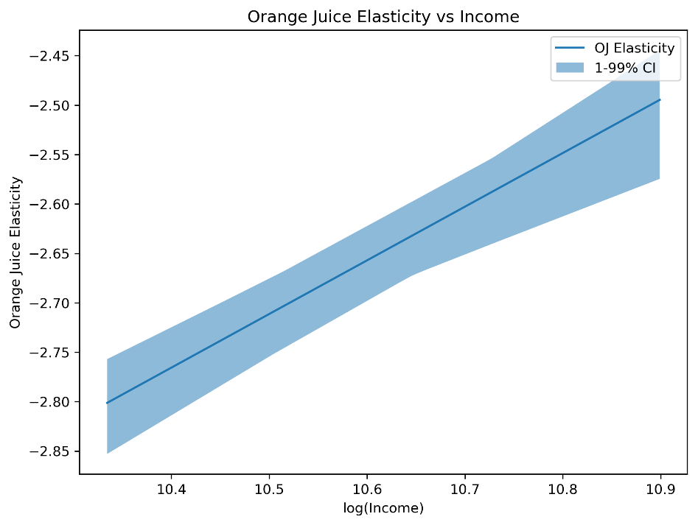
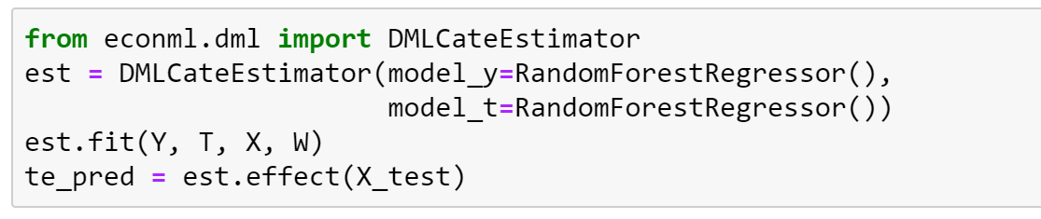
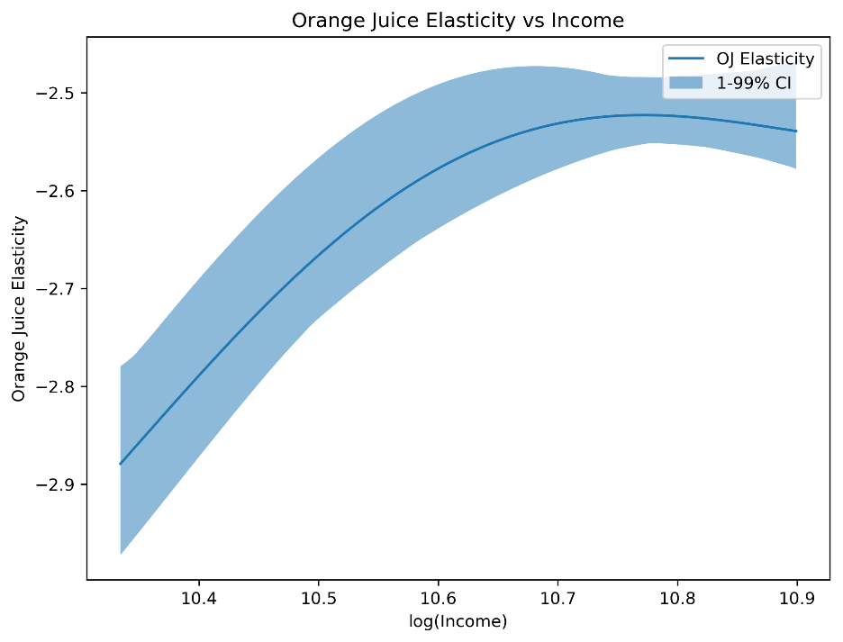
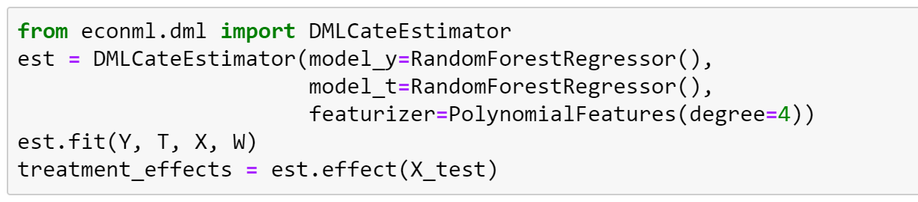
Orange Juice Elasticity
Linear Treatment Effect
Linear parametric form
Polynomial parametric form
Polynomial Treatment Effect

Slide 50






Git Repo: https://github.com/Microsoft/EconML
Documentation: https://econml.azurewebsites.net
Learn more about the ALICE project: https://aka.ms/alice
Thank you!
Greg Lewis
Keith Battocchi
Maggie Hei
Miruna Oprescu
Paul Oka
Vasilis Syrgkanis

Slide 51
What is the effect of $\hat{g}$ on achievable rate?
One might worry that the best achievable rate for
$$L_{D}\left(\hat{θ};\hat{g}\right)−L_{D}\left(θ_{0};\hat{g}\right)≤{\hat{R}}_{n}\left(θ\right)$$
Might be worse than that for:
$$L_{D}\left(\hat{θ};g_{0}\right)−L_{D}\left(θ_{0};g_{0}\right)≤{\hat{R}}_{n}\left(θ\right)$$
If target model space is convex, then the impact is at most constants (rate analysis solely uses the first order condition)
If target model space is non-convex, then tighter rates could potentially be achievable under $g_{0}$ because proofs depend on “well-specifiedness” of the model.
However, orthogonality can save us again!

Slide 52
Empirical Risk Minimization
Suppose the second stage algorithm is plug-in ERM
$$\hat{θ}={argmin}_{θ∈Θ} E_{n}\left[ℓ\left(θ\left(x\right), g\left(w\right), z\right)\right]$$
If loss $ℓ$ is strongly convex in $θ\left(x\right)$, then “fast” rates are captured by local Rademacher complexity
$$R_{n}\left(δ, G\right)=E\left[\sup_{g: {\left\|g\right\|}_{2}≤δ}\left|\frac{1}{n}\sum_{i}{ε_{i} g\left(x_{i}\right)}\right|\right]$$
Let $star\left(Θ−θ_{0}\right)=\{r \left(θ−θ_{0}\right):θ∈Θ, r∈[0,1]\}$
Let critical radius, solution to inequality:
$$R_{n}\left(δ, star\left(Θ−θ_{0}\right)\right)≤δ^{2}$$

Slide 53
ERM and Local Rademacher
Without nuisance functions, ERM achieves:
$$R_{n}\left(θ\right) \sim δ_{n}^{2}$$
Proof invokes first order optimality condition (convexity or well-specifiedness)
We extend proof to plugin ERM under orthogonality:
$${\hat{R}}_{n}\left(θ\right) \sim δ_{n}^{2}+R_{n}{\left(g\right)}^{4}$$

Slide 54
Plug-in ERM and Local Rademacher
Adaptation of Results for ERM without Nuisance: w.h.p.
Either ${\left\|θ−θ_{0}\right\|}_{2}≤δ_{n}$ or
$$\left|E_{n}\left[ℓ\left(θ,g\right)−ℓ\left(θ_{0},g\right)\right]−E\left[ℓ\left(θ, g\right)−ℓ\left(θ_{0},g\right)\right]\right|\sim δ_{n}{\left\|θ−θ_{0}\right\|}_{2}$$
(standard symmetrization arguments, talagrand’s concentration inequality, contraction inequalities)* (requires $δ_{n}^{2}=Ω\left(\frac{\log\left(\log\left(n\right)\right)}{n}\right)$
By ERM first term is negative:
$$E\left[ℓ\left(θ, g\right)−ℓ\left(θ_{0},g\right)\right]≤O\left(δ_{n}{\left\|θ−θ_{0}\right\|}_{2}\right)$$
By strong convexity:
$$E\left[ℓ\left(θ, g\right)−ℓ\left(θ_{0},g\right)\right]≥D_{θ}L_{D}\left(θ_{0},g\right)+λ {\left\|θ−θ_{0}\right\|}_{2}^{2}$$
By orthogonality:
$$D_{θ}L_{D}\left(θ,g\right) \sim R_{n}{\left(g\right)}^{4}+o\left({\left\|θ−θ_{0}\right\|}_{2}^{2}\right)$$

Slide 55
Example Classes
Sparse Linear Class: $Θ=\left\{\left\langle θ,x\right\rangle :θ∈R^{p}, {\left\|θ\right\|}_{0}≤s\right\}$: $δ_{n} \sim \sqrt{\frac{s\log\left(\frac{p}{s}\right)\log\left(n\right)}{n}}$
Neural Nets, with $W$ total weight params and depth $L$ [Bartlett et al.17a]: $δ_{n}∼\sqrt{L W\frac{log\left(W\right)}{n}}$
Neural Nets, adaptive rate [Bartlett et al.17b]: $δ_{n} \sim \frac{spectral properties of weight matrices}{n^{\frac{1}{4}}}$
RKHS of gaussian kernel: $δ_{n} \sim \frac{1}{n}$
Sobolev spaces: $δ_{n} \sim \frac{1}{n^{\frac{2}{3}}}$

Slide 56
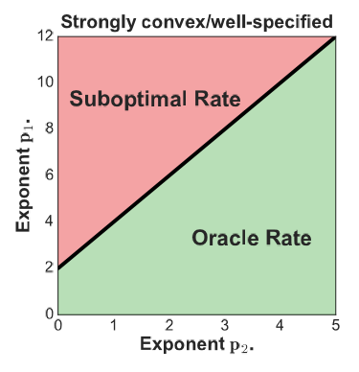
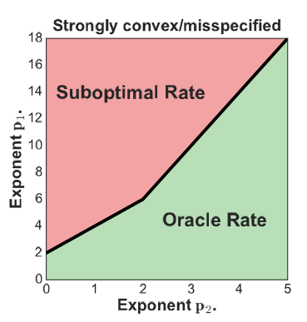
Oracle Rates for Non-Parametric Classes
Metric entropy $H\left(G, ε,n\right)$: log of size of smallest $ε$-empirical cover of $G$ on $n$ samples
Complexity measure $p$:
$$H\left(G, ε,n\right)=O\left(\max\left(ε^{−p},\log\left(1/ε\right)\right)\right)$$
Optimal rates for well-spec. regression (square loss):
$${\left\|g−g_{0}\right\|}^{2}≤O\left(n^{−\frac{2}{2+p}}\right)$$
Oracle rates for plugin square loss:
  Use of skeleton aggregation algorithm and prove robustness to nuisance errors in well-specified

Slide 57
Application: Treatment Effects
Orthogonal Square Loss (fast rates):
$$E\left[{\left(Y −q\left(X, W\right)−θ\left(X\right)⋅\left(T −p\left(X, W\right)\right)\right)}^{2}\right]$$
Parametric $θ\left(X\right)$: recovers the DML result that $n^{\frac{1}{4}}$ for nuisance suffices for oracle target rates
Generalizes results for RKHS [Nie-Wager]: $p=2$
Sparse linear classes [Chernozhukov et al’17a,b]: no RE condition
Neural networks [Farrell et al’18]: enable neural net for target model too + results that adapt to trained weights

Slide 58
Application: Policy Learning
Orthogonal linear loss (slow rates):
$$E\left[β\left(g, Z\right)⋅θ\left(X\right)\right]$$
$β(g, Z)$: doubly robust unbiased estimate
VC classes [Athey-Wager’17], [Zhou et al’18]: we go beyond VC classes + variance penalization approach for dependence on variance of loss at $θ_{0}$
Continuous treatments [Swaminathan-Joachims’15], [Kallus-Zhou’18]: deals with known propensity, employs continuous version of DR:
$$E\left[\left(f\left(T,X\right)+\frac{Y−f\left(T,X\right)}{p\left(T, X\right)}\right) θ\left(T, X\right)\right]$$
[New Result] Demirer, S., Lewis, Chernozhukov: continuous actions, with value $V\left(T,X\right)=⟨θ\left(X\right), φ\left(T, X\right)⟩$

