Slide 1
AGT Challenges and Opportunities in Deep Learning:
Generative Adversarial Networks
Vasilis Syrgkanis
Microsoft Research

Slide 2
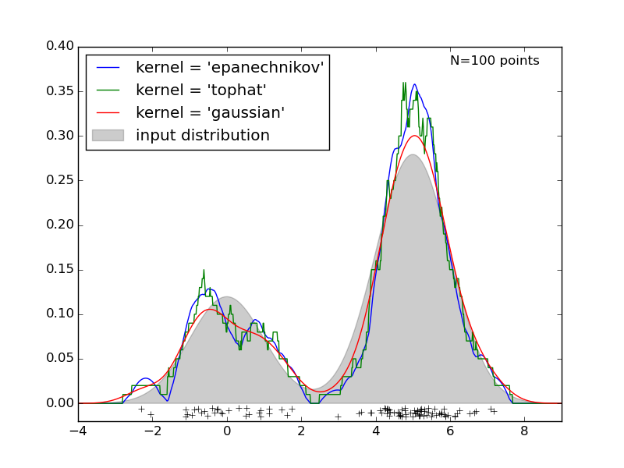
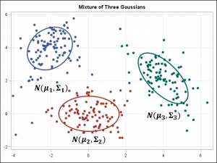
Learning Distributions

Slide 3
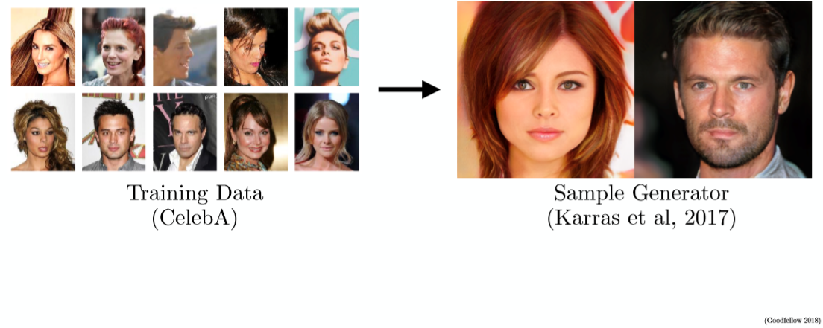
Learning Distributions of Complex Data

Slide 4
Potential Applications
Augmenting training data sets
Rapid prototyping: sampling feasible solutions
Missing structured data: film editing, image editing

Slide 5
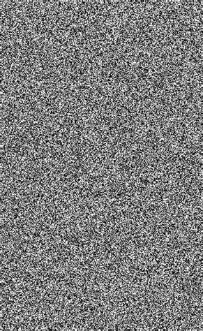
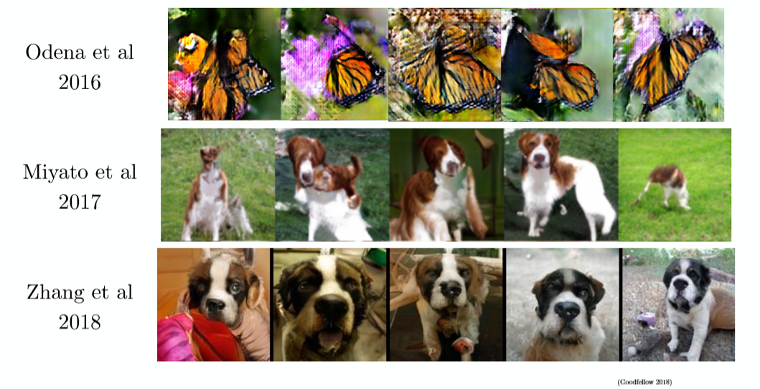

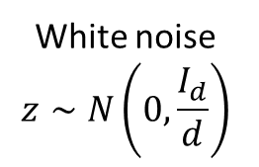
Expressing complex likelihoods
Implicit density learning
$$G(z)$$
White noise
$$z∼N\left(0,\frac{I_{d}}{d}\right)$$
Sample of an image
Generator

Slide 6
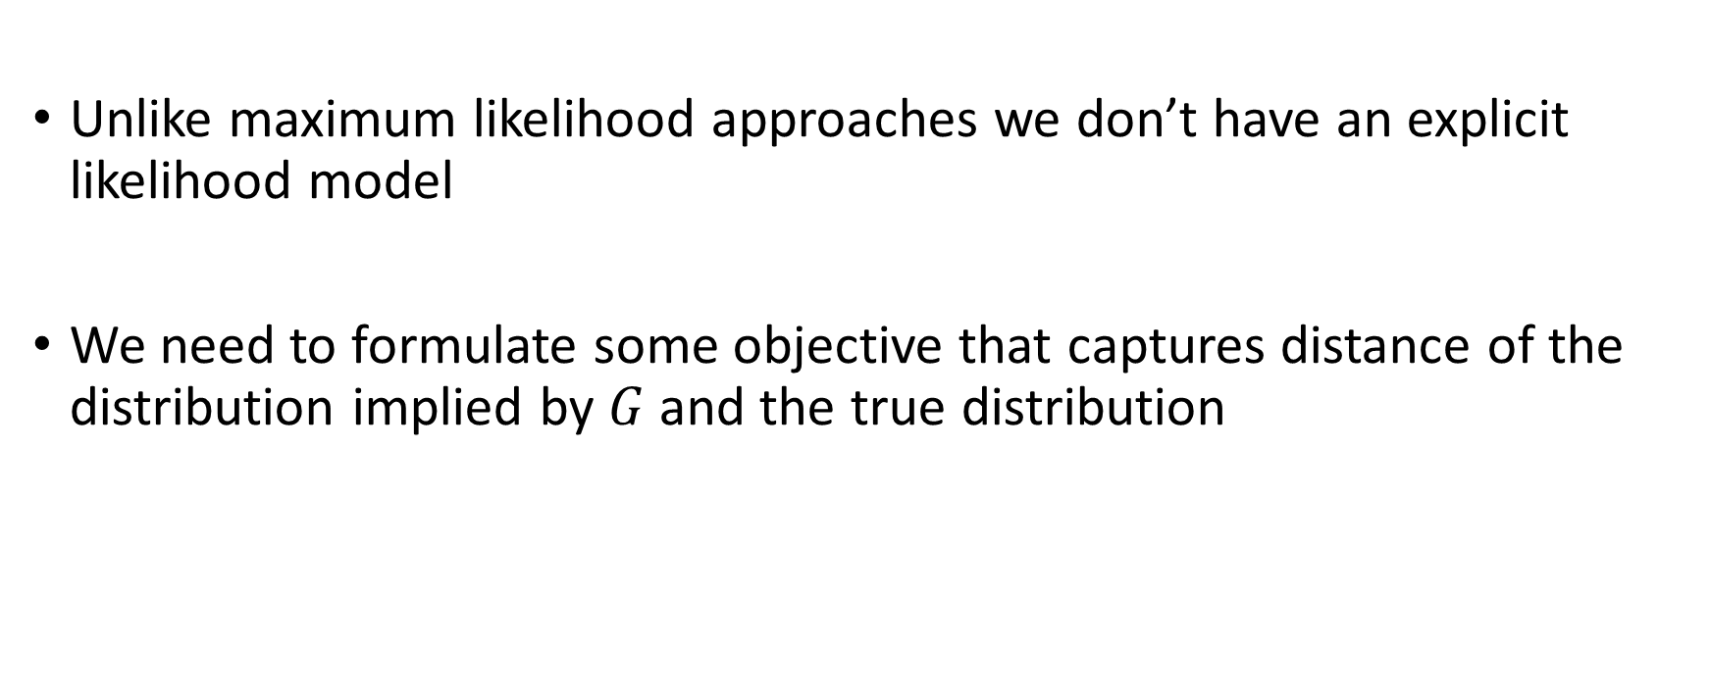
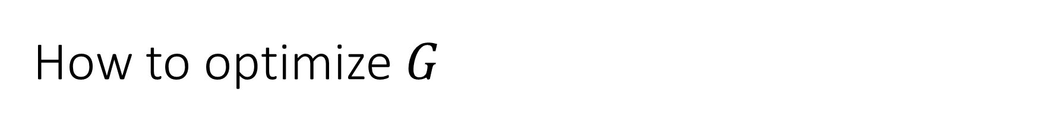
How to optimize $G$
Unlike maximum likelihood approaches we don’t have an explicit likelihood model
We need to formulate some objective that captures distance of the distribution implied by $G$ and the true distribution

Slide 7
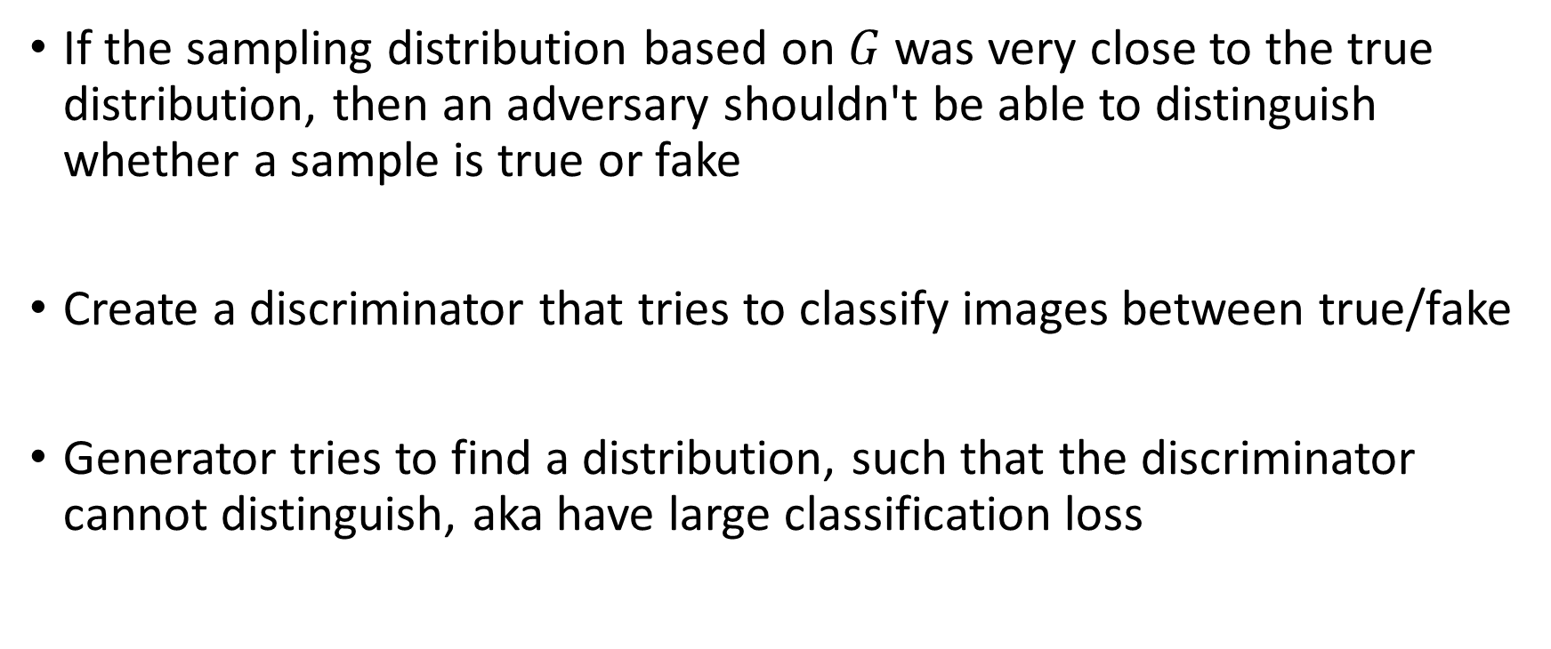
Generative Adversarial Networks
If the sampling distribution based on $G$ was very close to the true distribution, then an adversary shouldn't be able to distinguish whether a sample is true or fake
Create a discriminator that tries to classify images between true/fake
Generator tries to find a distribution, such that the discriminator cannot distinguish, aka have large classification loss

Slide 8

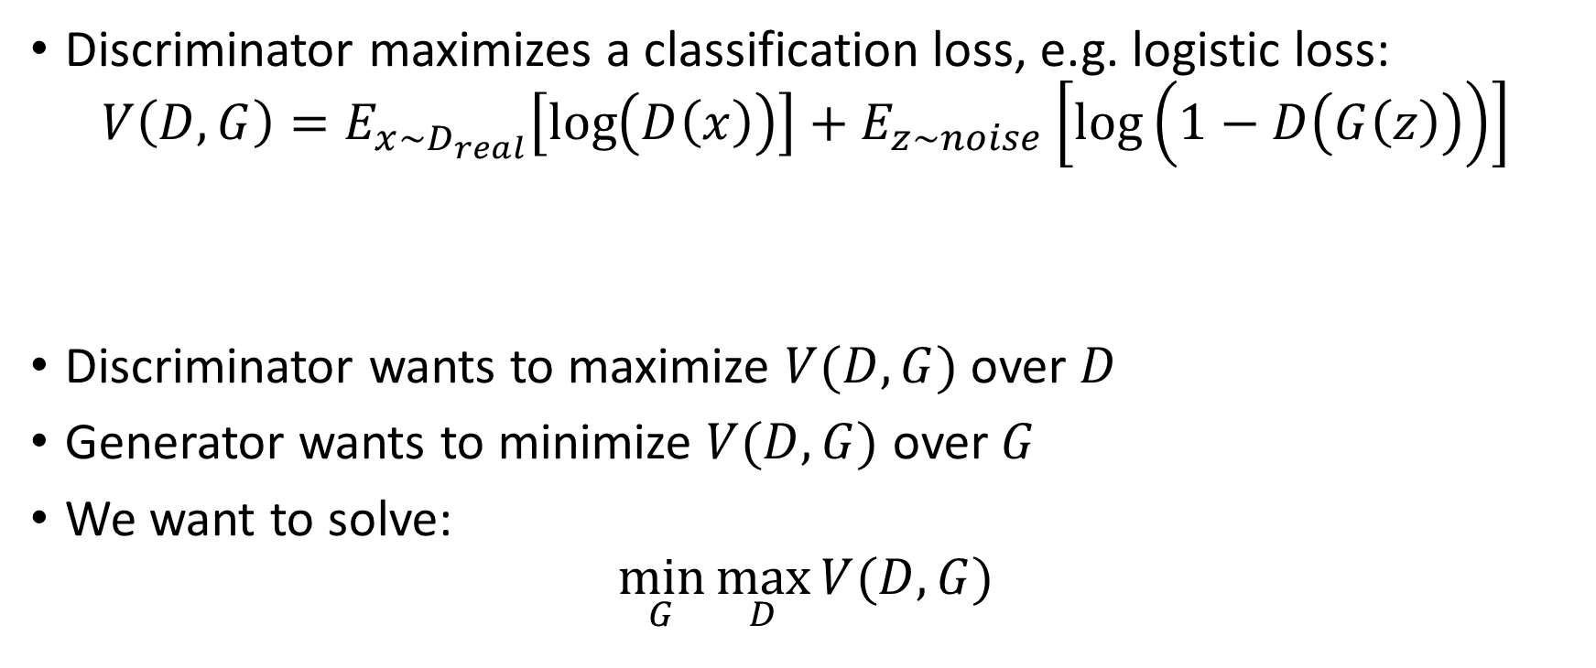

Zero-Sum Game Formulation
Discriminator maximizes a classification loss, e.g. logistic loss:
$$V\left(D, G\right)=E_{x∼D_{real}}\left[\log\left(D\left(x\right)\right)\right]+E_{z∼noise}\left[\log\left(1−D\left(G\left(z\right)\right)\right)\right]$$
Discriminator wants to maximize $V(D, G)$ over $D$
Generator wants to minimize $V(D, G)$ over $G$
We want to solve:
$$\min_{G}{\max_{D}{V(D, G)}}$$
Large if $D\left(x\right)$ close to $1$ on real images
Large if $D\left(x\right)$ close to $0$ on fake images

Slide 9

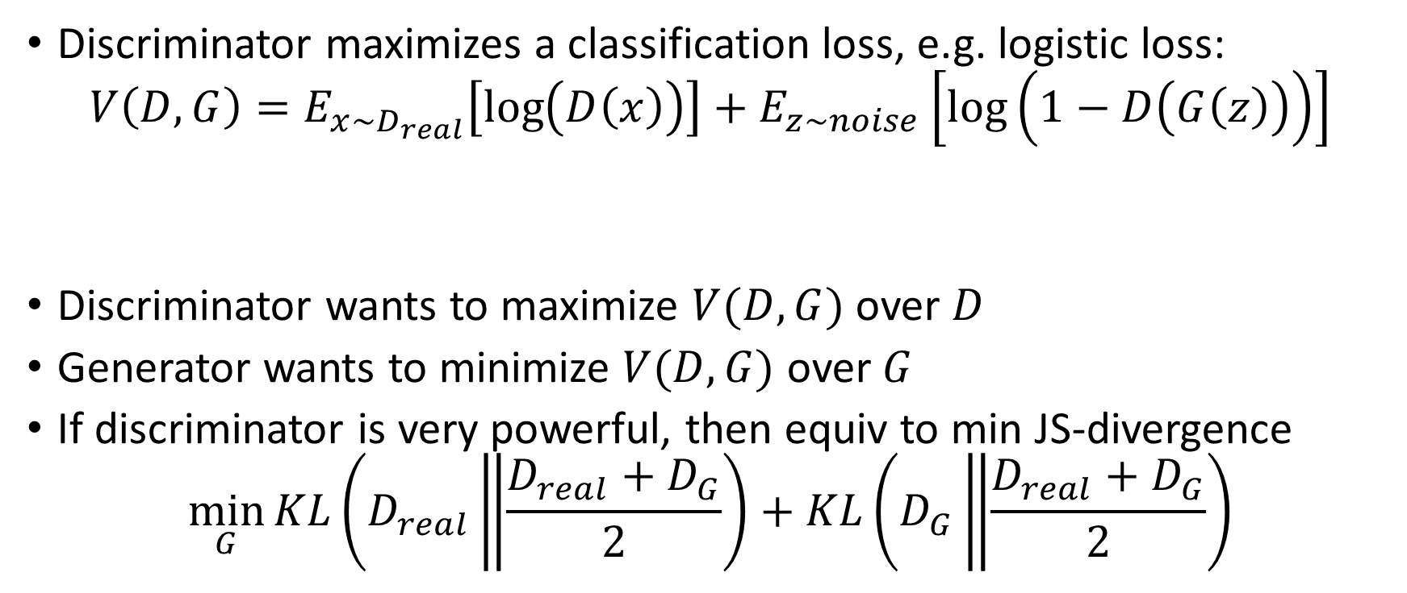

Zero-Sum Game Formulation
Discriminator maximizes a classification loss, e.g. logistic loss:
$$V\left(D, G\right)=E_{x∼D_{real}}\left[\log\left(D\left(x\right)\right)\right]+E_{z∼noise}\left[\log\left(1−D\left(G\left(z\right)\right)\right)\right]$$
Discriminator wants to maximize $V(D, G)$ over $D$
Generator wants to minimize $V(D, G)$ over $G$
If discriminator is very powerful, then equiv to min JS-divergence
$$\min_{G}{KL\left(D_{real}\left\|\frac{D_{real}+D_{G}}{2}\right.\right)+KL\left(D_{G}\left\|\frac{D_{real}+D_{G}}{2}\right.\right)}$$
Large if $D\left(x\right)$ close to $1$ on real images
Large if $D\left(x\right)$ close to $0$ on fake images

Slide 10
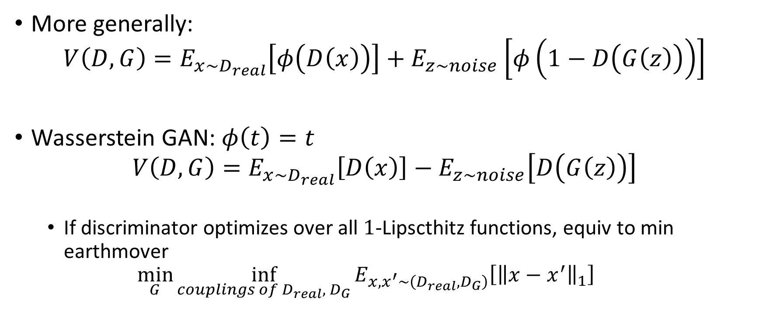
More generally: minimize divergence
More generally:
$$V\left(D, G\right)=E_{x∼D_{real}}\left[φ\left(D\left(x\right)\right)\right]+E_{z∼noise}\left[φ\left(1−D\left(G\left(z\right)\right)\right)\right]$$
Wasserstein GAN: $φ\left(t\right)=t$
$$V\left(D, G\right)=E_{x∼D_{real}}\left[D\left(x\right)\right]−E_{z∼noise}\left[D\left(G\left(z\right)\right)\right]$$
  If discriminator optimizes over all $1$-Lipscthitz functions, equiv to min earthmover
  $$\min_{G}{\inf_{couplings of D_{real}, { D}_{G}}{E_{x,x^{′}∼\left(D_{real},D_{G}\right)}\left[{\left\|x−x^{′}\right\|}_{1}\right]}}$$

Slide 11
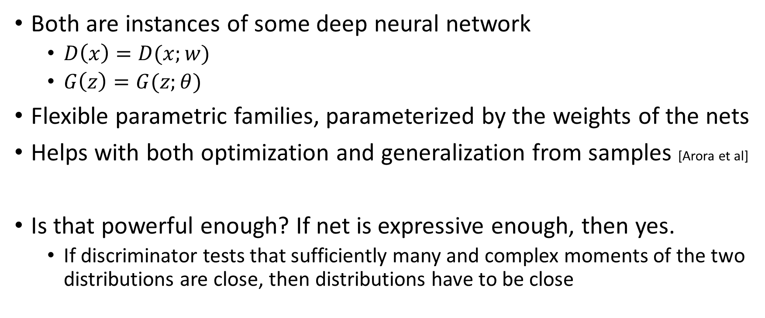
Modelling the Generator and Discriminator
Both are instances of some deep neural network
  $D\left(x\right)=D(x;w)$
  $G\left(z\right)=G(z;θ)$
Flexible parametric families, parameterized by the weights of the nets
Helps with both optimization and generalization from samples [Arora et al]
Is that powerful enough? If net is expressive enough, then yes.
  If discriminator tests that sufficiently many and complex moments of the two distributions are close, then distributions have to be close
Generalization and Equilibrium in Generative Adversarial Nets, Arora et al., 2017

Slide 12
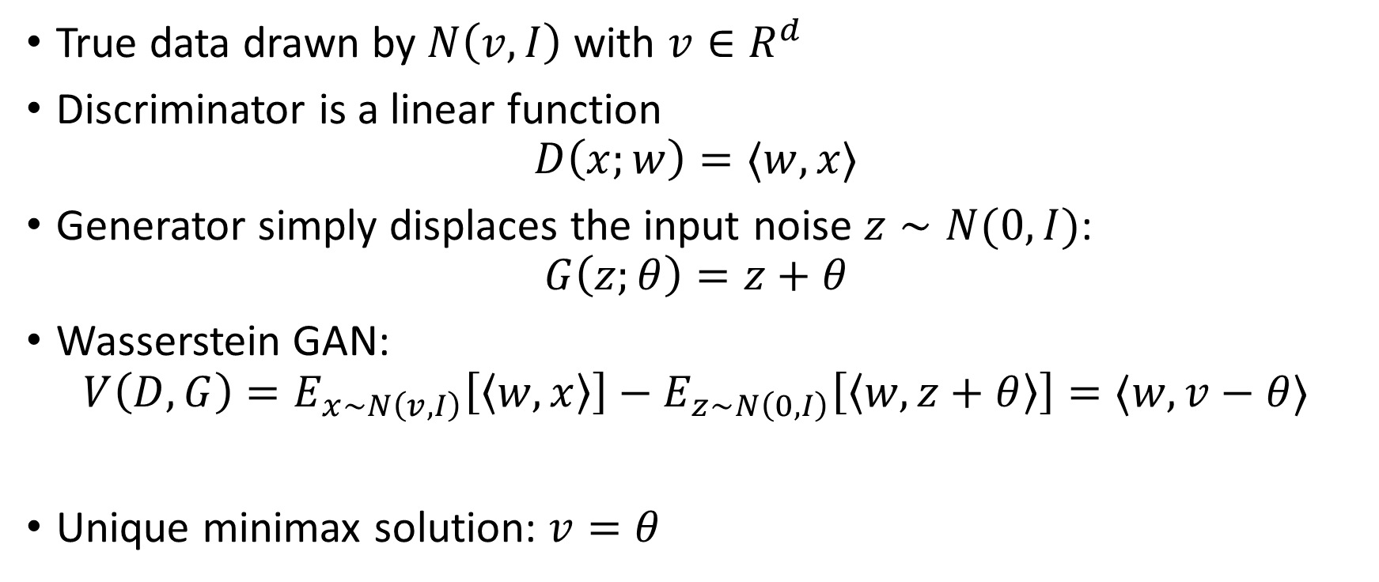
Example: Learning the Mean
True data drawn by $N\left(v, I\right)$ with $v∈R^{d}$
Discriminator is a linear function
$$D\left(x;w\right)=⟨w, x⟩$$
Generator simply displaces the input noise $z∼N(0, I)$:
$$G\left(z;θ\right)=z+θ$$
Wasserstein GAN:
$$V\left(D,G\right)=E_{x∼N\left(v,I\right)}\left[\left\langle w,x\right\rangle \right]−E_{z∼N\left(0,I\right)}\left[\left\langle w,z+θ\right\rangle \right]=⟨w, v−θ⟩$$
Unique minimax solution: $v=θ$

Slide 13
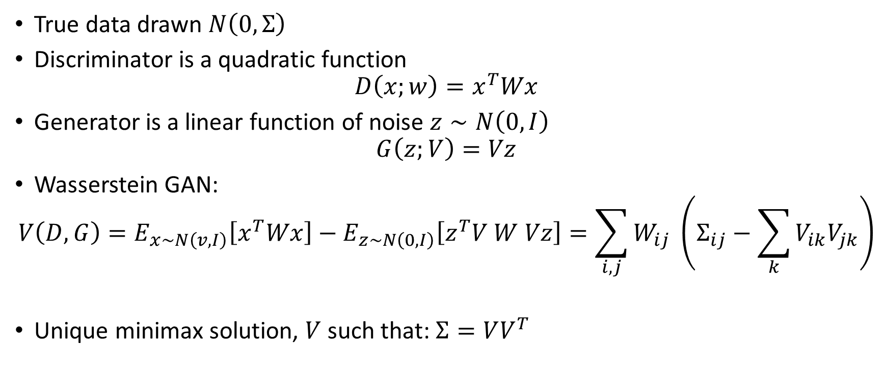
Example: Learning the Covariance
True data drawn $N\left(0, Σ\right)$
Discriminator is a quadratic function
$$D\left(x;w\right)=x^{T}Wx$$
Generator is a linear function of noise $z∼N\left(0, I\right)$
$$G\left(z;V\right)=Vz$$
Wasserstein GAN:
$$V\left(D,G\right)=E_{x∼N\left(v,I\right)}\left[x^{T}Wx\right]−E_{z∼N\left(0,I\right)}\left[z^{T}V W Vz\right]=\sum_{i,j}{W_{ij} \left(Σ_{ij}−\sum_{k}{V_{ik}V_{jk}}\right)}$$
Unique minimax solution, $V$ such that: $Σ=VV^{T}$

Slide 14
How to optimize from data?

Slide 15

Data vs Expectations
Replace expectations with empirical averages over $n$ samples
$$V_{n}\left(D, G\right)=\frac{1}{n}\sum_{x_{i}∈real}{φ\left(D\left(x_{i}\right)\right)}+\frac{1}{n}\sum_{z_{i}∈noise}{φ\left(1−D\left(G\left(z_{i}\right)\right)\right)}$$

Slide 16
Optimizing the loss
Similar to first part: we only really know how to optimize neural nets with gradient descent
But now inner optimization is also a neural net maximization
Too expensive to fully solve inner loop after every gradient step of the outer loop

Slide 17
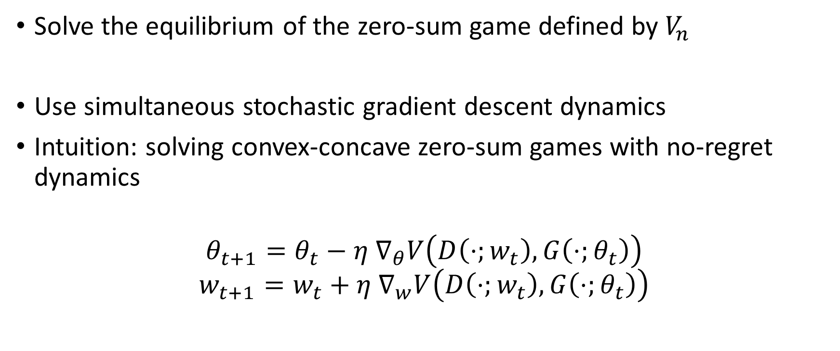
Minimax vs Zero-Sum Game
Solve the equilibrium of the zero-sum game defined by $V_{n}$
Use simultaneous stochastic gradient descent dynamics
Intuition: solving convex-concave zero-sum games with no-regret dynamics
$$θ_{t+1}=θ_{t}−η ∇_{θ}V\left(D\left(⋅;w_{t}\right), G\left(⋅;θ_{t}\right)\right)$$
$$w_{t+1}=w_{t}+η ∇_{w}V\left(D\left(⋅;w_{t}\right), G\left(⋅;θ_{t}\right)\right)$$

Slide 18
We now have all the ingredients…

Slide 19
Does it work?

Slide 20
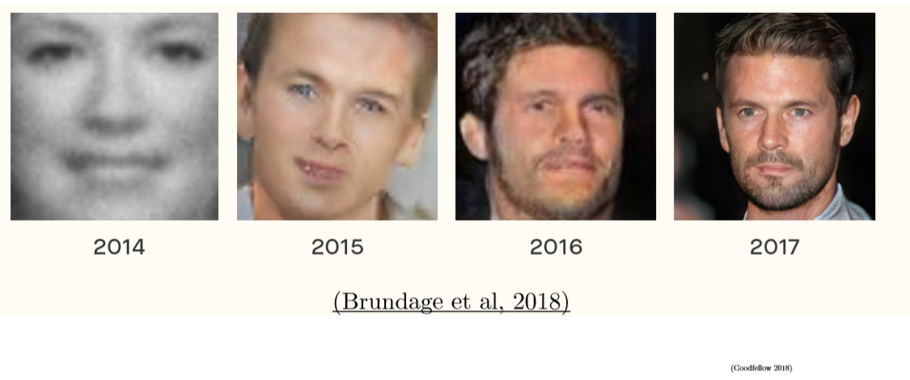

Slide 22
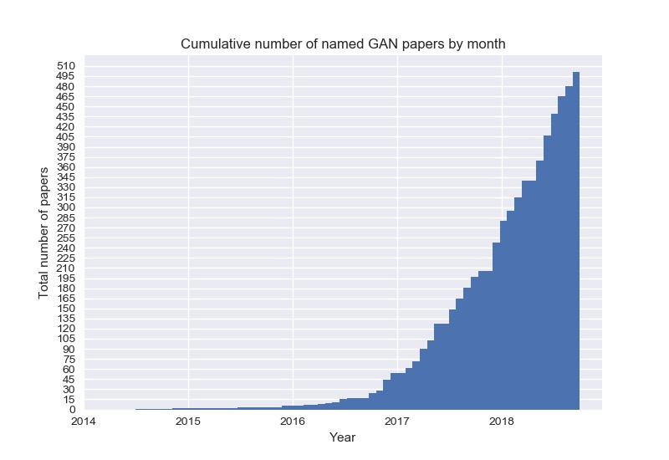

Slide 23
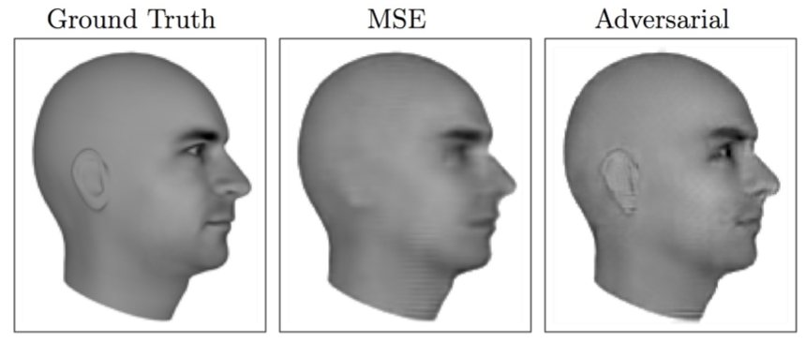
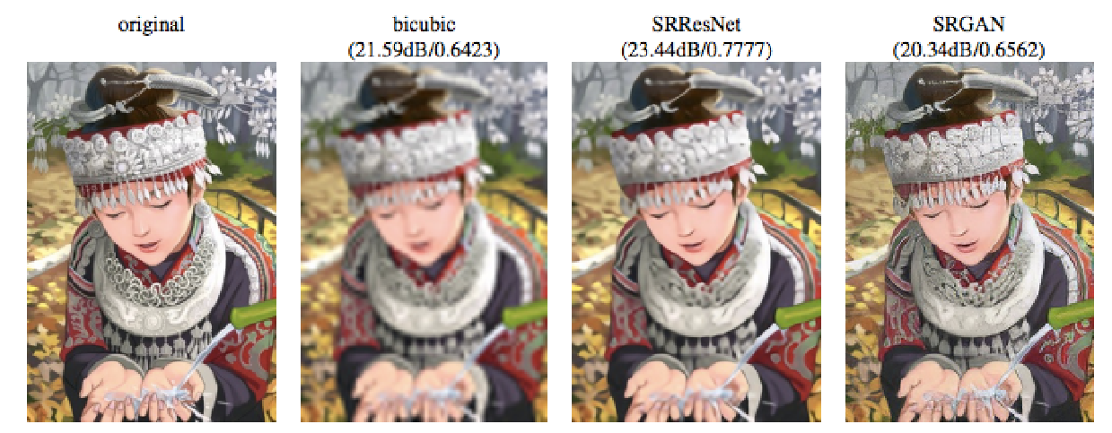
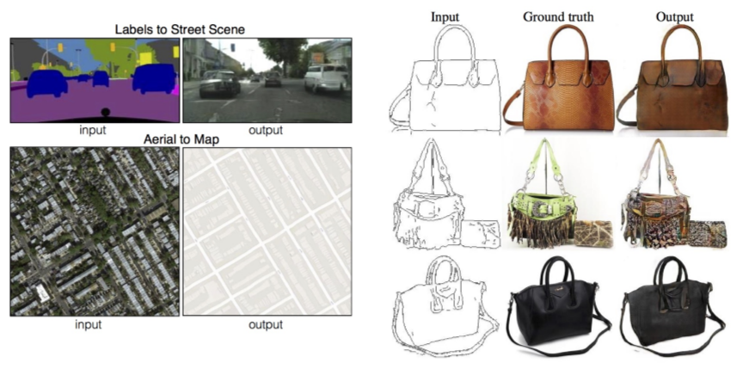
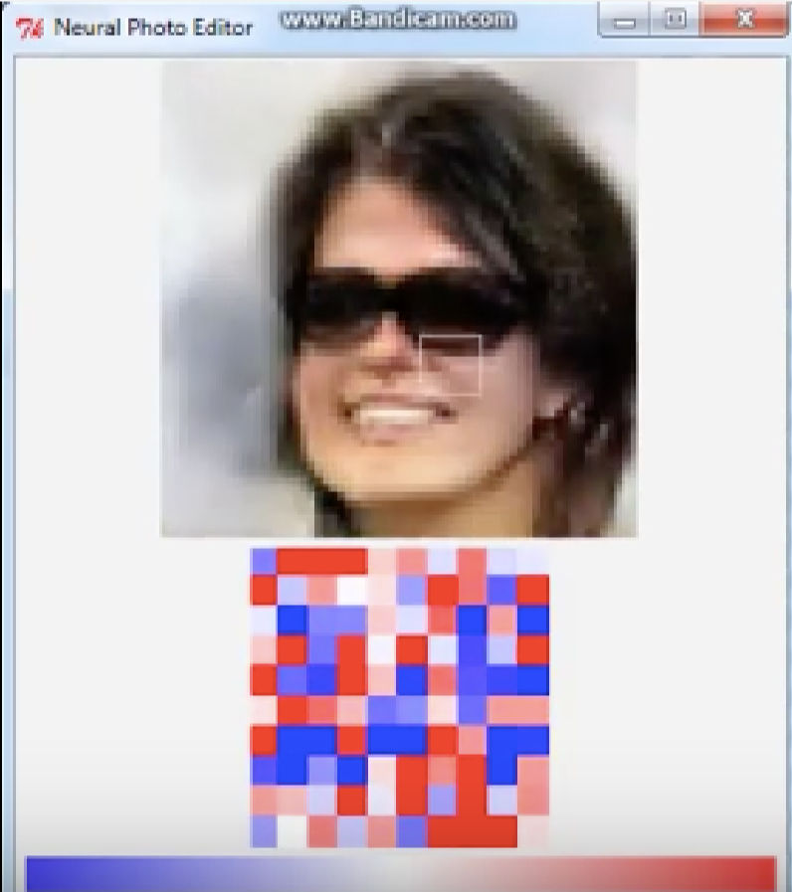
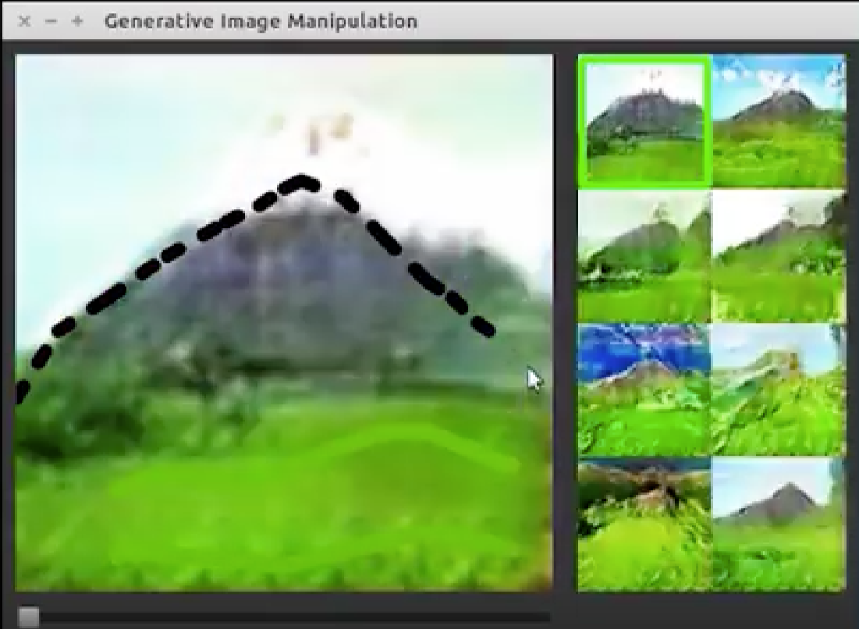
Applications
Next frame prediction in film
High-res image reconstruction
Sketch to image
Free-form drawing
Free-form image editing
Source: Goodfellow 2017, NIPS Tutorial

Slide 24
Main Hurdles in GAN Training

Slide 25
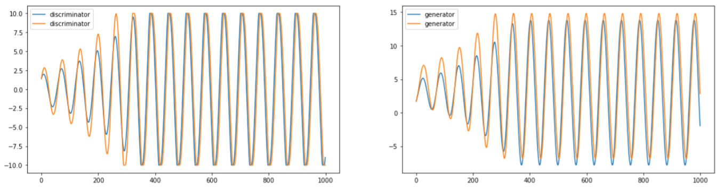
Unstable game dynamics
Consider example of learning the mean
Even ignore sampling error
Population gradient descent dynamics have limit cycles
Theorems from no-regret in zero-sum only guarantee the average converges

Slide 26
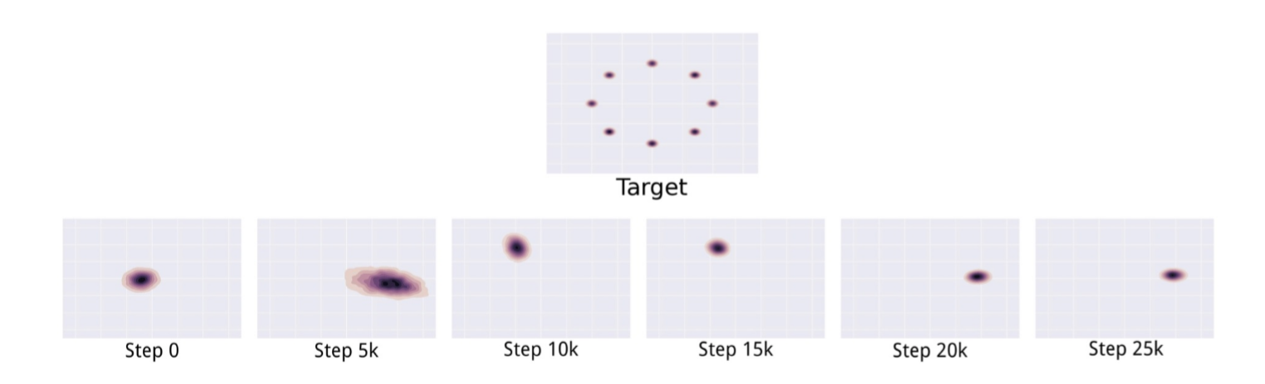
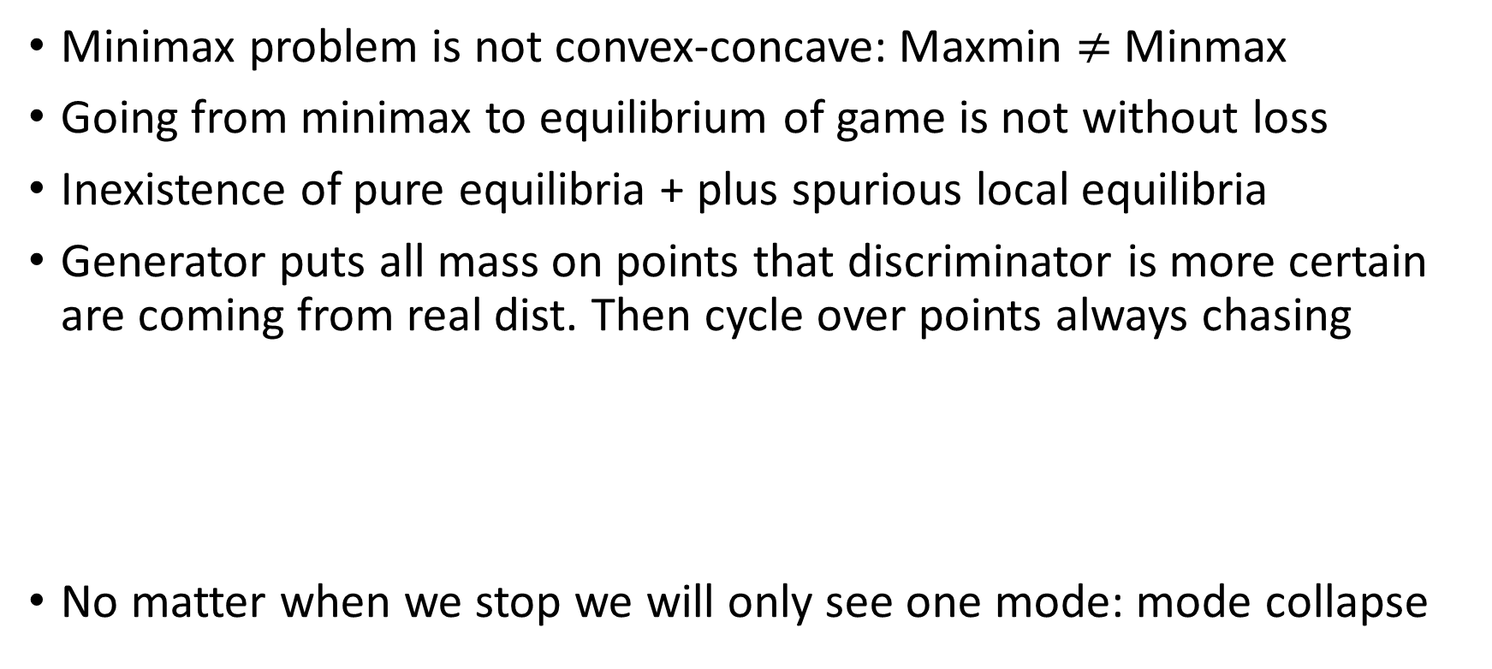
Bad/Inexistent Pure Equilibria
Minimax problem is not convex-concave: Maxmin $≠$ Minmax
Going from minimax to equilibrium of game is not without loss
Inexistence of pure equilibria + plus spurious local equilibria
Generator puts all mass on points that discriminator is more certain are coming from real dist. Then cycle over points always chasing
No matter when we stop we will only see one mode: mode collapse
[source: Goodfellow’17]

Slide 27
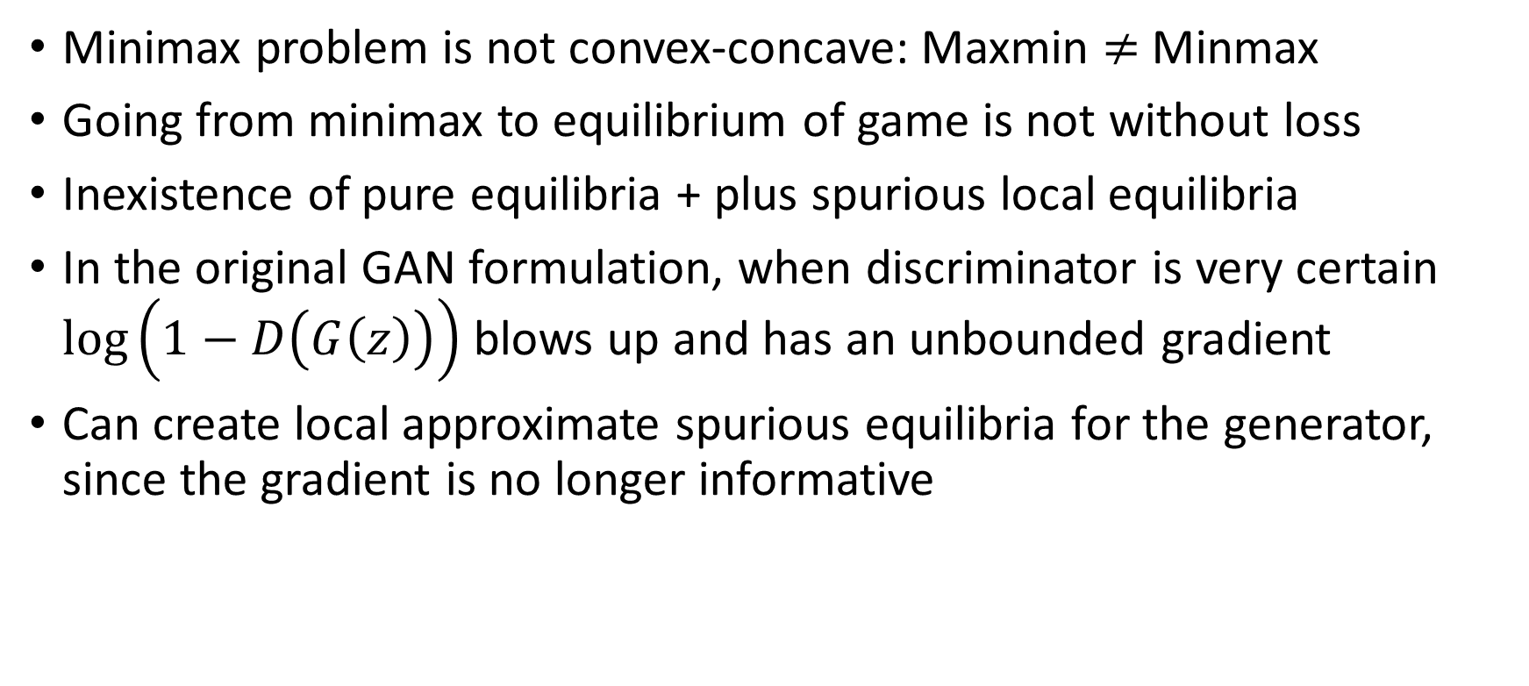
Bad/Inexistent Pure Equilibria
Minimax problem is not convex-concave: Maxmin $≠$ Minmax
Going from minimax to equilibrium of game is not without loss
Inexistence of pure equilibria + plus spurious local equilibria
In the original GAN formulation, when discriminator is very certain $\log\left(1−D\left(G\left(z\right)\right)\right)$ blows up and has an unbounded gradient
Can create local approximate spurious equilibria for the generator, since the gradient is no longer informative

Slide 28
Unstable Dynamics

Slide 29
Unstable dynamics in zero-sum games
Opportunity for EC community to propose new optimization algorithms that translate to better algorithms for solving for local equilibria in large continuous action spaces
Transfer ideas to modify existing GAN algorithms.
Already: Ideas from no-regret learning in games and the analysis of stable points of game dynamics

Slide 30
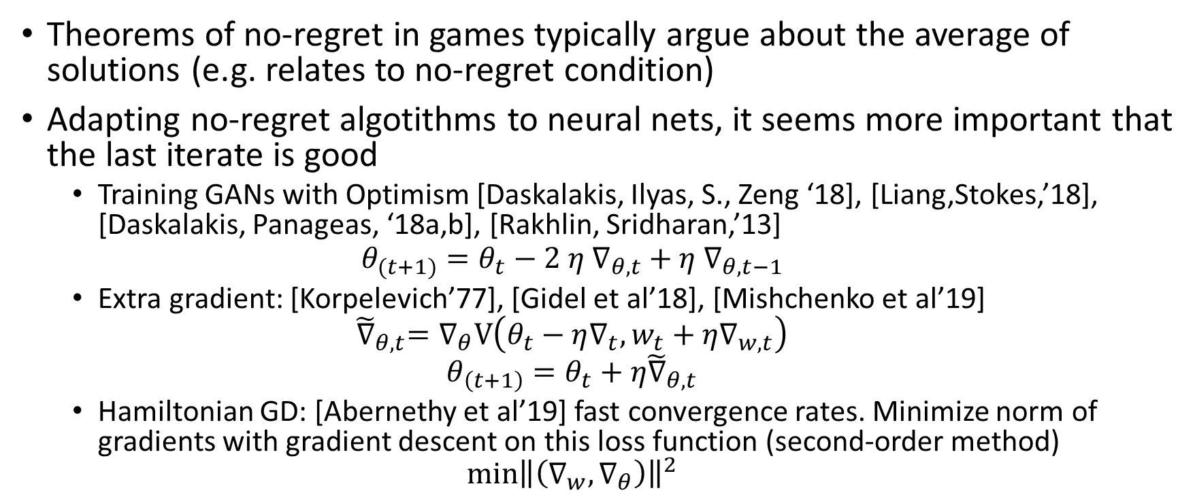
Line of work: Last Iterate Convergence
Theorems of no-regret in games typically argue about the average of solutions (e.g. relates to no-regret condition)
Adapting no-regret algotithms to neural nets, it seems more important that the last iterate is good
  Training GANs with Optimism [Daskalakis, Ilyas, S., Zeng ‘18], [Liang,Stokes,’18], [Daskalakis, Panageas, ‘18a,b], [Rakhlin, Sridharan,’13]
  $$θ_{(t+1)}=θ_{t}−2 η{ ∇}_{θ, t}+η ∇_{θ, t−1}$$
  Extra gradient: [Korpelevich’77], [Gidel et al’18], [Mishchenko et al’19]
  $${\tilde{∇}}_{θ, t}=∇_{θ}V\left(θ_{t}−η∇_{t}, w_{t}+η∇_{w, t}\right)$$
  $$θ_{\left(t+1\right)}=θ_{t}+η{\tilde{∇}}_{θ,t}$$
  Hamiltonian GD: [Abernethy et al’19] fast convergence rates. Minimize norm of gradients with gradient descent on this loss function (second-order method)
  $$\min{{\left\|\left(∇_{w}, ∇_{θ}\right)\right\|}^{2}}$$
Notes:
Abernethy:
file:///C:/Users/vasy/Dropbox/Research/MSR2019/GAN_tutorial/literature/1906.02027v1.pdf
Gidel:
file:///C:/Users/vasy/Dropbox/Research/MSR2019/GAN_tutorial/literature/1905.11373.pdf
file:///C:/Users/vasy/Dropbox/Research/MSR2019/GAN_tutorial/literature/1802.10551.pdf

Slide 31
Line of work: stable limit points
Characterize asympotically stable limit points of gradient dynamics and variants
Dynamical system theory
  Gradient descent GAN optimization is locally stable (for strongly concave games and in neighborhood, many conditions, linear discriminator) [Nagarajan, Kolter,’18]
  [Mertikopoulos et al. ‘18], [Daskalakis, Panageas,’18] : characterization of stable points of optimistic dynamics
Notes:
file:///C:/Users/vasy/Dropbox/Research/MSR2019/GAN_tutorial/literature/1706.04156.pdf
file:///C:/Users/vasy/Dropbox/Research/MSR2019/GAN_tutorial/literature/1706.08500.pdf

Slide 32
Regularizing the Loss Function
Altering the loss to make it strongly convex, so that GD dynamics are stabilized: add penalty as function of gradient of discriminator [Gulrajani et al.’17]
  Enforces a smooth version of the Lipschitzness constraint on the discriminator
Regularize the optimal transport distance [Sanjabi et al. ‘18]
  Results in wasserstein objective that instead of a 1-Lipschitz constraint, has a smooth penalty constraint in the objective.
Notes:
file:///C:/Users/vasy/Dropbox/Research/MSR2019/GAN_tutorial/literature/1705.09367.pdf
Improved Training of Wasserstein GANs
file:///C:/Users/vasy/Dropbox/Research/MSR2019/GAN_tutorial/literature/1704.00028.pdf
file:///C:/Users/vasy/Dropbox/Research/MSR2019/GAN_tutorial/literature/7940-on-the-convergence-and-robustness-of-training-gans-with-regularized-optimal-transport.pdf
* Non-zero sum game formulation, historical averaging, label smoothing
* Salimans: file:///C:/Users/vasy/Dropbox/Research/MSR2019/GAN_tutorial/literature/6125-improved-techniques-for-training-gans.pdf
* Spectral norm penalization to make discriminator smoother (a Lipscthiz function)
* Began: use an autoencoder (minimizes ||v - D(v)||^{1 or 2}) instead of a discriminator.
Try to find a sampling distribution such that the error distribution of the autoencoder is the
same under the true and the fake data. Completely different approach.

Slide 33
Open problems
Stochastic versions of gradient dynamics?
Some existing partial positive results: [Lin’19], [Zhou et al, 17]
Some existing partial negative results without strong convexity: [Juditsky et al’11]
Computation of local equilibrium solutions to non-convex concave games? Other ways of finding approximate local min-max?

Slide 34
Bad/Inexistent Pure Equilibria

Slide 35
Bad/Inexistent Local Equilibria
Pure equilibrium not guaranteed to exist
Large duality gap
Local equilibria can be far from minimax solutions

Slide 36
Line of work: Optimizing over Mixed Strategies
Expands the space of solutions to simulate mixtures over neural nets
Ensemble over multiple neural nets and use hedge to train weights [Arora et al,’17]
Implicit online learning over mixed strategies: run approximation of FTRL instead of GD [Grnarova et al.17]
  Best respond to sample of past discriminators/generators + regularizer
  Return mixture of a subset of the generators over a last window of iterations
Consider stylized versions of GAN game with finite strategies and apply Nash equilibrium algorithms, e.g. Parallel Nash memory [Savani et al 17, 18]
Notes:
file:///C:/Users/vasy/Dropbox/Research/MSR2019/GAN_tutorial/literature/1712.00679.pdf
file:///C:/Users/vasy/Dropbox/Research/MSR2019/GAN_tutorial/literature/1806.07268.pdf

Slide 37
Line of work: altering the game structure
Many discriminators [Durugkar et al’17]
Many generators [Zhang et al’18]
  Shows a diminishing duality gap as a function of number of generators
Intuition: many players simulates a good mixture, hence approximate pure Nash can potentially exist with many players
Similar intuition to Mix+GAN
Notes:
file:///C:/Users/vasy/Dropbox/Research/MSR2019/GAN_tutorial/literature/1611.01673.pdf
file:///C:/Users/vasy/Dropbox/Research/MSR2019/GAN_tutorial/literature/1811.08010.pdf

Slide 38
Open Problems
Understand the space of local equilibria of the GAN game, how sub-optimal can they be? Implicit approaches (e.g. analogous to PoA style analysis)
Design distribution learning games with provably only good equilibria? Multi-player games? Non-Zero Sum?

Slide 39
Concluding

Slide 40
Punchline
GANs are leading approach in research & practice to learn distributions of complex data
Two problems that EC community has expertise to provide new viewpoints:
Computation/Complexity of equilibria, no-regret learning in games, polymatrix games
Analysis of equilibria in games and design of games with good equilibria
Already several contributions from the EC/theory community in each of these directions that have received considerable attention
A great opportunity to have immediate impact in machine learning practice

