Slide 1
Learning and Mechanism Design
Vasilis Syrgkanis
Microsoft Research, New England

Slide 2
Points of interaction
Mechanism design and analysis for learning agents
  Online learning as behavioral model in auctions
Learning good mechanisms from data
  PAC learning applied to optimal mechanism design
  Online learning of good mechanisms
Learning from non-truthful auction data
  Econometric analysis in auction settings
Mechanism design for learning problems
  Online learning with strategic experts: incentivizing exploration, side-incentives
  Buying data: private data, costly data, crowdsourcing

Slide 3
Points of interaction
Mechanism design and analysis for learning agents
  Online learning as behavioral model in auctions
Learning good mechanisms from data
  PAC learning applied to optimal mechanism design
  Online learning of good mechanisms
Learning from non-truthful auction data
  Econometric analysis in auction settings
Mechanism design for learning problems
  Online learning with strategic experts: incentivizing exploration, side-incentives
  Buying data: private data, costly data, crowdsourcing

Slide 4
Key Insights
Auctions in practice are simple and non-truthful
How do players behave: simple adaptive learning algorithms, e.g. online learning
How good is the welfare of learning outcomes?
Is it computationally easy for players to learn?
Are there easily learnable simple mechanisms?

Slide 5

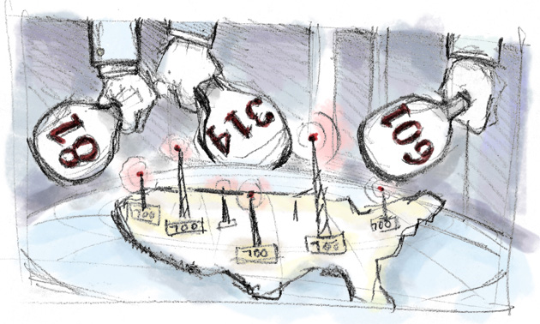


Mechanism Design in Combinatorial Markets
$m$ items for sale, to $n$ bidders
Each bidder has value $v_{i}(S)$ for bundle of items $S$
Typically, complement-free, e.g. submodular (decreasing marginal valuation), sub-additive (whole is worth at most sum of parts)
Quasi-linear utility: $u_{i}\left(S_{i},p_{i}\right)=v_{i}\left(S_{i}\right)−p_{i}$
Auctioneer’s objective: maximize welfare:
$$W\left(S_{1},…,S_{n}\right)=\sum_{i}{v_{i}\left(S_{i}\right)}$$
Values are only known to bidders

Slide 6
Algorithmic Mechanism Design
Vickrey-Clarke-Groves Mechanism
Truthful Algorithmic Mechanism Design
[Nisan-Ronen’99]
Many Mechanisms in Practice
Truthful reporting is dominant strategy
Maximizes social welfare
Too much communication: need to report my whole valuation
Computationally inefficient: requires being able to solve the welfare maximization problem
Computationally efficient mechanism
Settle with approximately optimal social welfare
Assume access to either a demand query or value query access to the valuation of each player
Non-truthful with simple allocation and pricing schemes
Many mechanisms running simultaneously or sequentially
Overall auction system is a non-truthful mechanism

Slide 7


How Do Players Behave?
Classical game theory: players play according to Nash Equilibrium
  How do players converge to equilibrium?
  Nash Equilibrium is computationally hard
Most scenarios: repeated strategic interactions
  Simple adaptive game playing more natural
  Learn to play well over time from past experience
  e.g. Dynamic bid optimization tools in online ad
  auctions
Caveats!
internet routing
advertising auctions

Slide 8
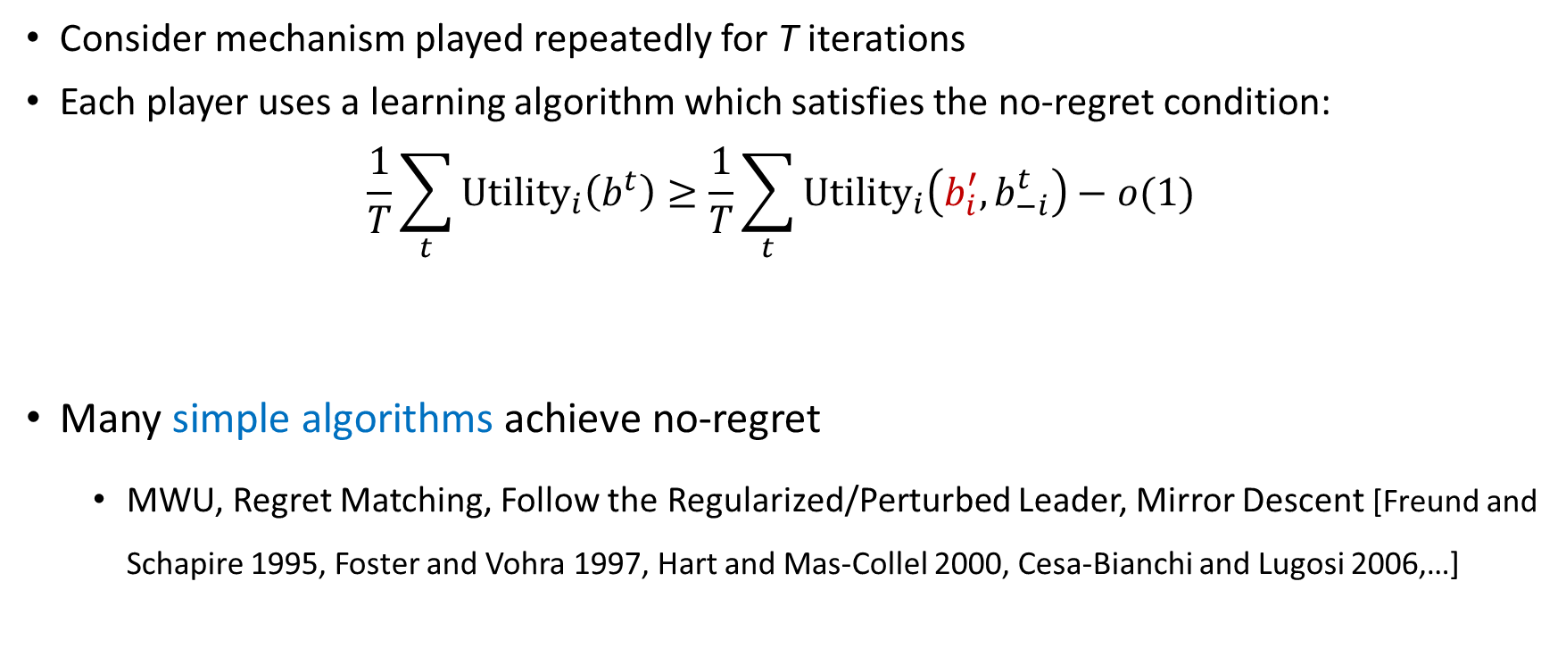
No-Regret Learning
Consider mechanism played repeatedly for T iterations
Each player uses a learning algorithm which satisfies the no-regret condition:
$$\frac{1}{T}\sum_{t}{{Utility}_{i}\left(b^{t}\right)}≥\frac{1}{T}\sum_{t}{{Utility}_{i}\left(b_{i}^{′},b_{−i}^{t}\right)}−o(1)$$
Many simple algorithms achieve no-regret
  MWU, Regret Matching, Follow the Regularized/Perturbed Leader, Mirror Descent [Freund and Schapire 1995, Foster and Vohra 1997, Hart and Mas-Collel 2000, Cesa-Bianchi and Lugosi 2006,…]
Average utility of algorithm
Average utility of fixed bid vector

Slide 9
Simple mechanisms with good welfare
Simultaneous Second Price Auctions (SiSPAs)
  Sell each individual item independently using a second price auction
  Bidders simultaneously submit a bid at each auction
  At each auction highest bidder wins and pays second highest bid
  Pros. Easy to describe, simple in design, distributed, prevalent in practice
  Cons. Bidders face a complex optimization problem
Welfare at no-regret [Bik’99,CKS’08, BR’11, HKMN’11,FKL’12,ST’13, FFGL’13]. If players use no-regret learning, average welfare is at least ¼ of optimal, even for sub-additive valuations.
Similar welfare guarantees for many other simple auctions used in practice: Generalized Second Price Auction, Uniform-price Multi-unit Auction (captured by notion of smooth mechanism [ST’13])

Slide 10
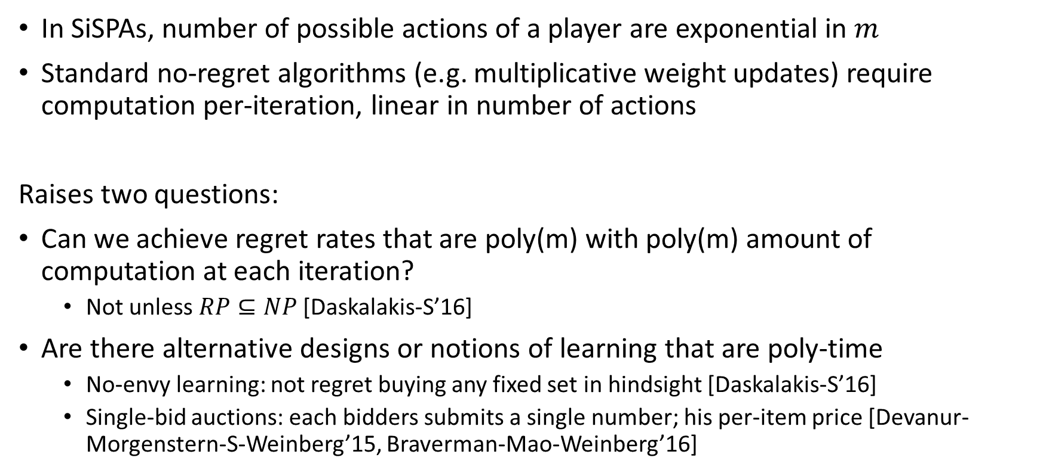
Computational Efficiency of No-Regret
In SiSPAs, number of possible actions of a player are exponential in $m$
Standard no-regret algorithms (e.g. multiplicative weight updates) require computation per-iteration, linear in number of actions
Raises two questions:
Can we achieve regret rates that are poly(m) with poly(m) amount of computation at each iteration?
  Not unless $RP⊆NP$ [Daskalakis-S’16]
Are there alternative designs or notions of learning that are poly-time
  No-envy learning: not regret buying any fixed set in hindsight [Daskalakis-S’16]
  Single-bid auctions: each bidders submits a single number; his per-item price [Devanur-Morgenstern-S-Weinberg’15, Braverman-Mao-Weinberg’16]

Slide 11
Points of interaction
Mechanism design and analysis for learning agents
  Online learning as behavioral model in auctions
Learning good mechanisms from data
  PAC learning applied to optimal mechanism design
  Online learning of good mechanisms
Learning from non-truthful auction data
  Econometric analysis in auction settings
Mechanism design for learning problems
  Online learning with strategic experts: incentivizing exploration, side-incentives
  Buying data: private data, costly data, crowdsourcing

Slide 12
Key Insights
Classic optimal mechanism design requires prior
What if we only have samples of values?
Approximately optimal mechanisms from samples
What is the sample complexity?
  A statistical learning theory question
With computational efficiency?
Online optimization of mechanisms
  Samples arrive online and not i.i.d.
What if we observe incomplete data?
  Prices and winners or chosen items from posted prices

Slide 13

Optimal Mechanism Design
Selling a single item
Each buyer has a private value $v_{i}∼F$
How do we sell the item to maximize revenue?
Myerson’82: Second price with reserve $r={argmax}_{p} p\left(1−F\left(p\right)\right)$
Setting the optimal reserve requires knowing $F$
Sample complexity of optimal mechanisms: what if instead of knowing $F$ we have $m$ samples from $F$? [Roughgarden-Cole’14, Mohri-Rostamizadeh’14]

Slide 14
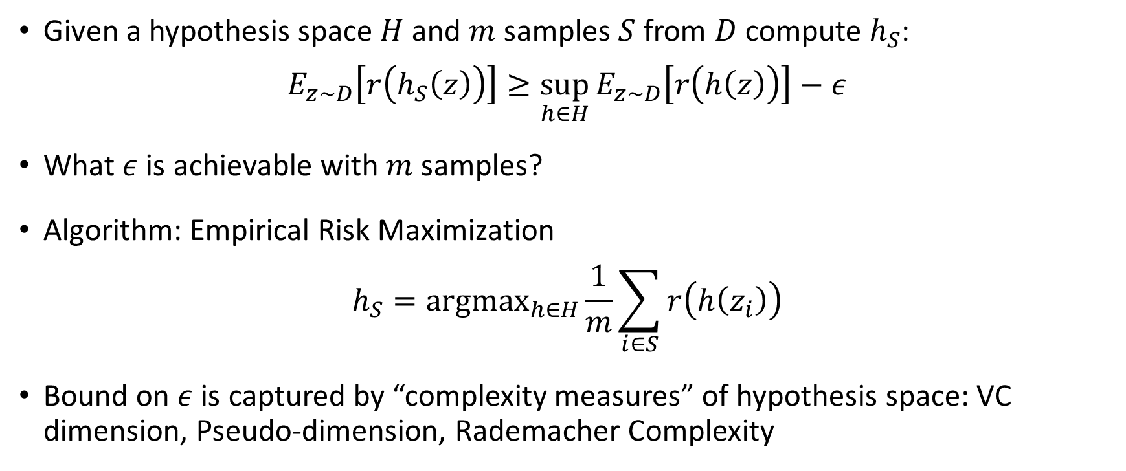
PAC Learning and Sample Complexity
Given a hypothesis space $H$ and $m$ samples $S$ from $D$ compute $h_{S}$:
$$E_{z∼D}\left[r\left(h_{S}\left(z\right)\right)\right]≥\sup_{h∈H}{E_{z∼D}\left[r\left(h\left(z\right)\right)\right]}−ε$$
What $ε$ is achievable with $m$ samples?
Algorithm: Empirical Risk Maximization
$$h_{S}={argmax}_{h∈H}\frac{1}{m}\sum_{i∈S}{r\left(h\left(z_{i}\right)\right)}$$
Bound on $ε$ is captured by “complexity measures” of hypothesis space: VC dimension, Pseudo-dimension, Rademacher Complexity

Slide 15
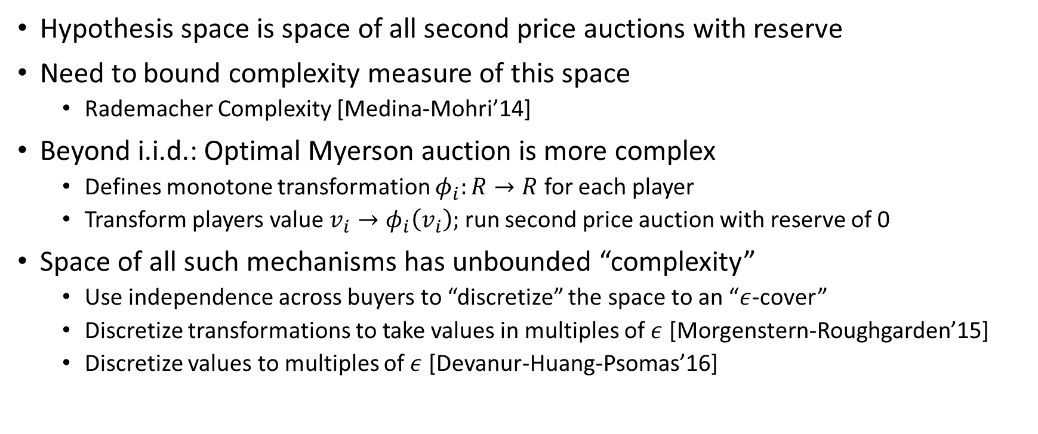
PAC Learning for Optimal Auctions
Hypothesis space is space of all second price auctions with reserve
Need to bound complexity measure of this space
  Rademacher Complexity [Medina-Mohri’14]
Beyond i.i.d.: Optimal Myerson auction is more complex
  Defines monotone transformation $φ_{i}:R→R$ for each player
  Transform players value $v_{i}→φ_{i}\left(v_{i}\right);$ run second price auction with reserve of 0
Space of all such mechanisms has unbounded “complexity”
  Use independence across buyers to “discretize” the space to an “$ε$-cover”
  Discretize transformations to take values in multiples of $ε$ [Morgenstern-Roughgarden’15]
  Discretize values to multiples of $ε$ [Devanur-Huang-Psomas’16]

Slide 16
Efficiently Learning Optimal Auctions
ERM for many of these problems can be computationally hard
What if we want a poly-time algorithm?
  Non-i.i.d. regular distributions [Cole-Roughgarden’14, Devanur et al’16]
  i.i.d. irregular distributions [Roughgarden-Schrijvers’16]
  Non-i.i.d. irregular distributions [Gonczarowski-Nisan’17]
Typically: discretization in either virtual value or value space and subsequently running Myerson’s auction on empirical distributions
Why efficient learnable? Bayesian version of the problem has closed form simple solution (Myerson)

Slide 17
Multi-item Optimal Auctions
Optimal mechanism is not well understood or easy to learn
Compete with simple mechanisms:
  Posted bundle price mechanisms [Morgenstern-Roughgarden’16] (Pseudo-dimension)
  Affine maximizers, bundle pricing, second-price item auctions [Balcan-Sandholm-Vitercik’15,16] (Rademacher complexity)
  Bundle, item pricing [S’17] (new split-sample growth measure)
  Yao’s simple approximately optimal mechanisms [Cai-Daskalakis’17] (new measure of complexity for product distributions)

Slide 18
Online Learning of Mechanisms
Valuation samples are not i.i.d. but coming in online arbitrary manner
Dynamically optimize mechanisms to perform as good as the best mechanism in hindsight?
  Optimizing over second price auctions with player-specific reserves [Roughgarden-Wang’16]
  Optimizing over Myerson style auction over discretized values [Bubeck et al’17]
  Reductions from online to offline problem for discretized Myerson and other auctions [Dudik et al’17]

Slide 19
Learning from incomplete data
What if we only observe responses to posted prices?
  Posting prices online and buyers selecting optimal bundle [Amin et al.’14, Roth-Ullman-Wu’16]
  Goal is to optimize revenue
  Assumes goods are continuous and buyers value is strongly concave
What if we only observe winners and prices?
  Can still compute good optimal reserve prices without learning values [Coey et al.’17]

Slide 20
Points of interaction
Mechanism design and analysis for learning agents
  Online learning as behavioral model in auctions
Learning good mechanisms from data
  PAC learning applied to optimal mechanism design
  Online learning of good mechanisms
Learning from non-truthful auction data
  Econometric analysis in auction settings
Mechanism design for learning problems
  Online learning with strategic experts: incentivizing exploration, side-incentives
  Buying data: private data, costly data, crowdsourcing

Slide 21
Key Insights
To make any inference we need to connect bids to values
Requires some form of equilibrium/behavioral assumption
  BNE, NE, CE, No-regret learning
In many cases value distribution can be re-constructed from bid distribution
If goal is to optimize revenue or infer welfare properties then learning the value distribution is not needed

Slide 22
Learning from non-truthful data
What if we have data from a first price auction or a Generalized Second Price auction?
Auctions are not truthful: we only have samples of bids not values
Not a PAC learning problem any more
Requires structural modeling assumptions to connect bids to values
Bayes-Nash equilibrium, Nash equilibrium, No-regret learners

Slide 23
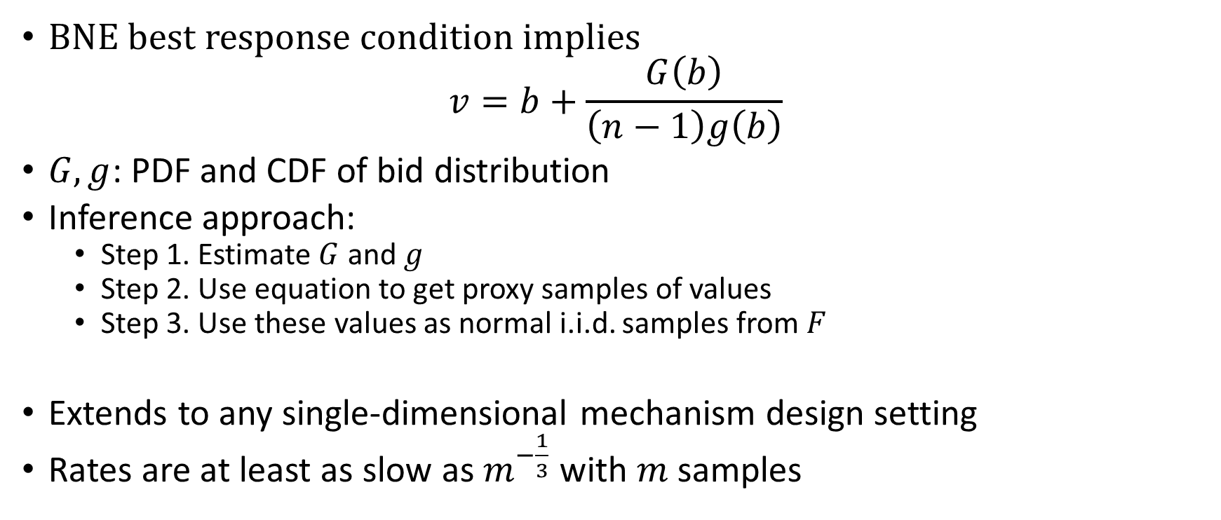
First Price Auction: BNE Econometrics
[Guerre-Perrigne-Vuong’00]
BNE best response condition implies
$$v=b+\frac{G\left(b\right)}{\left(n−1\right)g\left(b\right)}$$
$G,g$: PDF and CDF of bid distribution
Inference approach:
  Step 1. Estimate $G$ and $g$
  Step 2. Use equation to get proxy samples of values
  Step 3. Use these values as normal i.i.d. samples from $F$
Extends to any single-dimensional mechanism design setting
Rates are at least as slow as $m^{−\frac{1}{3}}$ with $m$ samples

Slide 24
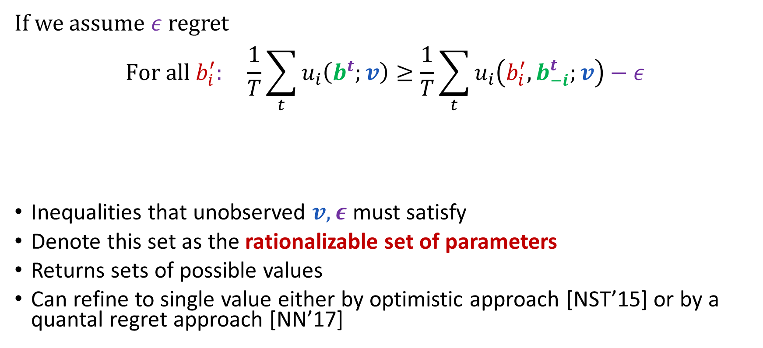
No-regret learning
[Nekipelov-Syrgkanis-Tardos’15, Noti-Nisan’16-17]
If we assume $ε$ regret
$$For all b_{i}^{′}: \frac{1}{T}\sum_{t}{u_{i}\left(b^{t};v\right)}≥\frac{1}{T}\sum_{t}{u_{i}\left(b_{i}^{′},b_{−i}^{t};v\right)}−ε$$
Inequalities that unobserved $v,ε$ must satisfy
Denote this set as the rationalizable set of parameters
Returns sets of possible values
Can refine to single value either by optimistic approach [NST’15] or by a quantal regret approach [NN’17]
Current average utility
Average deviating utility from fixed action
Regret

Slide 25
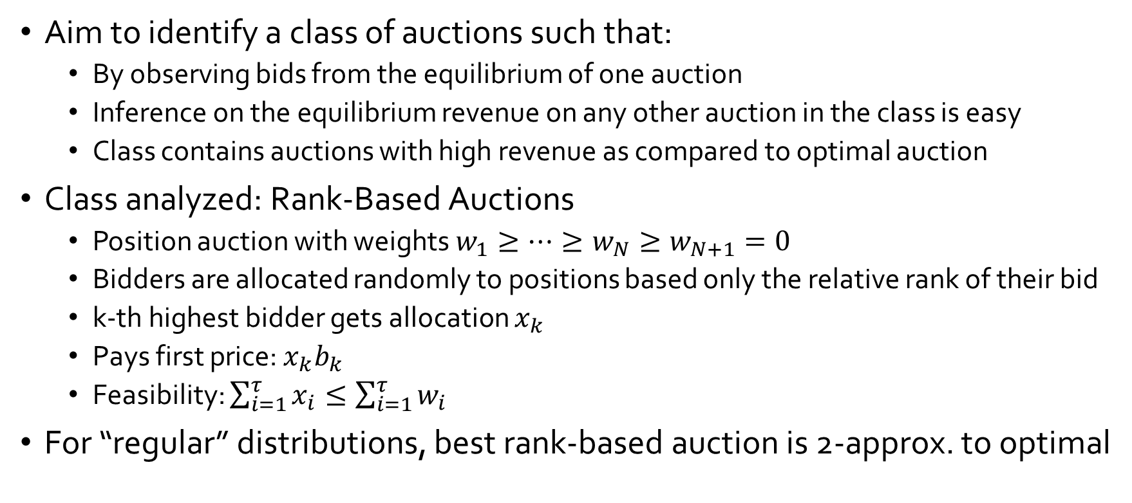
Revenue inference from non-truthful bids
[Chawla-Hartline-Nekipelov’14]
Aim to identify a class of auctions such that:
  By observing bids from the equilibrium of one auction
  Inference on the equilibrium revenue on any other auction in the class is easy
  Class contains auctions with high revenue as compared to optimal auction
Class analyzed: Rank-Based Auctions
  Position auction with weights $w_{1}≥…≥w_{N}≥w_{N+1}=0$
  Bidders are allocated randomly to positions based only the relative rank of their bid
  k-th highest bidder gets allocation $x_{k}$
  Pays first price: $x_{k}b_{k}$
  Feasibility: $\sum_{i=1}^{τ}{x_{i}}≤\sum_{i=1}^{τ}{w_{i}}$
For “regular” distributions, best rank-based auction is 2-approx. to optimal

Slide 26
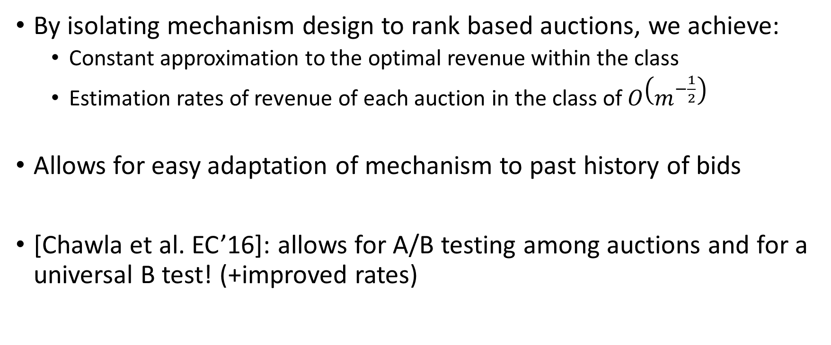
Revenue inference from non-truthful bids
[Chawla-Hartline-Nekipelov’14]
By isolating mechanism design to rank based auctions, we achieve:
  Constant approximation to the optimal revenue within the class
  Estimation rates of revenue of each auction in the class of $O\left(m^{−\frac{1}{2}}\right)$
Allows for easy adaptation of mechanism to past history of bids
[Chawla et al. EC’16]: allows for A/B testing among auctions and for a universal B test! (+improved rates)

Slide 27
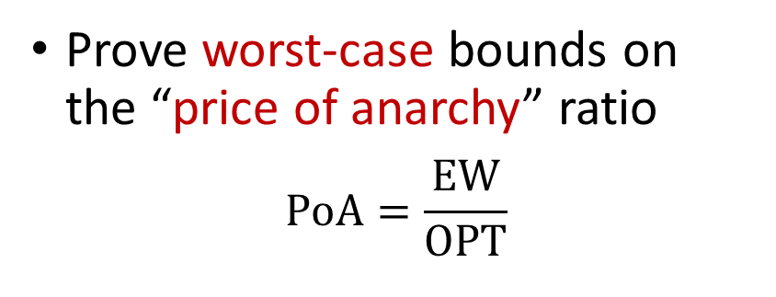
AGT Theory
Welfare inference from non-truthful bids
[Hoy-Nekipelov-S’16]
vs
Econometrics
Prove worst-case bounds on the “price of anarchy” ratio
$$PoA=\frac{EW}{OPT}$$
Observe bid dataset
Infer player values/distributions
Calculate quantity of interest
Bridges across two approaches
Use worst-case price of anarchy methodologies
Replace worst-case proofs with data-measurements

Slide 28
Points of interaction
Mechanism design and analysis for learning agents
  Online learning as behavioral model in auctions
Learning good mechanisms from data
  PAC learning applied to optimal mechanism design
  Online learning of good mechanisms
Learning from non-truthful auction data
  Econometric analysis in auction settings
Mechanism design for learning problems
  Online learning with strategic experts: incentivizing exploration, side-incentives
  Buying data: private data, costly data, crowdsourcing

Slide 29
Key Insights
Incentivizing exploration: online learning were choices are recommendations to strategic users
  Users might have prior biases and need to be convinced
  Goal is to incentivize taking a desired action
  Via information design or payment schemes
  Achieve good regret rates despite incentives
Bying data: most machine learning tasks require inputs from humans
  Crowdsourcing: incentivizing strategic agents to exert costly effort to produce labels
  Private data: buying private data for agents that value privacy and have a cost for providing them

Slide 30
Relevant courses
Daskalakis, Syrgkanis. Topics in Algorithmic Game Theory and Data Science, MIT 6.853, Spring 2017
https://stellar.mit.edu/S/course/6/sp17/6.853/index.html
Eva Tardos. Algorithmic Game Theory, Cornell CS6840, Spring 2017
http://www.cs.cornell.edu/courses/cs6840/2017sp/
Yiling Chen. Prediction, Learning and Games, Harvard CS236r, Spring 2016
https://canvas.harvard.edu/courses/9622
Nina Balcan. Connections between Learning, Game Theory, and Optimization, GTech 8803, Fall 2010
http://www.cs.cmu.edu/~ninamf/LGO10/index.html

Slide 31
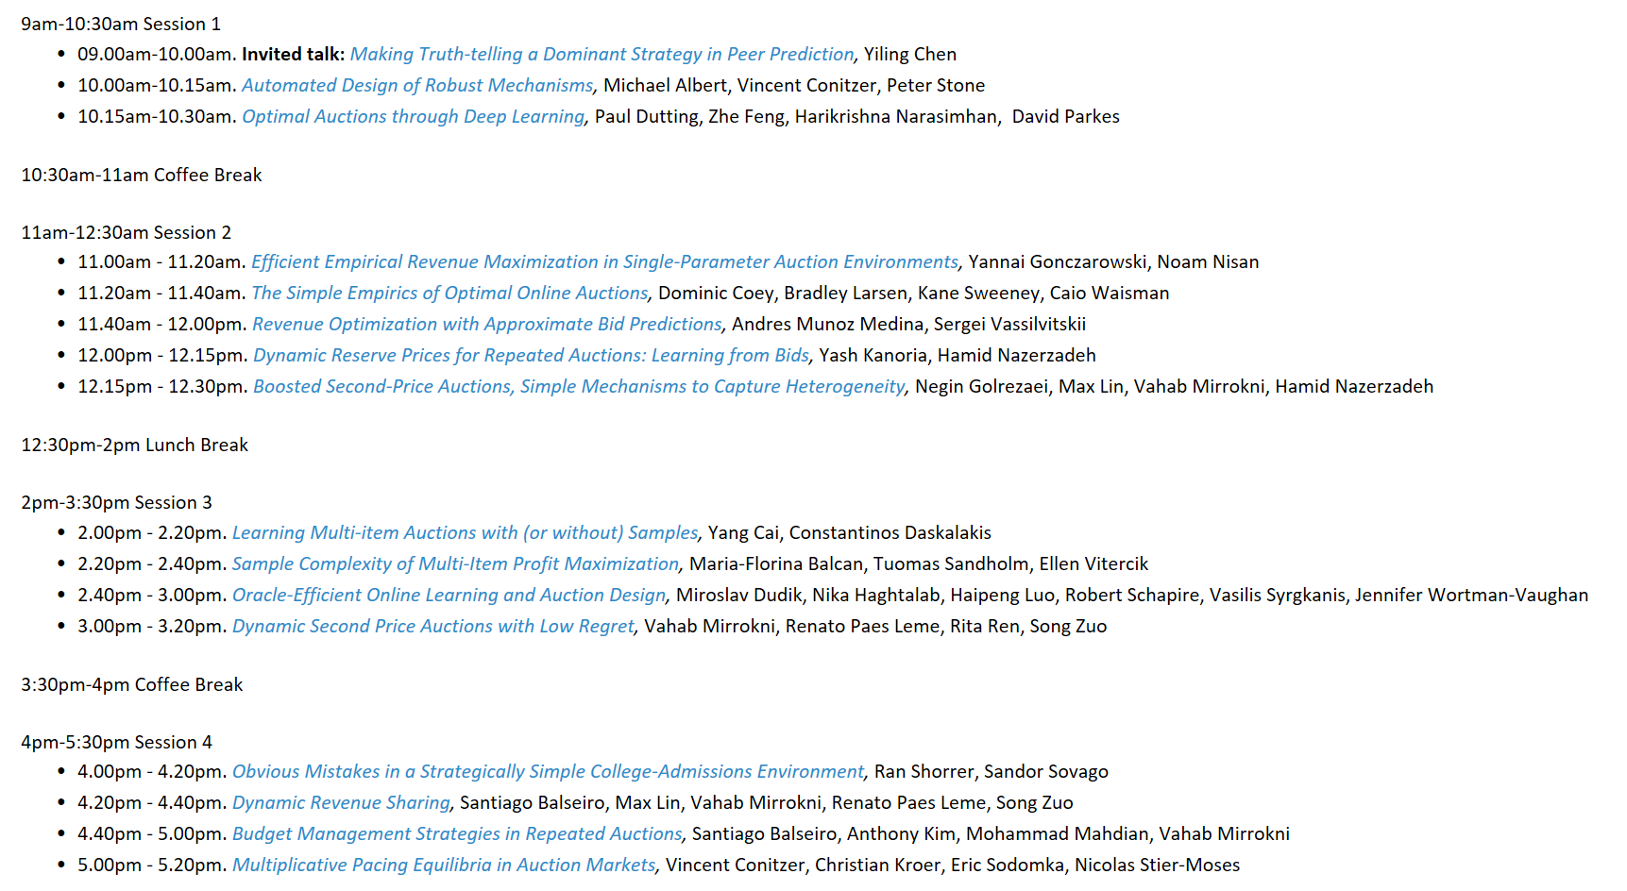
Workshop on AGT and Data Science

Slide 32
Points of interaction
Mechanism design and analysis for learning agents
  Online learning as behavioral model in auctions
Learning good mechanisms from data
  PAC learning applied to optimal mechanism design
  Online learning of good mechanisms
Learning from non-truthful auction data
  Econometric analysis in auction settings
Mechanism design for learning problems
  Online learning with strategic experts: incentivizing exploration, side-incentives
  Buying data: private data, costly data, crowdsourcing
Thank you!

