Slide 1


2018-2022 Jersey City Citi Bike Analysis
Last data refresh:
1/18/2024 5:40:11 PM UTC
Downloaded at:
1/18/2024 5:46:36 PM UTC

Slide 2
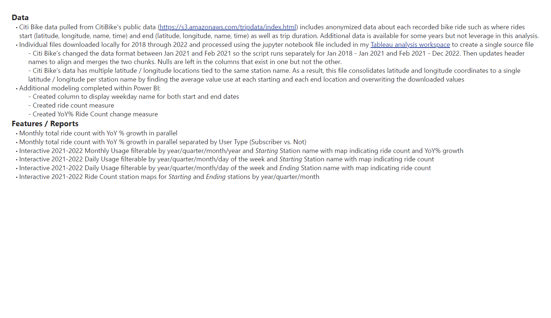

Slide 3
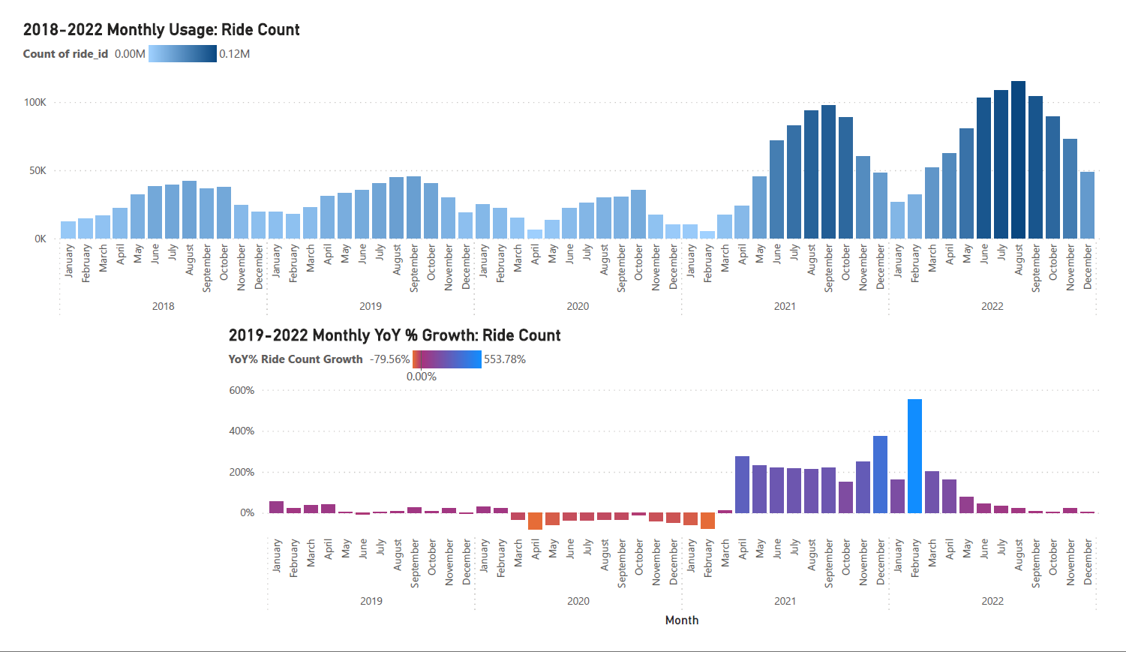

Slide 4
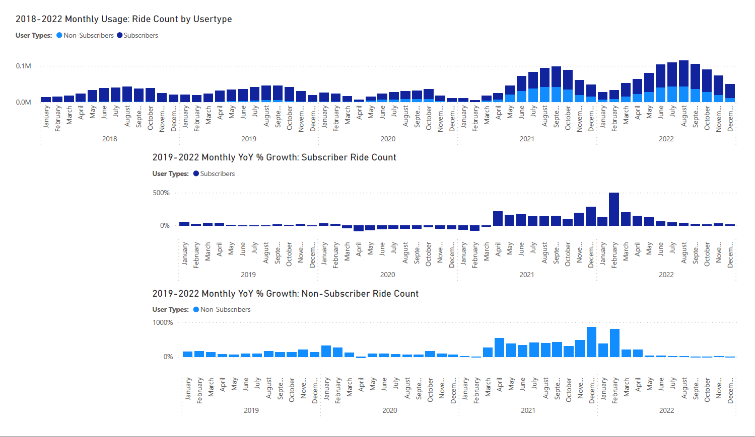

Slide 5
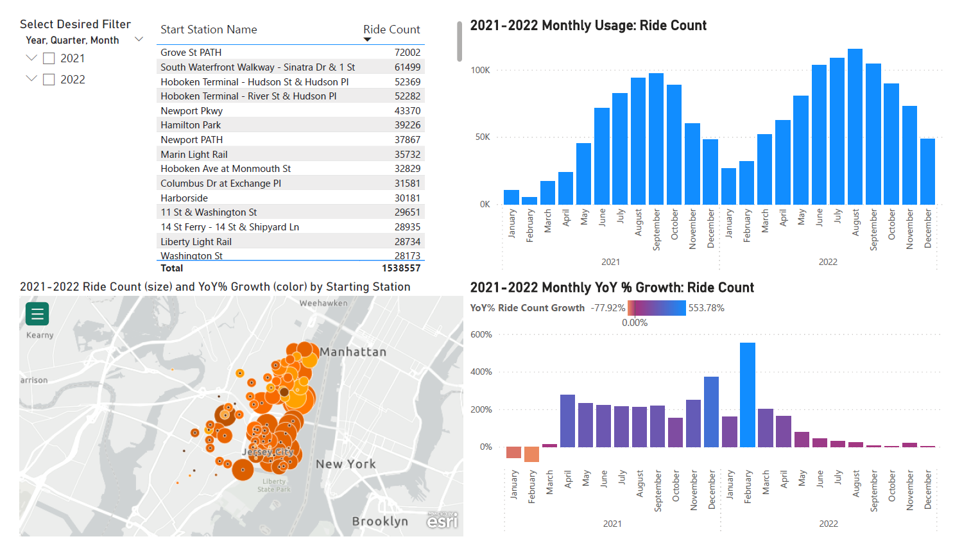

Slide 6
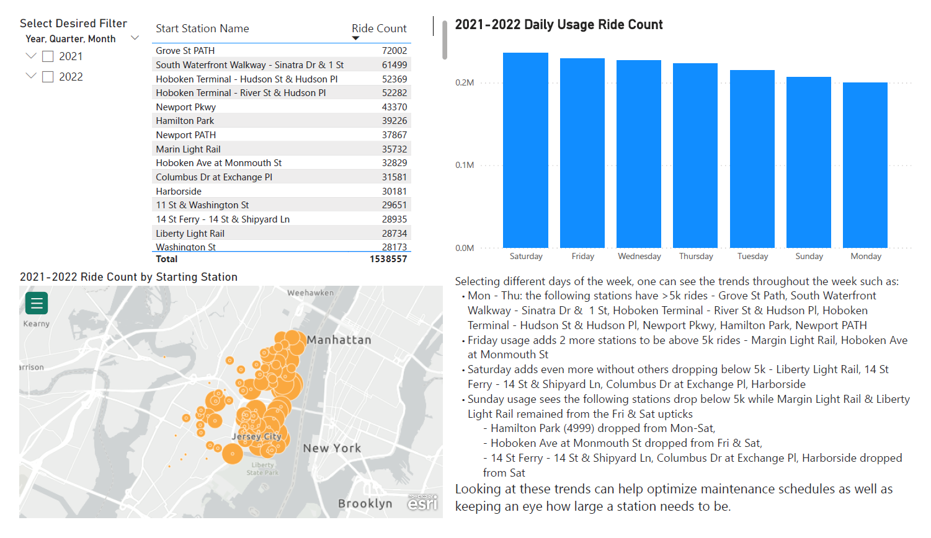

Slide 7
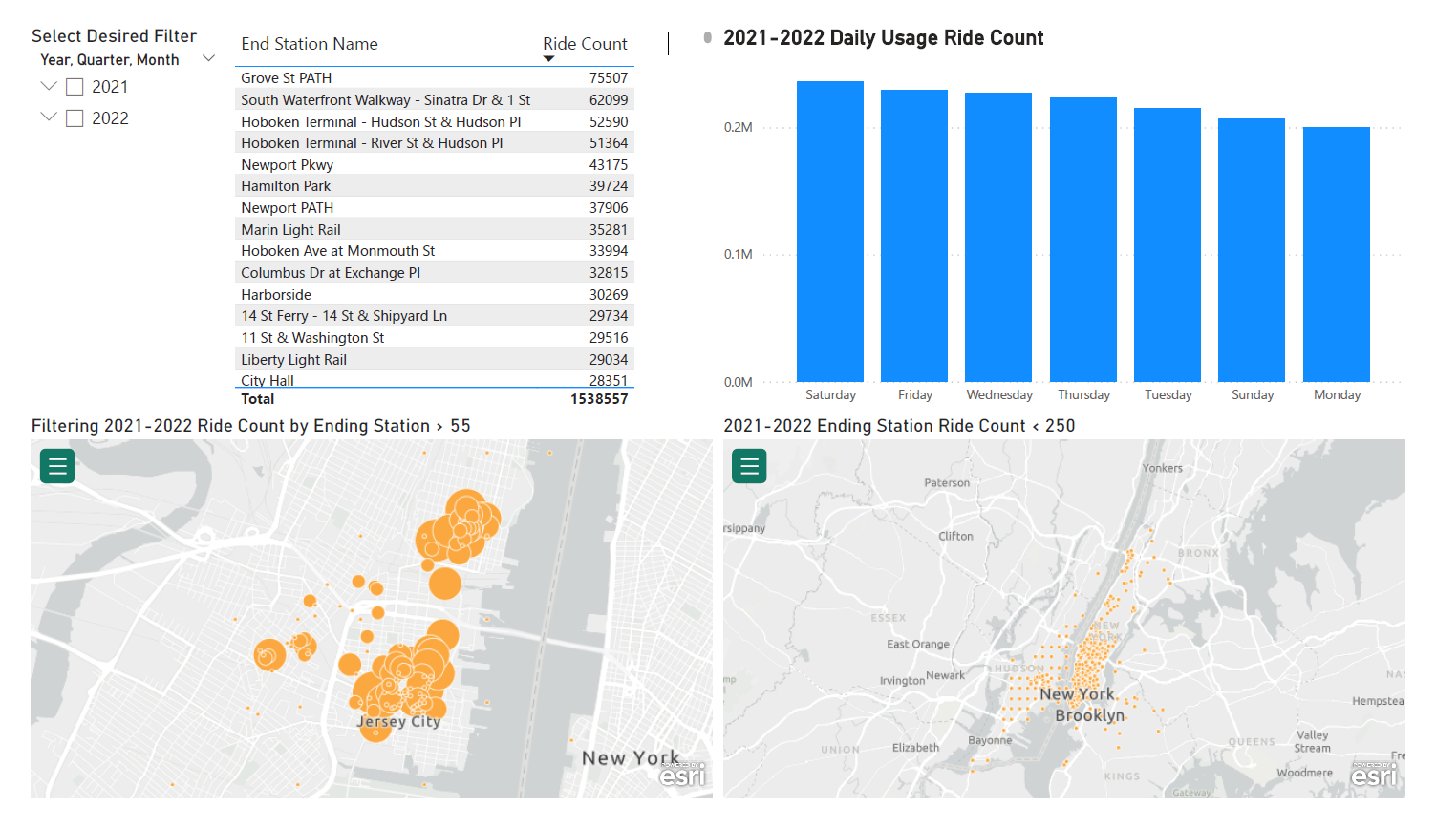

Slide 8
