Slide 1

Urban Real Estate Investing, US
Aaron Summers, Brannan Geshwind, Cory Selzer, Dulce Silva,
Rebekah Aldrich, Tait Ralston

Slide 2
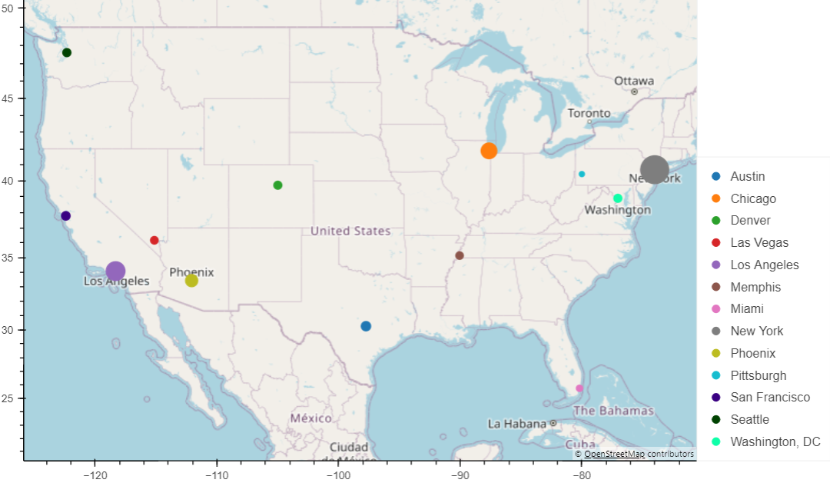
About us
We focus on real estate investing strategies with in the US looking at trends across property value, property sales, population sizes, job markets, crime, schools, and other factors our clients find key to their situation

Slide 3
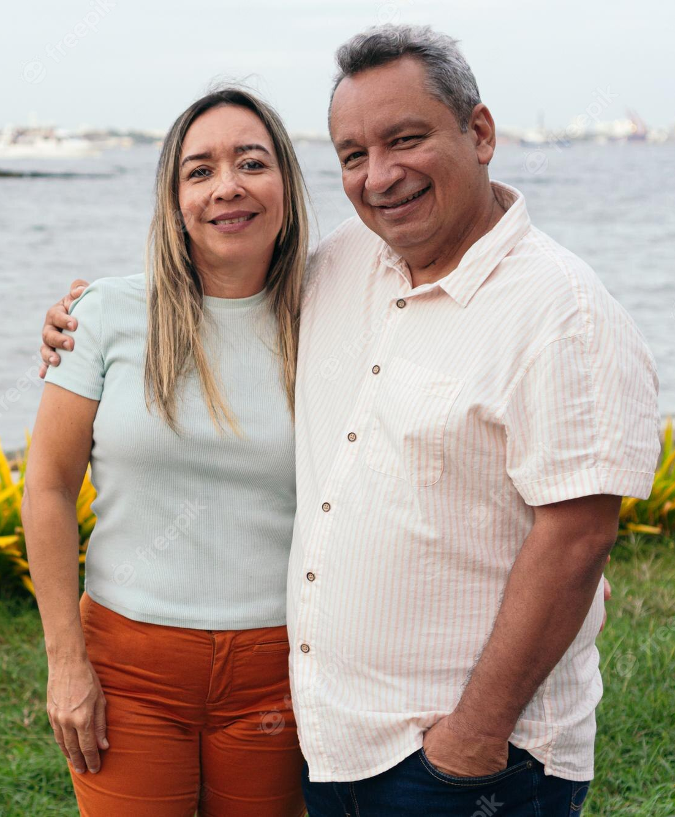
Meet our client
BIO
Couple in early 50s with 2 fully independent children located in suburbia Tampa, FL.
Looking to invest remotely in urban/suburban properties as another source of income. As beginners, they want to focus on starter family housing and have asked us to recommend where to focus in the US.
Key care abouts
Target Cities
Housing up to 1500 sq. ft.
Housing up to 3 bedrooms
Homes, Townhomes, Condos
Evidence of population growth
Evidence of property value growth
Evidence rental prices competitive to mortgage
Austin, Chicago, Denver, Memphis, New York, San Francisco
Other Considerations
Good school districts
Low crime rates
Positive Job Market
Property tax implications

Slide 4

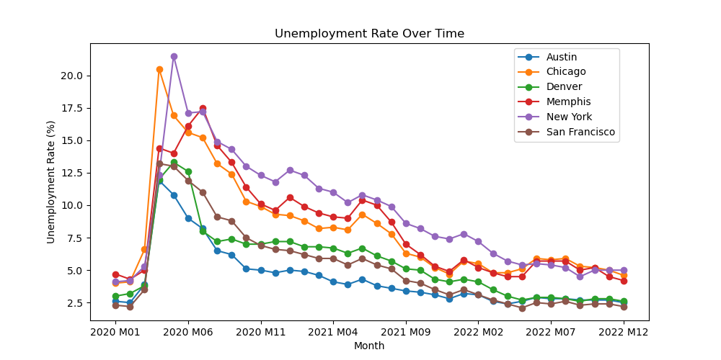
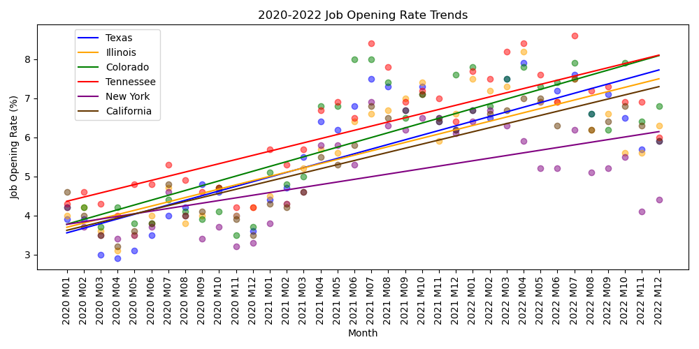
Job market trends
Source: U.S. Bureau of Labor Statistics
Austin, San Francisco, Denver
Have the lowest unemployment rates of the target cities.
Tennessee, Colorado, Texas
Have the highest job opening rate trends of the target states.
Denver, Colorado
Has the best overall job trend helping attract more people to the area compared to other target cities
Notes:
Other Notes:
Unemployment:
Denver, Austin, San Francisco are different (p-value: 0.178)
Denver & Austin are on the edge of being different (p-value: 0.053)
Job Openings:
Texas, Illinois, California are different (p-value: 0.854)
Texas and Illinois are different (p-value: 905)

Slide 5



Topic trends
Optional: Figure Name / Subheader
Optional: Figure Name / Subheader
Conclusion 1
Conclusion 2

Slide 6
topic trends
Optional Sub header
REPLACE THIS PIC with 1 or 2 charts!
Conclusion 1
…
Conclusion 2
…
Conclusion 1
…

Slide 7

trend comparison
Optional Subheader
Optional Subheader2
Optional Subheader3
Key Details
Key Details2
Key Details3

Slide 8

FINAL Recommendation
Highlight 1
Highlight 3
…
…
Highlight 2
Highlight 4
…
…

Slide 9
Premade slides after this!

Slide 10
Pitch deck
Mirjam Nilsson​​

Slide 11

About us
At Contoso, we empower farming communities to foster collaborative thinking to further drive workplace innovation. By closing the loop and leveraging ethical farming methods, we help businesses grow organically and nurture a consumer first mindset.

Slide 12
problem
Market gap
Customers
Organic agriculture continues to be consumer driven, but we're seeing a lapse of availability in the market for organic products
6.6% increase of retail sales of organic food proves that there's consumer interest for more organic produce
Costs
Usability
Loss of sales by not offering organic produce selection
Retail organic food sales were up by $112 billion in 2019
Financials
Customers want something that's healthy and available to pick up at their local supermarket or area

Slide 13


Product overview
Unique
First to market
Tested
Authentic
Only product specifically dedicated to the agricultural market
First beautifully designed product that's both stylish and functional
Conducted testing with young farmers in the area
Designed with the help and input of agricultural experts in the field

Slide 14
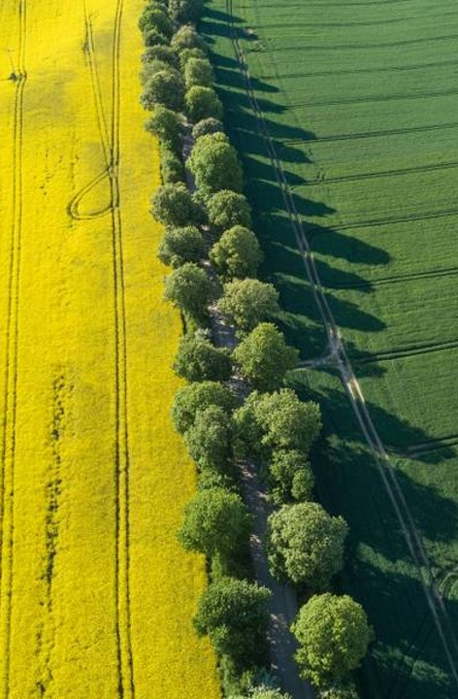
solution
Close the gap
Target audience
Our product makes organic farming easier, and no other product on the market offers the same benefits or yield.
Gen Z (18-25 years old)
Cost savings
Easy to use
Reduce expenses for replacement products
A simple product that gives customers the information they need in order to produce an abundance of rich produce

Slide 15

Product Benefits
Cool and stylish product​
Areas for community connections ​
Online store and market swap

Slide 16
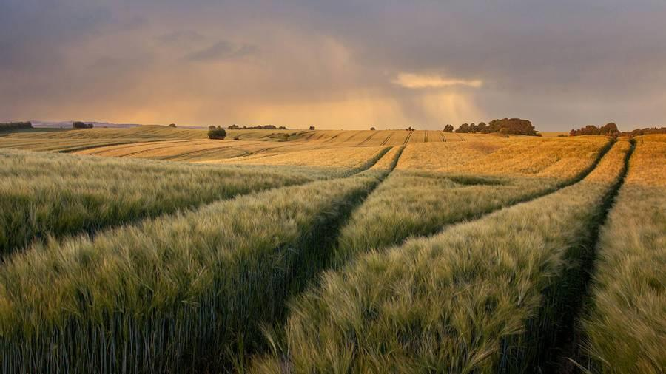
Company Overview

Slide 17

Business model
research
We based our research on market trends and social media​
abstract
We believe people need more products specifically dedicated to this niche market​
design
Minimalist and easy to use ​

Slide 18
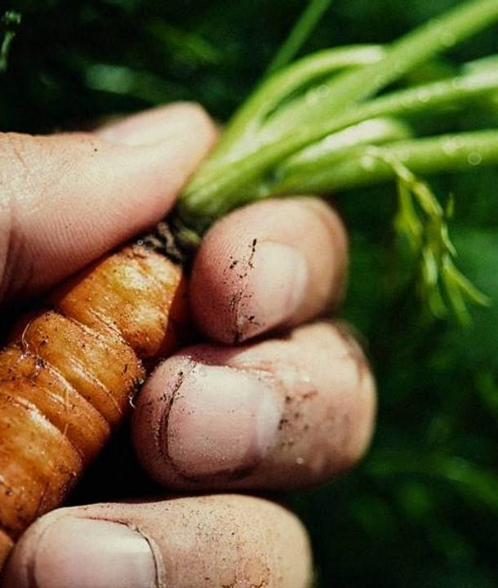
Market overview
Opportunity to build​
Fully inclusive market
Total addressable market​
$3B​
Freedom to invent​
Selectively inclusive market​
Serviceable available market​
$2B
Few competitors​
Specifically targeted market​
Serviceable obtainable market​
$1B

Slide 19

Market comparison
$3b
$2b
$1B
Opportunity to build
Freedom to invent
Few competitors
Addressable market​
Serviceable market​
Obtainable market​

Slide 20
Our competition
contoso
Competitors
Our product is priced below that of other companies on the market​
Design is simple and easy to use, compared to the complex designs of the competitors​
Affordability is the main draw for our consumers to our product​
Company A​ Product is more expensive​
Companies B & C ​ Product is expensive and inconvenient to use​
Companies D & E​ Product is affordable, but inconvenient to use

Slide 21
Competitive layout
convenient
contoso
A
Expensive​
affordable
B
D
C
E
Inconvenient​

Slide 22
Growth strategy
How we’ll scale in the future​
Feb 20xx
Roll out product to local farms in the region to help establish the product​
May 20xx
Release the product to the general public and monitor press and regional market trends​
Oct 20xx
Gather feedback from the agriculture and farming community to expand availability of the product​

Slide 23
Traction
Forecasting for success​
Metrics
Revenue by year
 | clients | orders | Gross avenue | Net revenue
20XX​ | 10​ | 1,100​ | $10,000​ | $7,000​
20XX​ | 20​ | 200​ | $20,000​ | $16,000​
20XX​ | 30​ | 300​ | $30,000​ | $25,000​
20XX​ | 40​ | 400​ | $40,000​ | $30,000​

Slide 24
2-year action plan
Get volunteers​
Gather feedback​
Deliver to consumers​
20XX
Jan
Feb
Mar
Apr
May
Jun
Jul
Aug
Sep
Oct
Nov
Dec
Run focus groups​
Test with farms​
Regional launch​
20XX
Jan
Feb
Mar
Apr
May
Jun
Jul
Aug
Sep
Oct
Nov
Dec

Slide 25

financials
 | Year 1 | Year 2 | year 3
Detailers​ | 5,000​ | 40,000​ | 160,000​ | ​
Users​ | 50,000​ | 400,000​ | 1,600,000​ | ​
Sales​ | 500,000​ | 4,000,000​ | 16,000,000​ | ​
Average Price per Sale​ | 75​ | 80​ | 90​ | ​
Revenue @ 15%​ | 5,625,000​ | 48,000,000​ | 216,000,000​ | ​
Gross Profit​ | 5,625,000​ | 48,000,000​ | 216,000,000​ | ​
Expenses​ | ​ | ​ | ​ | ​
Sales & Marketing​ | 5,062,500​ | 38,400,000​ | 151,200,000​ | ​
Customer Service​ | 1,687,500​ | 9,600,000​ | 21,600,000​ | 70%​
Product Development​ | 562,500​ | 2,400,000​ | 10,800,000​ | 10%​
Research​ | 281,250​ | 2,400,000​ | 4,320,000​ | 5%​
Total Expenses​ | 7,593,750​ | 52,800,000​ | 187,920,000​ | 2%​
EBIT | -1,968,750 | -4,800,000 | 28,080,000 | ​

Slide 26
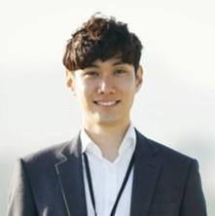



Meet the team
Takuma Hayashi​​
Mirjam Nilsson​​
Flora Berggren​​
Rajesh Santoshi​​
President
Chief Executive Officer​
Chief Operations Officer​
VP Marketing​

Slide 27

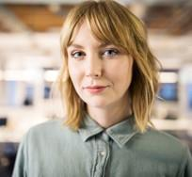






Meet the team
Takuma Hayashi​
Mirjam Nilsson​
Flora Berggren​
Rajesh Santoshi​
President
Chief Executive Officer
Chief Operations Officer
VP Marketing
Graham Barnes
Rowan Murphy
Elizabeth Moore
Robin Kline
VP Product
SEO Strategist
Product Designer
Content Developer

Slide 28
Funding
12K
32K
14K
82K
Campaigns​
Angel investments​
Cash
Shares
Revenue obtained from online campaigns and door-to-door sales​
Amount obtained through other investors
Liquid cash we
have on hand
Number of shares converted into USD

Slide 29

summary
At Contoso, we believe in giving 110%. By using ethical farming methods, we help farming communities grow organically and foster a consumer first mindset. We thrive because of our market knowledge and a great team behind our product. As our CEO says, "Efficiencies will come from proactively transforming how we do business."

Slide 30

Thank you
Mirjam Nilsson​​
206-555-0146​
mirjam@contoso.com​
www.contoso.com​

