Slide 1
Periocular Recognition Fused with Facial Attributes

Slide 2
Datasets
UBIPr :
Total Images : 10199 images
Had to clean up the dataset. Few images that were not clear and had issues.
Removed those images and we got 10138 images.
Left eye and right eye folders are separated for each subject.
There was an overlap of 3 images, which means left eye folder of a subject had a right eye image or vice versa.
Such images have been discarded. Therefore total number of images is down to 10,135 now.
The total number of folders were 504. Number of left eye and right eyes are equal to 252 each.
Based on having equal number of left and right eye, we are assuming number of subjects as 252
The males are 181, and females are 71
Images have been taken at 5 distances, so the image sizes (h x w) are (401 x 501),(441 x 561), (501 x 651),(651 x 801), (801 x 1001).
There are 3 images for each image size. Therefore each folder has 15 images, if one session. Some of the images have 2 sessions, which means upto 30 images in each folder.
CROSS-EYED :
Total Images : 1920 Images
Left eye and right eye folders are separated for each subject.
Based on having equal number of left and right eye, Total number of subjects are 120
Images have been taken at only one distance (h x w) are (800 x 900)
Each subject has 8 Left eye and 8 Right eye images.

Slide 3
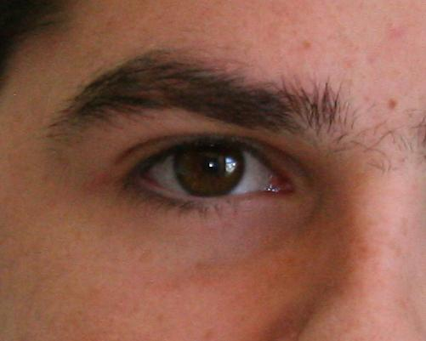
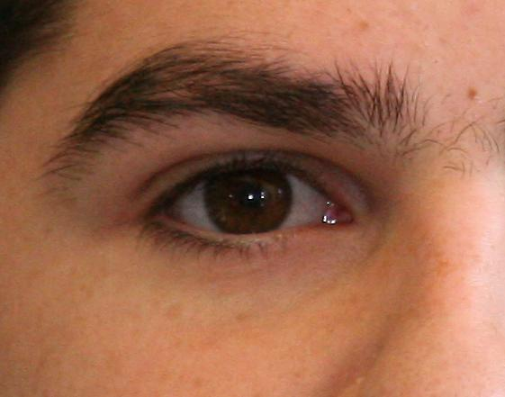
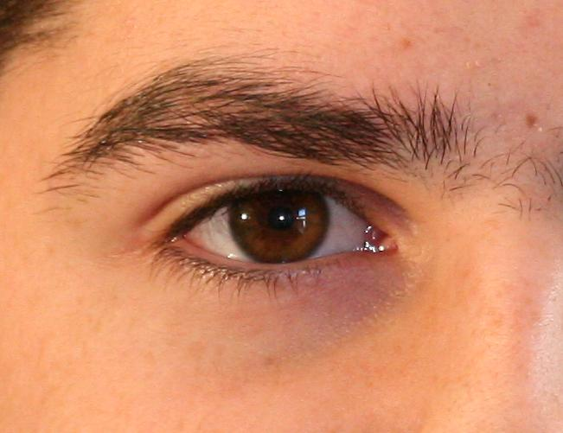
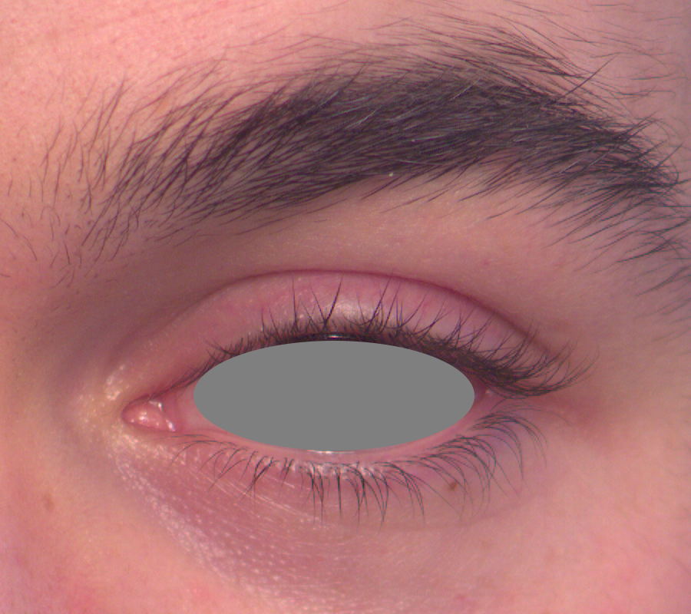
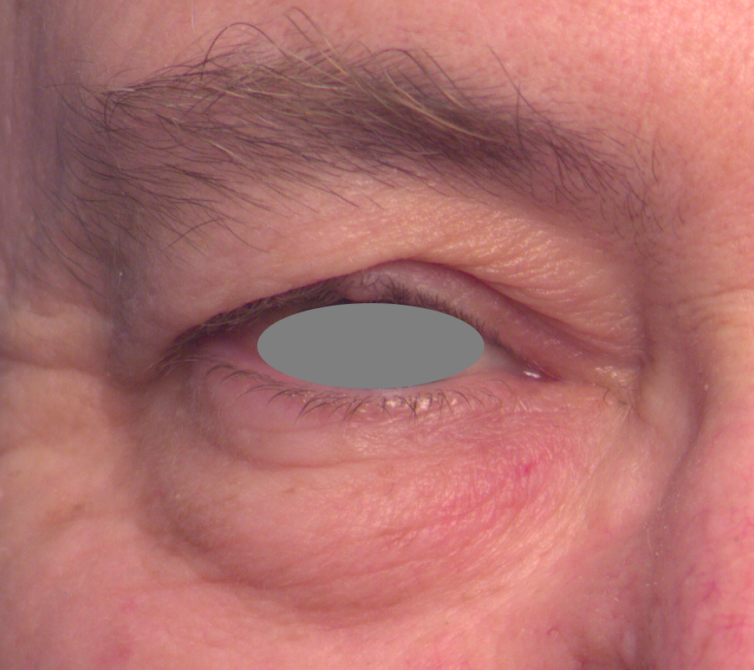
Sample Images
Sample Images from UBIPr
Sample Images from Cross-Eyed

Slide 4
Research Plan
Train a VGG_19/ReSNet 50 architecture for periocular recognition using UBIPr images.
Use only image sizes (441 x 561), (501 x 651) for training for periocular recognition.
For all the subjects (181 male and 71 females), we have about 4058 images for above image sizes
Use 61 female subjects and 61 male subjects to tackle the data imbalance issue
Train the VGG 19 convolutional layers along with GAP layer and couple of linear layers and Softmax for periocular recognition
After training periocular net, train multi-class classification network for attribute classification.
For UBIPr we have only genders annotated, we do not have ethnicity.
For Cross-Eyed, we have no attribute annotations.

Slide 5
Research Plan
Tasks:
Perform it only for one eye (Done)
Resize all the images to 401 x 501 (Done on the fly in Pytorch)
Take a look at Daemon Woodard papers.
Ask Moktari for Honk Kong Polytechnic dataset.
Use a balanced batch size for male and female (Remember to test it later)

