Slide 1
(x₂, y₂)
ID | City Names | Population | geometry
1 | City One | 1,000 | (x₁, y₁)
2 | City Two | 1,200 | (x₂, y₂)
3 | City Three | 800 | (x₃, y₃)
(x₁, y₁)
(x₃, y₃)
(x_{1,2}, y_{1,2})
(x_{1,4}, y_{1,4})
(x_{1,1}, y_{1,1})
ID | Street Names | geometry
1 | Street Ace | ((x_{1,1}, y_{1,1}), (x_{1,2}, y_{1,2}), (x_{1,3}, y_{1,3}), (x_{1,4}, y_{1,4}))
2 | Street Bottom | ((x_{2,1}, y_{2,1}), (x_{2,2}, y_{2,2}), (x_{2,3}, y_{2,3}))
(x_{1,3}, y_{1,3})
(x_{2,1}, y_{2,1})
(x_{2,3}, y_{2,3})
(x_{2,2}, y_{2,2})
(x_{1,1}, y_{1,1})
(x_{2,1}, y_{2,1})
(x_{2,2}, y_{2,2})
ID | Street Names | geometry
1 | State Star | ((x_{1,1}, y_{1,1}), (x_{1,2}, y_{1,2}), (x_{1,3}, y_{1,3}))
2 | State Moon | ((x_{2,1}, y_{2,1}), (x_{2,2}, y_{2,2}), (x_{2,3}, y_{2,3}), (x_{2,4}, y_{2,4}))
(x_{1,2}, y_{1,2})
(x_{1,3}, y_{1,3})
(x_{2,3}, y_{2,3})
(x_{2,4}, y_{2,4})

Slide 2
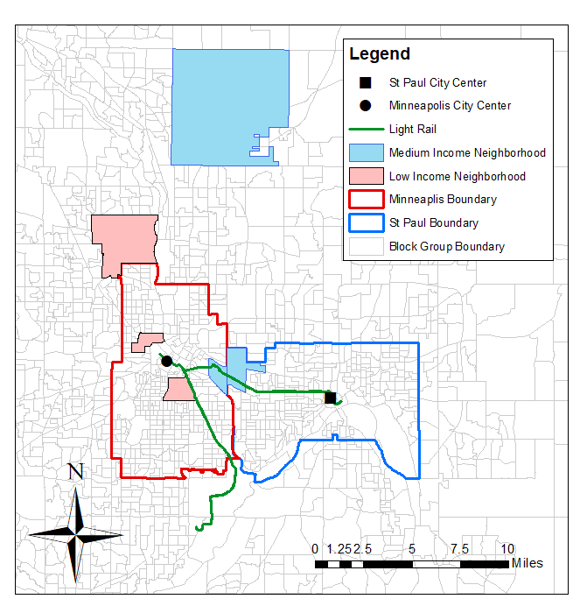
Point
Line
Polygon

