Slide 1
Web Technologies
Lecture 1
The Internet and HTTP

Slide 2
The Internet
From internetted, meaning interconnected
Global system of interconnected computer networks
2014 – more than 38% of the world is connected
Relies on the TCP/IP protocol

Slide 3
A bit of history
1960’s ARPANET is created
Early packet switching protocol
1981 - ARPANET is expanded by the National Science Foundation (NSF) - NSFNET
1982 - TCP/IP is standardized
Late 80’s & early 90’s ISPs begin to emerge
1990 - ARPANET is decommissioned
1990 - 1.5 mbs over the Atlantic between Cornell University and CERN
1990 - 1st web browser called WorldWideWeb
1995 - the Internet is fully commercialized
2007 - over 97% of the world telecom is over the Internet

Slide 4
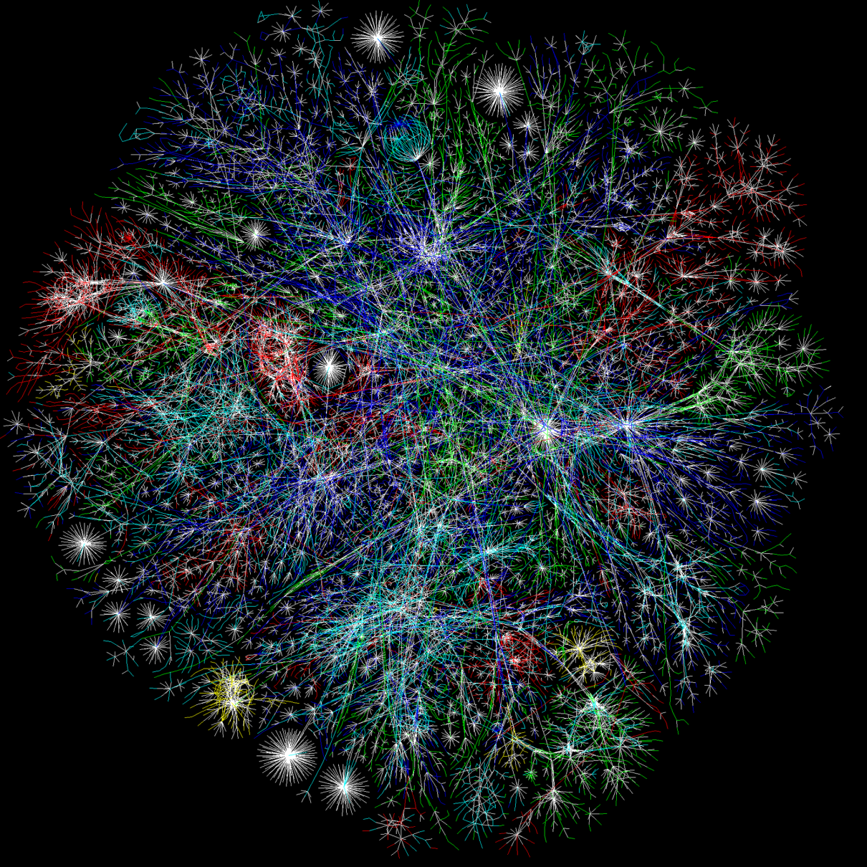
Connected World

Slide 5
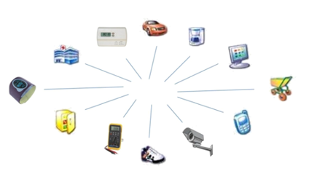
The Internet of Things
The Internet is a complex beast
Mobile devices
Smart sensors
Social networks
Etc.

Slide 6
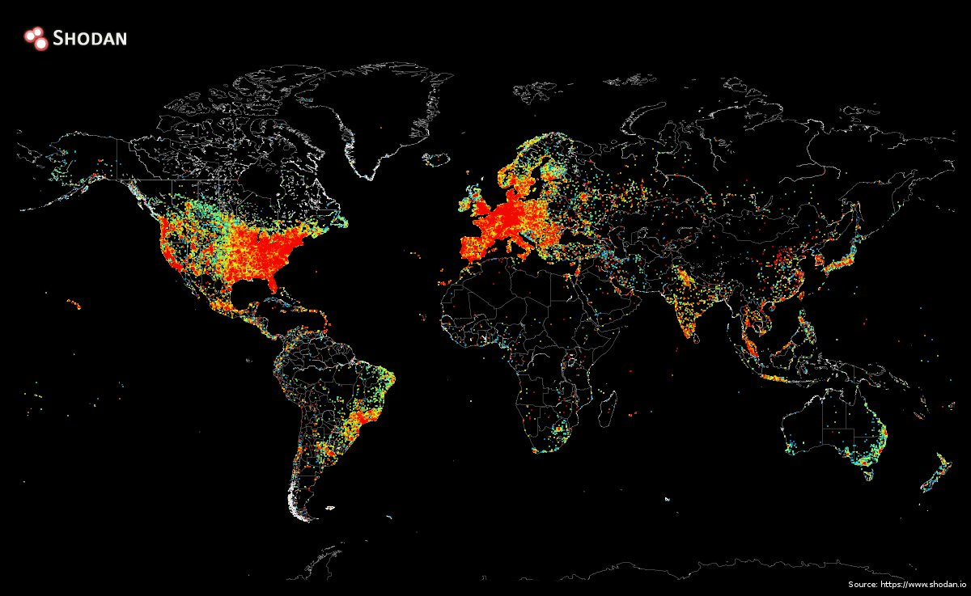
The Internet today

Slide 7
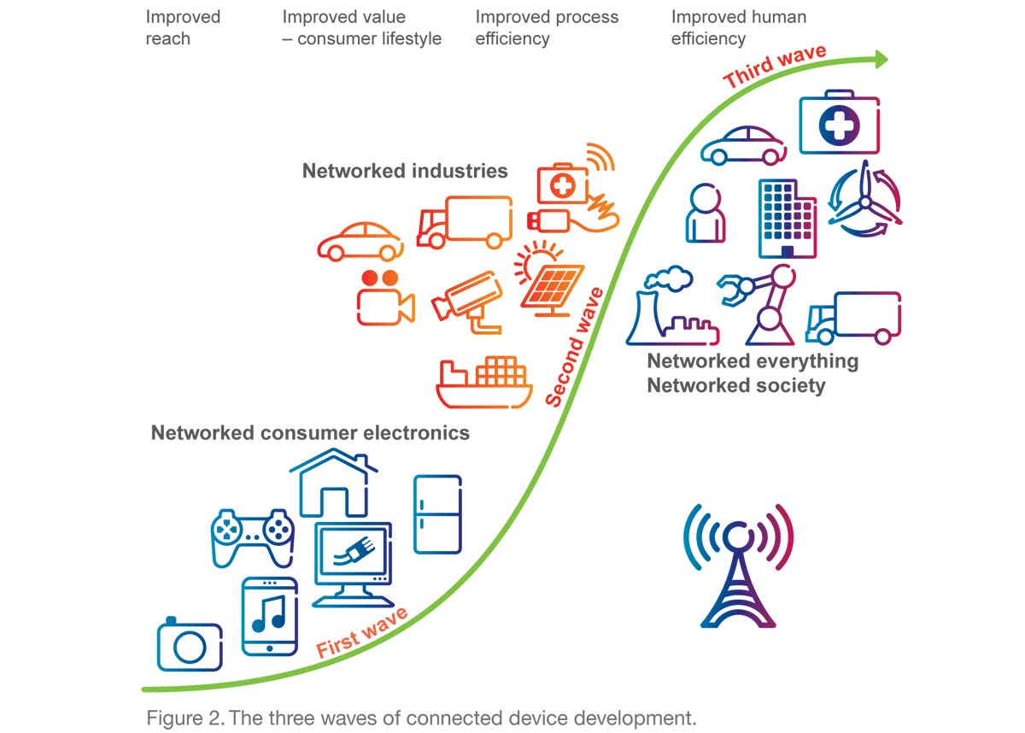
Towards a networked society

Slide 8
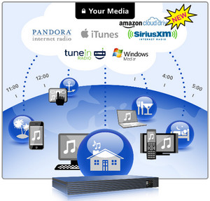
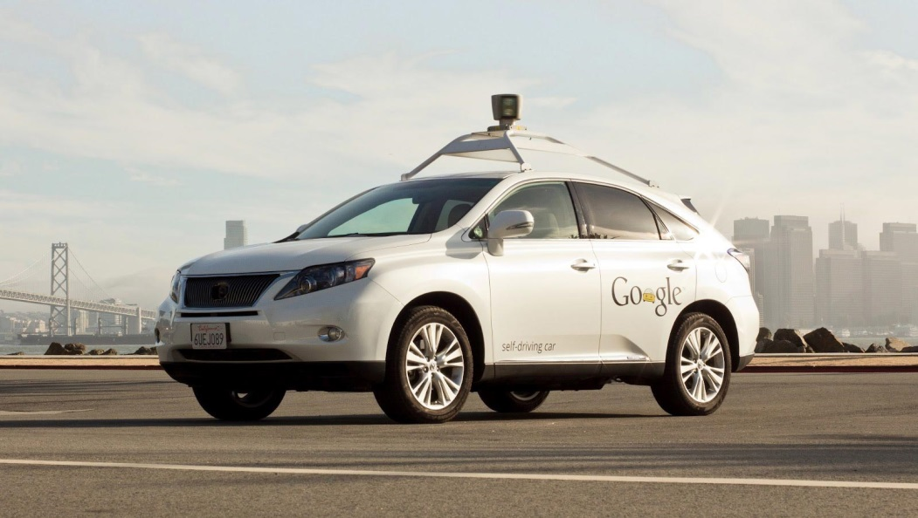
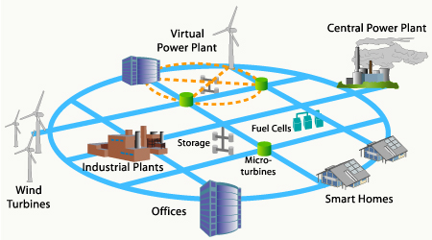
Examples

Slide 9
Fundamentals
Client-server model
E.g., web browsers
P2P
E.g., file sharing software
TCP/IP for communication
Many application level protocols
HTTP for web traffic
SSH for file transfer
POP3 for email
Etc.

Slide 10
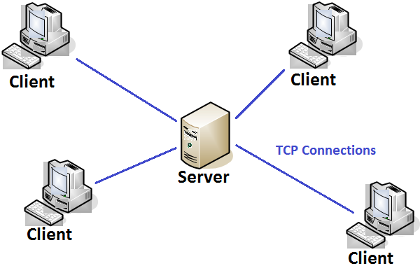
Client-server architecture
Many clients talk to one or more (via a proxy) servers

Slide 11
World Wide Web
A collection of documents and other resources
URI – Uniform Resource Identifier
2 subclasses:
URL – Uniform Resource Locator
Format: http://<host>[:<port>]/[<resource>][?<query>]
Example: http://www.test.ro:8080/get/animals?type=mamal
URN – Uniform Resource Name
Format: <scheme>:<hierarchy>[?<query>][#<fragment>]
Example: urn:animals:mamal:ferret:nose

Slide 12
HTTP
Hyper Text Processing Protocol
1999: HTTP/1.1
Reuse the same connection for multiple resource requests
Less latency
May 2015: HTTP/2 (proposed)
Header field compression
Concurrent exchanges on the same connection
HTTP/1.1 format:
Request
[method] [resource] [version]<CRLF> [header]: [value]<CRLF> <CRLF>
Response
[version] [status] [message]<CRLF>
[header]: [value]<CRLF> <CRLF>
[body]

Slide 13
HTTP sessions
Sequence of network request-responses
Establish TCP connection to a port (usually 80)
Server listens for requests from clients
GET, HEAD, POST, PUT, DELETE, TRACE, OPTIONS, CONNECT, PATCH
Server sends back status and message plus the body which represents the requested resource
Status codes:
Informational (1xx)
Successful (2xx): 200
Redirection (3xx): 301, 302
Client error (4xx): 404
Server error (5xx): 500

Slide 14
Example
Request
GET /index.html HTTP/1.1<CRLF> Host: www.example.com<CRLF> <CRLF>
Response
HTTP/1.1 200 OK<CRLF> Date: Mon, 23 May 2005 22:38:34 GMT<CRLF> Server: Apache/1.3.27 (Unix) (Red-Hat/Linux)<CRLF> Last-Modified: Wed, 08 Jan 2003 23:11:55 GMT<CRLF> Etag: "3f80f-1b6-3e1cb03b"<CRLF> Accept-Ranges: bytes<CRLF> Content-Length: 438<CRLF> Connection: close<CRLF> Content-Type: text/html; charset=UTF-8<CRLF> <CRLF> <Content ...>

Slide 15
HTTP session state
HTTP is stateless
Does not retain information or status about requests
Can be bypassed with cookies, server side sessions, hidden variables, web forms.

Slide 16
Synchronous vs. asynchronous
Synchronous = blocking
A complete page must be loaded with every client request
AJAX (2005) changed the game by making asynchronous communication possible
Asynchronous
Perform background tasks without blocking the interface
Example: load page content gradually (Google maps), autocompletion (Google search)

Slide 17
What to expect from this lecture
Basic information about Internet technologies
State vs stateless
Synchronous vs. asynchronous
Client side technologies
HTML, CSS
XML, DOM, AJAX, JQuery, JSON
Server side technologies
Web servers, templating engines, PHP, databases
Advanced topics on
Web services
RSS
Cloud fundamentals
Message queues

Slide 18
Grading
Written exam (60%)
Multiple choice
Lab assignments (40%)
Documentation
Personal page: www.info.uvt.ro/mfrincu
Google

