Slide 1
Web Technologies
Lecture 10
Web services

Slide 2
Web services
From W3C
A software system designed to support interoperable machine-to-machine interaction over a network
It has an interface described in a machine-processable format
Web Service Description Language (XML format)
Other systems interact with the Web service in a manner prescribed by its description using SOAP (Simple Object Access Protocol) messages, typically conveyed using HTTP with an XML serialization in conjunction with other Web-related standards
Note: https://docs.google.com/presentation/d/1xmDMmiFtSQG7Bu65g63r3HuEuyKw-wXDfzbrPDiZKd8/edit#slide=id.i0

Slide 3
Why web services?
Expose your application data and services
Bring together disparate data sources
Standardized protocols
Low cost of communication
Loose coupling

Slide 4
Big web services
Use XML messages that follow the SOAP standard
There is often a machine-readable description of the operations offered by the service written in the Web Services Description Language (WSDL).
WSDL is not a requirement, but can be used to generate clients using various languages including Java and .NET.

Slide 5
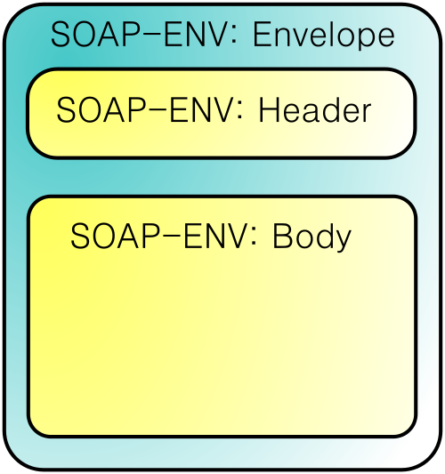
SOAP
Simple Object Access Protocol
Remote procedure calls
The XML based protocol consists of three parts
An envelope, which defines
what is in the message and
how to process it
A set of encoding rules for
expressing instances of
application-defined datatypes
A convention for representing
procedure calls and responses

Slide 6
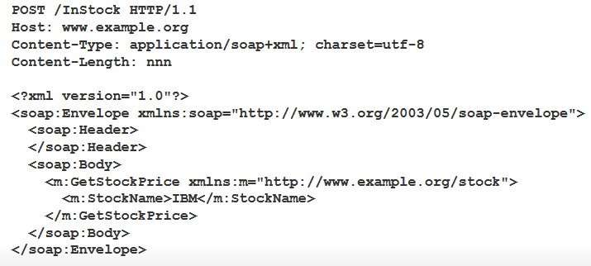
SOAP example

Slide 7
Pros and cons
Advantages
strict type checking
formal contract can be enforced
development tool support
Disadvantages
rigid schema
complexity
higher bandwidth due to envelope requirements
custom protocol, black box messages

Slide 8
REST
Representational State Transfer is a software architectural style for distributed hypermedia systems, such as the World Wide Web
Introduced by Roy Fielding in his PhD dissertation
University of California, Irvine
Note: source wikipedia REST

Slide 9
Design principles
Stateless Client/Server Protocol:
Each message contains all the information needed by a receiver to understand and/or process it
Keep things simple and avoid needless complexity
A set of uniquely addressable resources enabled by a universal syntax for resource identification
Everything is a Resource in a RESTful system
A set of well-defined operations that can be applied to all resources
In the context of HTTP, the primary methods are POST, GET, PUT, and DELETE
Similar (but not exactly) to the database world's notion of CRUD (Create, Read, Update, Delete)
The use of hypermedia both for application information and state transitions
Resources are typically stored in a structured data format that supports hypermedia links, such as HTML or XML
Note: While the Web is ONE embodiment of these principles, it is not the ONLY one
You can create RESTful systems using other protocols, methods, resources, etc. but those new entities must conform with these design principles

Slide 10
More on REST
Quotes from Roy T. Fielding:
“… resources are just consistent mappings from an identifier [such as a URL path] to some set of views on server-side state”
“If one view doesn’t suit your needs, then feel free to create a different resource that provides a better view …”
“These views need not have anything to do with how the information is stored on the server … [They just need] to be understandable (and actionable) by the recipient.”

Slide 11
And again REST
The largest known implementation of a system conforming to the REST architectural style is the World Wide Web
REST is more of an old philosophy than a new technology
SOAP looked to jump-start the next phase of internet development with a host of new specifications
REST espoused that existing principles and protocols of the Web are enough to create robust Web services.

Slide 12
REST and URLs
Every resource is URL-addressable
Example:
/mycollection
/mycollection/{id}
/loans
/mycollection/movies
/loans/overdue
Note: courses.ischool.berkeley.edu/i290-rmm/s12/.../Lecture3%20REST.pdf

Slide 13
Changing state
To change system state, simply change a resource
Example:
Within the /mycollection “bucket” you can:
Create an item
Update an item with new data
Delete an item

Slide 14
REST operations
GET – retrieve a copy of a resource
Example:
GET /mycollection/{id}
GET /mycollection
DELETE – remove a resource
Example: DELETE /mycollection/{id}
POST – create a resource
Example: POST /mycollection
PUT – create or update a resource
Example: PUT /mycollection{id}
Amazon's S3 service uses PUT to create objects in buckets
POST vs. PUT
HTTP/1.1 spec says that
POST's URI should point to a script
PUT's URI should point to the resource in question

Slide 15
Searches in REST
There are no methods for resource discovery such as LIST or FIND
Instead, collections and search results are treated as another type of resource with their own unique URLs
Not REST defined, but:
Search a term
GET /mycollection/?q=term
Search for a keyword
GET /mycollection/?kw=2001%20A%20Space%20Oddysey
Search for partial terms
GET /mycollection/?pt=2001

Slide 16
Error codes
HTTP status codes returned in the response header:
200 OK
The resource was read, updated, or deleted
201 Created
The resource was created
400 Bad Request
The data sent in the request was bad
403 Not Authorized
The Principal named in the request was not authorized to perform this action
404 Not Found
The resource does not exist
409 Conflict
A duplicate resource could not be created
500 Internal Server Error
A service error occurred

Slide 17
Error responses
Response in body when a 4xx or 5xx status is returned:
<error>
<code>{Mandatory code}</code>
<message>{Optional message}</message>
<resource-id>
{Resource ID, if available}
</resource-id>
<request-uri>
{URI of request}
</request-uri>
</error>

Slide 18
Transferring REST data
Various formats can be used to transmit representations of resources
XML and JSON are generally the most common.
JSON (JavaScript Object Notation) is a format specified by Douglas Crockford that uses a subset of the JavaScript syntax to represent data:
{
"name": "foo",
"description": "bar"
}

Slide 19
REST example
http://www.example.com/api/stock/ibm [GET]
<stock>
<name>IBM</name>
<price>139.84</price>
</stock>
http://www.example.com/api/stock/ibm [PUT]
<stock>
<price>142.98</price>
</stock>

Slide 20
Pros and cons
Advantages
multiple data formats
simplicity - known operations
lighter on bandwidth
REST application security rules can be set up using HTTP standards
Disadvantages
no common standard format
GET requests are limited in size

Slide 21
What’s next?
Creating SOAP and REST web services
Node.js
Cloud computing

