Slide 1
Web Technologies
Lecture 11
Implementing RESTful services

Slide 2
REST Services
REpresentational State Transfer
Stateless
Stardard design architecture for web APIs
Allows to publicly expose methods over the Internet to be accessed and manipulated outside the program itself
Web services
Get data from an application without having to visit the application itself (e.g., go to a particular website)
Achieved through RESTful URIs
Example: GET /mycollection/{id}

Slide 3
Building a RESTful service
Use a single URL for the requests
Avoids having multiple URLs
increases maintability
Achived through .htaccess rewrite rules
Handle cross domain requests to the unique URL
Receive HTTP requests
Extract endpoint from URI
Detect HTTP method (GET, POST, PUT, DELETE)
Assemble additional data provided in the header or URI
Pass information to proper method for processing
Send back HTTP response

Slide 4
Cross Origin Resource Sharing
CORS W3C specification
Enables cross domain communication
Javascript for instance explicitly prohibits this
See AJAX
Client and server side
Requires coordination between the two
Built on top of XMLHttpRequest
Server adds some headers allowing client to access its data
NOTE
Not a substitute for sound security practices!
It only allows cross domain access

Slide 5
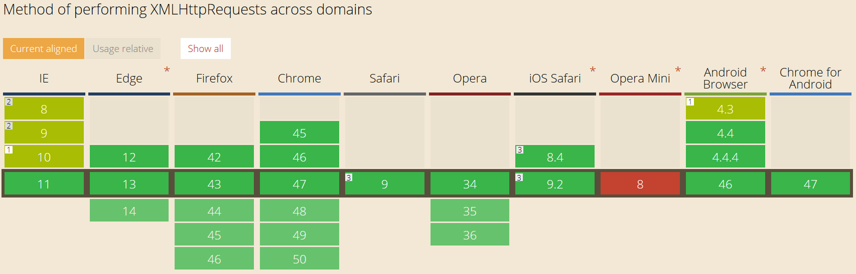
CORS browser support
Image source: http://caniuse.com/#search=cors

Slide 6
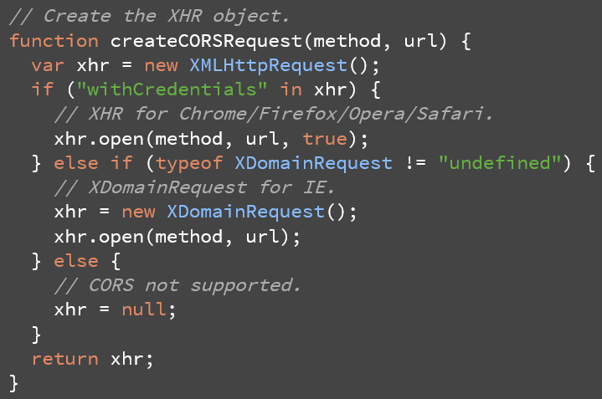
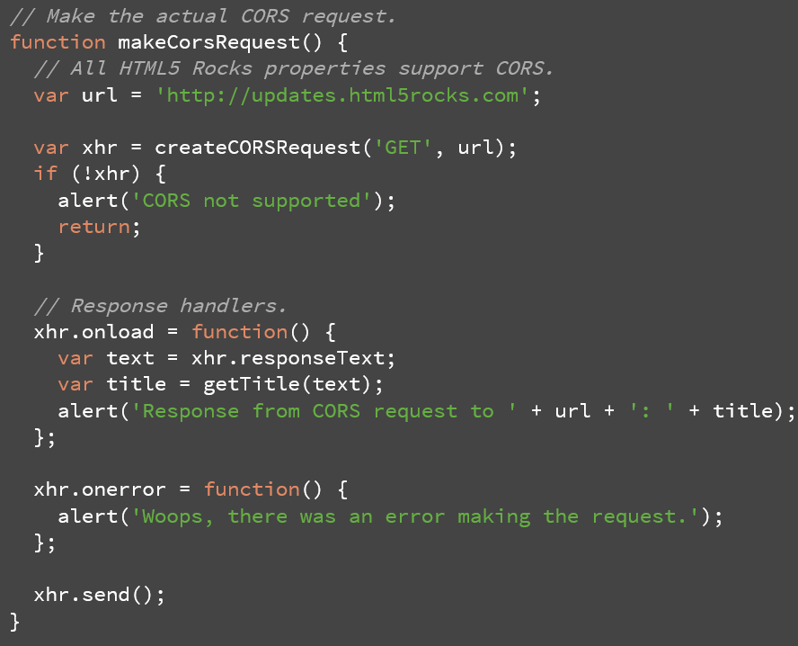
CORS on the client side
1. Create CORS request
2. Send the CORS request
A valid CORS request always contains an Origin header
POST /receiver HTTP/1.1
Origin: http://www.issuer.com
The header is added by the browser, and cannot be controlled by the user

Slide 7
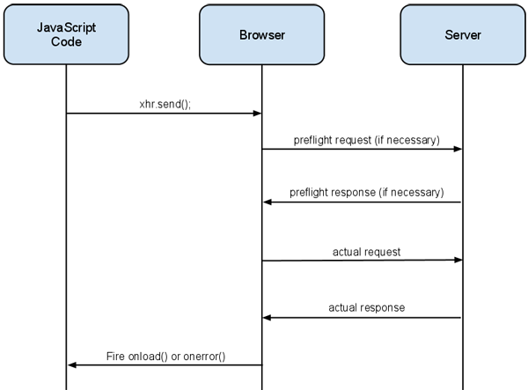
CORS on the server side
Requires to set up some response headers
Access-Control-Allow-Origin: mandatory
Access-Control-Allow-Methods: list of supported methods. Mandatory
Access-Control-Allow-Credentials: for cookies. Works in conjunction with the withCredentials property on the XMLHttpRequest 2 object
Access-Control-Expose-Headers: allows access to various response headers
Access-Control-Request-Method: the request method. Always present
Access-Control-Request-Headers: list of request headers
Access-Control-Max-Age: allows preflight response to be cahced
header("Access-Control-Allow-Origin: *");
header("Access-Control-Allow-Methods: *");
header("Content-Type: application/json");
PUT and DELET require a preflight request
Extracommunication with the server
Asks permission to make the actual request
Can be cached to avoid making it for every request
Source: http://www.html5rocks.com/en/tutorials/cors/

Slide 8
The .htaccess file
<IfModule mod_rewrite.c>
RewriteEngine On
RewriteCond %{REQUEST_FILENAME} !-f
RewriteCond %{REQUEST_FILENAME} !-d
RewriteRule api/v1/(.*)$ api/v1/api.php?request=$1 [QSA,NC,L]
</IfModule>
Check the existence of mod_rewrite
Activate rewrite engine
For any request that does not point to an existing file or directory forward it to api.php by using the paramter request
QSA: named capture is appended at the end of the URI
NC: URIs are not case sensitive
L: stop after processing this rule

Slide 9
API class
PHP implementation
JSON communication format
Abstract class defining the basic wrapper for the various endpoints the API will be using
Concrete class implementing endpoint functionality
Enable secure & cross domain access

Slide 10
API abstract class
abstract class API {
protected $method = ''; //PUT, GET, POST, DELETE
protected $endpoint = ''; //e.g.: /files
protected $verb = ''; //e.g.: /files/process
protected $args = Array(); //e.g.: /files/process/23
protected $file = Null; // input of the PUT request. Can be JSON text
public function __construct($request) {
header("Access-Control-Allow-Orgin: *");
header("Access-Control-Allow-Methods: *");
header("Content-Type: application/json");
//extract method, endpoint, verb, args
$this->args = explode('/', rtrim($request, '/'));
$this->endpoint = array_shift($this->args);
if (array_key_exists(0, $this->args) && !is_numeric($this->args[0])) {
$this->verb = array_shift($this->args);
}
$this->method = $_SERVER['REQUEST_METHOD'];
// search for PUT and DELETE in HTTP_X_HTTP_METHOD
if ($this->method == 'POST' && array_key_exists('HTTP_X_HTTP_METHOD', $_SERVER)) {
if ($_SERVER['HTTP_X_HTTP_METHOD'] == 'DELETE') {
$this->method = 'DELETE';
} else if ($_SERVER['HTTP_X_HTTP_METHOD'] == 'PUT') {
$this->method = 'PUT';
} else {
throw new Exception("Unexpected Header");
}
}
switch ($this->method) {
case 'DELETE':
case 'POST': $this->request = $this->_cleanInputs($_POST); break;
case 'GET': $this->request = $this->_cleanInputs($_GET); break;
case 'PUT': $this->request = $this->_cleanInputs($_GET);
$this->file = file_get_contents("php://input"); break; // read raw post data
default: $this->_response('Invalid Method', 405); break;
}
}
[…] // see next slide
}

Slide 11
API abstract class
Private methods
_response
Sets the response header and body
_cleanInputs
Stores the request variables in a key-value list
_requestStatus
Returns a message associated with a particular code
Used by _response
Public method
processApi
Determine if the concrete class implements the endpoint method called by the client
public function processAPI() {
if (method_exists($this, $this->endpoint)) {
// call the endpoint method
return $this->_response($this->{$this->endpoint}($this->args));
}
return $this->_response("No Endpoint: $this->endpoint", 404);
}

Slide 12
API concrete class
CORS opens up a huge security vulnerability
Must ensure that only certain clients with a unique key can access the API
require_once 'API.class.php';
class MyAPI extends API {
protected $token;
public function __construct($request, $origin) {
parent::__construct($request);
$User = new User()
if (!array_key_exists('apiKey', $this->request)) {
throw new Exception('No API Key provided');
} else if (!$APIKey->verifyKey($this->request['apiKey'], $origin)) {
throw new Exception('Invalid API Key');
} else if (!array_key_exists('token', $this->request)) {
throw new Exception('No User Token provided');
}
$this->token = $this->request['token']);
}
// Example of an Endpoint. Called by processAPI (see previous slide)
protected function returnToken() {
if ($this->method == 'GET') {
return "Your token is " . $this->token;
} else {
return "Only accepts GET requests";
}
}
}

Slide 13
Using the API
// Requests from the same server don't have a HTTP_ORIGIN header
if (!array_key_exists('HTTP_ORIGIN', $_SERVER)) {
$_SERVER['HTTP_ORIGIN'] = $_SERVER['SERVER_NAME'];
}
try {
$API = new MyAPI($_REQUEST['request'], $_SERVER['HTTP_ORIGIN']);
echo $API->processAPI();
} catch (Exception $e) {
echo json_encode(Array('error' => $e->getMessage()));
}
Note: http://coreymaynard.com/blog/creating-a-restful-api-with-php/

Slide 14
What’s next?
Node.js
Cloud computing

