Slide 1
Web Technologies
Lecture 12
Node.js

Slide 2
Javascript beyond browsers
Javascript was first used in browsers for client side programming
However, Javascript is a complete language which can be used in man contexts to achieve the same things as in other languages
Node.js is just another context allowing Javascript to run in the backend outside a browser

Slide 3
Node.js
Relies on Google’s V8 VM
Same Javascript runtime environment as the one used by Google Chrome
1st version released on Sep 2, 2008
Comes with lots of modules which help developers to avoid writing code from scratch
Node.js
Runtime + library
Create real-time websites with push capability

Slide 4
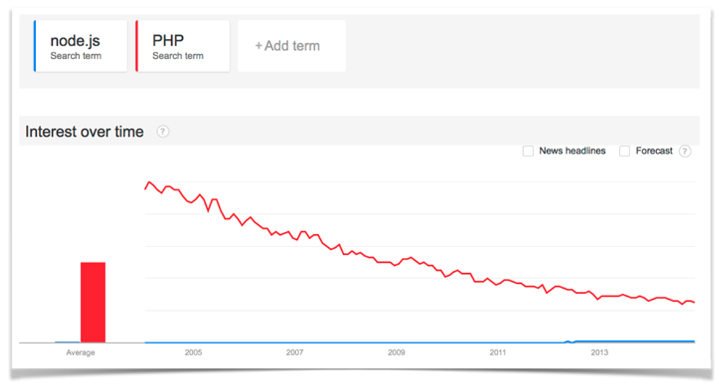
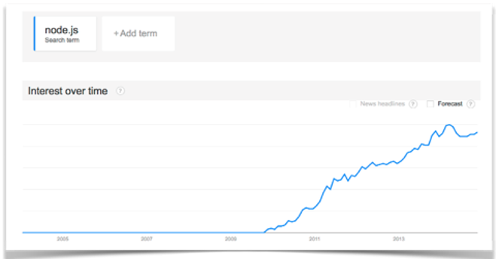
Node.js popularity

Slide 5
Request handling
Traditional web servers handle multiple requests:
Synchronous
Fork processes
Threads
These block thread execution
Example: eventually the server runs out of available PHP processes
Memory is used more and more
2Mb per request on an 8GB RAM machine → 4,000 concurrent requests
In Node.js it can be as big as 1M concurrent connections

Slide 6
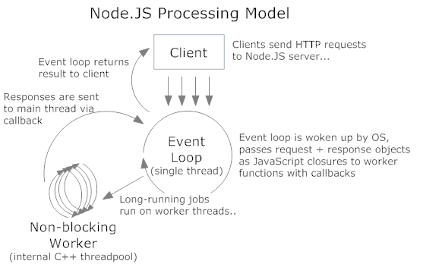
Node.js request handling
Single process
Event driven loop
Each request gets to the loop ring with a callback method
Non blocking & scalable

Slide 7
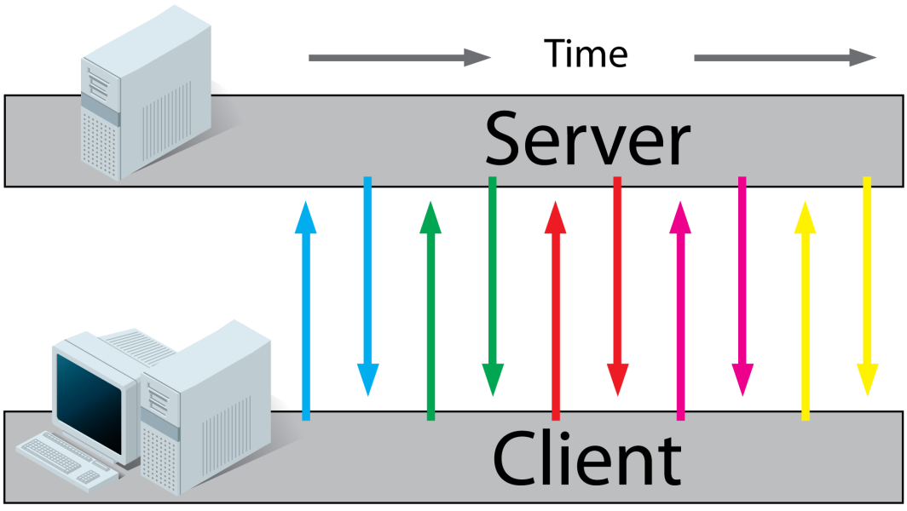
Communicating with the server
Traditionally, in client-server architectures, clients send requests to servers which reply back
Client polls server
If server is busy response time can be long
Lot of network traffic
Solution
Long polling
Server side push
Websockets

Slide 8
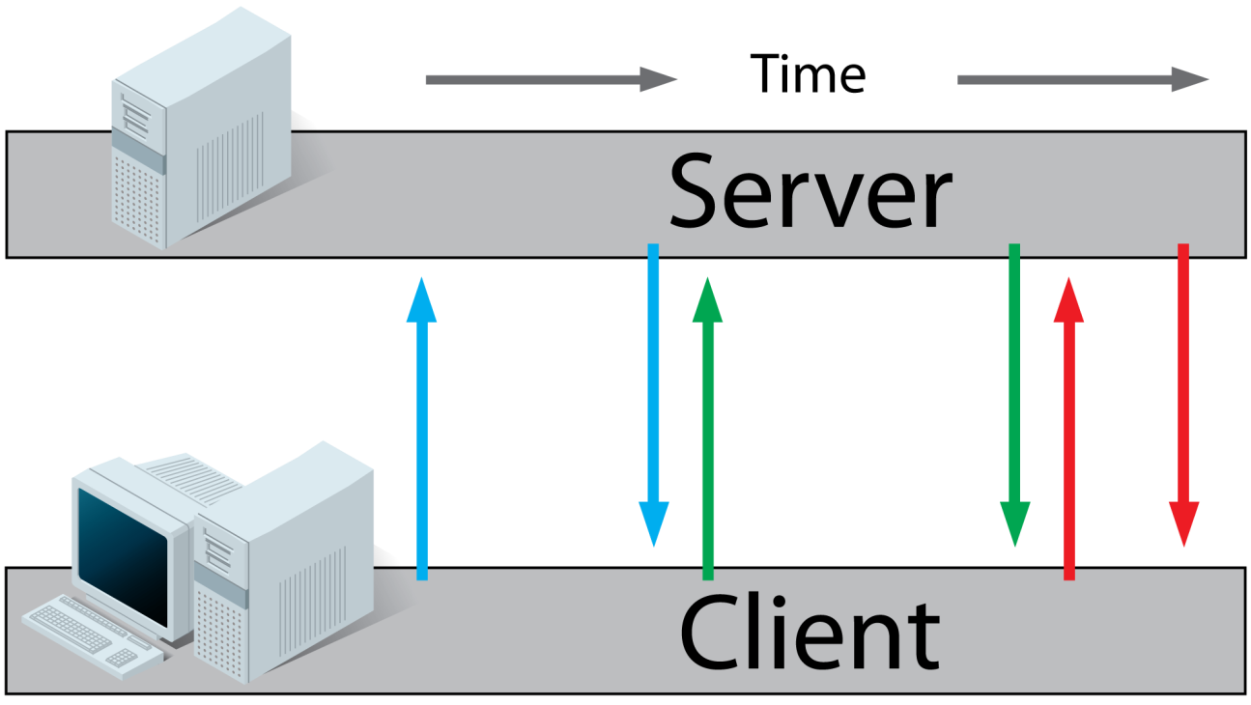
Long polling
Client sends request to server
If response is unavailable on server side server does not reply with an empty message
Instead it keeps connection open and replies as soon as response becomes available
Emulates server push
Client immediately sends back another request

Slide 9
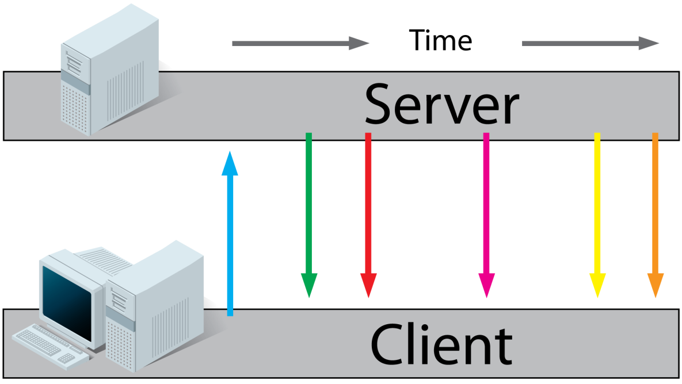
Server sent events
SSE
Similar to long polling but client does not send back a request after receiving the update from the server
Instead it keeps on receiving updates for the same request

Slide 10
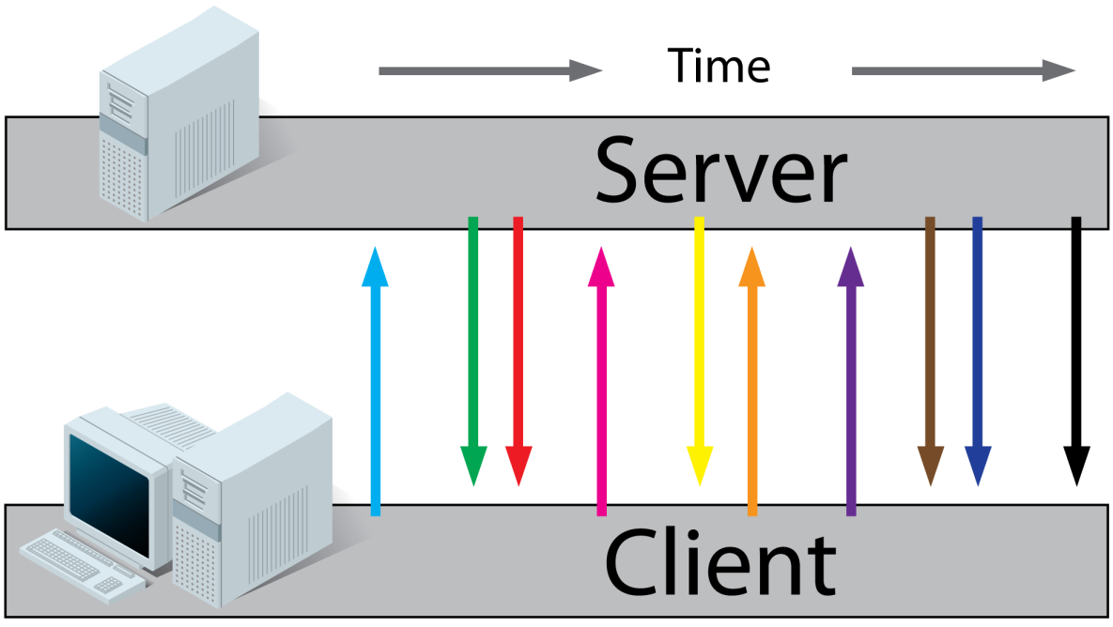
Websockets
HTML5
Full duplex TCP connection independent on the HTTP request/response
Server can send data to clients without any HTTP requests
Publish and subscribe to sockets for any change in data
Lightweight
No HTTP request headers
Much more websocket connections than HTTP connections

Slide 11
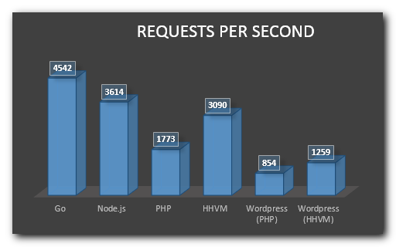
Node.js performance
Source: http://www.hostingadvice.com/blog/comparing-node-js-vs-php-performance/

Slide 12
Hello world
Node.js binary: https://nodejs.org/en/download/
Run code by typing: node hello-console.js
Source: http://howtonode.org/hello-node
Filenames end with .js
Just like regular Javascript files
Example:
// Call the console.log function console.log("Hello World");

Slide 13
Simple web server
// Load the http module to create an http server var http = require('http'); // Configure our HTTP server to respond with Hello World to all requests var server = http.createServer( function (request, response) { response.writeHead(200, {"Content-Type": "text/plain"}); response.end("Hello World\n"); }); // Listen on port 8000, IP defaults to 127.0.0.1 server.listen(8000); // Put a friendly message on the terminal console.log("Server running at http://127.0.0.1:8000/");

Slide 14
Dispatcher
You may need a dispatcher to handle different URLs:
var dispatcher = require('httpdispatcher');
…
var server = http.createServer( function (request, response) { dispatcher.dispatch(request, response);
}); …
dispatcher.setStatic('resources');
//A sample GET request
dispatcher.onGet("/page1", function(req, res) {
res.writeHead(200, {'Content-Type': 'text/plain'});
res.end('Page One');
});
//A sample POST request
dispatcher.onPost("/post1", function(req, res) {
res.writeHead(200, {'Content-Type': 'text/plain'});
res.end('Got Post Data');
});

Slide 15
When to (not) use Node.js
Not for CPU intensive applications
Web application with relational DB
No heavy server-side computation/processing
Fibbonacci computation
Good for fast scalable networked applications
Chat
API on top of an Object DB (e.g., MongoDB)
Queued inputs (e.g., message queues such as RabbitMQ, ZeroMQ)
Data streaming
Proxy servers
Real-time traffic/system monitoring

Slide 16
What’s next?
Cloud computing

