Slide 1
Web Technologies
Lecture 13
Introduction to cloud computing

Slide 2
Cloud Computing
NIST:
“a model for enabling ubiquitous, convenient, on-demand network access to a shared pool of configurable computing resources (e.g., networks, servers, storage, applications, and services) that can be rapidly provisioned and released with minimal management effort or service provider interaction.”
Gartner:
“a style of computing in which scalable and elastic IT-enabled capabilities are delivered as a service using Internet technologies.”
Webster:
“the practice of storing regularly used computer data on multiple servers that can be accessed through the Internet.”

Slide 3
On demand pay per use
On demand self-service
A consumer can provision computing services such as server resources, network, storage automatically as required
Geographically distributed and broad network access
The services are geographically distributed and are accessible broadly through internet and hence can be used with think or thin clients (such as mobile phones)
Multi-tenant resource pooling
The resources are shared among multiple clients using the cloud for better utilization of the underlying infrastructure. The allocation of resources is transperent to the consumer
Pay per use
Hourly (Amazon, Azure)
Per minute (Google)

Slide 4
Elasticity
Rapid elasticity
The consumer can rapidly request or release resources based on their requirements. This is useful in quickly scaling out to changing demands
Measured service (utility computing)
Different metering mechanisms are in place to monitor and track individual usages for services such as compute, network, sotrage and any other specialiazed services. The consumer only pays for the actual services used (pay-per-use model)

Slide 5
Service models
Infrastructure as a Service (IaaS) - utility computing
datacenter as a service
client provisions processing, storage, networks where she/he can run arbitrary software s.t. OS or applications
full control of the infrastructure through virtualized resources
Example: Amazon EC2
IaaS
PaaS
SaaS
Applications
Applications
Applications
Application Platform (distributed)
Application Platform (distributed)
Application Platform (distributed)
OS
OS
OS
Developer/User
Virtualization Software
Virtualization Software
Virtualization Software
Cloud Provider
Hardware
Hardware
Hardware

Slide 6
Service models (2)
Platform as a Service (PaaS)
developer point of view
deploy applications on the cloud using programming languages, libraries, and tools provided by the cloud provider
no management control of the infrastructure
Example: Google App Engine, Microsoft Azure
Software as a Service (SaaS)
end user point of view
use existing applications deployed on the cloud
software experiences are delivered through the Internet
Example: Google Drive, Flickr, Gmail

Slide 7
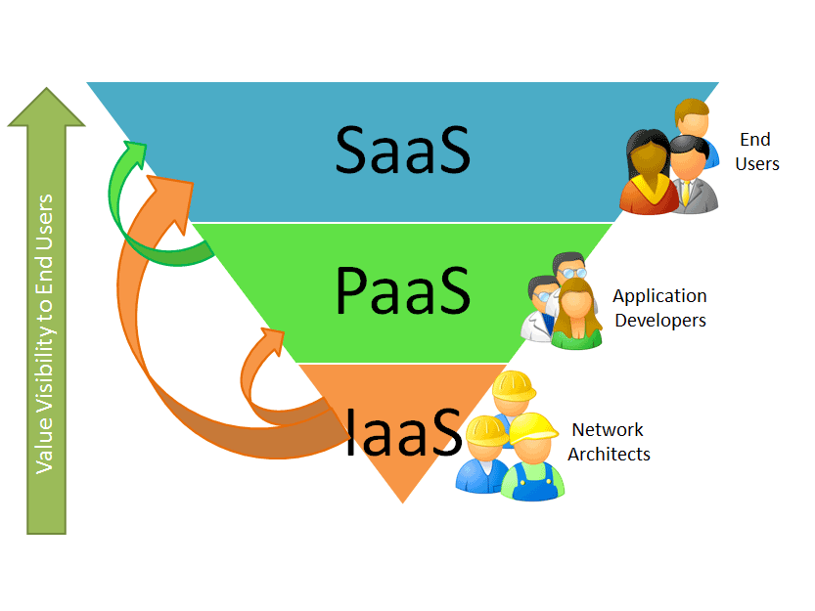
Cloud stack

Slide 8
Deployment models
Private clouds
Single organization owned, managed, and operated cloud infrastructure
Community clouds
Infrastructure provisioned for exclusive use by a specific community of consumers from organizations that have
Shared concerns
Owned, managed, and operated by one or more organizations in the community

Slide 9
Deployment models (2)
Public clouds
cloud infrastructure provisioned for public use
owned, managed, and operated by a business, academic or government institution, or a combination of them
usually accessible following a pay-per-use billing model
Hybrid clouds
composition of two or more private/community/public clouds that remain unique entities but are bound by standards or proprietary technology

Slide 10
Control vs. productivity
Different service models (IaaS, PaaS) provide different levels of control and productivity in terms of management overhead and administration requirements
IaaS provide greater control since everything from the OS to platform to application is under developer’s control
PaaS give higher productivity since the details of the underlying platform are completely hidden and transparent to the user
(e.g. handling scalability or VM lifecycle management)
Public vs. Private vs. Hybrid cloud deployments also imply different level of control over the infrastructure as well as data and computation

Slide 11
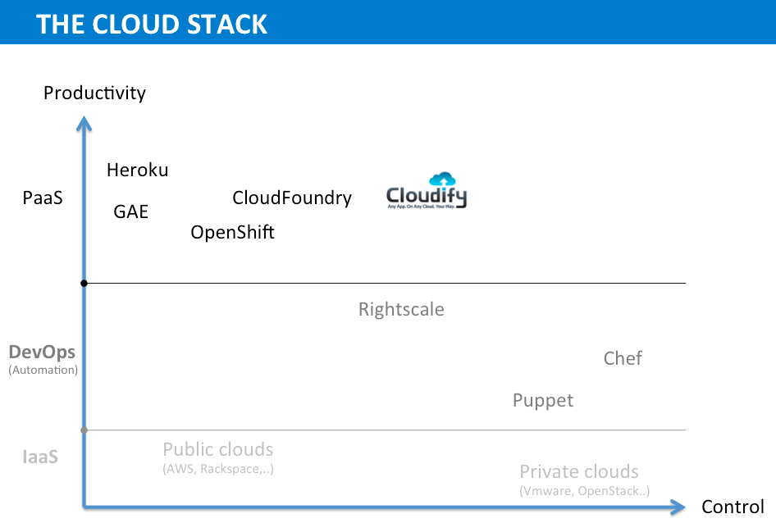
Control vs. productivity

Slide 12
Cloud concepts: virtualization
Cloud computing main aspect: elastic on demand
pay as you go
use as much as you want whenever you want
These notions are practical only if we have
lot of flexibility
efficiency in the back-end
These are readily available in Virtualized Environments and Machines

Slide 13
Virtualization
The creation of a virtual (rather than actual) version of something, such as an operating system, a server, a storage device or network resources
Allows sharing of physical resources among multiple users (tenants)
Allows deployment of hardware agnostic software
Allows easy configuration of virtual machine images and quick deployment of large number of services

Slide 14
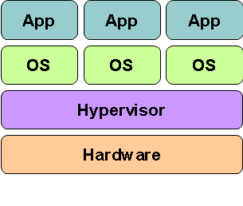
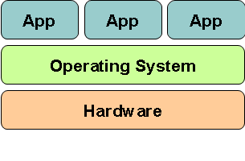
Virtualized vs. traditional computing
Traditional computing stack
Virtualized computing stack

Slide 15
Hypervisor/VMM
Software layer which:
Allows multiple guest OSs (Virtual Machines) to run simultaneously on a single physical host
Provides a hardware abstraction to the running guest OS and efficiently multiplexes underlying hardware resources

Slide 16
Multiprogramming vs. virtualization
Multi Programming – Each Process thinks it has complete control on all of the resources
Virtual Memory
CPU Sharing
Virtualization – OS assumes control of the entire underlying infrastructure through a hypervisors/VMM

Slide 17
Multiprogramming vs. virtualization (2)
Multi Programming | Virtualization
CPU shared among processes Memory shared using Page Tables Process knows it is being managed (system calls) | CPU shared among OSs Memory shared using more indirections: Multiple Page Tables OS may/ may not know it is being used

Slide 18
Amazon Web Services (AWS)
First Public Cloud (launched in 2006)
Collection of on-demnad pay-per-use computing services
Solutions in various service models:
IaaS: EC2, S3, ELB, Autoscaler
PaaS: Elastic Beanstalk, EMR
SaaS: Cloud Search, Elastic Transcoder
Other services:
Networking: DNS, CDN
Databases: relational, noSQL, memcache
Scripted deployment

