Slide 1
Web Technologies
Lecture 2
HTML and CSS

Slide 2
HTML
Hyper Text Markup Language
Describes web documents
Made up of nested HTML markup tags
<html></html>
Tags are the building blocks of websites
Embedded images and objects
Interactive web forms
Organized content
Each tag describes different document content
<head><head>
<body><body>
Web browsers interpret the tags and display the result on screen

Slide 3
Brief History
1980 – physicist Berners-Lee (CERN) proposed ENQUIRE a system for sharing documents
1989 – Berners-Lee proposed an Internet based hypertext system
1990 – Berners-Lee wrote a browser and server for it
1991 – 1st publicly available description of HTML
18 tags inspired from SGMLSquid
11 are still used in HTML 4

Slide 4
Brief history
1995 – HTML 2.0 specification is created
1996 – World Wide Web Consortium (W3C) takes over the specifications
1999 – HTML 4.01 specification is published
2000 – HTML becomes an international standard (ISO/IEC 15445:2000)
2004 – work on HTML 5 begins
2014 – HTML 5 standard is finalized

Slide 5
Markup language
System for annotating a document
Idea derives from the marking up of documents by editors
Some languages have predefined presentation semantics (HTML) other do not (XML)
Classification
Presentational markup
Used by traditional word processing editors
Markup hidden from users, editors, authors
Procedural markup
Embedded in text
Provides instructions on how to process the text
Latex, PostScript
Descriptive (semantic) markup
Label part of the text rather than providing specific instructions, i.e., decouple the structure from the rendering of the document
HTML’s tag <cite>

Slide 6
HTML 4
SGML application
Three flavors
Strict
Deprecated elements are forbidden
Transitional
Deprecated elements are allowed
Frameset
For frame related elements only
Major changes
Adopted many browser specific tags and attributed
Began the transition from visual markup tags to Cascading Style Sheets (CSS)
Old HTML:
<font color=“red”>Text in red</font>
New CSS:
<p style=“color:red”>Text in red</p>

Slide 7
HTML structure
Tags/Elements and attributes
<tagName1 attributeName1=“value1” attributeName2=“value 2”>content</tagname1>
<!DOCTYPE HTML PUBLIC "-//W3C//DTD HTML 4.01//EN" "http://www.w3.org/TR/html4/transitional.dtd">
<html>
<head>
<title>This is a title</title> </head>
<body>
<!-- Comment: display text in blue -->
<p style=“color:blue”>Hello world!</p>
</body>
</html>

Slide 8
HTML metadata
Allows to insert extra information in the document
Placed inside the <head></head> tag
Character set encoding
<meta http-equiv="content-type" content="text/html; charset=UTF-8">
Keywords and description
<meta name="keywords" content="HTML, CSS, XML, XHTML, JavaScript">
<meta name="description" content="Free Web tutorials on HTML and CSS">
Refresh page
<meta http-equiv="refresh" content="30">
Author info
Etc.

Slide 9
Transitional vs. strict
Transitional is a flavor which enables older version HTMLs to be migrated to version 4
Looser content model
Inline elements and direct text allowed in <body>, <blockquote>, <form>, <noscript> and <noframes> tags
Presentation elements allowed
Underline (<u>), strikeout (<s>), <center>, <font>, <basefont>
Presentation attributes allowed
Background, align, bgcolor, vspace, hspace, clear, compact, type, width
Other elements
Applet, menu, dir, isindex
In addition, in the Frameset flavor <frameset> replaces <body> and contains <frame> tags
In the Strict flavor the use of CSS is required for cosmetics

Slide 10

HTML 5
28 October 2014 – specification is released
Defines a single markup language which combines a series of features introduced by various specifications and browsers
Encourages interoperable implementations
What runs on Firefox should run unchanged on IE or Chrome
“Living standard”: can be improved but older features cannot be removed
2011 – 34 out of 100 most popular websites used HTML 5
2014 – 153 of Fortune 500 US companies used HTML 5 on their websites

Slide 11
HTML 5
New syntactic features
<video>, <audio>, <canvas>, <svg>
Removed deprecated tags
<font>, <center>
New page structure tags
<main>, <section>, <article>, <header>, <footer>, <aside>, <nav>, <figure>
Modified existing tags
<a>, <cite>, <menu>
DOM is part of HTML 5
Not based on SGML anymore
Includes the Web Forms 2.0

Slide 12
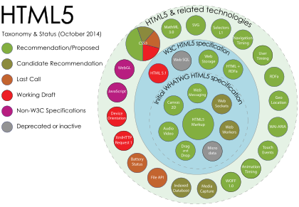
New APIs
APIs that can work with Javascript

Slide 13
More differences
Simpler doctype declaration
<!DOCTYPE html>
Simpler character encoding
<meta charset="UTF-8">
Default encoding is UTF-8

Slide 14
Cascading Style Sheets
First released in 1996
Style sheet language for describing the presentation of a document written in a markup language
Not restricted to HTML
Separates the document content from the presentation
CSS: all heading 1 elements should be bold
HTML: this text should be a level 1 heading

Slide 15
CSS syntax
Set of rules
Declaration block
Specifies the style sheet
Property + value
Example: color:red
Selectors
Declare which part of the HTML the style sheet applies to
Elements, classes, pseudo-classes, ids
Example: p .myclass { color:red }
Colors all p with the class myclass in the red color
<p class=“myclass”>Red text</p>
<p>Not red text</p>
<p class=“myclass”>Another red text</p>

Slide 16
Inserting CSS
Inline
<p style=“color:red;font-size:14pt;font-weight:bold”>
Internal stylesheet (as any HTML element)
<style>
p {
color:red;
font-size:14pt;
font-weight:bold;
}
</style>
External stylesheet (in a standalone .css file)
<head> <link rel="stylesheet" type="text/css" href="mystyle.css"> </head>

Slide 17
Multiple stylesheets
If an element has more than one stylesheet
Example: one internal and one in an external file
The more specific style will be applied
I.e., The closest to the element: external → internal → inline
Example:
External:
h1 { color: navy; margin-left: 20px; }
Internal:
h1 { color: orange; }
The style will be
color: orange; margin-left: 20px;

Slide 18

CSS 3
Work on the standard started in 1998
Split in modules
Most modules are W3C Recommendations and many of the new properties are already implemented in modern browsers
Old CSS still present
Still many debates
Example: “The CSS Working Group has reached an impasse on the issue of percentage margins (and padding) in flex and grid layout, and needs your input to help decide it.” (May 5, 2015 – www.css3.info)

Slide 19
New CSS modules
New modules
Selectors
Box Model
Backgrounds and Borders
Image Values and Replaced Content
Text Effects
2D/3D Transformations
Animations
Multiple Column Layout
User Interface

Slide 20
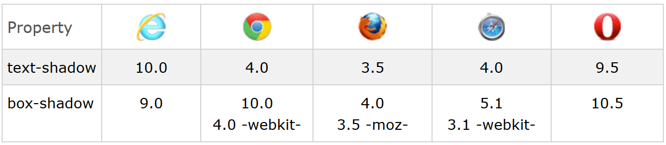

CSS 3 primer
Shadow effects
CSS 3:
h1 { text-shadow: 2px 2px red; }
HTML:
<h1>Test-shadow effect!</h1>

Slide 21
What’s next?
Web forms
XML & XHTML
Javascript
State vs. stateless
Dynamic HTML manipulation
AJAX
Synchronous vs. asynchronous
JQUERY

