Slide 1
Web Technologies
Lecture 3
Web forms

Slide 2
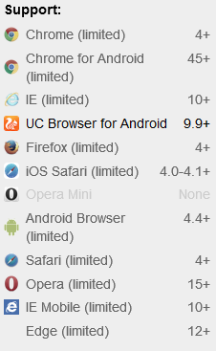
HTML5 forms
A component of a webpage that has
form controls
Text fields
Buttons
Checkboxes
Range controls
Color pickers
User interacts with the form providing data which is sent to the server for further processing
E.g.: returning results of a search or calculation

Slide 3
Web Forms 2.0
If a pattern is popular enough migrate it from a scripted solution to a more declarative form
Example
The :hover peusdo-class in CSS
CSS has limitations
HTML5 introduces many new form enhancements
Features were part of the WHATWG specification called Web Forms 2.0 now part of HTML5

Slide 4
The <form> tag
<form
method= "get"
enctype="application/x-www-form-urlencoded"
action="https://www.random.org/integers/">
</form>
Placed inside the <body> tag
Required attributes
method
Get (for querying data) or post (for sending data, e.g., a file)
action
URL of the service handling the submitted data
Optional enctype
application/x-www-form-urlencoded (default)
All characters encoded before being sent (e.g., spaces are converted to + characters and special characters to ASCII HEX)
& → &#X26 (&amp;), “ → &#x22 (&quot;)
multipart/form-data
No characters are encoded
Used for file uploads
text/plain
Spaces are encoded, special characters not

Slide 5
Form content
Contains controls
Many are represented by <input> elements
Controls are labeled with the <label> tag
Each part of a form is considered a paragraph and is separated by the rest by using <p> elements
<form …>
<p><label>Number of requested integers: <input></label></p>
</form>

Slide 6
Input types
Specified via the type attribute
hidden (HTML 4) text (HTML 4) search tel url email password (HTML 4) datetime date month week time | datetime-local number range color checkbox (HTML 4) radio (HTML 4) file submit (HTML 4) image reset (HTML 4) button (HTML 4)

Slide 7
Browser compatibility
Not all browsers support all input types
Check compatibility at https://html.spec.whatwg.org/multipage/forms.html
The browser will only retain the type value you set if it supports that input type
Otherwise, it will ignore the value you set and leave the type property as "text“
In this case, javascript handling of the value is required

Slide 8
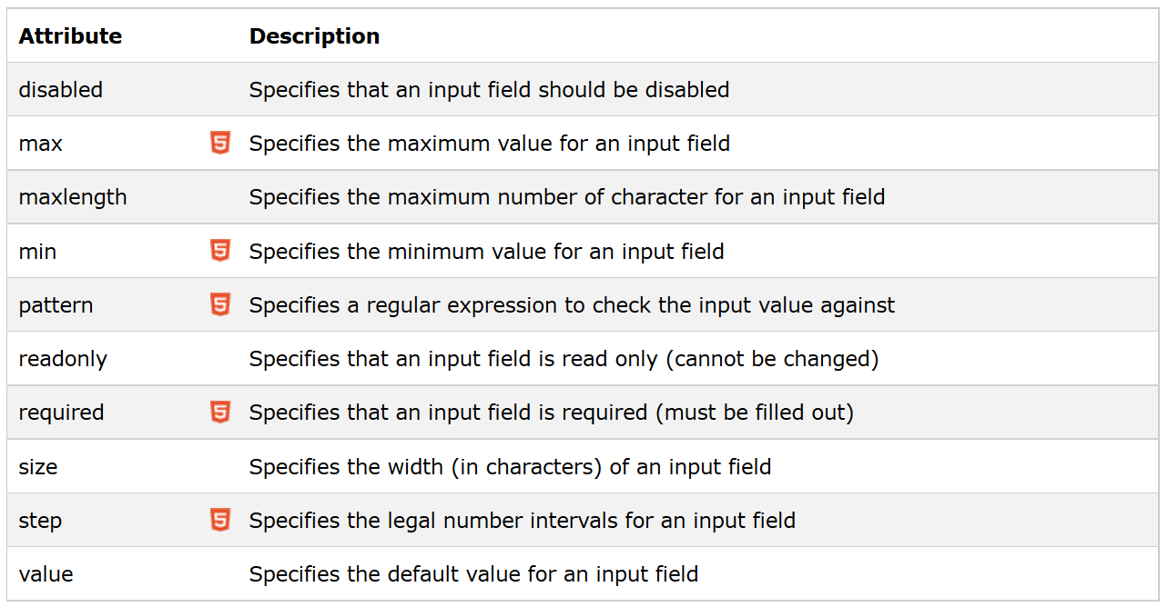
Input restrictions

Slide 9
Other form controls
<textarea> tag
Specifies a multi-row text field
<textarea>At w3schools.com you will learn how to make a website. We offer free tutorials in all web development technologies. </textarea>
<option>
Allows to setup a dropdown list with options
<select> <option value="volvo“ selected>Volvo</option> <option value="saab">Saab</option> <option value="opel">Opel</option> <option value="audi">Audi</option> </select>

Slide 10
New HTML5 attributes
Placeholder
When no input is entered display default text
Grayed
Disappears when clicked on the input
Autofocus
Focus on a particular form field
Required
Marks a field as required
Requires javascript to check for its existence
Autocomplete
Lets forms forget about auto-filling a field
Good in cases where you do not want other users to see some of your input such as bank accounts, etc.

Slide 11
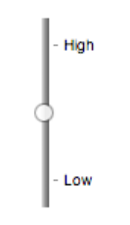
Listing predefined options
<datalist> tag
crossbreed between <input >and <select>
<input type="range" name="a" list="a-values"> <datalist id="a-values">
<option value="10" label="Low"> <option value="90" label="High">
</datalist>

Slide 12
Going into the future
Browser vendors competing on the prettiness and usability of their HTML5 form controls
Should web developers style them instead?
Already some controls such as calendars and sliders cannot be styled using CSS

Slide 13
Data requests
Get
Requests data from a specified resource
The query string is sent in the URL of the request
https://www.random.org/integers/?num=10&min=1&max=6&col=1&base=10&format=plain&rnd=new
Used by the REST (REpresentational State Transfer) architecture
Post
Submits data to be processed to a specified resource
The query string is sent in the HTTP body of the request
POST /test/demo_form.asp HTTP/1.1 Host: w3schools.com name1=value1&name2=value2

Slide 14
Get
GET requests can be cached
GET requests remain in the browser history
GET requests can be bookmarked
GET requests should never be used when dealing with sensitive data
GET requests have length restrictions
Depends on implementation
GET requests should be used only to retrieve data

Slide 15
Post
POST requests are never cached
POST requests do not remain in the browser history
POST requests cannot be bookmarked
POST requests have no restrictions on data length

Slide 16
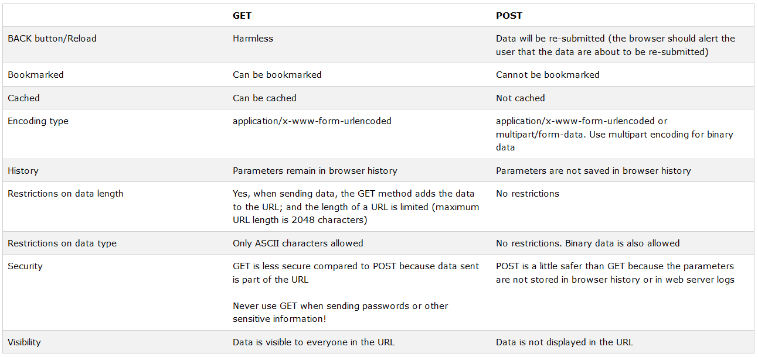
Get vs. post

Slide 17
What’s next?
XML & XHTML
Javascript
State vs. stateless
Dynamic HTML manipulation
AJAX
Synchronous vs. asynchronous
JQUERY
Server side programming

