Slide 1
Web Technologies
Lecture 4
XML and XHTML

Slide 2
XML
Extensible Markup Language
Set of rules for encoding a document in a format readable
By humans, and
Machines
W3C XML 1.0 Specification
Goals
Simplicity
Generability
Usability

Slide 3
XML
Focuses on documents
Can represent arbitrary data
Those used by web services
Many document formats
RSS
Atom
SOAP (communication and web service protocol)
XHTML (similar to HTML)
Office Open XML
XMPP (communication protocol)

Slide 4
A little history
1986 – Standard Generalized Markup Language (SGML)
1998 – SGML is reworked into XML
2000 – XHTML 1.0 is released
2001 – XHTML 1.1 is released
2008 XML 1.0 standard is released
2015 HTML 5.0 is published as a non SGML language

Slide 5
Markup and content
Markup text starts with
< and ends with >
Example: <div> </div>
Forms tags
Start tags
<div>
End tags
</div>
Empty-element tags
<br/>
& and ends with ;
Example: &amp; &acirc;
Everything else is content

Slide 6
Elements and attributes
Elements are logical document components which
start with a start tag and ends with an end tag, or
Consist of only an empty-element tag
Attributes are name-value pairs within an element
Except the end element
<img src=“my-image.jpg”/>

Slide 7
XML documents
Declaration
Elements
Attributes
<?xml version="1.0" encoding="UTF-8"?> <note> <to>Tove</to> <from>Jani</from> <heading>Reminder</heading> <body>Don't forget me this weekend!</body> </note>

Slide 8
XML characteristics
All opened elements need to closed
Case sensitive
<Div> is different from <div>
No shorthand features
Whereas in HTML we can write
<option selected>
In XHTML we must write
<option selected=“selected”>
On errors the parsing of a document stops

Slide 9
XML namespaces
Element names are defined by the developer
This leads to confusion
Same <table> element can have different meanings
Solve conflicts using prefixes
<my:table>
Prefixes require the definition of a namespace
<my:table xmlns:my=“http://address/to/my/namespace”>

Slide 10
CDATA
Character data section
Specifies a section of content that is marked to be interpreted purely as textual data, and not markup
<! [CDATA[ content ]]>
Avoids having encoded text which the parsers are not supposed to process
Example:
<![CDATA[<sender>John Smith</sender>]]>
Instead of &lt;sender&gt;John Smith&lt;/sender&gt;

Slide 11
XHTML
XHTML 1.0 is "a reformulation of the three HTML 4 document types as applications of XML 1.0“
XHTML was developed to make HTML more extensible and increase interoperability with other data formats
Compatibility with common XML tools, servers, and proxies
Extensibility by adding new features such as SVG and MathML all written in XML
Through namespaces

Slide 12
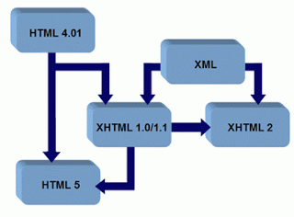
XHTML and HTML
Javascript and CSS is handled differently in XHTML
Complex relationship

Slide 13
Validating XML
DTD – Document Type Definition
Defines a standard for exchanging data
Example
Clients ensure that the data they receive from the web server is valid XHTML
Defined using <!DOCTYPE>
Example
<!DOCTYPE html>
XML Schema
XML alternative to DTD

Slide 14
DTD vs XML schemas
XML Schemas are written in XML
You don't have to learn a new language
You can use your XML editor to edit your Schema files
You can use your XML parser to parse your Schema files
You can manipulate your Schemas with the XML DOM
You can transform your Schemas with XSLT
XML Schemas are extensible to additions
XML Schemas support data types
It is easier to describe document content
It is easier to define restrictions on data
It is easier to validate the correctness of data
It is easier to convert data between different data types
XML Schemas support namespaces

Slide 15
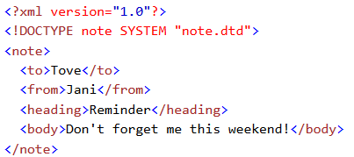
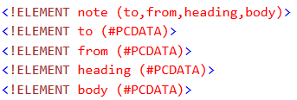
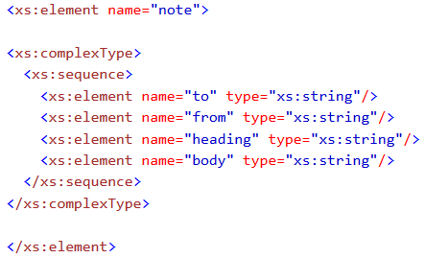
An example
DTD for the XML
Schema for the XML

Slide 16
Transforming XML
XSL – Extensible Stylesheet Language
Transform and render XML documents
XSLT
Language for transforming XML documents
XPath
Non-XML language used to address XML elements
Used from inside XSLT
Example
<xsl:for-each select=“./note">

Slide 17
What’s next?
Javascript
State vs. stateless
Dynamic HTML manipulation
AJAX
Synchronous vs. asynchronous
JQUERY
Server side programming
Web services

