Slide 1
Web Technologies
Lecture 5
Client side programming

Slide 2
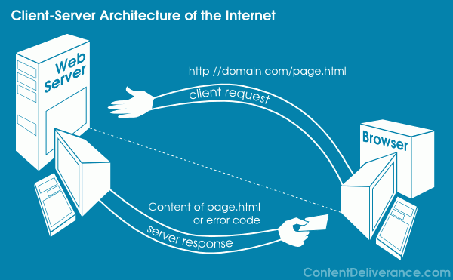
Client-server architecture

Slide 3
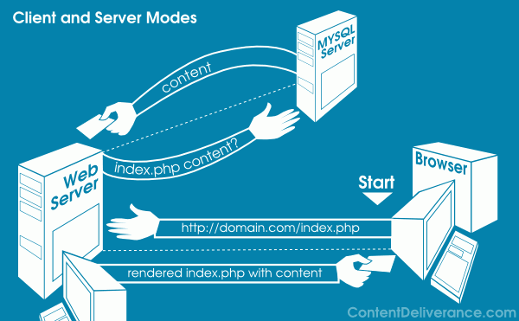
Client-server architecture

Slide 4
Client-side programming
Code runs in browser after the page is sent back from the server
HTML + CSS + Javascript
Code manipulates the page or responds to user behavior
Form validation
Autocomplete
HTML and CSS modifications (dynamic HTML)
Cookies (state preservation)

Slide 5
Advantages
Usability
Modify page without communicating with server
Efficiency
Enact small and quick changes to page without waiting for server to respond
Event driven
React to user interaction
Clicks, key presses

Slide 6
Disadvantages
Security
Everything is stored on client computer
Compatibility
Different browsers behave differently
Accessibility
Cannot write local files, open server connections, connect to databases, etc.

Slide 7
Javascript
A lightweight programming language
Scripting language
Enables interactive web pages
Autocomplete
Event handling
Page loads, page clicks, key presses, mouse moves, etc.
Form validation
Adapt page based on browser capabilities
Web standard
Browsers may handle javascript differently
Not related to Java

Slide 8
Javascript
Interpreted not compiled
Relaxed syntax and rules
Fewer and looser data types
No need to declare variables
Silent errors (few exceptions)
Focused on functions not classes
Embedded within a web page

Slide 9
Placing Javascript code
<head>
<script src=“myfile.js” type=“text/javascript”></script>
</head>
Javascript code can be also placed inside HTML but
It is not recommended
Content (HTML), presentation (CSS), and behavior (Javascript) should be separated
Javascript is Case sensitive

Slide 10
Javascript popups
alert(“Welcome to my website”);
Displays an alert dialog with a message for the user
answer = confirm(“Would you like to continue?”);
Returns a boolean value depending on whether the user clicked “Yes” or “No”
value = prompt(“Please enter your email address”, “Your name here”);
Returns the value entered in the prompt dialog
A default value can be specified as 2nd argument

Slide 11
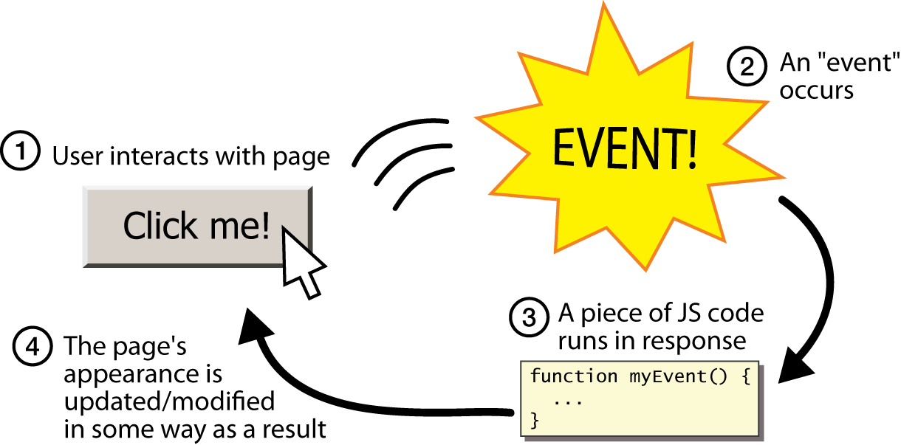
Javascript events
HTML code
<input type=“button” value=“Click me!” onclick=“myEvent();”>
Javascript code
function myEvent() {
alert(“Hello! This is my first JS)”);
}

Slide 12
Variables
var name = expression;
var age = 32;
var name = “John”;
var weight = “85.5”;
Variables are declared using the var keyword
Data types not specified
Javascript is loosely typed
Can find the type by calling typeof
Number, Boolean, String, Array, Object, Function, Null, Undefined

Slide 13
Document Object Model
DOM
A set of Javascript objects that represent each element on a page
Can be used to manipulate HTML
Dynamic HTML
Examine an element’s state
Checked vs. unchecked
Change state
Insert text in a div
Change style
Make a paragraph red

Slide 14

DOM hierarchy
When a page is loaded the browser creates a tree of objects (the DOM model)

Slide 15
Manipulating HTML
HTML code
<input type=“button” value=“Change paragraph text” onclick=“changeValue();” >
<p id=“text”>Click button to change me!</p>
Javascript code
function changeValue() {
var element = document.getElementById(“text"); element.innerHTML = “You just changed me!";
element.style.color=“blue”;
}

Slide 16
Manipulating HTML
HTML content
element.innerHTML
element.value
element.attribute
Where attribute is the attribute name of the element
Example: element.src
CSS
element.style.property
property is the CSS property to be changed
Example: element.style.color

Slide 17
Event listeners
addEventListener() method
document.getElementById(“myButton").addEventListener("click", displayDate);
Attach event listeners to the specified element
Does not override existing event handlers
Many handlers can be added to the same element
Handlers can be added to any DOM elements
Example: the window object
Handlers can be removed by using the removeEventListener()

Slide 18
What’s next?
State vs. stateless
Server vs. client side
Cookies and Web storage
AJAX
Synchronous vs. asynchronous
JQUERY
Server side programming
Web services

